Slide 1
2024 Employee Benefits
Graduate Assistants, Employees-in-Training, Fellows,
Scholars and Short-Term Academic Staff

Slide 2

Your Benefits
PURPOSE
  Prepare you for Benefits Enrollment
Employee
Benefits
AGENDA
  MyUW portal
  Payroll schedule & deductions
  Benefits review
  Answer your questions
www.wisconsin.edu/ohrwd/admin/download/benefits-orientation-pdf-Grad.pdf

Slide 3
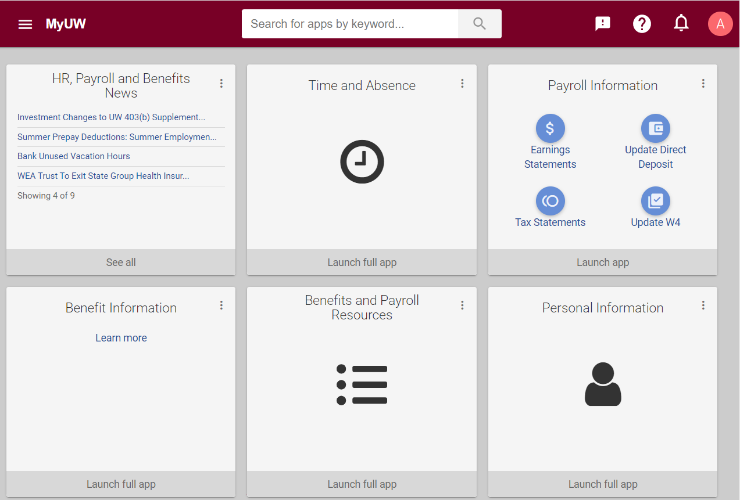
MyUW portal
Log in at my.wisconsin.edu/
USED FOR
Earnings Statements
Direct Deposit Updates
Tax Statements
Benefits Self Enrollment
Time and Leave Reporting
Personal Data Updates
HR, Payroll & Benefits News
Notes:
The MyUW Portal is your hub for Universities of Wisconsin News, Time & Absence Information, Payroll Information, and Benefits information. Log in regularly to stay up to date.

Slide 4
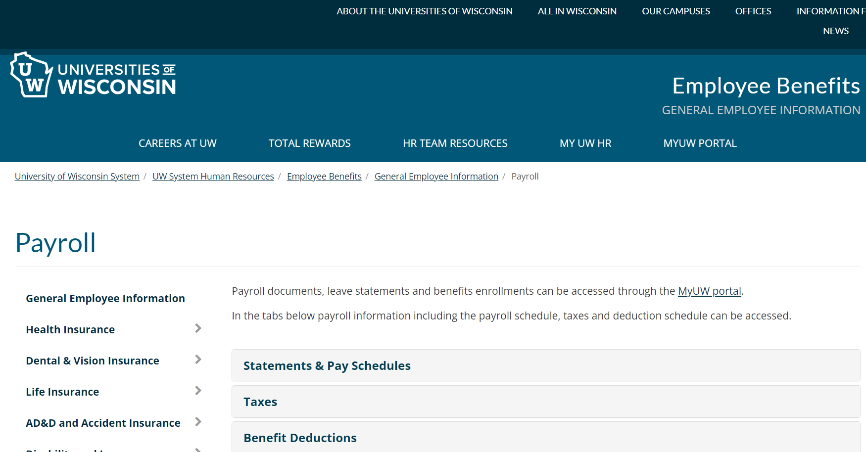
Payroll Schedule
Payroll web page: wisconsin.edu/ohrwd/benefits/general-employee-info/payroll/
All employees are paid every other Thursday
Payroll web page has pay dates, pay period dates, and more

Slide 5
Payroll Deductions
Taxes | Insurance Benefit Premiums | Spending & Savings Accounts and Supplemental Retirement Plans
Per IRS regulations, no taxes are withheld from earnings for: - Advanced Opportunity Fellow, fellow, Grad Intern or Trainee, Post-doc Fellow, Scholar or Trainee - May be responsible for paying taxes on income when you file your tax return | Deducted from two paychecks each month Paid for month of coverage Health, dental & vision deducted pretax for Federal, State, Social Security & Medicare | Deducted from two paychecks each month Deducted pretax for Federal, State, Social Security & Medicare Retirement plans allow after-tax (Roth) contributions
Notes:
Note: Advanced Opportunity Fellows, Fellows, Grad Interns/Trainees, Post-Doc Fellows and Scholars/Trainees are exempt from Social Security and Medicare taxes. These employees are not exempt from federal and state income tax, but the University will not withhold federal or state income tax from their earnings. However, they may be responsible for paying taxes on income when they file their tax return.

Slide 6
Insurance Premiums for 9-Month Employees
Insurance premiums are deducted from the first two biweekly paychecks each month during the academic year
Summer Prepay - Multiple insurance premiums are deducted during the three-month period prior to the end of the spring semester to keep coverage active between academic years (if appointment will continue the following fall semester)
Summer Earnings
  Insurance premiums are generally not deducted from summer session/appointment pay
  Flexible Spending Account and Retirement Plan contributions are deducted from summer session/appointment pay
Notes:
This information on this slide applies to 9-month/C-Basis employees only.
If you are an annual contract you will have insurance premiums deducted from 24 paychecks a year.
There are usually 2 paychecks a year where insurance premiums are not deducted. For 9-month employees this may be 1-2 times a year depending on your contract, summer pay, and how the payroll schedule works out each year. For annual paid employees this is generally 2 times a year.

Slide 7
Benefit Enrollment Opportunities
Initial Benefits Enrollment – You have 30 days from your benefits eligibility date to enroll in most benefits
Annual Benefits Enrollment – Available each fall with changes effective January 1
Life Events – If you experience a qualifying life event, most benefits have a 30-day window to enroll or make changes

Slide 8
Initial Benefits Enrollment and Effective Dates
You have 30 days to enroll in most benefits
Most benefits are effective the first of the month on or following your benefits eligibility date and will remain in place for the entire calendar year
Your benefits contact may provide you with an enrollment deadline worksheet that specifies your 30-day enrollment period and effective date for each benefit plan
Notes:
The Enrollment Deadline Worksheet provides you with:
Your job type (short-term academic staff, student assistant, employee in training)
Your 30-day enrollment period in which your elections must be made and
Effective date for each benefit plan

Slide 9
Qualifying Life Event
Family Status Change Examples | Employment Status Change Examples
Marriage or divorce Birth, adoption, guardianship of a child (60 days to enroll) Permanent Relocation Spouse or dependent child death | Change in employment category or appointment percentage End of employment Disability
Life Events allow you to change and/or enroll in some benefits
Need to submit paper applications within 30 days following the event
Reach out to your Benefits Contact
Notes:
Besides a Qualifying Life Event, employees may make changes to most of their benefits during the Annual Benefits Enrollment period held each fall.

Slide 10
Eligible Dependents
Most plans provide coverage for you and your eligible family members. This includes your:
  Spouse
  Dependent children (until age 26*) - Includes stepchildren, adopted children, pre-adoption placement, legal wards that become your permanent ward before age 26 and grandchildren until your insured child (the grandchild’s parent) turns age 18
Review the Dependent Eligibility Chart for more details.
*A child with a disability of long-standing duration dependent on you or the other parent for at least 50% support and maintenance, and incapable of self-support, may remain covered past age 26.
*Social Security numbers are required for all dependents. Enter Social Security numbers in the “National ID” field when adding dependents in the MyUW portal.

Slide 11
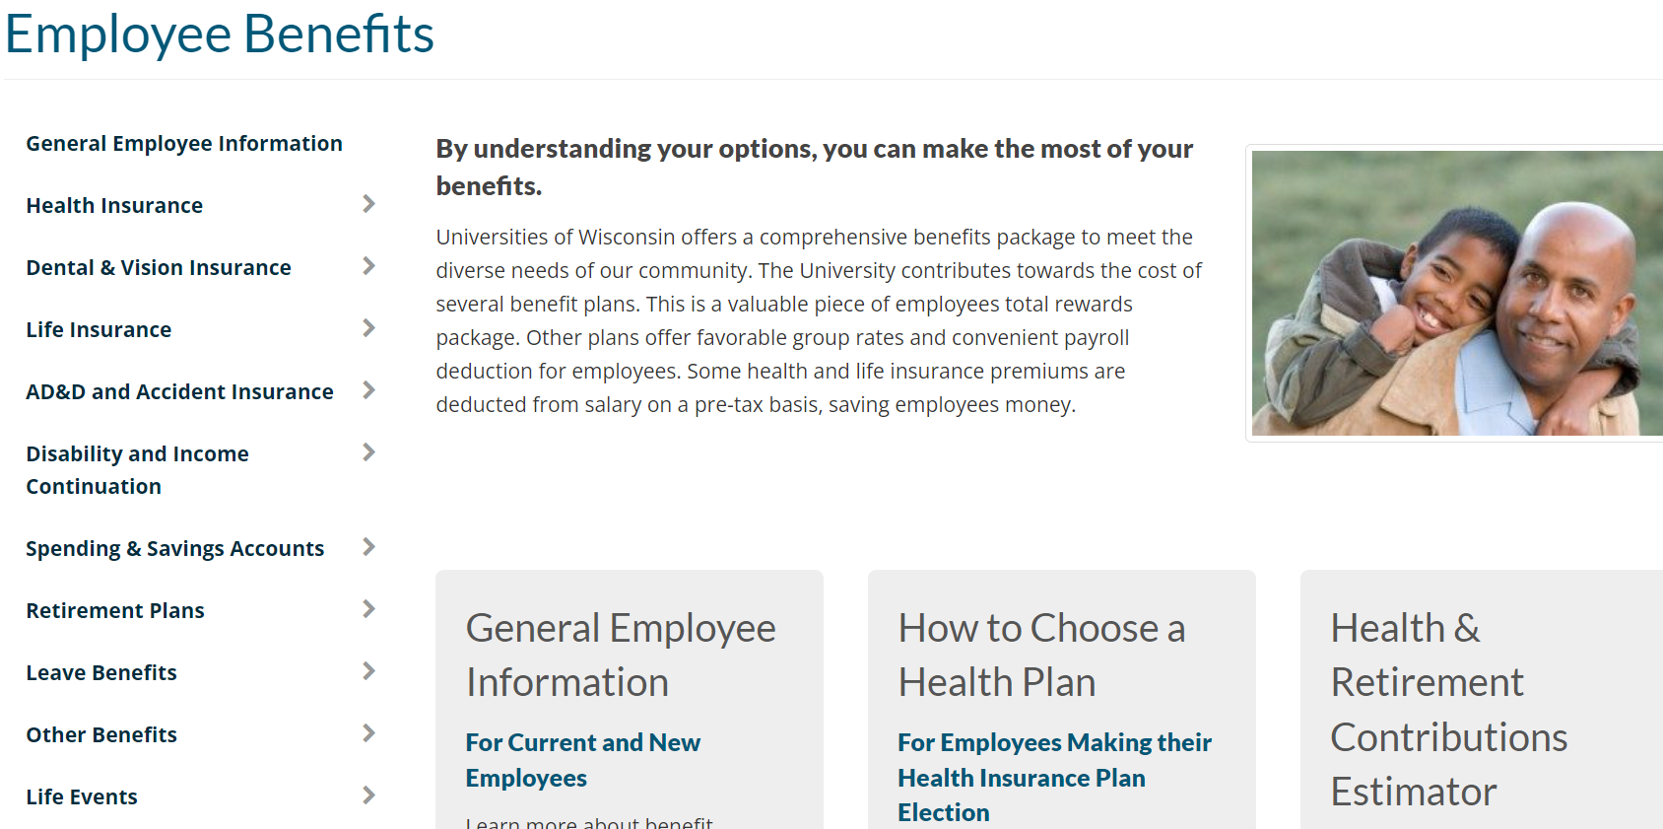
Enrollment Process
Employee Benefits website: wisconsin.edu/ohrwd/benefits/
REVIEW
Review the Benefits Summary
Review the Employee Benefits website for details about benefits and eligibility
Calculate the estimated value of your total compensation using the Health & Retirement Contributions Estimator

Slide 12
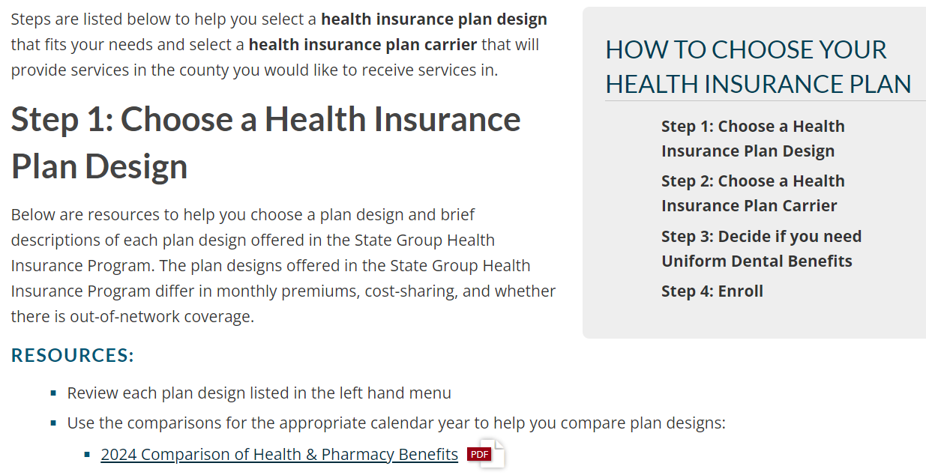
Enrollment Process
How to Choose Your Health Insurance Plan web page: www.wisconsin.edu/ohrwd/benefits/health/select-a-plan/
DECIDE
Consider your needs and the needs of your spouse and/or dependent(s)
Review the How to Choose Your Health Insurance Plan web page
Notes:
The How to Choose Your Health Insurance Plan web page will take you through step by step how to decide on a plan design and to choose a health insurance carrier and includes links to additional resources such as plan comparisons and the ETF health plan search tool.

Slide 13
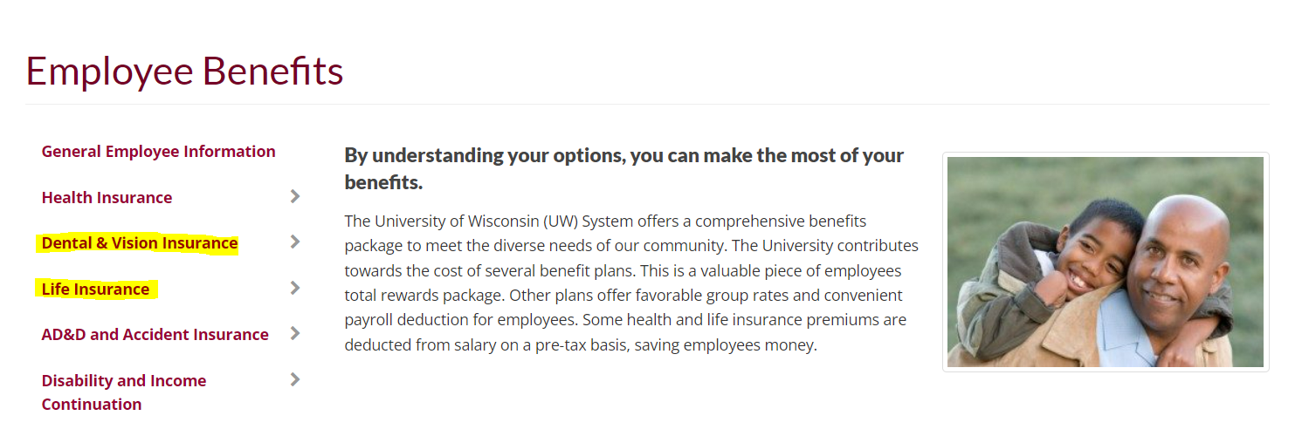
Enrollment Process
Universities of Wisconsin Employee Benefits website: wisconsin.edu/ohrwd/benefits/
DECIDE
Review the:
  Dental Comparison
  Vision Insurance Summary
  Life Insurance Plan Comparison
  Benefits Walkthrough
Notes:
Use the Dental Comparison to help you select a dental insurance plan.
Review the Vision Insurance Summary for plan details.
Review the Life Insurance Plan Comparison to help you select which life plans you may want to enroll in
Use the Benefits Walkthrough to walk you through the decisions you will need to make before making your elections in the MyUW portal. This tool will also estimate the benefit deductions from your paycheck.

Slide 14
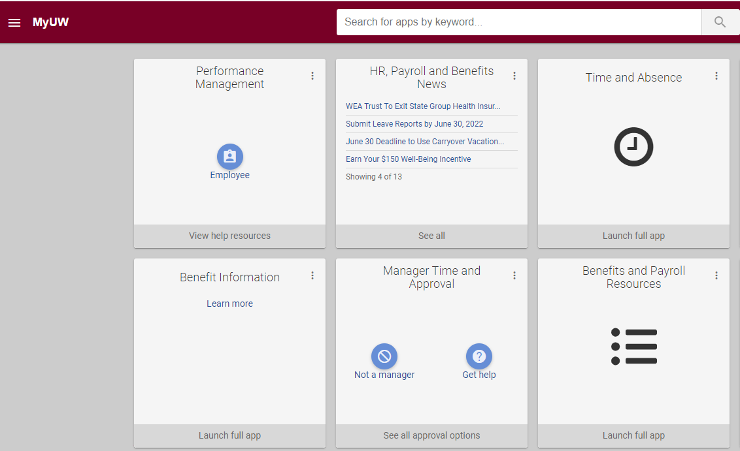
Enrollment Process
ENROLL
Go to the MyUW portal – click on Benefit Information tile to make your benefit plan elections unless your Enrollment Deadline Worksheet indicates you must submit paper applications
Choose your benefit plans and add dependents
Remember to enroll within 30 days of your hire date/benefits eligibility date
Notes:
Go to the MyUW portal to make your elections unless your Enrollment Deadline Worksheet indicates you must submit paper applications.

Slide 15

Paid Leave

Slide 16
Paid Leave –
Short-term Academic Staff
Paid leave is available for short-term academic staff who are expected to work
  At least 440 hours and
  At least one year
Notes:
Paid leave is allocated on a fiscal year basis (July 1 – June 30)

Slide 17

State Group Health Insurance

Slide 18
State Group Health Insurance – Effective Dates
Grad Assistants/Short-Term Academic Staff:
      Effective Date: 1st of the month following hire or eligibility
      Employer Contribution: Starts immediately
      You have a 30-day enrollment period from your benefit eligibility date (usually date of hire). Your spouse and eligible dependent children may also be enrolled at this time.

Slide 19
State Group Health Insurance – Plan Designs
Health Plan | Access Health Plan
Local county-based coverage, mainly in Wisconsin Select from various health insurance carriers that use specific networks Out-of-network coverage for urgent and emergency care only Lower monthly premium than the Access Plan | Nationwide coverage Health Insurance Carrier: Dean Health Plan Provider Networks: Dean Health Plan and First Health Lower out-of-pocket costs when in-network providers are used Higher monthly premium than the Health Plan
Notes:
If you want to receive services locally, choose the Health Plan.
If you need nationwide coverage, you will choose the Access Health Plan

Slide 20
State Group Health Insurance – Plan Designs
All insurers offer the same uniform benefits
All plan designs include pharmacy benefits, automatically (no additional cost)
All plan designs include uniform dental benefits, if elected (minimal cost)
All plan designs allow you to choose either individual or family coverage
If you enroll in health insurance, you will receive a health insurance ID card, a pharmacy benefits ID card and a dental insurance ID card (if you select the health insurance plan with dental)
  If you are married to another state/Universities of Wisconsin employee who is also eligible for State Group Health Insurance, you and your spouse may enroll in two individual policies or one family policy.
State Group Health Insurance designs: wisconsin.edu/ohrwd/benefits/health/

Slide 21
State Group Health Insurance – Plan Designs
 | Health Plan and Access Health Plan
Deductible Individual / Family | $250 / $500¹
¹ After an individual within a family plan meets the $250 deductible, medical services are
covered at the appropriate coinsurance level for that individual
Notes:
Information can be found in your Benefits Summary beginning on page ?

Slide 22
State Group Health Insurance – Plan Designs
 | Health Plan and Access Health Plan
Copayment Primary Care / Specialty Care | $15 / $25 (does not go toward deductible)
Coinsurance | After deductible: 10%
Out-of-Pocket Limit Individual / Family | $1,250 / $2,500
Preventive Services | $0 (plan pays 100%)
Emergency Room | $75 copay then deductible then coinsurance

Slide 23
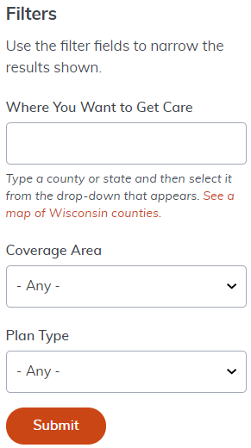
State Group Health Insurance
How to Choose Your Health Insurance Plan web page provides the steps to help you choose:
  Plan design
    Use the Comparison of Health & Pharmacy Benefits
  Health insurance carrier
    Use the Health Plan Search to find out which health insurance carriers will cover services provided in the county that you will receive them in
Notes:
Health Plan Search tool helps you select a carrier that will cover services in the county you want to receive services in and from the doctors, urgent care facilities and hospitals you want to use.
Go to the Health Plan Search tool and run through an example

Slide 24
State Group Health Insurance – Coverage
(local versus nationwide)
Local County-based Coverage | Nationwide Coverage
Choose the Health Plan Choose a health plan carrier that provides coverage for the county you will receive services in using the Health Plan Search Reminder: Local county-based coverage includes coverage for out-of-network services for emergency and urgent care | Choose the Access Plan Health Insurance Carrier: Dean Health Plan Provider Networks: Dean Health Plan and First Health

Slide 25
State Group Health Insurance – Enrollment Options when Covered by Another Plan
If the other plan is the State Group Health Insurance plan through a spouse or parent, you may not be covered on both plans. Therefore, you may:
  Remain on your spouse’s or parent’s plan until no longer eligible OR
  Enroll in your own plan through the Universities of Wisconsin
Or you may waive health insurance through the Universities of Wisconsin
Notes:
Elect Waive to waive health insurance.

Slide 26
State Group Health Insurance – Action Necessary when Covered by Another Plan
If you enroll in State Group Health Insurance through the Universities of Wisconsin and will remain enrolled in other health insurance coverage (such as through a spouse’s employer), you must enter your other health insurance coverage information in the MyUW portal
You must provide this information when you enroll in or add other coverage
Use the Other Health Information Guide to walk you through the process
If your other health insurance coverage will end prior to your coverage beginning through the Universities of Wisconsin, you should not add your other coverage information in the MyUW portal

Slide 27

Pharmacy Benefits

Slide 28
State Group Health Insurance – Pharmacy Benefits
 | Out-of-Pocket Cost* | Out-of-Pocket Limit Health Plan and Access Health Plan
Level 1 | $5 per fill | $600 individual $1,200 family
Level 2 | 20% (up to $50 maximum per fill) | $600 single $1,200 family
Level 3 | 40% (up to $150 maximum per fill + difference if dispense as written drug) | Does not apply to out-of-pocket limit; only applies to federal maximum out-of-pocket limit ($9,450 individual / $18,900 family)
Level 4 (through preferred specialty pharmacy only) | $50 per fill | $1,200 single $2,400 family
Find an in-network pharmacy and the formulary list: etf.benefits.navitus.com/
Notes:
Your cost at the pharmacy depends on the:
Plan design you select and the
Level of the drug on the formulary list (for example, generic vs. brand name)
Health Plans: You pay a copay or coinsurance per 30-day supply as outlined on the formulary list, up to the annual out-of-pocket maximum

Slide 29

Dental Insurance

Slide 30

Dental Insurance– Plan Designs
Uniform Dental Plan Preventive Dental Plan | Select Plan Select Plus Plan
You are eligible for one plan based on your State Group Health Insurance enrollment. The plans provide the same benefits & networks. Diagnostic & Preventive Services Cleanings Sealants X-rays Fluoride Treatments (to age 19) Fillings Non-Surgical Extractions Orthodontics for children Annual benefit maximum per person is $1,000 | You may enroll in one plan. The plans have different benefits levels & networks. Major Services Crowns Bridges Root canals Implants Surgical extractions Deductibles and annual benefit maximums vary by plan Orthodontics for children & adults (Select Plus Plan only) No coverage for preventive or basic services
Benefits provided by:
Notes:
You are eligible to enroll in dental insurance if you are eligible for State Group Health Insurance. If you want diagnostic & preventive coverage, you select between the Uniform Dental Plan and the Preventive Dental Plan. These two plans provide the same benefits but eligibility is based on whether you are enrolled in State Group Health.
If you want dental insurance to cover major services, you select between the Select Plan and the Select Plus Plan. The two plans provide different coverage levels and access different networks. These plans do not cover preventive or most basic services.

Slide 31
Dental Insurance– Plan Designs
Uniform Dental Plan | Preventive Dental Plan
Eligible if you enroll in State Group Health Insurance Premium is less than Preventive Dental Premium is added to your health insurance premium on your paycheck | Eligible if you waive State Group Health Insurance Premium is more than Uniform Dental Premium will appear as a separate deduction on your paycheck
View the coverage comparison and premiums in your Benefits Summary.
Locate an in-network dentist: Delta Dental website

Slide 32
Dental Insurance – Plan Comparison
 | Uniform Dental (SGH enrollees) and Preventive Dental (non-SGH enrollees)* | Select Plan | Select Plus Plan
Provider Network | Delta Dental PPO and Delta Dental Premier | Delta Dental PPO | Delta Dental PPO and Delta Dental Premier
Benefit Maximum | $1,000 | $1,000 | $2,500
Preventive services | 100% | Not covered | Not covered
Non-surgical extractions | 90% | Not covered | Not covered
Surgical extraction, root canal, crowns, bridges, periodontics (except maintenance) | Not Covered | 50% | 60% or 80%
Orthodontia | 50% up to $1,500 (up to age 19) | Not covered | 50% up to $1,500 (includes adult ortho)

Slide 33

Vision Insurance

Slide 34

Vision Insurance
If you are eligible for State Group Health Insurance, you are eligible for vision insurance
Provides coverage for eye exam* and materials (for example, glasses and/or contacts)
Once enrolled, you must remain enrolled for the entire calendar year
* A vision exam is covered by the State Group Health Insurance plan; however, it does not
cover materials.
Benefits provided by DeltaVision
(in partnership with EyeMed)
Find a DeltaVision provider near you: Find a DeltaVision/EyeMed provider Additional information: Vision Insurance Plan Summary
Notes:
Premium is deducted from 2 paychecks each month.

Slide 35

Life Insurance

Slide 36
Life Insurance
You may enroll in the following life insurance plan:
  Individual & Family Life Insurance
Coverage is guaranteed without proof of good health when first eligible
If you do not enroll when first eligible, you may be able to enroll with proof of good health (evidence of insurability)
Additional information: Life Insurance Comparison, Life Insurance Premiums

Slide 37
Life Insurance
Individual & Family Life Insurance
Elect up to $20,000 in employee coverage initially
Elect up to $10,000 spouse/domestic partner and $5,000 child(ren) coverage
Maximum coverage amounts allowed under the plan
  $300,000 employee
  $150,000 spouse/domestic partner
  $25,000 child(ren)
Annual increase opportunity each fall without providing proof of good health
Notes:
I&F – annual increase opportunity allows you to increase your coverage during annual benefits enrollment without proof of good health. The amounts range from $2,500 - $20,000.

Slide 38
Life Insurance – Beneficiary Designation
Most plans have a separate beneficiary designation
  Exception: State Group Life Insurance, Wisconsin Retirement System (WRS) and Accident Insurance use the same form
Some plans allow you to name a beneficiary online or to complete a paper form
Mail paper beneficiary designations directly to the address on each form
If you do not submit beneficiary forms, benefits are payable per Standard Sequence
Update as necessary, especially when you have a life event
Additional information: Beneficiary Information web page
Notes:
Standard sequence – is based on Wisconsin State Law, order is:
Surviving spouse or domestic partner
Surviving children
Surviving parents
Surviving siblings
Employee’s estate
If a covered dependent dies, benefits are automatically paid to the employee

Slide 39
Accidental Death & Dismemberment and
Accident Insurance

Slide 40
Accidental Death & Dismemberment and Accident Insurance
Accidental Death & Dismemberment | Accident Insurance
Offers coverage for accidental death and dismemberment (AD&D) for you, your spouse/domestic partner, and eligible children Includes Travel Assist coverage, Identity Theft Services, Critical Burn and Rehabilitation benefits Continuation coverage available at retirement | Provides cash payment to help cover out-of-pocket expenses in the event of an injury due to an accident Coverage for you, your spouse and eligible children Includes an AD&D component and Identity Theft services Continuation coverage available at end of employment
You may enroll in both plans: AD&D Insurance and Accident Insurance
Additional information: AD&D and Accident Insurance web page
Notes:
Eligible to enroll is you are eligible for State Group Health Insurance
AD&D – may enroll, change or cancel coverage at any time.
Accident insurance – may enroll as a new hire, during annual benefits enrollment or if you have a qualifying life event. Once enrolled, you are enrolled for the calendar year.
You are may name a beneficiary.

Slide 41

Flexible Spending Accounts (FSAs)

Slide 42
Flexible Spending Accounts (FSA)
Type of Account | Contribution and Carryover Limits | Description
Health Care | $3,050 per year $610 carryover | Help pay for eligible medical, dental, vision, and pharmacy benefit expenses not covered by insurance Expenses incurred by you, your spouse, child, or other qualifying tax dependent
Dependent Day Care | Up to $5,000 per year No carryover | Help pay for eligible dependent day care expenses such as after-school care, babysitting, adult or child day care, and preschool Eligible dependents include a spouse, child, or other qualifying tax dependent
Parking & Transit Accounts | $300/month/account Unlimited carryover | Help pay for work-related parking expenses (parking ramps, park-and-rides) and transit expenses (bus passes) May enroll or change your contribution at any time
Note: For the healthcare and parking & transit accounts, there is a minimum annual contribution and carryover amount of $50. Minimum carryover amount does not apply if you re-enroll for the next plan year.
Additional information: Spending and Savings Accounts web page
Notes:
Flexible spending accounts offer you an opportunity to pay certain health care, dependent care and work-related parking and transit expenses on a pre-tax basis.
You decide how much you want to contribute. Contributions are deducted from the first 2 paychecks each month.
Minimum annual contribution of $50 for the health care and parking & transit accounts.
May not change contribution amount during the year unless you have a qualifying life event.
Use it or lose it for all funds greater than carry over limit. There is no carry over for dependent day care accounts.
You must re-enroll annually to continue coverage.
Parking & transit are different. You have unlimited carryover and may enroll or change your contribution at any time. Parking account may not be used to reimburse you for parking at a University lot that is paid through payroll deduction because it is deducted pre-tax.

Slide 43

Retirement Plans

Slide 44
Retirement Plans - Supplemental Savings Programs
UW 403(b) Supplemental Retirement Program (SRP)
  Administered by Universities of Wisconsin
  Available record keepers are TIAA and Fidelity
  May enroll or change contributions at any time
  Contribute a flat dollar amount or percent of eligible earnings
  Contributions made the first two paychecks of each month (24 paychecks each year)
  Offers an array of investment options including Target Date Funds, index and actively managed mutual funds, and a separate Guaranteed Fixed Rate Annuity for each provider
  A self-directed brokerage option is available
  No employer match
For more information: 403(b) SRP
Notes:
All Universities of Wisconsin employees are eligible to participate. Allows you to save additional money on a pre-tax or Roth after-tax basis to help with future retirement needs.

Slide 45
Retirement Plans - Supplemental Savings Programs
Wisconsin Deferred Compensation (WDC) 457 Program
  Administered by the Department of Employee Trust Funds through Empower Retirement
  May enroll or change contributions at any time
  Contribute a flat dollar amount or percent of pay
  Contributions made the first two paychecks of each month (24 paychecks each year)
  Offers a wide range of investment options including a managed-account and a self-directed brokerage account
  No employer match
For more information: WDC Program
Notes:
All Universities of Wisconsin employees are eligible to participate.
You may participate in both the SRP and WDC plans and may make the maximum contributions to both.
The maximum contribution for 2024 is $23,000 for employees under age 50 and $30,500 for employees 50 and older.

Slide 46

Other Benefits

Slide 47
Well-Being Resources
Employee Assistance Program (EAP)
  Provides you and your immediate family members (members of your household) free and confidential resources to address personal and work-related concerns
  May also assist with legal services, financial services, and work-life services
  Allows up to six in-person or virtual sessions per person per issue per year
Well Wisconsin Program
  Available to you and your spouse if enrolled in State Group Health Insurance
  Designed to help make you more aware of your current and future health risks. Eligible to earn a $150 incentive (taxable) by completing a health assessment, health check, and one well-being activity by early October
For more information: Well-Being Resources and Other Benefits web page

Slide 48
Benefit Plan Resources
UW System Employee Benefits website:
  General Employee Information page
  Benefits Summary
  Health & Retirement Contributions Estimator
  Benefit Premiums
View earnings, leave, tax statements and benefit information: MyUW portal.

Slide 49



Questions
Universities of Wisconsin Employee Benefits website: www.wisconsin.edu/ohrwd/benefits/
Additional questions: Reach out to your benefits contact

