Slide 1
2024 Employee Benefits
Faculty, Academic Staff and Limited Appointees
University Staff Employees
(covered by the Wisconsin Retirement System)

Slide 2
Your Benefits
PURPOSE
Prepare you for Benefits Enrollment
Employee
Benefits
AGENDA
MyUW portal
Payroll schedule & deductions
Benefits review
Answer your questions
www.wisconsin.edu/ohrwd/admin/download/benefits-orientation-pdf-FAASLI-&-US.pdf

Slide 3
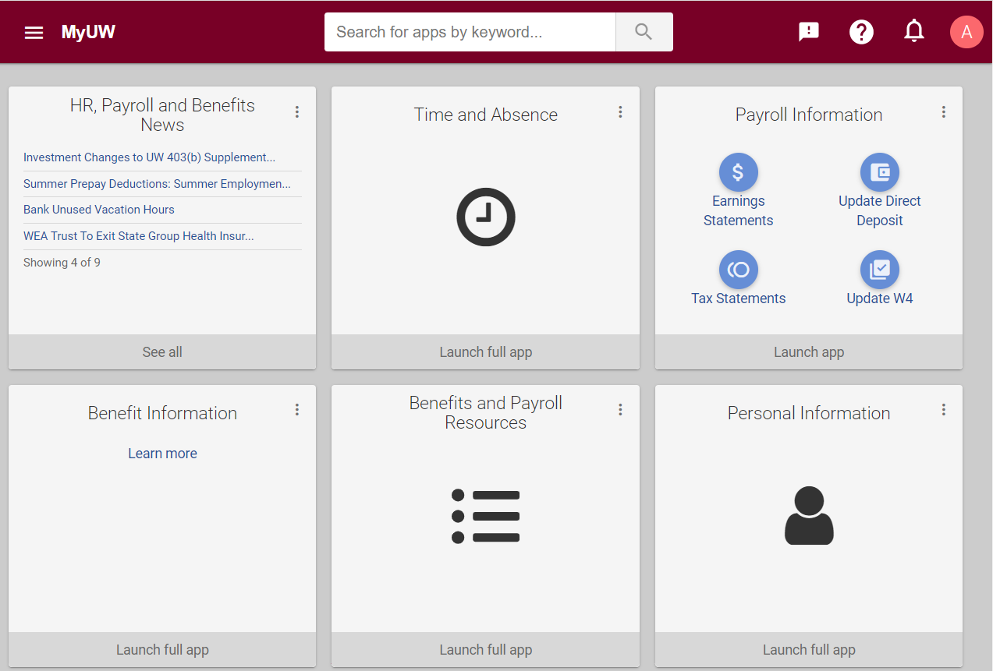
MyUW portal
Log in at my.wisconsin.edu/
USED FOR
Earnings Statements
Direct Deposit Updates
Tax Statements
Benefits Self Enrollment
Time and Leave Reporting
Personal Data Updates
HR, Payroll & Benefits News
Notes:
The MyUW Portal is your hub for Universities of Wisconsin News, Time & Absence Information, Payroll Information, and Benefits information. Log in regularly to stay up to date.

Slide 4
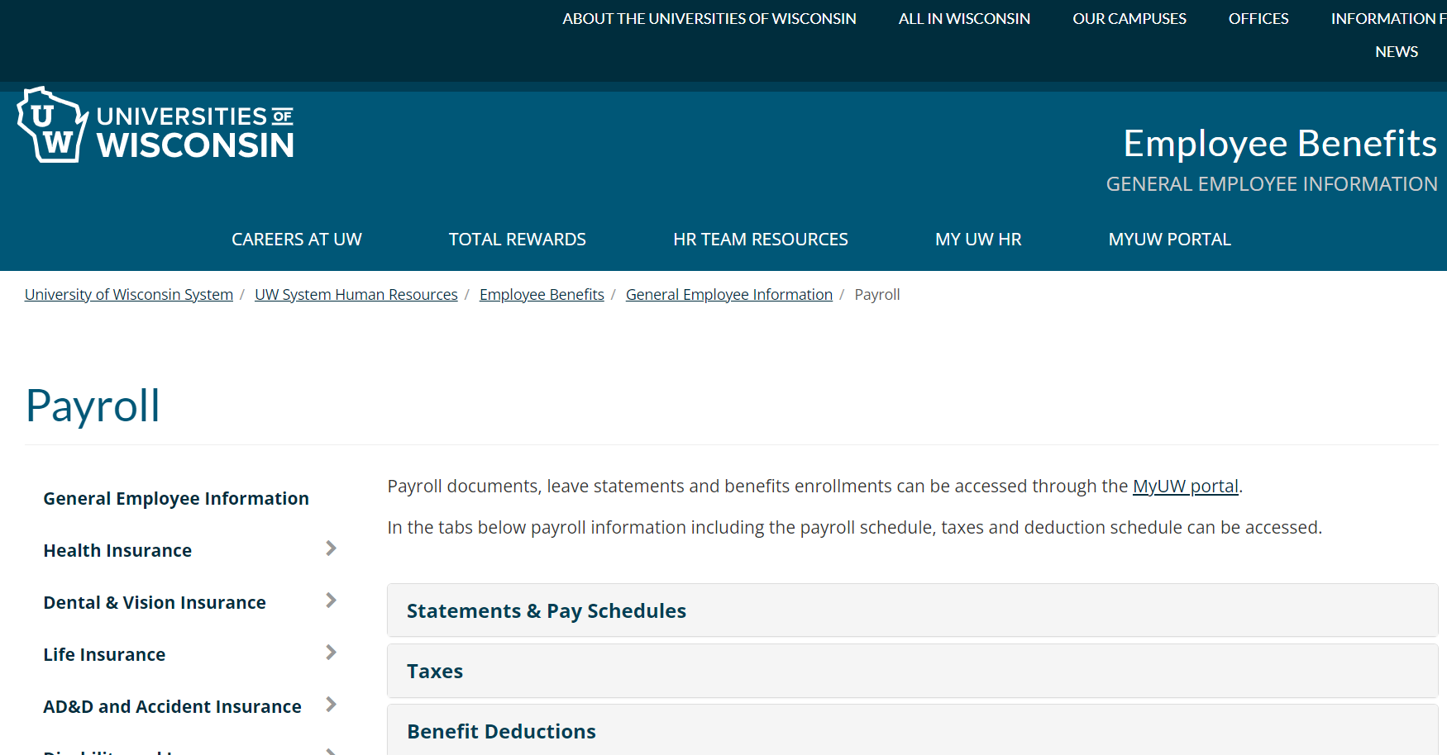
Payroll Schedule
Payroll web page: wisconsin.edu/ohrwd/benefits/general-employee-info/payroll/
All employees are paid every other Thursday
Payroll web page has pay dates, pay period dates, and more

Slide 5
Payroll Deductions
Taxes | Insurance Benefit Premiums | Spending & Savings Account and Supplemental Retirement Plans Contributions | Wisconsin Retirement System (WRS) Contributions
Deducted from all paychecks Federal & State Income Tax Social Security & Medicare Complete W-4 in MyUW portal | Deducted from two paychecks each month Paid for month of coverage Health, dental & vision deducted pretax for Federal, State, Social Security & Medicare | Deducted from two paychecks each month Deducted pretax for Federal, State, Social Security & Medicare Retirement plans allow after-tax (Roth) contributions | Deducted from all paychecks Deducted pretax for Federal & State

Slide 6
Insurance Premiums for 9-Month Employees
Insurance premiums are deducted from two paychecks each month during the academic year
Summer Prepay - Multiple insurance premiums are deducted during the three-month period prior to the end of the spring semester to keep coverage active between academic years (if appointment will continue the following fall semester)
Summer Earnings
Insurance premiums are generally not deducted from summer session/appointment pay
Flexible Spending Account and Retirement Plan contributions are deducted from summer session/appointment pay
Notes:
This information on this slide applies to 9-month/C-Basis employees only.
If you are an annual contract you will have insurance premiums deducted from 24 paychecks a year.
There are usually 2 paychecks a year where insurance premiums are not deducted. For 9-month employees this may be 1-2 times a year depending on your contract, summer pay, and how the payroll schedule works out each year. For annual paid employees this is generally 2 times a year.

Slide 7
Benefit Enrollment Opportunities
Initial Benefits Enrollment – You have 30 days from your benefits eligibility date to enroll in most benefits
Annual Benefits Enrollment – Available each fall with changes effective January 1
Life Events – If you experience a qualifying life event, most benefits have a 30-day window to enroll or make changes

Slide 8
Initial Benefits Enrollment and Effective Dates
You have 30 days to enroll in most benefits
Most benefits are effective the first of the month on or following your benefits eligibility date and will remain in place for the entire calendar year
Your benefits contact may provide you with an enrollment deadline worksheet that specifies your 30-day enrollment period and effective date for each benefit plan
Notes:
The Enrollment Deadline Worksheet provides you with:
Your job type (faculty, academic staff, limited appointee, university staff
Your 30-day enrollment period in which your elections must be made and
Effective date for each benefit plan

Slide 9
Qualifying Life Event
Family Status Change Examples | Employment Status Change Examples
Marriage or divorce Birth, adoption, guardianship of a child (60 days to enroll) Permanent Relocation Spouse or dependent child death | Change in employment category or appointment percentage End of employment Disability
Life Events allow you to change and/or enroll in some benefits
Need to submit paper applications within 30 days following the event
Reach out to your Benefits Contact
Notes:
Besides a Qualifying Life Event, employees may make changes to most of their benefits during the Annual Benefits Enrollment period held each fall.

Slide 10
Eligible Dependents
Most plans provide coverage for you and your eligible family members. This includes your:
Spouse
Dependent children (until age 26*) - Includes stepchildren, adopted children, pre-adoption placement, legal wards that become your permanent ward before age 26 and grandchildren until your insured child (the grandchild’s parent) turns age 18
Review the Dependent Eligibility Chart for more details.
*A child with a disability of long-standing duration dependent on you or the other parent for at least 50% support and maintenance, and incapable of self-support, may remain covered past age 26. *Social Security numbers are required for all dependents. Enter Social Security numbers in the “National ID” field when adding dependents in the MyUW portal.

Slide 11
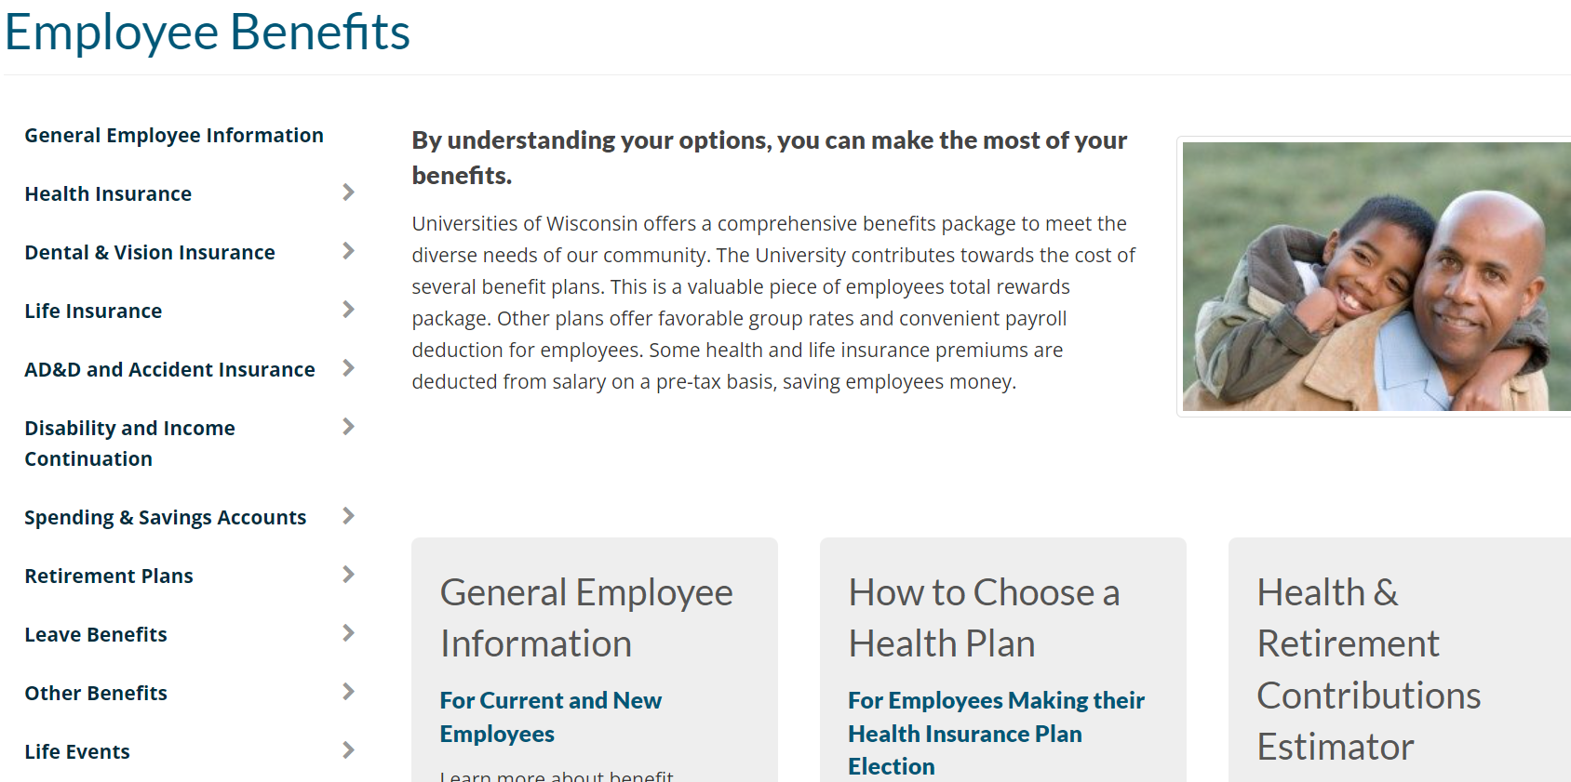
Enrollment Process
Employee Benefits website: wisconsin.edu/ohrwd/benefits/
REVIEW
Review the Benefits Summary
Review the Employee Benefits website for details about benefits and eligibility
Calculate the estimated value of your total compensation using the Health & Retirement Contributions Estimator

Slide 12
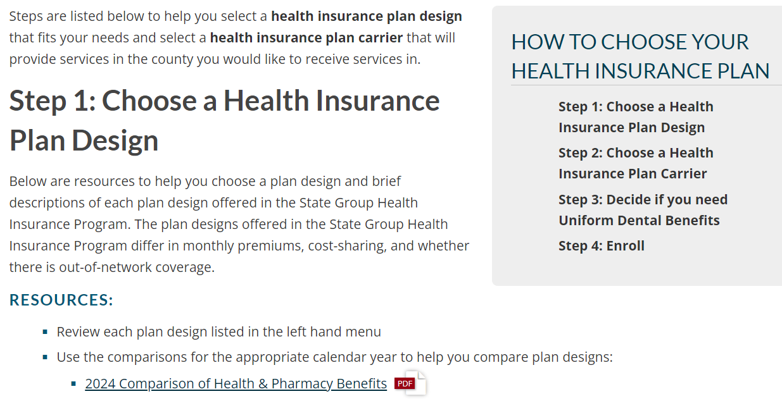
Enrollment Process
How to Choose Your Health Insurance Plan web page: www.wisconsin.edu/ohrwd/benefits/health/select-a-plan/
DECIDE
Consider your needs and the needs of your spouse and/or dependent(s)
Review the How to Choose Your Health Insurance Plan web page
Notes:
The How to Choose Your Health Insurance Plan web page will take you through step by step how to decide on a plan design and to choose a health insurance carrier and includes links to additional resources such as plan comparisons and the ETF health plan search tool.

Slide 13
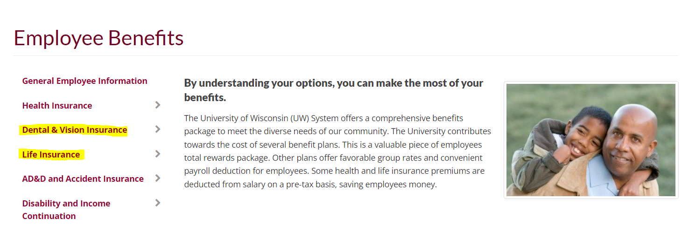
Enrollment Process
Universities of Wisconsin Employee Benefits website: wisconsin.edu/ohrwd/benefits/
DECIDE
Review the:
Dental Comparison
Vision Insurance Summary
Life Insurance Plan Comparison
Benefits Walkthrough
Notes:
Use the Dental Comparison to help you select a dental insurance plan.
Review the Vision Insurance Summary for plan details.
Review the Life Insurance Plan Comparison to help you select which life plans you may want to enroll in
Use the Benefits Walkthrough to walk you through the decisions you will need to make before making your elections in the MyUW portal. This tool will also estimate the benefit deductions from your paycheck.

Slide 14
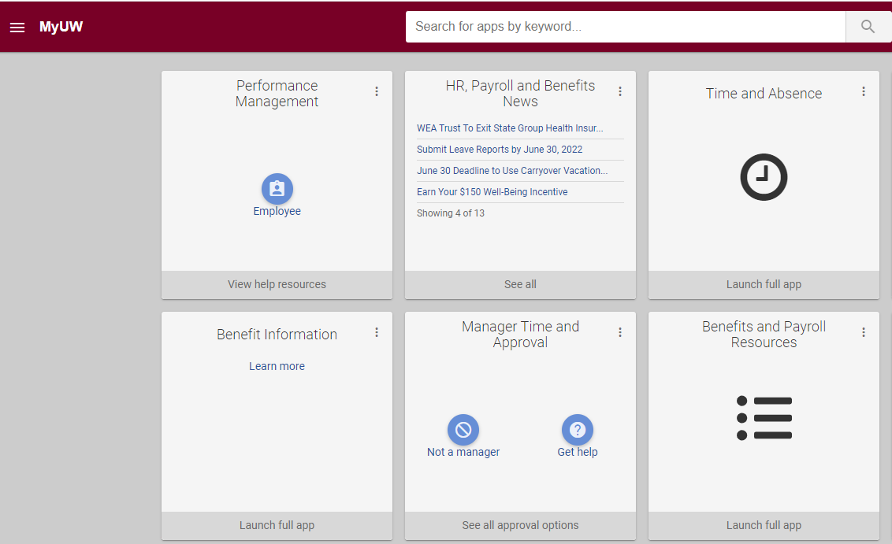
Enrollment Process
ENROLL
Go to the MyUW portal – click on Benefit Information tile to make your benefit plan elections unless your Enrollment Deadline Worksheet indicates you must submit paper applications
Choose your benefit plans and add dependents
Remember to enroll within 30 days of your hire date/benefits eligibility date
Notes:
Go to the MyUW portal to make your elections unless your Enrollment Deadline Worksheet indicates you must submit paper applications.

Slide 15
Transfer from a State Agency
If you have less than a 30-day break in service between a WRS eligible position at another State agency and your employment at the Universities of Wisconsin:
You must continue the same plans and coverage levels held through your previous State WRS position for some plans (health, dental, vision, accident, FSA)
You have a new enrollment opportunity for benefits provided only through the Universities of Wisconsin (Individual & Family Life Insurance)
Paper applications must be submitted (available on the Forms & Resources web page)
Review your Enrollment Deadline Worksheet for more information.
If you have more than a 30-day break in service, you have a new enrollment opportunity for benefits.
Notes:
For employees coming from State employment (classified) to Faculty, Academic Staff, or Limited Appointee position (unclassified), you will have a new Income Continuation Insurance enrollment.

Slide 16
Paid Leave

Slide 17
Paid Leave – Faculty, Academic Staff, and Limited Appointees
Vacation | 176 hours allocated on a fiscal year basis (July 1 – June 30) Full time employees earn about 6.76 hours of vacation each pay period Pro-rated for mid-year employment start dates Vacation can be used before it is earned Unused vacation earned in a fiscal year carries over to end of following fiscal year, then it will expire Banked leave available after 10 full fiscal years of service
Sick Leave | 176 hours granted at start of employment After the first 18 months, earn up to 96 hours per fiscal year Accumulates without limit Cannot be used before it is earned
If you are less than 100%, paid leave is prorated based on your appointment percentage
Academic year (nine-month) employees are not eligible for Vacation
Notes:
You may use vacation before it is earned. Unused vacation earned in a fiscal year can be carried over for one fiscal year and then will expire.
Vacation Banking
After 10 complete fiscal years of service (July 1–June 30), up to 40 hours of unused vacation may be put into a banked leave account each year. After 25 complete fiscal years of service, up to 80 hours of unused vacation may be put into a banked leave account each year. Banked leave may be used at any time or cashed out upon termination. Banked vacation hours do not expire.
Sick Leave
176 hours of sick leave are granted at the start of employment and can be used during the first 18 months of employment. After the first 18 months, up to 96 hours of sick leave is earned per fiscal year. Sick leave accumulates without limit, does not expire, and cannot be used before it is earned. Leave reports must be submitted monthly (or as leave is used) or your sick leave balance will be reduced.

Slide 18
Paid Leave – University Staff
Vacation Hours Allocated Each Calendar Year (January 1 – December 31)
Years of Service | Vacation Earned FLSA Non-Exempt | Vacation Earned FLSA Exempt
0 - 5 Years | 104 hours | 120 hours
5+ - 10 Years | 144 | 160
10+ - 15 Years | 160 | 176
15+ - 20 Years | 184 | 200
20+ - 25 Years | 200 | 216
25 Years and Above | 216 | 216
Pro-rated for mid-year employment start dates
Unused vacation can be carried over for one calendar year, then it will expire
May bank unused leave after 10 complete years of service (5 years depending on exempt status)
Sick Leave | Earn up to 5 hours per paycheck (130 hours per year) Accumulates without limit Cannot be used before it is earned
Notes:
Vacation
Allocated each calendar year, based on years of service and status.
You may use vacation before it is earned within the same calendar year.
Hours earned each year may carry over to end of following calendar year.
Hours lost if not used or banked (if eligible) by end of carry over period.
Sick Leave
Earn up to 5 hours per paycheck (130 hours per year)
Accumulates without limit
May only be used after it’s earned
Hours can be converted to credits to pay for State Group Health Insurance premiums in retirement (if eligible)

Slide 19
Paid Leave – All Eligible Employees
Legal Holidays | Nine per year: New Year’s Day, Martin Luther King Jr. Day, Memorial Day, Independence Day, Labor Day, Thanksgiving Day, Christmas Eve, Christmas Day, New Year’s Eve
Personal Holidays | 36 hours per year
Pro-rated for employees who work less than 100%
Hours lost if not used in the year granted
Academic year (nine-month) employees are not eligible for Personal Holiday and are paid for legal holidays that fall within the academic year
Leave Year :
Faculty, Academic Staff & Limited Appointees in 12-month appointments: July 1 – June 30
University Staff (excluding crafts workers): January 1 – December 31
Notes:
Personal Holidays
Granted on hire date and for Academic Staff and Limited Appointees every July 1st or for University Staff Employees January 1st thereafter.
Must be used during the fiscal or calendar year granted, unused hours expire and can not be carried over

Slide 20
Paid Leave – All Eligible Employees
Family Medical Leave (W/FMLA) | Eligibility requirement of 1,250 hours of state employment in the preceding 12 months (FMLA) or 1,000 hours of state employment in the preceding year (WFMLA). Up to 12 weeks of unpaid, job-protected leave each calendar year for specified family and medical reasons.
Jury Duty | Receive paid leave when summoned as a witness for the employer or impaneled as a jurist.
Bone Marrow and Human Organ Donation | Bone marrow donor: Up to five days off with pay. Human organ donor: Up to 30 days off with pay.
Catastrophic Leave | Donate certain types of paid leave to other employees granted an unpaid leave due to a catastrophic need
Military Leave | Job-protected leave for active duty or required field training. Receive differential pay for up to 30 days per calendar year for duty or training lasting three days or more. May also receive up to four years of differential pay and eligible benefits if on active duty.
Notes:
VOTING
If you cannot vote outside of work hours, you may receive paid leave to vote.
FACULTY SABBATICAL
If offered at your campus, faculty may request sabbatical leave after they have completed six full years of Universities of Wisconsin service. Eligible faculty receive 100% pay for one semester or up to 65% pay for a full academic year.

Slide 21
Time & Absence Reporting
Faculty, Academic Staff, Limited Appointees | University Staff
Submit leave hours used on a biweekly basis If no leave has been used, you are required to submit a monthly no leave taken report If not reported, your sick leave hours will be permanently reduced | Timesheets must be completed every pay period Report hours worked and absences taken
Complete in the MyUW portal
Review the Time and Absence Help web page for instructions on how to enter time and absences
Additional Information: Leave Benefits web page
Notes:
Full-time exempt employees will report absences in half or full day increments (4 or 8 hours)
Part-time and non-exempt employees report actual hours in 15-minute increments

Slide 22
State Group Health Insurance

Slide 23
State Group Health Insurance - Eligibility
You are eligible for the State Group Health Insurance Program if:
You are eligible for the Wisconsin Retirement System (WRS) benefits package, which is based on the following components:
Employment classification
Number of hours worked
Employment duration
If you do not need health insurance through the Universities of Wisconsin, you may be eligible to receive up to a $2,000 Health Opt-Out Incentive
Notes:
You are eligible for the State Group Health Insurance if you are eligible for the Wisconsin Retirement System (see page 15 of your Benefits Summary). WRS eligibility depends on your employment classification, requires a minimum number of hours to be worked, and a minimum employment duration. Your Human Resources office will inform you of your eligibility.

Slide 24
State Group Health Insurance – Effective Dates
Faculty, Academic Staff & Limited Appointees:
Effective Date: 1st of the month following hire or eligibility
Employer Contribution: Starts immediately
University Staff:
With Previous State WRS Service
No Previous State WRS Service
Effective Date | 1st of the month following hire date | 1st of the month following hire date or 1st of the 3rd month following hire date
Employer Contribution | Starts immediately | 3rd month of WRS employment
University Staff employees: Can have immediate coverage by paying the total premium or postpone until employer contribution begins
You have a 30-day enrollment period from your benefit eligibility date (usually date of hire). Your spouse and eligible dependent children may also be enrolled at this time.
Notes:
University Staff – With no prior state WRS service you would pay the first two months of the employee & employer portions of the premium. You may enroll in State Group Health Insurance and choose when you would like coverage to begin, either the first of the month following your date of hire or first of the month after you have two months of state WRS service. If you want immediate coverage, you will pay the total employee and employer portions of the premium until you have two months of state WRS service. The employer contribution begins the 3rd month of WRS employment.

Slide 25
State Group Health Insurance – Plan Designs
Health Plan or Access Health Plan | High Deductible Health Plan (HDHP) or Access HDHP
Higher premium Lower annual deductible (for medical services) Lower annual out-of-pocket limit (for medical services) Higher annual out-of-pocket limit (for pharmacy benefits) | Lower premium Higher annual deductible (combined for medical services and pharmacy benefits) Higher annual out-of-pocket limit (for medical services) Lower annual out-of-pocket limit (for pharmacy benefits)

Slide 26
State Group Health Insurance – Plan Designs
Health Plan and High Deductible Health Plan (HDHP) | Access Health Plan and Access HDHP
Local county-based coverage, mainly in Wisconsin Select from various health insurance carriers that use specific networks Out-of-network coverage for urgent and emergency care only Lower monthly premium ($39 to $276 per month) | Nationwide coverage Health Insurance Carrier: Dean Health Plan Provider Networks: Dean Health Plan and First Health Lower out-of-pocket costs when in-network providers are used Higher monthly premium ($85 to $663 per month)
Notes:
If you want to receive services locally, choose the Health Plan or the High Deductible Health Plan.
If you need nationwide coverage, choose the Access Health Plan or the Access HDHP.

Slide 27
State Group Health Insurance – Plan Designs
All insurers offer the same uniform benefits
All plan designs include pharmacy benefits, automatically (no additional cost)
All plan designs include uniform dental benefits, if elected (minimal cost)
All plan designs allow you to choose either individual or family coverage
If you enroll in health insurance, you will receive a health insurance ID card, a pharmacy benefits ID card and a dental insurance ID card (if you select the health insurance plan with dental)
If you are married to another state/Universities of Wisconsin employee who is also eligible for State Group Health Insurance, you and your spouse may enroll in two individual policies or one family policy.
State Group Health Insurance designs: wisconsin.edu/ohrwd/benefits/health/

Slide 28
State Group Health Insurance – Plan Designs
 | Health Plan and Access Health Plan | High Deductible Health Plan (HDHP) and Access HDHP
Health Savings Account (Employer Contribution) Individual / Family | N/A | Up to $750 / $1,500
Deductible Individual / Family | $250 / $500¹ | $1,600 / $3,200²
¹ After an individual within a family plan meets the $250 deductible, medical services are
covered at the appropriate coinsurance level for that individual
² Full family deductible must be met before any services are covered at coinsurance level
Notes:
Information can be found in your Benefits Summary beginning on page ?

Slide 29
State Group Health Insurance – Plan Designs
 | Health Plan and Access Health Plan | High Deductible Health Plan (HDHP) and Access HDHP
Copayment Primary Care / Specialty Care | $15 / $25 (does not go toward deductible) | After deductible: $15 / $25
Coinsurance | After deductible: 10% | After deductible: 10%
Out-of-Pocket Limit Individual / Family | $1,250 / $2,500 | $2,500 / $5,000
Preventive Services | $0 (plan pays 100%) | $0 (plan pays 100%)
Emergency Room | $75 copay then deductible then coinsurance | Deductible then $75 copay then coinsurance

Slide 30
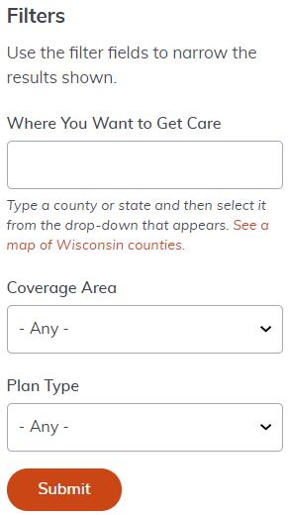
State Group Health Insurance
How to Choose Your Health Insurance Plan web page provides the steps to help you choose:
Plan design
Use the Comparison of Health & Pharmacy Benefits
Health insurance carrier
Use the Health Plan Search to find out which health insurance carriers will cover services provided in the county that you will receive them in
Notes:
Health Plan Search tool helps you select a carrier that will cover services in the county you want to receive services in and from the doctors, urgent care facilities and hospitals you want to use.
Go to the Health Plan Search tool and run through an example

Slide 31
State Group Health Insurance – Coverage (local versus nationwide)
Local County-based Coverage | Nationwide Coverage
Choose the Health Plan or the HDHP Choose a health plan carrier that provides coverage for the county you will receive services in using the Health Plan Search Reminder: Local county-based coverage includes coverage for out-of-network services for emergency and urgent care | Choose the Access Plan or the Access HDHP Health Insurance Carrier: Dean Health Plan Provider Networks: Dean Health Plan and First Health

Slide 32
State Group Health Insurance – HSA
A Health Savings Account (HSA) is owned by you
Triple tax-advantaged savings account:
Contributions
Distributions (if used for qualifying expenses)
Investment earnings are tax-free
Your contributions are voluntary and may be changed at any time
Once contributions are made to your HSA, they are yours
All unused funds at the end of each calendar year automatically carryover to the next calendar year
Optum is the plan administrator
Notes:
Optum is the chosen Administrator

Slide 33
State Group Health Insurance – HSA
Eligible for employer contribution*
Contributions are made on two paychecks each month
Health Insurance Coverage | Total Contribution Limit (Employer + Employee) | Employer Contribution
Health Insurance Coverage | Total Contribution Limit (Employer + Employee) | If you are eligible for the full employer share of premium
Individual | $4,150* | Up to $750
Family | $8,300* | Up to $1,500
*Pro-rated if you are not enrolled for the entire calendar year or if you are a part-time employee
*If you are or will attain age 55 in 2024, you may contribute an additional $1,000

Slide 34
State Group Health Insurance – HDHP
You must be eligible for both the HDHP and HSA to enroll in the HDHP or Access HDHP
HDHP Eligibility:
Must be covered under the Wisconsin Retirement System
Must be eligible for the Health Savings Account (HSA)
HSA Eligibility:
Must be enrolled in an HDHP through the Universities of Wisconsin
Cannot be enrolled in Medicare
Cannot have coverage under TRICARE or have accessed VA benefits within the past 90 days (which disqualifies you from HSA contributions; some exceptions apply)
Cannot have any other health plan not considered an HDHP
Cannot be enrolled in, or a covered dependent, under a health care FSA (such as spouse or parent)
Cannot be claimed as a dependent on someone else’s tax return (other than your spouse)

Slide 35
State Group Health Insurance – Enrollment Options when Covered by Another Plan
If the other plan is the State Group Health Insurance plan through a spouse or parent, you may not be covered on both plans. Therefore, you may:
Remain on your spouse’s or parent’s plan until no longer eligible OR
Enroll in your own plan through the Universities of Wisconsin
If the other plan is not the State Group Health Insurance plan, you want to remain on that plan and you want to enroll in the HDHP through the Universities of Wisconsin, your other plan must be an HDHP
Note: If you choose to remain enrolled in your other health insurance plan and do not enroll in health insurance through the Universities of Wisconsin, you may be eligible for up to a $2,000 Health Opt-Out Incentive for 2024
Notes:
If you choose to enroll in the Health Opt-Out Incentive make sure you elect the Health Opt-Out Incentive option when enrolling in the MyUW portal or if you use a paper application. Electing Waive does not enroll you in the Opt-Out Incentive.

Slide 36
State Group Health Insurance – Action Necessary when Covered by Another Plan
If you enroll in State Group Health Insurance through the Universities of Wisconsin and will remain enrolled in other health insurance coverage (such as through a spouse’s employer), you must enter your other health insurance coverage information in the MyUW portal
You must provide this information when you enroll in or add other coverage
Use the Other Health Information Guide to walk you through the process
If your other health insurance coverage will end prior to your coverage beginning through the Universities of Wisconsin, you should not add your other coverage information in the MyUW portal
If you elect an HDHP and your other coverage remains in place after your coverage through the Universities of Wisconsin begins and you do not provide other coverage information, you will be defaulted to the non-HDHP offered by the health insurance plan carrier you selected

Slide 37
Pharmacy Benefits

Slide 38
State Group Health Insurance – Pharmacy Benefits
 | Out-of-Pocket Cost* | Out-of-Pocket Limit Health Plan and Access Health Plan | Out-of-Pocket Limit HDHP and Access HDHP
Level 1 | $5 per fill | $600 individual $1,200 family | Included in medical out-of-pocket limit: $2,500 individual $5,000 family
Level 2 | 20% (up to $50 maximum per fill) | $600 single $1,200 family
Level 3 | 40% (up to $150 maximum per fill + difference if dispense as written drug) | Does not apply to out-of-pocket limit; only applies to federal maximum out-of-pocket limit ($9,450 individual / $18,900 family)
Level 4 (through preferred specialty pharmacy only) | $50 per fill | $1,200 single $2,400 family
Find an in-network pharmacy and the formulary list: etf.benefits.navitus.com/
Notes:
Your cost at the pharmacy depends on the:
Plan design you select and the
Level of the drug on the formulary list (for example, generic vs. brand name)
Health Plans: You pay a copay or coinsurance per 30-day supply as outlined on the formulary list, up to the annual out-of-pocket maximum
HDHPs: After the deductible, you pay a copay or coinsurance per 30-day supply as outlined on the formulary list, up to the annual out-of-pocket maximum

Slide 39
Health Insurance Opt-Out Incentive

Slide 40
Health Insurance Opt-Out Incentive
May be available if you do not need health insurance through the Universities of Wisconsin
Receive up to $2,000 annually; prorated for new hires
Incentive is taxable and paid on two paychecks each month
You must reenroll each year to receive the incentive. Select the “health opt-out incentive in the MyUW portal (not waive)
You are eligible if you:
Are eligible for the WRS Benefits Package
Are eligible for the employer contribution to your health insurance
Are not a dependent on another State Group Health Insurance Plan
Opt-Out Incentive web page: wisconsin.edu/ohrwd/benefits/opt-out/
Notes:
Paid on two paychecks each month, evenly over 24 pay periods a year.
The Opt-Out election does not carry over from year to year, you must reenroll each year during Annual Benefits Enrollment.
If you choose the Opt-Out Incentive, your unused sick leave credits have no value unless you enroll in the State Group Health Program in the future.
If you enroll through the MyUW portal – to receive the Opt-Out Incentive, select the Opt-Out Incentive option. If you elect the Waive option, you will not receive the Opt-Out Incentive. If you are not eligible for the Opt-Out Incentive and do not need health insurance, select the Waive option.

Slide 41
Dental Insurance

Slide 42
Dental Insurance– Plan Designs
Uniform Dental Plan Preventive Dental Plan | Select Plan Select Plus Plan
You are eligible for one plan based on your State Group Health Insurance enrollment. The plans provide the same benefits & networks. Diagnostic & Preventive Services Cleanings Sealants X-rays Fluoride Treatments (to age 19) Fillings Non-Surgical Extractions Orthodontics for children Annual benefit maximum per person is $1,000 | You may enroll in one plan. The plans have different benefits levels & networks. Major Services Crowns Bridges Root canals Implants Surgical extractions Deductibles and annual benefit maximums vary by plan Orthodontics for children & adults (Select Plus Plan only) No coverage for preventive or basic services
Benefits provided by:
Notes:
You are eligible to enroll in dental insurance if you are eligible for State Group Health Insurance. If you want diagnostic & preventive coverage, you select between the Uniform Dental Plan and the Preventive Dental Plan. These two plans provide the same benefits but eligibility is based on whether you are enrolled in State Group Health.
If you want dental insurance to cover major services, you select between the Select Plan and the Select Plus Plan. The two plans provide different coverage levels and access different networks. These plans do not cover preventive or most basic services.

Slide 43
Dental Insurance– Plan Designs
Uniform Dental Plan | Preventive Dental Plan
Eligible if you enroll in State Group Health Insurance Premium is less than Preventive Dental Premium is added to your health insurance premium on your paycheck | Eligible if you waive State Group Health Insurance OR select the Health Opt-Out Incentive Premium is more than Uniform Dental Premium will appear as a separate deduction on your paycheck
View the coverage comparison and premiums in your Benefits Summary.
Locate an in-network dentist: Delta Dental website

Slide 44
Dental Insurance – Plan Comparison
 | Uniform Dental (SGH enrollees) and Preventive Dental (non-SGH enrollees)* | Select Plan | Select Plus Plan
Provider Network | Delta Dental PPO and Delta Dental Premier | Delta Dental PPO | Delta Dental PPO and Delta Dental Premier
Benefit Maximum | $1,000 | $1,000 | $2,500
Preventive services | 100% | Not covered | Not covered
Non-surgical extractions | 90% | Not covered | Not covered
Surgical extraction, root canal, crowns, bridges, periodontics (except maintenance) | Not Covered | 50% | 60% or 80%
Orthodontia | 50% up to $1,500 (up to age 19) | Not covered | 50% up to $1,500 (includes adult ortho)

Slide 45
Vision Insurance

Slide 46
Vision Insurance
If you are eligible for State Group Health Insurance, you are eligible for vision insurance
Provides coverage for eye exam* and materials (for example, glasses and/or contacts)
Once enrolled, you must remain enrolled for the entire calendar year
* A vision exam is covered by the State Group Health Insurance plan; however, it does not
cover materials.
Benefits provided by DeltaVision
(in partnership with EyeMed)
Find a DeltaVision provider near you: Find a DeltaVision/EyeMed provider Additional information: Vision Insurance Plan Summary
Notes:
Vision exam – if enrolled in the HDHP, is covered after you meet the deductible.
Premium is deducted from 2 paychecks each month.

Slide 47
Life Insurance

Slide 48
Life Insurance
You may enroll in two life insurance plans:
State Group Life Insurance
Individual & Family Life Insurance
Coverage is guaranteed without proof of good health when first eligible
If you do not enroll when first eligible, you may be able to enroll with proof of good health (evidence of insurability)
Additional information: Life Insurance Comparison, Life Insurance Premiums

Slide 49
Life Insurance
State Group Life Insurance | To be eligible for this life insurance, you must be eligible for the Wisconsin Retirement System (WRS) and under age 70 when first enrolled Covers you up to five times your annual salary Dependent coverage available - Covers your spouse up to $20,000 and your eligible children up to $10,000 each Continues into retirement at group policy rates Universities of Wisconsin pays a portion of the premium
Individual & Family Life Insurance | Up to $20,000 initially for employee, $10,000 spouse/domestic partner and $5,000 child(ren) coverage Maximum coverage of $300,000 employee, $150,000 spouse/domestic partner and $25,000 child(ren) Annual increase opportunity
Notes:
Both plans provide group term life insurance.
I&F – annual increase opportunity allows you to increase your coverage during annual benefits enrollment without proof of good health. The amounts range from $2,500 - $20,000.

Slide 50
Life Insurance – Beneficiary Designation
Most plans have a separate beneficiary designation
Exception: State Group Life Insurance, Wisconsin Retirement System (WRS) and Accident Insurance use the same form
Some plans allow you to name a beneficiary online or to complete a paper form
Mail paper beneficiary designations directly to the address on each form
If you do not submit beneficiary forms, benefits are payable per Standard Sequence
Update as necessary, especially when you have a life event
Additional information: Beneficiary Information web page
Notes:
Standard sequence – is based on Wisconsin State Law, order is:
Surviving spouse or domestic partner
Surviving children
Surviving parents
Surviving siblings
Employee’s estate
If a covered dependent dies, benefits are automatically paid to the employee

Slide 51
Accidental Death & Dismemberment and Accident Insurance

Slide 52
Accidental Death & Dismemberment and Accident Insurance
Accidental Death & Dismemberment | Accident Insurance
Offers coverage for accidental death and dismemberment (AD&D) for you, your spouse/domestic partner, and eligible children Includes Travel Assist coverage, Identity Theft Services, Critical Burn and Rehabilitation benefits Continuation coverage available at retirement | Provides cash payment to help cover out-of-pocket expenses in the event of an injury due to an accident Coverage for you, your spouse and eligible children Includes an AD&D component and Identity Theft services Continuation coverage available at end of employment
You may enroll in both plans: AD&D Insurance and Accident Insurance
Additional information: AD&D and Accident Insurance web page
Notes:
Eligible to enroll is you are eligible for State Group Health Insurance
AD&D – may enroll, change or cancel coverage at any time.
Accident insurance – may enroll as a new hire, during annual benefits enrollment or if you have a qualifying life event. Once enrolled, you are enrolled for the calendar year.
You are may name a beneficiary.

Slide 53
Income Continuation Insurance

Slide 54
Income Continuation Insurance
Provides up to 75% of gross base wages if unable to work due to illness or injury
Insures annual earnings up to $120,000
Must exhaust up to 1,040 hours of sick leave or elimination period, whichever is longer, before benefits are paid
Application required to elect or decline coverage
Additional information: Income Continuation Insurance web page

Slide 55
Income Continuation Insurance
Faculty, Academic Staff & Limited Appointees
Enroll within 30 days of your hire/eligibility date or within 60 days of becoming eligible for the employer contribution towards your premium
Choose your elimination period: 30, 90, 125 or 180 days
Choose your coverage effective date:
Early Coverage - 1st of month on/following your eligibility date (not eligible for employer contribution until you complete 12 months of state WRS service)
Deferred Coverage - begins when you are eligible for the employer contribution (1st of month following completion of 12 months of state WRS service)

Slide 56
Income Continuation Insurance
University Staff
Enroll within 30 days of your hire/eligibility date
Deferred enrollment opportunities when you reach certain premium categories, determined by sick leave balance
Your elimination period is 30-days
Category | Category 1 | Category 2 | Category 3* | Category 4 | Category 5 | Category 6
Sick Leave Balance | 0 – 184 hours | 185 – 519 hours | Accrue 80 hours of unused leave * | 520 – 728 hours | 728 – 1,040 hours | 1,041 +
Cost | $$$$ | $$$ | $$ | $$ | $ | $0
* Category 3 – special rate category, must meet annually to qualify for the employer contribution.
Notes:
Enrollment opportunities:
Within 30 days of your hire/eligibility date
Deferred enrollment- first time you are eligible for premium category 3, 4, or 5
Enroll any year you are eligible for category 6
You may also enroll through evidence of insurability, but approval is not guaranteed
Premium is based on your accrued unused sick leave balance and your eligible earnings, which are evaluated at the end of every calendar year. The more sick leave hours you retain, the lower your premium.

Slide 57
Flexible Spending Accounts (FSAs)

Slide 58
Flexible Spending Accounts (FSA)
Type of Account | Contribution and Carryover Limits | Description
Health Care | $3,050 per year $610 carryover | Help pay for eligible medical, dental, vision, and pharmacy benefit expenses not covered by insurance Expenses incurred by you, your spouse, child, or other qualifying tax dependent
Limited Purpose | $3,050 per year $610 carryover | Only available if you enroll in an HDHP through the Universities of Wisconsin Help pay for eligible dental, vision, and post-deductible medical/pharmacy benefit expenses not covered by insurance Expenses incurred by you, your spouse, child, or other qualifying tax dependent
Dependent Day Care | Up to $5,000 per year No carryover | Help pay for eligible dependent day care expenses such as after-school care, babysitting, adult or child day care, and preschool Eligible dependents include a spouse, child, or other qualifying tax dependent
Parking & Transit Accounts | $300/month/account Unlimited carryover | Help pay for work-related parking expenses (parking ramps, park-and-rides) and transit expenses (bus passes) May enroll or change your contribution at any time
Note: For the healthcare, limited purpose and parking & transit accounts, there is a minimum annual contribution and carryover amount of $50. Minimum carryover amount does not apply if you re-enroll for the next plan year.
Additional information: Spending and Savings Accounts web page
Notes:
Flexible spending accounts offer you an opportunity to pay certain health care, dependent care and work-related parking and transit expenses on a pre-tax basis.
You decide how much you want to contribute. Contributions are deducted from the first 2 paychecks each month.
Minimum annual contribution of $50 for the health care, limited purpose and parking & transit accounts.
May not change contribution amount during the year unless you have a qualifying life event.
Use it or lose it for all funds greater than carry over limit. There is no carry over for dependent day care accounts.
You must re-enroll annually to continue coverage.
Parking & transit are different. You have unlimited carryover and may enroll or change your contribution at any time. Parking account may not be used to reimburse you for parking at a University lot that is paid through payroll deduction because it is deducted pre-tax.

Slide 59
Retirement Plans Wisconsin Retirement System

Slide 60
Retirement Plans - WRS
Administered by the Department of Employee Trust Funds (ETF)
If eligible, you are automatically enrolled
The WRS provides you with a monthly benefit (annuity) payable for life once you reach retirement age
Prior WRS service may affect application deadlines, WRS eligibility and vesting
Minimum retirement age is 55. Normal retirement age is 65.
For 2024, for most employees, the employee contribution is 6.9% and the employer contribution is 6.9%
For information about eligibility, vesting and retirement: Universities of Wisconsin Retirement Plans web page
Notes:
Eligible if you are expected to work a minimum number of hours during one year.
Provides a monthly benefit payable for life once you reach retirement age and complete 5 years of WRS creditable service.
Both you and the Universities of Wisconsin contribute to the WRS. Contributions are pre-tax. The 2024 employee contribution rate is 6.90%. The employer contribution is also 6.90%.
The contribution rates are evaluated each year and may change.
You may make additional contributions to your WRS account on a post-tax basis. The additional contributions earn the same rate of interest as your employee required contributions.

Slide 61
Retirement Plans - WRS
Investment Funds
Core Fund
Contributions are automatically invested in the Core Fund
A fully diversified balanced fund with a mixture of holdings
Variable Fund
You may elect to have 50% of your contributions invested in the Variable Fund
Variable fund invested solely in stocks
Retirement
Monthly annuity will be based on a calculation using your years of creditable service and your three highest years of earnings or the cash value of your account, whichever is greater
Death or Disability Benefits
Notes:
The investment funds are managed by the State of Wisconsin Investment Board
To invest in the Variable Fund, you need to submit a Variable Fund Election form to the Department of Employee Trust Funds. If your form is received within 30 days after your participation begins, your election is effective the first day of your WRS coverage. Otherwise it is effective Jan 1 of the year following receipt.

Slide 62
Retirement Plans - Supplemental Savings Programs
UW 403(b) Supplemental Retirement Savings Program (SRP)
Administered by Universities of Wisconsin
Available record keepers are TIAA and Fidelity
May enroll or change contributions at any time
Contribute a flat dollar amount or percent of eligible earnings
Contributions made the first two paychecks of each month (24 paychecks each year)
Offers an array of investment options including Target Date Funds, index and actively managed mutual funds, and a separate Guaranteed Fixed Rate Annuity for each provider
A self-directed brokerage option is available
No employer match
For more information: 403(b) SRP
Notes:
All Universities of Wisconsin employees are eligible to participate. Allows you to save additional money on a pre-tax or Roth after-tax basis to help with future retirement needs.

Slide 63
Retirement Plans - Supplemental Savings Programs
Wisconsin Deferred Compensation (WDC) 457 Program
Administered by the Department of Employee Trust Funds through Empower Retirement
May enroll or change contributions at any time
Contribute a flat dollar amount or percent of pay
Contributions made the first two paychecks of each month (24 paychecks each year)
Offers a wide range of investment options including a managed-account and a self-directed brokerage account
No employer match
For more information: WDC Program
Notes:
All Universities of Wisconsin employees are eligible to participate.
You may participate in both the SRP and WDC plans and may make the maximum contributions to both.
The maximum contribution for 2024 is $23,000 for employees under age 50 and $30,500 for employees 50 and older.

Slide 64
Sick Leave Credit Conversion Program
Unused sick leave hours may be converted to credits to pay for State Group Health Insurance at layoff, retirement, death or termination with 20 years of service
Accumulated Sick Leave Conversion Credit Program: Accumulated sick leave is multiplied by your highest basic pay rate in a qualifying position and converted to credits to pay for State Group Health Insurance
Supplemental Health Insurance Conversion Credit Program: Allows you to earn additional sick leave credits once you have at least 15 years of continuous state service
Must be covered by the State Group Health Insurance Program to use the credits
Unused sick leave credits have no value if you waive health coverage or elect the Opt-Out Incentive
For more information: Sick Leave Credit Conversion

Slide 65
Other Benefits

Slide 66
Well-Being Resources
Employee Assistance Program (EAP)
Provides you and your immediate family members (members of your household) free and confidential resources to address personal and work-related concerns
May also assist with legal services, financial services, and work-life services
Allows up to six in-person or virtual sessions per person per issue per year
Well Wisconsin Program
Available to you and your spouse if enrolled in State Group Health Insurance
Designed to help make you more aware of your current and future health risks. Eligible to earn a $150 incentive (taxable) by completing a health assessment, health check, and one well-being activity by early October
For more information: Well-Being Resources and Other Benefits web page

Slide 67
Other Benefits
529 College Savings Plan
Allows you to save for K-12 education expenses and post-high school education
Minimum $15 per pay period contribution
Career-Related Education Reimbursement
Employees with a half-time or greater appointment may be eligible for reimbursement up to 100% of the cost of one course (up to 5 credits) per semester at any state-accredited public or private higher educational institution
Lifestyle Program
Travel assistance, beneficiary financial counseling, legal services, legacy planning services
Long-Term Care Insurance
If you are eligible for the WRS, you, your spouse, parents, and spouse’s parents who live in Wisconsin are eligible for Long-Term Care (LTC) Insurance
May provide coverage for assisted living, adult day care, hospice care, nursing homes and more
May enroll at any time
Notes:
529 Savings Plan – available through Edvest. To set up an account, visit the Edvest website
Education Reimbursement – dependent upon availability of department funding and you must receive prior authorization.
Lifestyle Program – available to employees enrolled in State Group Life, Individual & Family Life and University Insurance Association Life insurance. Services provided free of charge
Long-term Care Insurance – policies are individually underwritten and premiums are based on several factors including age and health at the time of application. Apply through coverage at anytime through Mutual of Omaha by contacting HealthChoice.

Slide 68
Benefit Plan Resources
Universities of Wisconsin Employee Benefits website:
General Employee Information page
Benefits Summary
Faculty, Academic Staff, Limited Appointees
University Staff
Health & Retirement Contributions Estimator
How to Choose Your Health Insurance Plan
Benefit Premiums
View earnings, leave, tax statements and benefit information: MyUW portal

Slide 69
Questions
Universities of Wisconsin Employee Benefits website: www.wisconsin.edu/ohrwd/benefits/
Additional questions: Reach out to your benefits contact

