Slide 1

Introducing
AP Precalculus
Launch Year: 2023-24
First Exam: May 2024
Spring 2022
UPDATED MAY 31

Slide 2
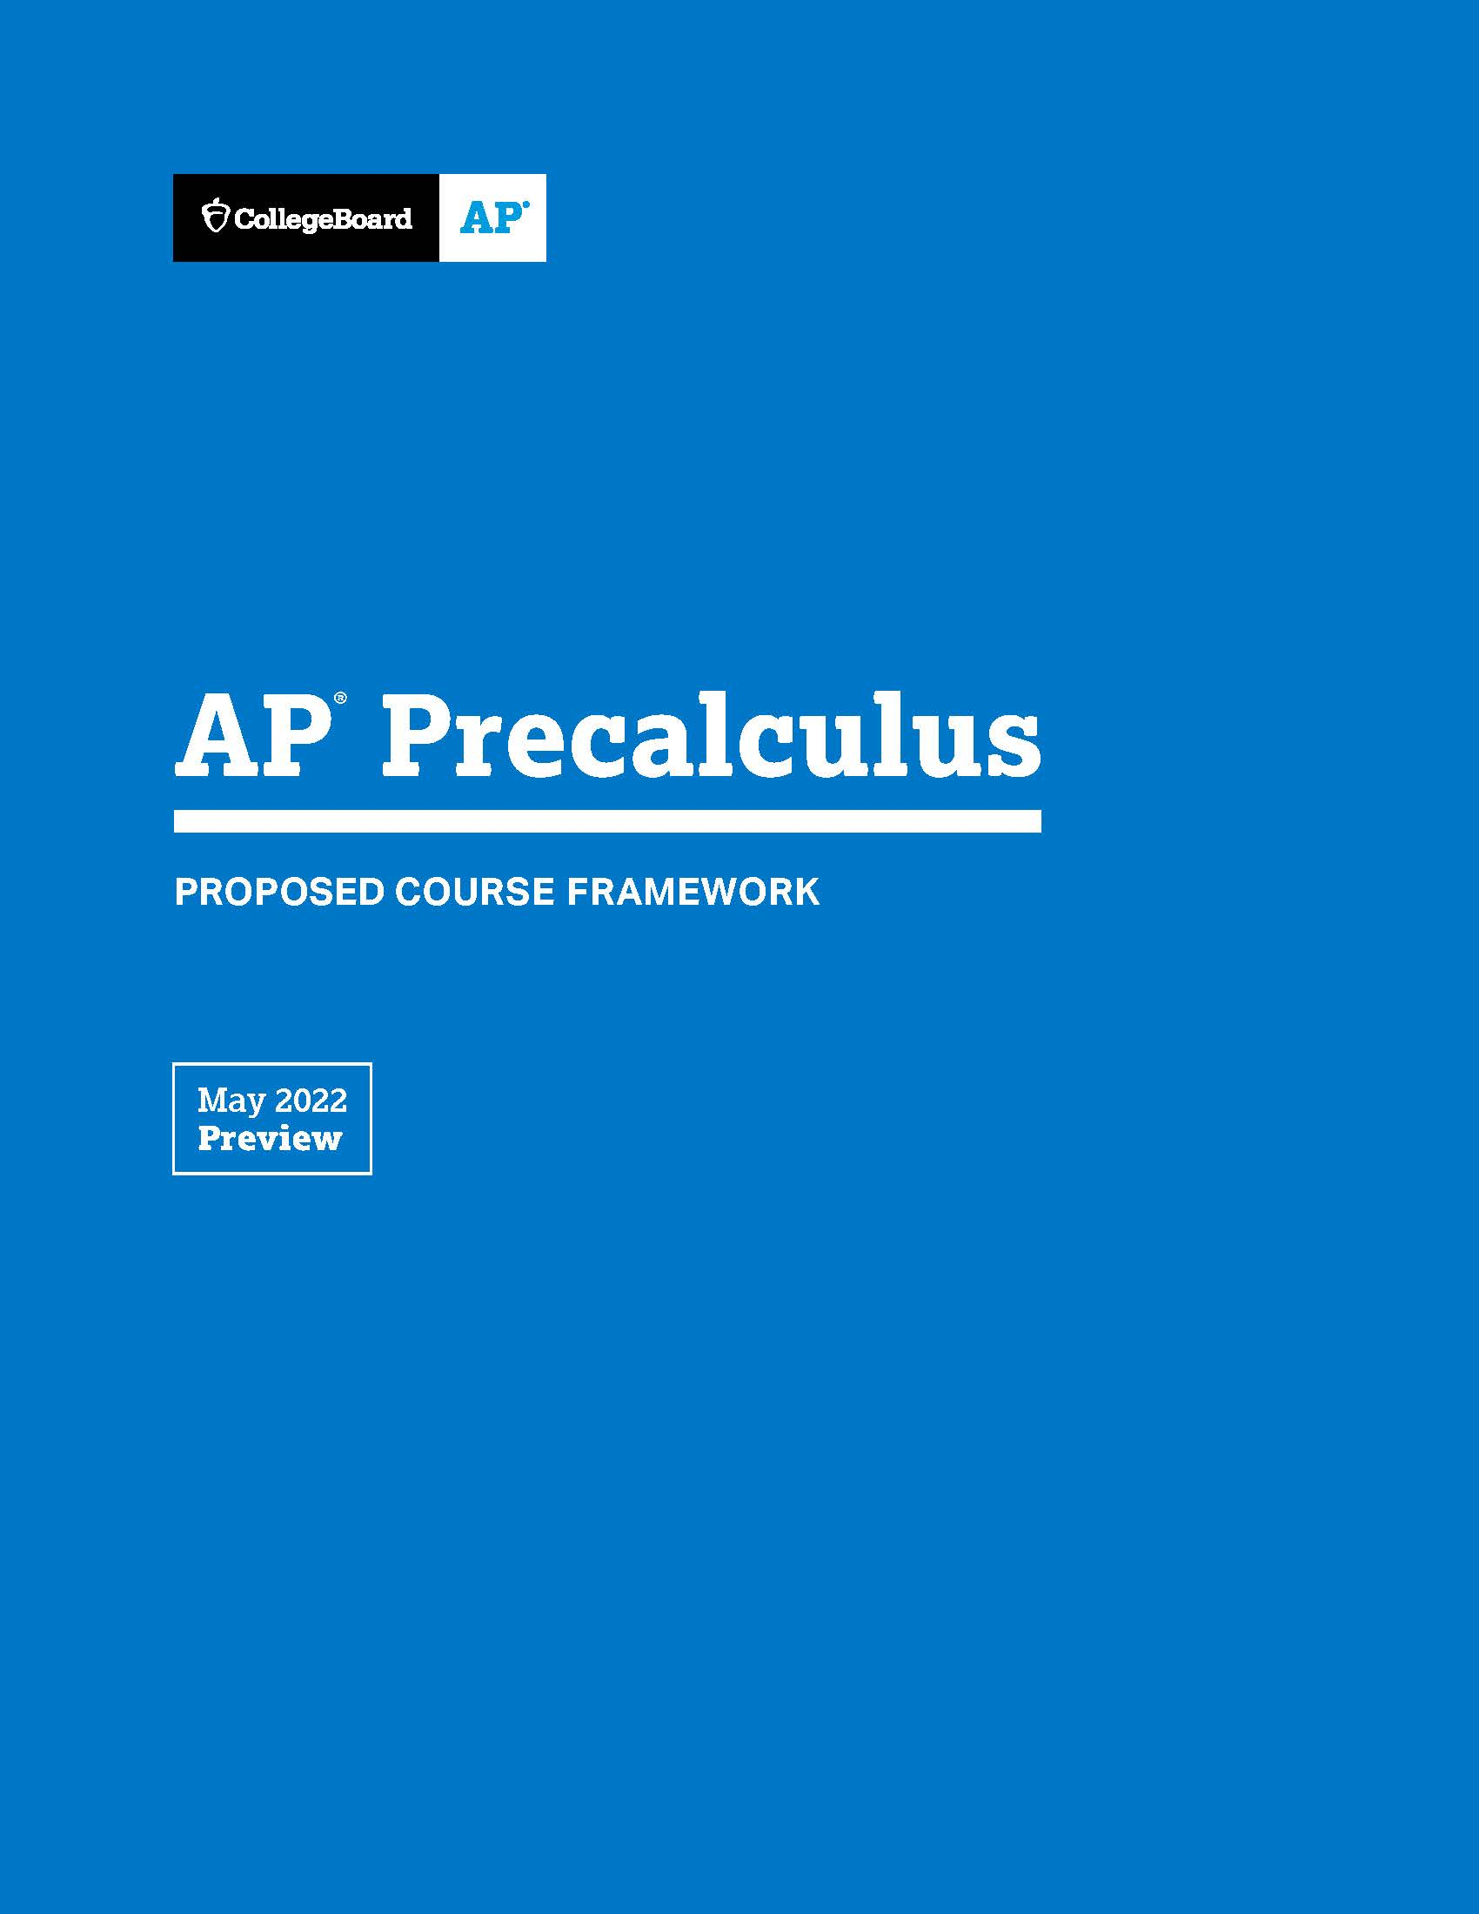
AP Precalculus Coming in 2023-24
COMING IN 2023-24
AP Precalculus
Created to prepare a wide range of students to succeed in math they’ll encounter in college.
Spring 2022
AP Course
and Exam Description
Spring 2023
Spring 2023
Summer 2023
Fall
2023
May
2024
Download the
AP Course
Framework
Download the
AP Course and Exam Description
AP Course Audit opens for teachers to begin submitting their syllabus.
AP Summer Institutes offer AP Precalculus.
School can offer AP Precalculus in the 2023-24 academic year.
First AP Precalculus Exam given.

Slide 3
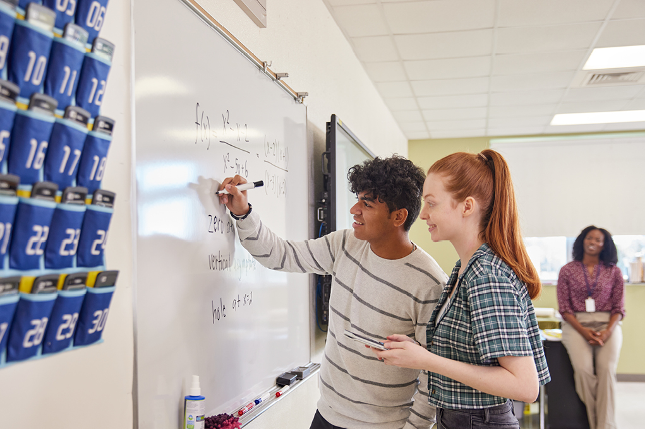
Introducing AP Precalculus
01
Why offer AP Precalculus?
Inadequate Preparation for College Math, Benefits of AP Precalculus
02
Who should take AP Precalculus?
Algebra 1 in Grade 9, Algebra 1 in Grade 8, Majors/Careers Not Requiring Calculus
03
What’s in AP Precalculus?
Student Experience, Unit Outline, Course at a Glance, Mathematical Practices
04
Bring AP Precalculus to your school.
Textbooks, Calculators, Teacher Supports, Student Readiness

Slide 4
Why offer AP Precalculus?
1

Slide 5
College math represents a frustrating barrier to success.
Every year, thousands of new college students must take remedial math.
The Mathematical Association of America has described Americans’ struggle with math as “the most significant barrier” to completing both STEM and non-STEM degrees.¹
40%
“The evidence is clear that calculus functions as a critical gatekeeper for U.S. students seeking to enter STEM majors and careers,” according to researchers from Just Equations, a California-based public policy institute. “Calculus’ reputation as a weed-out course is well deserved.”³
Students who enter college as STEM majors, but switch to a non-STEM major or fall short of a degree after failing common gateway courses, particularly calculus.²
Looking across all majors, 40% of college students lack sufficient math in high school to enroll in college-level math courses, so must spend time and money on remedial math courses that do not count toward their degrees. Nearly half of these students fail to fulfill the math requirement.⁴
¹ “A Common Vision” Mathematical Association of America (MAA) https://www.maa.org/sites/default/files/pdf/CommonVisionFinal.pdf
² https://www.nytimes.com/2011/11/06/education/edlife/why-science-majors-change-their-mind-its-just-so-darn-hard.html?pagewanted=all
³ https://justequations.org/wp-content/uploads/Learning-Lab-Calculus-Report-Layout-ADA.pdf
⁴ Chen, X. (2016). Remedial Coursetaking at U.S. Public 2- and 4-Year Institutions: Scope, Experiences, and Outcomes (NCES 2016-405). U.S. Department of Education. Washington, DC: National Center for Education Statistics. Retrieved May 2022 from http://nces.ed.gov/pubsearch.

Slide 6
How will AP Precalculus make a difference?
1
More time.
4
Trusted standard.
AP Precalculus provides students with 140 hours of contact time with their instructor; in comparison, students who wait and take precalculus in college will typically receive 48 hours of contact.
The AP Precalculus exam is developed and scored by college professors, rather than by a student’s own teacher, setting an unimpeachable standard across a wide range of classrooms.
2
5
Teacher as coach, ally.
Familiar space, more practice.
AP Precalculus meets students where they are in the familiar environment of a high school classroom and provides free online practice and videos that can be tailored to individual students’ needs for additional help.
AP students tend to see their teachers as their coaches and allies, dedicated to helping them learn what is necessary for college credit.
3
Motivation.
Many students are galvanized by the opportunity to earn college credit, devoting more time and effort to the sort of practice and focus that math proficiency demands.

Slide 7
Who should take AP Precalculus?
2

Slide 8
Who should take AP Precalculus?
1
Algebra 1 in Grade 9
AP Precalculus will prepare students who start Algebra 1 in 9th grade for a successful transition into a STEM major in college.
2
Algebra 1 in Grade 8
AP Precalculus will help students who take Algebra 1 before 9th grade be more prepared for success in AP Calculus.
3
Majors/Careers
Not Requiring Calculus
AP Precalculus will help students fulfill their college math requirement when their majors and careers do not require calculus.

Slide 9
The culminating math experience
1
Half of American students don’t begin Algebra 1 until 9th grade.
Accordingly, most of these students interested in STEM majors and careers will first encounter calculus in college. If they’re not ready for calculus, they will need to take precalculus in college first.
These students deserve solid preparation for STEM majors and careers. Providing them with an AP credit opportunity for precalculus will motivate many students to persist in four years of high school math and will significantly boost student readiness for the subsequent math classes they will need to major in STEM.
Algebra 1
in Grade 9
AP Precalculus will prepare students who start Algebra 1 in 9th grade for a successful transition into a STEM major in college.

Slide 10
Prep for AP Calculus
2
Half of American students take Algebra 1 prior to 9th grade.
While many of these students aspire to take calculus in high school, many are not ready.
Students who take AP Precalculus before their senior year will be much better prepared for success in AP Calculus, and for any subsequent math they may need in college.
Algebra 1
in Grade 8
AP Precalculus will help students who take Algebra 1 before 9th grade be more prepared for success in
AP Calculus.

Slide 11
For no-calculus majors/careers
3
Students interested in non-STEM majors will often be able to use a qualifying AP Precalculus Exam score to fulfill a college math requirement.
These students can then focus their valuable time and college budget on the courses most necessary for their majors and careers, avoiding the need to repeat content already mastered in AP Precalculus.
Offering a college-level precalculus course in high school will afford a wide range of high school students a new and valuable way to improve math readiness and on-time college graduation.
Majors/Careers
Not Requiring Calculus
AP Precalculus will help students fulfill their college math requirement when their majors and careers do not require calculus.

Slide 12
Math Pathways
The math pathways available to students starting with Algebra 1.
Year 1 | Year 2 | Year 3 | Year 4 | Year 5+
Algebra 1 | Geometry | Algebra 2 | AP Precalculus* | AP Calculus AB* AP Calculus BC*^ AP Statistics*
 |  |  | AP Statistics | AP Calculus AB AP Calculus BC AP Precalculus
 |  |  | AP Calculus AB | AP Calculus BC AP Statistics
 | Algebra 2 | Geometry | AP Precalculus* AP Calculus AB AP Statistics | AP Calculus AB* AP Calculus BC*^ AP Statistics*
 | Geometry and Algebra 2 | AP Precalculus* AP Statistics AP Calculus AB | AP Calculus AB* AP Calculus BC*^ AP Statistics | AP Calculus AB AP Calculus BC AP Statistics*
* Represents an anticipated sequence for most students on this pathway.
^ It is anticipated that a higher percentage of students may pursue AP Calculus BC having had AP Precalculus due to topic coverage not found in some precalculus courses.
Note: The Pre-AP course sequence is Pre-AP Algebra 1, Pre-AP Geometry with Statistics, Pre-AP Algebra 2.

Slide 13

Credit and Placement
AP Precalculus
Precalculus fulfills a math requirement at a diverse range of colleges and universities, including the majority of public institutions.
However, most highly selective colleges do not treat precalculus as a college-level course, and thus college credit for AP Precalculus will not be available at such institutions; instead, AP Precalculus will provide students attending such colleges with superb preparation for AP Calculus in high school or college calculus when they matriculate.
AP Precalculus exam scores can also be used by college for math and science course placement among newly enrolling students.

Slide 14
“AP Precalculus is a well-balanced and meaningful course that will be beneficial for every student regardless of their intended future plans. The content captures the modeling of our dynamic, changing world which can ignite a passion and appreciation for the pursuit of many areas related to mathematics.”
Julie Harrison, Spelman College, Development Committee Member

Slide 15
What’s in AP Precalculus?
3

Slide 16
About the Course
AP Precalculus prepares students for other college-level mathematics and science courses.
AP Precalculus
The AP Program convened college faculty to build a precalculus course that invites a diverse group of students to prepare for college mathematics, encourages more students to complete four years of mathematics in high school, and improves student readiness to succeed in STEM courses and majors in college.
In AP Precalculus, students explore everyday situations and phenomena using mathematical tools and lenses.
Through regular practice, students build deep mastery of modeling and functions, and they examine scenarios through multiple representations. They will learn how to observe, explore, and build mathematical meaning from dynamic systems, an important practice for thriving in an ever-changing world.

Slide 17

What will students experience in AP Precalculus?
Modeling Real-World Data: Students will apply the mathematical tools they acquire in real-world modeling situations. By examining scenarios, conditions, and data sets and determining and validating an appropriate function model, students gain a deeper understanding of the nature and behavior of each function type.
Exploring Multiple Representations: Students will examine functions through multiple representations. Students will gain a deeper understanding of functions by examining them graphically, numerically, verbally, and analytically.

Slide 18
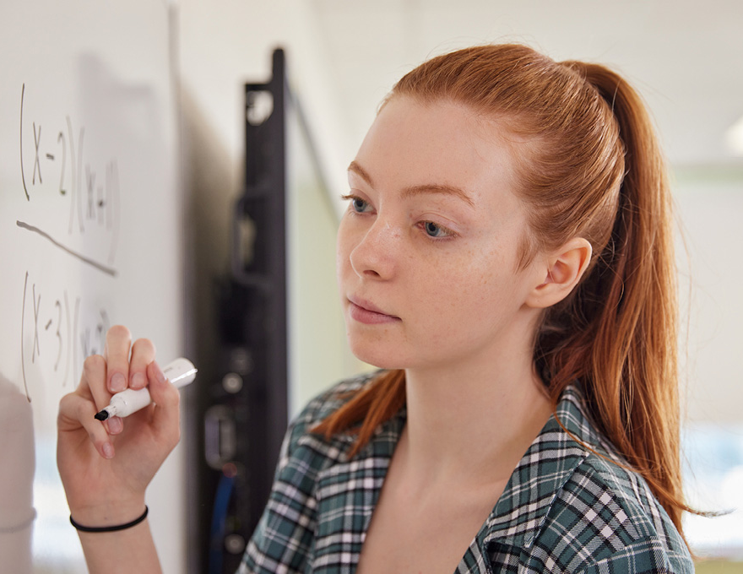
What will students experience in AP Precalculus? (continued)
Mastering Symbolic Manipulation: Students will develop rigorous symbolic manipulation skills needed for future mathematics courses. Students learn that a single mathematical object can have different analytical representations depending on the function type or coordinate system, and that the different analytical representations reveal different attributes of the mathematical object.
Harnessing a Dynamic World: Students will engage in function building that reflects not a static view of things but embodies how things change. Every function representation characterizes the way in which values of one variable simultaneously change as the values in another variable change. This understanding of functions and their graphs as embodying dynamic covariation of quantities prepares students to tame an ever-changing world.

Slide 19
Unit Outline
Course Content
The course content is organized into units of study that provide a suggested sequence for the course. These units comprise the content and conceptual understandings that colleges and universities typically expect students to master to qualify for college credit and/or placement.
UNIT
1
Polynomial and Rational Functions
6–6.5 Weeks
UNIT
2
Exponential and Logarithmic Functions
6–6.5 Weeks
UNIT
3
Trigonometric and Polar Functions
7–7.5 Weeks
UNIT
4
Functions Involving Parameters, Vectors, and Matrices
7–7.5 Weeks

Slide 20
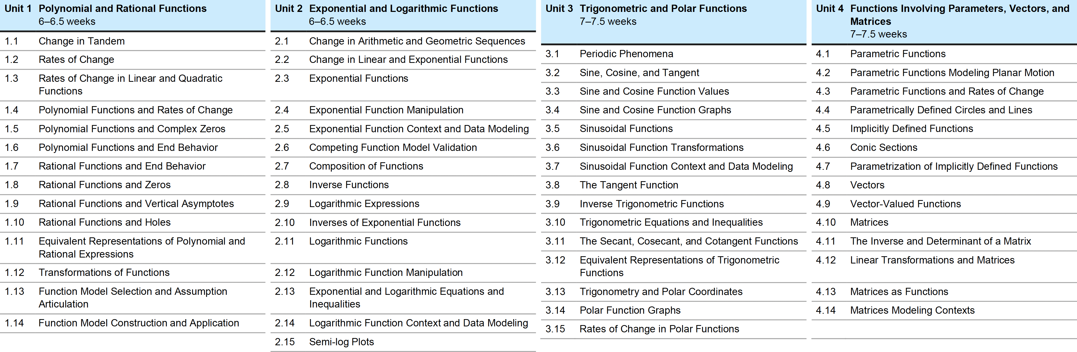
Course at a Glance
AP Precalculus

Slide 21
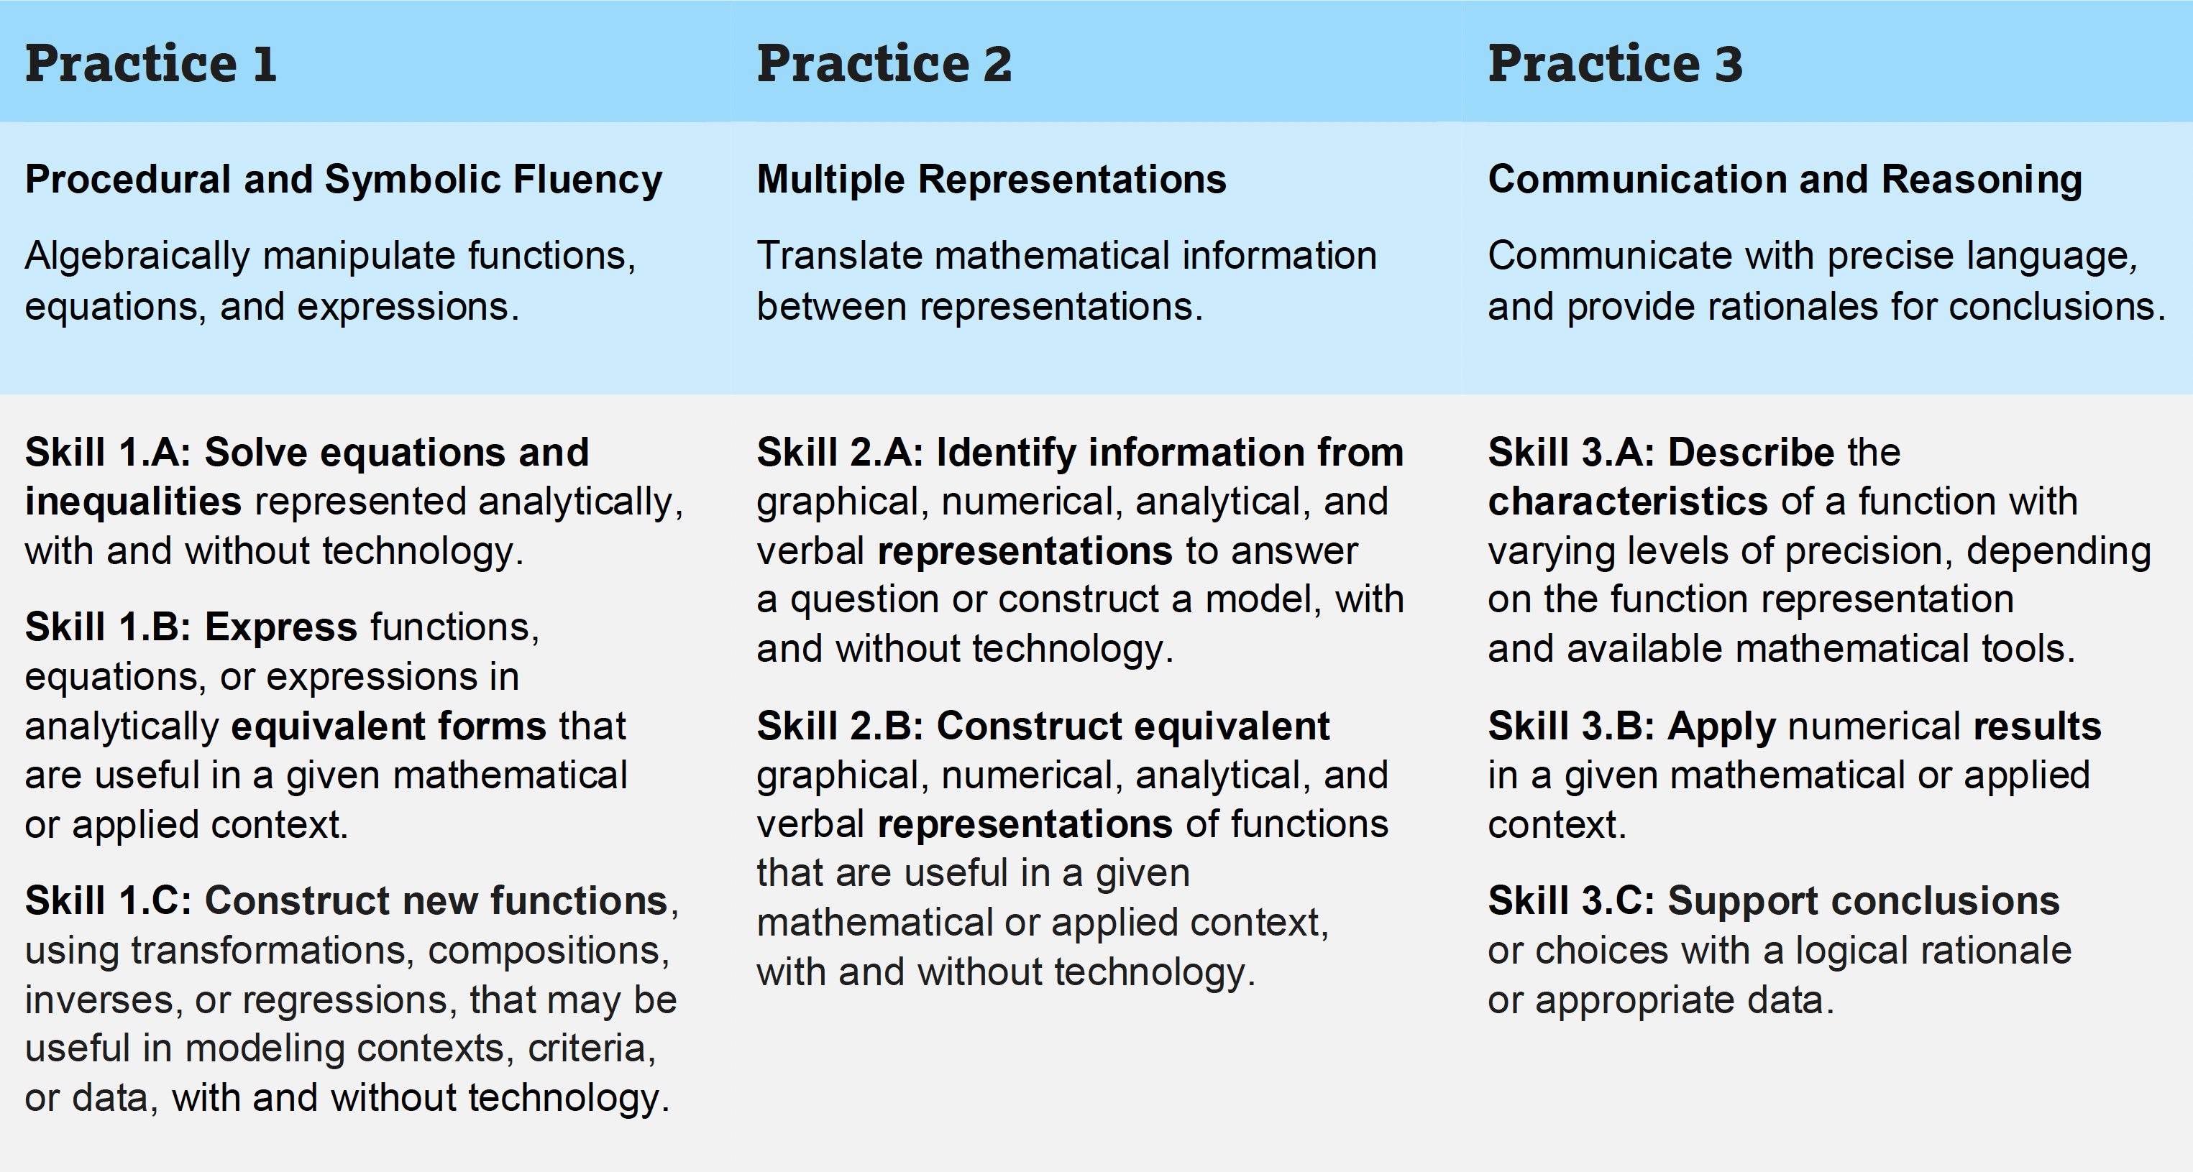
Mathematical Practices
AP Precalculus
The eight distinct skills are associated with three mathematical practices.
Students should build and master these skills throughout the course.
While many different skills can be applied to any one content topic, the framework supplies skill focus recommendations for each topic to help assure skill distribution throughout the course.

Slide 22
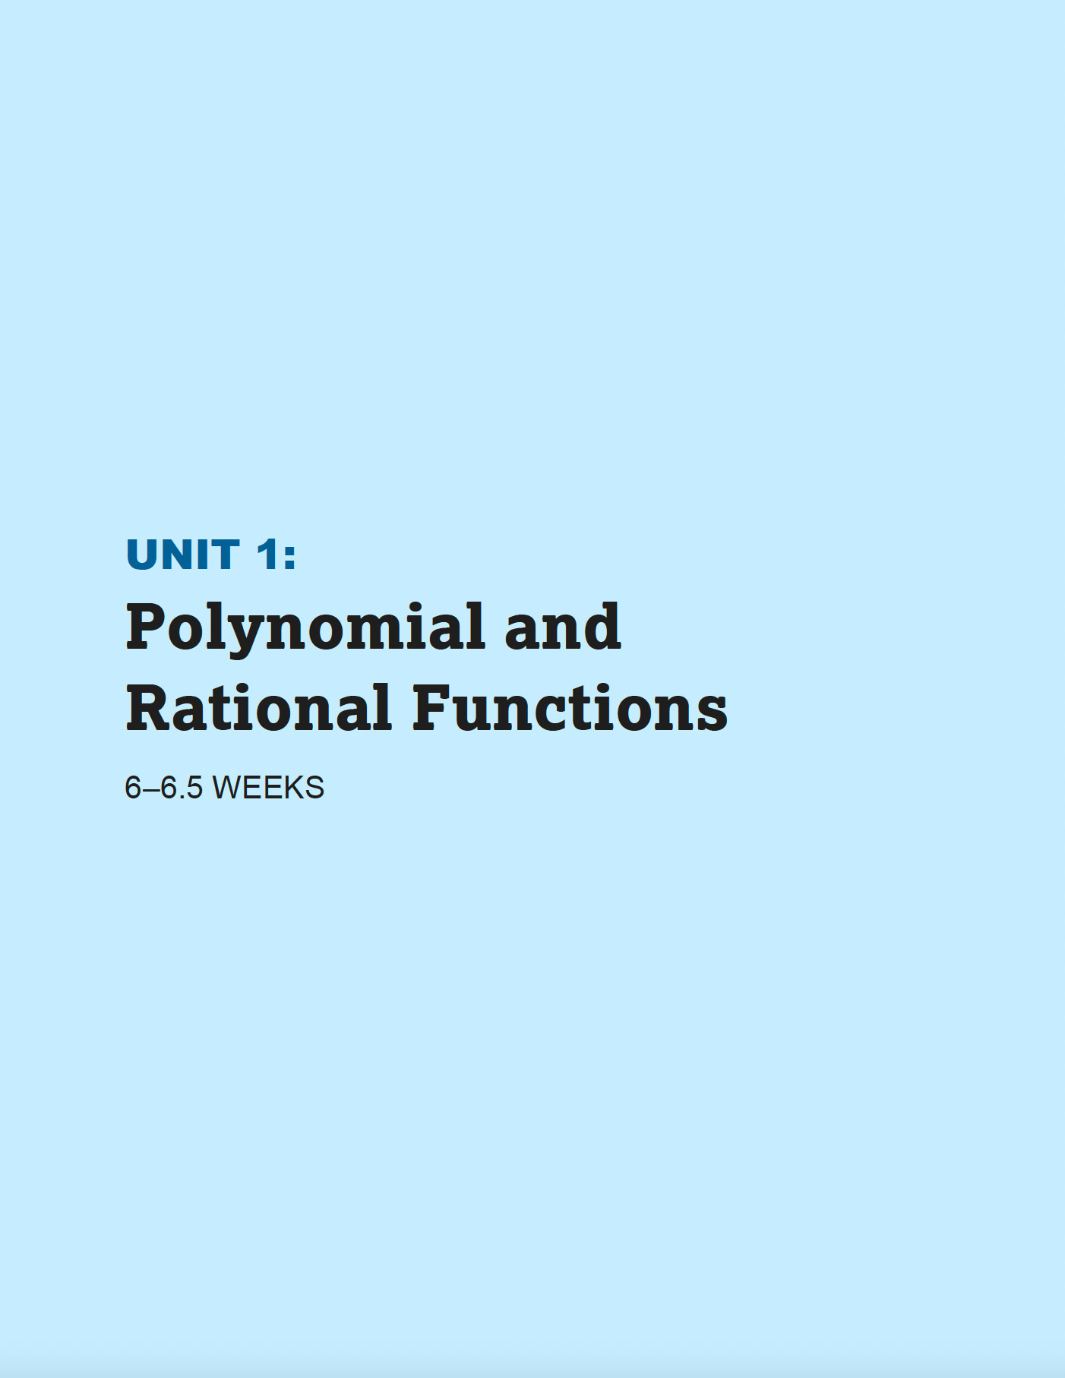
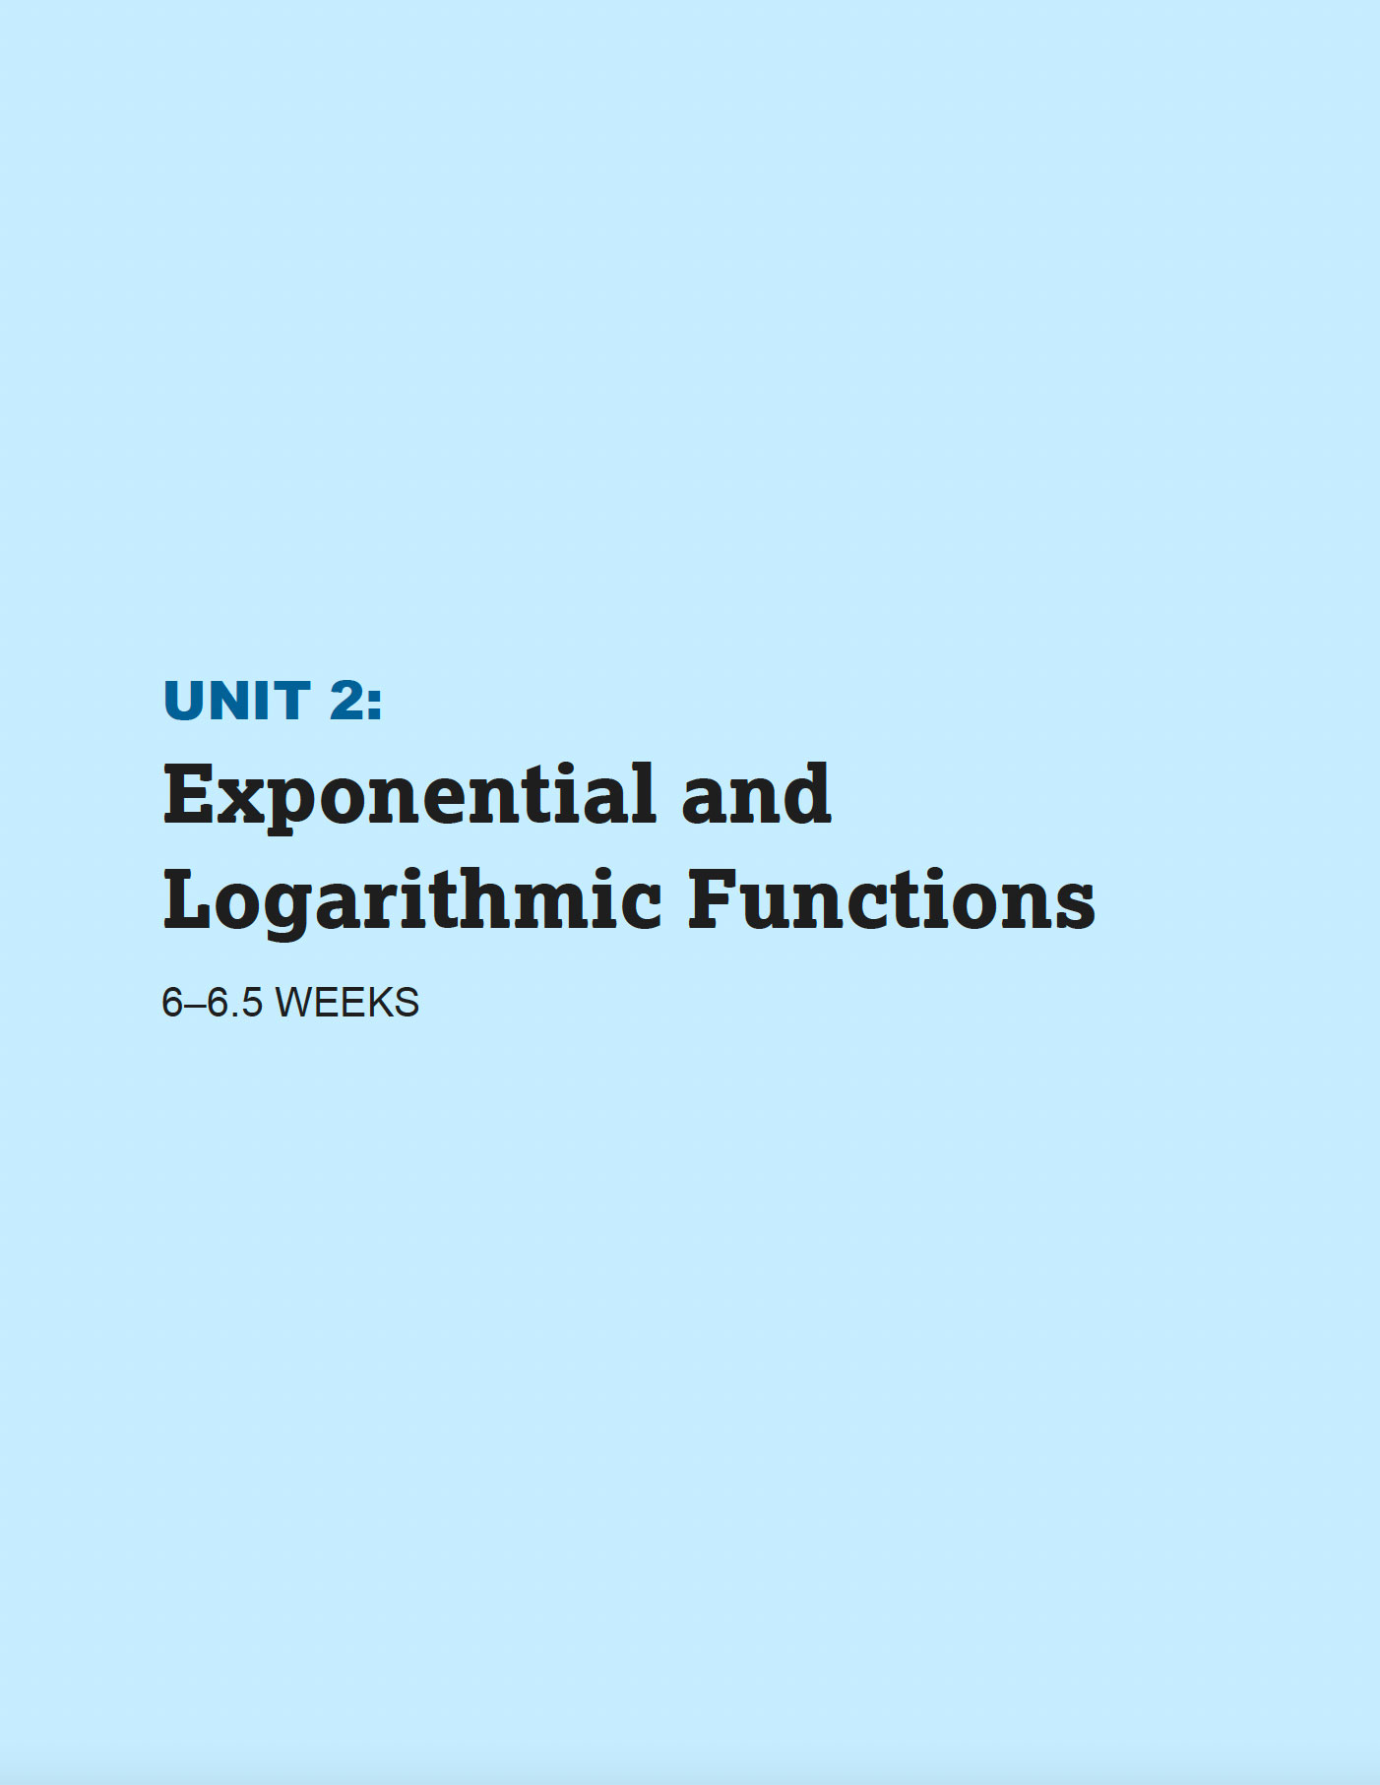
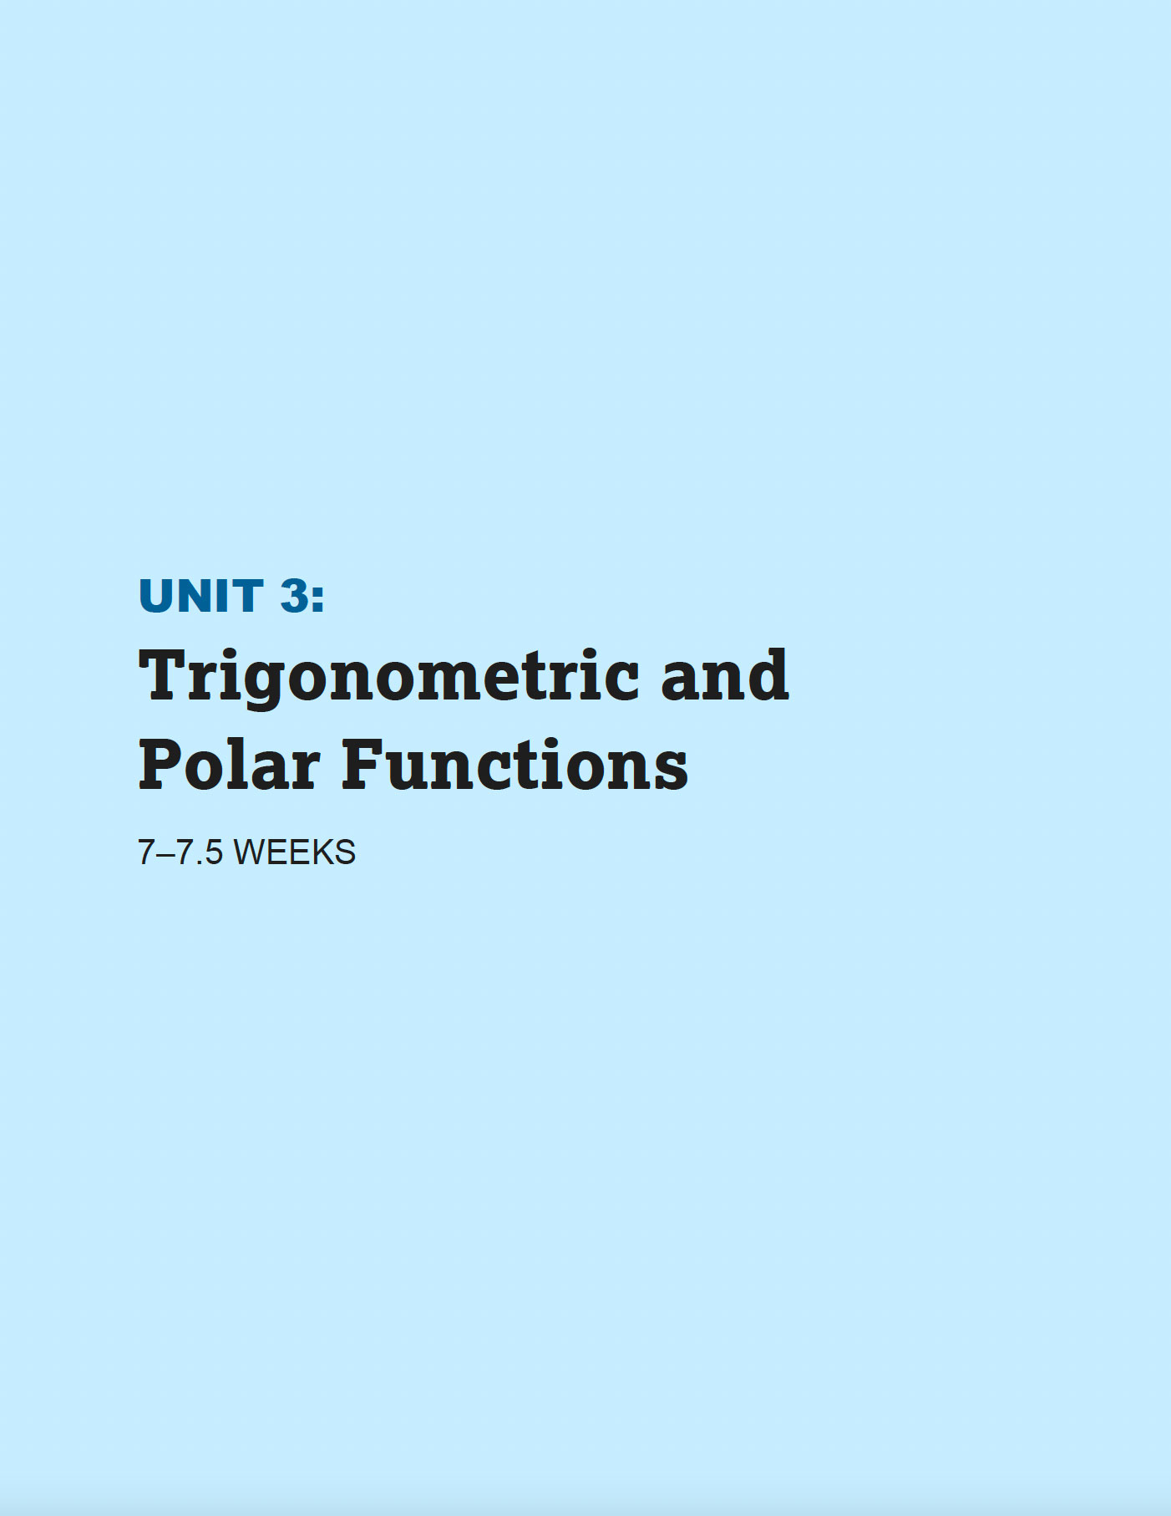
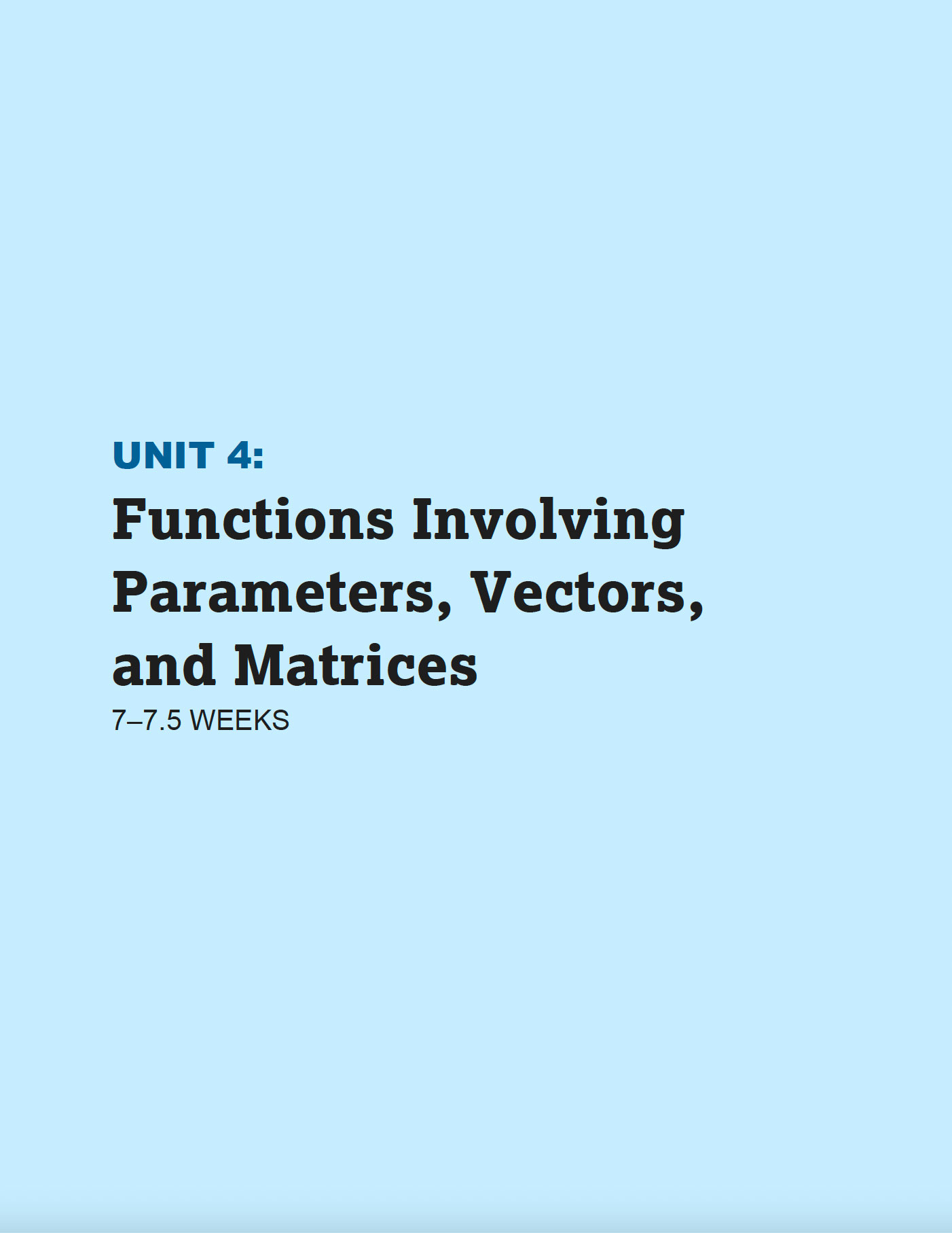
Unit Notes
AP Precalculus
Each unit includes these features:
Exploration, analysis, and application of new function types.
Deep development of a key function concept applicable across function types such as transformations, compositions, and inverses.
Examination of how variables change relative to each other for each of the function types.
Use of each function type to model contexts and data sets.
Rigorous application of the algebraic skills needed to engage with each function type.

Slide 23
Technology Notes
Technology should be used throughout the course as a tool to explore concepts.
Students should specifically practice using technology to do the following:
Perform calculations (e.g., exponents, roots, trigonometric values, logarithms)
Graph functions and analyze graphs
Generate a table of values for a function
Find real zeros of functions
Find points of intersection of graphs of functions
Find minima/maxima of functions
Find numerical solutions to equations in one variable
Find regressions equations to model data
Perform matrix operations (e.g., multiplication, finding inverses)
Important: Technology should not replace the development of symbolic manipulation skills.
When algebraic expressions and equations are accessible with precalculus-level algebraic manipulation, students are expected to find zeros, solve equations, and calculate values without the help of technology.
Most of the AP Exam will need to be completed without the use of technology. However, selected questions will require students to use a graphing calculator to complete the tasks delineated above.

Slide 24
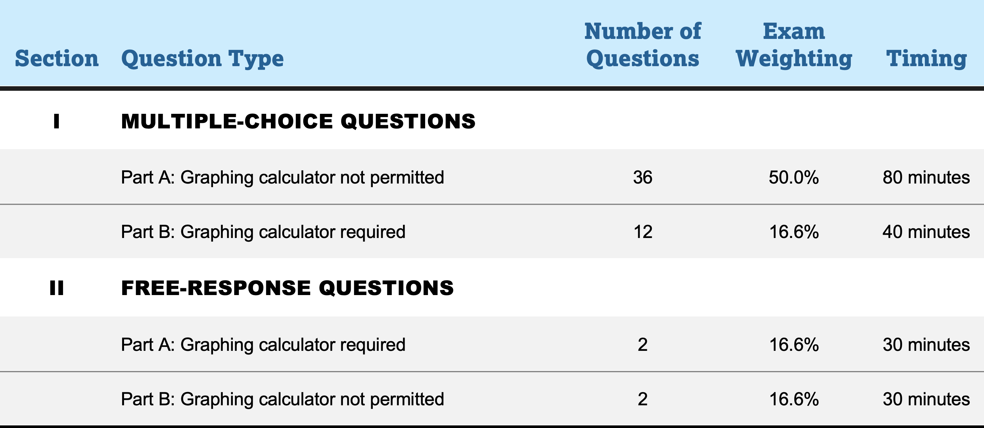
About the Exam
AP Precalculus
The AP Precalculus Exam assesses student understanding of the mathematical practices and learning objectives outlined in the course framework.
The exam is 3 hours long and includes 48 multiple-choice questions and four 6-point free-response questions.
The details of the exam, including exam weighting, timing, and calculator requirements,
can be found to the right.

Slide 25
Bring AP Precalculus to Your School
4

Slide 26
Confirm Textbook Alignment
Not all publishers will have AP editions of precalculus textbooks available in the
2023-24 school year.
Adopt
an AP edition
Use a general college-level precalculus textbook
To fulfill the college-level textbook requirement prior to the adoption of an AP edition:
Teachers must submit a syllabus
that indicates how they intend to provide supplemental college-level resources.
SUMMER 2022
An example textbook list will be
made available for AP Precalculus.

Slide 27

Be Ready with Approved Calculators
What’s Permitted on Exam Day
Course | Type of calculator allowed | Section I Multiple Choice | Section II Free Response
AP Precalculus | Graphing calculator | Required for Part B | Required for Part A
AP Calculus AB | Graphing calculator | Required for Part B | Required for Part A
AP Calculus BC | Graphing calculator | Required for Part B | Required for Part A
SUMMER 2022
The list of approved graphing calculators for AP Exams
will be updated to indicate which approved calculators have
the built-in capabilities needed
for AP Precalculus.
Reminders about exam day rules:
Students can’t share calculators with other exam takers.
If a student doesn’t want to use a calculator, they may take an exam without one. However, if a student choose to take an exam without a calculator, they must hand copy, date, and sign a Calculator Release Statement on exam day, which will be provided by the AP coordinator or proctor.

Slide 28

Support Teachers
Professional Learning Opportunities
Teachers can enroll in an AP Summer Institute (APSI) for Precalculus, a four-day professional learning experience that equips teachers with a deep understanding of the course framework, exam, and instructional supports. APSI scholarships will be available to teachers who qualify.
Additional one-day professional learning workshops will also be available.
AP students and teachers receive access to AP Classroom, free, digital instructional resources and through-course supports that include instructional videos, formative assessments, and personalized feedback reports.

Slide 29

Ensure Students are Ready
For Success in AP Precalculus
Expected Prior Knowledge and Skills | Algebra 1 | Geometry | Algebra 2
Proficiency with linear functions
Proficiency in polynomial addition and multiplication
Proficiency in factoring quadratic trinomials
Proficiency in using the quadratic formula
Proficiency in solving right triangle problems involving trigonometry
Proficiency in solving linear and quadratic equations and inequalities
Proficiency in algebraic manipulation of linear equations and expressions
Proficiency in solving systems of equations in two and three variables
Familiarity with piecewise-defined functions
Familiarity with exponential functions and rules for exponents
Familiarity with radicals (e.g., square roots, cube roots)
Familiarity with complex numbers

Slide 30
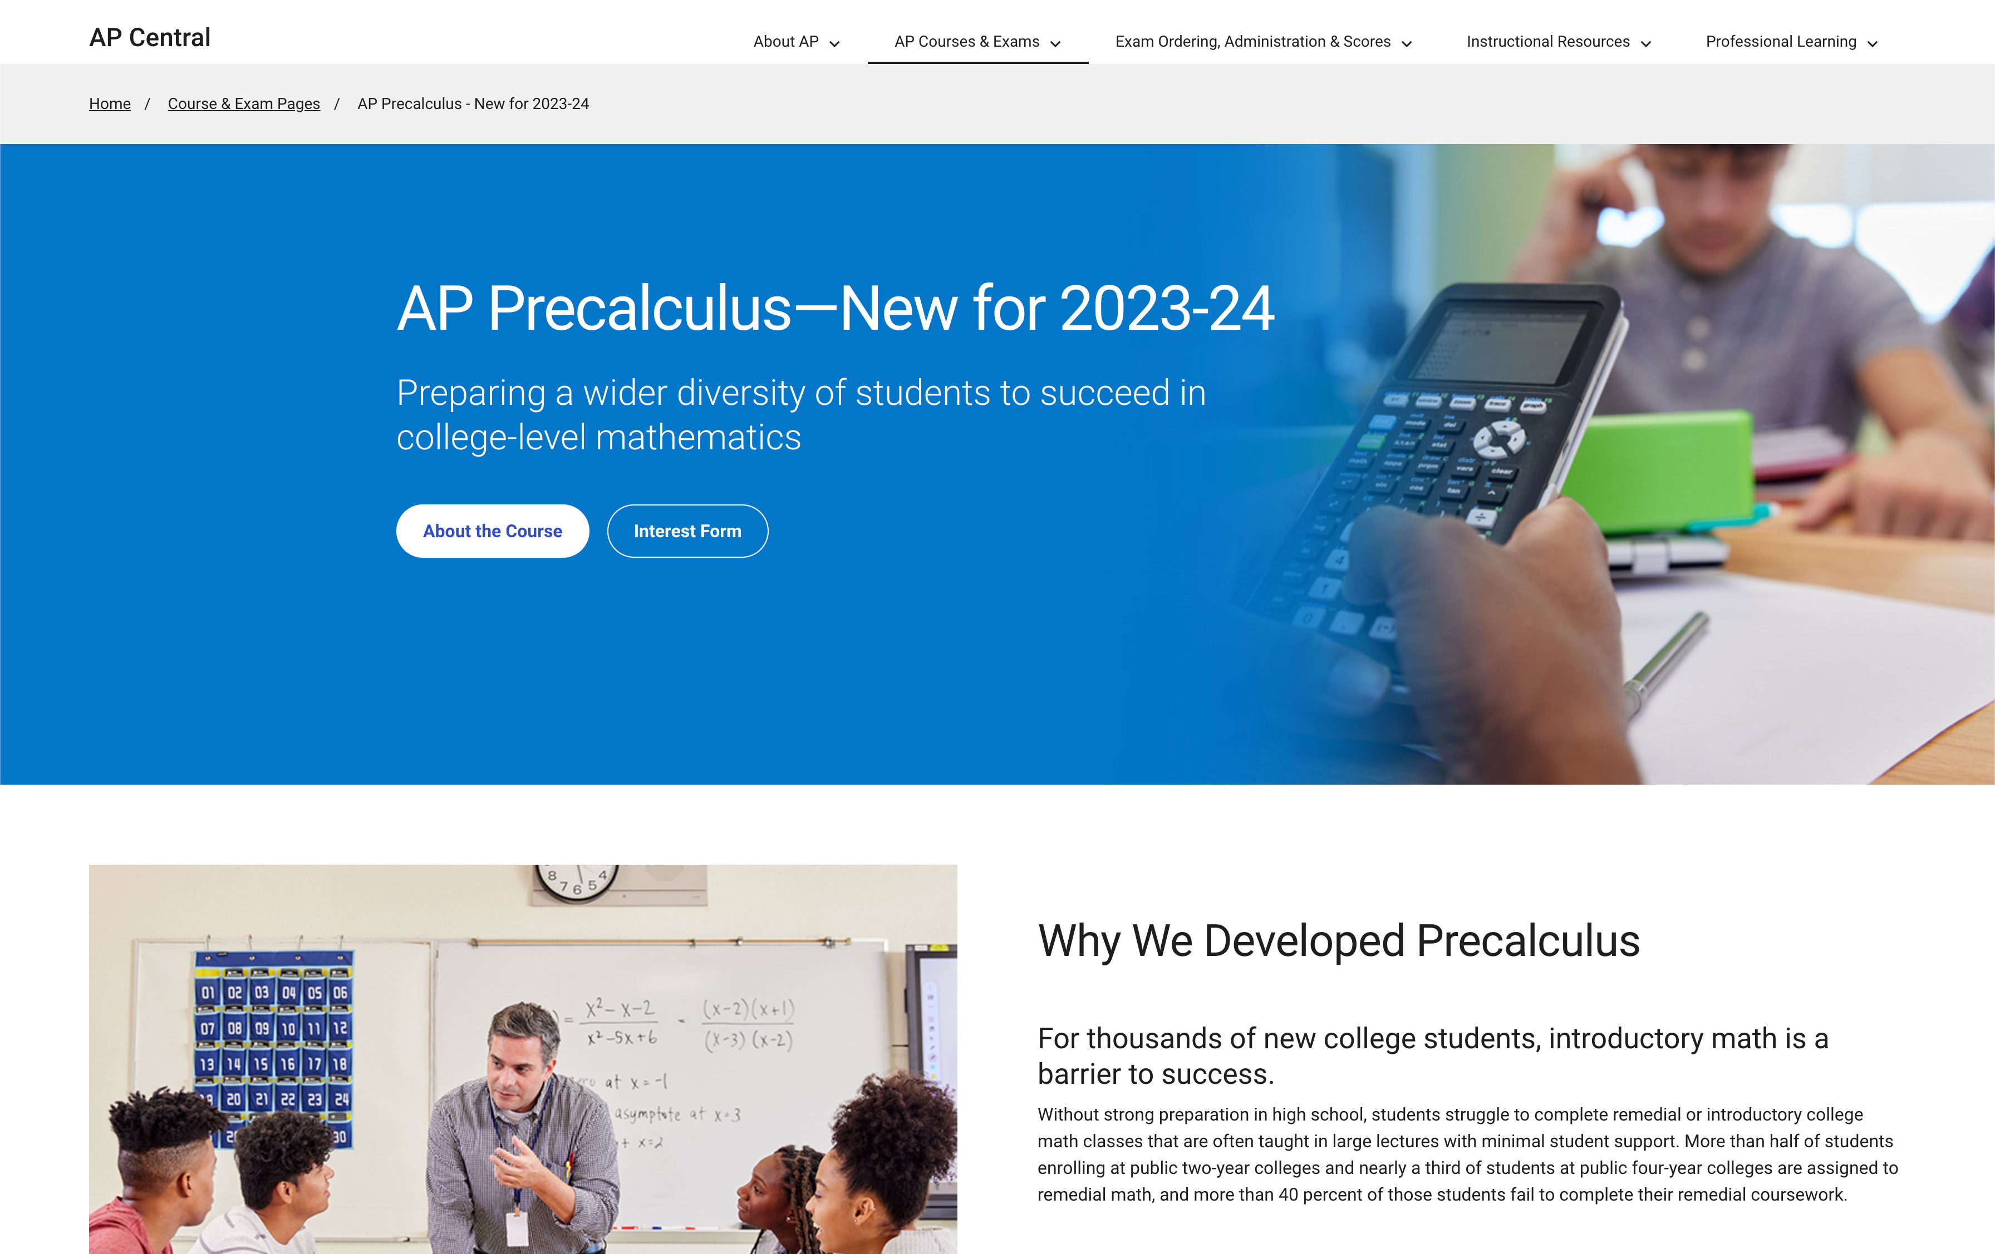
To learn more about AP Precalculus https://apcentral.collegeboard.org/courses/ap-precalculus

