Slide 1
UW System Math Initiative Math Steering Committee meeting
Friday, November 1, 2019
Pyle Center
Madison, WI

Slide 2
Meeting objectives
Draft Wisconsin fundamental features of corequisite support in mathematics
Review institutional data on corequisite and pre-requisite mathematics outcomes
Review variety of nursing programs at UW institutions and consider implications for gateway mathematics

Slide 3
Why draft fundamental features of co-req?
Common language
Guidance for folks developing co-req
Implications for transfer
Notes:
We think this group is the right group to come up with co-req features.
If you currently have, or are developing, co-req, this is a chance to share what you think are the key features.
If you do not have co-req, this is a chance to think about how other institutions’ co-req might affect you (such as through transfer), or what might be important if your institution develops co-req in the future.

Slide 4
Let’s start with some data…
How are co-req remedial math courses working in our System currently?
How might these data inform our development of fundamental features of co-req?
Notes:
At the September workshop, a couple of folks asked for data for their institution.
Today, you have a chance to dig into your institution’s data on remedial math students.
I have a viz for each of your institutions. It will allow you to explore the outcomes of pre-req and co-req students that you saw at the September workshop, with your institution’s data.
I’m going to walk you through the viz using UW Colleges as an example.
Then, you’ll have time to explore the viz for your institution on your own.
Then, we’ll have some small group discussion and sharing.
Then, we’ll consider how what we’ve learned might inform fundamental features of co-req.

Slide 5
Individual reflection
Go through the entire viz once
Tab through each page
Think about the questions above the charts
Hover over the charts to see raw numbers
Ignore the filters!
Jot down what you learned
(Optional): Go back for more investigation
Start here: https://www.wisconsin.edu/math-initiative/data/
Then I will give you the web page for your institution.

Slide 6
Small group exploration
What did you learn?
What surprised you?
What additional information would be helpful?
Notes:
WTW group: SUP, STO, STP, PLT
MIL: RVF, OSH, GBY
EAU: Alex said their problem is their advisors, PKS (DeAnn talking about some things they want to move forward at PKS), LAC, MAD (no co-req)

Slide 7
Report out
What did you learn?
What surprised you?
What additional information would be helpful?
How might these data inform our development of fundamental features of co-req?
Notes:
What additional information would be helpful? Possible prompts:
Effectiveness:
Why is there an equity gap in co-req outcomes?
Outcomes after 1st year: Is there any evidence that pre-req students “catch up” to the math they need by the end of the second year?
How do students do in the next course after the gateway course? Do co-reqs provide adequate preparation / content coverage?
Implementation:
How would course enrollments change with shift from pre-req to co-req? How might credit hours of co-req be adjusted to balance workload?
How might grade distribution in gateway courses shift with addition of co-req students?
What is the trade-off between a pre-req and co-req for lowest-prepared students? Between co-req and placement without support?
How might these data inform our development of fundamental features of co-req? Possible prompts:
What can we do about the equity gaps of students coming through co-req?
Is there a case for providing co-req to a particular type of student (e.g. score range)?
What’s in the best interest of students?

Slide 8
Unpack ideas for fundamental features of co-req
Small group reflection:
Workshop UW groups’ draft ideas for fundamental features
Tennessee fundamental features
Georgia fundamental features
What’s essential?
What’s nice to have?
What needs more clarity?
Notes:
What’s in the best interest of students?

Slide 9
Lunch

Slide 10
Report out and synthesize
What’s essential?
What’s nice to have?
What needs more clarity?

Slide 11
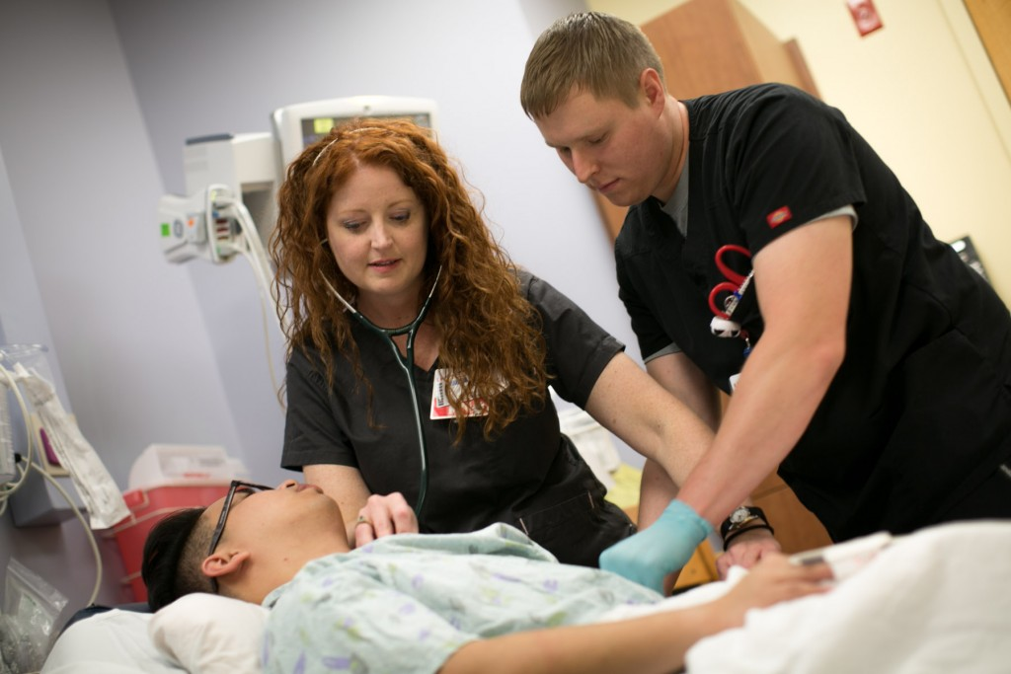
Nursing programs in UW System
Review summary
Consider and discuss implications for gateway courses at your institution

Slide 12
Next steps
Nov. 1-mid-December 2019: MSC vets Wisconsin corequisite fundamental features draft
November to Dec. 10, 2019: Education Subcommittee vets, collects and submits feedback on EC/MCEA gateway math learning outcomes
Jan. 6-7, 2020: Education Subcommittee meets at UW-La Crosse
Jan. 9-10, 2020: MSC meets in Madison
Jan. 24, 2020: ICT submits Year 2 annual report and Year 3 project plan by this deadline

