Slide 1
Using Role-based Group Discussions in a Large Online Course Presented by Angie Stombaugh, UW-Eau Claire
UW System Virtual Showcase April 3-4, 2018
Welcome to:

Slide 2
Change Needed Related to My Teaching
This Photo by Unknown Author is licensed under CC BY

Slide 3
My biggest concern with group work is:
Group dynamics
Balancing the workload of the group
Grading individual vs. Group work
Monitoring the group process

Slide 4
Two Major Parts of My Group Work
Group Process
Weekly Experience
This Photo by Unknown Author is licensed under CC BY-NC-ND
This Photo by Unknown Author is licensed under CC BY-NC-ND

Slide 5
Contract
Establishing team procedures or schedule
Identifying expectations
4 group rules
Specifying the consequences for failing to follow these procedures and fulfill these expectations
This Photo by Unknown Author is licensed under CC BY-NC-SA

Slide 6
Group Process
Peer Survey
Strengths and Weaknesses Summary

Slide 7
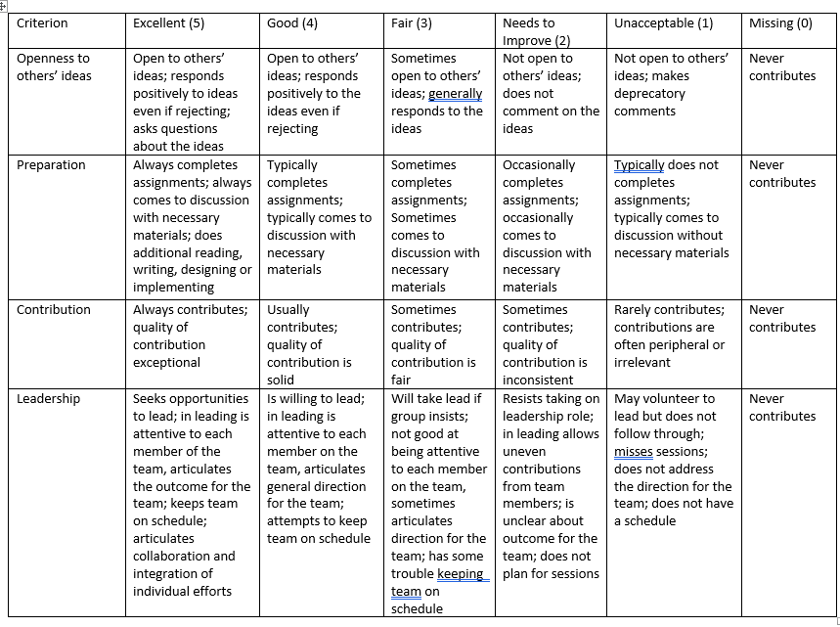
Final Evaluation of Each Other

Slide 9
Weekly Experience
Individual Work
Group Work
This Photo by Unknown Author is licensed under CC BY-NC-ND
This Photo by Unknown Author is licensed under CC BY-NC-ND

Slide 10
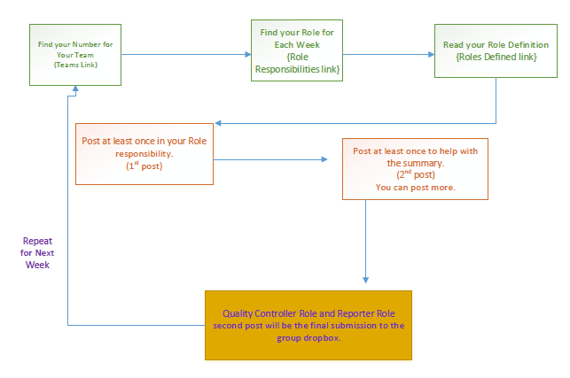
Weekly Workflow for Discussions

Slide 11
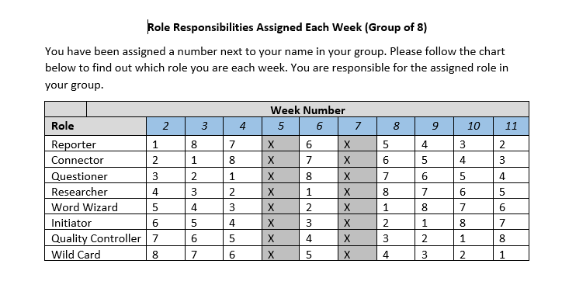
Finding Your Role
Each student assigned to a group and assigned a number within the group for the entire semester.
Role Responsibility Assigned Each Week

Slide 12
Weekly Workflow for Discussions

Slide 13
Initiator
Your job is to get the discussion started. Your post should try to get the conversation started by answering all or parts of the discussion question. This does not need to be a final product, simply attempting to answer the question. We encourage to add in this post where you need assistance so your team can help. Since you are the initiator, you will want to post early this week so your team can add to your post. More Work with This Role
This Photo by Unknown Author is licensed under CC BY-NC-ND

Slide 14
Connector
Your job is to find connections between the module materials and the world outside. That means connecting the materials to your own life, happenings in clinical, similar events at other times and places, stories in the news, or other writings on the same topic.
This Photo by Unknown Author is licensed under CC BY-NC-ND

Slide 15
Questioner
Your job is to provide 3 questions that you had about the module materials. What were you wondering about while you were reading? Did you have questions about what was being described? How do things fit together?
This Photo by Unknown Author is licensed under CC BY-NC-ND

Slide 16
Researcher
Your job is to look up background information on any topic related to the module discussion. This is not a formal research report. The idea is to find some information or material that helps your group understand the module better. Possible areas to explore are websites, textbooks, or scholarly articles. Don’t forget your APA reference. More Work with This Role
This Photo by Unknown Author is licensed under CC BY-NC-ND

Slide 17
Word Wizard
Your job is to review the module for important words-new, interesting, strange, important, puzzling, or unfamiliar words-words that members of the groups need to notice and understand. Provide the group with at least 2 words and their definition

Slide 18
Wild Card
Assumes the role of any missing member. You will be expected to post at least two times.
This Photo by Unknown Author is licensed under CC BY-ND

Slide 19
Reporter
Your job is to prepare a brief summary of your group’s answer to the discussion question(s). You serve as the group spokesperson and summarize the group’s conclusion. You are responsible for turning in the final summary. This will count as your post related to your role. Your individual score in this role is related to your ability to complete this summary. More Work with This Role
This Photo by Unknown Author is licensed under CC BY-NC-ND
This Photo by Unknown Author is licensed under CC BY-SA

Slide 20
Quality Controller
Your job is to ensure that the group is having a quality discussion. You will be evaluating the posts of your group mates and completing the Quality Control Report. You are responsible for turning in the Quality Control Report. This will count as your post related to your role. Your individual score in this role is related to your ability to complete the form.
This Photo by Unknown Author is licensed under CC BY
This Photo by Unknown Author is licensed under CC BY-NC-ND
This Photo by Unknown Author is licensed under CC BY-SA

Slide 21
Quality Controller Report
When evaluating the posts of an individual, the individual must complete the following to receive (= Meets Expections) mark:
Must complete at least 2 posts
To ensure the posts are a quality post, the post should answer at least 4 of the following questions:
Is the information accurate?
Are the posts relevant to the topic under discussion?
Do the posts answer the question(s) required?
Do the posts teach something new?
Do the posts apply a concept in a new way?
Do the posts add to the academic atmosphere of the discussion?

Slide 22
Weekly Workflow for Discussions

Slide 23
Grading Each Week
Individual Grade
Group Grade
Individual assignment
Role Grade (5 pts)
Grade on the Summary (10 pts)
Extra Credit Winner
This Photo by Unknown Author is licensed under CC BY-SA

Slide 24
Changes Created with this Format
Before Groups
With Groups
Grade 66 initial posts and track additional 132 replies
Poor quality in initial posts and responses
Knew how the entire discussion is going
Very labor intensive
Grade 8 summaries & 8 Quality Control reports
Quality in summaries
Outside sources
Integrating experiences
Don’t know what really is happening in the discussion

Slide 25
Trying the Audit
This Photo by Unknown Author is licensed under CC BY-SA

Slide 27
Evaluation
Your moderator will be placing the link to evaluate this session in the Chat area.
They will also be placing a link to evaluate the whole 2018 UW-S LTDC Virtual Showcase in the Chat area as well.
Thank You for Attending!
See you in 2019!

