Slide 1
SPILL PREVENTION, CONTROL & COUNTERMEASURE (SPCC) TRAINING TEMPLATE
for University of Wisconsin campuses
Revised: May 2017

Slide 2
COURSE INTRODUCTION
Welcome to the UWSA Spill Prevention Control & Countermeasure (SPCC) training presentation, which is intended for use by University of Wisconsin campuses as a template and to be supplemented with facility-specific information.
This training will orient you to the United States Environmental Protection Agency (USEPA) SPCC rule, which applies to certain facilities storing oil products. All oil-handling personnel must receive at least annual training to respond properly to spills in their work areas.

Slide 3
COURSE INTRODUCTION
This training course discusses the applicability of the SPCC rule and the details you should be aware of, including information on:
  Regulatory overview
  Facility sources
  Spill prevention and control
  Spill countermeasures
  Spill reporting
  Inspections and recordkeeping
You also need to be familiar with the SPCC plan written for your facility. Your facility’s SPCC plan documents facility-specific information you should be aware of and contains the training and inspection forms you will be learning more about. Please reference your facility’s SPCC plan as you proceed.

Slide 4
REGULATORY OVERVIEW
What is the SPCC Rule?
The Spill Prevention Control & Countermeasure (SPCC) rule is part of the federal Oil Pollution Prevention regulations (40 CFR 112) issued under the Clean Water Act, which aim to prevent the discharge of oil in harmful quantities into or upon the navigable waters or adjoining shorelines of the United States.
An SPCC plan as required under these regulations should be used as a reference for proper oil storage, as a tool for spill prevention, as a guide for facility inspections and tank testing, and as a resource during emergency response to control, contain and clean up an oil release.

Slide 5
REGULATORY OVERVIEW
Applicability
Under the Clean Water Act, facilities require an SPCC plan if they meet the following conditions:
  Aboveground oil storage capacity of more than 1,320 gallons in all containers 55 gallons or greater in volume; or
  Underground oil storage capacity of more than 42,000 gallons; and
  There is reasonable potential for a release to reach waters of the U.S.
Waters of the U.S. include conveyances to water such as storm drains, dry ditches, wetlands, mudflats and sandflats.

Slide 6
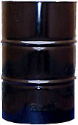
REGULATORY OVERVIEW
Applicability
Storage volumes are based on container capacity, and only containers and oil-filled equipment 55-gallons or greater in volume are counted.
For example, 5-gallon containers, 30-gallon containers and containers that are permanently closed are not counted toward the total volume of oil in regards to an SPCC plan.

Slide 7
REGULATORY OVERVIEW
Applicability
Oil is defined by the Clean Water Act as “oil of any kind or in any form including, but not limited to, petroleum, fuel oil, sludge, oil refuse and oil mixed with wastes other than dredged spoil and oily mixtures.” Under the SPCC rule, this definition encompasses:
    Petroleum and non-petroleum based oils
    Crude oil
    Refined products
    Animal fats, oils and greases
    Vegetable oils
Examples: crop oil, diesel fuel, gasoline, hydraulic oil, synthetic oils and vegetable oils from crops.
Milk and milk product containers are now exempt from the SPCC capacity calculations and rule requirements.

Slide 8
REGULATORY OVERVIEW
Written SPCC Plan Requirements
The SPCC plan is certified by a registered Professional Engineer and must be maintained on site at your facility. The SPCC plan written for your facility covers the following mandatory information:
    Facility and operation description
    Certification and approval
    Reportable spill record
    Description of petroleum and other hazardous materials
    Location and description of storage tanks, containers and equipment
    Potential release scenarios and spill control materials
    Facility drainage
    Inspections
    Security
    Personnel training
    Notification and reporting

Slide 9
FACILITY SOURCES
Please refer to your facility’s SPCC Plan for a complete list of oil storage and location maps at your UW campus.
[Insert photos and descriptions of oil storage sources at specific campus or facility here.]

Slide 10
SPILL PREVENTION & CONTROL
Secondary Containment
All oil sources listed in your facility’s SPCC plan are required to be designed with appropriate containment and/or diversionary structures to prevent the most likely discharge anticipated. Common examples of secondary containment include:
  Double-wall tank construction
  Concrete containment berms
  Spill pallets for portable drums
  Nearby sorbent materials/spill kits
  Oil/water separators
  Self-contained concrete-floored rooms

Slide 11
SPILL PREVENTION & CONTROL
Oil Transfer Activities
Oil transfers at your facility may include filling, emptying, dispensing or transferring oil from tanks and containers. During oil transfer activities, facility personnel should follow control measures to prevent discharges, such as:
  Overseeing major oil loading/unloading activities
  Temporarily covering nearby drains with magnetic covers
  Using wheel chocks/similar barriers to prevent movement of transfer vehicles
  Requesting tanker trucks be equipped with overflow shut-off valves
  Inspecting oil transfer vehicles for leaks before and after loading/unloading
  Requiring direct audible communication between person dispensing from tanker truck and person filling receiving tank or container
  Using funnel or pump when adding or removing smaller quantities of oil to tanks, containers, or filling oil-filled electrical equipment reservoirs
Use of the Fuel Transfer Checklist in your facility SPCC plan is recommended for oil transfers conducted by outside vendors. The Notice to Petroleum Vendors/Employees should be posted prominently in key fuel transfer areas.

Slide 12
SPILL COUNTERMEASURES
When should I respond to a oil release?
Much of an SPCC plan deals with preventing spills. However, if a release does occur, when should you respond and when should you call authorities? If your job description includes cleanup of small spills AND you have been properly trained by your supervisor/employer, then go ahead and clean it up using information in your facility’s SPCC plan and this training course.
All spills must be cleaned up. However, you are not required to respond to catastrophic releases. If a drum or tank becomes punctured, you would most likely evacuate the area and call for professional assistance.

Slide 13
SPILL COUNTERMEASURES
Oil Spill Release Criteria
Incidental (Minor) Discharge
An incidental discharge is defined as one that poses no significant harm or threat to human health or the environment. Incidental discharges are generally those where:
  The discharge is small (e.g., less than 20 gallons)
  The discharge can be easily contained
  The discharge is unlikely to reach a navigable waterway, storm sewer or sanitary drain
  Clean-up procedures do not pose a health or safety hazard
  Proper response equipment is available for a safe cleanup
  Response by facility personnel may be possible for the above types of discharges

Slide 14
SPILL COUNTERMEASURES
Oil Spill Release Criteria
Non-incidental (Major) Discharge
A non-incidental discharge is defined as one that cannot be safely controlled or cleaned up by facility personnel, such as when:
  The discharge is large enough to spread beyond the immediate area
  The discharge cannot be contained
  The discharge may reach a navigable waterway, storm sewer or sanitary drain
  The discharge requires special equipment or training to clean up
  There is danger of fire or explosion
The above discharges require response by the Fire Department – call 911.

Slide 15
SPILL COUNTERMEASURES
Oil Spill Release Response Steps
Incidental (Minor) Discharge
  Secure the site
  Control and contain the spill
  Notify the Facility Emergency Coordinator
  Clean up the spill
  Complete the Spill Incident Report form
Refer to your facility’s SPCC plan for more detail, including notification information and reporting forms.

Slide 16
SPILL COUNTERMEASURES
Oil Spill Release Response Steps
Non-incidental (Major) Discharge
  Secure the site
  Contact the Facility Emergency Coordinator
  Contact the Fire Department
  Complete the Spill Incident Report form
  Control and contain the spill
  Clean up the spill (by or as directed by Fire Department or by an outside contractor)
Refer to your facility’s SPCC plan for more detail, including notification information and reporting forms.

Slide 17
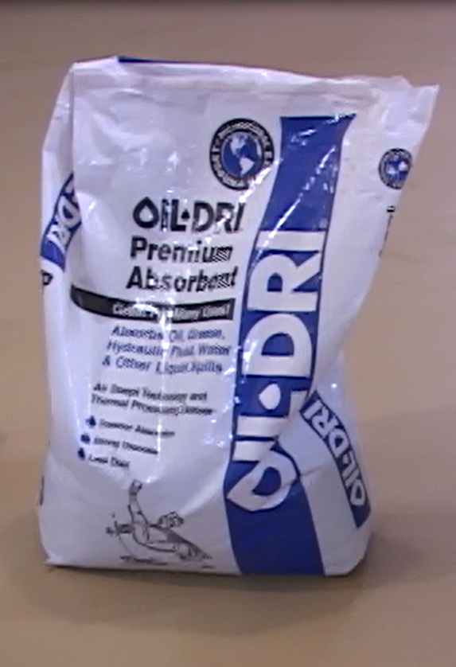
SPILL COUNTERMEASURES
Spill Response Materials
Granular Absorbents and Spill Pads
Granular absorbents can be poured on incidental drips and around small spills to stop the spill from spreading and facilitate cleanup.
Spill pads can be used to absorb oil from incidental drips and small spills on impervious surfaces.

Slide 18
SPILL COUNTERMEASURES
Spill Response Materials
Drain Covers & Blockers
A sock like the one shown here can be placed around spills to protect trench or floor drains. Temporary drain covers can also be used to cover floor drains in the event of a spill. Socks and other oil-only absorbent spill response materials should be kept inside spill kits.
Protecting floor drains is critical since it means the difference between a controlled spill and a spill that is beyond your control (and perhaps into the environment).

Slide 19
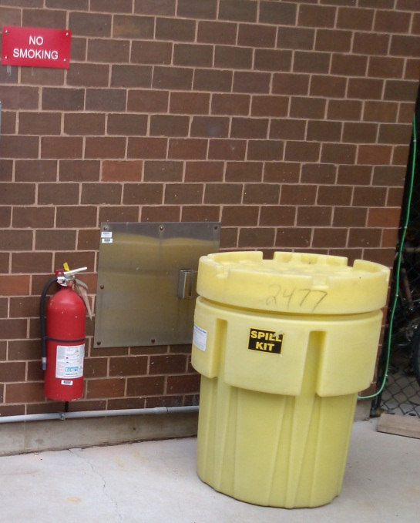
SPILL COUNTERMEASURES
Spill Response Materials
Spill Kits
This is an example of a weatherproof spill kit. There are absorbent pads, booms and socks inside the barrel, as well as temporary drain covers. Kits like these should be placed near oil storage tanks, drums and oil-containing equipment.

Slide 20
SPILL REPORTING
Certain spills must be reported to both internal personnel and external agencies (federal, state or local agencies). Should a reportable release of oil or hazardous materials to the environment occur from your facility, the appropriate agencies must be contacted immediately.
In the event of a spill, the employee discovering the release shall immediately consult the response procedures within the SPCC plan to make the appropriate notifications.
Please review the Oil Spill Notification Procedures section of your facility’s SPCC plan. An example is given on the next slide.

Slide 21
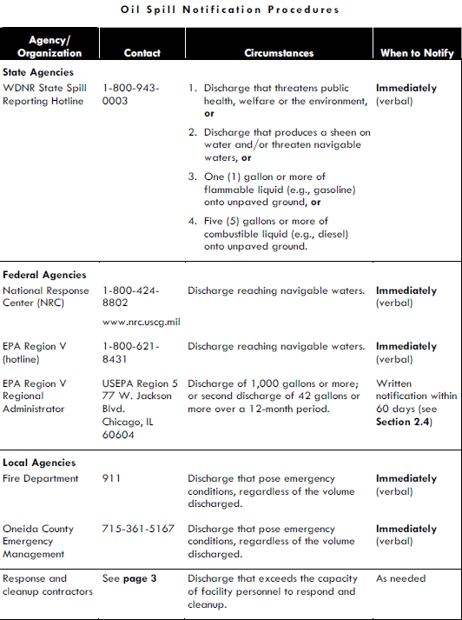
SPILL REPORTING
An example of oil spill notification procedures outlined in an SPCC plan is shown here.
In addition to the notifications specified in your facility SPCC plan, your safety department needs to be notified of any spills.
[Insert EH&S/Safety phone number here.]

Slide 22
SPILL REPORTING
Wisconsin Spill Reporting Requirements
Spills must be reported to the Wisconsin Department of Natural Resources (DNR) if:
  One gallon or more of a flammable liquid (e.g., gasoline) is discharged onto an unpaved surface
  Five gallons or more of a combustible liquid (e.g., diesel) is discharged onto an unpaved surface
  Discharge threatens public health, welfare or the environment
  Discharge produces a sheen on water and/or threatens navigable waters
Wisconsin Spill Reporting Hotline: (800) 943-0003

Slide 23
INSPECTIONS & RECORDKEEPING
As part of the SPCC rule, your facility is required to inspect equipment to ensure that it is well maintained. This is performed as a spill prevention measure.
Visual inspection of tanks and piping, dispensing equipment and tank support structures should be conducted on an as-used basis. Formal, documented inspections of oil storage containers and equipment are to be conducted monthly and annually. Checklists for documenting these inspections are included in the appendix of your facility’s SPCC plan.
Any discrepancies noted during the inspections must be corrected or identified to appropriate personnel. Repairs should be recorded on the Tank and Container Repair Record form, which is also located in the appendix of your facility’s SPCC plan.

Slide 24
INSPECTIONS & RECORDKEEPING
Monthly inspections should include checking:
Storage areas for signs of debris that may block access
Storage areas for unlabeled or outdated containers
Tanks, containers and associated piping for evidence of leakage or spillage
Tanks and containers for water or oil in the tank interstice or secondary containment
An example of a monthly inspection checklist is shown here.

Slide 25
INSPECTIONS & RECORDKEEPING
Annual inspections should include checking:
Secondary containment for evidence of damage
Tank foundation and support structures for signs of settlement, corrosion or damage
Tank container exterior coatings, normal and emergency vents for needed cleaning or maintenance
Tank or container liquid level and overfill prevention sensing devices
Spill kits for replacement/ replenishment of spill response materials
An example of an annual inspection checklist is shown here.

Slide 26
INSPECTIONS & RECORDKEEPING
Record Retention
EPA requires facilities to maintain SPCC records for no less than three years. Per University of Wisconsin policy, facilities are required to retain all records that have been stored with a facility’s SPCC plan including:
  SPCC training records
  Inspection forms
  Spill incident reports and reporting logs
  Tank and container repair records
  Oil spill disposal records

Slide 27
ADDITIONAL RESOURCES
UWSA Spill and SPCC Information:
www.wisconsin.edu/ehs/environmental/spill-prevention-control-and-countermeasure
Small Oil Spill Cleanup Demonstration VIDEO:
www.youtube.com/watch?feature=player_embedded&v=rKmS8VfNNgQ

Slide 28
Questions?
Contact your SPCC plan Facility Emergency Coordinator for specific facility information.
Contact the UWSA Senior Environmental Health Specialist for general SPCC information:
www.wisconsin.edu/ehs

