Slide 1

Compensation Administration Tool
Training

Slide 2

Overall Process Flow

Slide 3
Training Overview
Roles and Responsibilities
CAT Functionality
CAT Reporting
Additional Functionality
Training and Support

Slide 4
Training Overview
Roles and Responsibilities
CAT Functionality
CAT Reporting
Additional Functionality
Training and Support

Slide 5
What Does an Admin Do?
Run the Initialization Report
Perform the IR to IPS Transfer
Adjust the Institutional Planning Spreadsheet
Upload the IPS to CAT and AAP
Run the IR to IPS Upload Process
HRS to CAT Compare Report
Missing From CAT Report
HRS Change Report
Record Errors Report
Position Report
Under Min/Over Max Report
Audit Log Report
Run CAT Reports
Turn Off Job Data Feed
Query a CAT EPM View
IPS Load Edit/ Overwrite
Compare to BSUM
Admin Tasks
Lock and Freeze Users

Slide 6
What Does an Update User Do?
Adjust the Institutional Planning Spreadsheet
Upload the IPS to CAT and AAP
Update the IPS and Run the IPS Upload Process
HRS to CAT Compare Report
Missing From CAT Report
HRS Change Report
Record Errors Report
Position Report
Under Min/Over Max Report
Audit Log Report
Run CAT Reports
Query a CAT EPM View
Compare to BSUM
Update Tasks

Slide 7
What Does a Read-Only User Do?
HRS to CAT Compare Report
Missing From CAT Report
HRS Change Report
Record Errors Report
Position Report
Under Min/Over Max Report
Audit Log Report
Run CAT Reports
Query a CAT EPM View
Read-Only Tasks

Slide 8
Training Overview
Roles and Responsibilities
CAT Functionality
CAT Reporting
Additional Functionality
Training and Support

Slide 9
Training Overview
CAT Functionality
Locating the CAT & IPS Files
The IR to IPS to CAT Process
CAT and AAP
CAT Setup

Slide 10
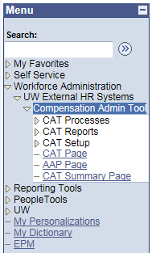
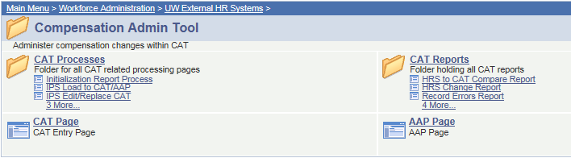
Locating the CAT
The CAT can be found by navigating in PeopleSoft to
Workforce Administration →
UW External HR Systems → Compensation Admin Tool

Slide 11
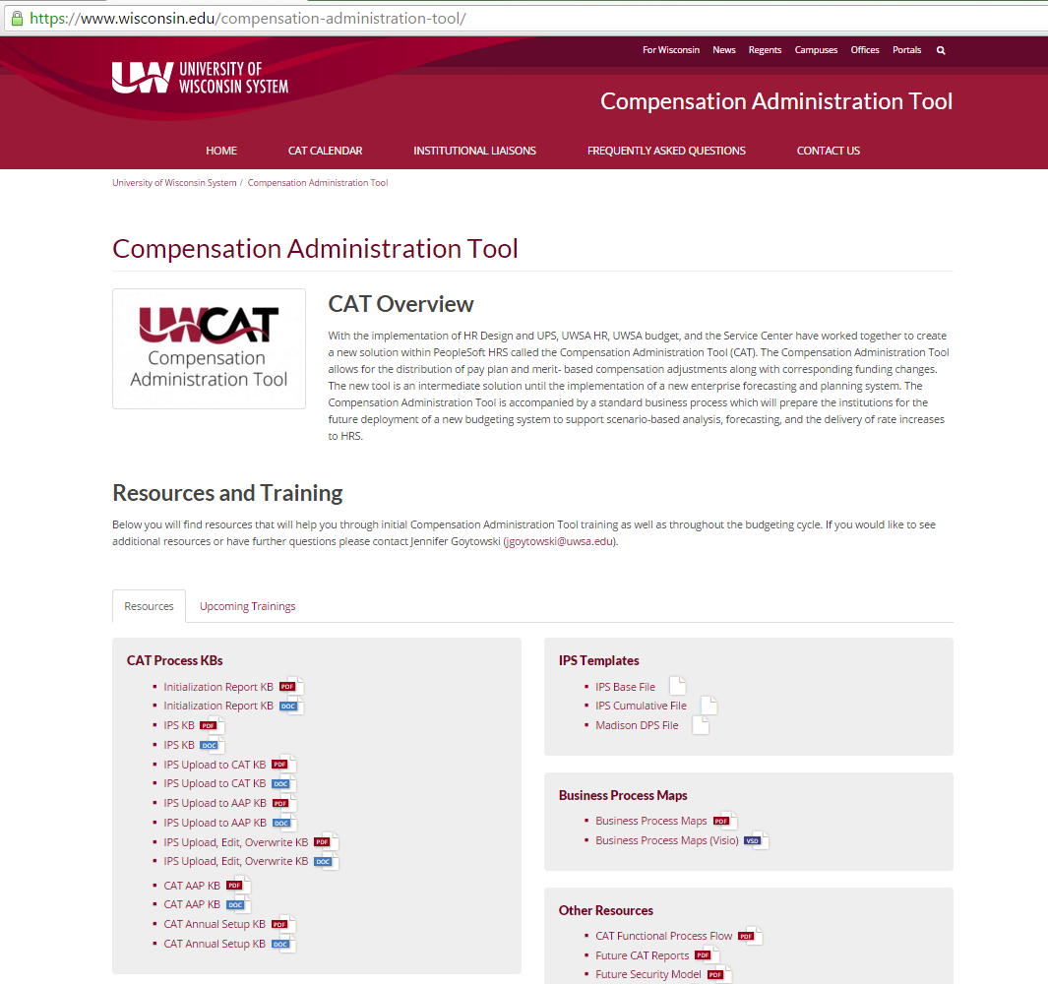
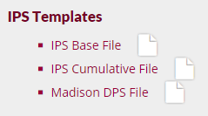
Locating the IPS
The IPS template files can be found under the Resources and Training section on the homepage of the CAT website

Slide 12
Training Overview
CAT Functionality
Locating the CAT & IPS Files
The IR to IPS to CAT Process
CAT and AAP
CAT Setup

Slide 13
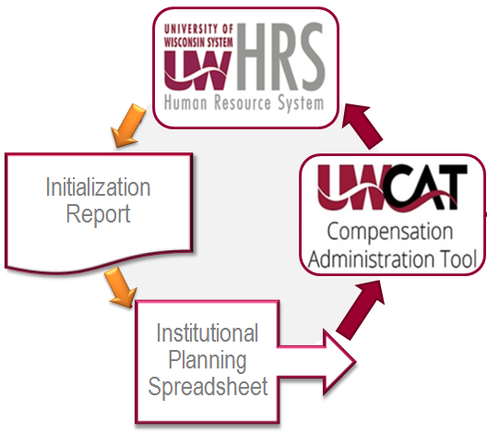
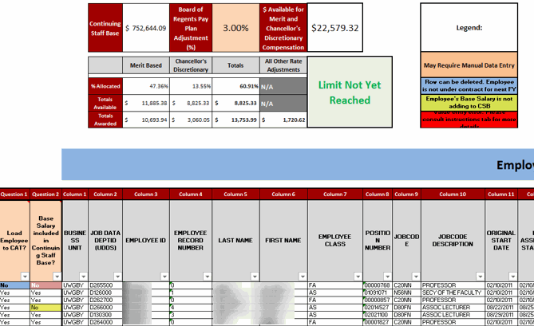
Initialization Report (IR) and
Institutional Planning Spreadsheet (IPS)
The IR pulls current HRS data, which is transferred to the IPS - a spreadsheet used to analyze employee populations and assign rate and funding changes. These changes can be made en masse or on an individual basis.
Notes:
How do you get to the CAT?
Where do you find the IPS?
That IR box should be highlighted

Slide 14
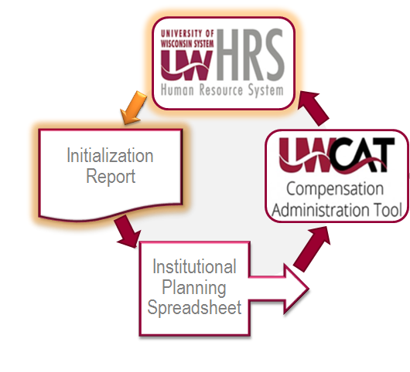
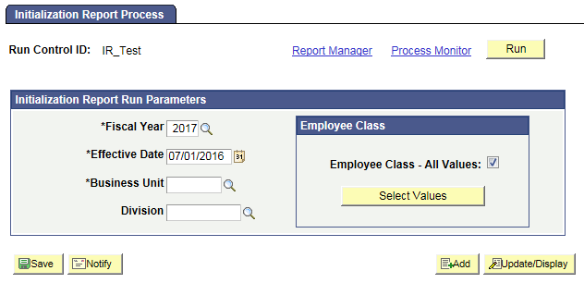
Initialization Report (IR)
The IR allows the user to create a run control, specifying these particular fields:
  Fiscal Year
  Effective Date (ex. 07/01/2016)
  Business Unit
  Division
  Employee Class
Notes:
Effective date: 07/01

Slide 15
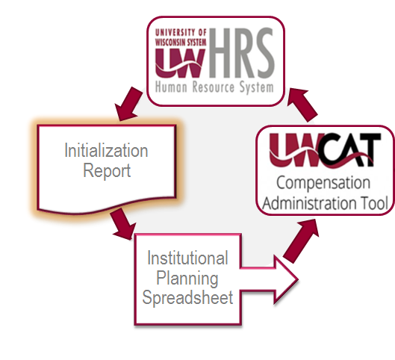
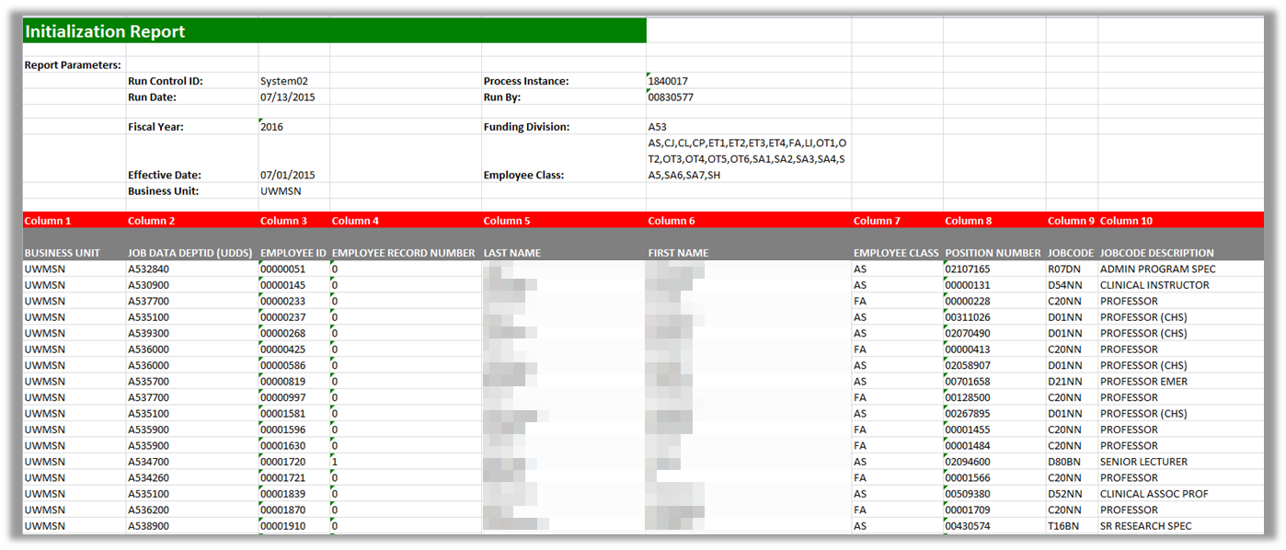
Initialization Report (IR)
When the process is run, it will provide an Excel spreadsheet output file, specifying fields including:
  Business Unit
  Department ID
  Employee ID
  Employee Record Number
There may be two Excel outputs
  One for employees with five or fewer funding splits
  One for employees with more than five funding splits
  Name
  Employee Class
  Etc.

Slide 16
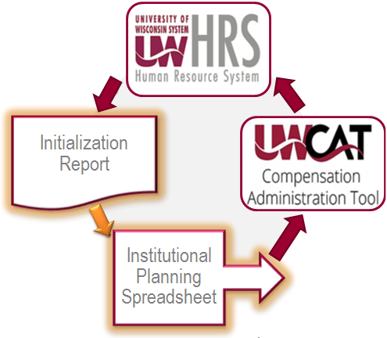

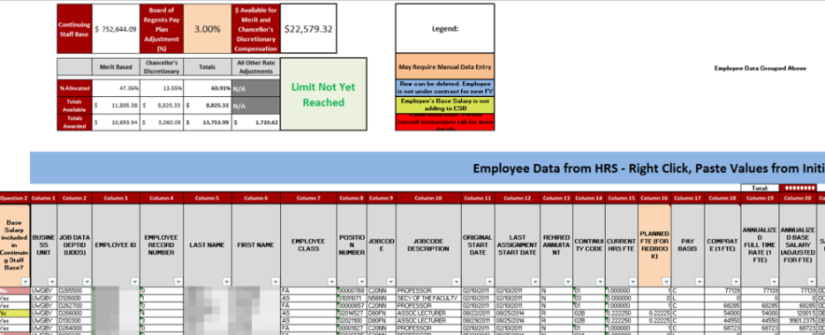
IR to IPS Transfer
This is a manual transfer process between the IR Excel file and the IPS Excel template file.
  This template file can be found on the CAT website.
    www.wisconsin.edu/compensation-administration-tool
  Each institution will choose between the IPS Base template and the IPS Cumulative template depending on their institutional annual setup preferences.

Slide 17
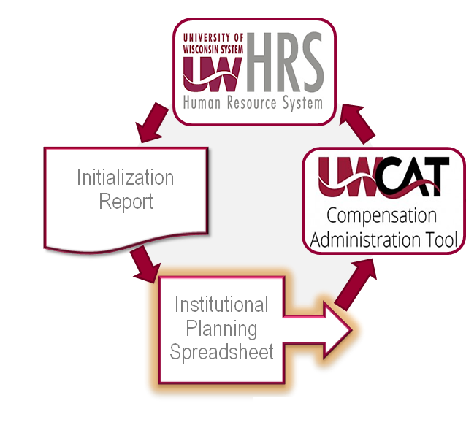

Institutional Planning Spreadsheet (IPS)
The input fields of the IPS are populated manually by copying and pasting from the IR.
Compensation and funding changes can be made en masse and automatically calculated on this sheet for employees with up to five funding splits.

Slide 18
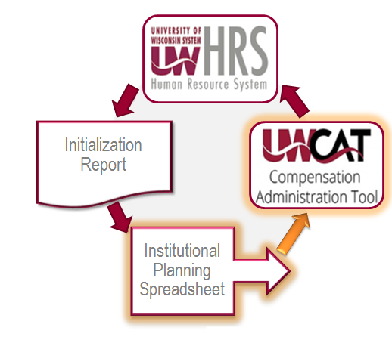
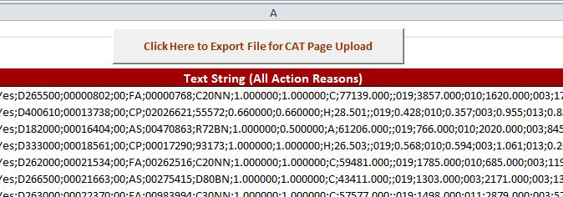
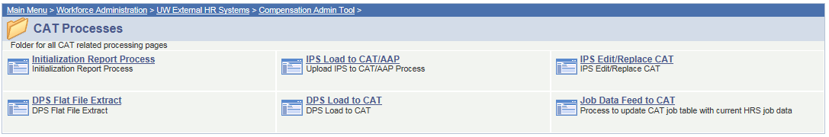
IPS Data Upload to CAT
The rate and funding data in the IPS is then loaded into the Compensation Administration Tool through the IPS to CAT Upload Process.

Slide 19
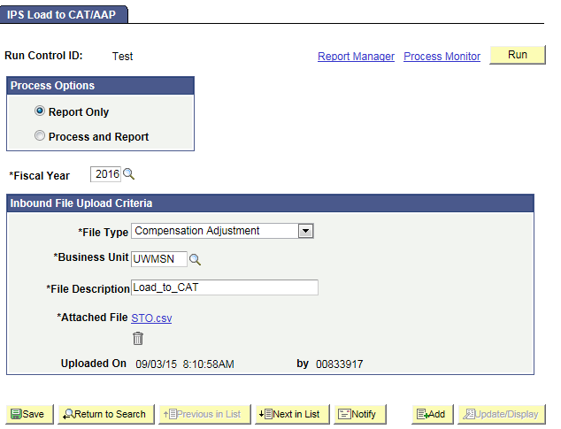
IPS Data Upload to CAT
The rate and funding data in the IPS is then loaded into the Compensation Administration Tool through the IPS to CAT Upload Process.

Slide 20
Training Overview
CAT Functionality
Locating the CAT & IPS Files
The IR to IPS to CAT Process
CAT and AAP
CAT Setup

Slide 21
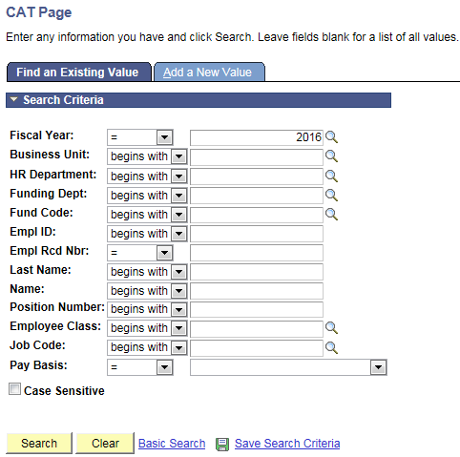
CAT Employee Search Page
User looks for employee records by entering one or more of the search criteria

Slide 22
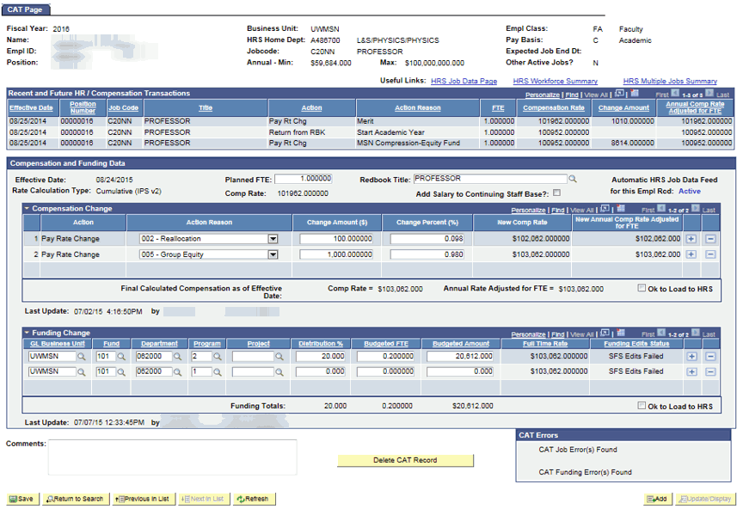
CAT Employee Data Page

Slide 23
Employee Attributes
Pulls key demographics from HRS

Slide 24
Recent and Future HR Transactions
Pulls recent transactions from an employee’s job record in HRS that are relevant to the compensation process

Slide 25
When the Job Data Feed is ON:
Data from HRS is updated nightly and when the employee record page is viewed

Slide 26
Compensation Data
Displays compensation changes which will be added to an employee’s job record
Populates through the IPS upload and manual additions

Slide 27
Funding Data
Displays an employee’s funding splits and distribution percentages
Populates through the IPS upload and manual additions

Slide 28
Funding Edits
Funding splits are validated against SFS Actuals or CAT ledger combo edits
When ‘OK to Load to HRS’ is checked, Actuals edits will be run.
When ‘OK to Load to HRS’ is not checked, an institution can specify whether they would like Actuals or CAT edits to be run.

Slide 29
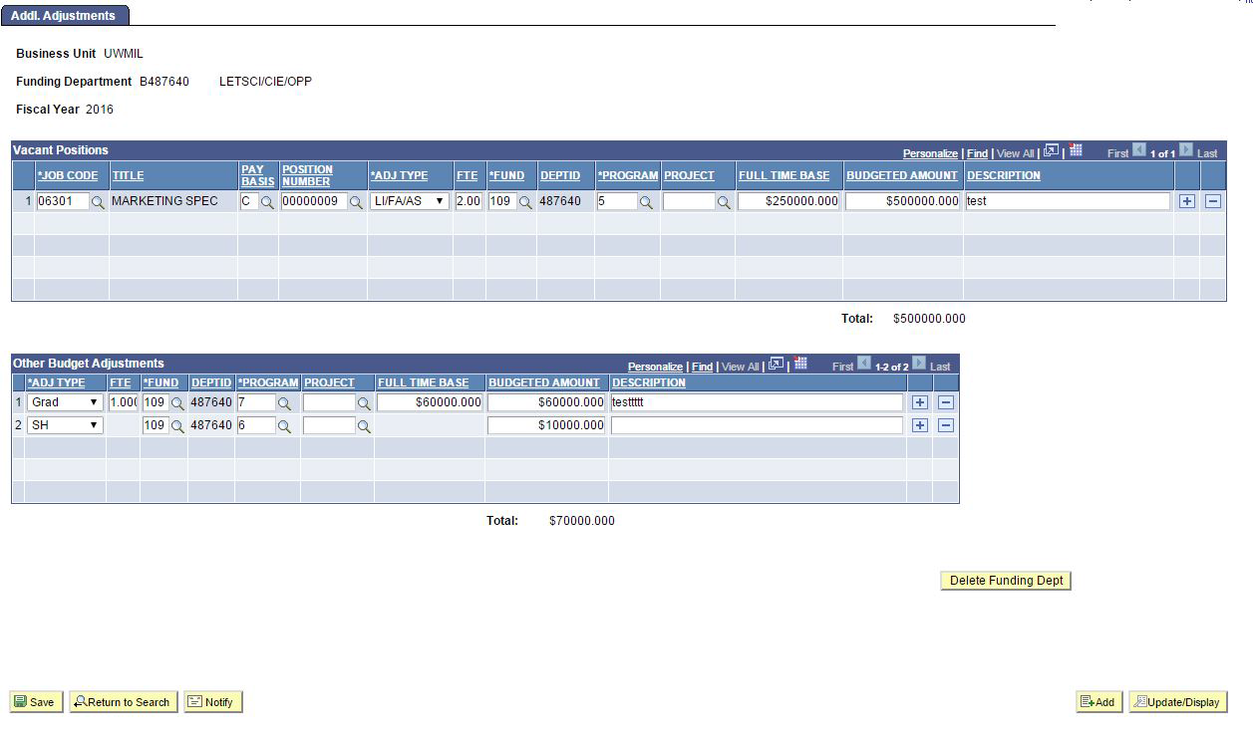
Additional Adjustments Page
Group, Lump, Vacant and Negative position adjustments are made in the AAP by funding department

Slide 30
Additional Adjustments Page
Vacant Positions
Departments can add placeholder positions into their annual budgets
This section will populate through the IPS Upload and new rows can also be added manually

Slide 31
Additional Adjustments Page
Other Budget Adjustments
Other adjustments necessary for budgeting, such as accounting for group, lump sum or negative positions are entered here
This section will populate through the IPS Upload and new rows can also be added manually

Slide 32
Training Overview
Roles and Responsibilities
CAT Functionality
CAT Reporting
Additional Functionality
Training and Support

Slide 33
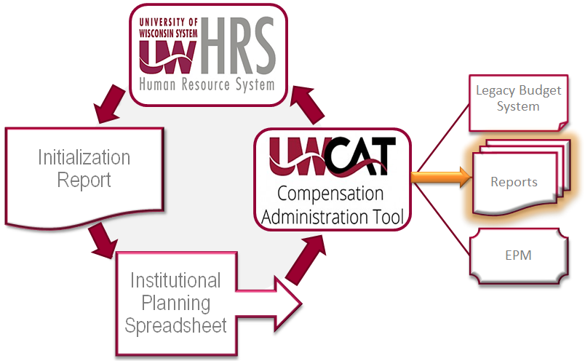
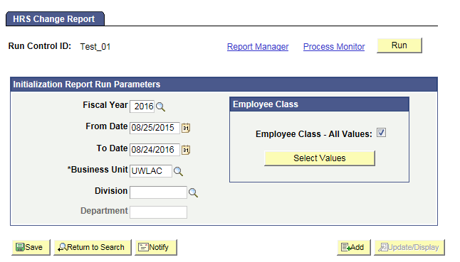
CAT Reporting
Seven Excel reports can be generated based on CAT and HRS data from an institutional, division, and department level. CAT data is also fed back to the legacy mainframe and to EPM.

Slide 34
CAT Reporting
Job Changes in HRS
Pulls records that exist in CAT and have undergone changes in key job fields in HRS
Pulls records for which there are discrepancies between key job fields in CAT and HRS
Pulls CAT records with compensation, job, or funding errors
Pulls CAT records with annual compensation above or below their limit errors
HRS Change
HRS to CAT Compare
Errors in CAT
Record Errors
Under Min Over Max

Slide 35
CAT Reporting
Monitoring
Data dump of all jobs in the CAT and all positions in the AAP
A record of all adds/edits and deletes in the CAT/AAP and who edited them during a defined period of time
Employees that Exist in HRS and do not exist in the CAT
Position Report
Audit Log
Missing From CAT

Slide 36
CAT Reporting Needs During the Comp Admin Cycle
HRS
Reporting Needs from the CAT can be categorized into the following:
Job changes (Action depends on Feed ON/OFF)
  Employee Addition/Termination/Transfer
  Job attribute changes (FTE, CompRate, etc.)
Errors and data quality validation in the CAT
Reconciliation of Merit allocations
General monitoring of data
Feed
CAT
With the implementation of the CAT tool, updates to various key fields in HRS will automatically update the CAT tool and be reflected in the compensation/funding changes – when the feed is ON. When the feed is OFF manual action may be needed.
Feed ON
Feed OFF
Comp Admin Cycle Start
Automated Feed
Business Unit
Empl Class
Pay Basis
EJED
DeptID
JobCode
Title
CompRate Changes
Comp Admin Cycle End
Notes:
Put this before slides on specific reports

Slide 37
When to Run Which Report: Automatic HRS Feed is ON vs. OFF
Comp Admin Cycle Start
Comp Admin Cycle End
Feed ON
Feed OFF
Hire/Term/Transfer changes
Job attribute changes
All Job changes
Job changes in HRS
HRS to CAT Compare Report
HRS Change Report
HRS to CAT Compare Report
Errors in the CAT
CAT Record Errors Report
CAT Over Max Under Min Report
Monitoring
CAT Position Report
Missing from CAT Report
CAT Audit Log

Slide 38
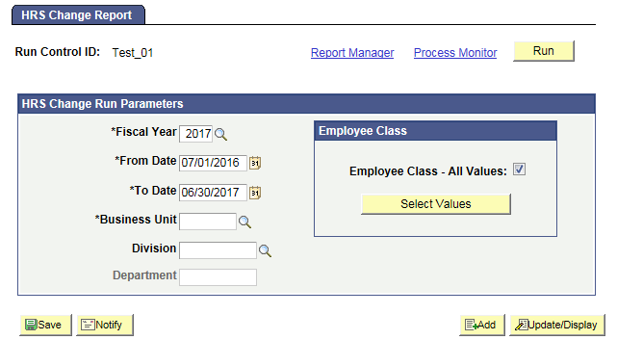
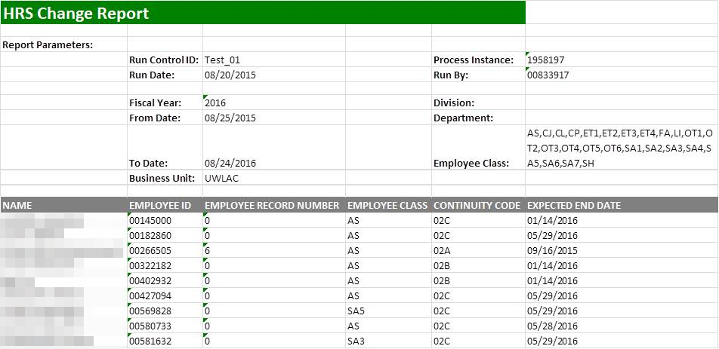
HRS Change Report
Identifies employee records that exist in the CAT and have undergone a change in HRS: an update to the fields Business Unit, HR Department, Position Number, Jobcode, Pay Basis, Title, FTE, Payroll Status, or Comprate, as well as Hires, Rehires, Transfers, or Terminations
Allows users to review the records on this report and determine if the compensation changes entered in the CAT are still accurate, if a new record in the CAT needs to be created, or if a CAT record needs to be deleted
Job Changes in HRS

Slide 39
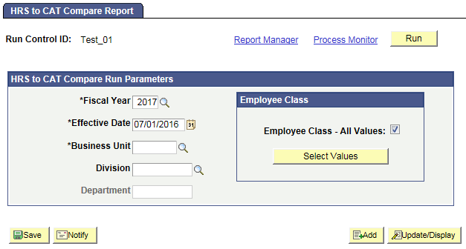
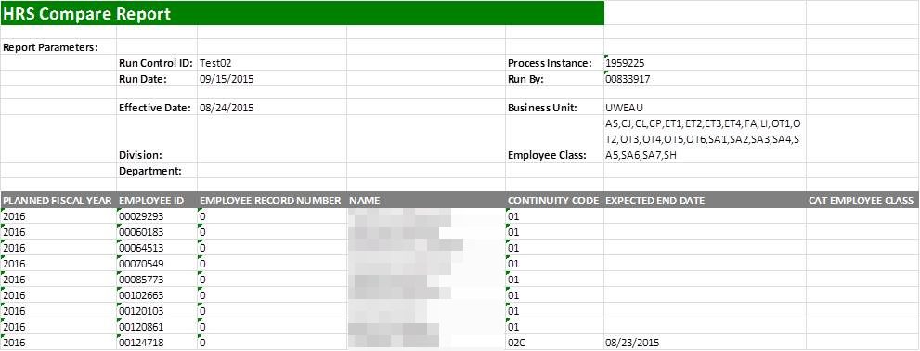
HRS to CAT Compare Report
Identifies employee records where key fields differ between the CAT and HRS
Catches things like: Business Unit/Department updates, Position Number updates, Compensation Rate updates, Empl Class updates, Title updates, Job Code updates, FTE updates, and Terminations
Allows the user to review discrepancies for that employee record in the CAT and determine if the rate increases need to be altered based on the new job data information that was entered in HRS
Job Changes in HRS

Slide 40
Action Needed by Report: Automatic HRS Feed is ON
Action May Be Needed
Job Change in HRS Occurred
Action Needed
Title Change
Review and Potentially Edit Comp Increases
Action May Be Needed
Action Needed
New Hire
Potentially Add to CAT
Employee Terminated
Delete from CAT
Action Needed
Transfer/Position # Change
Delete and Re-Add to CAT
Comprate Change
Review and Potentially Edit Comp Increases
Action May Be Needed
Action May Be Needed
FTE, EJED Change
Potentially Edit Planned FTE or Remove from CAT
CAT Report to Run
HRS to CAT Compare Report
HRS Change Report
Notes:
Use this content on individual reports (delete these slides)

Slide 41
Action Needed by Report: Automatic HRS Feed is OFF
Job Change in HRS Occurred
Action Needed
Employee Terminated
Delete from CAT
Title Change
Review and Potentially Edit Comp Increases
Action Needed
Action May Be Needed
Action May Be Needed
Action Needed
Comprate Change
Review and Potentially Edit Comp Increases
Transfer/Position # Change
Delete and Re-Add to CAT
Action May Be Needed
New Hire
Potentially Add to CAT
FTE, EJED Change
Potentially Edit Planned FTE or Remove from CAT
Action May Be Needed
CAT Report to Run
HRS to CAT Compare Report

Slide 42
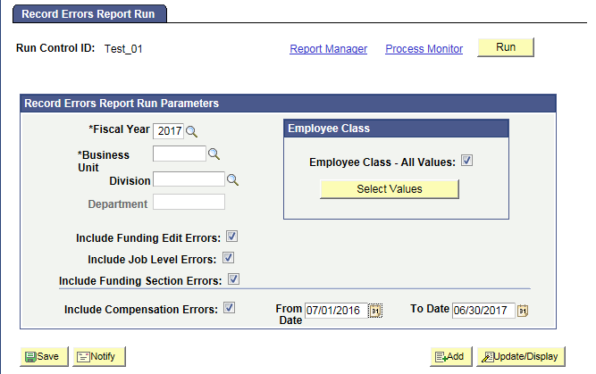
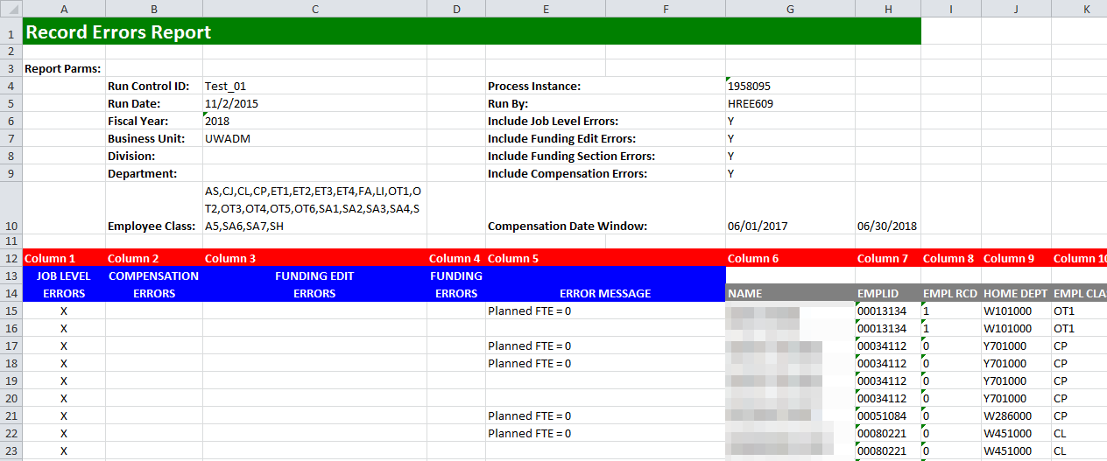
Record Errors Report
Displays all records in the budget that have generated any sort of employee-level error based on the edits set up in the CAT
Contains all Job Level Errors, Compensation Change Errors, Funding Edit Errors (SFS Actuals, CAT ledger errors) and Funding Section Errors (distribution % errors)
Allows users of the CAT to be able to quickly identify any empl record with an error on a single consolidated report
Will be run frequently throughout the budgeting cycle and errors must be resolved before the cycle ends
Errors in CAT

Slide 43
Action Needed by Report: Automatic HRS Feed is ON or OFF
CAT Error Identified
Action Needed
Compensation Errors
Job Level Errors
Funding Section Errors
Duplicate Action Reason in HRS & CAT
Planned FTE = 0
No funding information entered in the CAT
Duplicate Action Reason in CAT
Planned FTE > 1 on multiple Empl Records
Funding distribution is greater than 100%
Decimal amount entered in Comprate for salaried employees
Sum of individual Budgeted FTEs do not equal Total Planned FTE
Sum of individual Budgeted Amounts does not equal Original Comp Amount Adj for FTE
$0 Comprate Entered
Funding Edit Errors
On an individual funding split, Distrib %, Budgeted FTE, or Budgeted Amount = 0
Funding string failed SFS Actual or SFS Budget Edits
CAT Report to Run
Record Errors Report

Slide 44
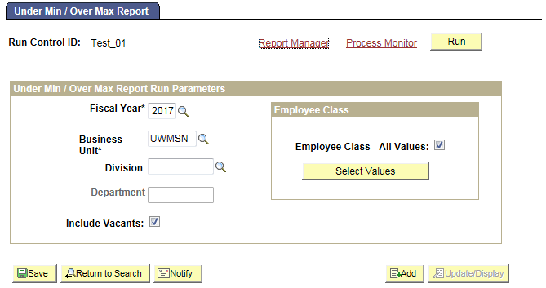
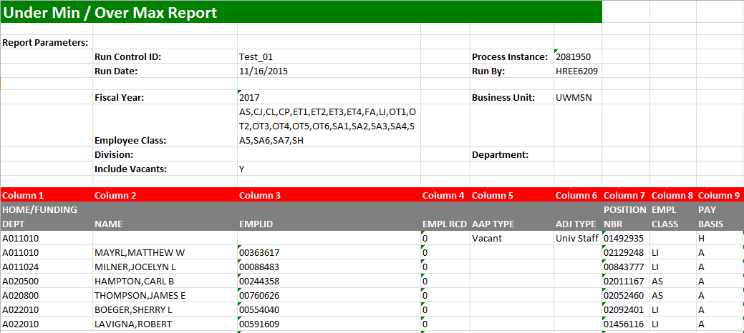
Under Min / Over Max Report
Displays employee records where an individual's (or vacant’s) updated compensation rate is above or below the range for that title in HRS
Pulls title min/maxes from HRS as of the beginning of the next fiscal year
Allows users to see which employee records have an over max/under min error so they can update the appropriate comp adjustments in the CAT to be within the salary range
Errors in CAT

Slide 45
Action Needed by Report: Automatic HRS Feed is ON or OFF
CAT Error Identified
Action Needed
Action Needed
Employee’s salary is above the max or below the min for their JobCode in HRS
Review and Adjust Comp Increases
CAT Report to Run
Under Min Over Max Report

Slide 46
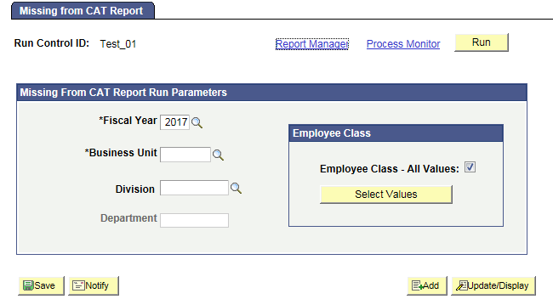
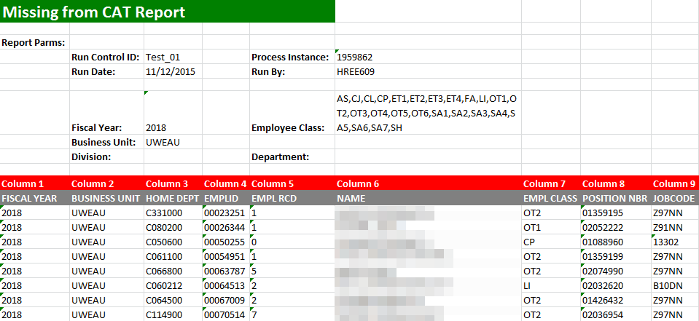
Missing From CAT Report
Displays employees who exist in HRS, but do not exist in CAT
Catches employees that may have been hired after the Initialization Report (IR) was run, or before the first of the next fiscal year, and employee records excluded while working in the IR or Institutional Planning Spreadsheet (IPS)
Should be run regularly, starting after the IPS is loaded into the CAT
Monitoring

Slide 47
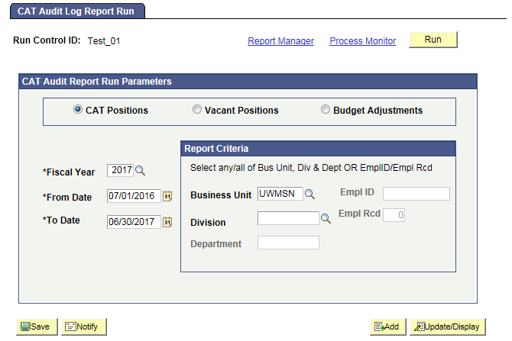
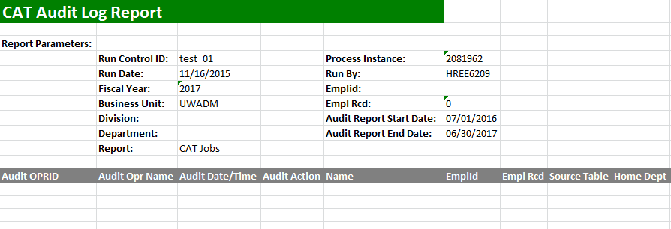
Audit Log Report
Displays which users have edited and saved particular CAT, Vacant Position and Budget Adjustment records
Pulls records separately from the Audit Log tables for CAT, Vacant Positions and Budget Adjustments, and can generate three unique reports
Allows users of the CAT to view if other users have changed the information on a shared employee so they can communicate with other users to determine if the compensation increases and funding entered in the CAT is correct
Monitoring

Slide 48
Reports to Monitor: Automatic HRS Feed is ON or OFF
Data dump of all jobs in the CAT and all positions in the AAP
All employees that exist in HRS and do not exist in the CAT
Action May Be Needed
Action May Be Needed
Action May Be Needed
Data to be Reviewed if User is Able
A record of all adds/edits and deletes in the CAT/AAP and who executed them
CAT Report Name
CAT Position Report
Missing from CAT Report
CAT Audit Log

Slide 49
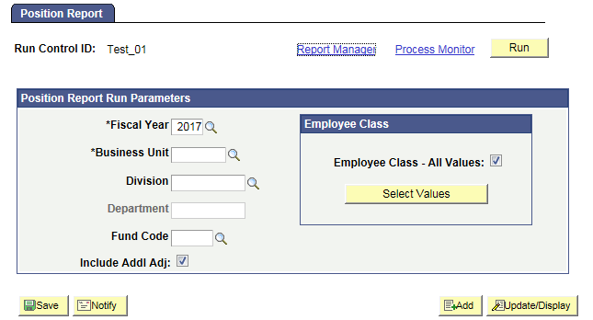
Position Report
Pulls key information on all Positions (CAT Records) and Vacant/Other Bud Adjustment rows (Additional Adjustments Page records) based on selected run control criteria
Allows users of CAT to view all records that exist in the CAT and the AAP and see a complete picture of their budgeted salary. They may also distribute it to other users who may not have access to the CAT/AAP, but need to see the data that it houses
Monitoring

Slide 50
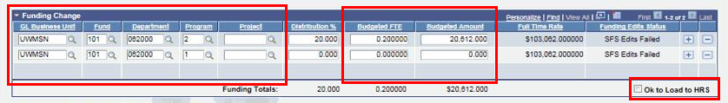
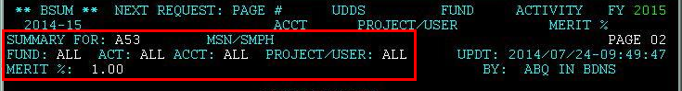
BSUM
Data will be read instantly from the CAT and populate the appropriate fields on the remaining pages of 2, 3, 5, 6, 26, and 27 of BSUM.
Any employee class (including Student Help and LTE) is allowed to be loaded to or entered in the CAT Page, and consequently be included in FTE calculation in BSUM.
Users will now make all changes in CAT that were previously done in BDGT, BADJR and BRATE.
Users will refer to BSUM for reporting purposes to gather salary, budget, and allocation totals.

Slide 51
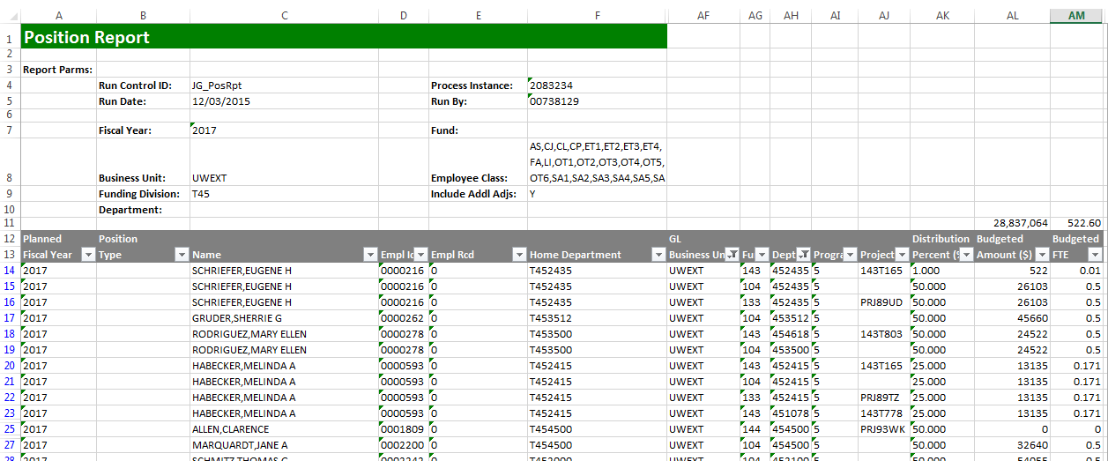
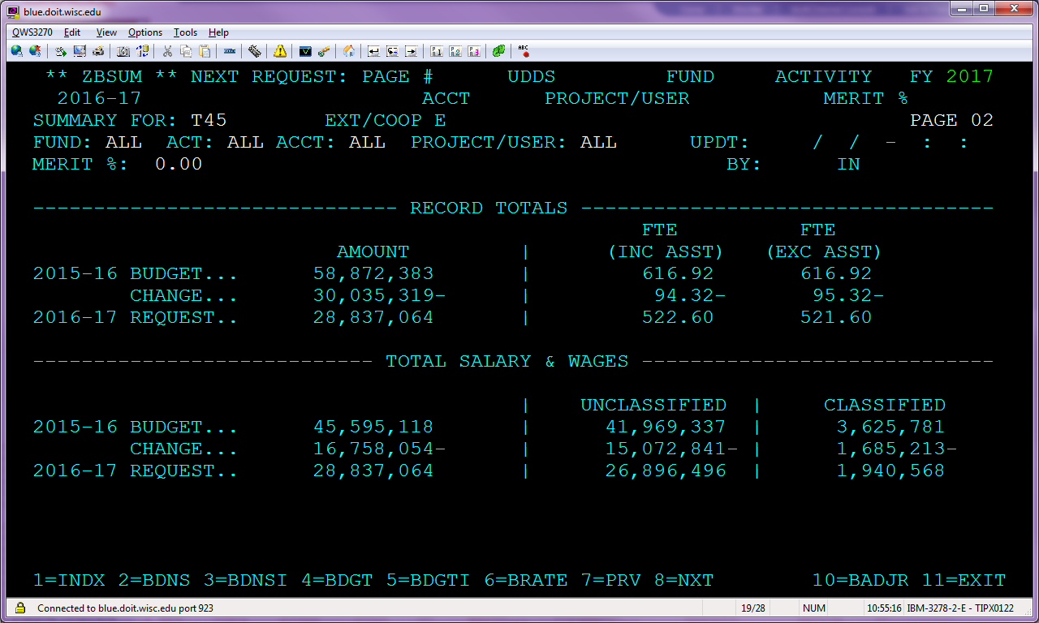
Tying Out the Position Report to BSUM

Slide 52
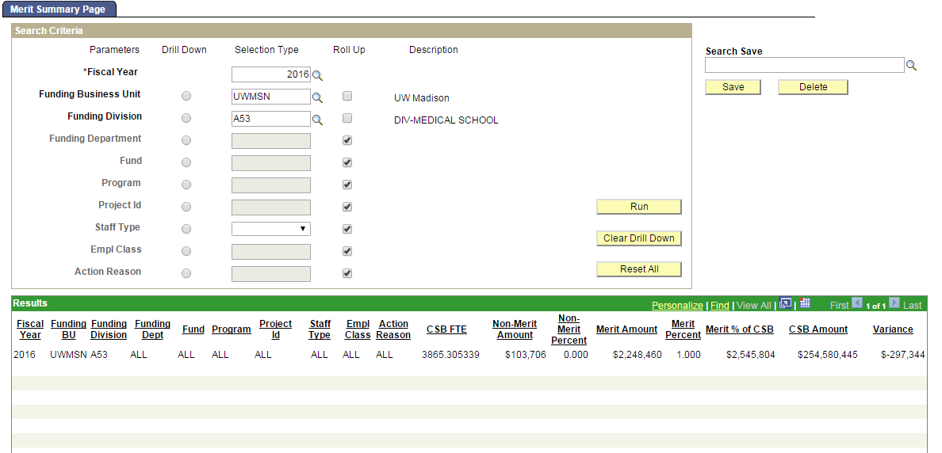
CAT Summary Reporting Page
Allows users to summarize key metrics critical for analyzing compensation distribution against the employee population, focusing on merit compensation changes and Continuing Staff Basis (CSB)
Allows users to monitor the allocated compensation changes as a percentage of the continuing staff base to make sure it is meeting the pay plan guidelines
Calculates data for “CSB FTE” and “CSB Amount” based on employees marked as yes in the “Add Salary to Continuing Staff Base?” check box from the CAT page and only summarizes data for the Action Reasons that are marked “Include in CSB” on the Annual Setup Page for each institution
Notes:
Roll up / drill down – conceptual background

Slide 53
Training Overview
Roles and Responsibilities
CAT Functionality
CAT Reporting
Additional Functionality
Training and Support

Slide 54

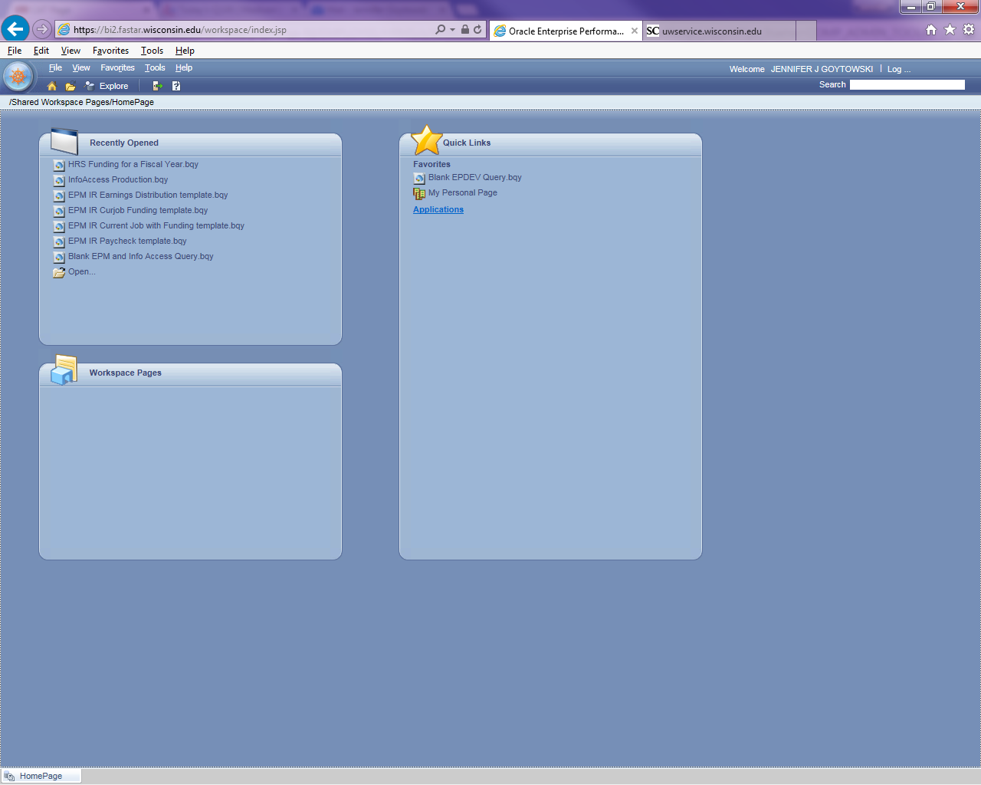
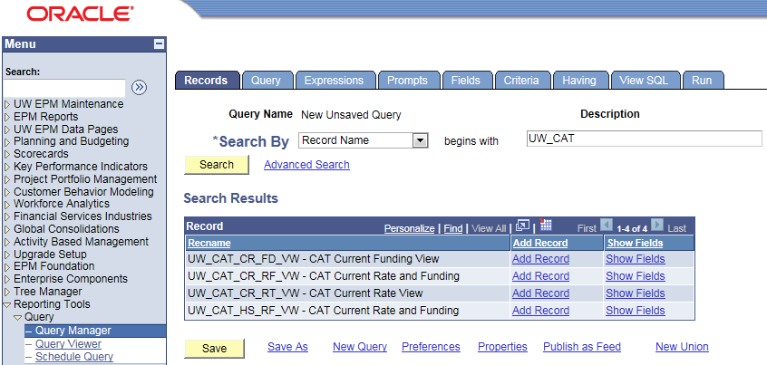
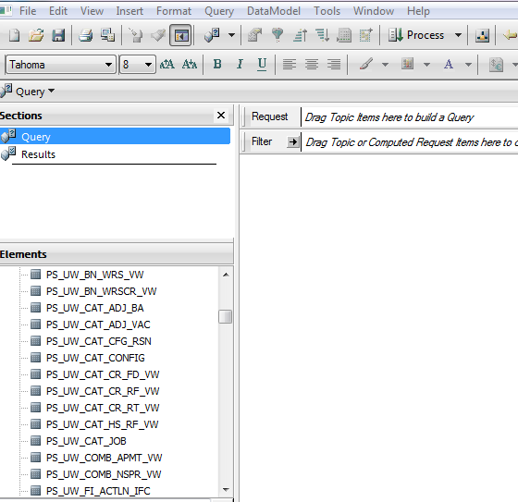
EPM and Interactive Reporting
Overnight data transfer
Views available in Interactive Reporting
  There are two options to access EPM queries:
    Web client: https://bi2.fastar.wisconsin.edu/workspace/index.jsp
    Studio client: found on your desktop

Slide 55
EPM Views – CAT and AAP Combined
Current CAT All Rate and Funding View: (PS_UW_CAT_CA_RF_VW) This view contains all employee job, compensation, and funding data from the CAT Page and AAP stored within the EPM tables for the current fiscal year.
Current CAT All Funding View: (PS_UW_CAT_CA_FD_VW) This view contains all employee job and funding data from the CAT Page and AAP stored within the EPM tables for the current fiscal year.
Historical CAT All Rate and Funding View: (PS_UW_CAT_HA_RF_VW) The view contains all employee job, compensation, and funding data from the CAT Page and AAP stored within the EPM tables for all prior fiscal years.

Slide 56
EPM Views – CAT and AAP Separate
Current CAT Rate and Funding View: (PS_UW_CAT_CR_RF_VW) This view contains all employee job, compensation, and funding data from the CAT Page stored within the CAT EPM tables for the current fiscal year.
Current CAT Funding View: (PS_UW_CAT_CR_FD_VW) This view contains all employee job and funding data from the CAT Page stored within the CAT EPM tables for the current fiscal year.
Current CAT Rate View: (PS_UW_CAT_CR_RT_VW) This view contains all employee job and compensation data from the CAT Page stored within the CAT EPM tables for the current fiscal year.
Historical CAT Rate and Funding View: (PS_UW_CAT_HS_RF_VW) The view contains all employee job, compensation, and funding data from the CAT Page stored within the CAT EPM tables for all prior fiscal years.
AAP Vacant Positions View: (PS_UW_CAT_ADJ_VAC) This view contains all vacant position data from the AAP for the current and all prior fiscal years.
AAP Other Budget Adjustments View: (PS_UW_CAT_ADJ_BA) This view contains all other budget adjustment data from the AAP for the current and all prior fiscal years.

Slide 57
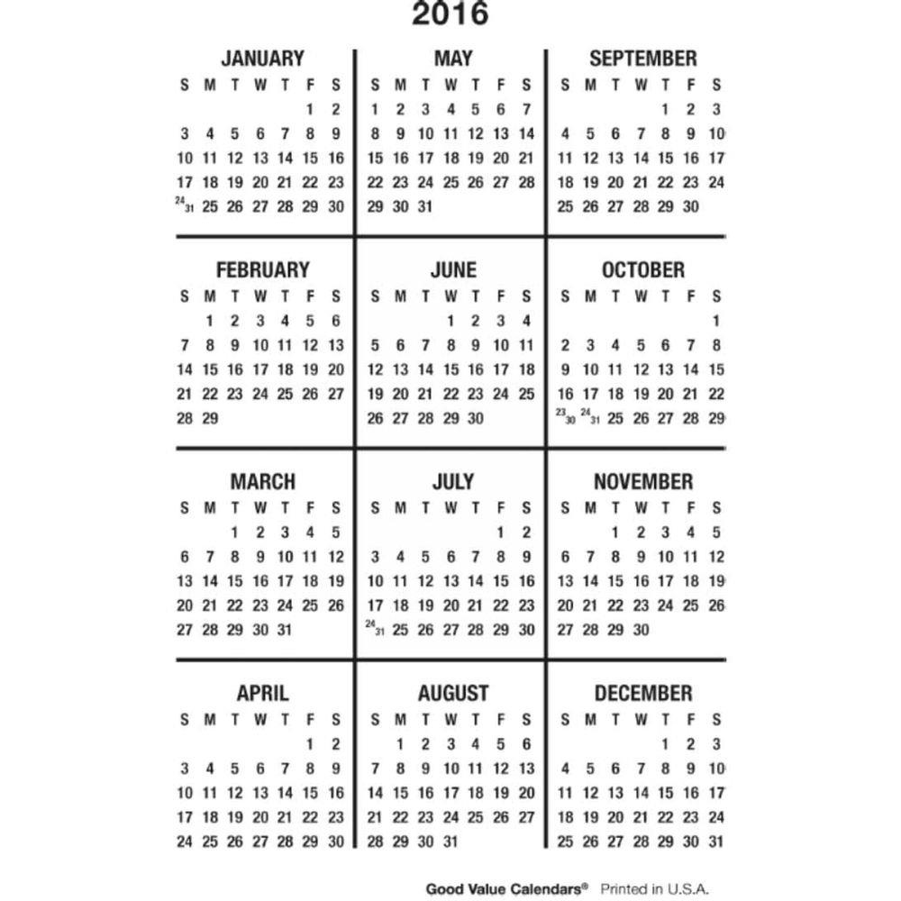
Example Annual Budget Timeline
Distribute IPS
Collect IPS and Upload
CAT Page Entry
Lock Users
Notes:
Timeline, chevrons, reference very high level (see project plan as example)
Maybe just reference through liaison calls

Slide 58
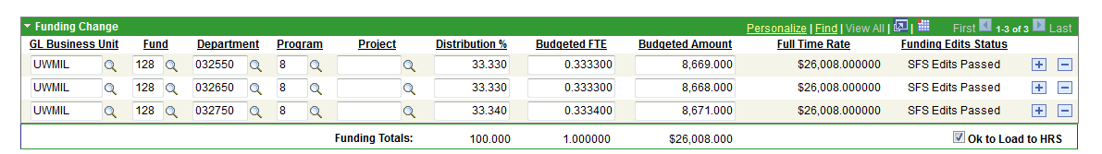
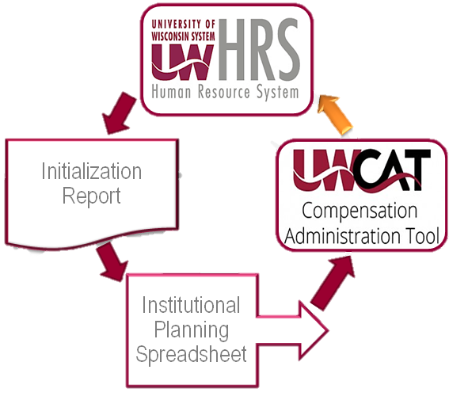
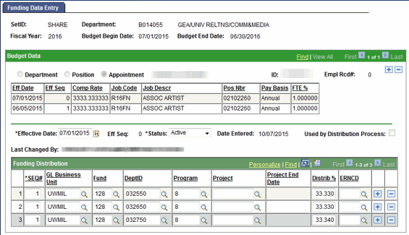
CAT to Commitment Accounting
Loads funding data to Commitment Accounting in HRS
Runs annually, once an institution has completed all calculations and budget planning within the CAT

Slide 59
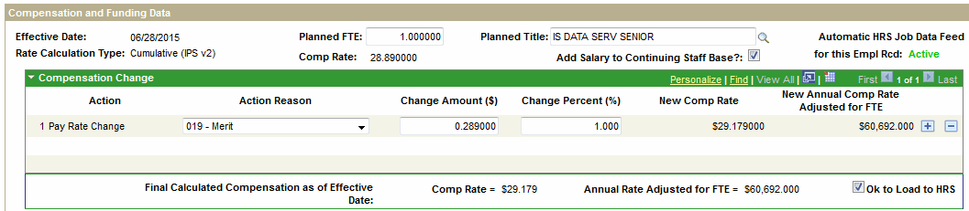
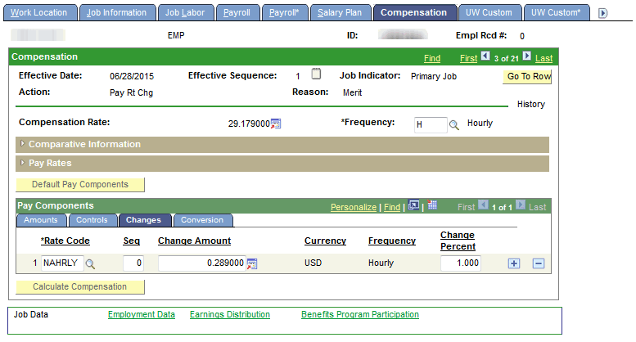
HR Mass Update
Updates Job and Compensation data loaded into HRS
Runs annually, once an institution has completed all calculations and budget planning within the CAT

Slide 60
Training Overview
Roles and Responsibilities
CAT Functionality
CAT Reporting
Additional Functionality
Training and Support

Slide 61
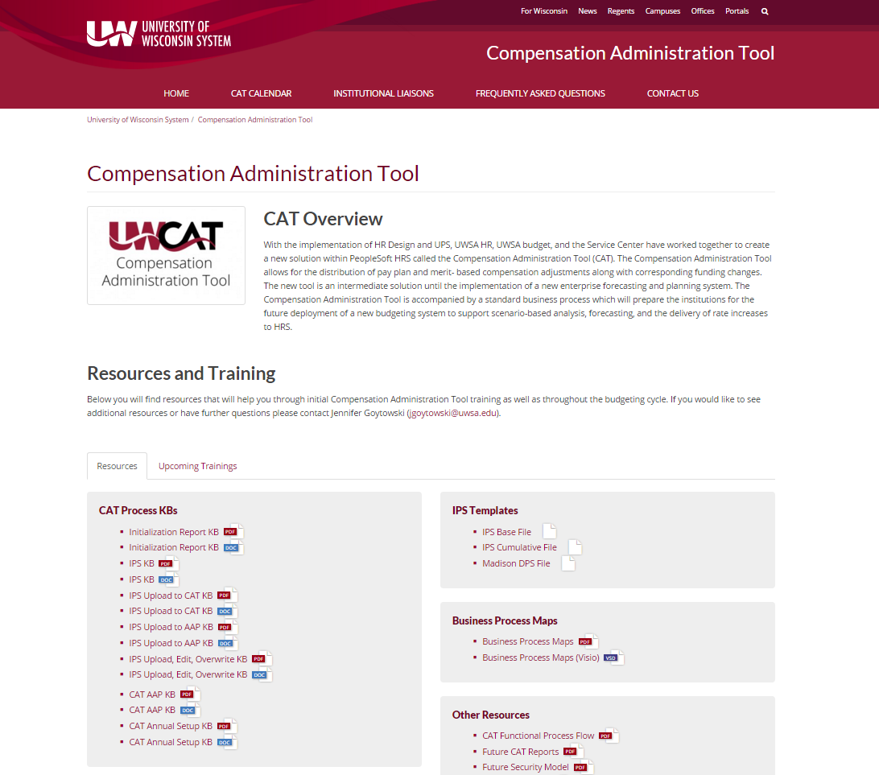
Training Toolkit
UW CAT Website
KBs
User Guides
FAQs
Videos
catquestions@uwsa.edu

Slide 62
Useful Links
CAT Website | https://www.wisconsin.edu/compensation-administration-tool/
HRQA Test Environment | https://test.ps.wisconsin.edu/hrqa-login
Interactive Reporting | https://bi2.fastar.wisconsin.edu/workspace/index.jsp
UWSA Budget | https://www.wisconsin.edu/budget-planning/annual-operating-budget/

Slide 63
Support Model
Refer directly to your institutional liaison for information on training and business process
All other functional and technical questions can be routed to catquestions@uwsa.edu

