Slide 1
Compensation Administration Tool
Training – September 2019

Slide 2
Agenda
Populate & Upload Institutional Planning Spreadsheet (IPS)
Compensation Admin Tool (CAT Page) & Additional Adjustments Page (AAP)
CAT Reporting
Overview
CAT Setup – Lock Users & Data Freeze
Initialization Report (I.R.)
Resources and Support

Slide 3
What is the Compensation Administration Tool (CAT)?
The Compensation Administration Tool (CAT) is used to manage compensation and funding changes during the budgeting cycle.
Gives users the ability to upload budget population in mass via an excel spreadsheet (IPS).
Gives users the ability to enter proposed compensation and funding changes.
Gives users the ability to edit proposed compensation and funding changes previously loaded from the IPS.
Supports advanced search capabilities.
Displays a summary of an employee’s historical record in HRS, for easy reference.
Displays summary information by Business Unit, Dept, etc.
Has necessary checks and edits to ensure data accuracy.
Transfers finalized compensation and funding data to HRS and summary level data to the budget system.

Slide 4
Overall Process Flow (Technical)

Slide 5
Training Overview
CAT Functionality
Locating the CAT & IPS Files
The IR to IPS to CAT Process
CAT and AAP
CAT Setup – Lock Users & Data Freeze

Slide 6
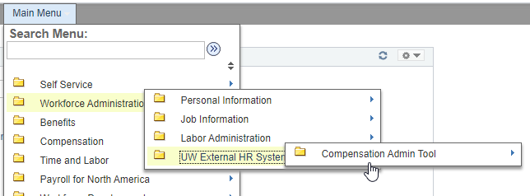
Navigation
The CAT can be found by navigating in PeopleSoft to: Workforce Administration → UW External HR Systems → Compensation Admin Tool

Slide 7
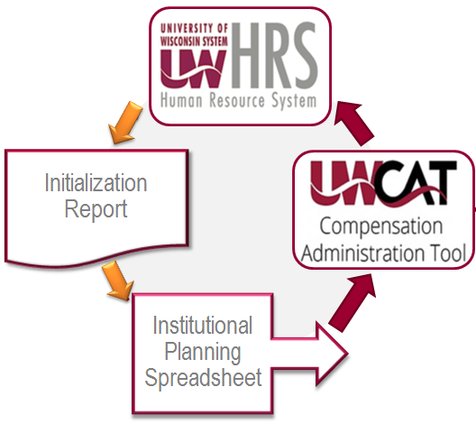
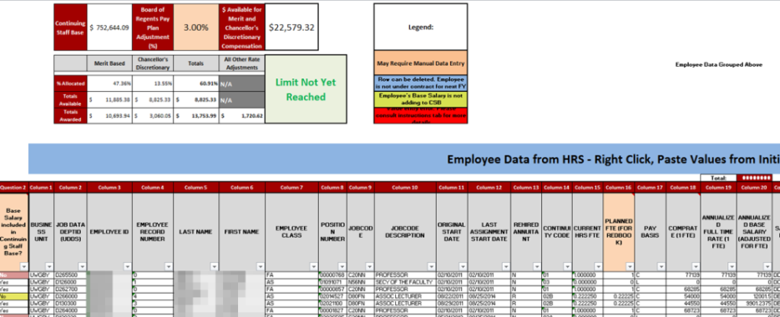
Initialization Report (IR) and Institutional Planning Spreadsheet (IPS)
The IR pulls current HRS employee and funding data, which is transferred to the IPS.
The IPS is a spreadsheet used to analyze employee populations and assign rate and funding changes. Changes can be made in mass or on an individual basis.

Slide 8
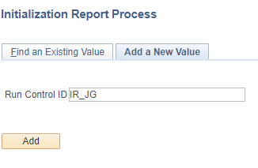
Navigation to Initialization Report (IR)
The IR run control can be found by navigating in PeopleSoft to: Workforce Administration → UW External HR Systems → Compensation Admin Tool → CAT Processes → Initialization Report Process
Click the “Add a New Value” tab to create a new run control ID. Enter a run control ID. This can be any unique identifier (ex. Your initials & date). Remember – No spaces are allowed in the run control ID. Click the “Add” button.

Slide 9
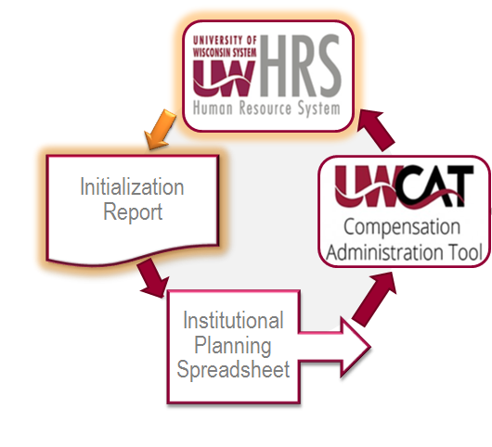
Initialization Report (IR)
The IR Process allows the user to create a run control, specifying these particular fields:
Fiscal Year
Effective Date (ex. 07/01/2020)
Business Unit
Division
Employee Class – Typically campuses select only certain empl classes (e.g., FA, AS, LI, CP and CJ).
Click ‘Save’ and then click ‘Run’.
The Process Scheduler Request page will appear. Click ‘Ok’.
Notes:
Effective date: 07/01

Slide 10
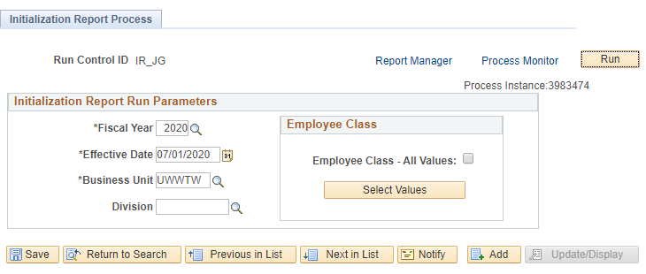
Initialization Report (IR)
On the run control page, note the process instance number. Click “Process Monitor”.
On the Process Monitor page, click the “Refresh” button intermittently until the run status is “Success” and the distribution status is “Posted”. Click “Details”. This will take you to the Process Details page.

Slide 11
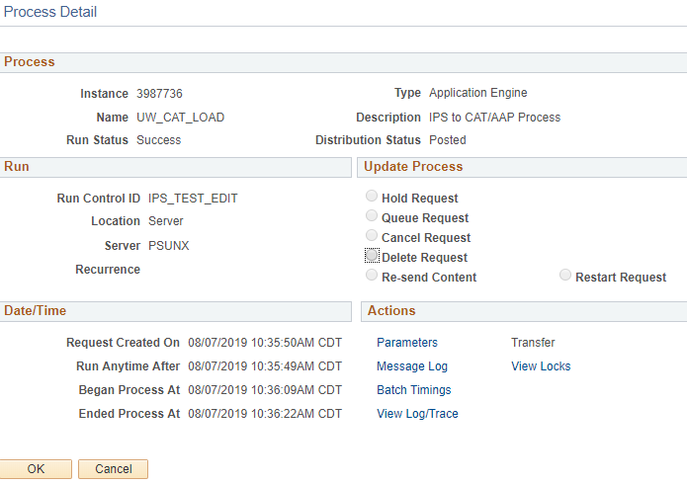
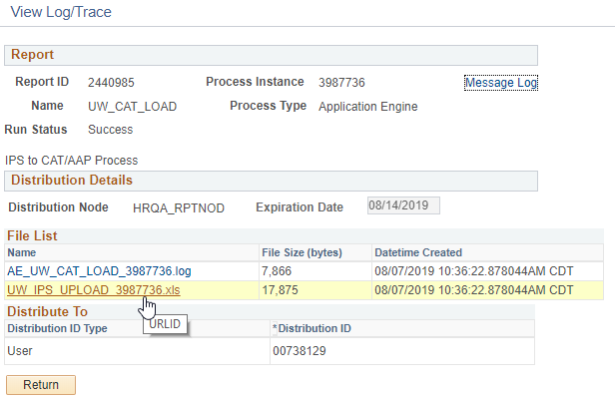
CAT Entry - Detail
On the Process Detail page, click “View Log/Trace”. On “View Log/Trace” page, click the .xls link to review the output file. (Example of output file on next slide.)

Slide 12
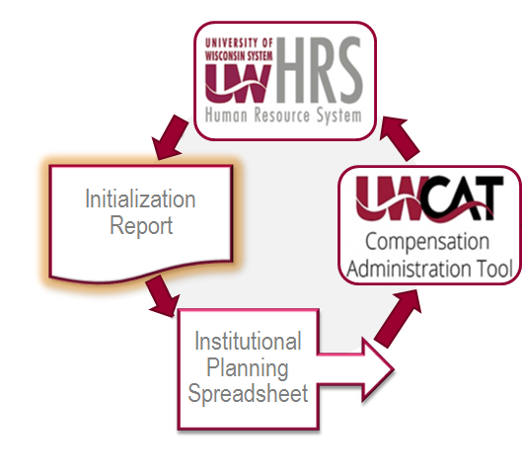
Initialization Report (IR)
When the process is run, it will provide an Excel spreadsheet output file, specifying fields including:
Business Unit
Department ID
Employee ID
Employee Record Number
There may be two Excel outputs
One for employees with five or fewer funding splits
One for employees with more than five funding splits
Name
Employee Class
Etc.

Slide 13
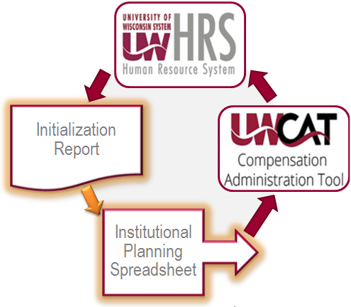
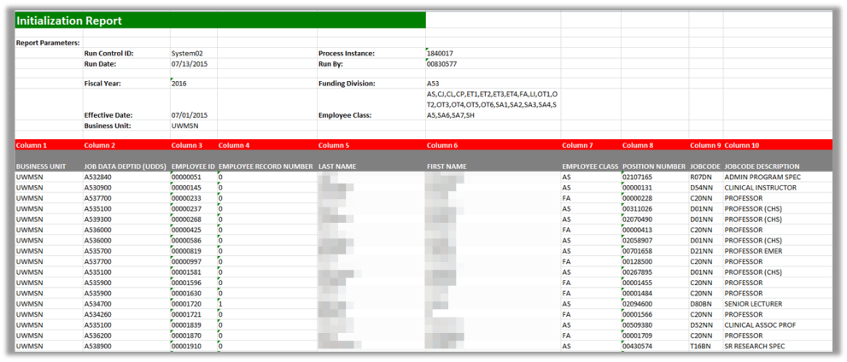
IR to IPS Transfer
This is a manual transfer process between the IR Excel file and the IPS Excel template file.
This template file can be found on the CAT website.
www.wisconsin.edu/compensation-administration-tool
Each institution will choose between the IPS Base template and the IPS Cumulative template depending on their institutional annual setup preferences.

Slide 14
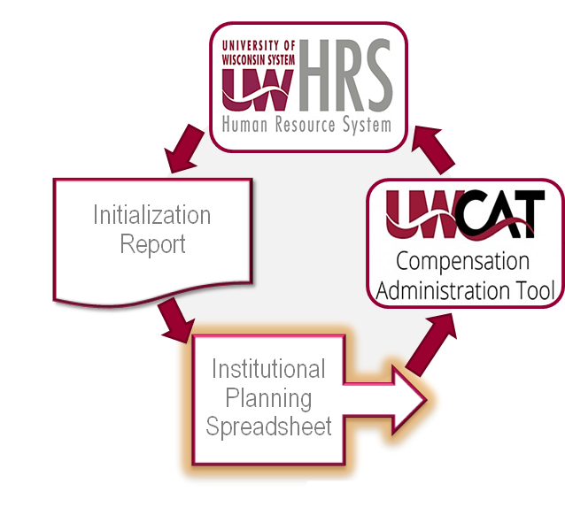
Institutional Planning Spreadsheet (IPS)
The input fields of the IPS are populated manually by copying and pasting from the IR.
Columns 1 – 33 from IR are copied to those columns in the IPS for employee HR data.
Columns 77-116 from the IR are copied to the IPS starting with column 77 for funding data.
Compensation and funding changes can be made en masse and automatically calculated on this sheet for employees with up to five funding splits.

Slide 15
IPS Data
Once the IPS entry is complete, click the ‘IPS→CAT’ tab. Drag down the text string formula until zeros appear in the rows. Delete these rows.
Scroll to the top of the IPS->CAT page. Click on the “Click Here to Export File for CAT Upload” at the top of the page. Save file as a .CSV file.
A message box “Make sure this file looks correct” will appear. Press OK.
A Notepad file will appear on the screen. Do not edit the file. Exit out of the Notepad screen.

Slide 16
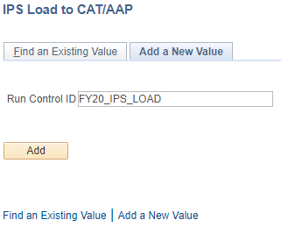
IPS Data Upload to CAT
The rate and funding data in the IPS is then loaded into the Compensation Administration Tool through the IPS to CAT Upload Process.
The IPS Load run control can be found by navigating in PeopleSoft to: Workforce Administration → UW External HR Systems → Compensation Admin Tool → CAT Processes → IPS Load to CAT/AAP
Click the “Add a New Value” tab to create a new run control ID. Enter a run control ID. This can be any unique identifier (ex. Your initials & date). Remember – No spaces are allowed in the run control ID. Click the “Add” button.

Slide 17
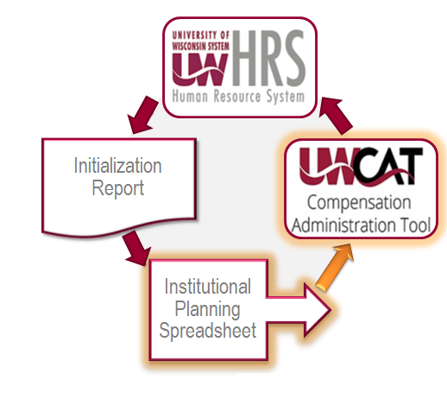
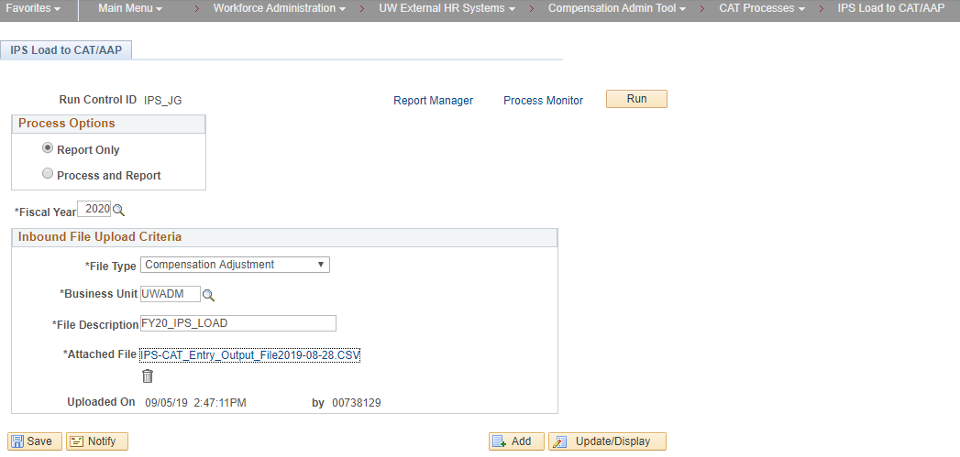
IPS Data Upload to CAT
The IPS Load run control will appear.
Choose a process mode to run in. “Report Only” will process the data but not commit it to CAT. (An output file is generated that allows the data and any errors to be reviewed.) “Process and Report” will commit data to the CAT and generates an output file.
Confirm Fiscal Year is populated with correct fiscal year.
Select File Type: ‘Comp Adjust’ is for employee data; ‘Add’l Adjust’ is for AAP data.
Select your Business Unit.
Enter a file desc which will be used to name the output file.
Click the “Upload File” link next to the Attached File to browse for, select and upload the CSV file that was created from the IPS.
Click “Save” and then click “Run”.
The Process Scheduler Request page will appear. Click “Ok”.
Click “Process Monitor”.

Slide 18
CAT Entry - Detail
On the Process Detail page, click “View Log/Trace”. On “View Log/Trace” page, click the .xls link to review the output file. (Example of output file on next slide.) Remember: If “Report Only” process mode was used, data has not been committed to the CAT.

Slide 19
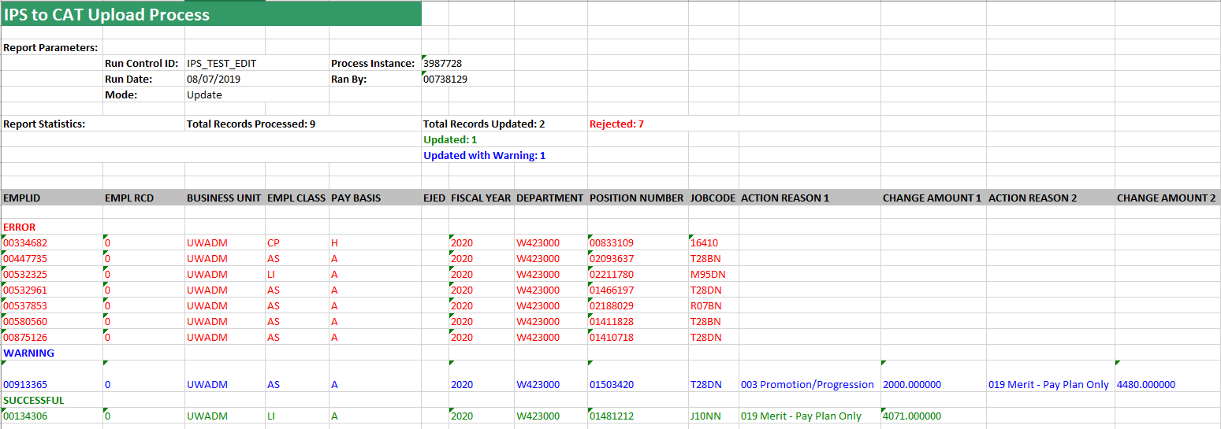
CAT Entry - Detail
Example of Output File
Note:
EMPLIDs in red indicate the entry has not been loaded.
EMPLID in blue was updated with warning
EMPLIDs in green was updated successfully.
The ‘Error Message Database’ on the CAT website is a resource to interpret any errors.

Slide 20
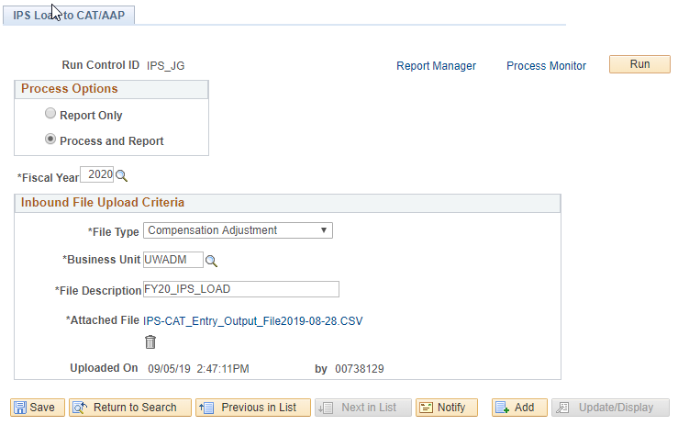
CAT Entry - Detail
Remember: If you ran the report in “Report Only” process mode, review the output file, make any adjustments, then run again in “Process and Report” mode to complete the upload to CAT.

Slide 21
Training Overview
CAT Functionality
Locating the CAT & IPS Files
The IR to IPS to CAT Process
CAT and AAP
CAT Setup – Lock Users & Data Freeze

Slide 22
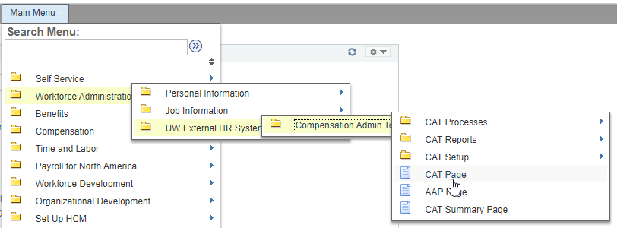
CAT Employee Page
The CAT Employee Page can be found by navigating in PeopleSoft to: Workforce Administration → UW External HR Systems → Compensation Admin Tool → CAT Page

Slide 23
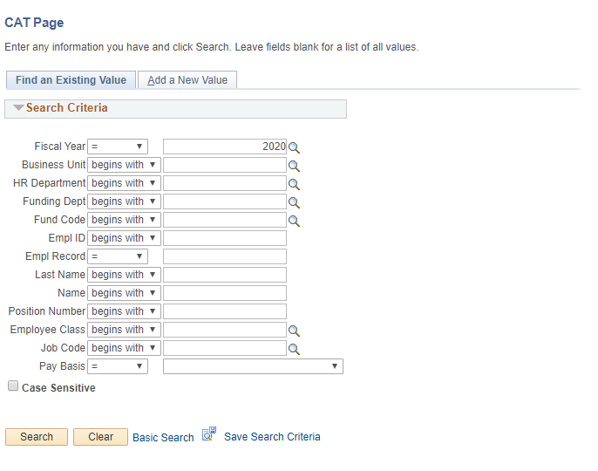
CAT Employee Search Page
User looks for employee records by entering one or more of the search criteria

Slide 24
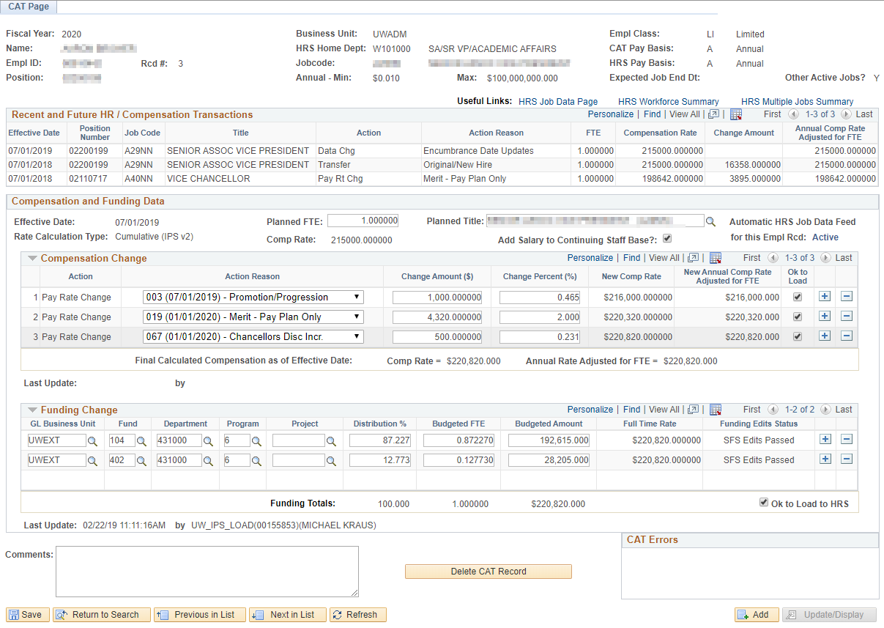
CAT Employee Data Page

Slide 25
Employee Attributes
Pulls key demographics from HRS.

Slide 27
When the Job Data Feed is ON:
Data from HRS is updated nightly and when the employee record page is viewed.

Slide 28
Can be updated to reflect a known change to an employee.
This data does not load to HRS.

Slide 29
‘Ok to Load’
When ‘OK to Load to HRS’ is checked, the comp change will be loaded into HRS at the specified effective date.
When ‘OK to Load to HRS’ is not checked, the comp change will not load to HRS but will still be included in PlanUW salary data.
Rate Calc Type determines how each comp change is calculated.
This is determined by each campus and communicated to UWSA during the annual setup process.

Slide 30
Compensation Data
Displays compensation changes which will be added to an employee’s job record.
Populates through the IPS upload and manual additions.

Slide 31
Funding Data
Displays an employee’s funding splits and distribution percentages
Populates through the IPS upload and manual additions

Slide 32
Funding Edits
Funding splits are validated against SFS Actuals or CAT ledger combo edits.
When ‘OK to Load to HRS’ is checked, Actuals edits will be run.
When ‘OK to Load to HRS’ is not checked, an institution can specify whether they would like Actuals or CAT edits to be run.

Slide 33
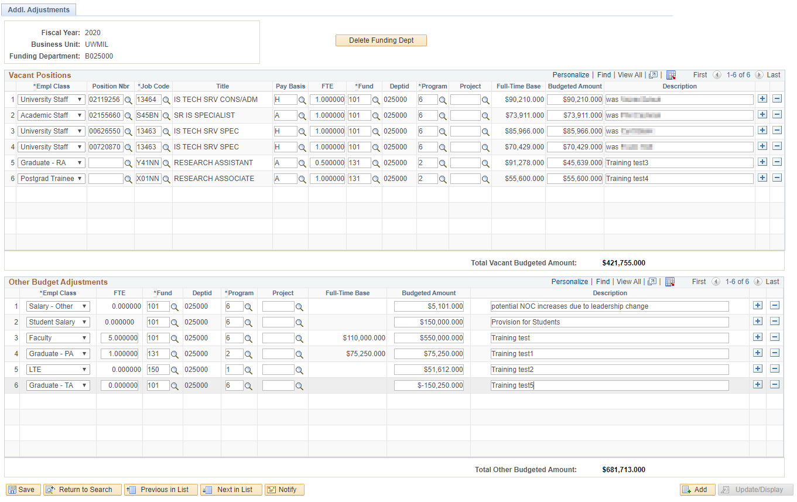
Additional Adjustments Page
Group, Lump, Vacant and Negative position adjustments are made in the AAP by funding department

Slide 34
Additional Adjustments Page
Vacant Positions
Departments can add placeholder positions into their annual budgets
This section will populate through the IPS Upload and new rows can also be added manually

Slide 35
Additional Adjustments Page
Other Budget Adjustments
Other adjustments necessary for budgeting, such as accounting for group, lump sum or negative positions are entered here
This section will populate through the IPS Upload and new rows can also be added manually

Slide 36
Training Overview
CAT Functionality
Locating the CAT & IPS Files
The IR to IPS to CAT Process
CAT and AAP
CAT Setup – Lock Users & Data Freeze

Slide 37
Navigation
The Annual Setup & Lock Users pages can be found by navigating in PeopleSoft to: Workforce Administration → UW External HR Systems → Compensation Admin Tool → CAT Setup

Slide 38
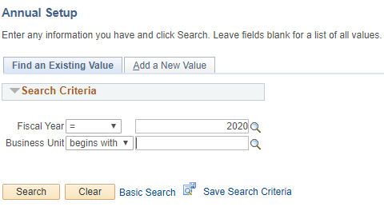
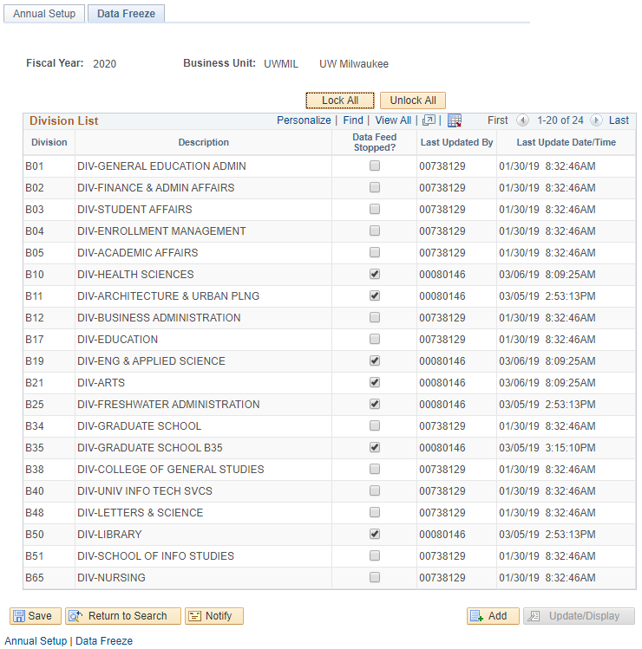
CAT Setup - Data Freezing
When the time comes to perform final reconciliation, each institution will select the time to turn off the automatic job data feed between HRS Job Data and CAT records.
On the Annual Setup Page, fill in your Business Unit and click on ‘Search’.
This can be done by division on the Data Freeze tab of the Annual Setup Page in CAT Setup.

Slide 39
CAT Setup - User Locking
This page is used to ‘lock’ users, especially toward the end of the budgeting cycle.
When a user is locked, their access is switched to View Only. When a user is unlocked, their access corresponds to their given CAT security role.
If a user has the Read Only role, they will remain View Only regardless of if they are locked or unlocked.
At the beginning of each planning year and when a new user is given a CAT security role, the UW System CAT Admin must visit this page and unlock them in order for the new user to be given their full access.

Slide 40
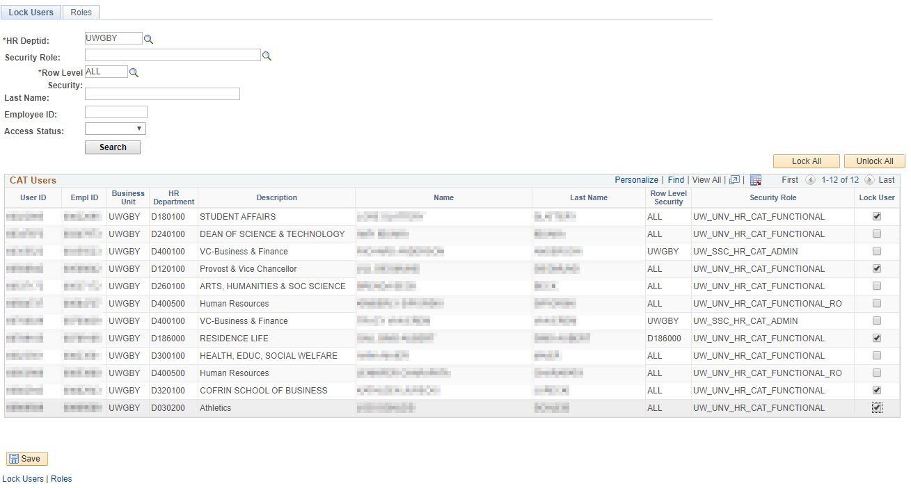
CAT Setup - User Locking
Lock Users: to lock users out of CAT at the end of the budget cycle
Note: an institution can search by Department or Business Unit to find employees
Notes:
Highlight HR dept – how they see their employees

Slide 41
Training Overview
CAT Reporting
Additional Functionality
Training and Support

Slide 42
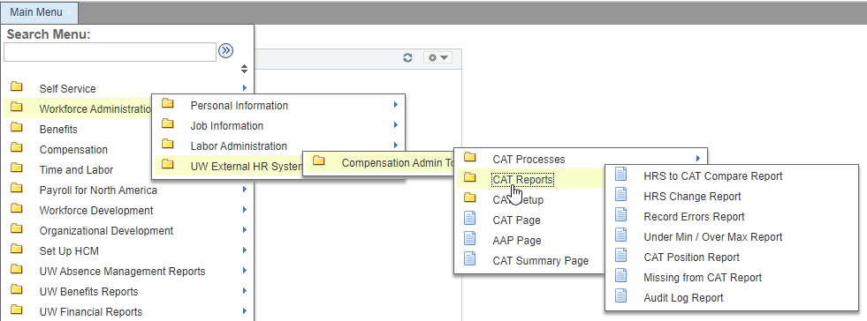
Navigation
The CAT Reports can be found by navigating in PeopleSoft to: Workforce Administration → UW External HR Systems → Compensation Admin Tool → CAT Reports

Slide 43
Reports Inventory
# | Report Name | Description
1 | HRS to CAT Compare | Identifies employee records where key fields differ between the CAT and HRS. Key Fields that may differ if feed is on or off: Position Number, Terminations, New Hires Key Fields that may differ only if feed is off: Empl Class, Pay Basis, Department, Job Code, Title, FTE, EJED, Comprate.
2 | HRS Change Report | This report identifies employee records that exist in the CAT and have undergone a change in HRS. A change is defined as an update to the fields Business Unit, Department, FTE, Pay Basis, Title, EJED, Comprate, Position Number or Leave Status. This report also pulls Terminations, Transfers, or New Hires, though this report is not the main mechanism to catch and correct those changes.
3 | Record Error Report | This report displays all records in the CAT that have generated any sort of (job-level) error based on the edits that have been set up in the CAT. A full list of errors is available in the functional design, and will be included in the KB/training. Job Level Errors (ex: no funding set up) Funding Edit Errors (ex: did not pass SFS edits) Compensation Errors (ex: duplicate action reasons entered in the CAT) Funding Section Errors (ex: distribution % do not add to 100%)
4 | Min/Max Report | Displays records where the individual's or vacant position's future budget salary exceeds or is below the rate for that title in HRS.
5 | Position Report | This report is a pull of all data points on all positions (CAT Records) and Vacant/Bud Adjustment rows (Additional Adjustments Page records) based on selected run control criteria.
6 | Missing from CAT Report | This report displays employees who exist in HRS, but do not exist in the CAT.
7 | CAT Audit Log | Displays which userids have added, deleted or edited particular CAT/ AAP records.

Slide 44
When to Run Which Report: Automatic HRS Feed is ON vs. OFF
Comp Admin Cycle Start
Comp Admin Cycle End
Feed ON
Feed OFF
Hire/Term/Transfer changes
Job attribute changes (e.g., Title, FTE, Comprate)
All Job changes
Job changes in HRS
HRS to CAT Compare Report
HRS Change Report
HRS to CAT Compare Report
Errors in the CAT
CAT Record Errors Report
CAT Over Max Under Min Report
Monitoring
CAT Position Report
Missing from CAT Report
CAT Audit Log

Slide 45
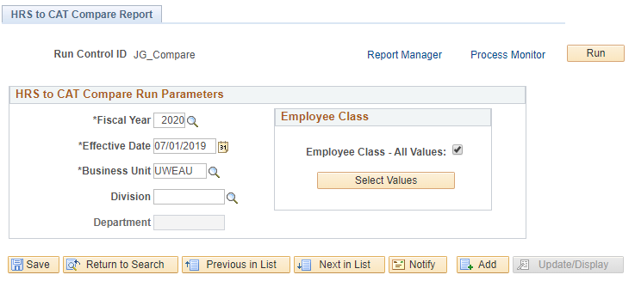
HRS to CAT Compare Report
Identifies employee records where key fields differ between the CAT and HRS.
Catches things like: Business Unit/Department updates, Position Number updates, Compensation Rate updates, Empl Class updates, Title updates, Job Code updates, FTE updates, Hires and Terminations.
Allows the user to review discrepancies for that employee record in the CAT and determine if the rate increases need to be altered based on the new job data information that was entered in HRS.
Job Changes in HRS

Slide 46
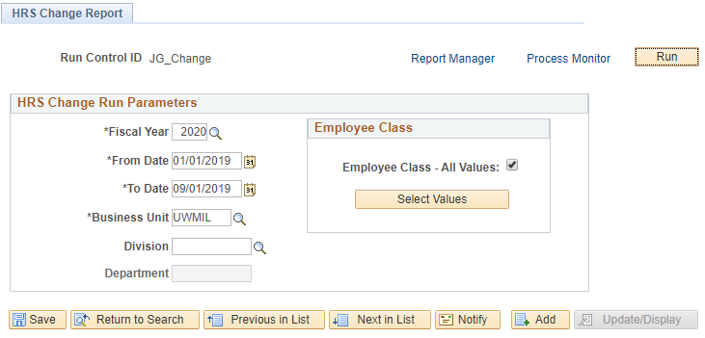
HRS Change Report
Identifies employee records that exist in the CAT and have undergone a change in HRS: an update to the fields Business Unit, HR Department, Position Number, Jobcode, Pay Basis, Title, FTE, Payroll Status, or Comprate, as well as Hires, Rehires, Transfers, or Terminations.
Allows users to review the records on this report and determine if the compensation changes entered in the CAT are still accurate, if a new record in the CAT needs to be created, or if a CAT record needs to be deleted.
Job Changes in HRS

Slide 47
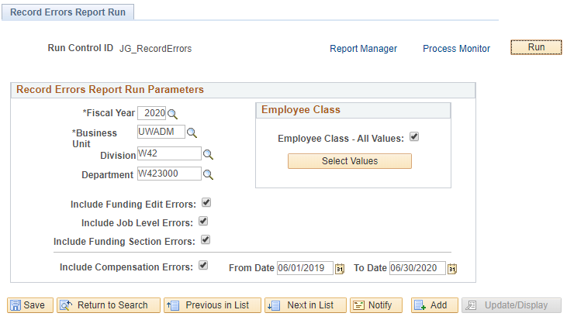
Record Errors Report
Displays all records in the budget that have generated any sort of employee-level error based on the edits set up in the CAT.
Contains all Job Level Errors, Compensation Change Errors, Funding Edit Errors (SFS Actuals, CAT ledger errors) and Funding Section Errors (distribution % errors).
Allows users of the CAT to be able to quickly identify any empl record with an error on a single consolidated report.
Will be run frequently throughout the budgeting cycle and most errors must be resolved before the cycle ends.
Errors in CAT

Slide 48
Action Needed by Report: Automatic HRS Feed is ON or OFF
CAT Error Identified
Action Needed
Compensation Errors
Job Level Errors
Funding Section Errors
Duplicate Action Reason in HRS & CAT
Planned FTE = 0
No funding information entered in the CAT
Duplicate Action Reason in CAT
Planned FTE > 1 on multiple Empl Records
Funding distribution is greater than 100%
Decimal amount entered in Comprate for salaried employees
Sum of individual Budgeted FTEs do not equal Total Planned FTE
Sum of individual Budgeted Amounts does not equal Original Comp Amount Adj for FTE
$0 Comprate Entered
Funding Edit Errors
On an individual funding split, Distrib %, Budgeted FTE, or Budgeted Amount = 0
Funding string failed SFS Actual or SFS Budget Edits
CAT Report to Run
Record Errors Report

Slide 49
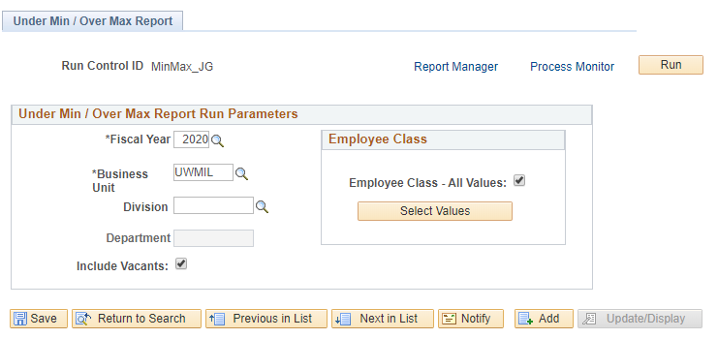
Under Min / Over Max Report
Displays employee records where an individual's (or vacant’s) updated compensation rate is above or below the range for that title in HRS.
Pulls title min/maxes from HRS as of the beginning of the next fiscal year.
Allows users to see which employee records have an over max/under min error so they can update the appropriate comp adjustments in the CAT to be within the salary range.
Errors in CAT

Slide 50
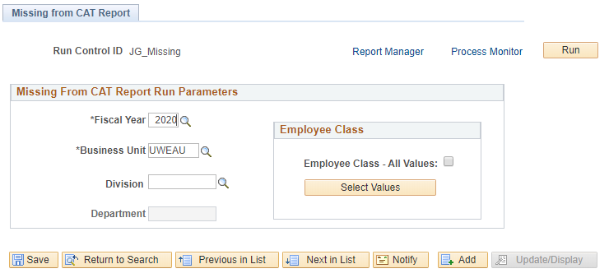
Missing From CAT Report
Displays employees who exist in HRS, but do not exist in CAT.
Catches employees that may have been hired after the Initialization Report (IR) was run, or before the first of the next fiscal year, and employee records excluded while working in the IR or Institutional Planning Spreadsheet (IPS).
Should be run after the IPS is loaded into the CAT.
Monitoring

Slide 51
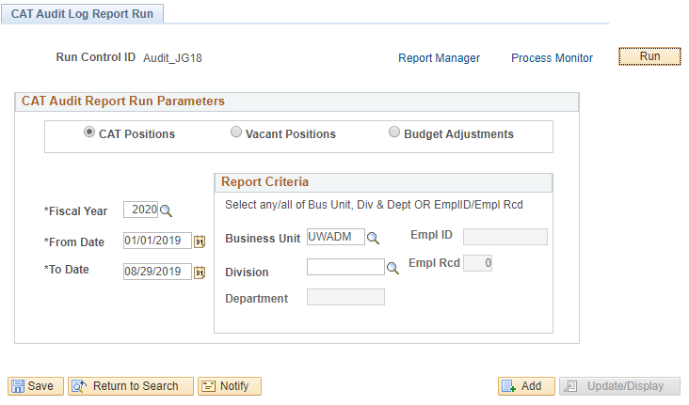
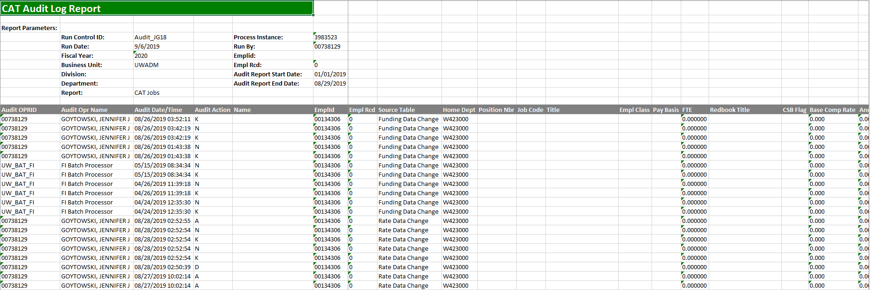
Audit Log Report
Displays which users have edited and saved particular CAT, Vacant Position and Budget Adjustment records.
Pulls records separately from the Audit Log tables for CAT, Vacant Positions and Budget Adjustments, and can generate three unique reports.
Allows users of the CAT to view if other users have changed the information on a shared employee so they can communicate with other users to determine if the compensation increases and funding entered in the CAT is correct.
Monitoring

Slide 52
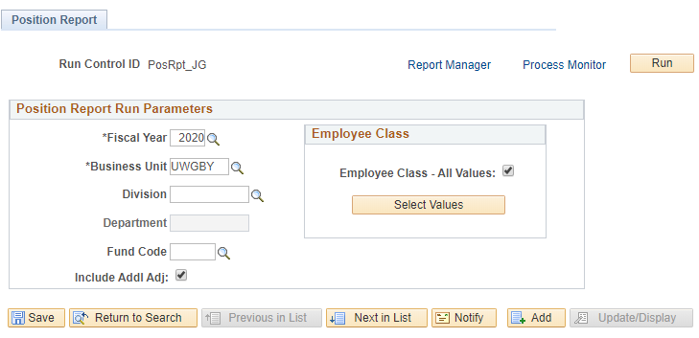
Position Report
Pulls key information on all Positions (CAT Records) and Vacant/Other Bud Adjustment rows (Additional Adjustments Page records) based on selected run control criteria.
Allows users of CAT to view all records that exist in the CAT and the AAP and see a complete picture of their budgeted salary. They may also be distribute it to other users who may not have access to the CAT/AAP, but need to see the data that it houses.
Monitoring

Slide 53
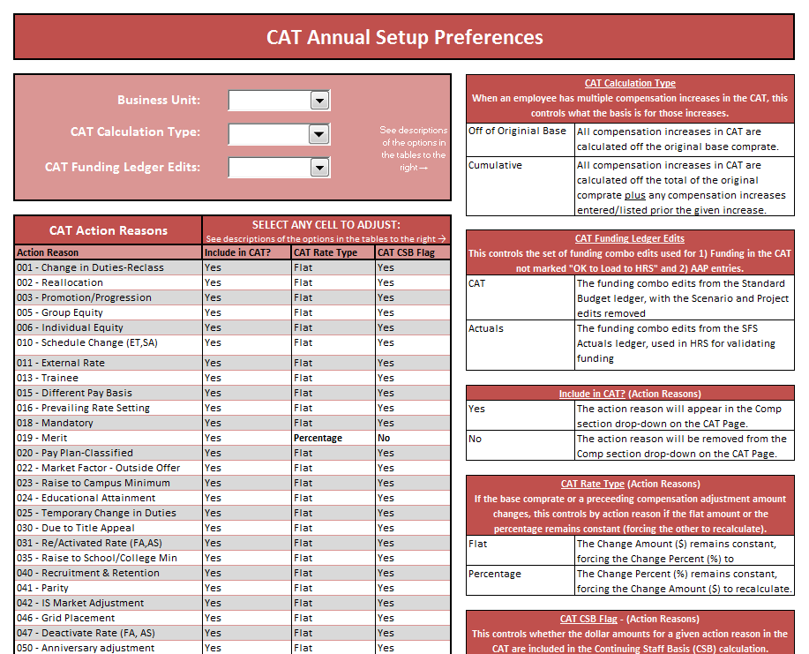
CAT Summary Page
Allows users to summarize key metrics for analyzing compensation distribution against the employee population, focusing on merit and chancellor’s discretionary compensation changes to ensure pay plan guidelines are met.
Calculates data for “CSB FTE” and “CSB Amount” based on employees marked as yes in the “Add Salary to Continuing Staff Base?” check box from the CAT page and only summarizes data for the Action Reasons that are marked “Include in CSB” on the Annual Setup Page for each institution.
Notes:
Effective date: 07/01

Slide 54
Training Overview
CAT Reporting
Additional Functionality
Training and Support

Slide 55
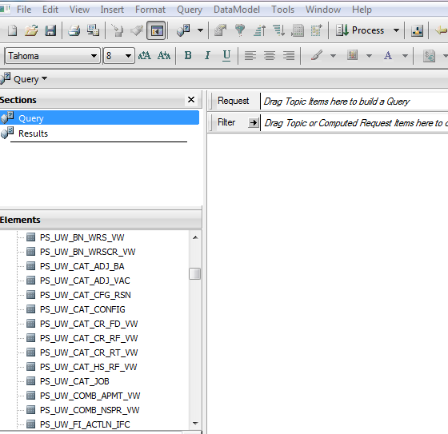
Interactive Reporting
Overnight data transfer
Views available in Interactive Reporting
Users can access EPM queries through the Studio Client (installed on your desktop).

Slide 56
EPM Views – CAT and AAP Combined
Current CAT All Rate and Funding View: (PS_UW_CAT_CA_RF_VW) This view contains all employee job, compensation, and funding data from the CAT Page and AAP stored within the EPM tables for the current fiscal year.
Current CAT All Funding View: (PS_UW_CAT_CA_FD_VW) This view contains all employee job and funding data from the CAT Page and AAP stored within the EPM tables for the current fiscal year.
Historical CAT All Rate and Funding View: (PS_UW_CAT_HA_RF_VW) The view contains all employee job, compensation, and funding data from the CAT Page and AAP stored within the EPM tables for all prior fiscal years.

Slide 57
EPM Views – CAT and AAP Separate
Current CAT Rate and Funding View: (PS_UW_CAT_CR_RF_VW) This view contains all employee job, compensation, and funding data from the CAT Page stored within the CAT EPM tables for the current fiscal year.
Current CAT Funding View: (PS_UW_CAT_CR_FD_VW) This view contains all employee job and funding data from the CAT Page stored within the CAT EPM tables for the current fiscal year.
Current CAT Rate View: (PS_UW_CAT_CR_RT_VW) This view contains all employee job and compensation data from the CAT Page stored within the CAT EPM tables for the current fiscal year.
Historical CAT Rate and Funding View: (PS_UW_CAT_HS_RF_VW) The view contains all employee job, compensation, and funding data from the CAT Page stored within the CAT EPM tables for all prior fiscal years.
AAP Vacant Positions View: (PS_UW_CAT_ADJ_VAC) This view contains all vacant position data from the AAP for the current and all prior fiscal years.
AAP Other Budget Adjustments View: (PS_UW_CAT_ADJ_BA) This view contains all other budget adjustment data from the AAP for the current and all prior fiscal years.

Slide 58
Training Overview
CAT Reporting
Additional Functionality
Resources and Support

Slide 59
CAT Resources and Links
Compensation Administration Tool Website
https://www.wisconsin.edu/compensation-administration-tool/
Resources Include:
CAT Process KB Documents
CAT Reporting KB Documents
Training Session Materials
Business Process Resources
UAT Scripts & Workbooks
CAT User Guides
Error Message Database

Slide 60
Support
Refer directly to your institutional liaison for information on training and business process
All other functional and technical questions can be routed to catquestions@uwsa.edu

Slide 61
Questions?

