Slide 1

Compensation Administration Tool
Refresher Training
2018

Slide 2
Agenda
Populate & Upload Institutional Planning Spreadsheet (IPS)
Compensation Admin Tool (CAT) Page & Additional Adjustments Page (AAP)
CAT Reporting
Overview
CAT Setup – Lock Users & Data Freeze
Initialization Report (I.R.)
Resources and Support

Slide 3
IPS/CAT Pay Plan Amount Entry
Campuses will enter the full FY19 merit increase for each employee as one amount into the IPS or CAT using pay action reason code 067 Chancellor’s Discretionary and/or 019 – Merit. The full merit amount entered should be the sum of the July 1st, 2018 merit increase and the January 1st, 2019 merit increase.
The budgeted annual salary, after entering the full merit amount and any other adjustments, should be the employee’s final annual salary as of January 1st, 2019.
In the Mass HR Update process, the Service Center will split the merit amount for each employee and will load those amounts into HRS at the designated pay plan implementation dates.
Campuses will also need to enter a negative amount into the AAP to reconcile to the pay plan allocations due to the last six months of the January 1st, 2019 pay plan not being allocated until FY20.
To assist in the pay plan reconciliation process, users can utilize the CAT Summary Page (similar to BSUM Page 7).

Slide 4

Overall Process Flow (Technical)

Slide 5
Training Overview
CAT Functionality
Locating the CAT & IPS Files
The IR to IPS to CAT Process
CAT and AAP
CAT Setup – Lock Users & Data Freeze

Slide 6
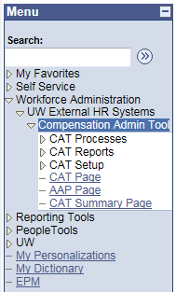
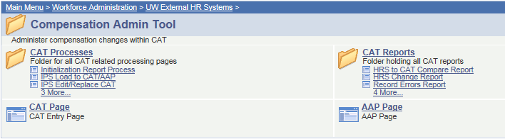
Navigation
The CAT can be found by navigating in PeopleSoft to:
Workforce Administration →
UW External HR Systems →
Compensation Admin Tool

Slide 7
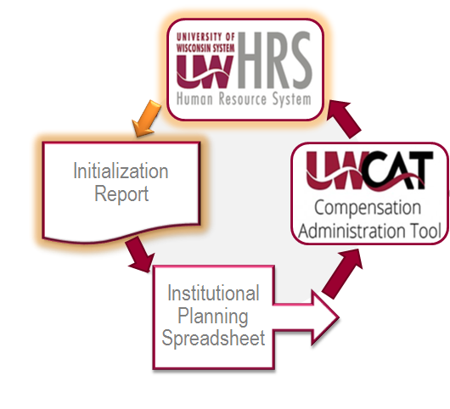
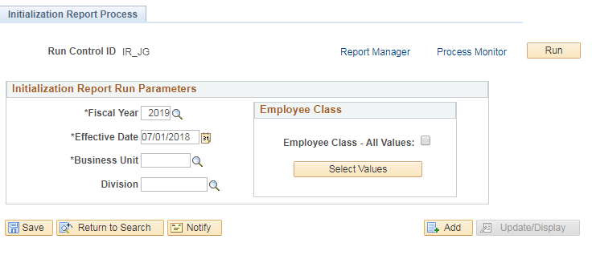
Initialization Report (IR)
The IR allows the user to create a run control, specifying these particular fields:
  Fiscal Year
  Effective Date (ex. 07/01/2018)
  Business Unit
  Division
  Employee Class
Notes:
Effective date: 07/01

Slide 8
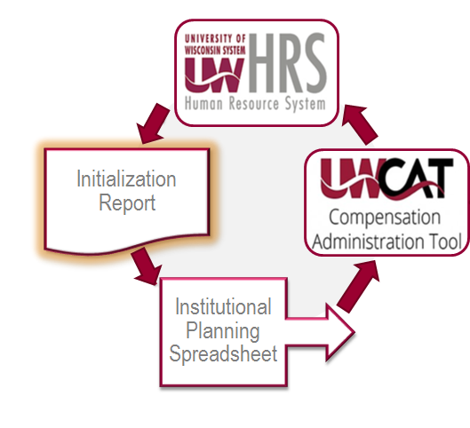
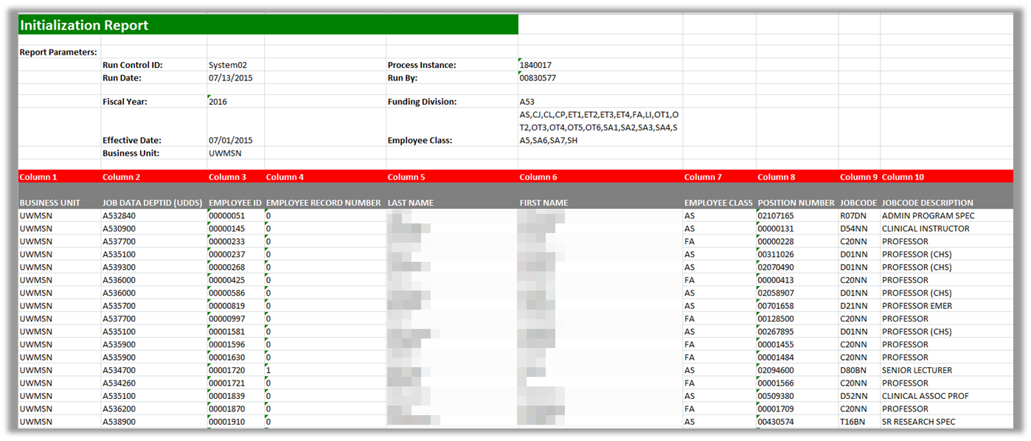
Initialization Report (IR)
When the process is run, it will provide an Excel spreadsheet output file, specifying fields including:
  Business Unit
  Department ID
  Employee ID
  Employee Record Number
There may be two Excel outputs
  One for employees with five or fewer funding splits
  One for employees with more than five funding splits
  Name
  Employee Class
  Etc.
Notes:
Columns 1-33 are data pulled from HRS/job data; columns 77-116 is commitment account/funding data.
Remind users to do any sorting in the IR. If try to sort in IPS, because of all the complex formulas, it sometimes breaks excel.

Slide 9
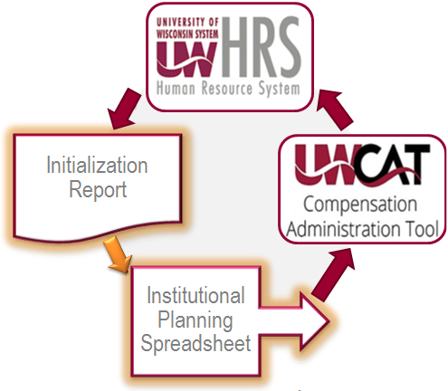
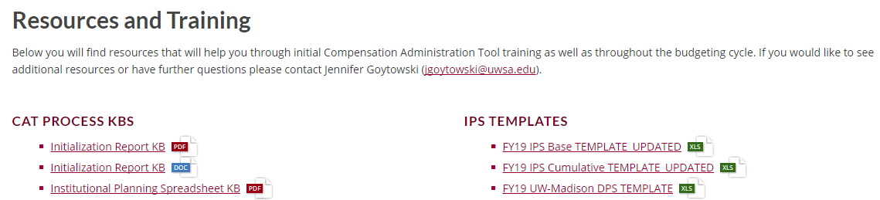

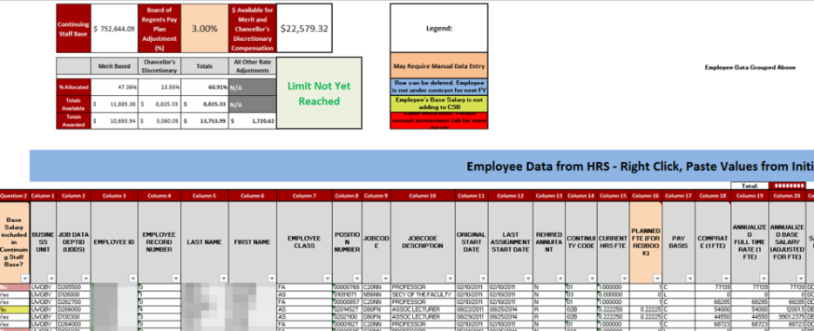
IR to IPS Transfer
This is a manual transfer process between the IR Excel file and the IPS Excel template file.
  This template file can be found on the CAT website.
    www.wisconsin.edu/compensation-administration-tool
  Each institution will choose between the IPS Base template and the IPS Cumulative template depending on their institutional annual setup preferences.

Slide 10
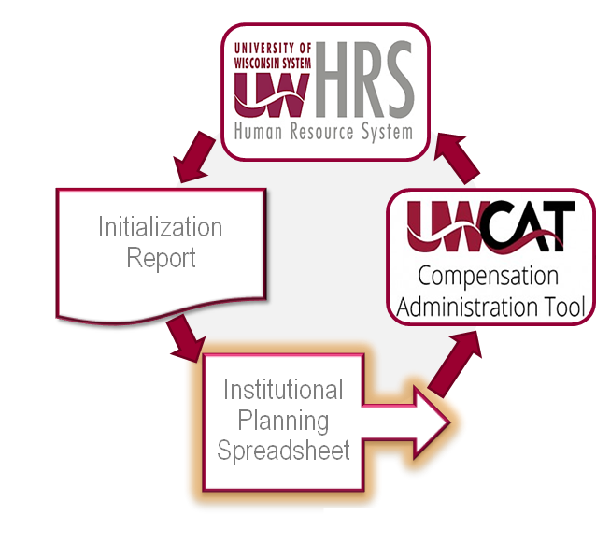

Institutional Planning Spreadsheet (IPS)
The input fields of the IPS are populated manually by copying and pasting from the IR.
Compensation and funding changes can be made en masse and automatically calculated on this sheet for employees with up to five funding splits.

Slide 11
Institutional Planning Spreadsheet Changes
Merit, Chancellor’s Discretionary and other adjustments summary table at the top of the page has been updated.
A Chancellor’s Discretionary section has been added within the IPS.
Sections for ‘Other Pay Rate Adjustments’ have been reduced from four to three.
A Compensation Plan Summary pivot table has been added in a new tab within the IPS workbook.

Slide 12
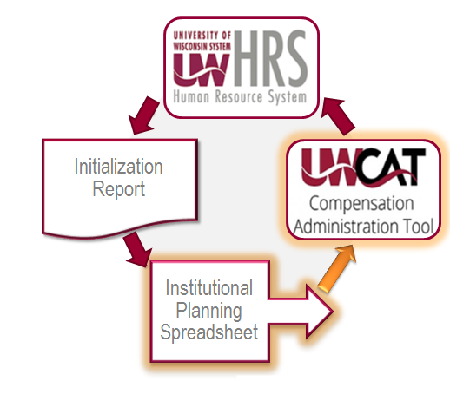
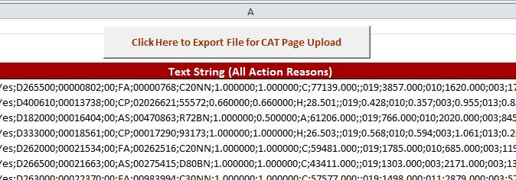
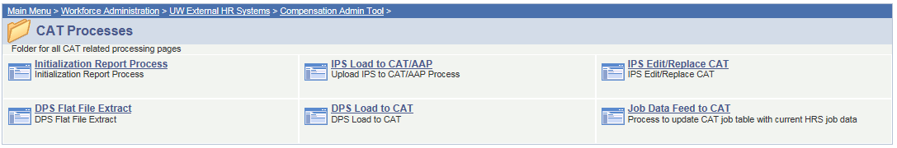
IPS Data Upload to CAT
The rate and funding data in the IPS is then loaded into the Compensation Administration Tool through the IPS to CAT Upload Process.
Notes:
IPS -> CAT Tab within IPS – make sure you have all of the data from your IPS captured in your CSV file.

Slide 13
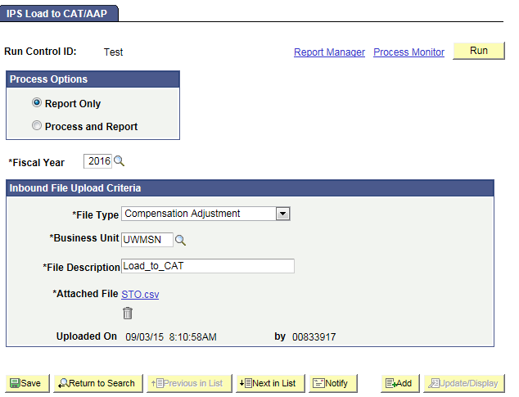
IPS Data Upload to CAT
The rate and funding data in the IPS is then loaded into the Compensation Administration Tool through the IPS to CAT Upload Process.
Notes:
Output file contains ‘Updated’ (green), ‘Updated with Warning (blue) and ‘Rejected’ (red).

Slide 14
Training Overview
CAT Functionality
Locating the CAT & IPS Files
The IR to IPS to CAT Process
CAT and AAP
CAT Setup – Lock Users & Data Freeze

Slide 15
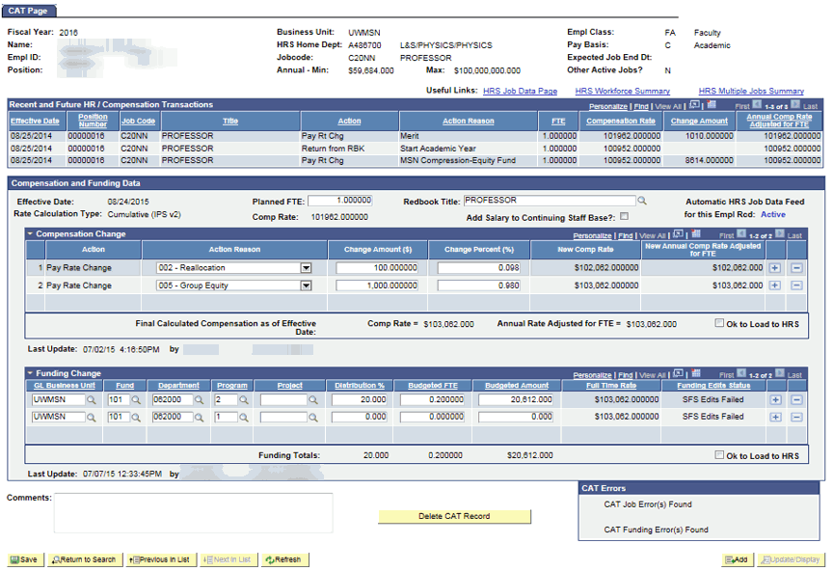
CAT Employee Data Page
Notes:
Very top section – Employee Attributes – Pulls key demographics from HRS.
Recent & Future HR Transactions – Pulls recent transactions from an employee’s job record in HRS that are relevant to the compensation process.
Compensation Data – Displays compensation changes which will be added to an employee’s job record. Populates through the IPS upload and manual additions.
When Job Data Feed is ON: Data from HRS is updated nightly and when the employee record page is viewed.
Funding Data – Displays an employee’s funding splits and distribution percentages. Populates through the IPS upload and manual additions.
Funding Edits – Funding splits are validated against SFS Actuals or CAT ledger combo edits. When ‘OK to Load to HRS’ is checked, Actuals edits will be run. When ‘Ok to Load to HRS’ is not checked, an institution can specify whether they would like Actuals or CAT edits to be run.

Slide 16
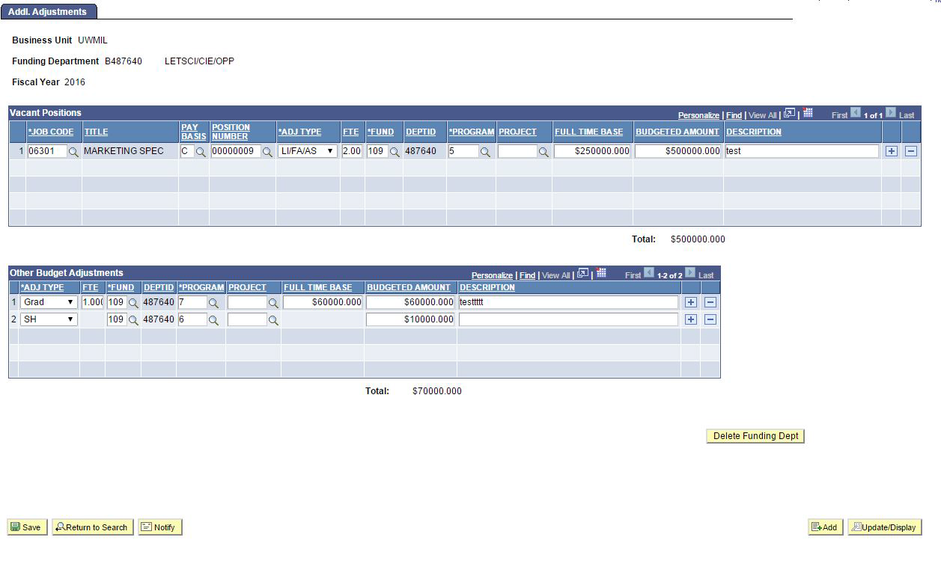
Additional Adjustments Page
Notes:
Group, Lump, Vacant and Negative position adjustments are made in the APP by funding department.
Vacant Positions – Departments can add placeholder positions into their annual budgets. This section can be populated through the IPS Upload or new rows can be added manually.
Other Budget Adjustments – Other adjustments necessary for budgeting, such as accounting for group, lump sum or negative positions are entered here. This section can be populated through the IPS Upload or new rows can be added manually.

Slide 17
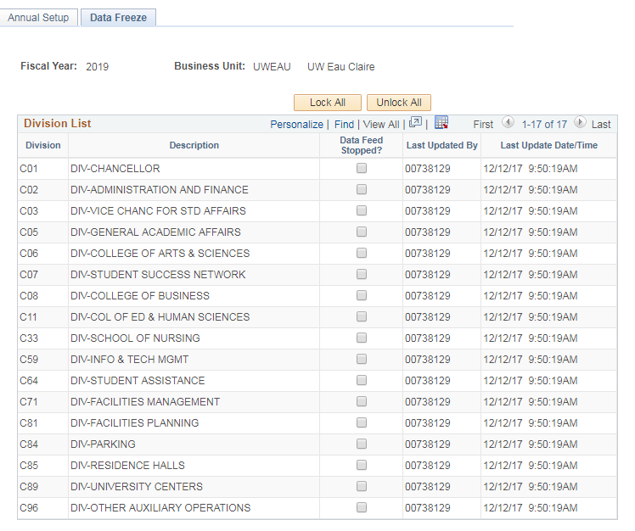
CAT Setup - Data Freezing
When the time comes to perform final reconciliation, each institution will select the time to turn off the automatic job data feed between HRS Job Data and CAT records.
This can be done by division on the Data Freeze tab of the Annual Setup Page in CAT Setup.

Slide 18
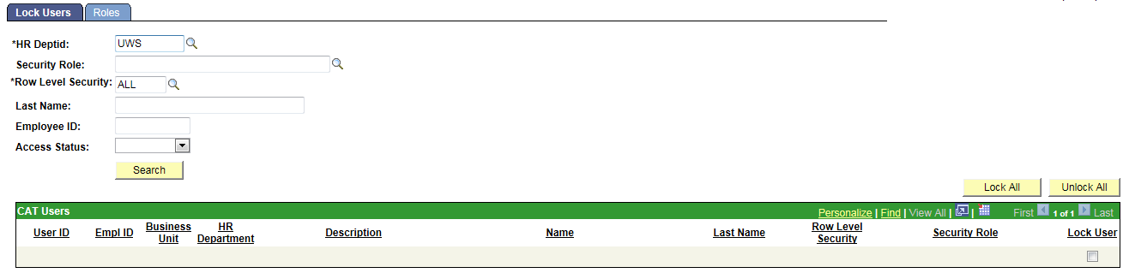
CAT Setup - User Locking
This page is used to ‘lock’ users, especially toward the end of the budgeting cycle.
When a user is locked, their access is switched to View Only. When a user is unlocked, their access corresponds to their given CAT security role.
If a user has the Read Only role, they will remain View Only regardless of if they are locked or unlocked.
At the beginning of each planning year and when a new user is given a CAT security role, the UW System CAT Admin must visit this page and unlock them in order for the new user to be given their full access.

Slide 19
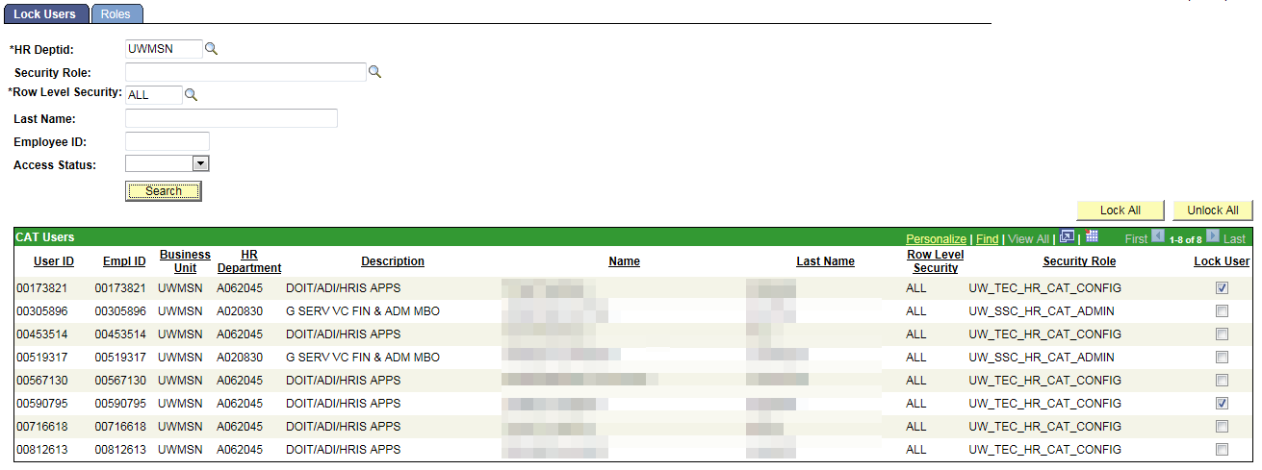
CAT Setup - User Locking
Lock Users: to lock users out of CAT at the end of the budget cycle
Note: an institution can search by Department or Business Unit to find employees
Notes:
Employees are organized by their HR dept.

Slide 20
Training Overview
CAT Reporting
Additional Functionality
Resources & Support

Slide 21
Reports Inventory
# | Report Name | Description
1 | HRS to CAT Compare | Identifies employee records where key fields differ between the CAT and HRS. Identifies employee records where key fields differ between the CAT and HRS. Key Fields that may differ if feed is on or off: Position Number, Terminations, New Hires Key Fields that may differ only if feed is off: Empl Class, Pay Basis, Department, Job Code, Title, FTE, EJED, Comprate.
2 | HRS Change Report | This report identifies employee records that exist in the CAT and have undergone a change in HRS. A change is defined as an update to the fields Business Unit, Department, FTE, Pay Basis, Title, EJED, Comprate, or Position Number or Leave Status. This report also pulls Terminations, Transfers, or New Hires, though this report is not the main mechanism to catch and correct those changes.
3 | Record Error Report | This report displays all records in the CAT that have generated any sort of (job-level) error based on the edits that have been set up in the CAT. A full list of errors is available in the functional design, and will be included in the KB/training. Job Level Errors (ex: no funding set up) Funding Edit Errors (ex: did not pass SFS edits) Compensation Errors (ex: duplicate action reasons entered in the CAT) Funding Section Errors (ex: distribution % do not add to 100%)
4 | Min/Max Report | Displays records where the individual's or vacant position's future budget salary exceeds or is below the rate for that title in HRS.
5 | Position Report | This report is a pull of all data points on all positions (CAT Records) and Vacant/Bud Adjustment rows (Additional Adjustments Page records) based on selected run control criteria. This will replace the "2A or Budget Position" report out of 3270.
6 | Missing from CAT Report | This report displays employees who exist in HRS, but do not exist in the CAT.
7 | CAT Audit Log | Displays which userids have added, deleted or edited particular CAT/ AAP records.

Slide 22
When to Run Which Report: Automatic HRS Feed is ON vs. OFF
Comp Admin Cycle Start
Comp Admin Cycle End
Feed ON
Feed OFF
Hire/Term/Transfer changes
Job attribute changes
All Job changes
Job changes in HRS
HRS to CAT Compare Report
HRS Change Report
HRS to CAT Compare Report
Errors in the CAT
CAT Record Errors Report
CAT Over Max Under Min Report
Monitoring
CAT Position Report
Missing from CAT Report
CAT Audit Log

Slide 23
Automatic HRS Feed is ON
HRS to CAT Compare Report & HRS Change Report
Action May Be Needed
Job Change in HRS Occurred
Action Needed
Title Change
Review and Potentially Edit Comp Increases
Action May Be Needed
Action Needed
New Hire
Potentially Add to CAT
Employee Terminated
Delete from CAT
Action Needed
Transfer/Position # Change
Delete and Re-Add to CAT
Comprate Change
Review and Potentially Edit Comp Increases
Action May Be Needed
Action May Be Needed
FTE, EJED Change
Potentially Edit Planned FTE or Remove from CAT
CAT Report to Run
HRS to CAT Compare Report
HRS Change Report

Slide 24
Automatic HRS Feed is OFF
HRS to CAT Compare Report
Job Change in HRS Occurred
Action Needed
Employee Terminated
Delete from CAT
Title Change
Review and Potentially Edit Comp Increases
Action Needed
Action May Be Needed
Action May Be Needed
Action Needed
Comprate Change
Review and Potentially Edit Comp Increases
Transfer/Position # Change
Delete and Re-Add to CAT
Action May Be Needed
New Hire
Potentially Add to CAT
FTE, EJED Change
Potentially Edit Planned FTE or Remove from CAT
Action May Be Needed
CAT Report to Run
HRS to CAT Compare Report

Slide 25
Record Errors Report: Automatic HRS Feed is ON or OFF
CAT Error Identified
Action Needed
Compensation Errors
Job Level Errors
Funding Section Errors
Duplicate Action Reason in HRS & CAT
Planned FTE = 0
No funding information entered in the CAT
Duplicate Action Reason in CAT
Planned FTE > 1 on multiple Empl Records
Funding distribution is greater than 100%
Decimal amount entered in Comprate for salaried employees
Sum of individual Budgeted FTEs do not equal Total Planned FTE
Sum of individual Budgeted Amounts does not equal Original Comp Amount Adj for FTE
$0 Comprate Entered
Funding Edit Errors
On an individual funding split, Distrib %, Budgeted FTE, or Budgeted Amount = 0
Funding string failed SFS Actual or SFS Budget Edits
CAT Report to Run
Record Errors Report

Slide 26
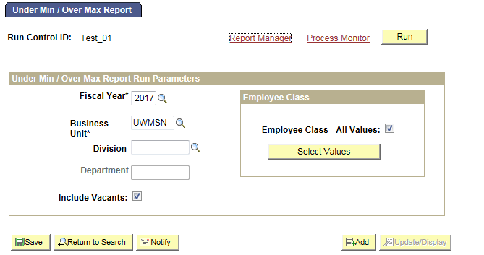
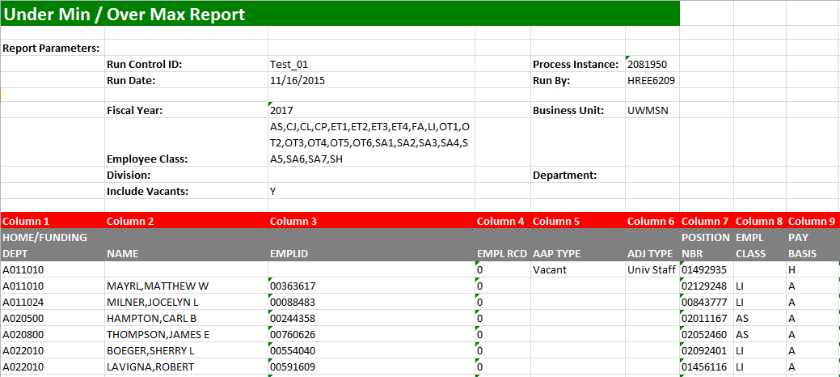
Under Min / Over Max Report
Displays employee records where an individual's (or vacant’s) updated compensation rate is above or below the range for that title in HRS
Pulls title min/maxes from HRS as of the beginning of the next fiscal year
Allows users to see which employee records have an over max/under min error so they can update the appropriate comp adjustments in the CAT to be within the salary range
Errors in CAT

Slide 27
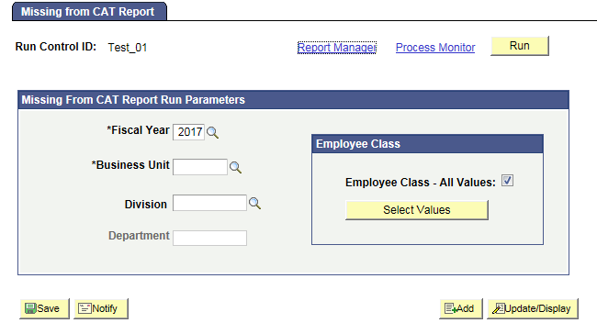
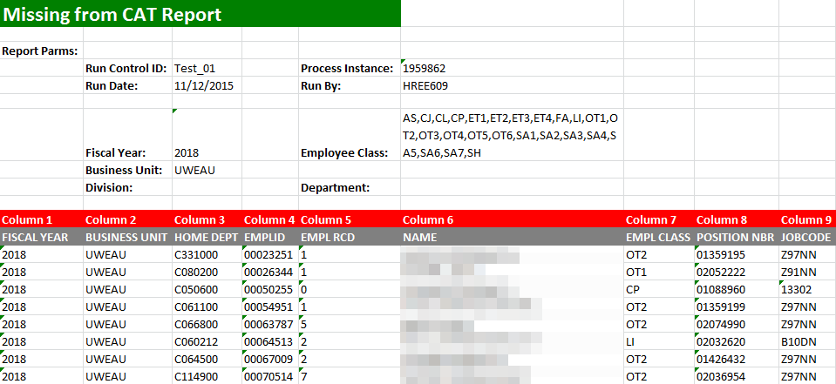
Missing From CAT Report
Displays employees who exist in HRS, but do not exist in CAT
Catches employees that may have been hired after the Initialization Report (IR) was run, or before the first of the next fiscal year, and employee records excluded while working in the IR or Institutional Planning Spreadsheet (IPS)
Should be run regularly, starting after the IPS is loaded into the CAT
Monitoring

Slide 28
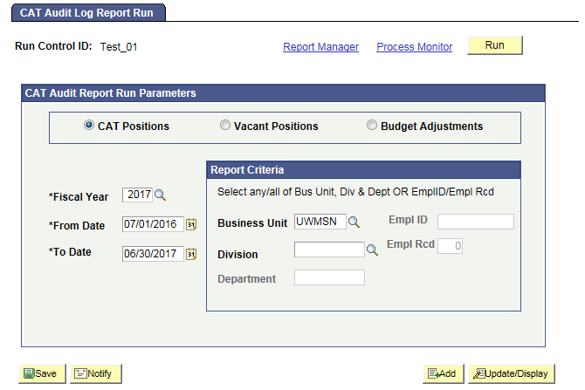
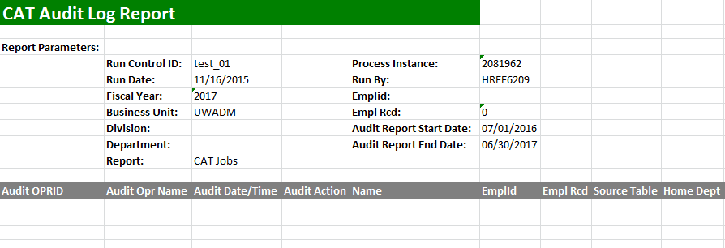
Audit Log Report
Displays which users have edited and saved particular CAT, Vacant Position and Budget Adjustment records
Pulls records separately from the Audit Log tables for CAT, Vacant Positions and Budget Adjustments, and can generate three unique reports
Allows users of the CAT to view if other users have changed the information on a shared employee so they can communicate with other users to determine if the compensation increases and funding entered in the CAT is correct
Monitoring

Slide 29
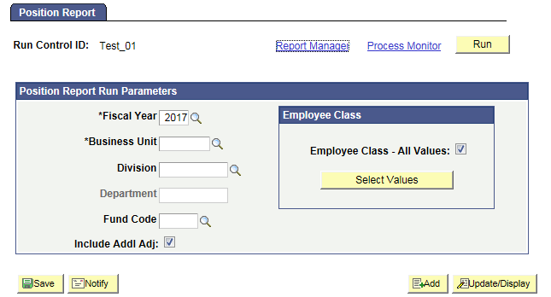
Position Report
Pulls key information on all Positions (CAT Records) and Vacant/Other Bud Adjustment rows (Additional Adjustments Page records) based on selected run control criteria
Allows users of CAT to view all records that exist in the CAT and the AAP and see a complete picture of their budgeted salary. They may also distribute it to other users who may not have access to the CAT/AAP, but need to see the data that it houses
Monitoring

Slide 30
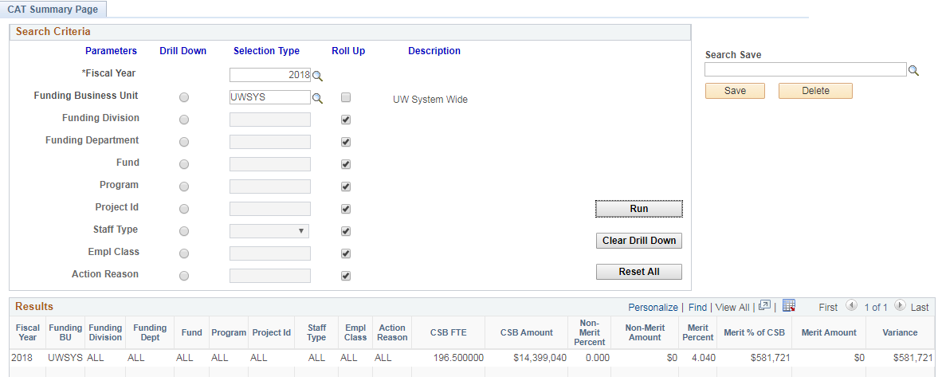
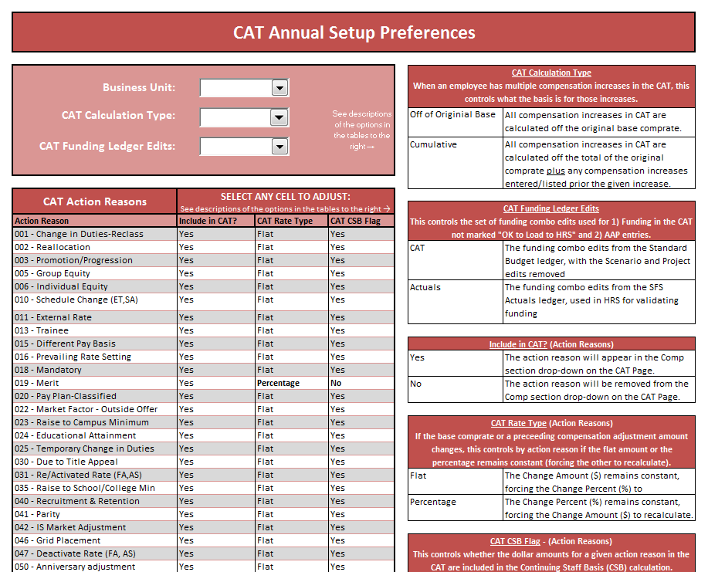
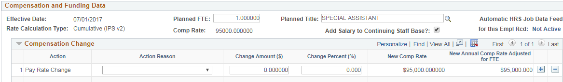
CAT Summary Page
Allows users to summarize key metrics for analyzing compensation distribution against the employee population, focusing on merit and chancellor’s discretionary compensation changes to ensure pay plan guidelines are met.
Calculates data for “CSB FTE” and “CSB Amount” based on employees marked as yes in the “Add Salary to Continuing Staff Base?” check box from the CAT page and only summarizes data for the Action Reasons that are marked “Include in CSB” on the Annual Setup Page for each institution.
Notes:
Effective date: 07/01

Slide 31
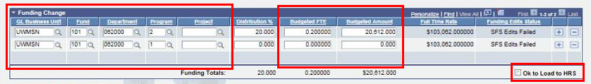
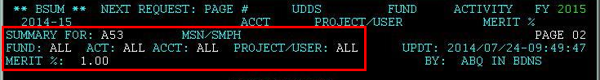
BSUM
Data will be read instantly from the CAT and populate the appropriate fields on the remaining pages of 2, 3, 5, 6, 26, and 27 of BSUM.
Any employee class (including Student Help and LTE) is allowed to be loaded to or entered in the CAT Page, and consequently be included in FTE calculation in BSUM.
Users will refer to BSUM for reporting purposes to gather salary, budget, and allocation totals.

Slide 32
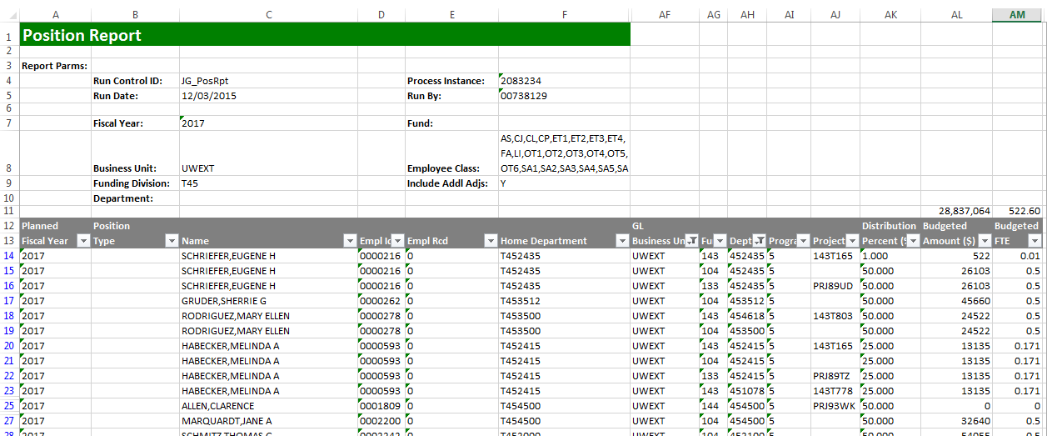
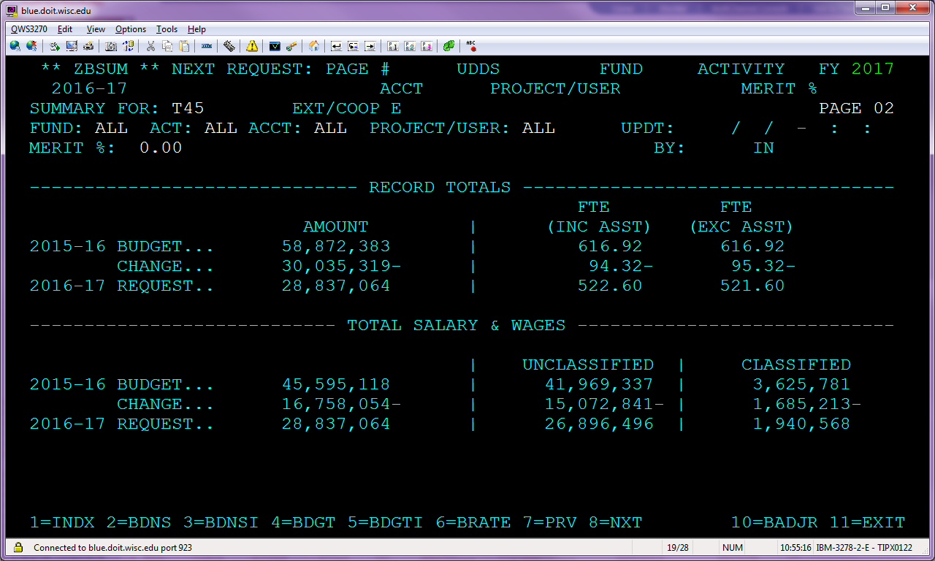
Tying Out the Position Report to BSUM

Slide 33
Training Overview
CAT Reporting
Additional Functionality
Resources & Support

Slide 34

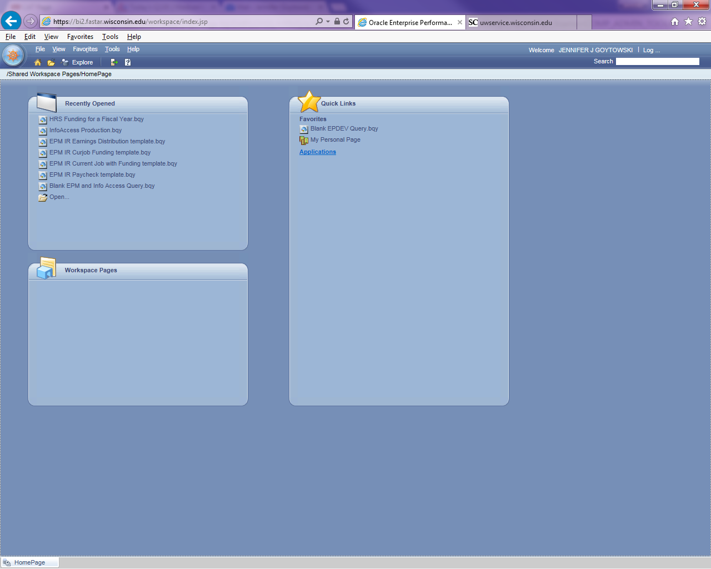
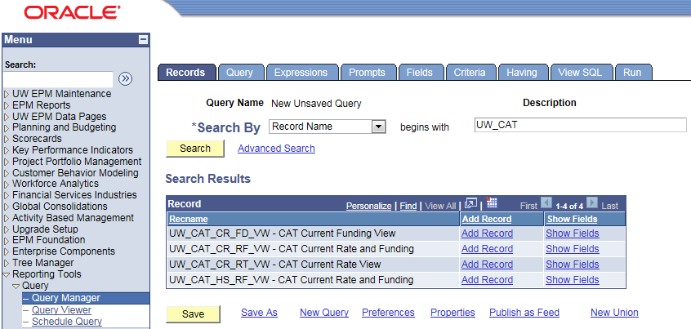
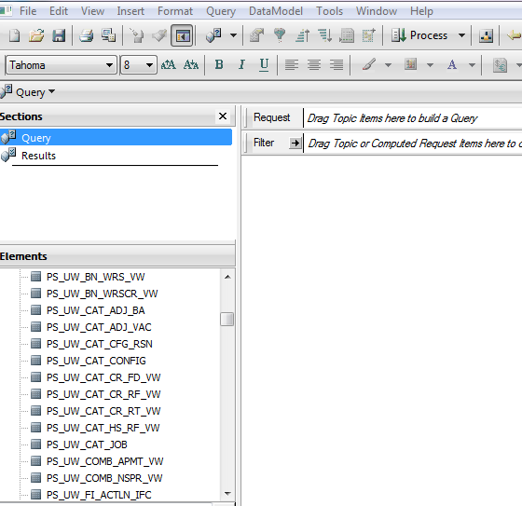
EPM and Interactive Reporting
Overnight data transfer
Views available in Interactive Reporting
  There are two options to access EPM queries:
    Web client: https://bi2.fastar.wisconsin.edu/workspace/index.jsp
    Studio client: found on your desktop

Slide 35
EPM Views – CAT and AAP Combined
Current CAT All Rate and Funding View: (PS_UW_CAT_CA_RF_VW) This view contains all employee job, compensation, and funding data from the CAT Page and AAP stored within the EPM tables for the current fiscal year.
Current CAT All Funding View: (PS_UW_CAT_CA_FD_VW) This view contains all employee job and funding data from the CAT Page and AAP stored within the EPM tables for the current fiscal year.
Historical CAT All Rate and Funding View: (PS_UW_CAT_HA_RF_VW) The view contains all employee job, compensation, and funding data from the CAT Page and AAP stored within the EPM tables for all prior fiscal years.

Slide 36
EPM Views – CAT and AAP Separate
Current CAT Rate and Funding View: (PS_UW_CAT_CR_RF_VW) This view contains all employee job, compensation, and funding data from the CAT Page stored within the CAT EPM tables for the current fiscal year.
Current CAT Funding View: (PS_UW_CAT_CR_FD_VW) This view contains all employee job and funding data from the CAT Page stored within the CAT EPM tables for the current fiscal year.
Current CAT Rate View: (PS_UW_CAT_CR_RT_VW) This view contains all employee job and compensation data from the CAT Page stored within the CAT EPM tables for the current fiscal year.
Historical CAT Rate and Funding View: (PS_UW_CAT_HS_RF_VW) The view contains all employee job, compensation, and funding data from the CAT Page stored within the CAT EPM tables for all prior fiscal years.
AAP Vacant Positions View: (PS_UW_CAT_ADJ_VAC) This view contains all vacant position data from the AAP for the current and all prior fiscal years.
AAP Other Budget Adjustments View: (PS_UW_CAT_ADJ_BA) This view contains all other budget adjustment data from the AAP for the current and all prior fiscal years.

Slide 37
Training Overview
CAT Reporting
Additional Functionality
Resources and Support

Slide 38
CAT Resources and Links
Compensation Administration Tool Website
  https://www.wisconsin.edu/compensation-administration-tool/
  Resources Include:
  CAT Process KB Documents
  CAT Reporting KB Documents
  Demonstration Videos
  Training Session Materials
  Business Process Resources
  UAT Scripts & Workbooks
  CAT User Guides
  Error Message Database

Slide 39

Support
Refer directly to your institutional liaison for information on training and business process
All other functional and technical questions can be routed to catquestions@uwsa.edu

Slide 40
Questions?

