Slide 1

Compensation Administration Tool
Refresher Training
February 2017

Slide 2
Agenda
Populate & Upload Institutional Planning Spreadsheet (IPS)
Compensation Admin Tool (CAT Page) & Additional Adjustments Page (AAP)
CAT Reporting
Overview
CAT Setup – Lock Users & Data Freeze
Initialization Report (I.R.)
Resources and Support

Slide 3
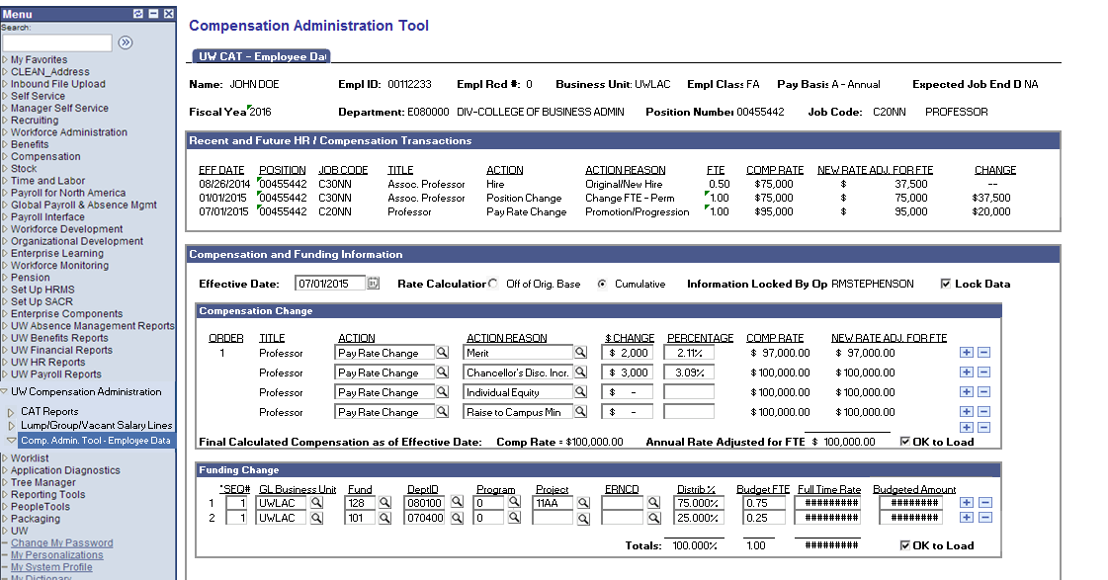
What is the CAT?
Mock-up
A tool built in PeopleSoft to manage comp. and funding changes during the budgeting cycle, that will:
Replace BDGT, BADJR, BRATE transactions in 3270 (essentially minimizing person level data in the mainframe system!)
Transfer finalized comp. and funding data to HRS and summary level data to the budget system
Give users the ability to enter proposed compensation and funding changes directly into PeopleSoft and bypass the IPS
Give users the ability to edit proposed compensation and funding changes previously loaded from the IPS
Support advanced search capabilities
Display a summary of an employee’s historical record in HRS, for easy reference
Display summary information by Business Unit, Dept, etc.
Will have necessary checks and edits to ensure data accuracy
The tool will NOT:
Replace the mainframe budget system entirely
Be updated en masse without the IPS

Slide 4

Overall Process Flow (Technical)

Slide 5
Training Overview
CAT Functionality
Locating the CAT & IPS Files
The IR to IPS to CAT Process
CAT and AAP
CAT Setup – Lock Users & Data Freeze

Slide 6
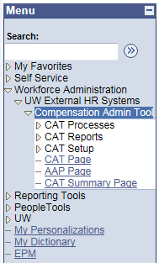
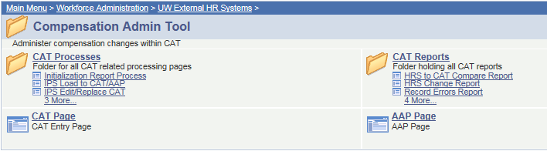
Navigation
The CAT can be found by navigating in PeopleSoft to:
Workforce Administration →
UW External HR Systems →
Compensation Admin Tool

Slide 7
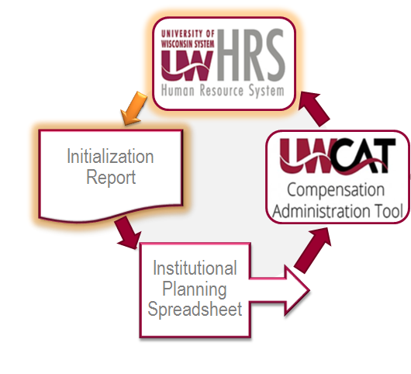
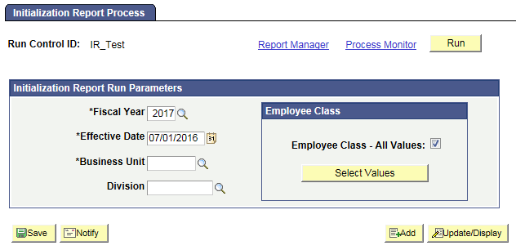
Initialization Report (IR)
The IR allows the user to create a run control, specifying these particular fields:
  Fiscal Year
  Effective Date (ex. 07/01/2016)
  Business Unit
  Division
  Employee Class
Notes:
Effective date: 07/01

Slide 8
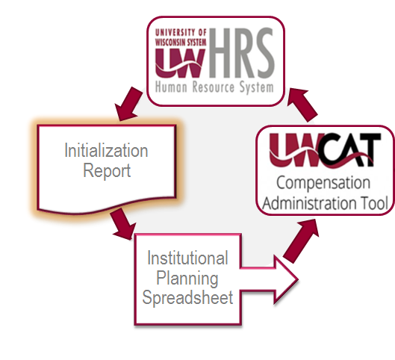
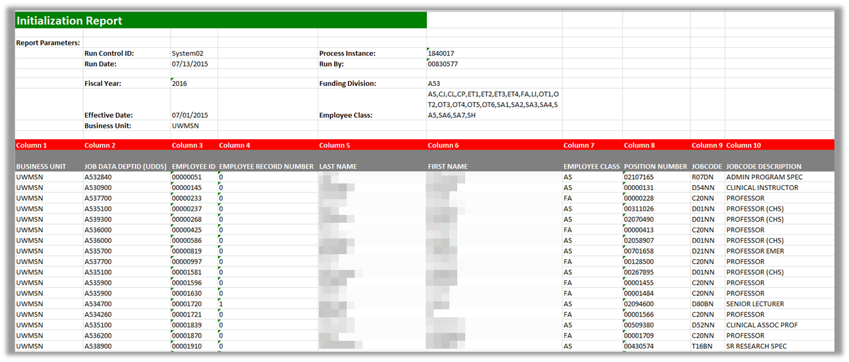
Initialization Report (IR)
When the process is run, it will provide an Excel spreadsheet output file, specifying fields including:
  Business Unit
  Department ID
  Employee ID
  Employee Record Number
There may be two Excel outputs
  One for employees with five or fewer funding splits
  One for employees with more than five funding splits
  Name
  Employee Class
  Etc.

Slide 9
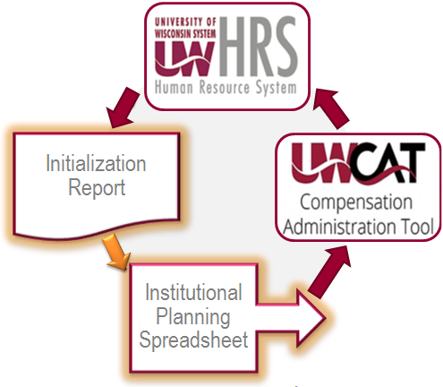
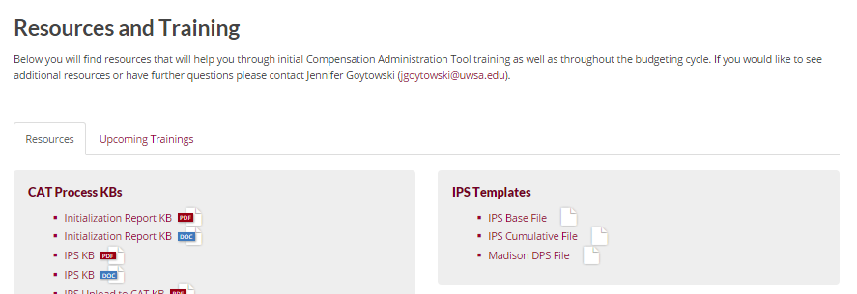

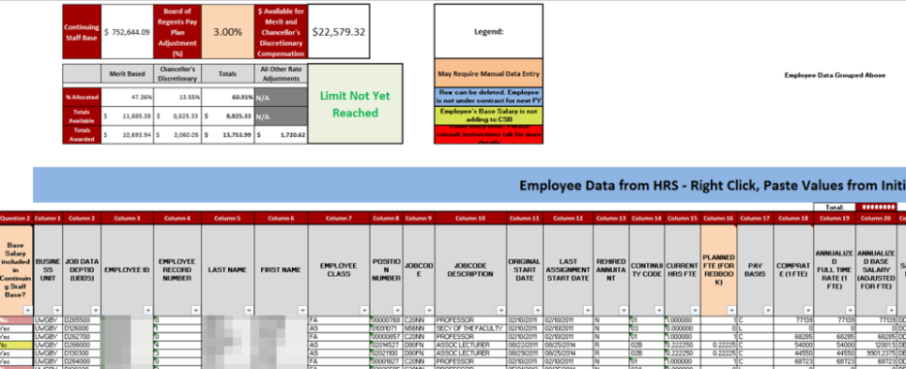
IR to IPS Transfer
This is a manual transfer process between the IR Excel file and the IPS Excel template file.
  This template file can be found on the CAT website.
    www.wisconsin.edu/compensation-administration-tool
  Each institution will choose between the IPS Base template and the IPS Cumulative template depending on their institutional annual setup preferences.

Slide 10
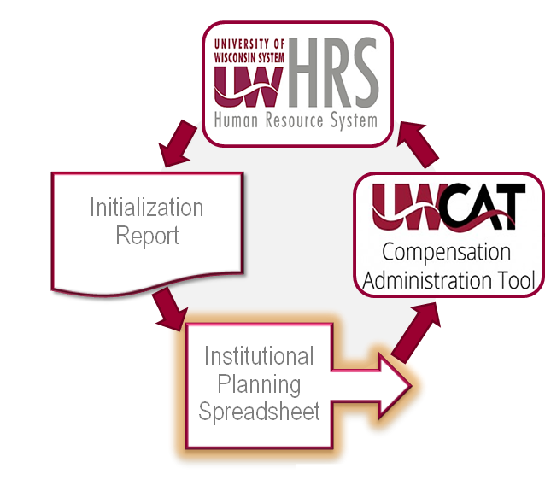

Institutional Planning Spreadsheet (IPS)
The input fields of the IPS are populated manually by copying and pasting from the IR.
Compensation and funding changes can be made en masse and automatically calculated on this sheet for employees with up to five funding splits.

Slide 11
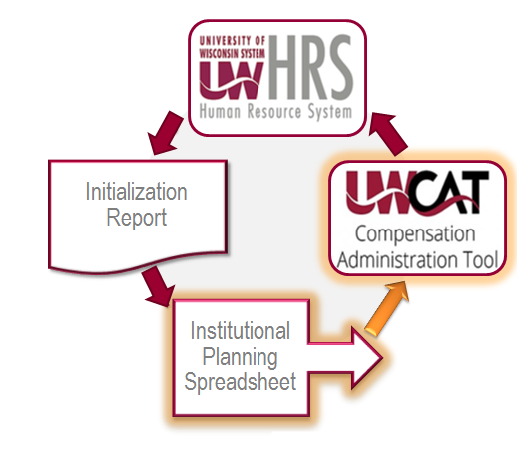
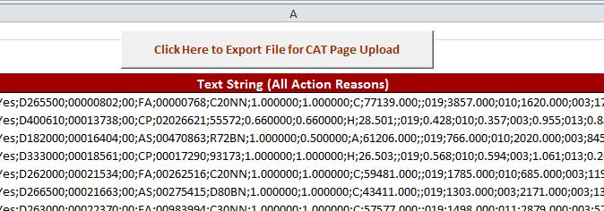
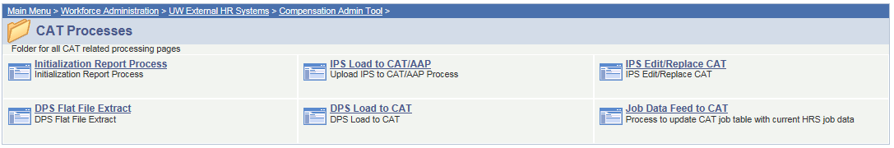
IPS Data Upload to CAT
The rate and funding data in the IPS is then loaded into the Compensation Administration Tool through the IPS to CAT Upload Process.

Slide 12
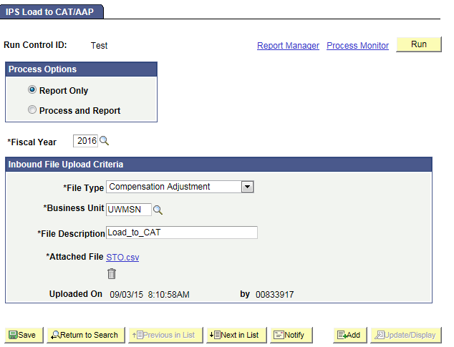
IPS Data Upload to CAT
The rate and funding data in the IPS is then loaded into the Compensation Administration Tool through the IPS to CAT Upload Process.

Slide 13
Training Overview
CAT Functionality
Locating the CAT & IPS Files
The IR to IPS to CAT Process
CAT and AAP
CAT Setup – Lock Users & Data Freeze

Slide 14
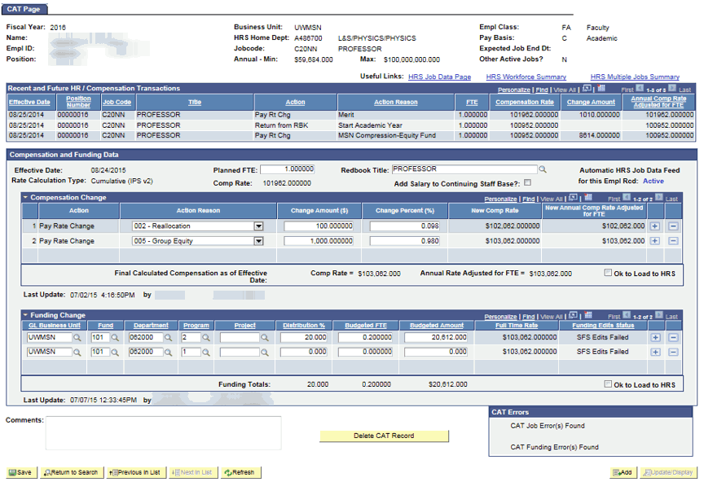
CAT Employee Data Page

Slide 15
Employee Attributes
Pulls key demographics from HRS

Slide 16
Recent and Future HR Transactions
Pulls recent transactions from an employee’s job record in HRS that are relevant to the compensation process

Slide 17
When the Job Data Feed is ON:
Data from HRS is updated nightly and when the employee record page is viewed

Slide 18
Compensation Data
Displays compensation changes which will be added to an employee’s job record
Populates through the IPS upload and manual additions

Slide 19
Funding Data
Displays an employee’s funding splits and distribution percentages
Populates through the IPS upload and manual additions

Slide 20
Funding Edits
Funding splits are validated against SFS Actuals or CAT ledger combo edits
When ‘OK to Load to HRS’ is checked, Actuals edits will be run.
When ‘OK to Load to HRS’ is not checked, an institution can specify whether they would like Actuals or CAT edits to be run.

Slide 21
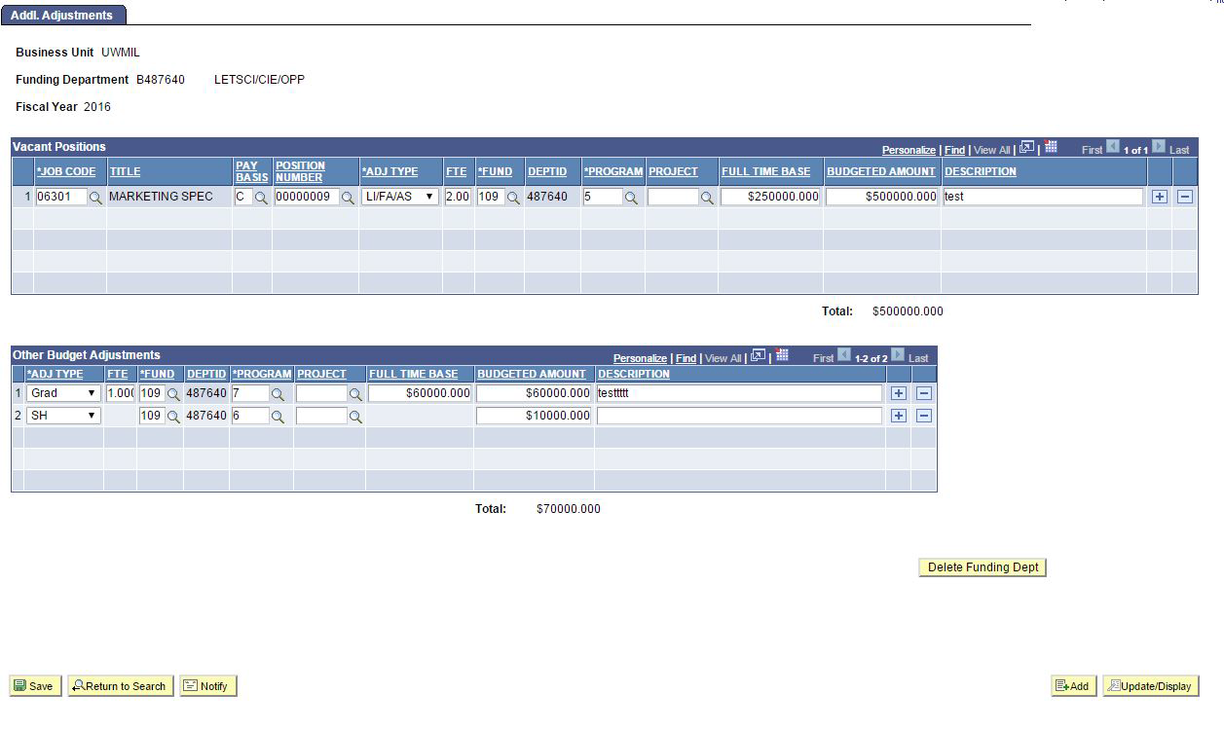
Additional Adjustments Page
Group, Lump, Vacant and Negative position adjustments are made in the AAP by funding department

Slide 22
Additional Adjustments Page
Vacant Positions
Departments can add placeholder positions into their annual budgets
This section will populate through the IPS Upload and new rows can also be added manually

Slide 23
Additional Adjustments Page
Other Budget Adjustments
Other adjustments necessary for budgeting, such as accounting for group, lump sum or negative positions are entered here
This section will populate through the IPS Upload and new rows can also be added manually

Slide 24
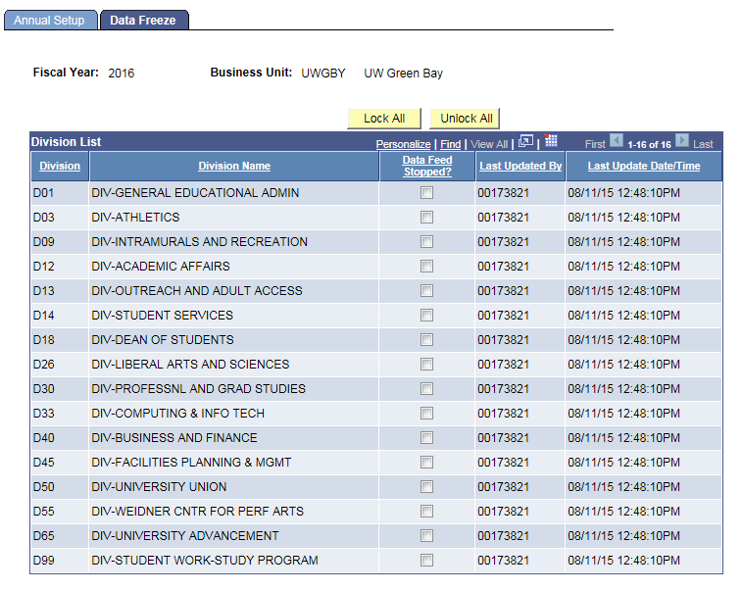
CAT Setup - Data Freezing
When the time comes to perform final reconciliation, each institution will select the time to turn off the automatic job data feed between HRS Job Data and CAT records.
This can be done by division on the Data Freeze tab of the Annual Setup Page in CAT Setup.

Slide 25
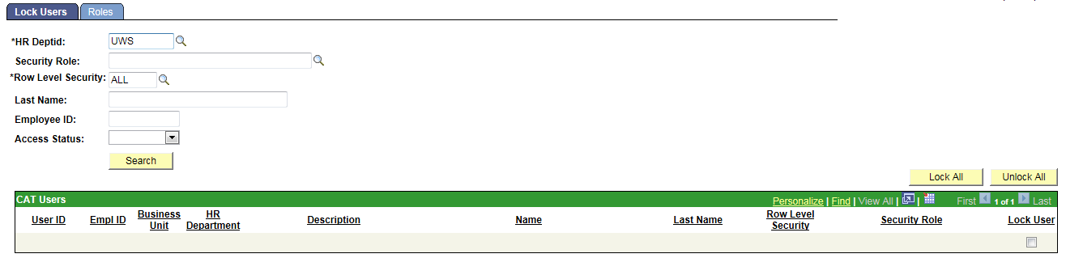
CAT Setup - User Locking
This page is used to ‘lock’ users, especially toward the end of the budgeting cycle.
When a user is locked, their access is switched to View Only. When a user is unlocked, their access corresponds to their given CAT security role.
If a user has the Read Only role, they will remain View Only regardless of if they are locked or unlocked.
At the beginning of each planning year and when a new user is given a CAT security role, the UW System CAT Admin must visit this page and unlock them in order for the new user to be given their full access.

Slide 26
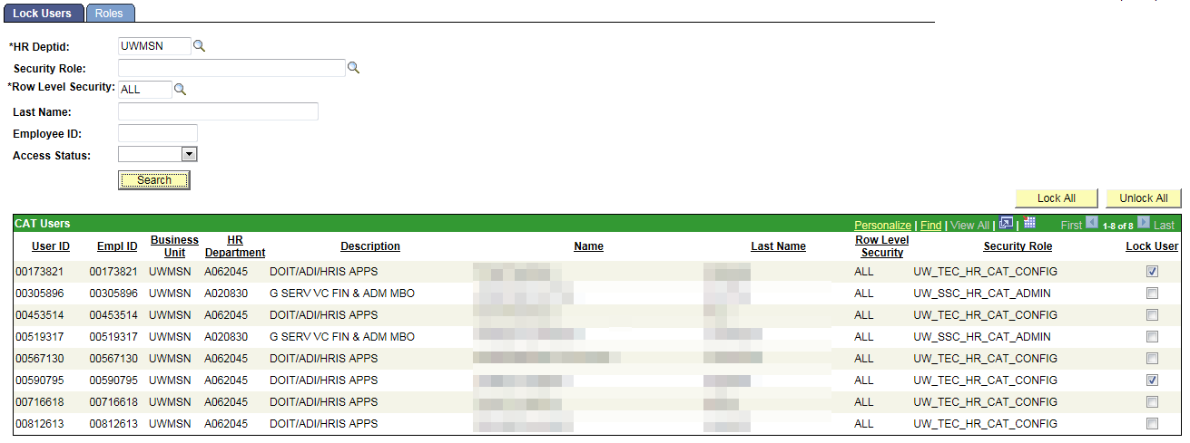
CAT Setup - User Locking
Lock Users: to lock users out of CAT at the end of the budget cycle
Note: an institution can search by Department or Business Unit to find employees
Notes:
Highlight HR dept – how they see their employees

Slide 27
Training Overview
CAT Reporting
Additional Functionality
Training and Support

Slide 28
Reports Inventory
# | Report Name | Description
1 | HRS to CAT Compare | Identifies employee records where key fields differ between the CAT and HRS. Identifies employee records where key fields differ between the CAT and HRS. Key Fields that may differ if feed is on or off: Position Number, Terminations, New Hires Key Fields that may differ only if feed is off: Empl Class, Pay Basis, Department, Job Code, Title, FTE, EJED, Comprate.
2 | HRS Change Report | This report identifies employee records that exist in the CAT and have undergone a change in HRS. A change is defined as an update to the fields Business Unit, Department, FTE, Pay Basis, Title, EJED, Comprate, or Position Number or Leave Status. This report also pulls Terminations, Transfers, or New Hires, though this report is not the main mechanism to catch and correct those changes.
3 | Record Error Report | This report displays all records in the CAT that have generated any sort of (job-level) error based on the edits that have been set up in the CAT. A full list of errors is available in the functional design, and will be included in the KB/training. Job Level Errors (ex: no funding set up) Funding Edit Errors (ex: did not pass SFS edits) Compensation Errors (ex: duplicate action reasons entered in the CAT) Funding Section Errors (ex: distribution % do not add to 100%)
4 | Min/Max Report | Displays records where the individual's or vacant position's future budget salary exceeds or is below the rate for that title in HRS.
5 | Position Report | This report is a pull of all data points on all positions (CAT Records) and Vacant/Bud Adjustment rows (Additional Adjustments Page records) based on selected run control criteria. This will replace the "2A or Budget Position" report out of 3270.
6 | Missing from CAT Report | This report displays employees who exist in HRS, but do not exist in the CAT.
7 | CAT Audit Log | Displays which userids have added, deleted or edited particular CAT/ AAP records.

Slide 29
When to Run Which Report: Automatic HRS Feed is ON vs. OFF
Comp Admin Cycle Start
Comp Admin Cycle End
Feed ON
Feed OFF
Hire/Term/Transfer changes
Job attribute changes
All Job changes
Job changes in HRS
HRS to CAT Compare Report
HRS Change Report
HRS to CAT Compare Report
Errors in the CAT
CAT Record Errors Report
CAT Over Max Under Min Report
Monitoring
CAT Position Report
Missing from CAT Report
CAT Audit Log

Slide 30
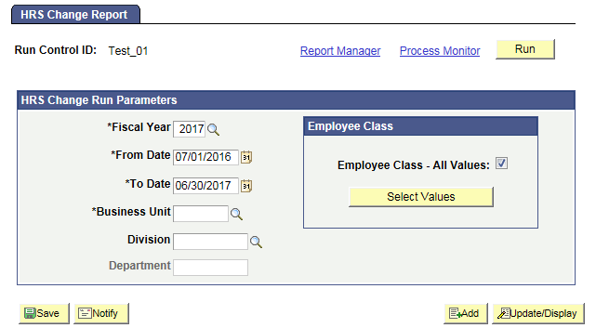
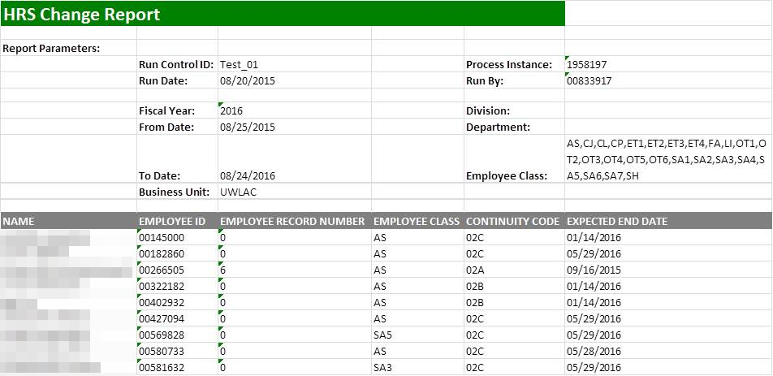
HRS Change Report
Identifies employee records that exist in the CAT and have undergone a change in HRS: an update to the fields Business Unit, HR Department, Position Number, Jobcode, Pay Basis, Title, FTE, Payroll Status, or Comprate, as well as Hires, Rehires, Transfers, or Terminations
Allows users to review the records on this report and determine if the compensation changes entered in the CAT are still accurate, if a new record in the CAT needs to be created, or if a CAT record needs to be deleted
Job Changes in HRS

Slide 31
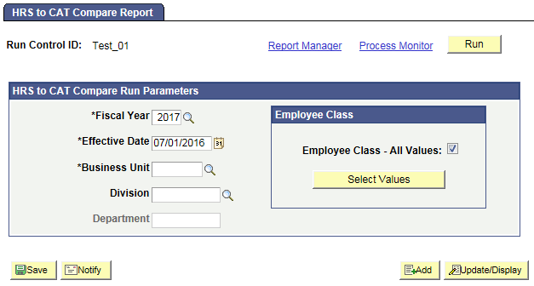
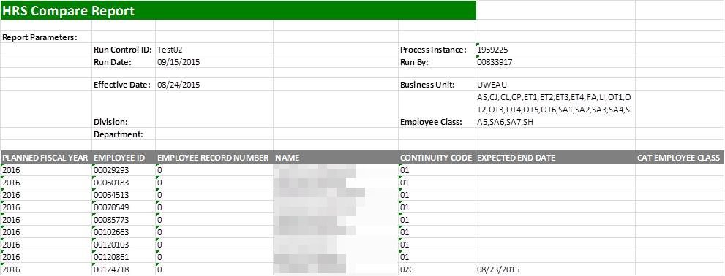
HRS to CAT Compare Report
Identifies employee records where key fields differ between the CAT and HRS
Catches things like: Business Unit/Department updates, Position Number updates, Compensation Rate updates, Empl Class updates, Title updates, Job Code updates, FTE updates, and Terminations
Allows the user to review discrepancies for that employee record in the CAT and determine if the rate increases need to be altered based on the new job data information that was entered in HRS
Job Changes in HRS

Slide 32
Action Needed by Report: Automatic HRS Feed is ON
Action May Be Needed
Job Change in HRS Occurred
Action Needed
Title Change
Review and Potentially Edit Comp Increases
Action May Be Needed
Action Needed
New Hire
Potentially Add to CAT
Employee Terminated
Delete from CAT
Action Needed
Transfer/Position # Change
Delete and Re-Add to CAT
Comprate Change
Review and Potentially Edit Comp Increases
Action May Be Needed
Action May Be Needed
FTE, EJED Change
Potentially Edit Planned FTE or Remove from CAT
CAT Report to Run
HRS to CAT Compare Report
HRS Change Report
Notes:
Use this content on individual reports (delete these slides)

Slide 33
Action Needed by Report: Automatic HRS Feed is OFF
Job Change in HRS Occurred
Action Needed
Employee Terminated
Delete from CAT
Title Change
Review and Potentially Edit Comp Increases
Action Needed
Action May Be Needed
Action May Be Needed
Action Needed
Comprate Change
Review and Potentially Edit Comp Increases
Transfer/Position # Change
Delete and Re-Add to CAT
Action May Be Needed
New Hire
Potentially Add to CAT
FTE, EJED Change
Potentially Edit Planned FTE or Remove from CAT
Action May Be Needed
CAT Report to Run
HRS to CAT Compare Report

Slide 34
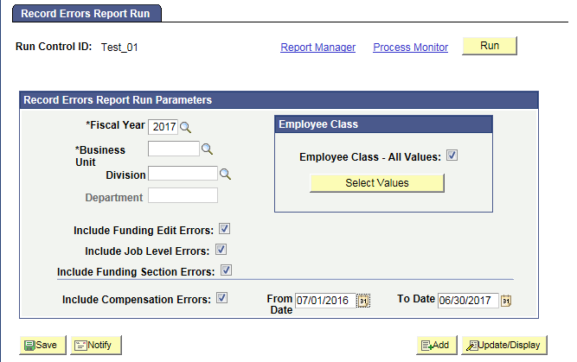
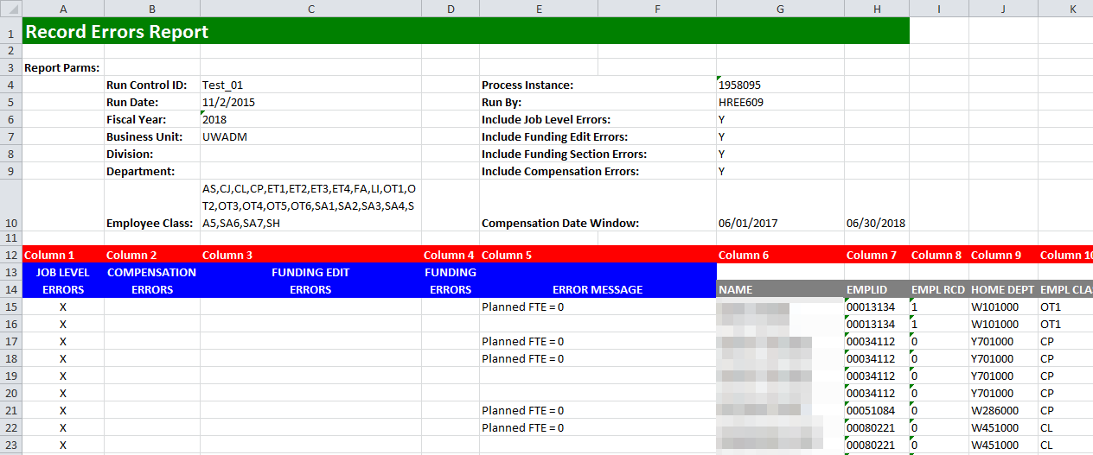
Record Errors Report
Displays all records in the budget that have generated any sort of employee-level error based on the edits set up in the CAT
Contains all Job Level Errors, Compensation Change Errors, Funding Edit Errors (SFS Actuals, CAT ledger errors) and Funding Section Errors (distribution % errors)
Allows users of the CAT to be able to quickly identify any empl record with an error on a single consolidated report
Will be run frequently throughout the budgeting cycle and errors must be resolved before the cycle ends
Errors in CAT

Slide 35
Action Needed by Report: Automatic HRS Feed is ON or OFF
CAT Error Identified
Action Needed
Compensation Errors
Job Level Errors
Funding Section Errors
Duplicate Action Reason in HRS & CAT
Planned FTE = 0
No funding information entered in the CAT
Duplicate Action Reason in CAT
Planned FTE > 1 on multiple Empl Records
Funding distribution is greater than 100%
Decimal amount entered in Comprate for salaried employees
Sum of individual Budgeted FTEs do not equal Total Planned FTE
Sum of individual Budgeted Amounts does not equal Original Comp Amount Adj for FTE
$0 Comprate Entered
Funding Edit Errors
On an individual funding split, Distrib %, Budgeted FTE, or Budgeted Amount = 0
Funding string failed SFS Actual or SFS Budget Edits
CAT Report to Run
Record Errors Report

Slide 36
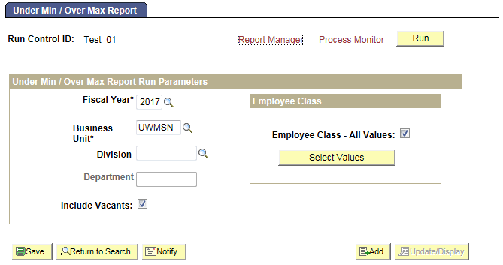
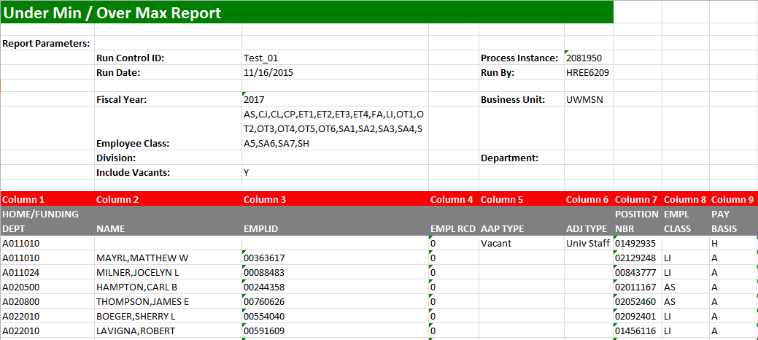
Under Min / Over Max Report
Displays employee records where an individual's (or vacant’s) updated compensation rate is above or below the range for that title in HRS
Pulls title min/maxes from HRS as of the beginning of the next fiscal year
Allows users to see which employee records have an over max/under min error so they can update the appropriate comp adjustments in the CAT to be within the salary range
Errors in CAT

Slide 37
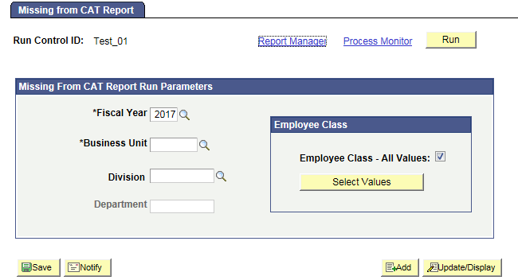
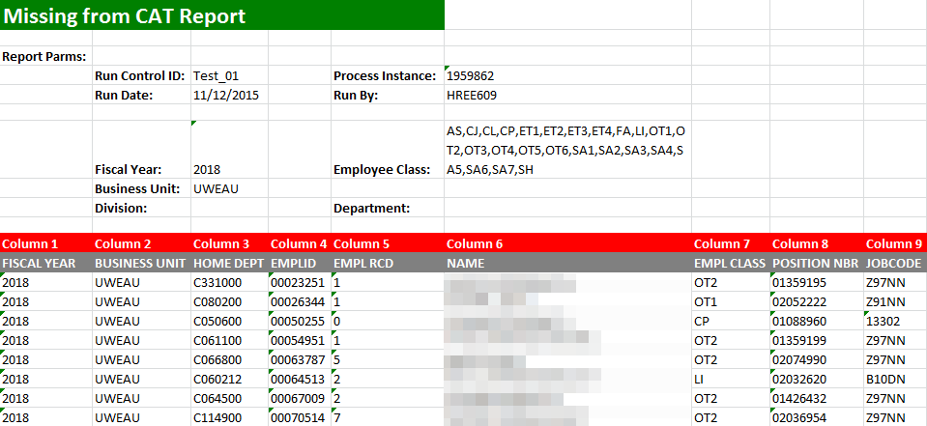
Missing From CAT Report
Displays employees who exist in HRS, but do not exist in CAT
Catches employees that may have been hired after the Initialization Report (IR) was run, or before the first of the next fiscal year, and employee records excluded while working in the IR or Institutional Planning Spreadsheet (IPS)
Should be run regularly, starting after the IPS is loaded into the CAT
Monitoring

Slide 38
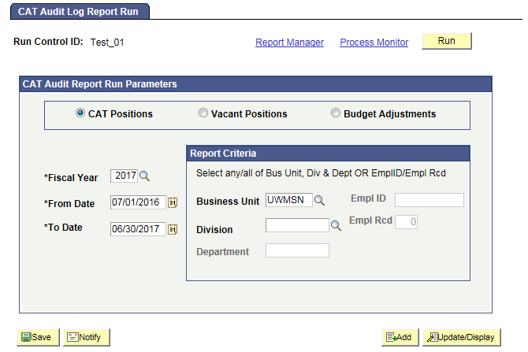
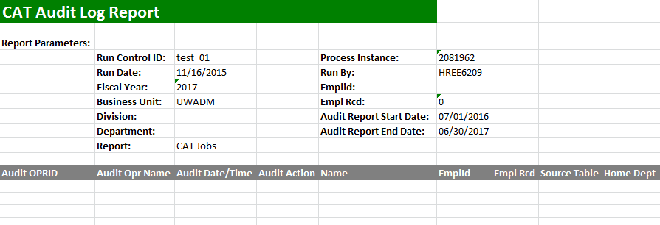
Audit Log Report
Displays which users have edited and saved particular CAT, Vacant Position and Budget Adjustment records
Pulls records separately from the Audit Log tables for CAT, Vacant Positions and Budget Adjustments, and can generate three unique reports
Allows users of the CAT to view if other users have changed the information on a shared employee so they can communicate with other users to determine if the compensation increases and funding entered in the CAT is correct
Monitoring

Slide 39
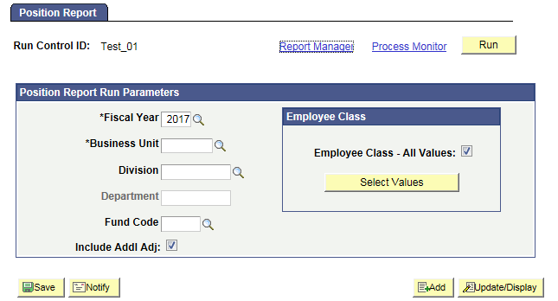
Position Report
Pulls key information on all Positions (CAT Records) and Vacant/Other Bud Adjustment rows (Additional Adjustments Page records) based on selected run control criteria
Allows users of CAT to view all records that exist in the CAT and the AAP and see a complete picture of their budgeted salary. They may also distribute it to other users who may not have access to the CAT/AAP, but need to see the data that it houses
Monitoring

Slide 40
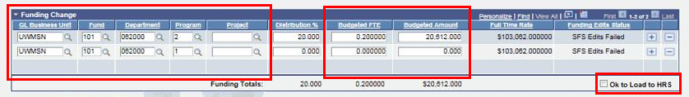
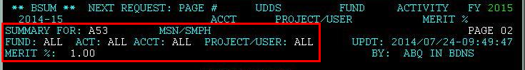
BSUM
Data will be read instantly from the CAT and populate the appropriate fields on the remaining pages of 2, 3, 5, 6, 26, and 27 of BSUM.
Any employee class (including Student Help and LTE) is allowed to be loaded to or entered in the CAT Page, and consequently be included in FTE calculation in BSUM.
Users will now make all changes in CAT that were previously done in BDGT, BADJR and BRATE.
Users will refer to BSUM for reporting purposes to gather salary, budget, and allocation totals.

Slide 41
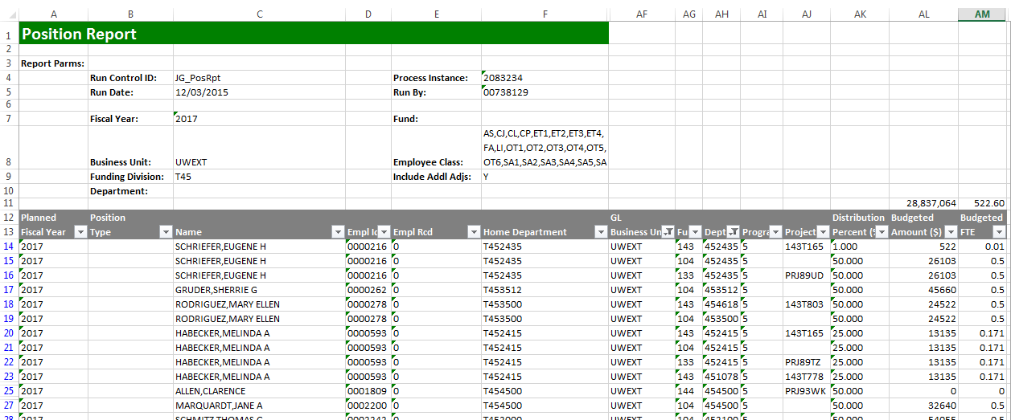
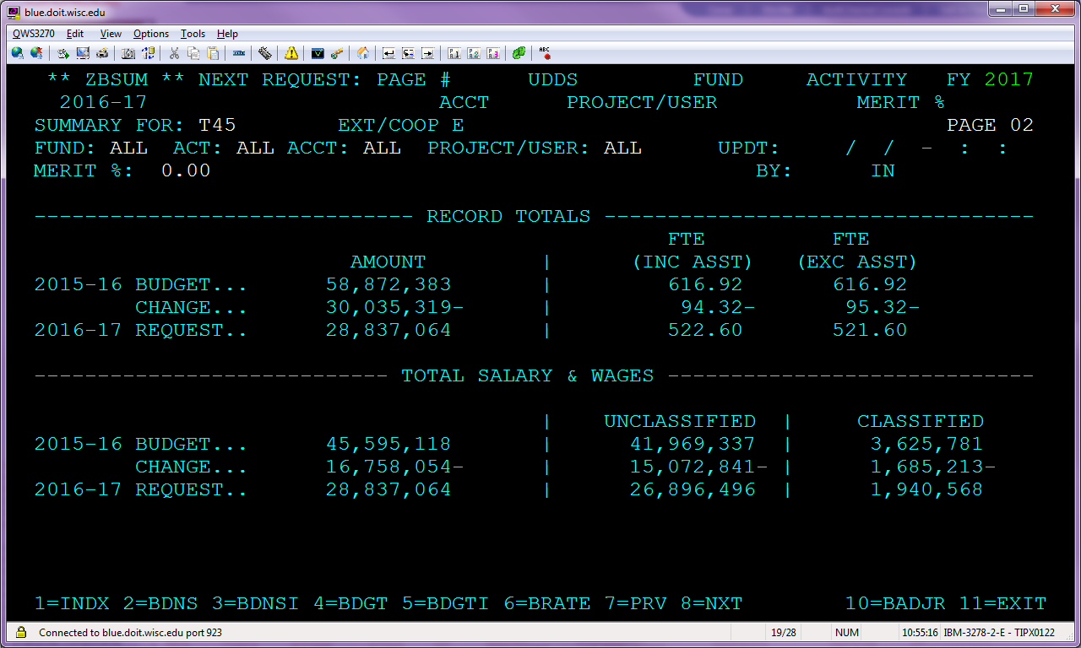
Tying Out the Position Report to BSUM

Slide 42
Training Overview
CAT Reporting
Additional Functionality
Training and Support

Slide 43

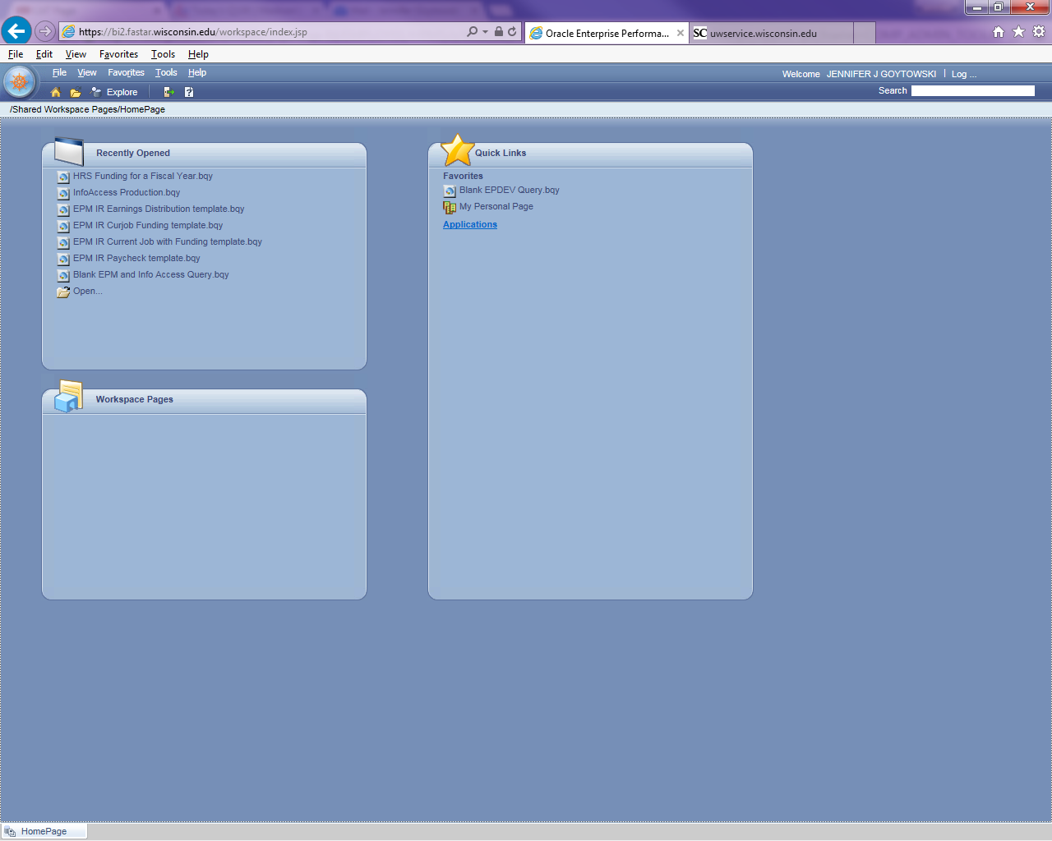
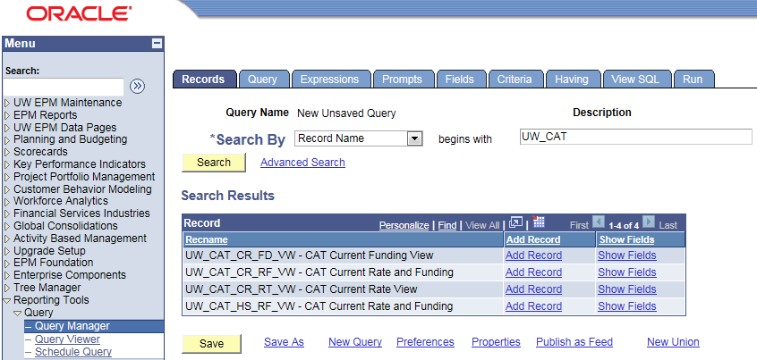
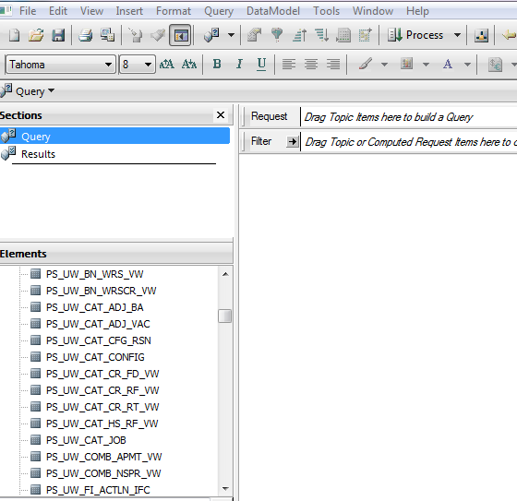
EPM and Interactive Reporting
Overnight data transfer
Views available in Interactive Reporting
  There are two options to access EPM queries:
    Web client: https://bi2.fastar.wisconsin.edu/workspace/index.jsp
    Studio client: found on your desktop

Slide 44
EPM Views – CAT and AAP Combined
Current CAT All Rate and Funding View: (PS_UW_CAT_CA_RF_VW) This view contains all employee job, compensation, and funding data from the CAT Page and AAP stored within the EPM tables for the current fiscal year.
Current CAT All Funding View: (PS_UW_CAT_CA_FD_VW) This view contains all employee job and funding data from the CAT Page and AAP stored within the EPM tables for the current fiscal year.
Historical CAT All Rate and Funding View: (PS_UW_CAT_HA_RF_VW) The view contains all employee job, compensation, and funding data from the CAT Page and AAP stored within the EPM tables for all prior fiscal years.

Slide 45
EPM Views – CAT and AAP Separate
Current CAT Rate and Funding View: (PS_UW_CAT_CR_RF_VW) This view contains all employee job, compensation, and funding data from the CAT Page stored within the CAT EPM tables for the current fiscal year.
Current CAT Funding View: (PS_UW_CAT_CR_FD_VW) This view contains all employee job and funding data from the CAT Page stored within the CAT EPM tables for the current fiscal year.
Current CAT Rate View: (PS_UW_CAT_CR_RT_VW) This view contains all employee job and compensation data from the CAT Page stored within the CAT EPM tables for the current fiscal year.
Historical CAT Rate and Funding View: (PS_UW_CAT_HS_RF_VW) The view contains all employee job, compensation, and funding data from the CAT Page stored within the CAT EPM tables for all prior fiscal years.
AAP Vacant Positions View: (PS_UW_CAT_ADJ_VAC) This view contains all vacant position data from the AAP for the current and all prior fiscal years.
AAP Other Budget Adjustments View: (PS_UW_CAT_ADJ_BA) This view contains all other budget adjustment data from the AAP for the current and all prior fiscal years.

Slide 46
Training Overview
CAT Reporting
Additional Functionality
Resources and Support

Slide 47
CAT Resources and Links
Compensation Administration Tool Website
  https://www.wisconsin.edu/compensation-administration-tool/
  Resources Include:
  CAT Process KB Documents
  CAT Reporting KB Documents
  Demonstration Videos
  Training Session Materials
  Business Process Resources
  UAT Scripts & Workbooks
  CAT User Guides
  Error Message Database

Slide 48

Support
Refer directly to your institutional liaison for information on training and business process
All other functional and technical questions can be routed to catquestions@uwsa.edu

Slide 49
Questions?

