Slide 1
Early Math Placement Tool (EMPT): Preparing Students for College-Level Mathematics
Mark Schroeder, M.S.
Sonya K. Sedivy, Ph.D.

Slide 2
Early Math Placement Tool: What it is
University of Wisconsin System
Wisconsin Technical Colleges
WI
DPI
Notes:
* The EMPT is a free, statewide program sponsored by the University of Wisconsin System, the Wisconsin Technical Colleges, and the Department of Public Instruction.

Slide 3
Early Math Placement Tool: What it is
Two Versions:
Paper and Pencil
Online
Two Forms:
Form A
Form B

Slide 4
Early Math Placement Tool: What it is
Evaluation of students’ readiness to transition to college-level math
Online guide for the math requirements of all public universities and technical colleges in WI

Slide 5
Early Math Placement Tool: What it is not
Not intended to assess individual teachers or the quality of a mathematics curriculum
Results are for teachers only, not administrators, school boards, or district coordinators

Slide 6
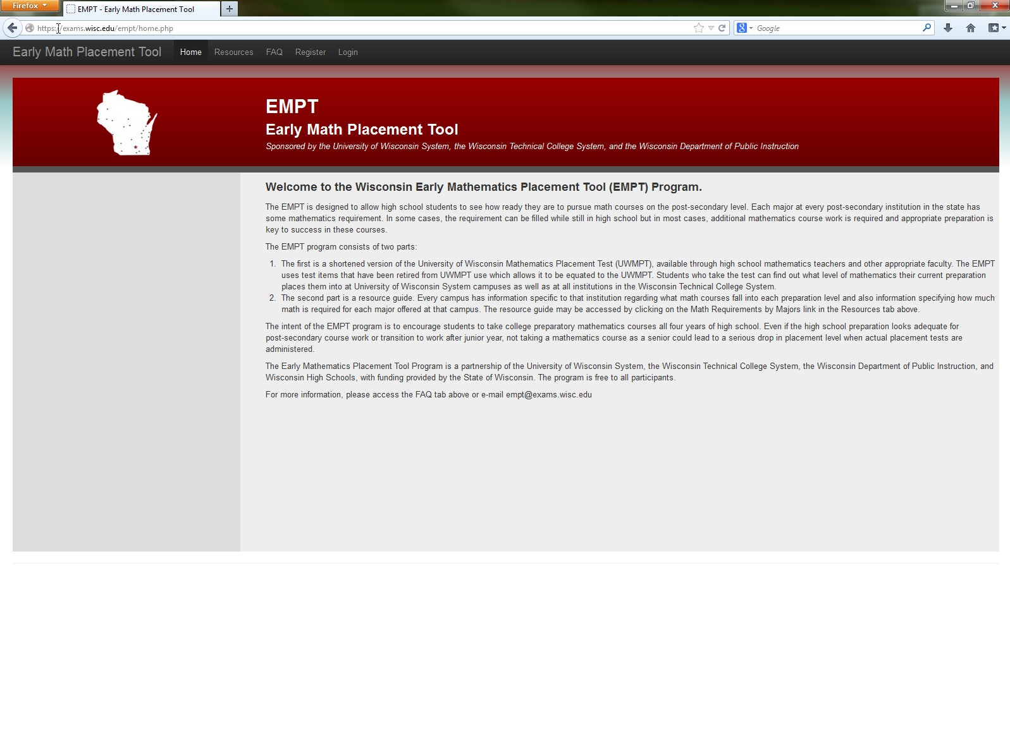
EMPT Web Page

Slide 7
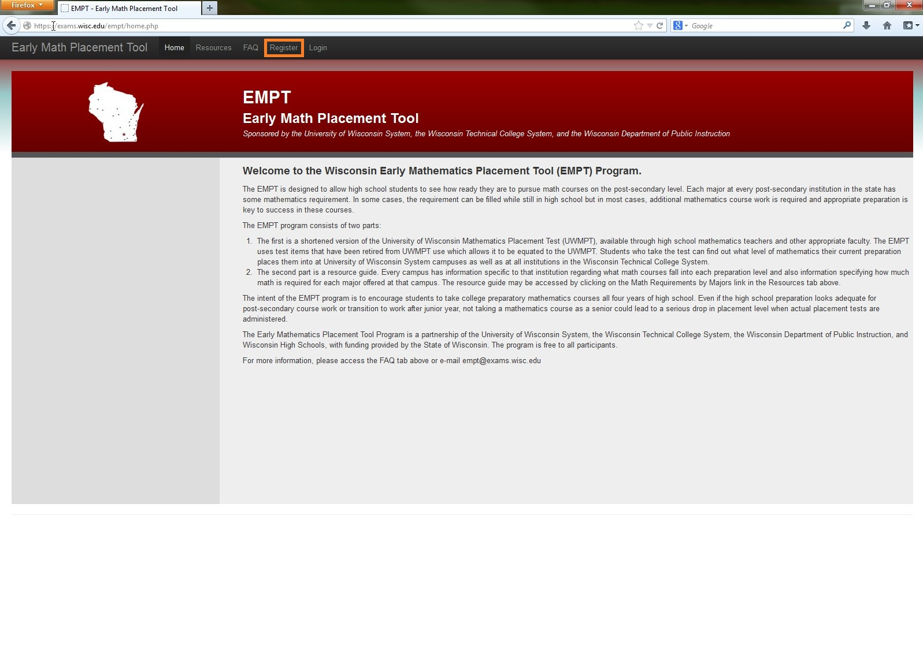

Slide 8
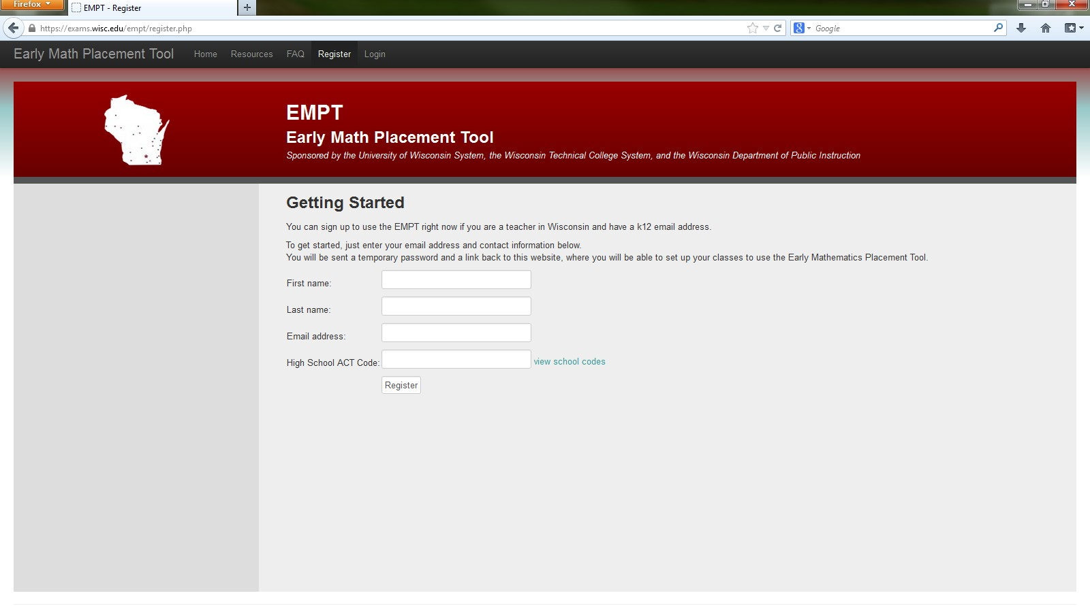
Enter required information
Notes:
This brings you to the registration page……where you just enter the required details and our system confirms your registration with an email.

Slide 9
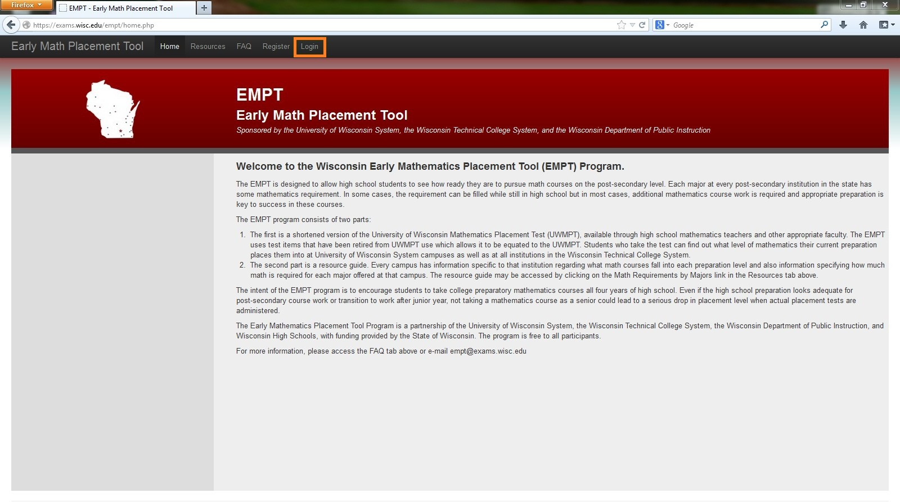
Teacher Login
Notes:
To access the features you need to login from the main page…

Slide 10
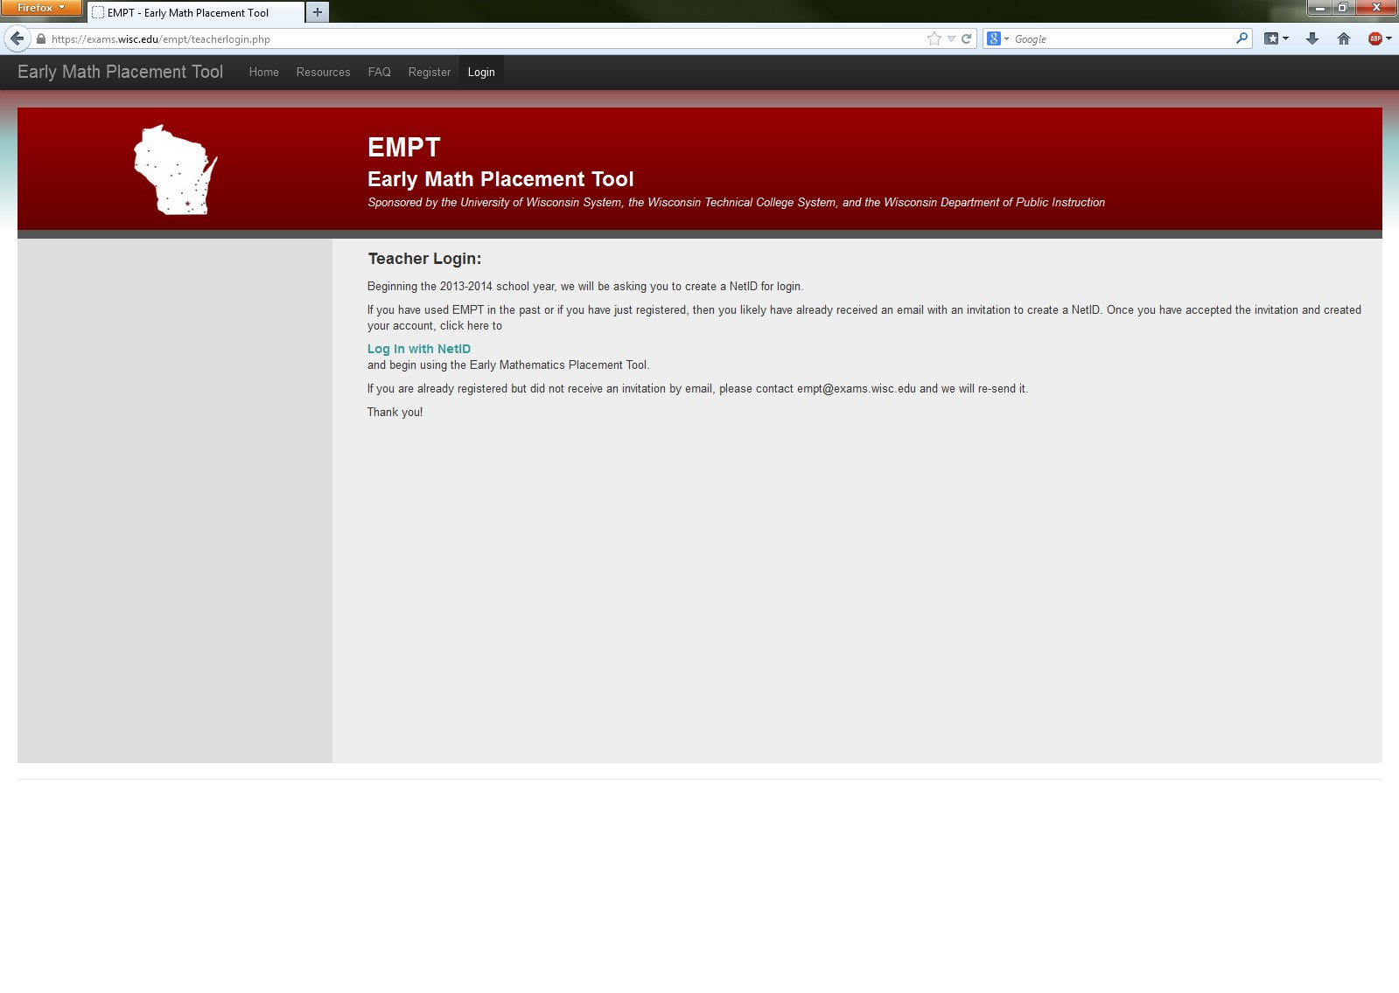
Teacher Login

Slide 11
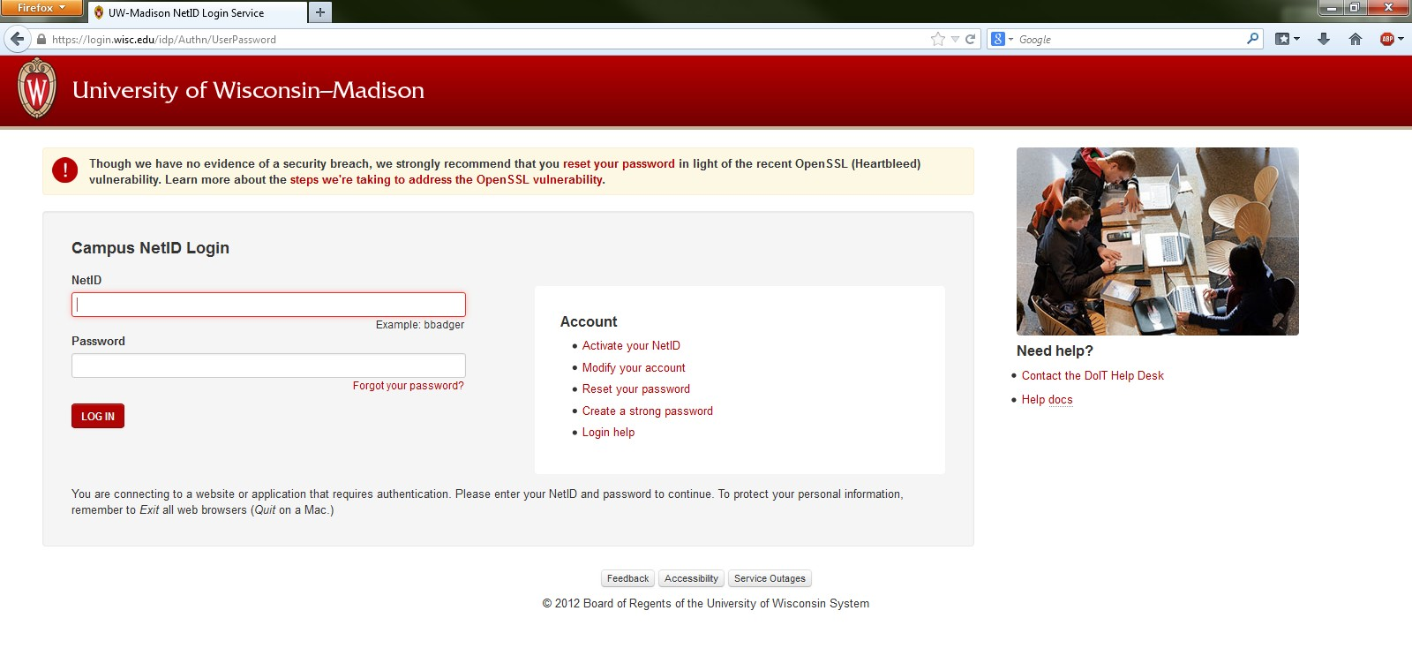
Teacher Login

Slide 12
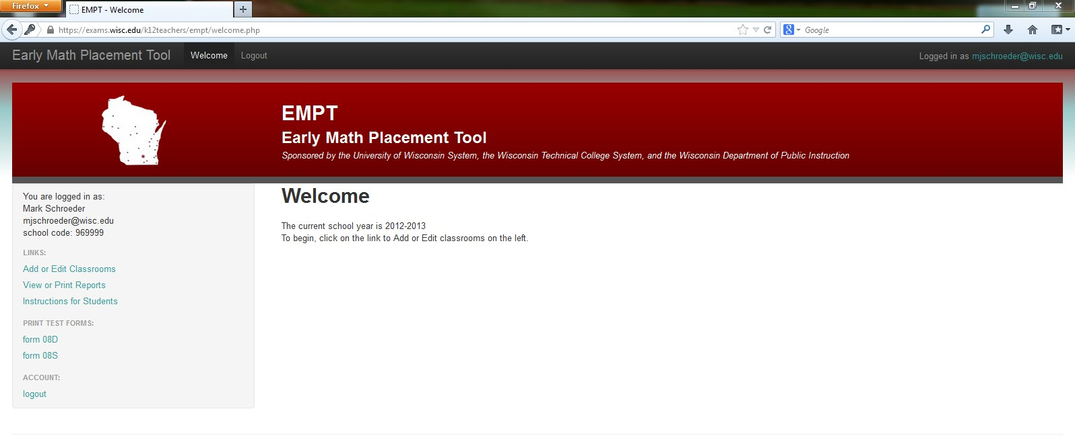
Next, register a class
Notes:
After you have logged in, you can access the reports and features made available.

Slide 13
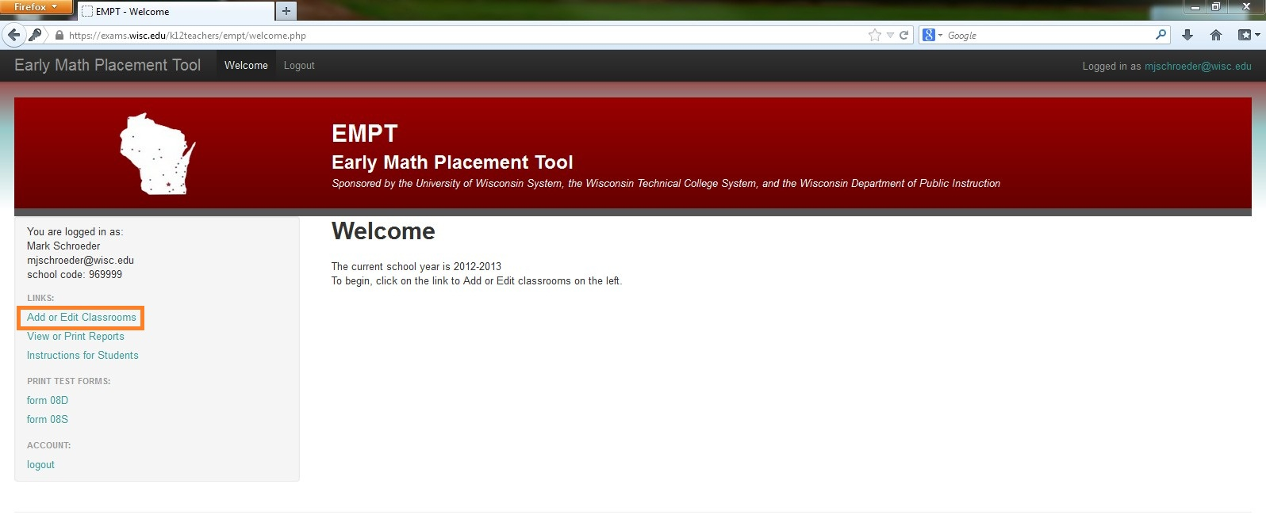
Next, register a class
Notes:
To add a classroom, click on the “add or edit classrooms” here on the left sidebar.

Slide 14
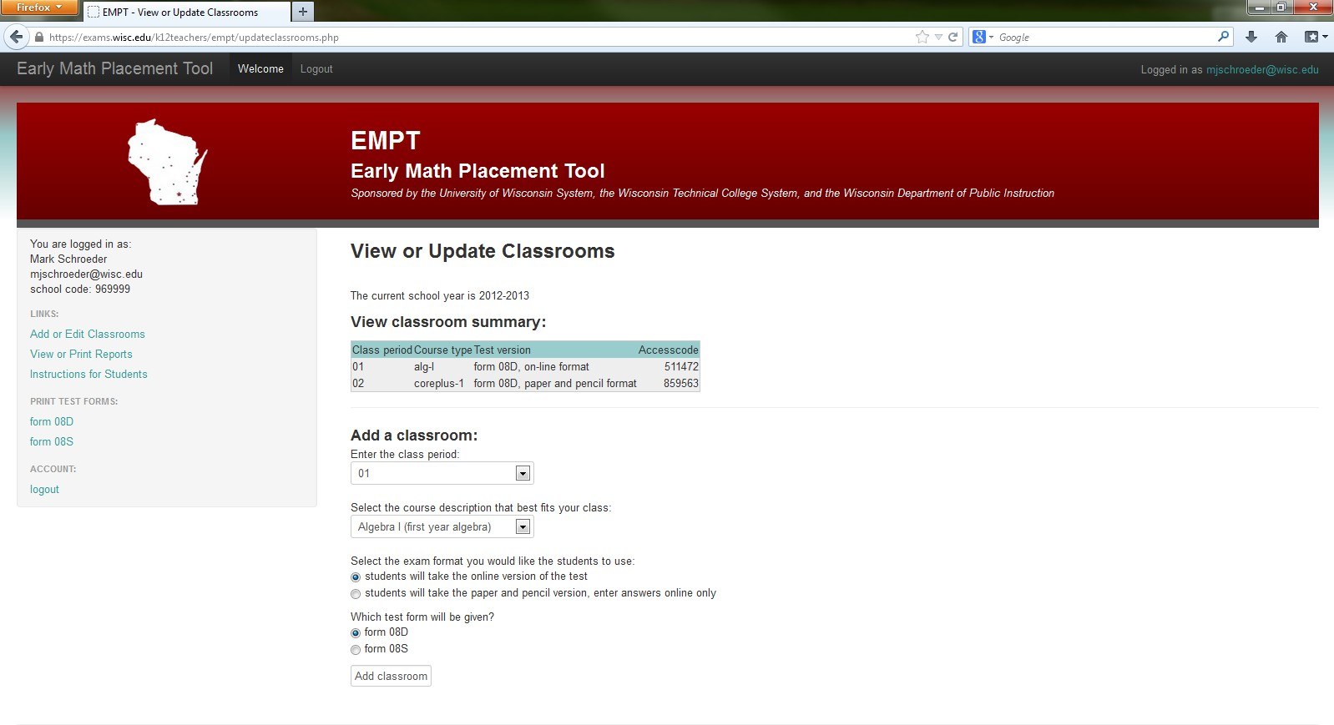
Next, register a class
Notes:
This brings you to your summary page which lists all the classes you have and the number of students tested. To add a class…

Slide 15
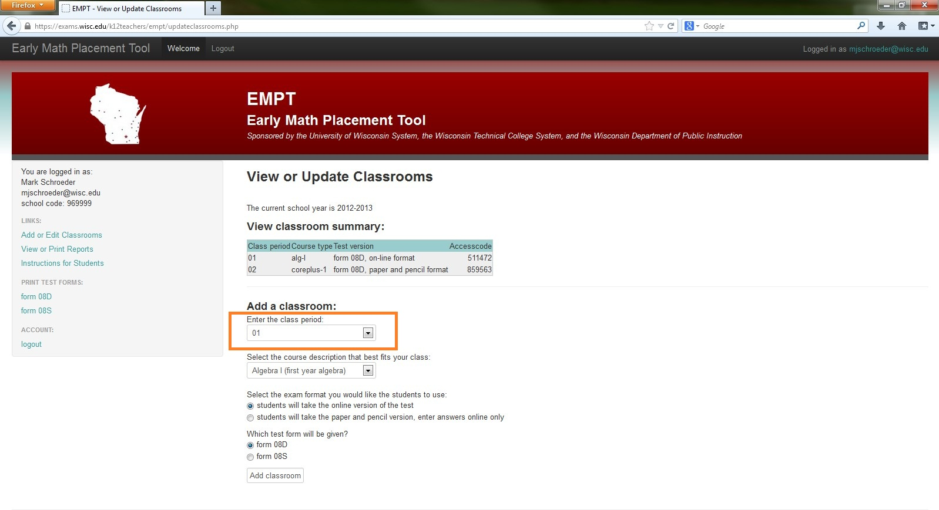
Next, register a class
Notes:
Select the period and …

Slide 16
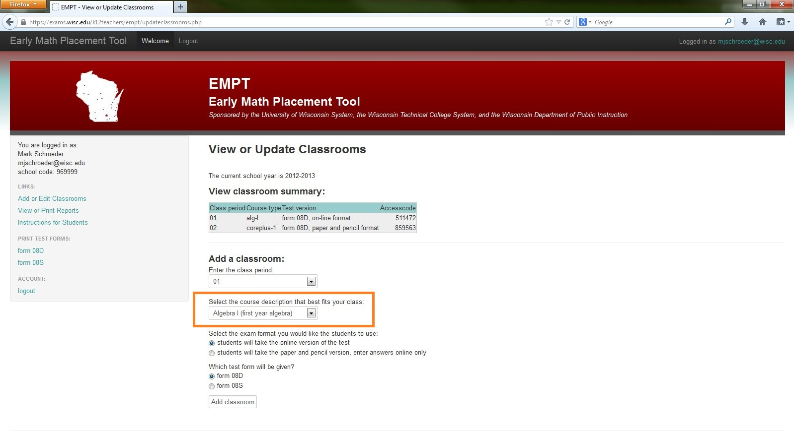
Next, register a class
Notes:
…then type of curriculum you are using for that period.

Slide 17
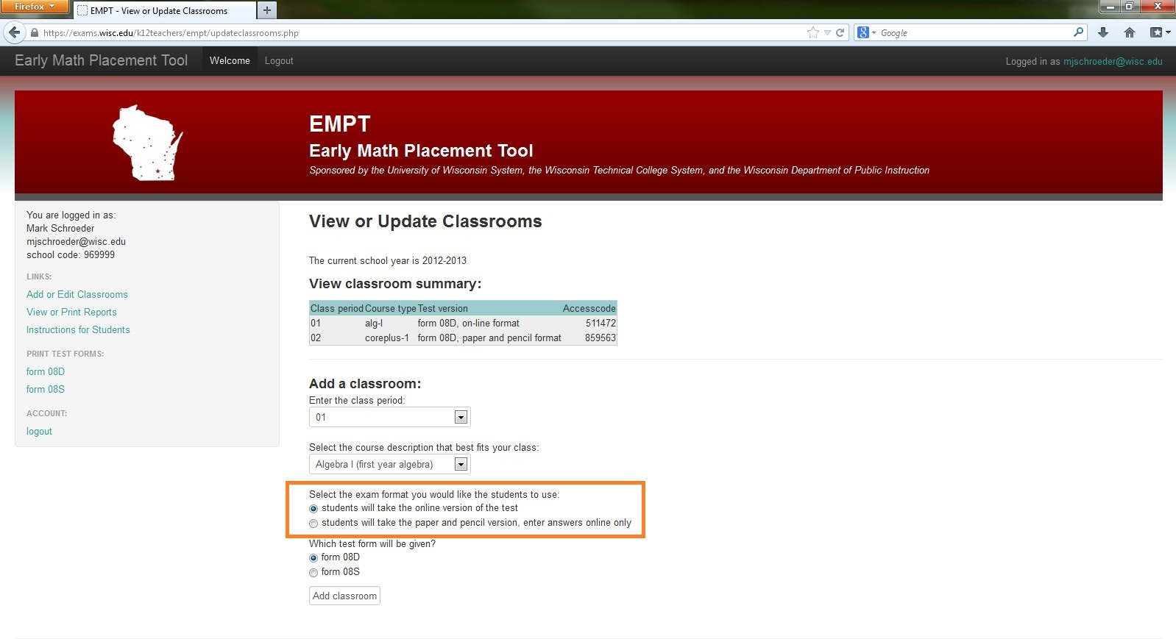
Next, register a class
Notes:
You then need to choose the format…

Slide 18
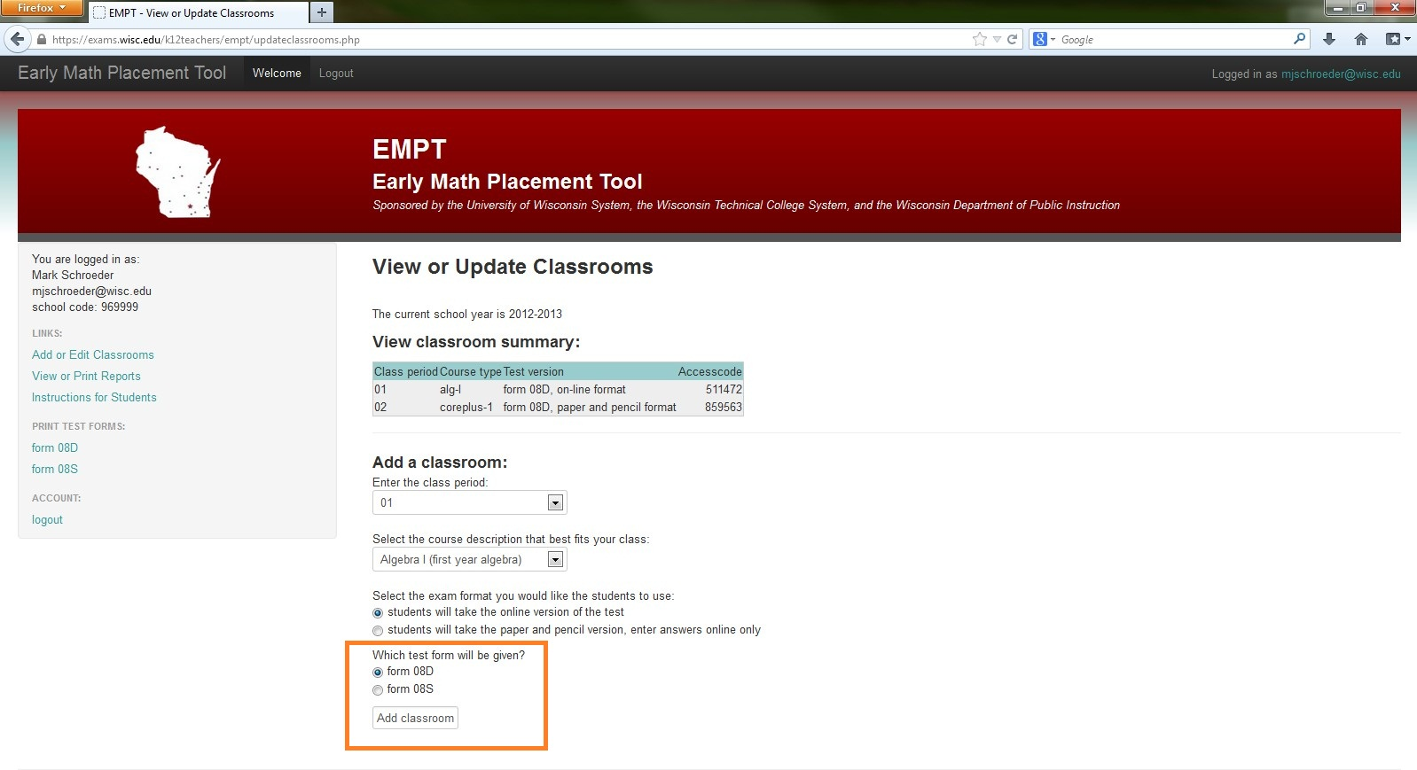
Next, register a class
Notes:
…and version.

Slide 19
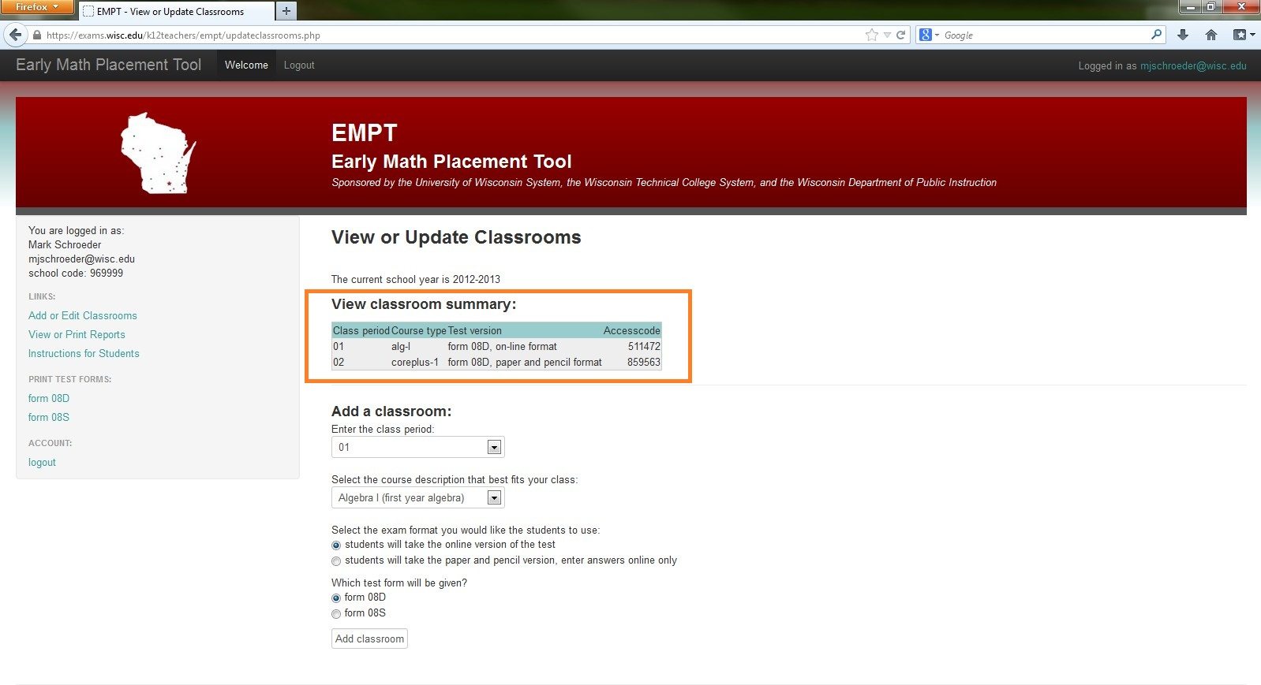
Next, register a class
Notes:
After your class is registered it will appear here in your classroom summary.

Slide 20
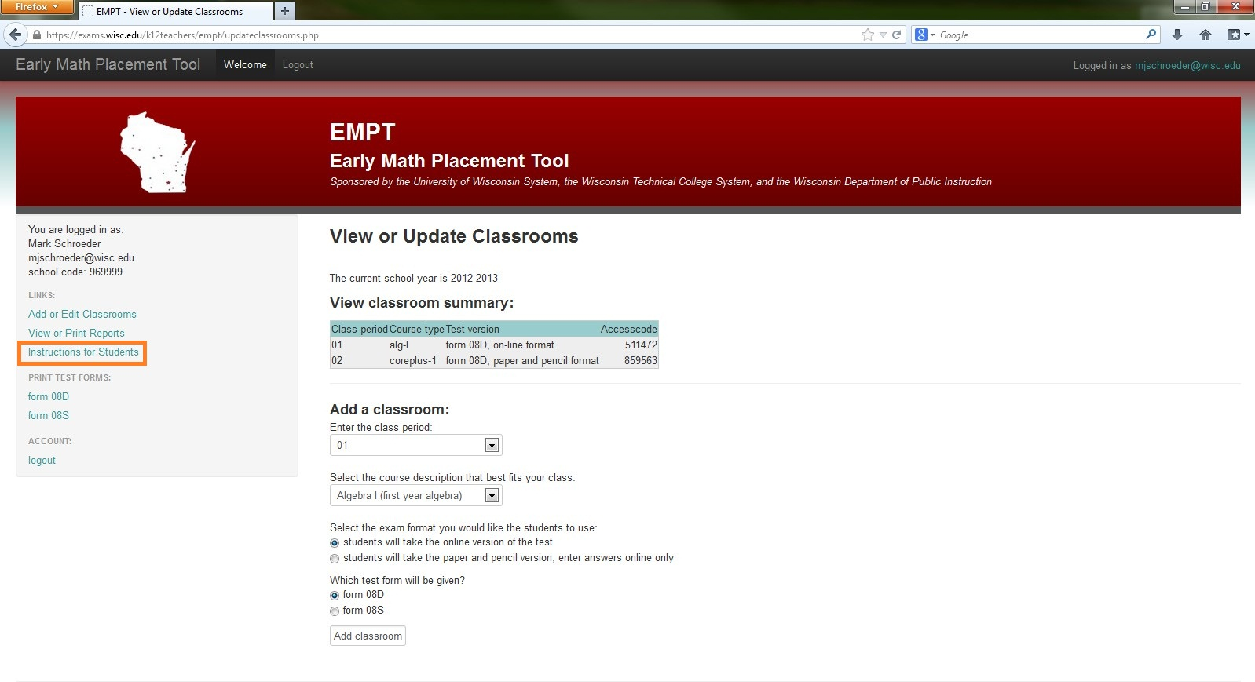
Student instructions
Notes:
So, now you’ve registered your classes. The information for students is located here…

Slide 21
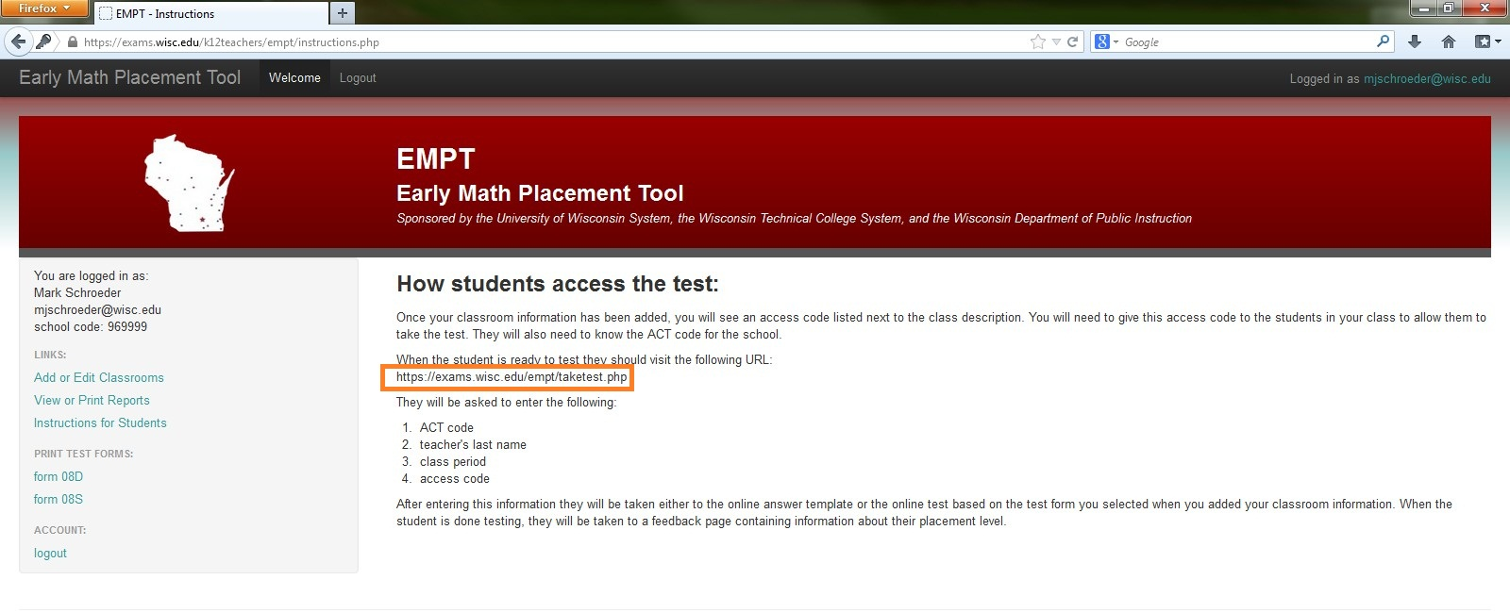
Student instructions
Notes:
Just give this address to students. If you forget the address, you can always click the “Instructions for students” on the left sidebar after you login.

Slide 22
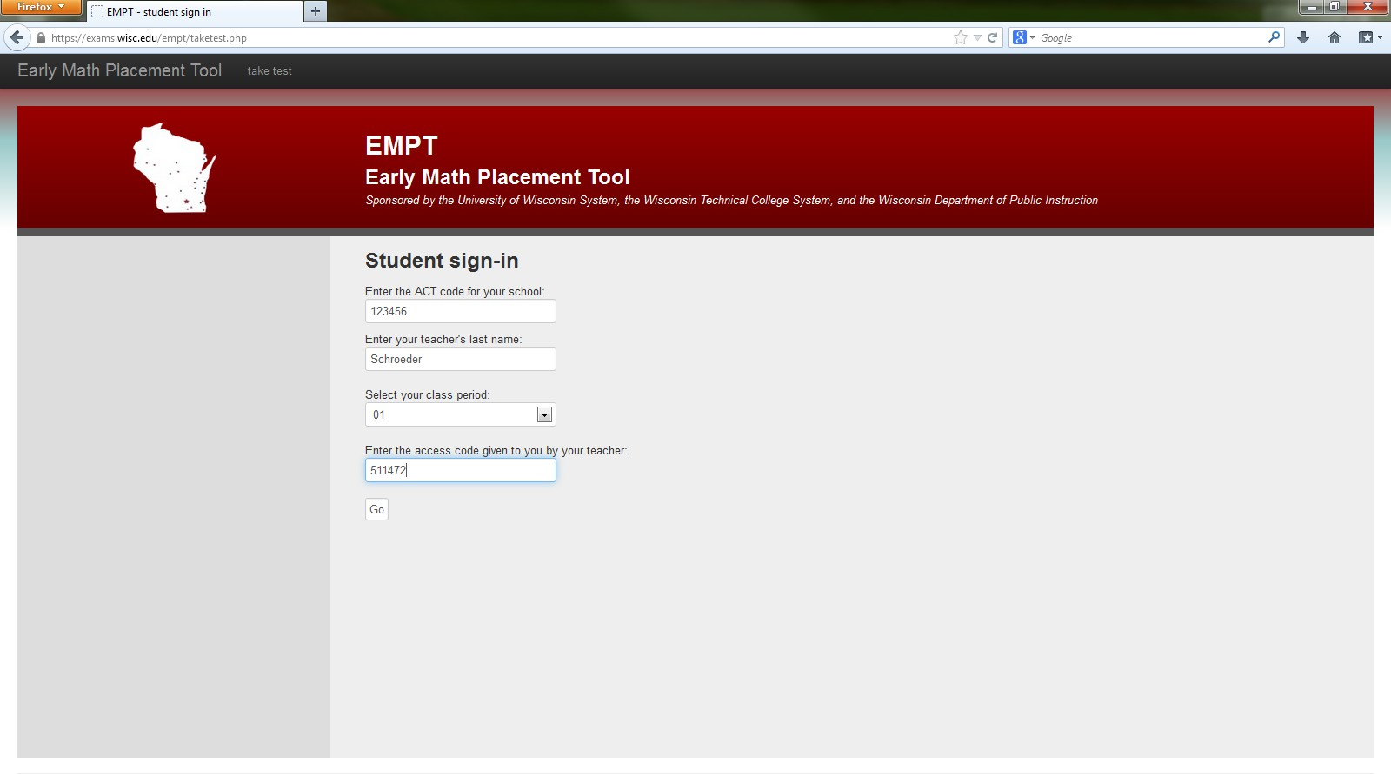
Student login
Notes:
Here is the student page. To begin, students enter your school’s ACT code, their teacher’s last name, class period, and the access code you gave them. The access code is located here…

Slide 23
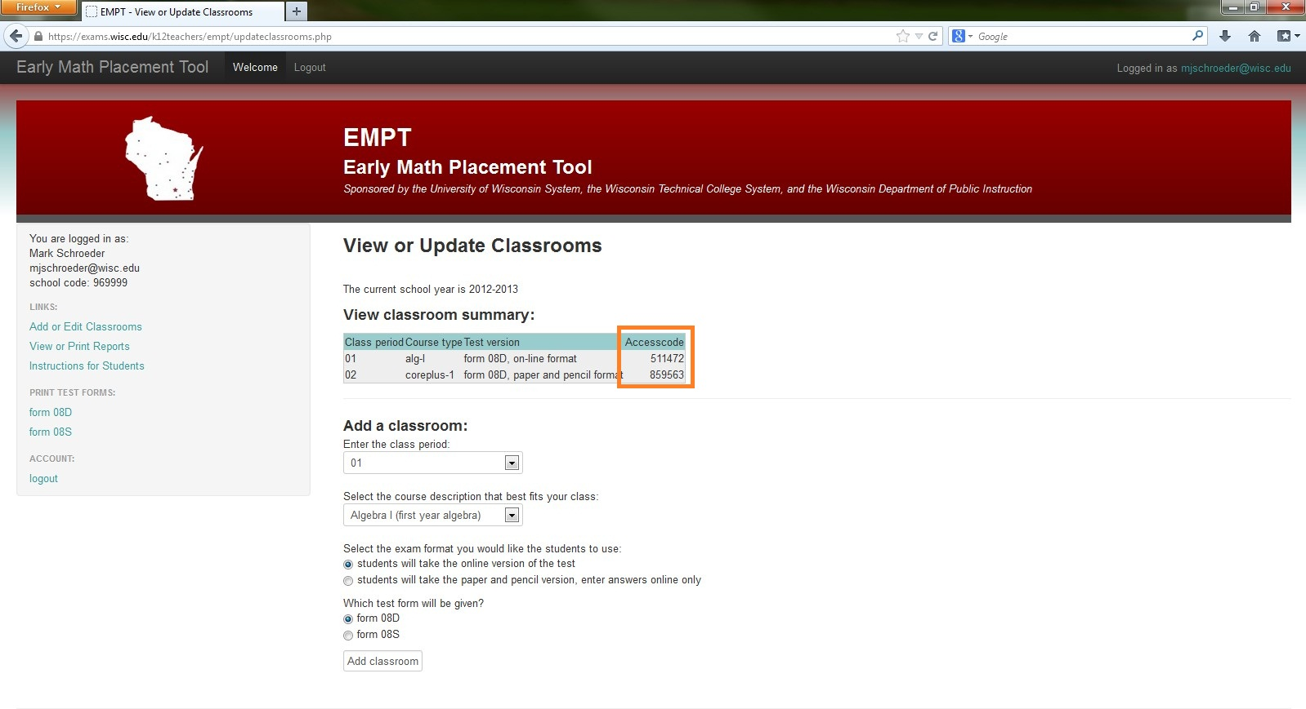
Next, register a class
Notes:
…here on your “classroom summary.” So, after the student has entered the teacher information…

Slide 24
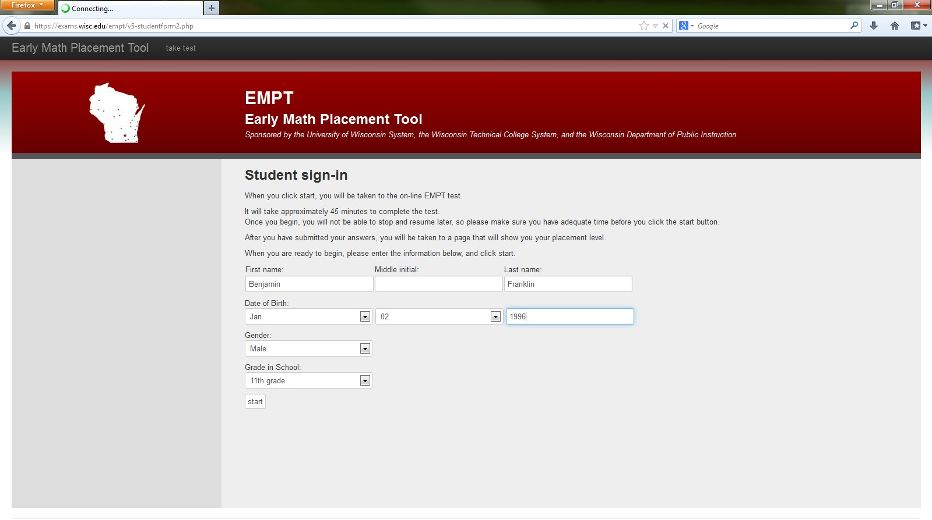
Student login
Notes:
…they are presented with a page to enter their own details: name, date of birth, gender, and grade.

Slide 25
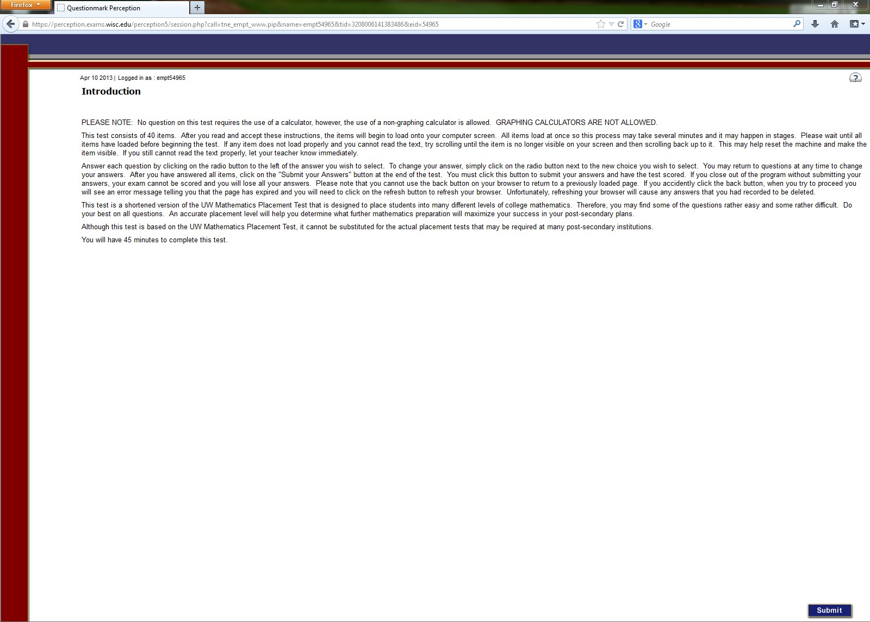
EMPT Format
Notes:
After students log in, they are presented with the format of the EMPT which you already preselected. In this case I selected the online, disclosed format.

Slide 26
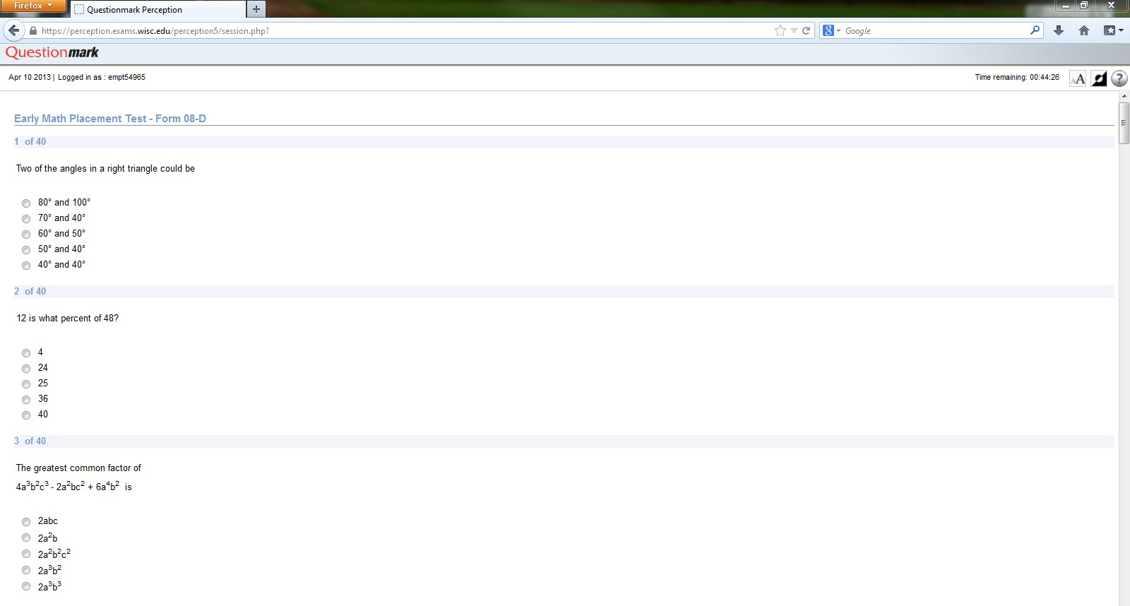
EMPT Format
Notes:
This is the page with problems students are presented with…

Slide 27
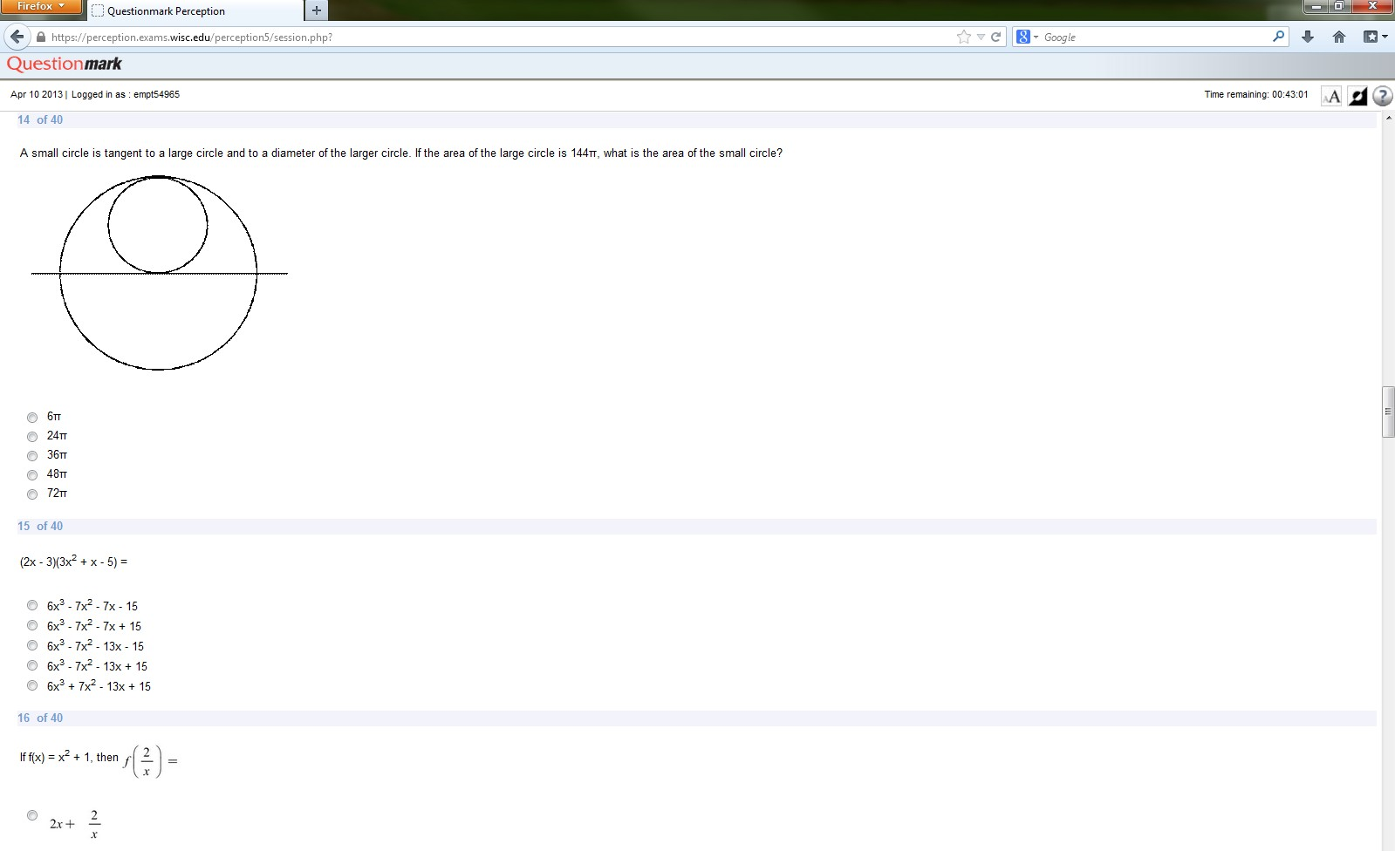
EMPT Format
Notes:
..remember there are 40 problems …

Slide 28
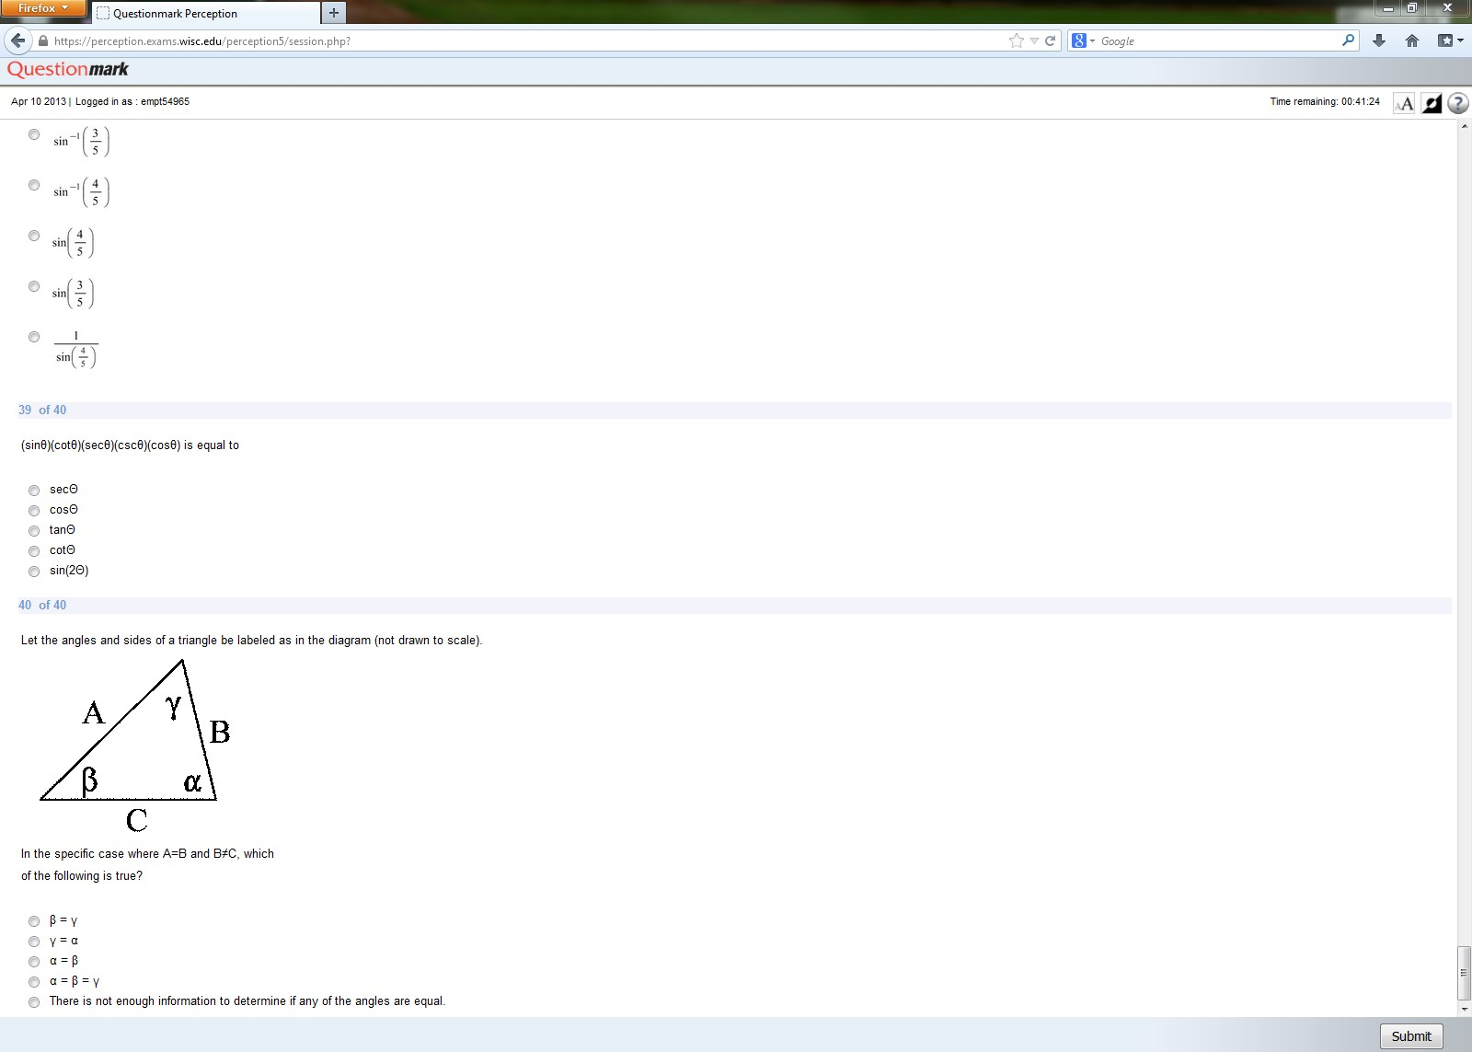
EMPT Format
Notes:
…and students have 45 minutes to complete them.

Slide 29
Paper and Pencil Version
Notes:
Say, you select the paper and pencil version for your class. Well, after the students have completed the test the information still needs to be entered. It’s similar to the online version…students enter the same information…

Slide 30
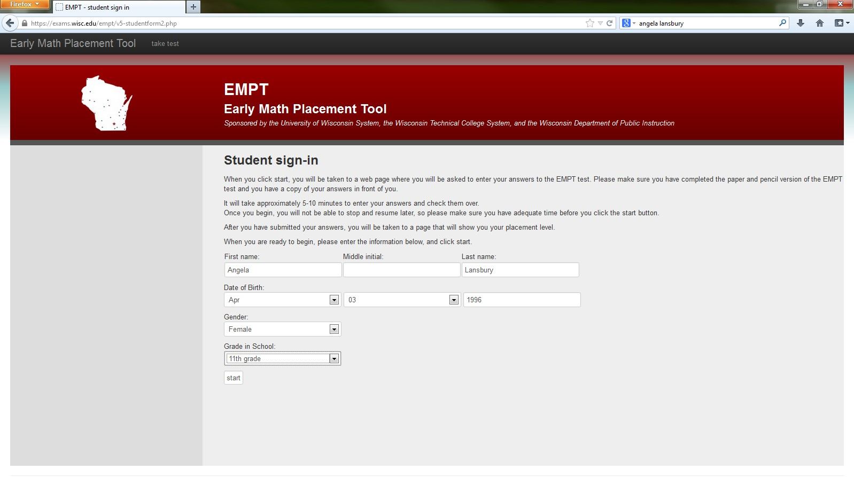
Paper and Pencil Version
Notes:
…and are then presented with the page to enter their information.

Slide 31
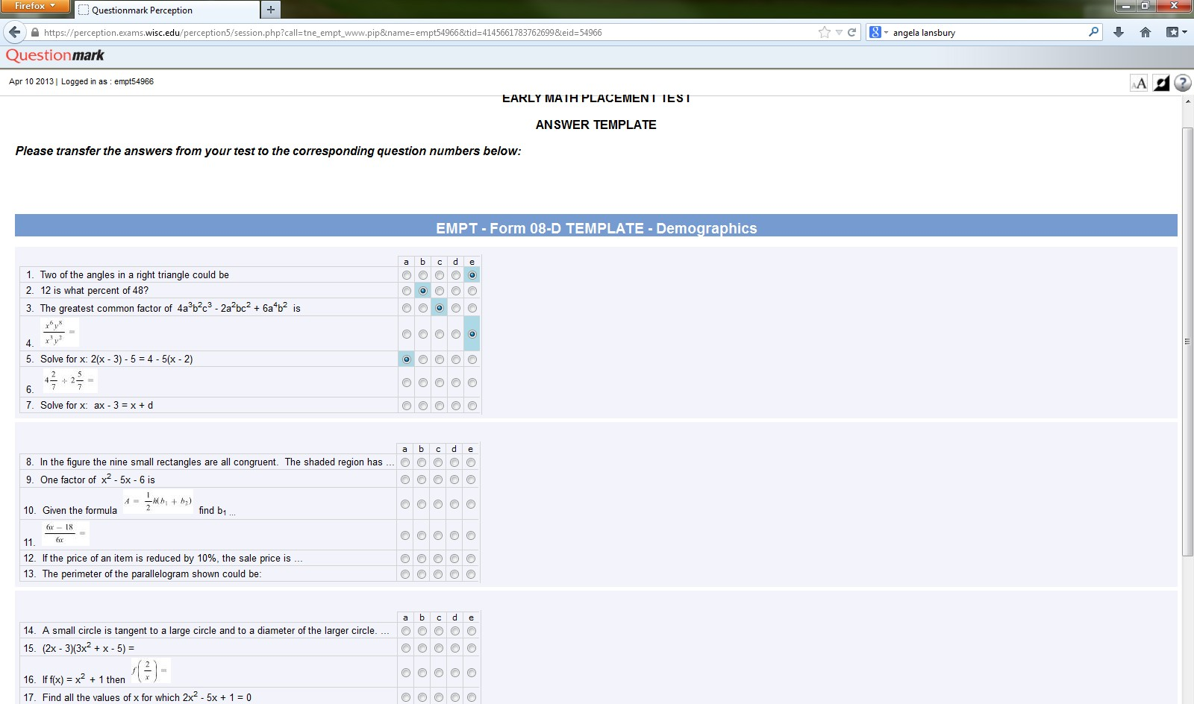
Paper and Pencil Version
Notes:
This next part is different. Here students need to transfer their answers from the template, on the last page of the printed out assessment, to this template.

Slide 32
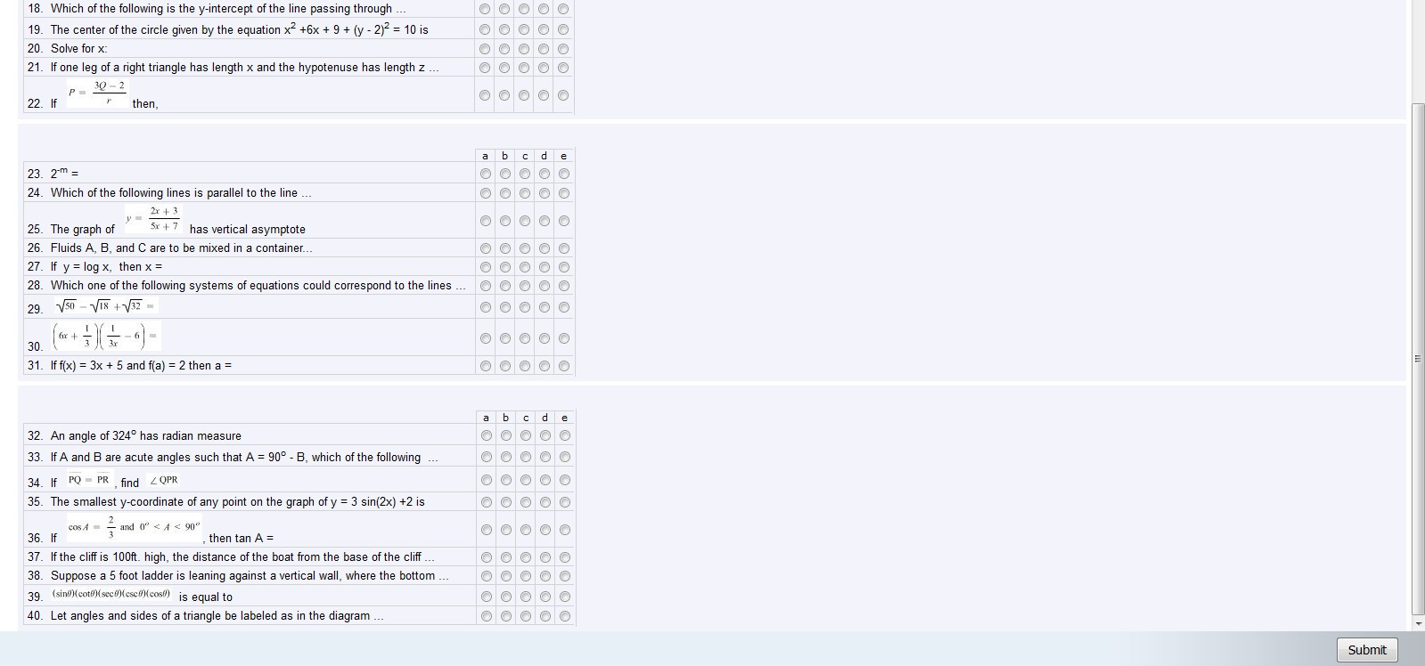
Paper and Pencil Version
Notes:
Once they have finished they click “submit” and …

Slide 33
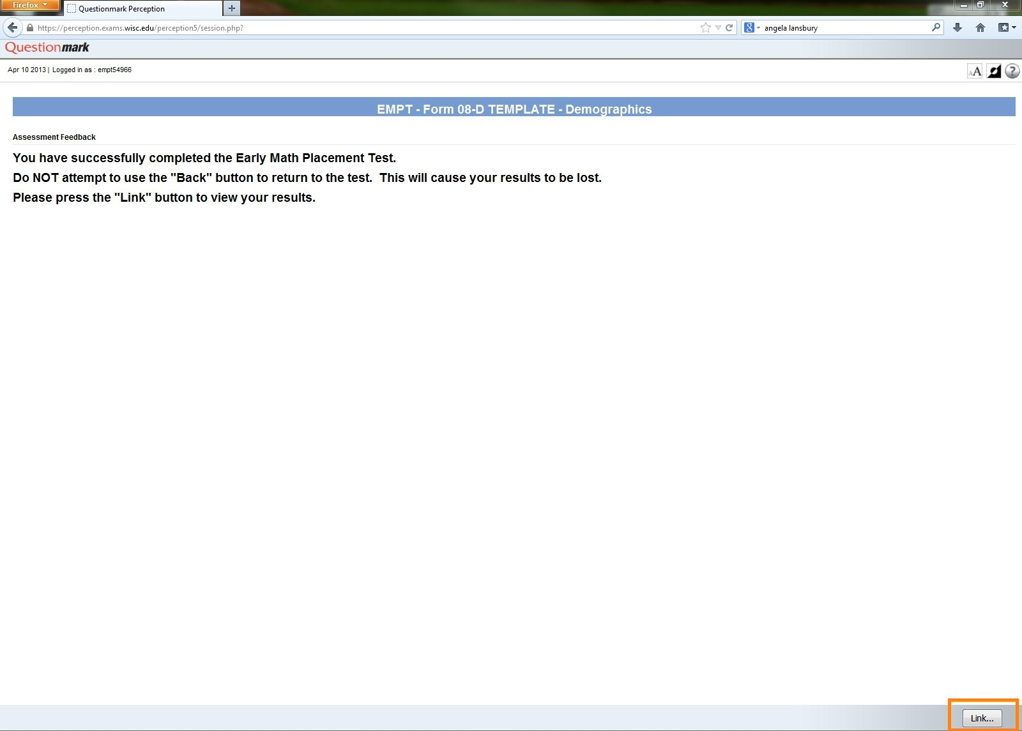
Notes:
Click on “Link” to review the Student Feedback

Slide 34
Student Feedback
Notes:
…they are presented with the results of the assessment. In this case, we can see that the student placed at level 1 and the student feedback details where the student did well and gives a descriptive comparison of the score.

Slide 35
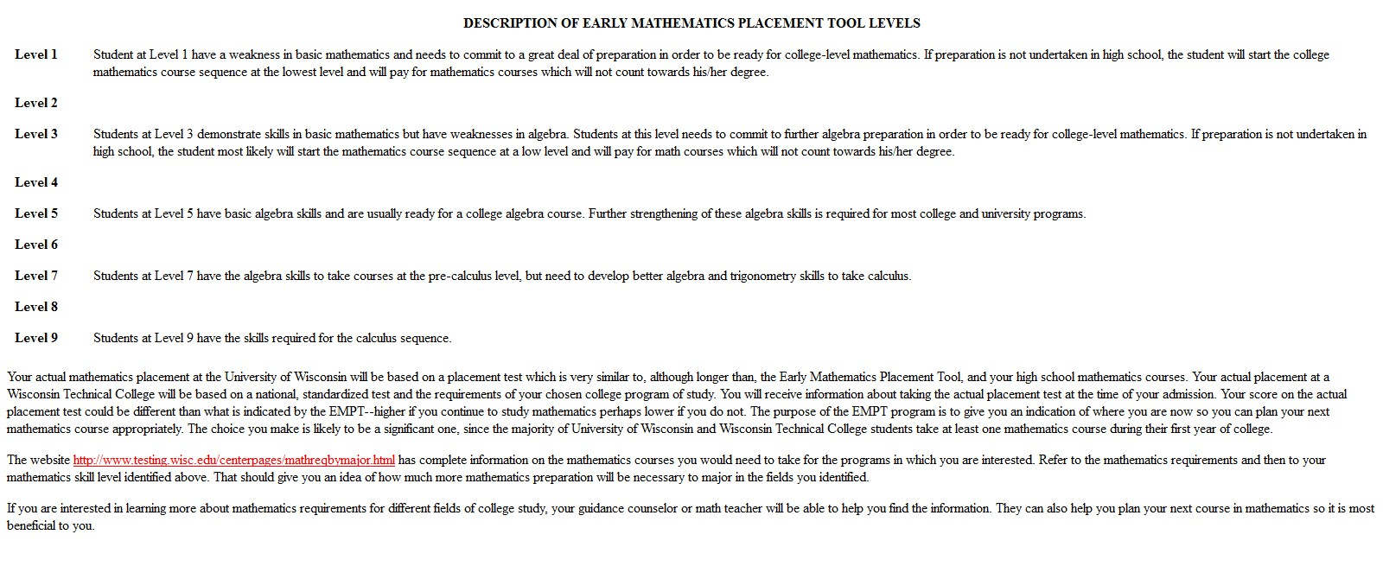
Same Student Feedback
Notes:
Here we can see the descriptive feedback for Level 1 through Level 9. The feedback for online and paper and pencil versions are identical.

Slide 36
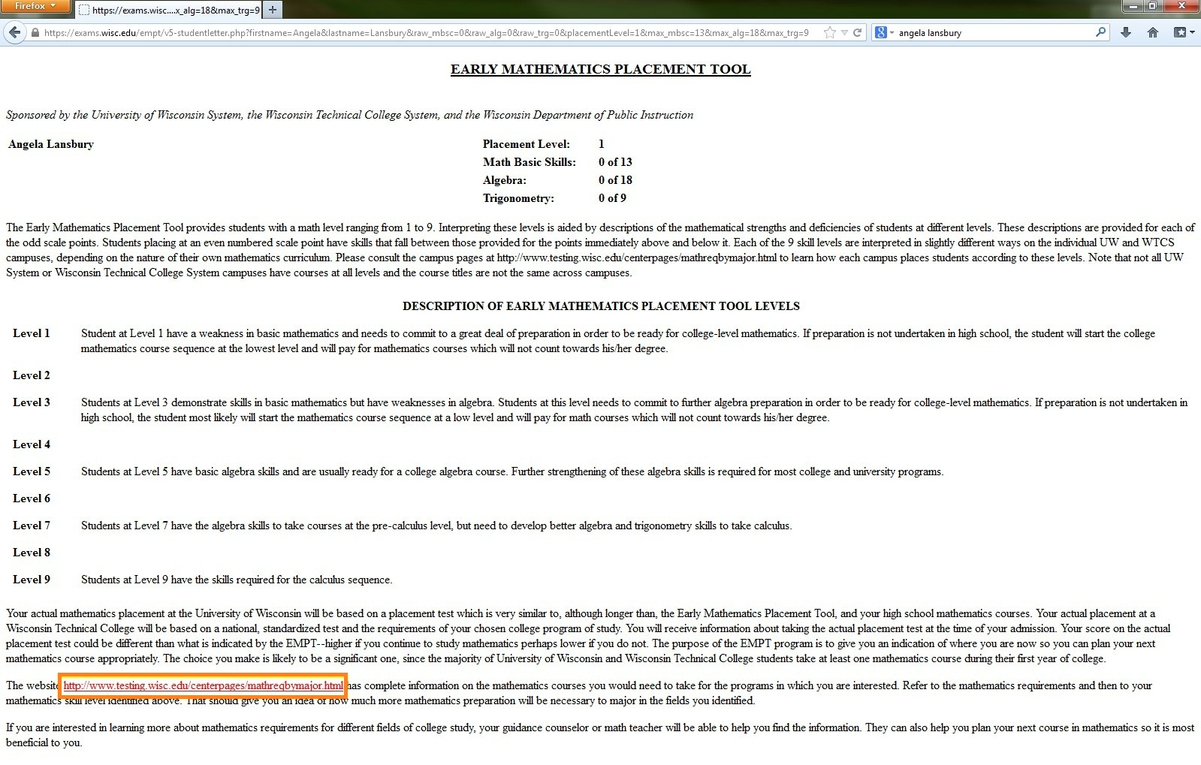
Same Student Feedback
Notes:
The student feedback also lists the web site where they can go to receive more information about the math requirements for specific universities.

Slide 37
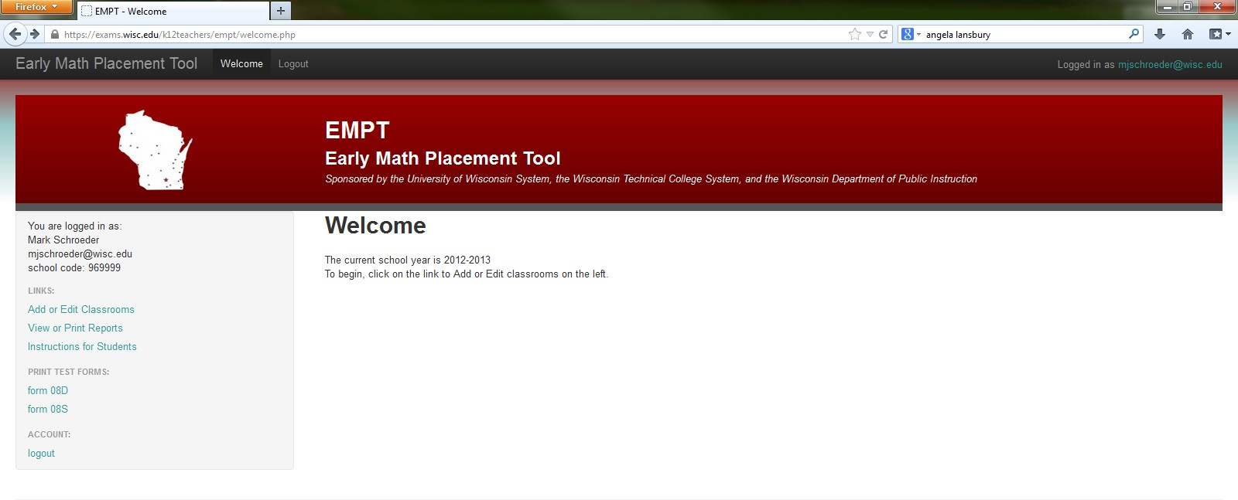
Teacher Feedback
Notes:
There are several options available for teachers about their classes.

Slide 38
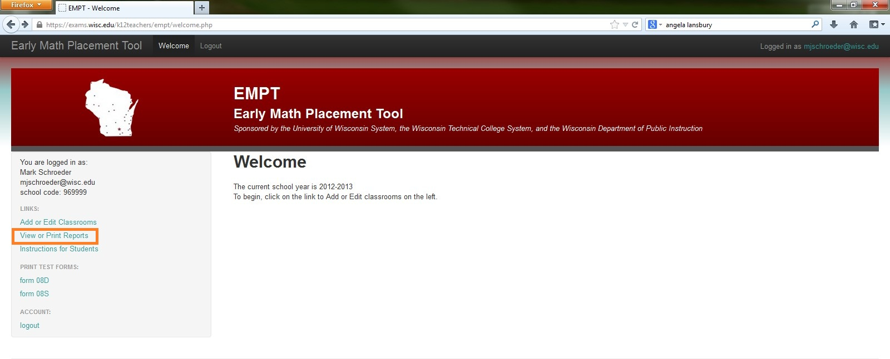
Teacher Feedback
Notes:
All these features are available under “View or print reports” highlighted here on the left sidebar.

Slide 39
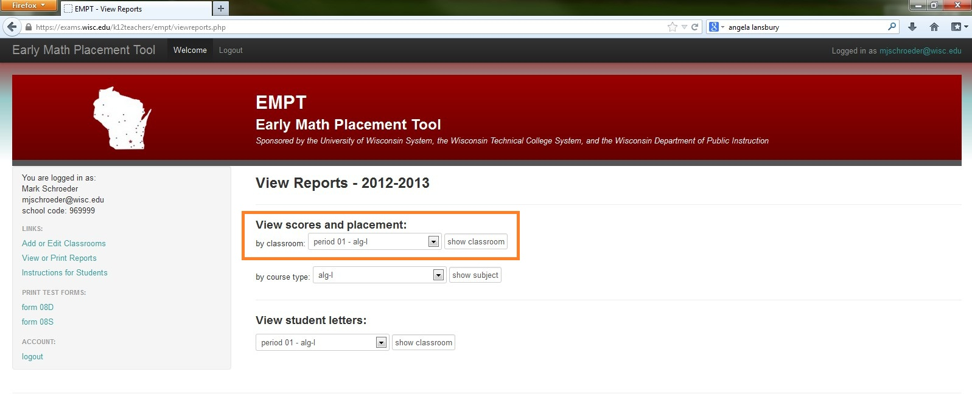
View or Print Reports
Notes:
The first feature I want to highlight is the scores by classroom report highlighted here.

Slide 40
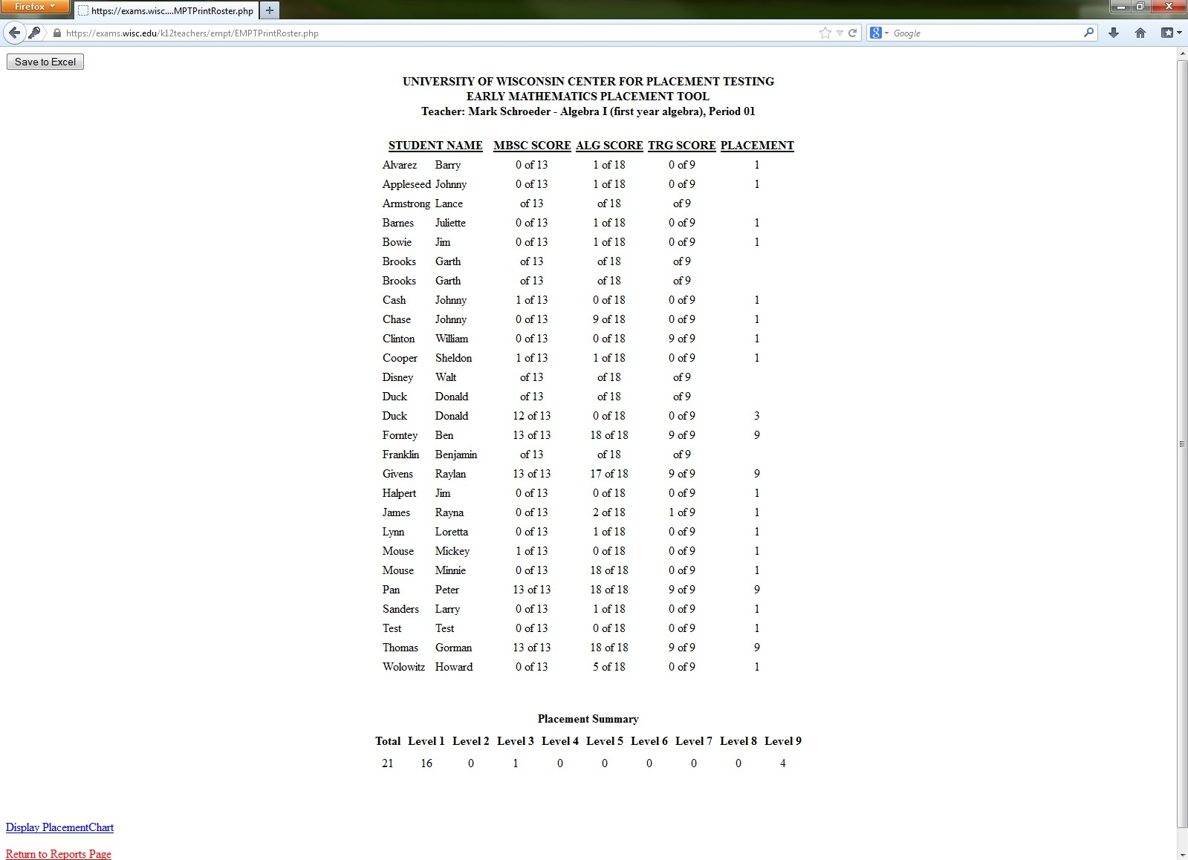
Report by Classroom
Notes:
The report by classroom lists the subscores and placement level of all your students in that class.

Slide 41
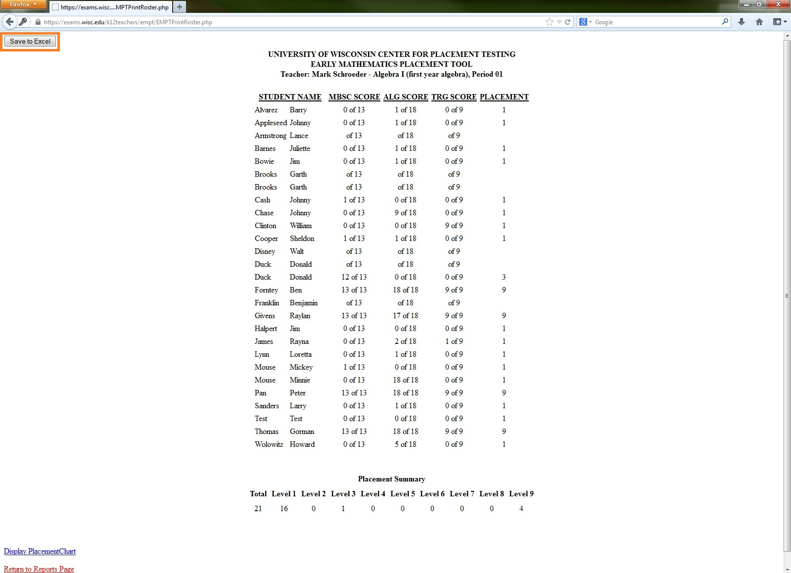
Report by Classroom
Notes:
Two features I want to also highlight: You can export this table to Excel, as seen here, or …

Slide 42
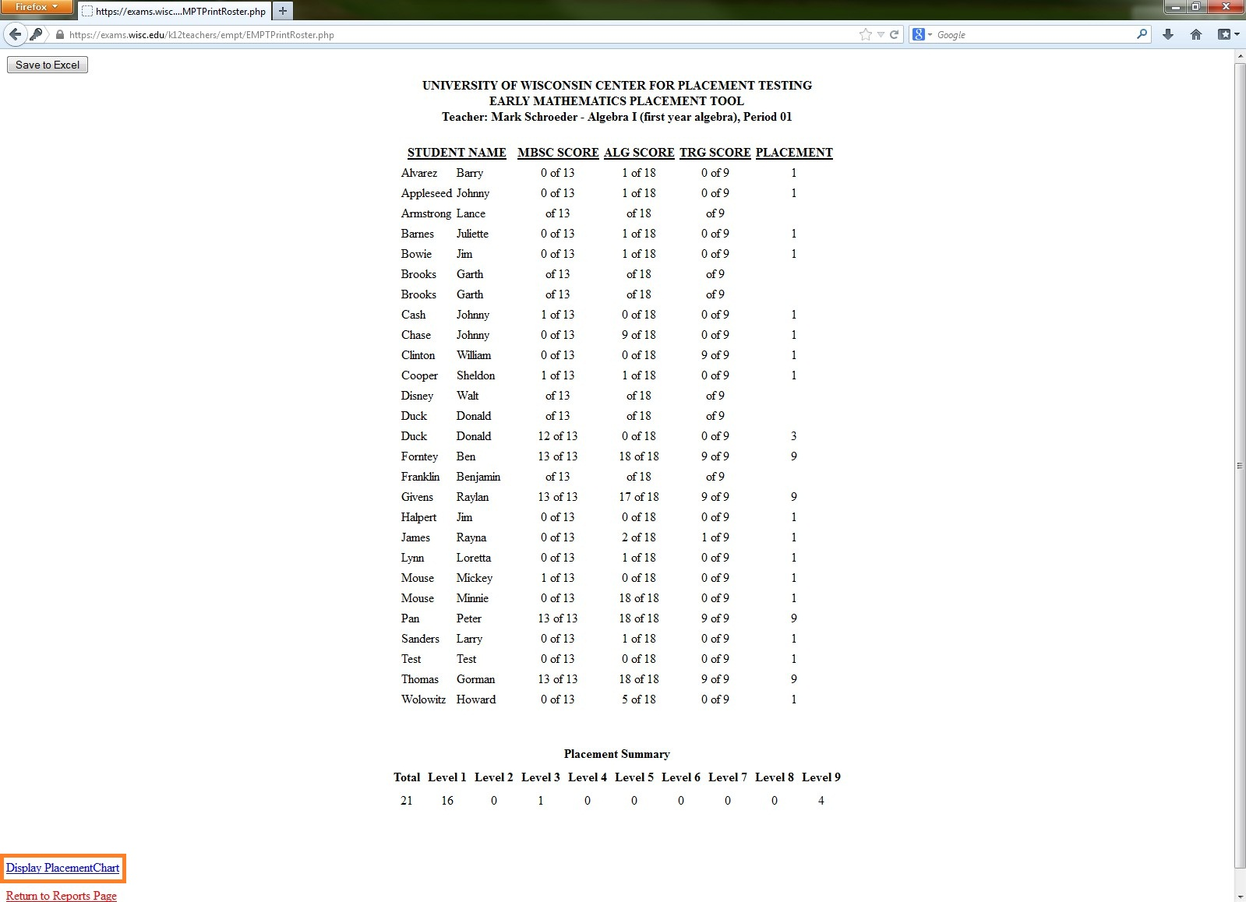
Report by Classroom
Notes:
…click “Display Placement Chart” here and this gives you …

Slide 43
Display Placement Chart
Notes:
…a histogram of that particular classes placement level.

Slide 44
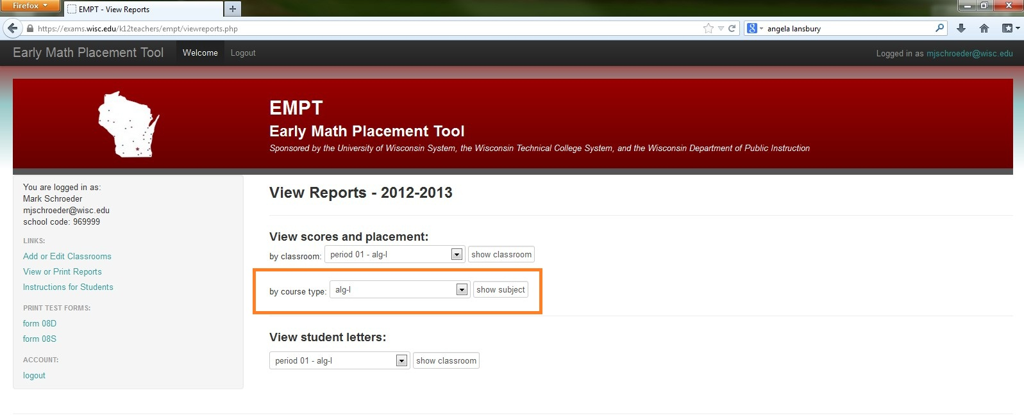
Reports by Course Type
Notes:
The report by course type is similar, but for example, if you have entered 2 or more classes with the same text –say a geometry class– this will concatenate all classes of the same curriculum together.

Slide 45
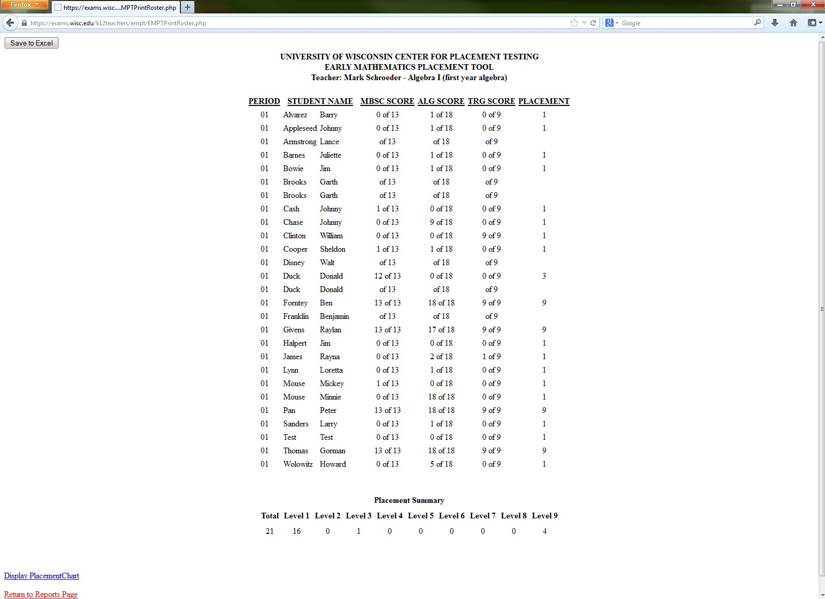
Reports by Course Type
Notes:
This report is similar to the reports by classroom, but in this report all students using the same curriculum (for example, geometry) are put into 1 report for you. You are also able to export this to Excel or get a histogram by clicking “Same to Excel” or “Display Placement Chart”

Slide 46
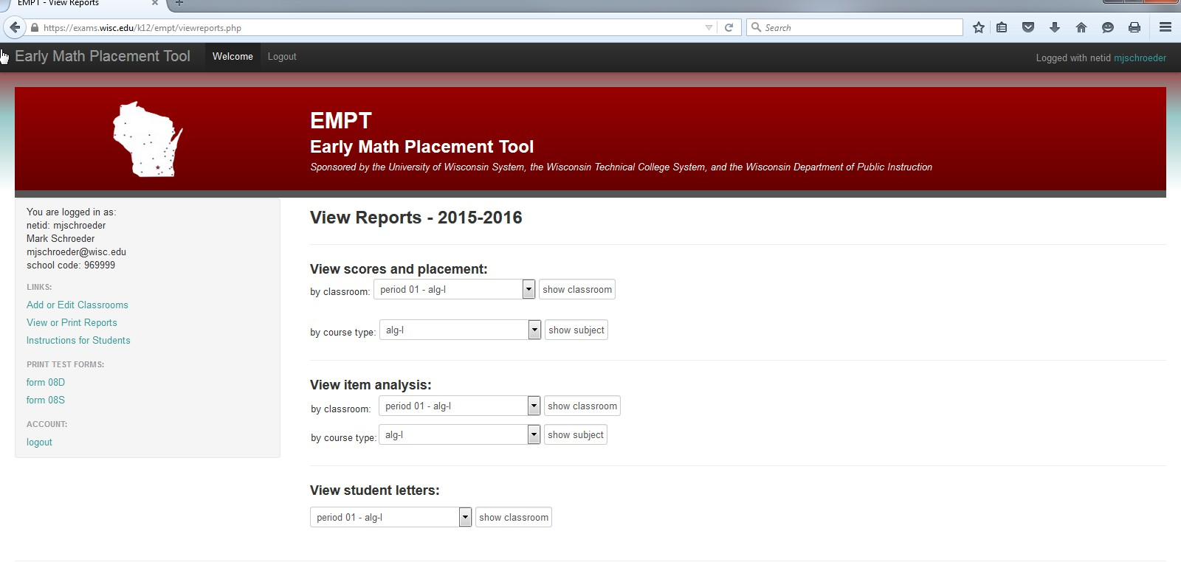
Item Analysis
Notes:
Another useful feature is the item analysis. There are two kinds of item analysis available…

Slide 47
Item Analysis

Slide 48
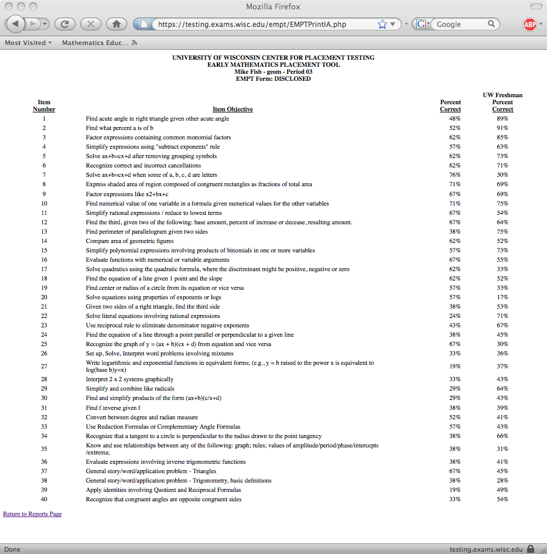
Item Analysis
Notes:
Let’s take a look at an item analysis by classroom… This gives you the performance across each item on the test …

Slide 49
Item Analysis
Notes:
…highlighted here and …

Slide 50
Item Analysis
Notes:
…gives you a comparison of the percentage correct for all incoming UW freshman.

Slide 51
EMPT lowers remedial rates
Actual 2014 MPT Placement Level | Participated in 2012-13 EMPT | Did Not Participate in 2012-13 EMPT
1 | 2.7% | 6.2%
2 | 3.9% | 8.1%
3 | 8.4% | 14.2%
4 | 16.6% | 15.6%
5 | 12.2% | 10.7%
6 | 11.6% | 10.1%
7 | 3.2% | 2.4%
8 | 13.3% | 9.9%
9 | 28.3% | 22.9%

Slide 52
EMPT helps students improve
2014 MPT Levels | 2012-2013 EMPT Levels
 | 1 | 2 | 3 | 4 | 5 | 6 | 7 | 8 | 9 | Total | Avg. Level
1 | 20 | 7 | 11 | 1 | 1 | 2 | 0 | 1 | 3 | 46 | 2.67
2 | 24 | 12 | 13 | 5 | 9 | 3 | 0 | 0 | 1 | 67 | 2.67
3 | 28 | 17 | 49 | 13 | 23 | 13 | 0 | 0 | 3 | 146 | 3.29
4 | 31 | 27 | 89 | 45 | 57 | 25 | 8 | 2 | 3 | 287 | 3.71
5 | 21 | 14 | 44 | 22 | 55 | 33 | 8 | 8 | 6 | 211 | 4.34
6 | 5 | 7 | 44 | 20 | 53 | 28 | 11 | 24 | 9 | 201 | 5.04
7 | 1 | 0 | 6 | 6 | 14 | 14 | 5 | 6 | 3 | 55 | 5.58
8 | 0 | 5 | 14 | 11 | 54 | 25 | 26 | 45 | 51 | 231 | 6.57
9 | 3 | 4 | 14 | 9 | 61 | 59 | 31 | 100 | 209 | 490 | 7.44
Total | 133 | 93 | 284 | 132 | 327 | 202 | 89 | 186 | 288 | 1734 | 5.33
Avg. Level | 3.35 | 4.06 | 4.59 | 5.08 | 6.08 | 6.48 | 7.42 | 8.04 | 8.40 | 6.15
2010 MPT Level

Slide 53
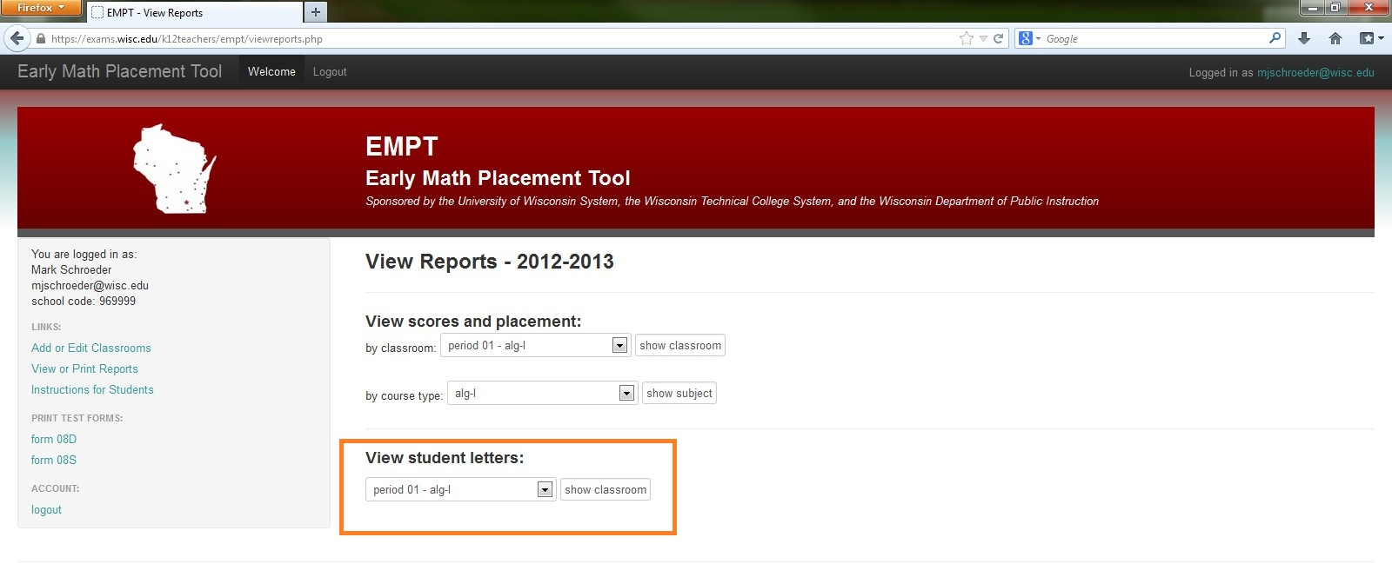
Viewing the Student Letters
Notes:
Finally, the student letters section gives you the individual student letters for each classroom…

Slide 54
Viewing the Student Letters
Notes:
This option contains all the student feedback letters for each of your classes. The only difference now is that these letters are available as a PDF document you can print; to either mail or send home to parents.

Slide 55
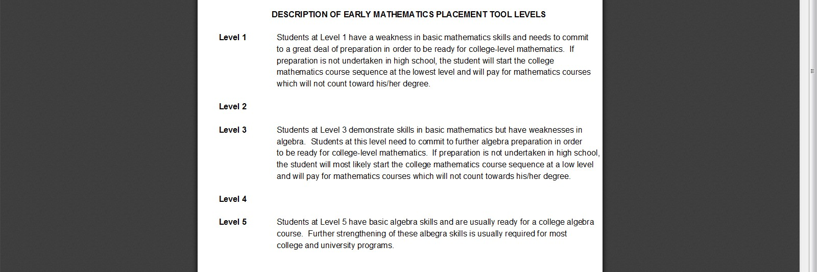
Viewing the Student Letters
Notes:
These are the same student letters that were presented to students after they completed the assessment.

Slide 56
Math Requirements by Major
Notes:
The final section I want to demonstrate for you is the actual second part of the EMPT program. The “math requirements by major.” Before you login, this can be found by first clicking on “Resources” then …

Slide 57
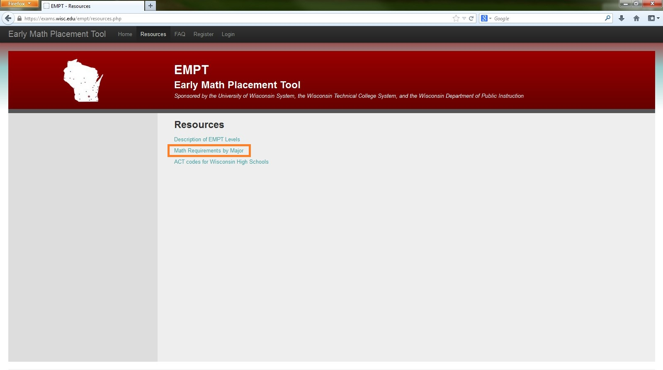
Math Requirements by Major
Notes:
…on “math requirements by major.”

Slide 58
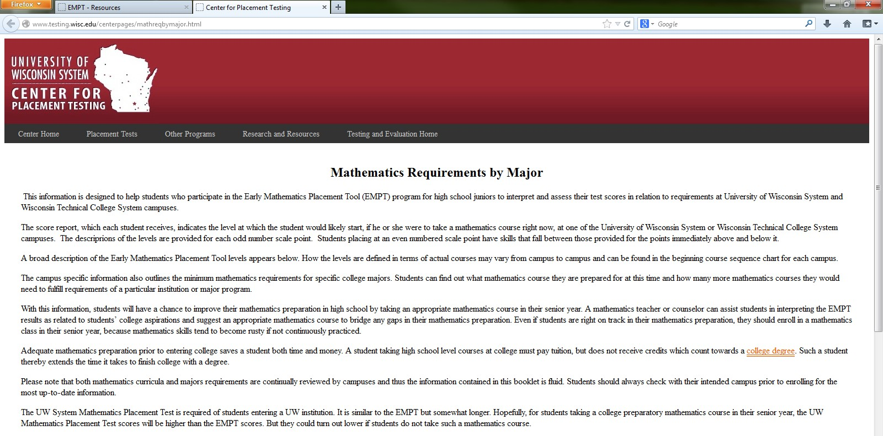
Math Requirements by Major
Notes:
The page has the same descriptive information as the student feedback letters and if we scroll down…

Slide 59
Math Requirements by Major
Notes:
…you can select any one of Wisconsin’s public universities or the technical college to get specific information.

Slide 60
Math Requirements by Major
Notes:
For example, if I click on Platteville …

Slide 61
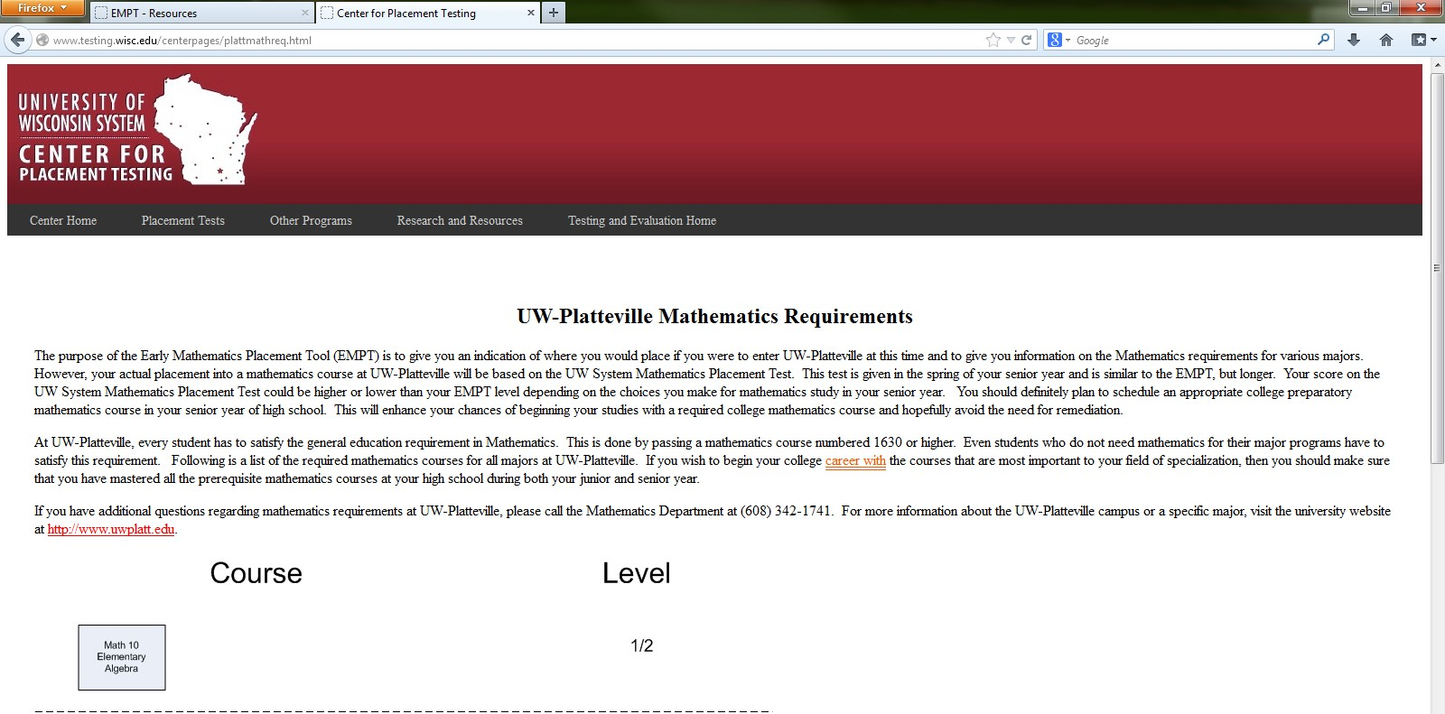
Math Requirements by Major
Notes:
I am presented with a page that details specific information for Platteville and tells me which courses …

Slide 62
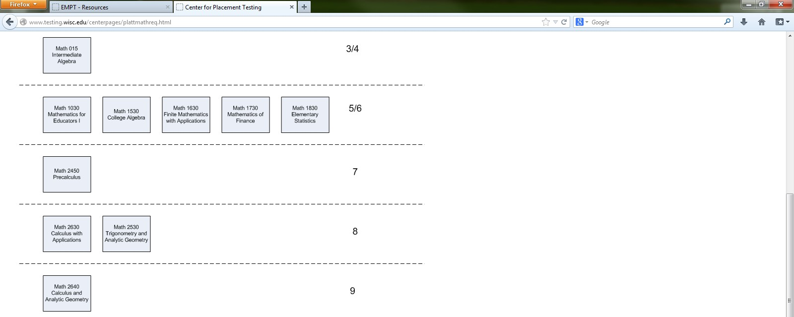
Math Requirements by Major
Notes:
…correspond with specific math courses offered at Platteville. Finally, the last part details…

Slide 63
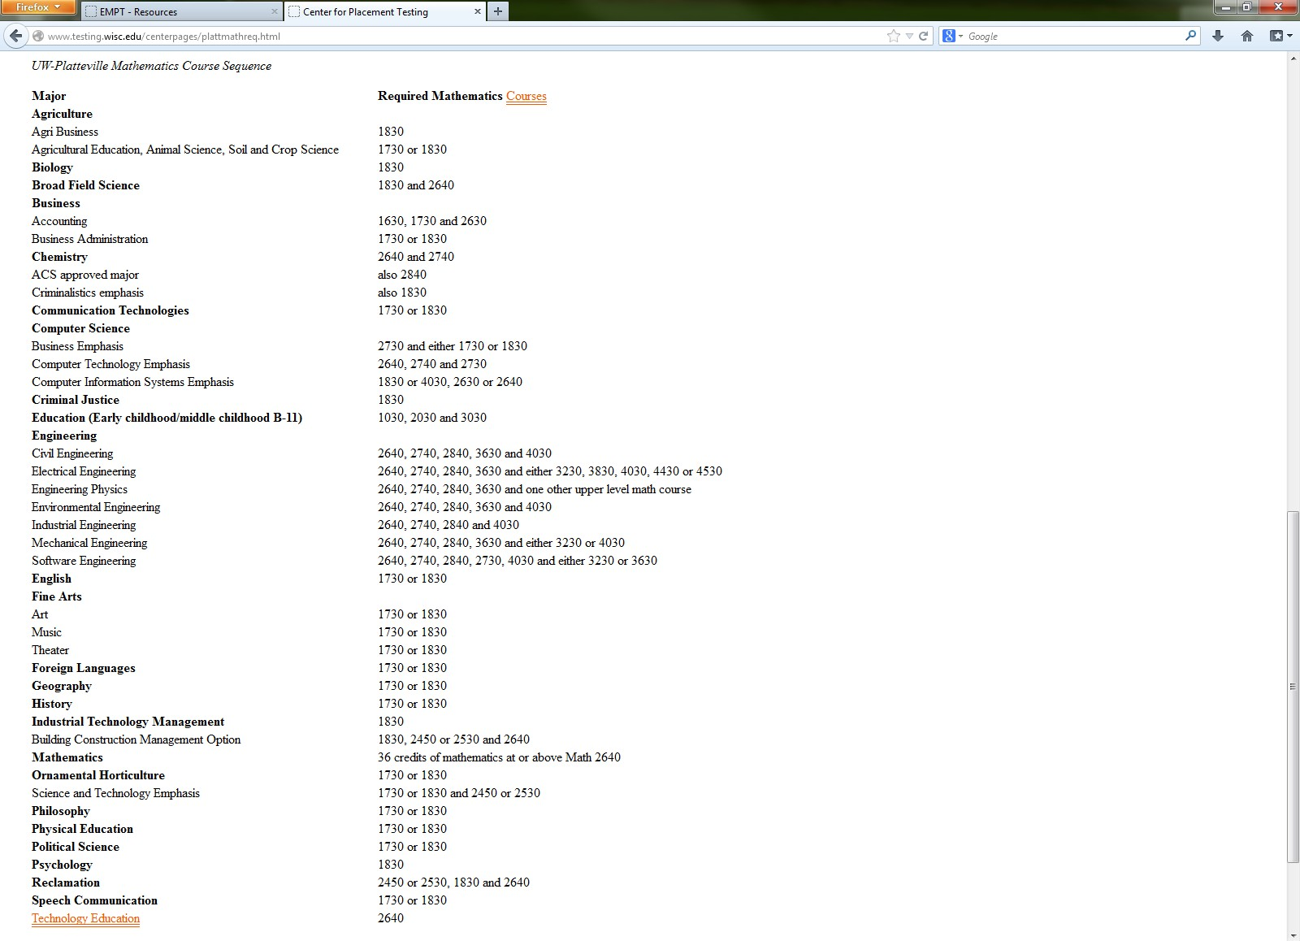
Math Requirements by Major
Notes:
…the required math courses for each of the majors also offered here at Platteville.

Slide 64
EMPT Overview
 | ’13-’14 | ’14-’15 | ’15-’16
Schools | 104 | 127 | 60
Registered teachers | 159 | 192 | 83
Registered classes | 429 | 628 | 224
Total number of students | 8,730 | 12,030 | 3,239

Slide 65
EMPT Users by Grade Level

Slide 66
Thank you!
empt@exams.wisc.edu
https://exams.wisc.edu/empt/home.php

