Slide 1
College Readiness Webinar: College Admissions will begin soon.
Please mute your sound to avoid
noise distraction during the
webinar.

Slide 2
College Readiness Webinar:
College Admissions
Presenters:
Troy Moldenhauer
Director of Admissions & Recruitment, UW-Parkside
Brian Troyer
Director of Undergraduate Admissions, UW-Milwaukee

Slide 3
Goals for Today
The Importance of Applying Early
Application Consideration
Application Timeline
Available Resources

Slide 4
The Importance of Applying Early
What to include in the application
Letters of recommendation
Proper preparation in high school
Development courses (course placement)

Slide 5
The Importance of Applying Early
Math senior year
Strong English curriculum
Academic Rigor (take core courses and beyond)
Prior-Prior year

Slide 6
Application Consideration
Application Statement
We want to learn about your students:
Goals and aspirations
Why our school?
What are you interested in studying and why?
Are there any life experiences that might help us understand you, or may explain other parts of your application/academics?
This is a student’s chance to bring her/his ‘voice’ to the college application.

Slide 7
Application Consideration
Skill sets (talent and ability, activities, employment)
Evaluations of transcripts (dual credit courses, academic rigor (AP, Honors, etc.), trends in grades, courses taken)

Slide 8
Application Timeline
How long does it take to process an application?
What is a “complete” application?
Applications are not reviewed until complete
Some campuses have self-service / application tracking software

Slide 9
Available Resources
UW System workshops
Individual campuses offer assistance
Wisconsin Education Fairs (WEFs)
UW HELP

Slide 10
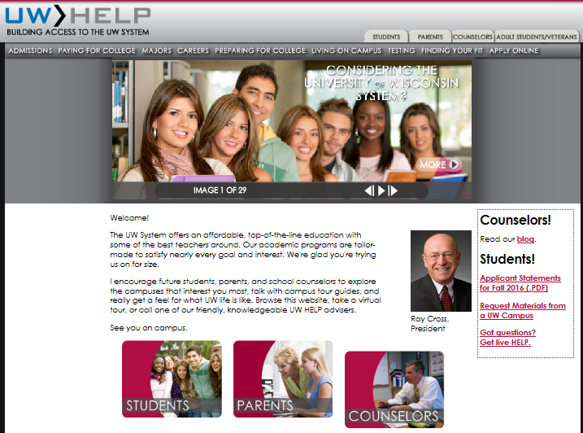
http://uwhelp.wisconsin.edu/

Slide 11
Available Resources
Campus and State websites
Publications (Introduction to the UW System)
College Goal Wisconsin (for FAFSA Completion)
National Association of College Admission Counseling (www.nacacnet.org)

Slide 12
http://www.nacacnet.org

Slide 13
Questions & Comments

Slide 14
Contact Information
Troy Moldenhauer
Director of Admissions and Recruitment
University of Wisconsin – Parkside
262-595-2355 moldenht@uwp.edu
Brian Troyer
Director of Undergraduate Admissions
University of Wisconsin – Milwaukee
414-229-4445 troyerb@uwm.edu

