Slide 1
Welcome! The College Readiness for English webinar will begin soon. Please mute your sound to avoid noise distraction during the webinar.

Slide 2
College Readiness for English
presented by Virginia Crank, UW-La Crosse; Wade Mahon, UW-Stevens Point; Karen McLeer, UW-Platteville; Shevaun Watson, UW-Milwaukee

Slide 3
Framework for Success in Postsecondary Writing
Eight habits of mind essential for success in college writing:
Curiosity – the desire to know more about the world.
Openness – the willingness to consider new ways of being and thinking in the world.
Engagement – a sense of investment and involvement in learning.
Creativity – the ability to use novel approaches for generating, investigating, and representing ideas.
Persistence – the ability to sustain interest in and attention to short- and long-term projects.
Responsibility – the ability to take ownership of one’s actions and understand the consequences of those actions for oneself and others.
Flexibility – the ability to adapt to situations, expectations, or demands.
Metacognition – the ability to reflect on one’s own thinking as well as on the individual and cultural processes used to structure knowledge.

Slide 4
Rhetorical Knowledge
“Rhetorical Dexterity”
the ability to read, write, and function effectively within a broad array of rhetorical situations in and outside of school-based contexts
meta-level understanding of communication contexts and their varying needs and demands
anticipating this variety, expecting it
understanding that one is never done learning to write, but that new situations will necessarily involve “un-learning” and “re-learning” forms, “rules,” expectations, etc.
this is as much a skill as it is a mindset

Slide 5
Rhetorical Knowledge
Rhetorical Dexterity for Reading
exposure to a wide range of nonfiction texts—and difficult texts
shift from “what happened” to “what the author is trying to do”
more experience with tracking an argument or moves in a long discussion
Rhetorical Dexterity for Researching
explicit discussion about wide range of source types—and the need for and credibility of each
facilitating more individual decision-making about sources (with defense/rationale)
shift from prescribed processes for research to a more recursive and “messy” process
Rhetorical Dexterity for Writing
shift from discussions of correctness to discussions of credibility (within specific situations)
teach forms/modes/genres, but overlay with concepts of inevitable variability and limitedness
shift from linear processes and requirements to facilitating the “organic” learning that happens in the act of writing

Slide 6
Critical Thinking, Reading, and Writing
“Critical Thinking” describes the ability to recognize, analyze, and evaluate the logical connections between ideas
This ability does not come naturally and is not easy to learn
Some advanced critical thinking vocabulary students struggle with in their writing (examples):
Deliberate practice can help develop these skills
Key teaching tool: “Argument Mapping”—Helps us to visualize the relationships between ideas
(UWSP project: https://argumentmapping.wordpress.com/)
(Rationale.com)

Slide 7
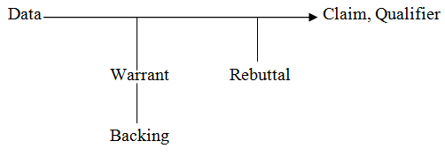
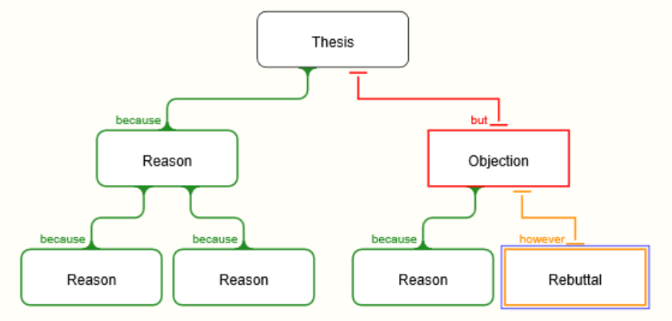
Critical Thinking, Reading, and Writing
Mapping the logical structure of arguments:
Toulmin Method Rationale.com

Slide 8
Critical Thinking, Reading, and Writing
Mapping the rhetorical structure of arguments
Strategic (vs. topical) outlines: emphasis on what a paragraph/section is doing vs. what it is saying
Paragraphs Sections
Introduction Introduction
Body #1 Background
5 ¶ Essay Body #2 Proposition (Thesis) Classical Arrangement
Body #3 Proof
Conclusion Refutation
Conclusion

Slide 9
Critical Thinking, Reading, and Writing
Critical Reading and Writing
Both reading and writing benefit from logical and rhetorical mapping
Reading:
Students need to be able to identify the main idea in any text they read.
Identifying the rhetorical structure / outline of a text helps them pinpoint the author’s strategy, the “thesis,” and the underlying logical structure.
Writing:
Students need to be able to articulate the main idea / thesis of what they are writing.
Both logical and rhetorical “maps” help them visualize what they need to say and how their arguments differ from opposing views.

Slide 10
Writing Processes
Common Steps
Writing processes allows students to explore, invent, make missteps, recover, and view their work from multiple perspectives—ultimately to produce a more effective final product.
Invention
Planning The process is not always linear (unlike my presentation).
Drafting
Feedback
Revision
Editing

Slide 11
Writing Processes
Flexibility is Essential
Introduce students to multiple strategies for their writing toolbox.
Invention (outlines, mapping, web diagrams, freewriting, brainstorming)
Planning (audience awareness, assignment review, research)
Drafting (paper, computer, dictation)
Feedback (instructor or peer)
Revision (look again vs. fixing)
Editing (timing is everything)

Slide 12
Writing Processes
Value
If students realize that writing processes can help them communicate their ideas more effectively, they are more likely to use them when NOT directed.
College composition—students will receive some level of guidance through the writing process
Other college courses—students need to direct themselves and seek out feedback on their own (Writing Center, instructor, peers)

Slide 13
Knowledge of Conventions
Conventions arise from a history of use and facilitate reading by invoking common expectations between writers and readers. These expectations are not universal; they vary by genre, by discipline, and by occasion.
Conventions of format and structure based on range of genres
Conventions of mechanics and grammar taught in context
Conventions of source integration and acknowledgement to avoid plagiarism

Slide 14
Knowledge of Conventions
Conventions of format and structure based on range of genres:
College writers will be asked to consider how genre dictates things like structure, tone, paragraphing, thesis placement, and mechanics.
Genres: editorial, proposal, report, research article, narrative.
Students will be expected to move beyond the five-paragraph essay format.
Students will take more responsibility for analyzing genres to understand their demands.

Slide 15
Knowledge of Conventions
Conventions of mechanics and grammar taught in context:
Most professors will place error-free writing far below content and development in importance.
Most professors will not teach the conventions of mechanics and grammar.
Instruction at the sentence level will focus more on stylistic choices rather than correctness.
Conventions of grammar and mechanics become an audience/genre issue.

Slide 16
Knowledge of Conventions
Conventions of source integration and acknowledgement to avoid plagiarism:
Again, genre and audience needs will dictate source integration and citation.
Students will learn citation systems preferred by various disciplines.
Respect for intellectual property will inform discussions of plagiarism.
Source integration and acknowledgement are used to build a writer’s credibility.

Slide 17
Questions?

