Slide 1
Brunch & Learn – Plan UW Budget Account Levels
October 23, 2018

Slide 2
Agenda
Budget CoA Background
Webforms
Levels FAQ
Levels by Account Type:
Fringe
Non Comp
Revenue

Slide 3
Budget CoA Background – Pre-work
Before
Budgets were developed in 3270 only with Major Class accounts such as Total Fringe, Total S&E, etc.
There was no Revenue Budgeting
Issue
3270 accounts – Too High Level – Lead to a lack of meaningful budget analysis
SFS GL accounts – Too Detailed for Most Institutions – Using these accounts for planning and budgeting would be time consuming and cumbersome
Lack of consensus on how much detail, is the right amount of detail between institutions
Solution
A new Budget CoA was finalized in 2017 during the BPFS Planning / Pre-work phase. This tree:
Is consistent across every Institution in the UW System
Was developed in SFS to source into the PlanUW application. It is called PLANUW_BUDGET_ACCT
Contains accounts for Revenue
Has Account code rollups between the Major Classes and GL account levels
Was specifically designed to allow inputs at different account levels along the hierarchy to provide institutions the flexibility and choice to budget at a detailed or higher levels

Slide 4
Level 1
Highest Level of Budget Input
“Required” Level
Level 2
An intermediate level in between the GL accounts and level 1
Level 3
The lowest (or most granular) level available for Non Comp and Revenue budgeting, and will contain exclusively GL accounts from SFS
Level 4
The lowest (or most granular) level available for Fringe budgeting, and will contain exclusively GL accounts from SFS
Budget CoA Background - Levels
There are Four specific account levels in Plan UW

Slide 5
Budget CoA Background – Account Categories
 | Salary | Fringe | Non-Comp | Revenue
Level 1 | #N/A Budgeted in CAT | 1 | 16 | 51
Level 2 |  | 10 | 44 | 60
Level 3 |  | 19 | 241 | 265
Level 4 |  | 62

Slide 6
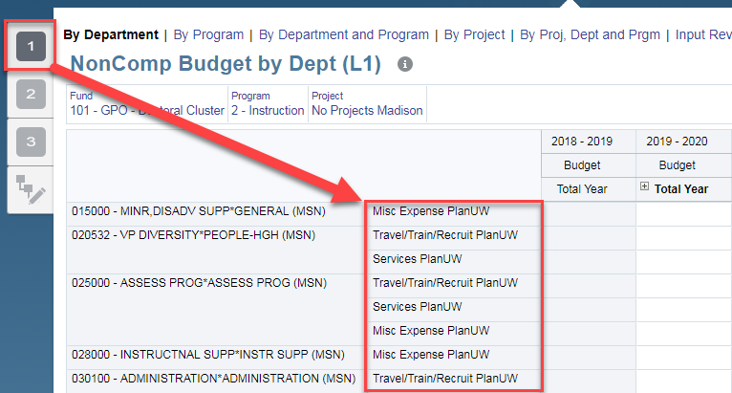
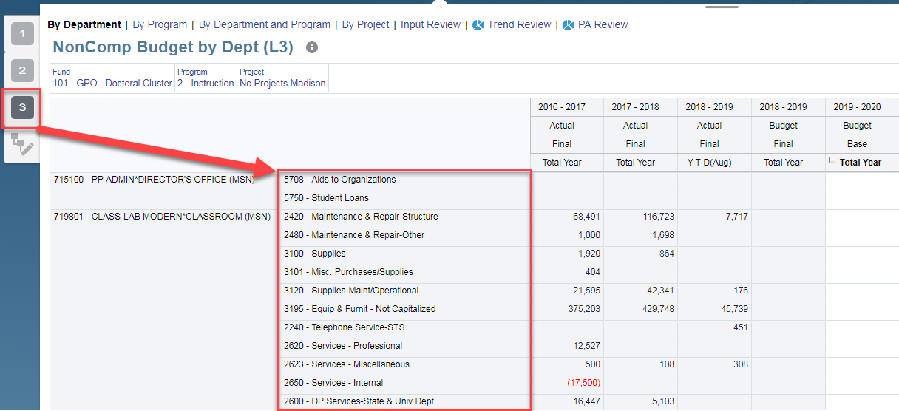
Webforms – Nav Flows
The webforms in PlanUW are organized by the level of accounts they contain
Level 1
Level 3

Slide 7
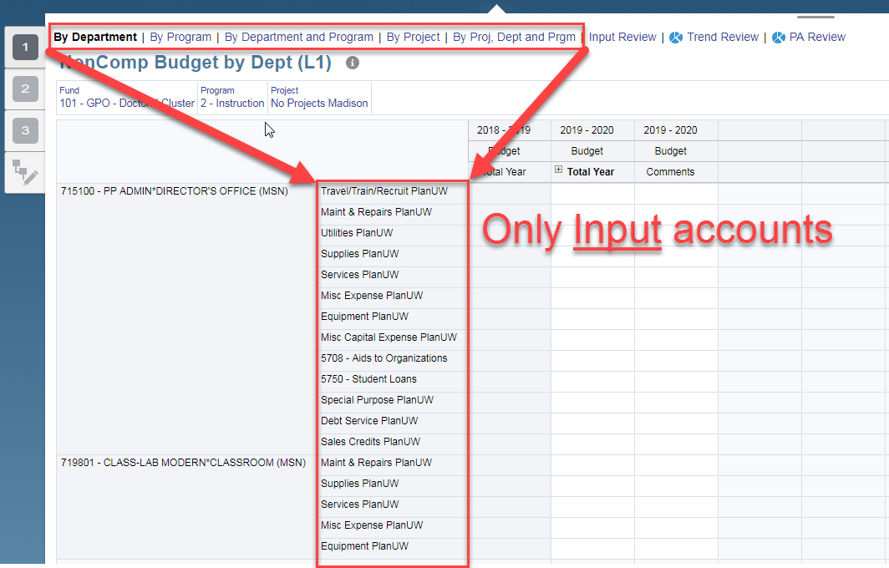
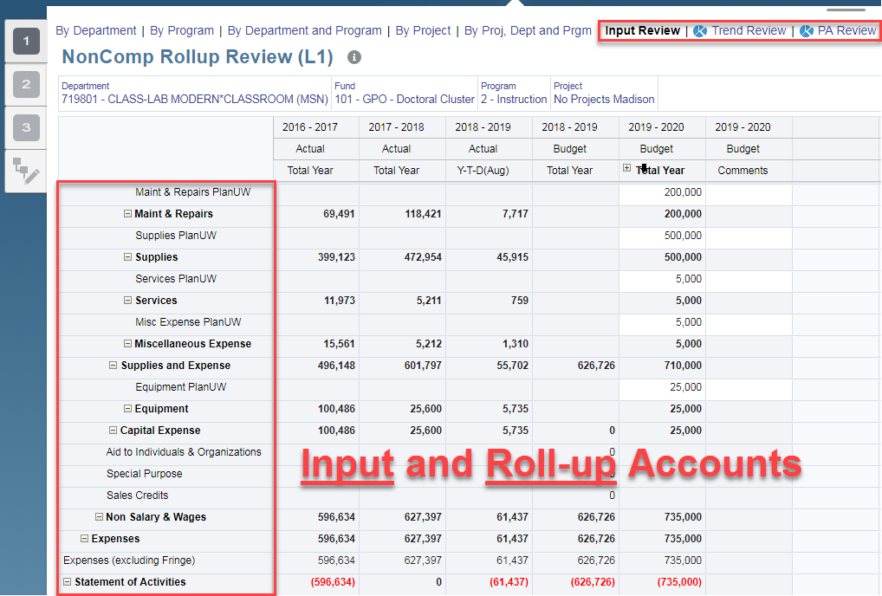
Webforms – Rollup (Rolldown) accounts vs. Input accounts
Plan UW and GL accounts are Input accounts. Rollup accounts aggregate the Plan UW and GL accounts underneath them.
Notes:
***Each Plan UW account will have an associated Rollup account to rollup the budget input and the actuals loaded into the GL accounts

Slide 8
Budget CoA Levels – FAQ
Can I use multiple levels to build my budget?
Yes – you can use different levels to build your budget, but it is important to understand why and where you are using different levels.
Anything to watch out for when using multiple levels?
Be careful to not unintentionally enter the same budget data using different levels
Example – Do not budget $100k for “Travel/Train/Recruit Plan UW” AND “Recruiting Plan UW” if it truly represents the same Budget

Slide 9
Budget CoA Levels – FAQ cont.
Do inputs at different levels overwrite each other?
No – An input into the “Travel/Train/Recruit Plan UW” Level 1 account will not overwrite an entry in the “Recruiting Plan UW” Level 2 account
Can I use multiple levels and utilize the higher Levels as “other” accounts?
Yes - But again, it is important to understand and coordinate where you are doing this
Are certain accounts being used in multiple levels?
Yes - To ensure that users can build a comprehensive budget without having to cross levels, higher level accounts (levels 1 and 2) are used in lowers levels when they don’t have the same level of detail as other account rollups.
For example, Maint & Repairs PlanUW is included in level 1 and 2
Also, GL accounts can exist at higher levels (such as 1 or 2) when they are the highest required level one needs to budget at. No Plan UW accounts were created in these cases.
For example, 3790 - Material for Resale is included in level 1, 2 and 3

Slide 10
Budget CoA Levels – FAQ cont.
What levels are actuals from SFS getting loaded to in PlanUW:
Actuals data is getting loaded to the GL level in PlanUW (level 3 for NonComp and Revenue, and level 4 for Fringe)
Can Actuals data be mapped to the higher levels allowing me to see Actuals data in the Input forms I use?
To keep a standard design among institutions, this was not included in the Phase 1 requirements or design. Please coordinate with system if this is an enhancement you may wish to pursue in the future.
I know I will not use certain levels for certain accounts. Can we apply security to prevent user input?
Please coordinate with system on potential security changes. Applying security to the account dimension may be complex. However, applying security to prevent users from seeing forms is much simpler and easier to maintain.
How will the new Budget CoA be leveraged in reports outside of PlanUW, like from WISDM?
System is continuing to meet with Financial Administration to ensure proper Budget reporting capabilities

Slide 11
Salary and FTE Accounts

Slide 12
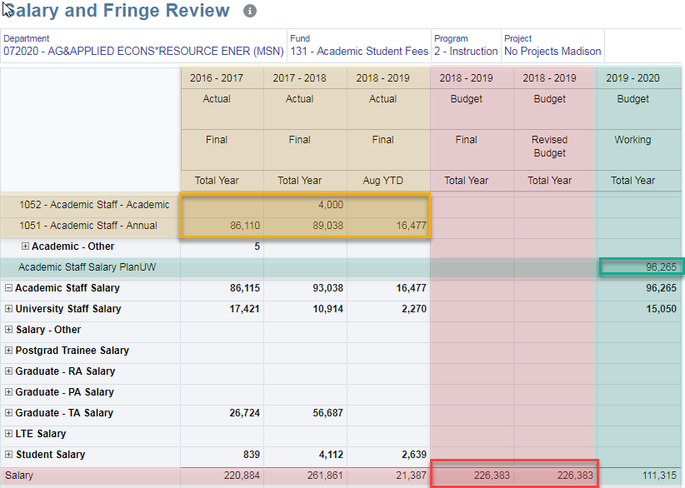
Salary
Since Salary data will be input from CAT, the accounts will not be input into. Thus no input level distinction is necessary
Actual data is loaded to the GL accounts from SFS
The Redbook budget will be loaded to a Total Salary account
Working Budget data is loaded to the PlanUW accounts from CAT

Slide 13
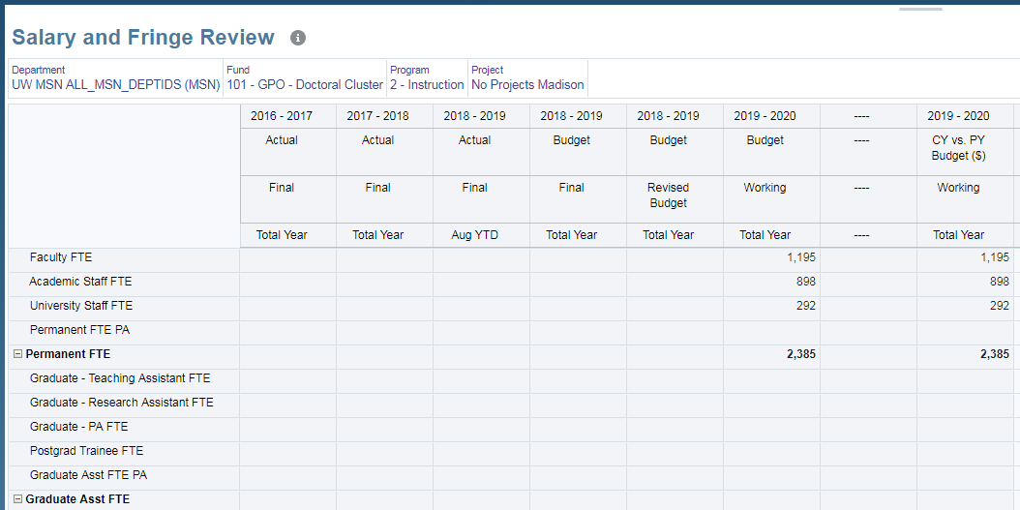
FTE
FTE data will be input from CAT as well

Slide 14
Fringe Accounts

Slide 15
Level 1 - 1 Account
FRINGE PLANUW
Level 2 - 10 Accounts
Rate Driven Option by 5 Position accounts OR Input
Level 3 - 19 Accounts
FICA, Group Health and Misc. Fringe by Position
Level 4 - 62 accounts
All G/L Accounts
Fringe Levels

Slide 16
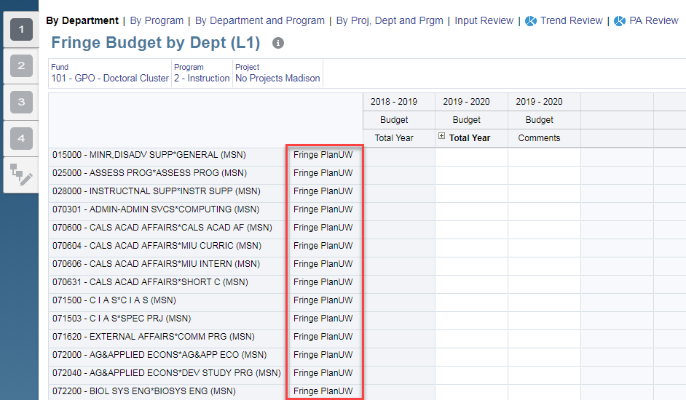
Fringe – Level 1
INPUT ONLY
Four levels exist in Fringe because, unlike the Non-Compensation and Revenue Categories, there is one total Fringe input account.
Level 1 only has one account:
Fringe Input Plan UW

Slide 17
Fringe – Level 2
RATE DRIVEN OR INPUT
The driver-based calculation by fringe rate can be used at level 2 to calculate Fringe amounts by Position.
5 out of the 10 Level 2 Fringe accounts are included in the fringe calculation:
Faculty/Acad Fringe Input
University Staff Misc. Fringe Input
LTE Fringe Input
Grad Assistant Fringe Input
Student Fringe Input
The other 5 Level 2 Fringe accounts are not driven by the calculation because they are not grouped by position:
Misc. Fringe Input
FICA Input
1921 - Group Health Insurance - ER
Other Group Health Input
Fringe-Gift/Fed Trf Input
 | Included in Rate Driven method?
Faculty/Acad Fringe | Yes
University Staff Misc. Fringe | Yes
LTE Fringe | Yes
Grad Assistant Fringe | Yes
Student Fringe | Yes
Misc. Fringe | No
FICA | No
1921 - Group Health Insurance - ER | No
Other Group Health | No
Fringe-Gift/Fed Trf | No

Slide 18
Fringe – Level 3
INPUT ONLY
Level 3 Fringe provides the ability to Input by Positions 1-5 above by:
Group Health
FICA
Misc
Note Student Fringe only has FICA
The 5 input accounts from level 2 that are not broken down by position exist at level 3 as well:
Misc. Fringe Input
FICA Input
1921 - Group Health Insurance - ER
Other Group Health Input
Fringe-Gift/Fed Trf Input
 | Group Health | FICA | Misc.
Faculty/Acad Fringe | X | X | X
University Staff Misc. Fringe | X | X | X
LTE Fringe | X | X | X
Grad Assistant Fringe | X | X | X
Student Fringe |  | X

Slide 19
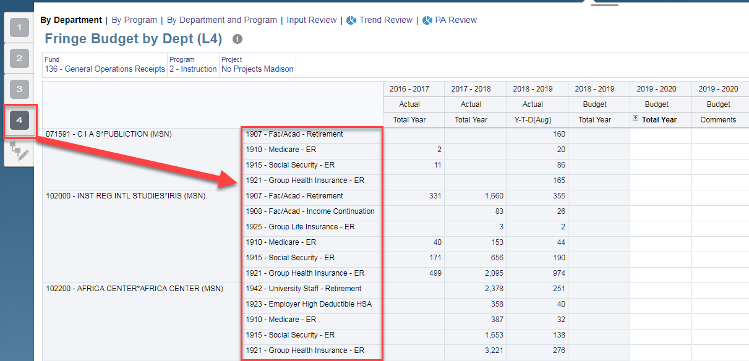
Fringe – Level 4
INPUT ONLY
Level 4 The lowest (or most granular) level available for Fringe budgeting, and will contain exclusively GL accounts from SFS.

Slide 20
Non Comp Accounts

Slide 21
Level 1
16 Accounts
Level 2
44 Accounts
Level 3
241 accounts
All G/L Accounts
Non Compensation Levels

Slide 22
Non Comp Expenditures
There are 16 required Level 1 accounts for Non Comp Expenditures
 |  |  |  | # of Accounts at each Level
# | Account | Major Class | Unique Levels | 1 | 2 | 3 | Account overlap?
1 | 3790 - Material for Resale | Supplies and Expense | 1 | 1 | 1 | 1 | Full Overlap at levels 1, 2 & 3
2 | Travel/Train/Recruit PlanUW | Supplies and Expense | 3 | 1 | 3 | 64 | No Overlap
3 | Maint & Repairs PlanUW | Supplies and Expense | 2 | 1 | 1 | 6 | Full Overlap at levels 1 & 2
4 | Utilities PlanUW | Supplies and Expense | 3 | 1 | 3 | 9 | Partial Overlap at levels 1 & 2
5 | Supplies PlanUW | Supplies and Expense | 2 | 1 | 1 | 13 | Full Overlap at levels 1 & 2
6 | Services PlanUW | Supplies and Expense | 3 | 1 | 7 | 31 | Partial Overlap at levels 2 & 3
7 | Misc Expense PlanUW | Supplies and Expense | 3 | 1 | 15 | 53 | Partial Overlap at levels 2 & 3
8 | Equipment PlanUW | Capital Expense | 2 | 1 | 1 | 11 | Full Overlap at levels 1 & 2
9 | Misc Capital Expense PlanUW | Capital Expense | 3 | 1 | 4 | 23 | Partial Overlap at levels 1 & 2
10 | 5708 - Aids to Organizations | Aid to Individuals & Organizations | 2 | 4 | 4 | 21 | Full Overlap at levels 1 & 2 Partial Overlap at levels & 3
11 | 5750 - Student Loans
12 | Other Aids PlanUW
13 | Fellows & Scholars PlanUW
14 | Special Purpose PlanUW | Special Purpose | 3 | 1 | 2 | 3 | Partial Overlap at levels 2 & 3
15 | Debt Service PlanUW | Debt Service | 2 | 1 | 1 | 2 | Full Overlap at levels 1 & 2
16 | Sales Credits PlanUW | Sales Credits | 2 | 1 | 1 | 2 | Full Overlap at levels 1 & 2

Slide 23
Non Comp Expenditures (Material for Resale)
Supplies and Expense
Unique Levels | 1
Level 1 accounts | 1
Level 2 accounts | 1
Level 3 accounts | 1
Account Overlap | Yes
Full or Partial Overlap? | Full
Levels with Overlap? | 1, 2 & 3
Full Overlap at levels 1, 2 & 3
Implication: It doesn’t matter what level you use. Budgeting for this required account will be the same.

Slide 24
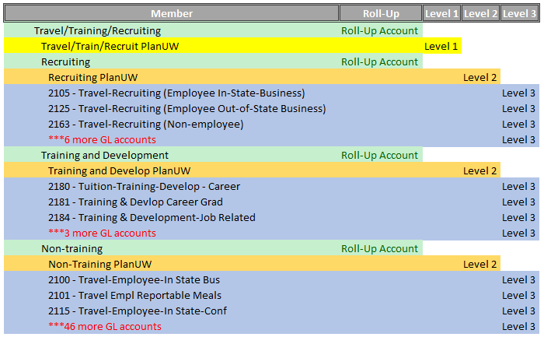
Non Comp Expenditures (Travel/Training/Recruiting)
Supplies and Expense
Unique Levels | 3
Level 1 accounts | 1
Level 2 accounts | 3
Level 3 accounts | 64
Account Overlap | No
Full or Partial Overlap? | #N/A
Levels with Overlap? | #N/A
No Overlap
Implication: This is the most straight forward case. Each has a completely unique set of accounts.

Slide 25
Non Comp Expenditures (Maintenance & Repairs)
Supplies and Expense
Unique Levels | 2
Level 1 accounts | 1
Level 2 accounts | 1
Level 3 accounts | 6
Account Overlap | Yes
Full or Partial Overlap? | Full
Levels with Overlap? | 1 & 2
Full Overlap at levels 1 & 2
Implication: It doesn’t matter if you use level 1 or 2. Budgeting for this rollup will be the same.

Slide 26
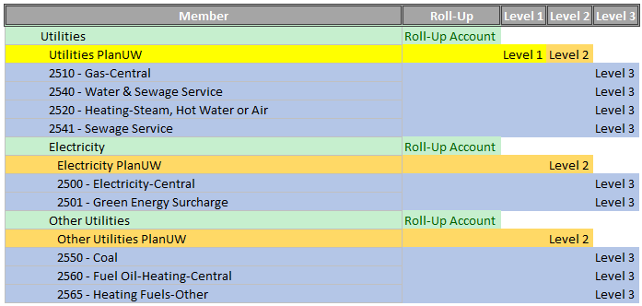
Non Comp Expenditures (Utilities)
Supplies and Expense
Unique Levels | 3
Level 1 accounts | 1
Level 2 accounts | 3
Level 3 accounts | 9
Account Overlap | Yes
Full or Partial Overlap? | Partial
Levels with Overlap? | 1 & 2
Partial Overlap at levels 1 & 2
Implication: Using Level 1 vs. 2 may change the meaning of the budgeted amount in the Utilities PlanUW account depending on your processes. At Level 1, the budgeted amount accounts for the full Utilities budget. However, if you use the same account at Level 2, you are implying budgeted amount only accounts for the 4 GL accounts: 2510, 2540, 2520, and 2541.

Slide 27
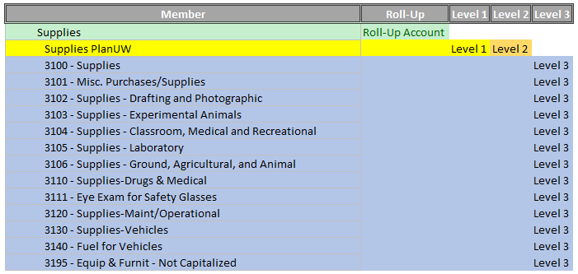
Non Comp Expenditures (Supplies)
Supplies and Expense
Unique Levels | 2
Level 1 accounts | 1
Level 2 accounts | 1
Level 3 accounts | 13
Account Overlap | Yes
Full or Partial Overlap? | Full
Levels with Overlap? | 1 & 2

Slide 28
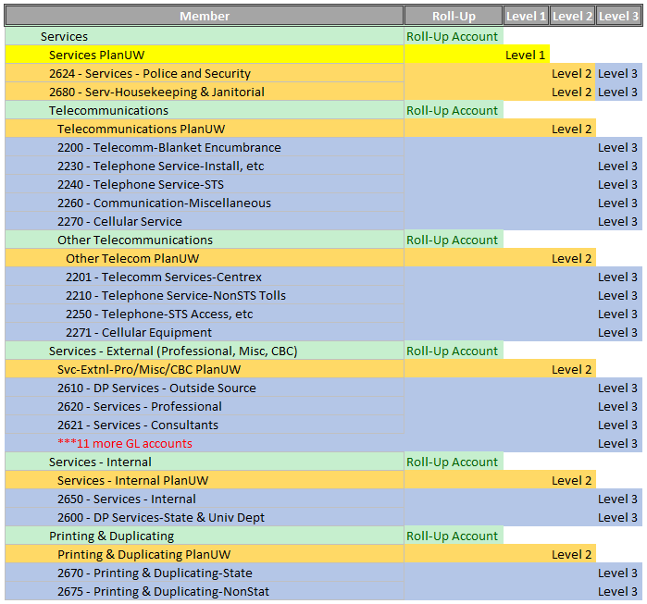
Non Comp Expenditures (Services)
Supplies and Expense
Unique Levels | 3
Level 1 accounts | 1
Level 2 accounts | 7
Level 3 accounts | 31
Account Overlap | Yes
Full or Partial Overlap? | Partial
Levels with Overlap? | 2 & 3
Partial Overlap at levels 2 & 3
Implication: Unlike the partial overlap between Level 1 and 2, using Level 2 vs. 3 does not change the meaning of the budgeted amount in accounts 2624 or 2680 as they are both distinct GL accounts. The choice between budgeting at levels 2 and 3 simply implies what level of granularity you wish to use for the other services rollups.

Slide 29
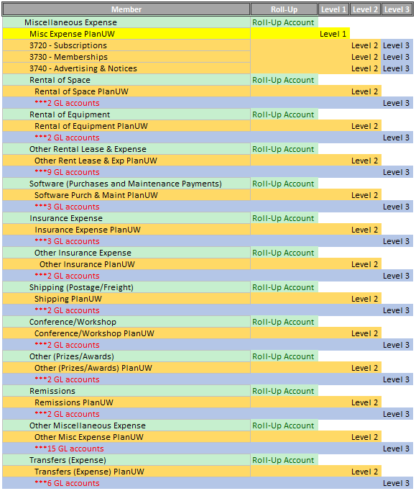
Non Comp Expenditures (Misc. Expense)
Supplies and Expense
Unique Levels | 3
Level 1 accounts | 1
Level 2 accounts | 15
Level 3 accounts | 53
Account Overlap | No
Full or Partial Overlap? | Partial
Levels with Overlap? | 2 & 3

Slide 30
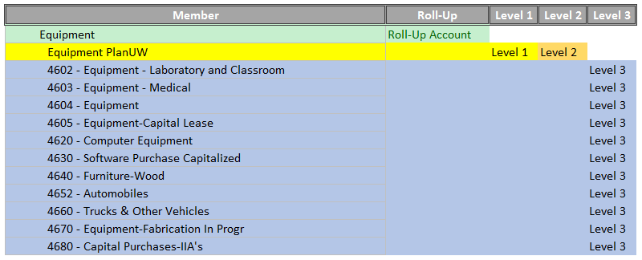
Non Comp Expenditures (Equipment)
Capital Expense
Unique Levels | 2
Level 1 accounts | 1
Level 2 accounts | 1
Level 3 accounts | 11
Account Overlap | Yes
Full or Partial Overlap? | Full
Levels with Overlap? | 1 & 2

Slide 31
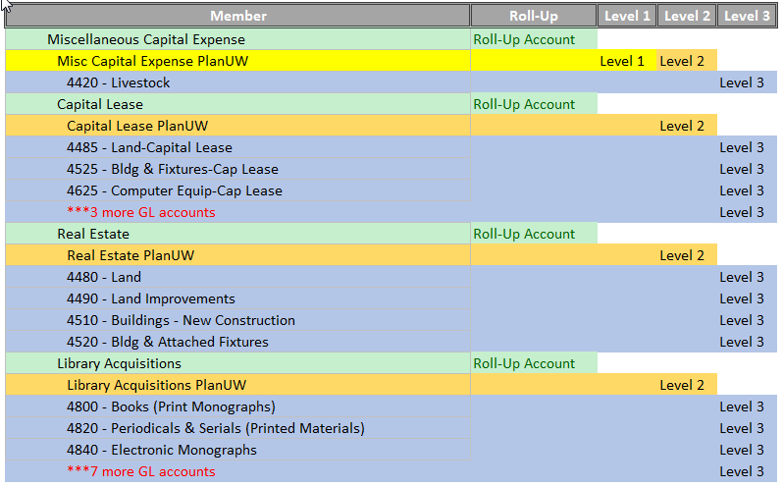
Non Comp Expenditures (Misc. Capital Exp)
Capital Expense
Unique Levels | 3
Level 1 accounts | 1
Level 2 accounts | 4
Level 3 accounts | 23
Account Overlap | Yes
Full or Partial Overlap? | Partial
Levels with Overlap? | 1 & 2

Slide 32
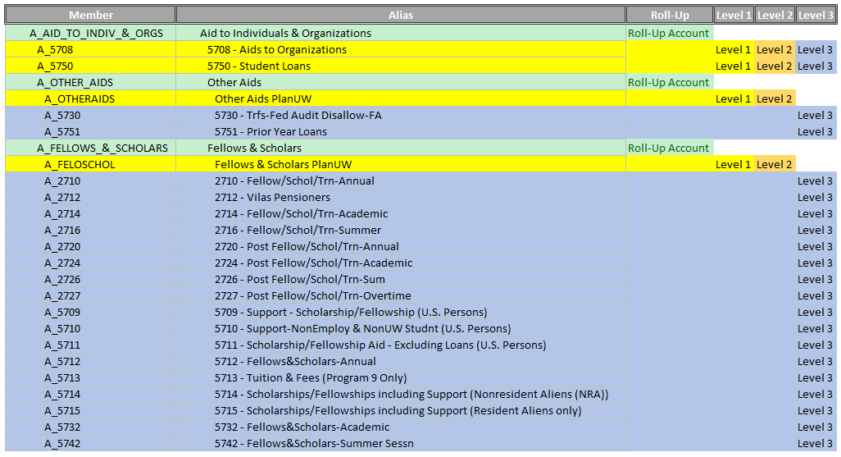
Non Comp Expenditures (Aid to Indv. & Orgs)
Aid to Individuals & Organizations
Unique Levels | 2
Level 1 accounts | 4
Level 2 accounts | 4
Level 3 accounts | 21
Account Overlap | Yes
Full or Partial Overlap? | Both
Levels with Overlap? | 1, 2 & 3
Full Overlap at levels 1 & 2
Partial Overlap at levels 2 & 3
Implication: Just like the partial overlap between Levels 2 and 3, using Level 1 vs. 2 vs. 3 does not change the meaning of the budgeted amount in accounts 5708 or 5750 as they are both distinct GL accounts. The choice between budgeting at levels 1, 2 and 3 simply implies what level of granularity you wish to use for the other aids rollups, and if you have amounts for those rollups.

Slide 33
Non Comp Expenditures (Special Purpose)
Special Purpose
Unique Levels | 3
Level 1 accounts | 1
Level 2 accounts | 2
Level 3 accounts | 3
Account Overlap | Yes
Full or Partial Overlap? | Partial
Levels with Overlap? | 2 & 3

Slide 34
Non Comp Expenditures (Debt Service)
Debt Service
Unique Levels | 2
Level 1 accounts | 1
Level 2 accounts | 1
Level 3 accounts | 2
Account Overlap | Yes
Full or Partial Overlap? | Full
Levels with Overlap? | 1 & 2

Slide 35
Non Comp Expenditures (Sales Credits)
Sales Credits
Unique Levels | 2
Level 1 accounts | 1
Level 2 accounts | 1
Level 3 accounts | 2
Account Overlap | Yes
Full or Partial Overlap? | Full
Levels with Overlap? | 1 & 2

Slide 36
Revenue Accounts

Slide 37
Level 1
51 Accounts
Level 2
60 Accounts
Level 3
265 accounts
All G/L Accounts
Revenue Levels

Slide 38
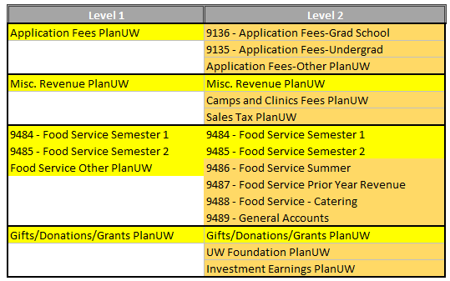
Revenue
There are only 11 Revenue accounts that exist at Level 2, but not at Level 1 (highlighted in Orange in the table below). These level 2 accounts provide more detail for:
Application Fees
Misc. Revenue
Food Service, and
Gifts/Donations/Grants
Example:

Slide 39
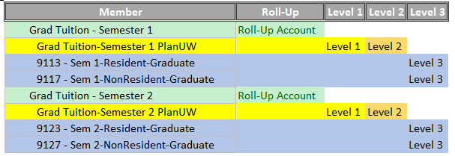
Revenue cont.
This means that there is no difference between budgeting at Level 1 or at Level 2 for:
Tuition
Misc. Fees
Segregated Fees
Continuing Ed Fees
Housing Revenue
Parking Revenue, and
Textbook Sales & Rental

Slide 40
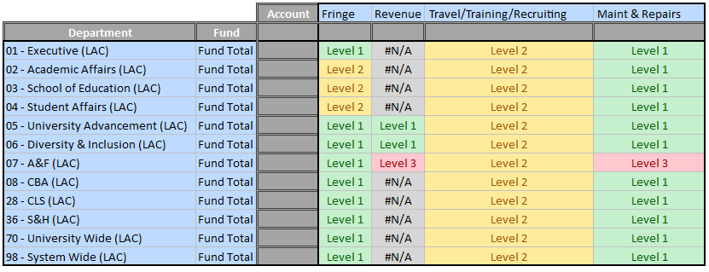
So now what? What levels should I use?
There are no requirements from system, so the decision falls to the Institutions - But how do I go about deciding?
Recommendation – Use the Budget Account Level Documentation to develop a matrix about what levels you plan to use by the account categories, divisions, funds, etc. – Go as granular or High level as you would like or need!
An example may look like the following:
This is not required, and there is no set format to use, but this exercise may help Institutions in deciding what levels to use for what.

Slide 41
Questions?

