Slide 1
Smart View

Slide 2
Course Objectives
In this course, you will be introduced to Smart View.
An overview of SmartView in the PlanUW environment
Smart View Options Setup
Opening Forms and Reports in Excel
Connecting via the Panel option in Smart View
Creating Ad-Hoc Reports in Smart View

Slide 3
Smart View

Slide 4
Smart View
Smart View provides a common Microsoft Office interface for Oracle’s Enterprise Performance Management (EPM)
Using Smart View allows users to view, import, manipulate, distribute, and share data through Microsoft Excel, Word, and PowerPoint interfaces
Smart View benefits include:
A common Microsoft Office interface for all PlanUW users
Ad hoc or Free-form Analysis
Decreased Query time
Ability to import documents from Financial Reporting and quickly create custom reports

Slide 5
Is Smart View Downloaded?
How can you tell if you Smart View is downloaded in your system?
When Smart View is downloaded in your system, it creates a Smart View ribbon in Excel.
If this ribbon is not found, either Smart View is not installed or the process of installation requires additional steps
If Smart View is not installed, please contact your institution’s IT Department.

Slide 6
Smart View Options Set Up

Slide 7
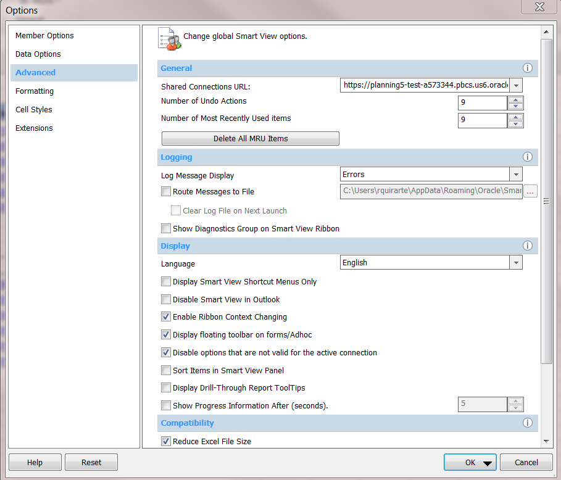
Smart View Set Up - Setting URL
To update the default URL, copy the URL below, select the Smart View Tab > Options >Advanced> Paste URL.
- TRAINING URL: https://planning4-test-a573344.pbcs.us6.oraclecloud.com:443/HyperionPlanning/SmartView
To continue, DO NOT click on OK yet. Move on to the next slide to continue with the set up

Slide 8
Smart View Set Up - Setting URL
POD | LINK TO TEST ENVIRONMENT
PLNUWNE | https://planning4-test-a573344.pbcs.us6.oraclecloud.com:443/HyperionPlanning/SmartView
PLNUWMSN | https://planning-test-a573344.pbcs.us6.oraclecloud.com:443/HyperionPlanning/SmartView
PLNUWMIL | https://planning2-test-a573344.pbcs.us6.oraclecloud.com:443/HyperionPlanning/SmartView
PLNUWSO | https://planning3-test-a573344.pbcs.us6.oraclecloud.com:443/HyperionPlanning/SmartView
PLNUWWST | https://planning5-test-a573344.pbcs.us6.oraclecloud.com:443/HyperionPlanning/SmartView

Slide 9
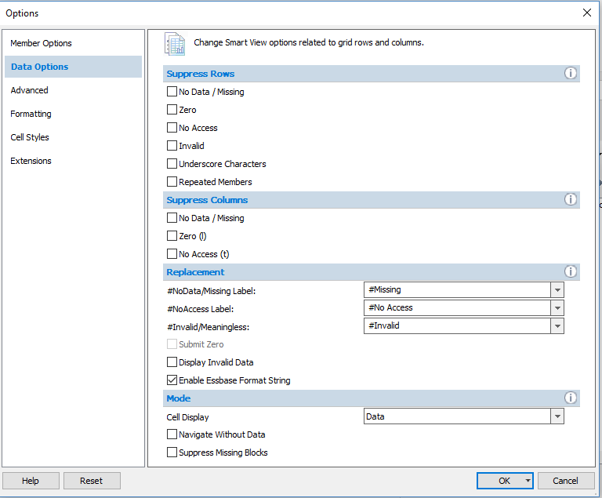
Unchecking all Suppression – Data Options
Select Data Options, deselect ‘Suppress Missing Blocks’ and validate that ‘Suppress Missing Data’ within the rows and columns are not checked.
Uncheck
If an error appears saying ‘Ad Hoc grid cannot be opened as there are no valid rows of data’ select ‘Options’ in the Smart View ribbon.
Uncheck

Slide 10
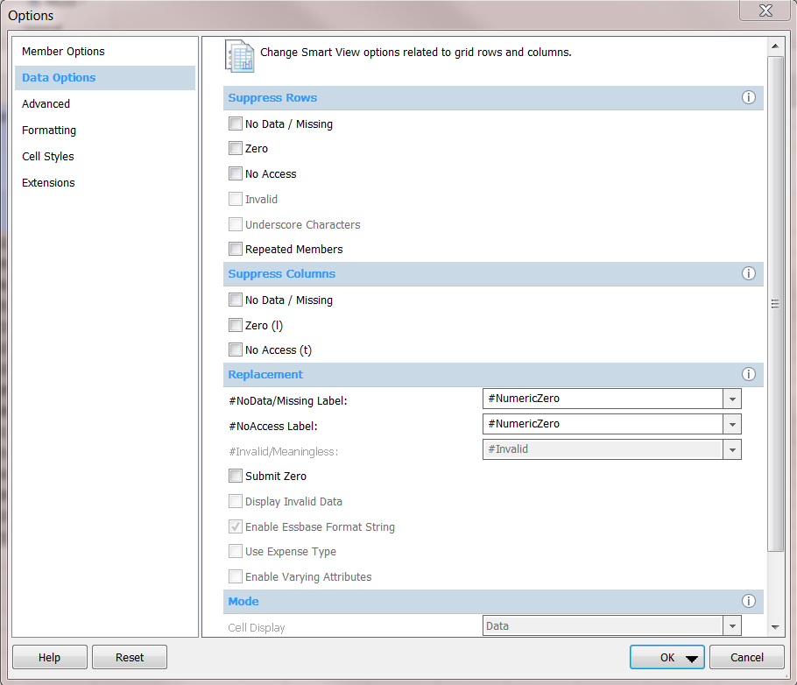
Suppression and Replacement
Within Data Options, navigate to Replacement, adjust #NoData/Missing Label and #No Access Label to #NumericZero
Based on user preference, the #NoData/Missing Label and #NoAccess Labels can be updated.
Replacement

Slide 11
Opening Forms in Excel

Slide 12
Opening Forms in Excel
To access forms in Excel using Smart View:
Access the desired form to export in PlanUW
Click on the Actions drop down
Click on Open in Smart View

Slide 13
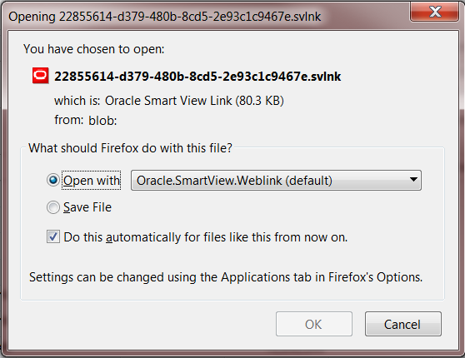
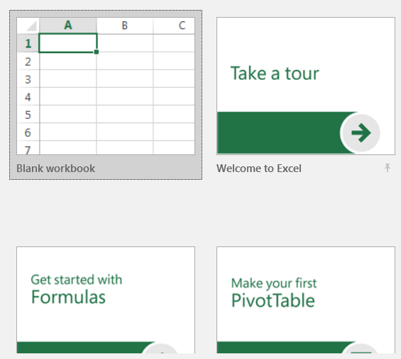
Opening Forms in Excel – Firefox Browser
When this prompt appears, the user has the option of saving the file or opening it. Click on Open with to continue.
Simultaneously, the file will be downloaded on the browser used for PlanUW, and Excel will open. Click to open a Blank Workbook.
Once the blank Excel workbook opens, return to PlanUW and click on the recently downloaded file to open the form in the blank workbook.

Slide 14
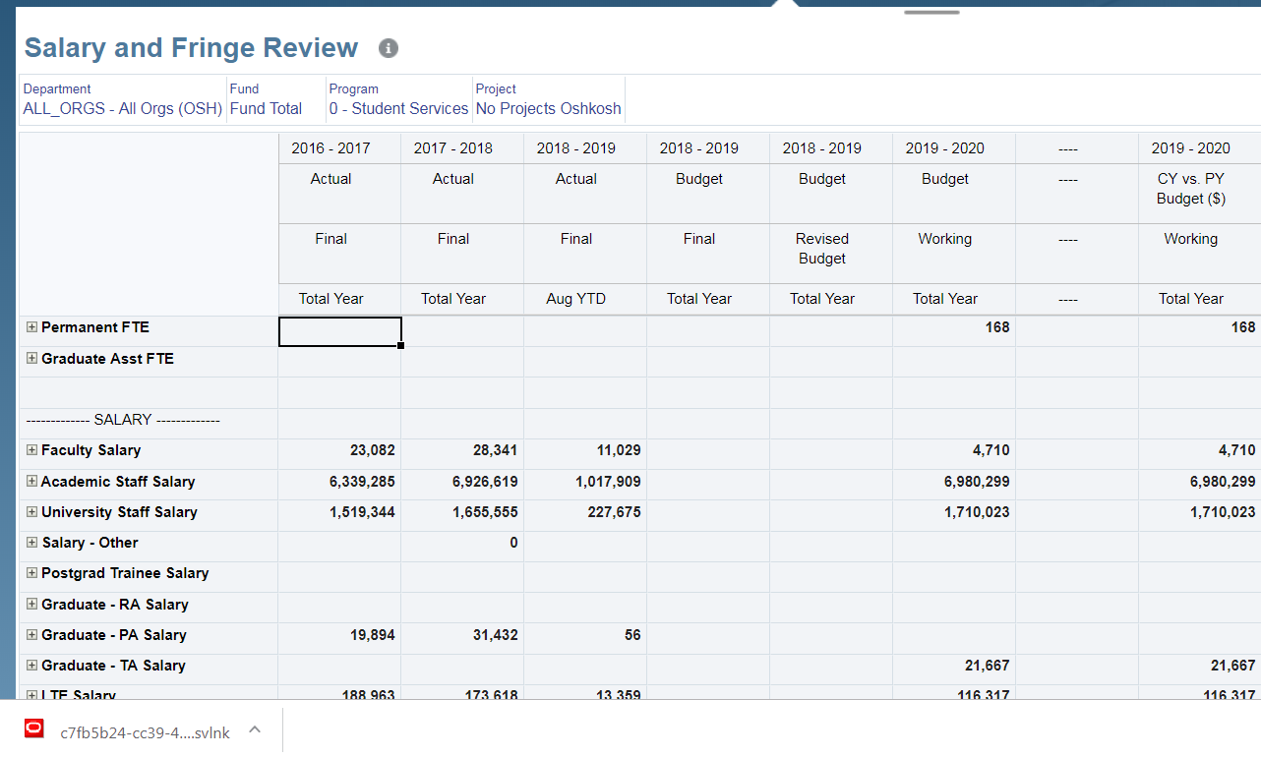
Opening Forms in Excel – Chrome Browser
If you are using Chrome as a browser to use PlanUW, remember that the file will download to the bottom of the page. Click on the file once it downloads.

Slide 15
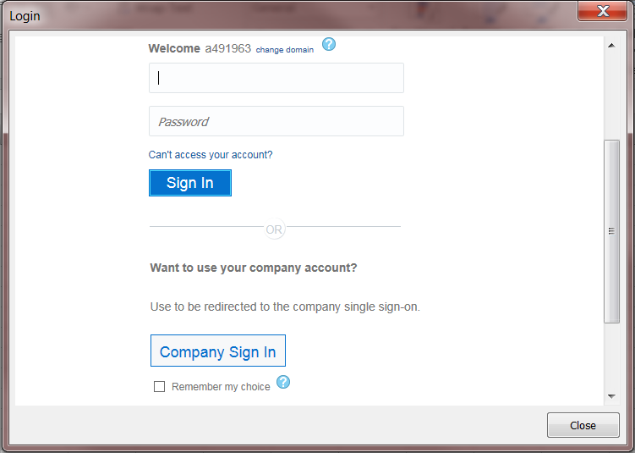
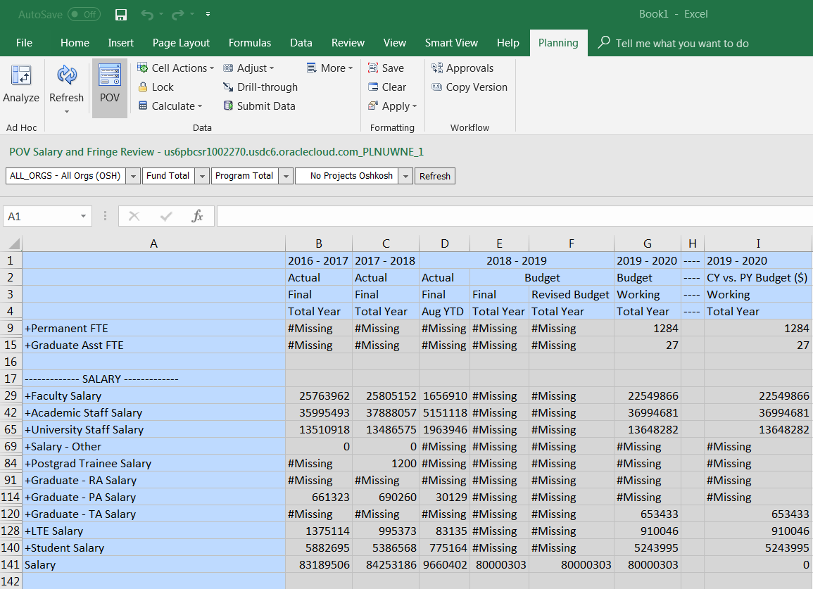
Opening Forms in Excel
Continue to sign in. Once the login credentials are accepted, the form will open in Excel as shown.
Currently there is a workaround necessary for submitting and pushing data in Smart View forms. All steps of this work around in the appendix of the presentation.

Slide 16
Opening Reports in Excel

Slide 17
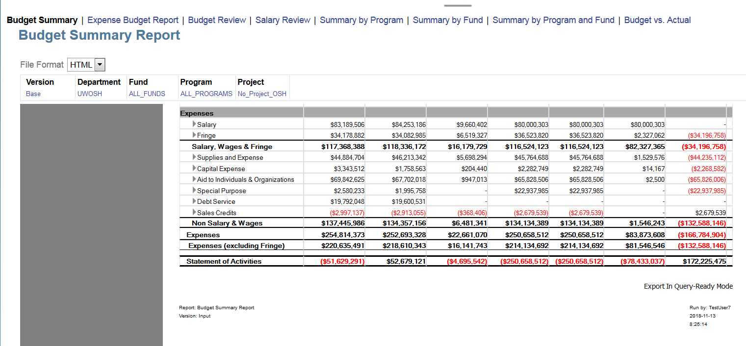
Opening Reports in Excel using Firefox
To access reports in Excel, first find the desired report and select the HTML File Format.
Once the report displays, scroll down to the Export In Query-Ready Mode and click on it.
Notes:
Note how “Query Ready Mode” is different from “Excel” file format

Slide 18
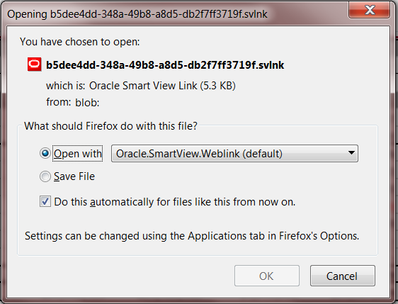
Opening Reports in Excel using Firefox
When this prompt appears, the user has the option of saving the file or opening it. Click on Open with to continue.
Simultaneously, the file will be downloaded on the browser used for PlanUW, and Excel will open. Click to open a Blank Workbook.
Once the blank Excel workbook opens, return to PlanUW and click on the recently downloaded file to open the Report in the blank workbook.

Slide 19
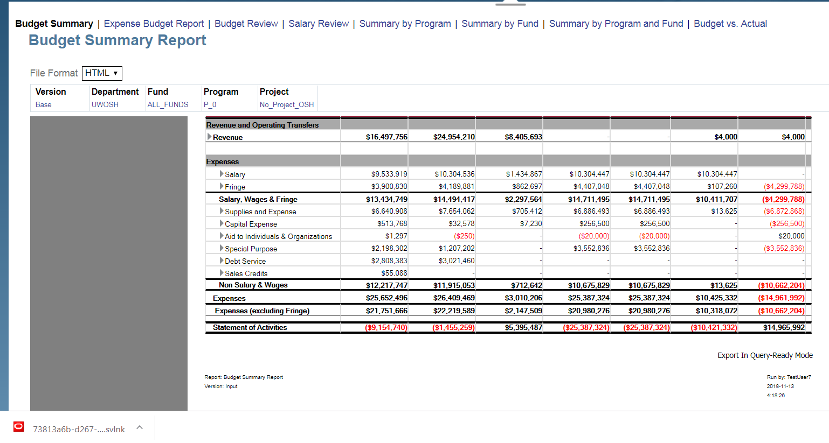
Opening Reports in Excel – Chrome Browser
If you are using Chrome as a browser to use PlanUW, remember that the file will download to the bottom of the page. Click on the file once it downloads to open the report in Excel.

Slide 20
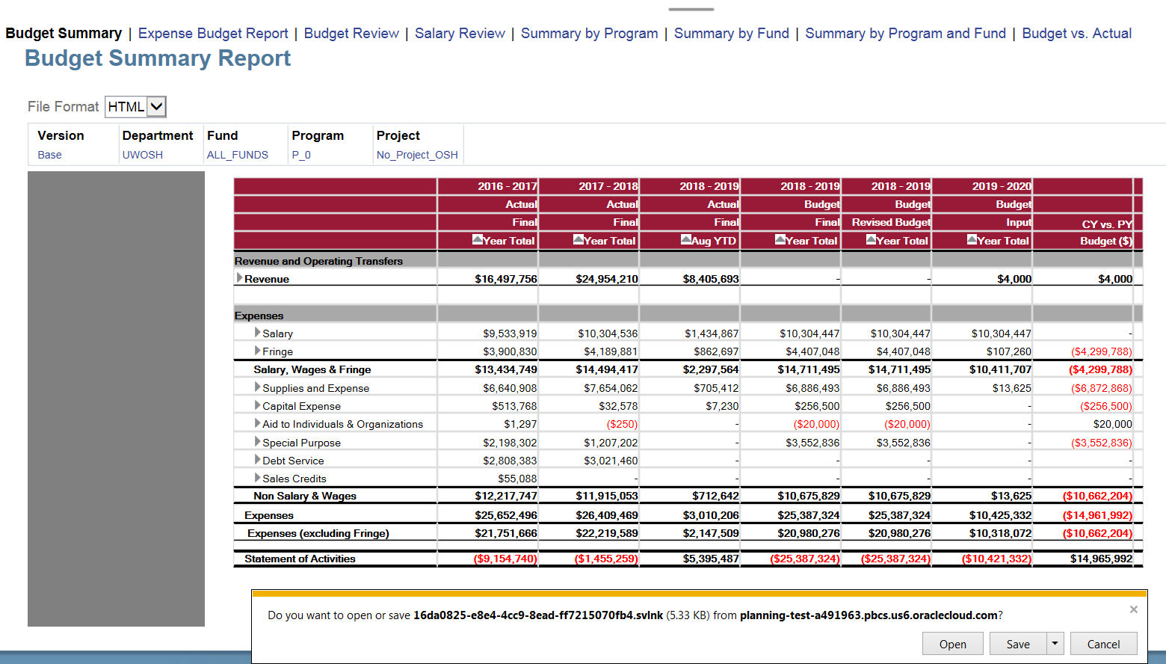
Opening Reports in Excel – Internet Explorer Browser
If you are using Internet Explorer as a browser to use PlanUW, the Open or Save prompt will appear at the bottom of the page. Click on Open to continue.

Slide 21
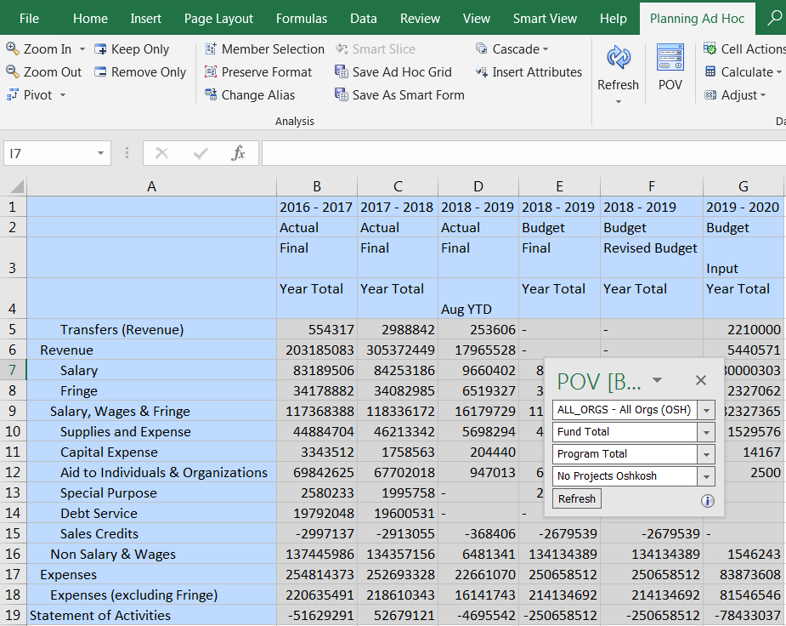
Opening Reports in Excel
The last step via any browser is to sign in. The sign in pop up will appear. Enter your username and password, and click on Sign In.
The report will open now in Excel.

Slide 22
Connecting via the Panel

Slide 23
Connecting Via the Panel Option
To access forms via the Panel option in Excel, select the Smart View ribbon and click on the Panel option highlighted below.
Smart View Ribbon
Select Panel to create data source connections

Slide 24
Data Source Connections
The Smart View panel contains the following panes:
Home - Links to Shared Connections and Private Connections and a list of recently used items.
Shared Connections - Drop down list of available connections from Hyperion Shared Services - Including currently selected connection
Private Connections - Drop down list of available connections that is saved on a user’s local computer - Including the currently selected connection
Recently Used - A list of connections that were recently used on a user’s local computer.
Click Shared Connections
‘Action’ Panel
Shared Connections are stored in a in a central location and can then be saved as private connections. You can edit private connections as well as use them to connect to other applications.

Slide 25
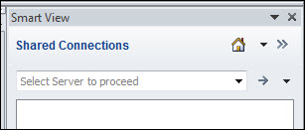
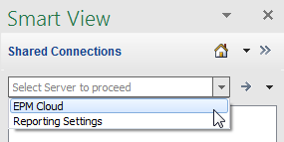
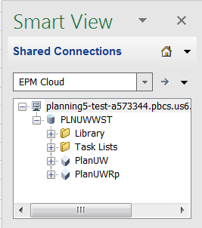
Managing Database Connections
Connection type must be selected from the drop down list.
Select connection type from the drop-down in the ‘Action’ panel
Select “EPM Cloud”
Once EPM Cloud is selected, the action panel will display available databases in a tree list. We can also pull forms which provide an intuitive layout for you to work with to enter data.
Select desired cube and click Connect, or double-click on desired cube
Expand tree list

Slide 26
Connecting to Planning Ad Hoc Ribbon
After a connection is made, select ‘Ad hoc analysis’ at the bottom of the dialog box to start an ad hoc analysis grid or spreadsheet
Select Ad Hoc analysis
Planning Ad Hoc ribbon
Notice that both a Smart View and a Planning Ad Hoc ribbon are present after an ad hoc spreadsheet connection is made.

Slide 27
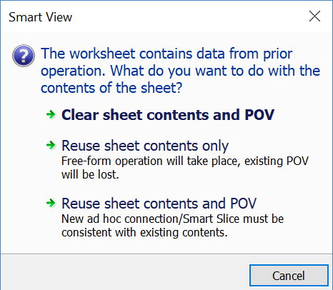
Reconnecting an old SmartView template
Smart View ad hoc grids can be saved in an Excel workbook and reconnected at a later time. To reconnect the workbook follow the same steps in the slides above to connect via the Panel.
After clicking Ad hoc Analysis on an old template, the user will be prompted with the selections below.
To use the old workbook exactly as is, select Reuse sheet contents and POV. This is the most common option.
To use only the grid from the old workbook, select Reuse Sheet contents only. The POV will be reset.
To completely reuse the sheet, select Clear sheet contents and POV. This will reset the grid and the POV.

Slide 28
Using Smart View

Slide 29
Smart View Options
The following slides demonstrate steps for changing Smart View options…..

Slide 30
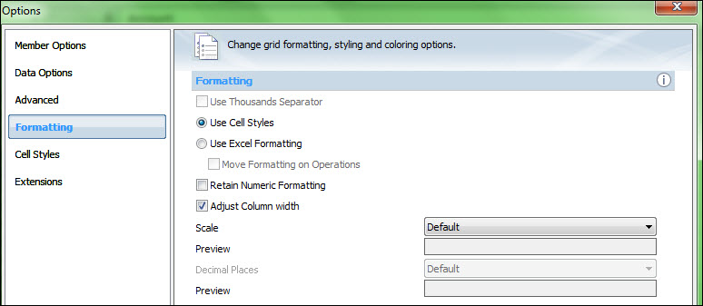
Enabling Automatic Column Width Adjustment
In Smart View Options, under Formatting, enable the automatic adjustment of Excel column width to accommodate the contents of member and data cells.
Select Adjust Column Width
If ‘Adjust column width’ is not selected, you can adjust the width of columns manually.

Slide 31
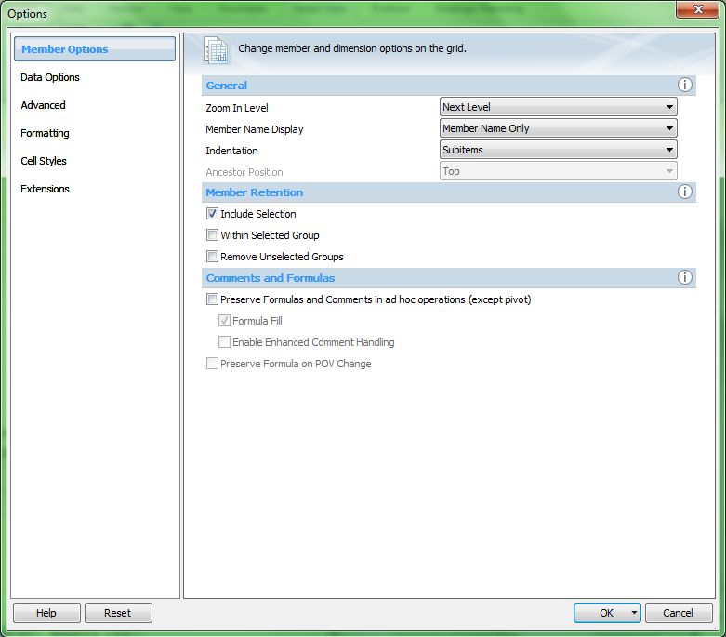
Excel Formulas
Excel formulas are preserved when you perform ad hoc operations, except for Pivot.
To execute queries more quickly, you can disable the preservation of formulas and comments.
However, if you select this option,
formulas are overwritten when you
perform ad hoc operations.
Do this only if you do not need to
preserve formulas and want to
execute queries faster.
Select or deselect ‘Preserve Formulas’

Slide 32
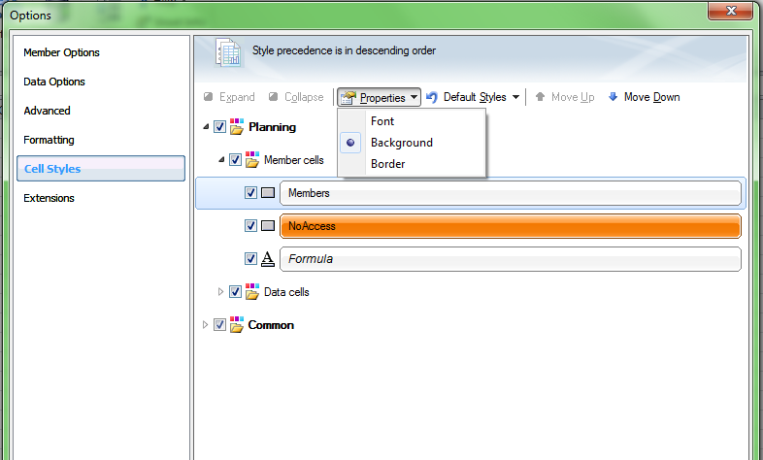
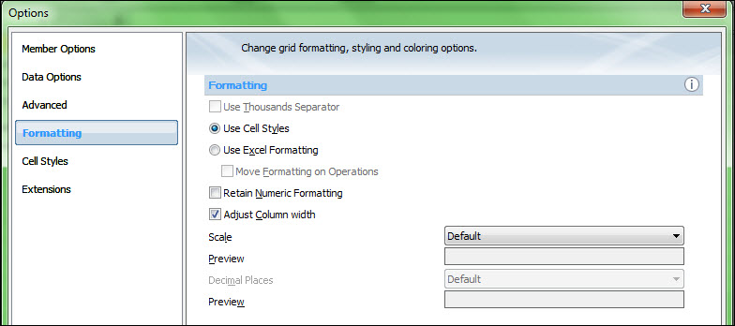
Formatting
Using Smart View (Cell Styles) Formatting
Set cell styles within the ‘Cell Styles’ section of the dialog box using the ‘Properties’ drop down.
The ‘Cell Styles’ use must be set in the ‘Formatting’ section of the ‘Options’ dialog box.
Using Excel Formatting
With this option selected, If you use Excel formatting, your formatting selections, including conditional formatting, are applied and retained on the grid when you refresh or perform ad hoc operations.
NOTE: To copy parent cell formatting to zoomed-in cells, select Move Formatting on Operations.

Slide 33
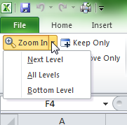
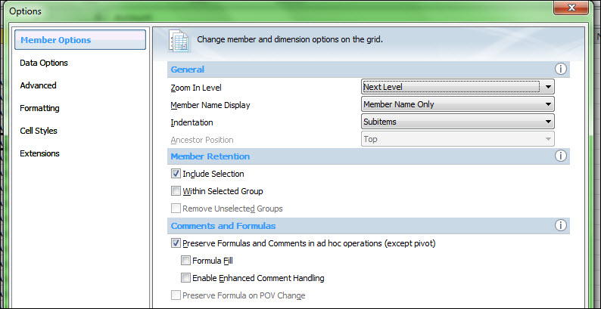
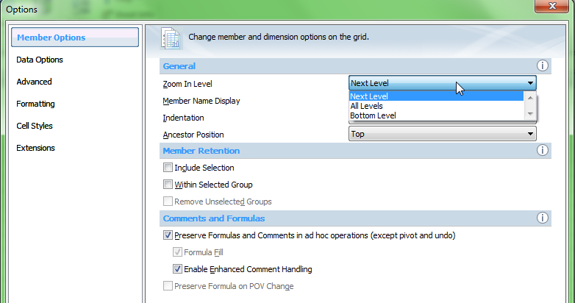
Smart View Zoom
Smart View allows for zooming in on a member in a grid to display data for their children and descendants.
Zoom In and Zoom Out
You can set options to specify which members are retained and displayed as zooms occur, as well as set a default zoom level.
Member Retention Selections

Slide 34
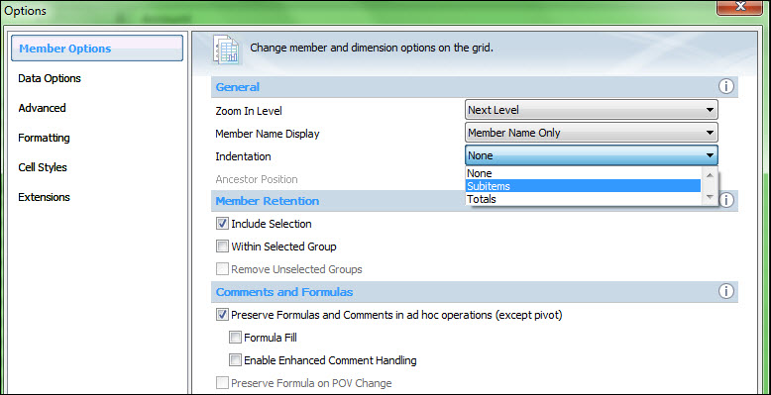
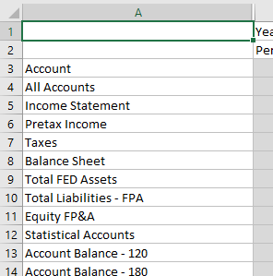
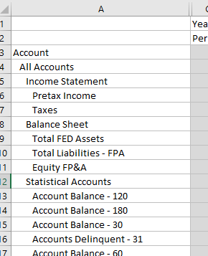
Indentation
To aid in presentation and identification of varying levels of members, Smart View allows the setting of indention for members within Smart View Options>Member Options.
Adjust Indentation
Indentation: ‘None’
Indentation: ‘Subitems’

Slide 35
Ad Hoc Analysis:
Pivoting, Keep Only/Remove Only, Cascade

Slide 36
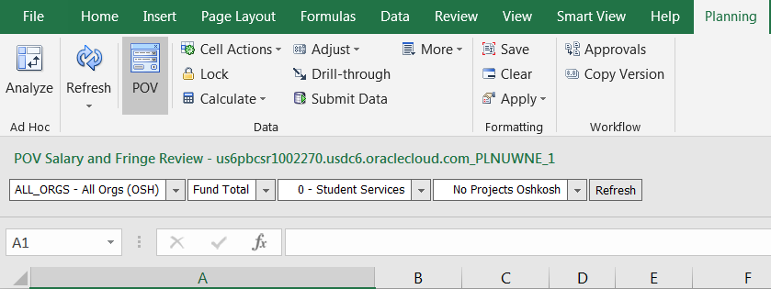
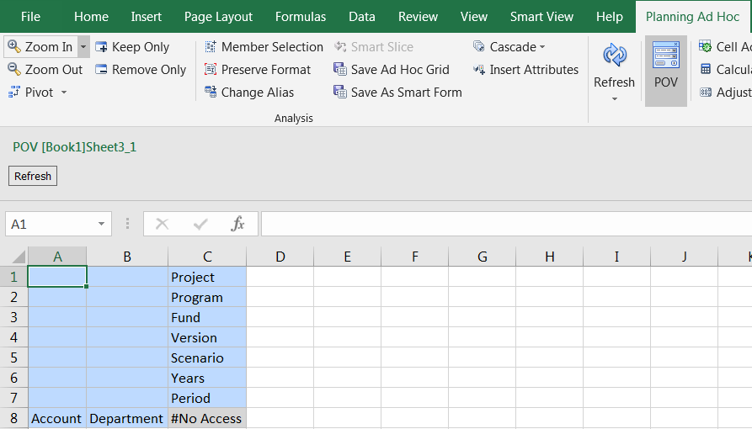
Select Dimension/Dimension Members in Grid Format
In the Planning Ad Hoc ribbon, the dimensions can be displayed, in POV toolbar, in rows and columns, or floating POV box
POV display toggle
1. POV Selection Box display:
Dimension display in POV Toolbar
Dimension display Floating POV box
POV display toggle
3. Floating POV Box display:
2. Row and Column display:
Dimension display in row, column view

Slide 37
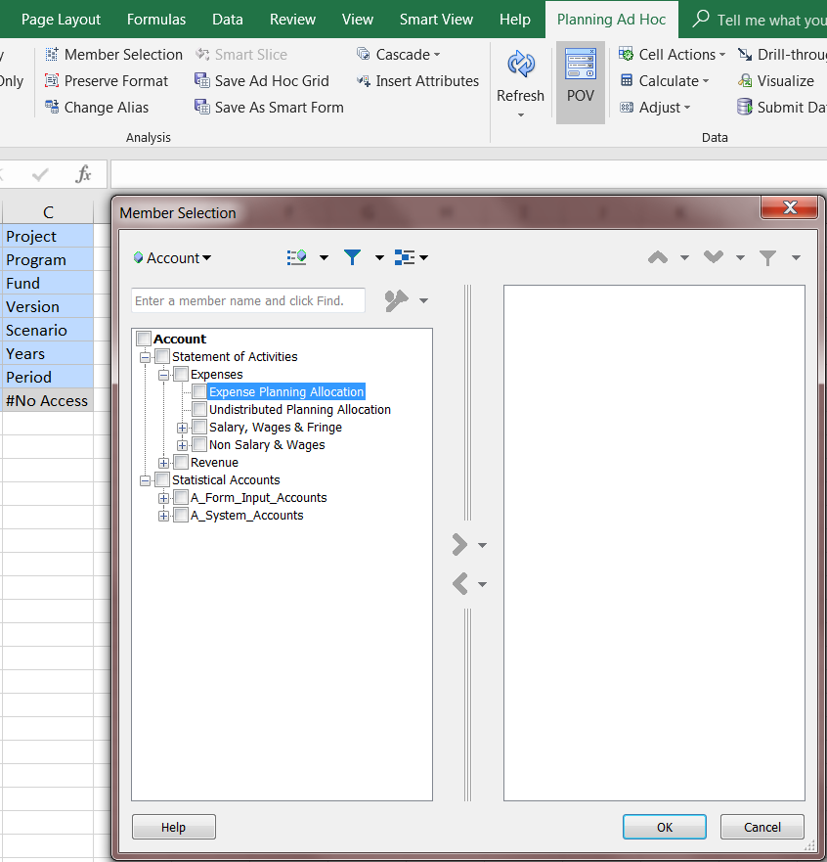
Selecting Members
Smart View allows for member selection in three ways: member selection, direct input, or the POV toolbar selection
Member Selection
Option 1: Member Selection - Highlight the member in the spreadsheet and click on the ‘Member Selection’ from the Planning Ad Hoc ribbon. A dialog box displaying the available selections within the highlighted dimension will then be displayed.
Check the box of the member to select. Then move to the right side by clicking on the right arrow.
The drop-down arrows next to the movement arrows allow you to select if you want a relative of that member, such as “Children of All Accounts.”
Search Box
Available Selections
Movement arrows

Slide 38
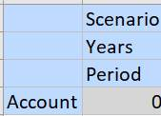
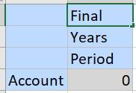
Selecting Members
Smart View allows for member selection in three ways: member selection, direct input, or the POV toolbar selection
Option 2: Direct Input - The member name can be directly entered into the spreadsheet cell containing the dimension. NOTE: When using this option, the member name must be entered in exactly as it is displayed in PlanUW, otherwise it will not be recognized. It is not case sensitive.

Slide 39
Selecting Members
Smart View allows for member selection in three ways: member selection, direct input, or the POV toolbar selection
Option 3: POV toolbar selection - Click on the drop-down arrow to the right of a dimension in the POV toolbar. Next, click on the ellipsis - this displays the ‘Member Selection’ dialog box. The member selection process is the same as Option 1.
In the example below, a number of additional Scenarios were selected in the member selection dialog box of Scenario
The POV Toolbar also allows for typing the member name directly into the POV Toolbar. As an example, to change the Scenario from Actual to Budget.
You can also type in the member name directly in the POV toolbar as long as you know the exact spelling.
Type in member name Actual
Click drop-down arrow and click the ellipsis
Additional Scenarios
Click Refresh

Slide 40
Toggling Between POV Toolbar and Row, Column
Members can also be moved to the POV Toolbar from the spreadsheet and moved from the spreadsheet into the POV Toolbar.
To move from the POV Toolbar, right click the drop-down arrow next to the dimension and drag it to the grid.
The reverse can be done to move a member from the spreadsheet to the POV Toolbar by right-clicking on the member in the spreadsheet and dragging to the POV Toolbar.
Right click on drop down arrow

Slide 41
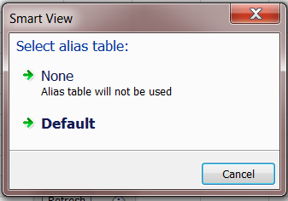
Aliases and Alias Tables
Aliases are alternate names for database member names. Database member names are often numbers or account codes; their aliases can be more descriptive.
To set an alias table for the current worksheet, select ‘Change Alias’ from the Planning Ad Hoc ribbon.
Select ‘Change Alias’
If the user selects the None option, the Alias table for members will not be used.

Slide 42
Pivoting
You can pivot a dimension between rows and columns if there are two or more dimensions in the row or column that contains the dimension that you want to pivot.
If you do this, the other members in its group are also pivoted.
Pivot

Slide 43
Undo and Redo
In Smart View data source, ‘Undo’ undoes the Zoom In, Zoom Out, Keep Only, Remove Only or Refresh by restoring the view prior to the execution of the last command.
NOTE: You cannot undo operations that are performed on the server rather than within Smart View, such as calculations, refreshes, and submitting data.
There are a limitation on the number of times a user can “undo.” To specify the number of permitted undo and redo actions, adjust this in Smart View Options (see below)
Undo and Redo

Slide 44
Keep Only/Remove Only
You can remove members and the associated member data from the grid.
‘Keep Only’ and ‘Remove Only’ operate on all instances of the selected members in the grid.
Keep Only and Remove Only

Slide 45
Data and Data Cells

Slide 46
Data and Data Cells – Retrieving Data
In Smart View once your grid is set, you can retrieve and refresh data. You have the option to refresh within the current worksheet or for all worksheets in the workbook. Refresh brings back the most current data in PlanUW.
Select Refresh or Refresh All Worksheets

Slide 47
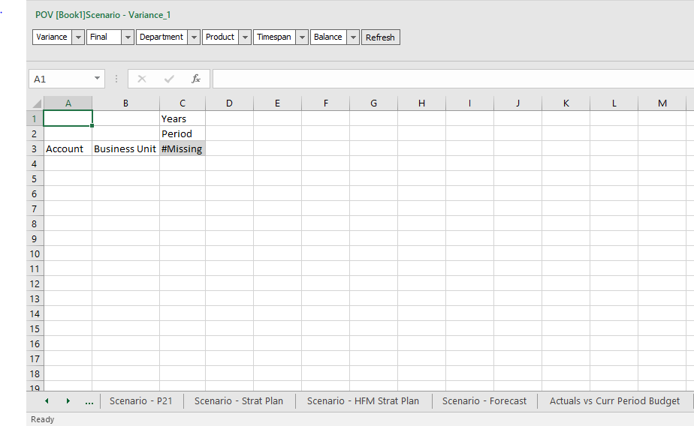
Cascade
The purpose of cascading is to create one standard format for a report and reuse it across the dimension being cascaded.
The benefit is to standardize and reduce the amount of effort and maintenance required to produce a booklet of reports.
Select Cascade
Select the dimension to cascade and the members within that dimension to cascade

Slide 48
Copying and Pasting Sheets
Allows for the copying of the dimensions, layout, and connection settings from one sheet within Excel to another.
A new sheet will appear with the grid contents of the sheet you copied. You will then Import Metadata.
Drop Down
Move or Copy
Move to End
OK
Import Metadata

Slide 49
Copying and Pasting Sheets
The POV will match that of the sheet that was initially copied.
Yes
Refresh

Slide 50
Course Summary

Slide 51
Completed Course Summary
In this course, you have been introduced to the PlanUW system.
You have learned about:
An overview of Smart View in the PlanUW system
Smart View Options Setup
Opening Forms and Reports in Excel
Connecting via the Panel option in Smart View
Using Smart View!

Slide 52
Support Resources
You can use the following resources for reference and support:
This course, located on the UW System Website/Plan UW: Planning & Budgeting Cloud Service
Project Website: https://www.wisconsin.edu/budget-planning/system-project/
Coworkers and Subject Matter Experts
Available Quick Reference Guides:
Process KBS
Reporting KBS
User Guides

