Slide 1
PlanUW Implementation
SmartView Webforms and Ad Hoc Grids
March 19, 2019

Slide 2
SmartView Forms and Grids

Slide 3
What is a Webform?
Webforms are used for a variety of purposes in PlanUW including:
Reviewing historical data
Entering new budget data
Facilitating the Fringe Rate, Budget Approval, and Version Copy processes
Controlled Dimensionality
All dimensions(Accounts, Depts, Funds, Programs, Projects, etc.) are built into all webforms and locked into place. How these dimensions are set and whether or not they are visible to the end user is all defined by the development team and cannot be altered by end users. Dimensions are locked in either the Point-of-View or in the Rows or Columns.
Point-of-View(POV)
Webforms have a predetermined POV that limits the list of available members an end user has to choose from for a given dimension.
Rows and Columns
Webforms have a fixed set of rows and columns, which are either displayed or hidden as a result of suppression.

Slide 4
What is an Ad Hoc grid?
SmartView Ad Hoc analysis can be used for a variety of purposes including:
Reviewing historical data
Entering new budget data (NOT RECOMMENDED)
Data analysis and on-demand reporting
Slicing and Dicing!
Free-form Dimensionality
All dimensions(Accounts, Depts, Funds, Programs, Projects, etc.) are used to create an Ad Hoc grid. However, unlike webforms, ad hoc grids can be configured and manipulated by end users. Dimensions can be moved(or “pivoted”) easily between the Point-of-View, Rows, and Columns.
Point-of-View(POV)
Ad Hoc grids have undefined POV dimensions, which list all available members within a dimensions allowing end user to freely choose any members.
Note that security will still limit how the user can interact with the data. For example, an end user may pull an intersection that they do not have access to, but they will be shown #NoAccess instead of the actual data value.

Slide 5
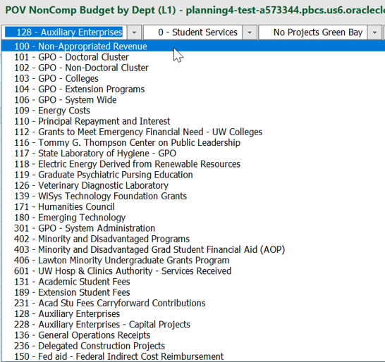
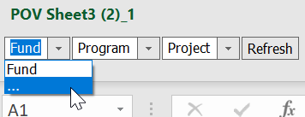
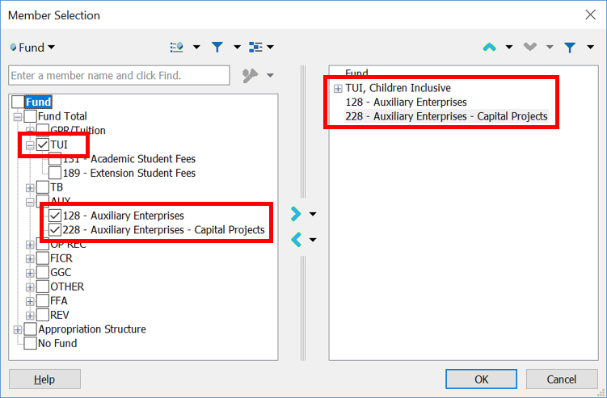
Build-Your-Own POV
Webforms:
Predefined list of available members
No flexibility for inclusions or exclusions
Ad Hoc:
Build your own list of members
Cherry-pick specific members or use functions to create a custom list

Slide 6
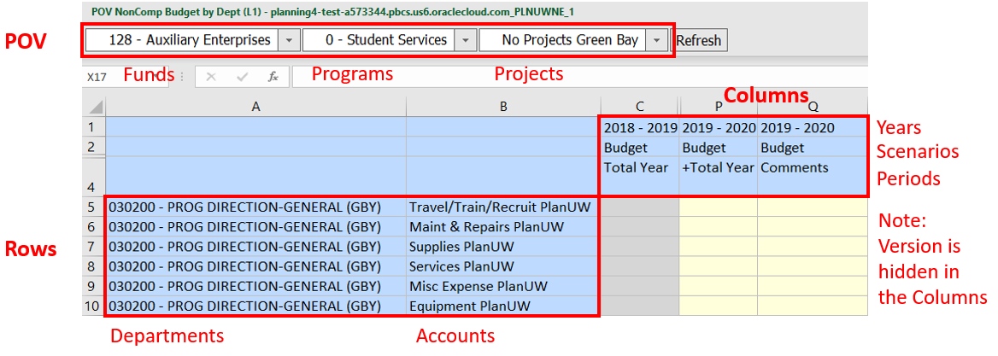
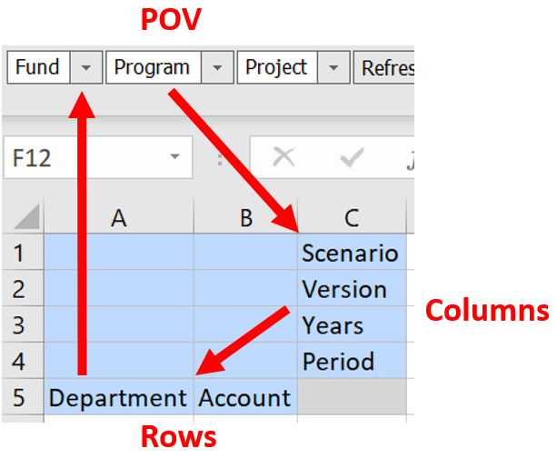
Customize the Grid
Webforms:
Dimensions are locked in POV, Rows, or Columns
Users can enter data to YearTotal or individual Months
Ad Hoc:
Pivot dimensions freely between the POV, Rows, and Columns
Use SmartView and Excel functionality to add/remove and change dimension members
Users must enter data to individual Months

Slide 7
Submit Data
Webforms:
Users may navigate to the Planning tab and click Submit Data
Ad Hoc:
Users may navigate to the Planning Ad Hoc tab and click Submit Data
** This is NOT RECOMMENDED **
Both:
Users may navigate to the Smart View tab and click Submit Data

Slide 8
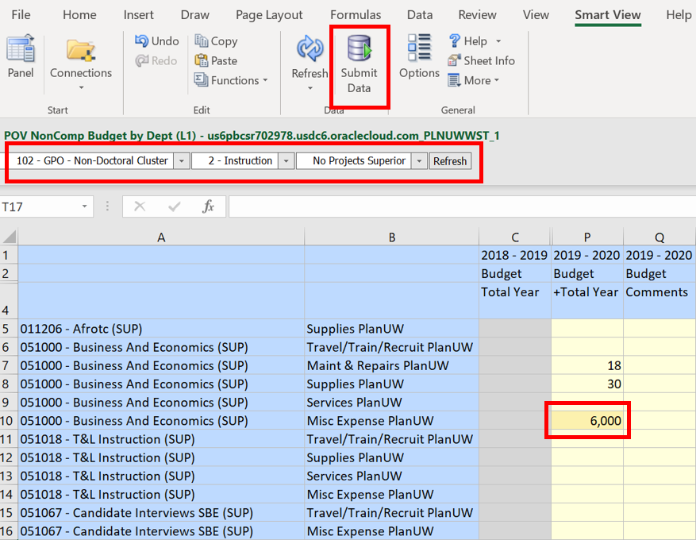
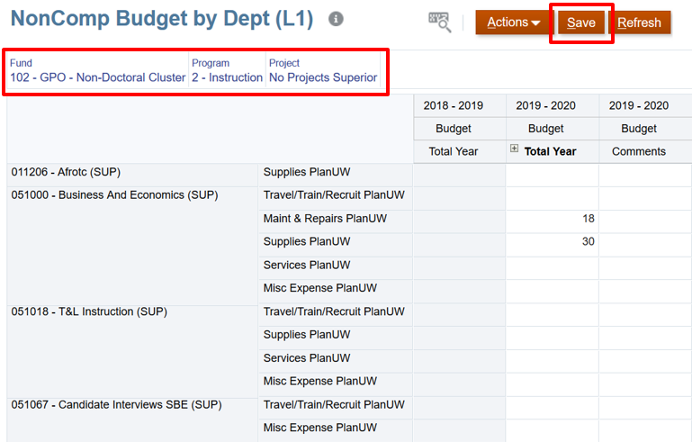
Business Rules and Data Pushes
Webforms:
Data is automatically pushed to Reporting Cube upon clicking Submit Data
Business Rules run automatically upon clicking Submit Data
Ad Hoc:
To push data to Reporting Cube and run Business Rules:
Users must navigate to a Webform in PlanUW that contains the data they entered (all dimensionality present in Ad Hoc grid MUST also be present in Webform) then click Save

Slide 9
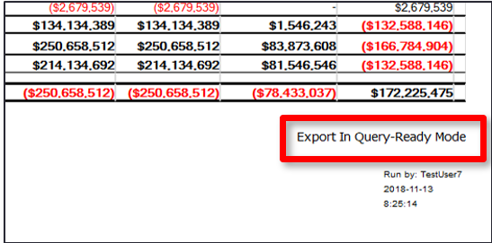
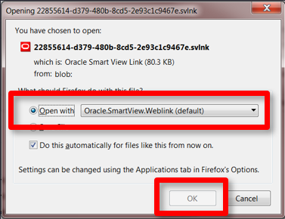
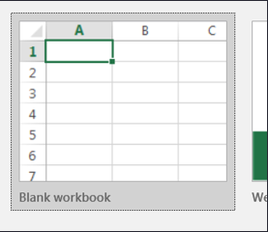
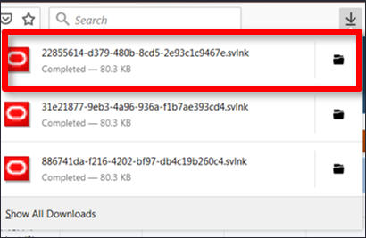
Opening Reports From the Web in SmartView
Quick Steps:
Select the desired report and view in HTML File Format. Click Export In Query-Ready Mode.
Click on Open with to continue. User has the option of saving the file or opening it.
Excel will open. Click to open a Blank Workbook.
Click on the recently downloaded file to open the Report in the blank workbook.
Export in Query-Ready Mode should be used on all Reports. It is a great place to get a starting point for building Ad Hoc reports.
Opening a report in Query Ready Mode allows the user to pivot columns and rows to analyze data in a manner applicable to them.
** Query Ready mode Equals Smart View Ad hoc**
1
2
3
4

Slide 10
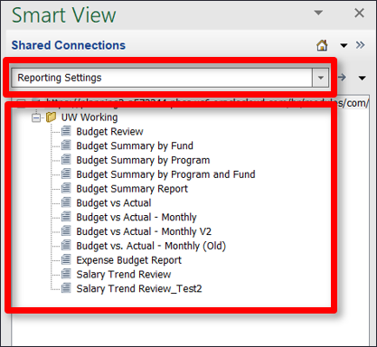
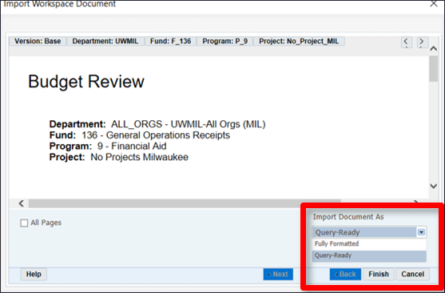
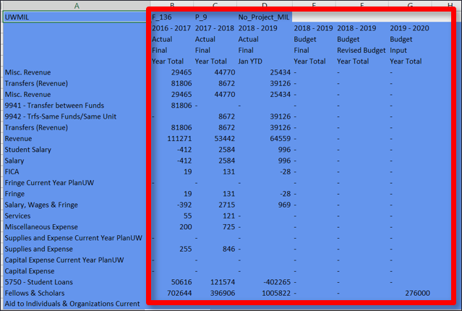
Opening Reports Directly from SmartView
Quick Steps:
Select Reporting Settings
Select “Query-Ready” or “Fully Formatted.” Click Finish.
A Grid will open.
** This does NOT provide the same functionality as taking a Report to Query-Ready Mode via the Web, and is NOT RECOMMENDED **
1
2
3

Slide 11
End Users: Roles and Responsibilities
Power Users
Update the Fringe Calculation Rates
Enter data in Webforms and perform Ad Hoc Analysis
Run Reports
Planners
Enter data in Webforms and perform Ad Hoc Analysis
Run Reports
Viewers
View data in Webforms and perform Ad Hoc Analysis in Read-Only mode
Run Reports

Slide 12
Webform vs Ad Hoc: Pros and Cons
Functionality | Webforms | Ad hoc
Preset Database Connection | X
Pre- Filtered Level 0 Members | X
Automatic Data Maps | X
Automatic Business Rules | X
Enter at “YearTotal” | X
Flexibility in Grid Design |  | X
Create Customized Dynamic Reports |  | X

Slide 13
I still want to enter data via Ad Hoc…
If you would still like to enter data in PlanUW via an Ad Hoc, please consider the following items:
​
If you are going to be submitting data via an Ad Hoc, please discuss with the admins and explain the use case. All questions/concerns should be submitted via PlanUW@uwsa.edu. ​
Submitting data in an Ad Hoc will NOT trigger the push to reports. All data is pushed to reports on a nightly bases, so at most there will be a one day lag.
**If immediate reporting is necessary the Data Push will need to be launched manually – please contact the admins for more information on this process*​*
Fringe rates should NOT be submitted via an Ad Hoc, as there are Business Rules that need to be applied to calculate correctly ​
**If Fringe Rates are entered via an Ad Hoc, please contact the admins for more information on this process*​*

Slide 14
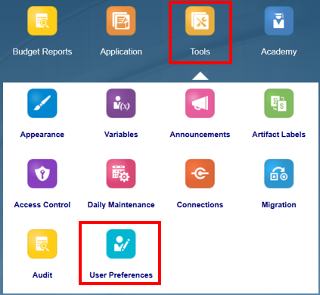
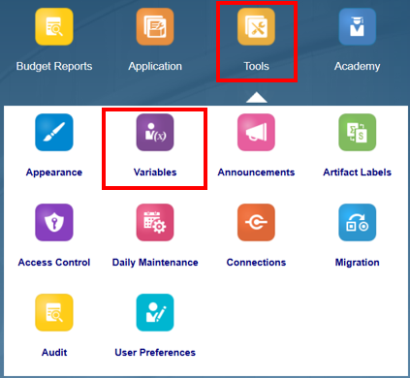
Setting User Variables as a Power Users
Power Users have access to “Define” the list of User Variables that all other users choose from. When this list is re-defined(intentionally or accidentally), it erases the User Variable selections ALL users have previously made, requiring ALL users to reselect their User Variable.
Do
Set your own individual User Variable under the User Preferences card
Don’t
Re-define the list of User Variables under the Variables card

