Slide 1
Plan UW - the redwood experience

Slide 2
Notable Changes in Redwood
New ‘look’ but functionality remains the same.
Forms and Reports tabs are located at the bottom of the page.
Forms Point of View (POV) items are selected from dropdown menu and render instantly once selected.
‘Actions’ dropdown limited but functionality is found elsewhere on the form.
Filter option on columns.

Slide 3
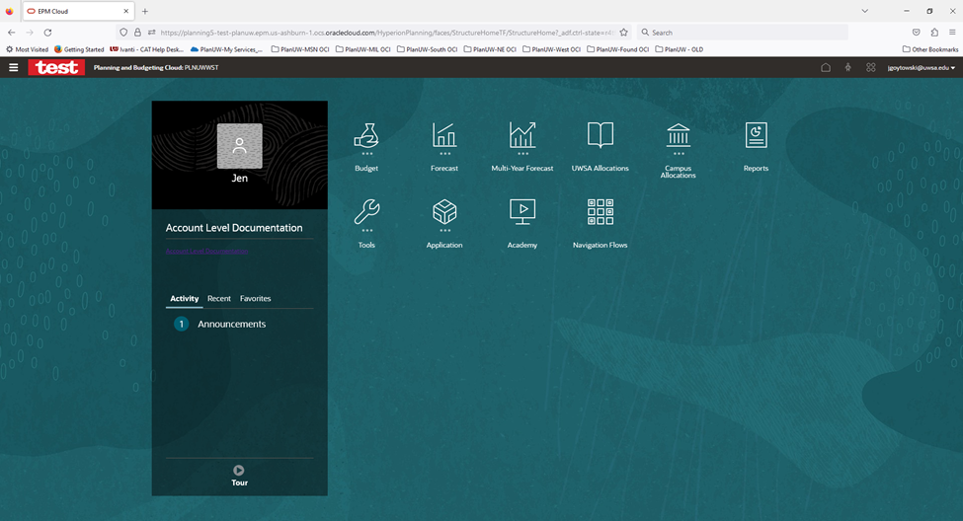
New ‘Look’

Slide 4
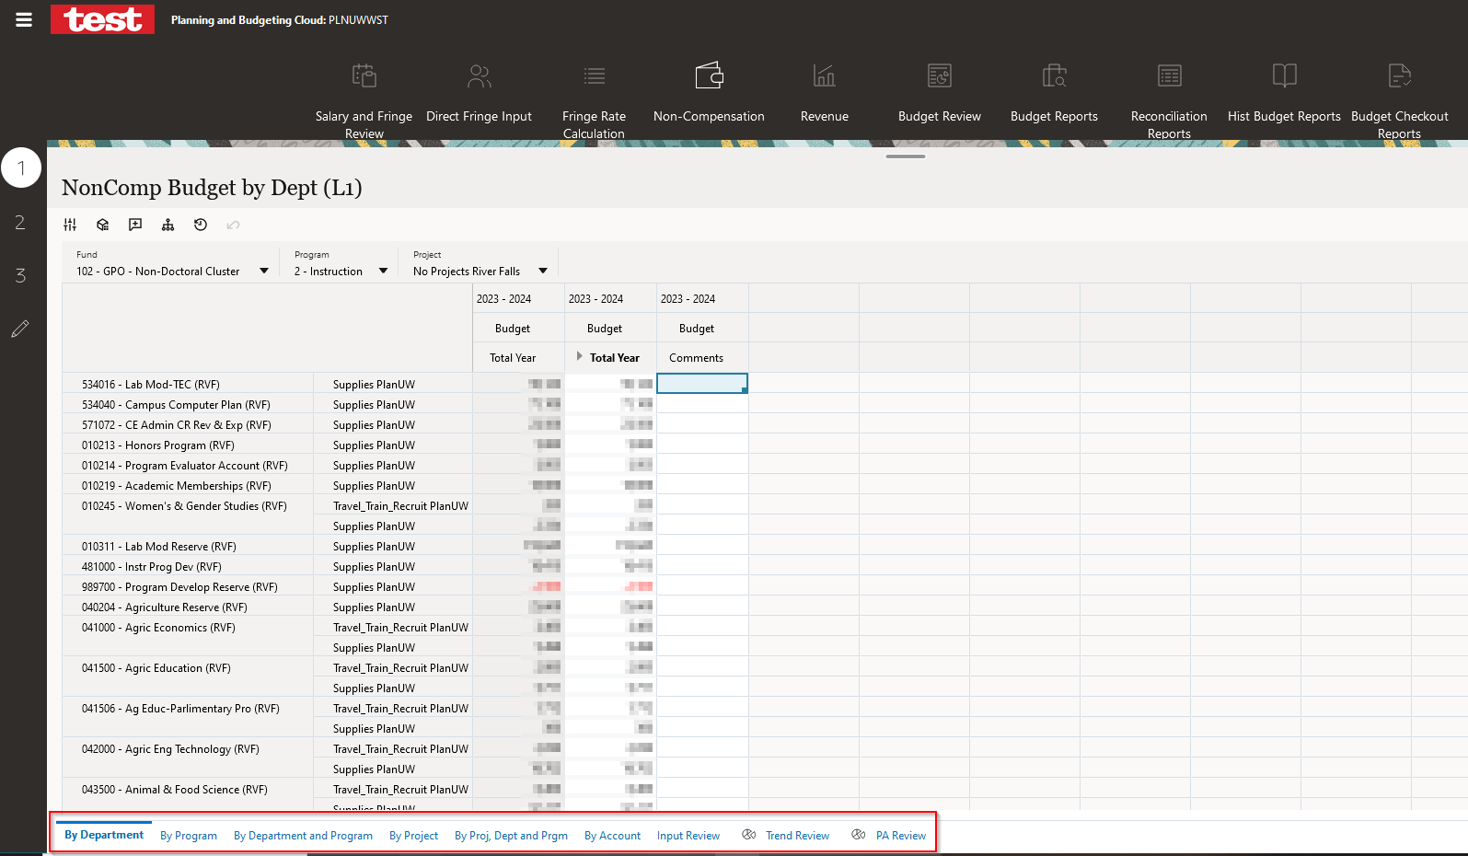
Form and Review tabs located at the bottom of the page.

Slide 5
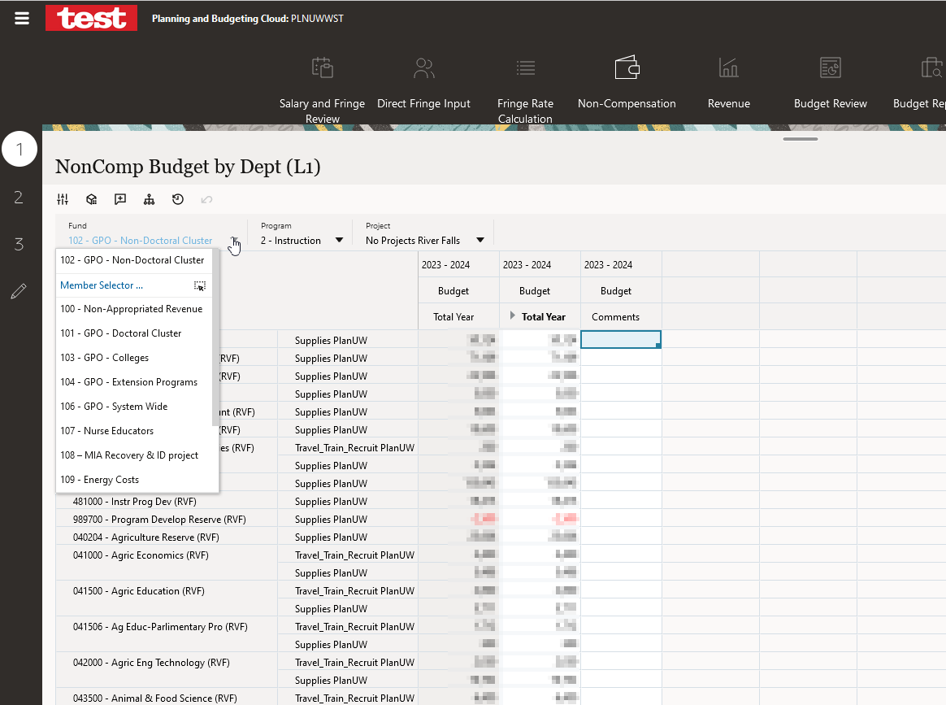
Point of View (POV) items are selected from dropdown menu (or member selector) and render instantly once selected.

Slide 6
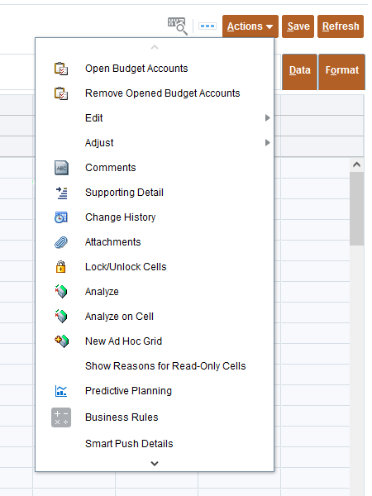
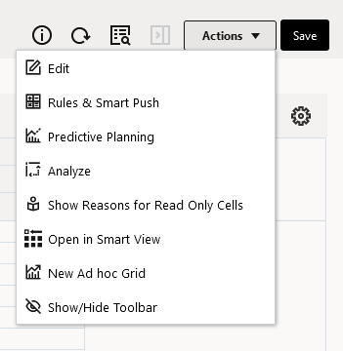
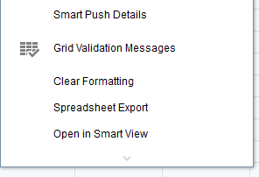
‘Actions’ dropdown limited but functionality is found elsewhere on the form.
Old
New
VS

Slide 7
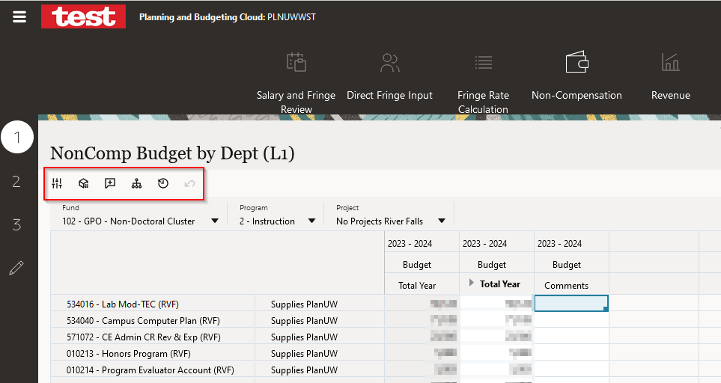
‘Actions’ dropdown limited but functionality is found elsewhere on the form – Continued.
Adjust
Grid Spread
Comments
Line Item Details
Change History
Undo
2
4
6
1
3
5

Slide 8
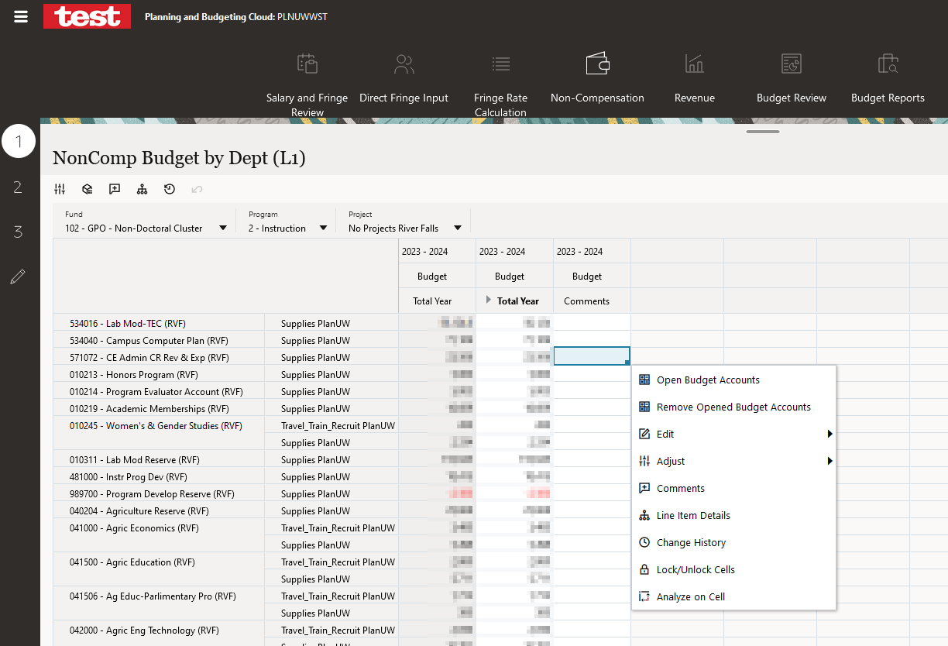
‘Actions’ dropdown limited but functionality is found elsewhere on the form – Continued.
‘Right’ click in any editable cell for additional items such as Open Budget Accounts and Remove Opened Budget Accounts.

Slide 9
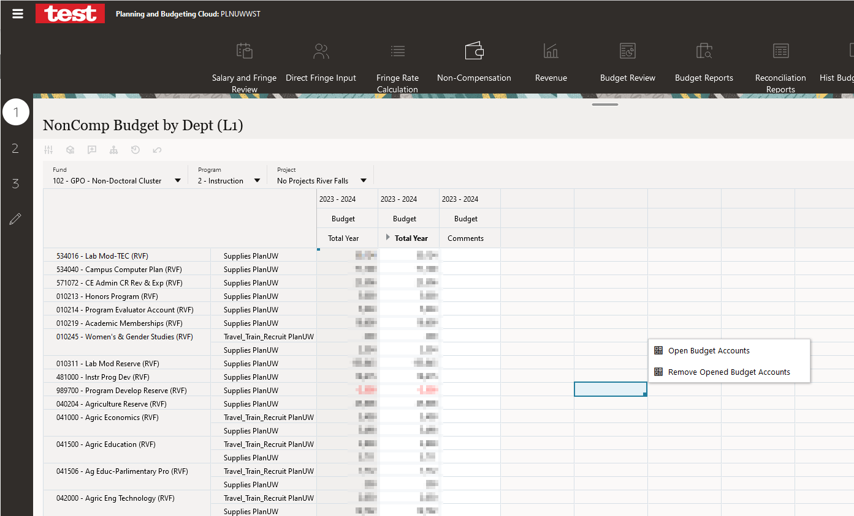
‘Actions’ dropdown limited but functionality is found elsewhere on the form – Continued.
Also, ‘Right’ click in any non-editable cell to Open Budget Accounts or Remove Opened Budget Accounts.

Slide 10
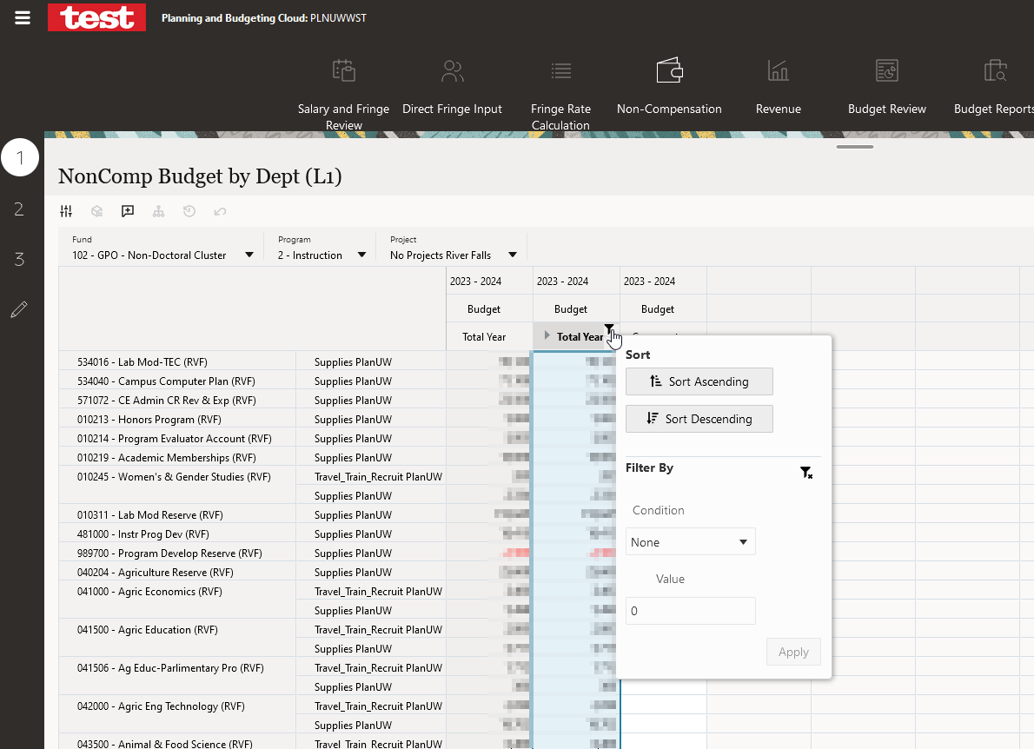
Filter option on columns
Hover cursor over top right corner of column title for filter to appear. Click on filter to access filter menu.

Slide 11
Thank you
Please send any questions to PlanUW@uwsa.edu.

