Slide 1
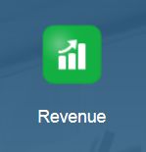
Input Revenue Data

Slide 2
Input Revenue Data in Annual Budgeting Process

Slide 3
Revenue Input Process
A few things to consider before beginning the Revenue Input process:
This input process can take place at all three levels.
At all three levels, the input process can take place by:
  By Department
  By Program
  By Department & Program
This presentation will cover the Revenue Input process at Level 1 and it will cover it By Department, By Program, and By Department & Program. This will be followed by an Input Review section.

Slide 4
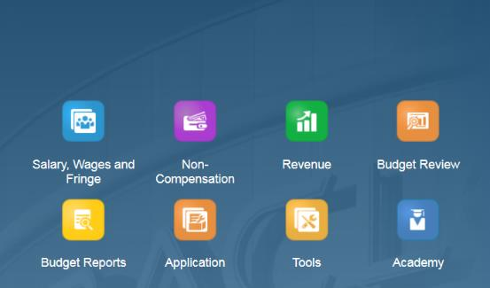
Revenue Input Process
To begin the input process for Revenue:
Click the Revenue tile to open the spreadsheet.
NOTE: For this example, we are entering data at LEVEL 1. To enter data at LEVEL 2 or LEVEL 3 follow the same instructions but selecting the correct level.

Slide 5
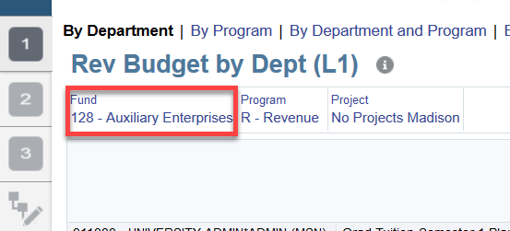
Revenue Input Process
The form will automatically display data By Department. As in previous steps, select a Fund, Program, and Project that has prior year actual data.
NOTE: To update the Fund information, click on Fund. The options to update the fund are shown next.

Slide 6
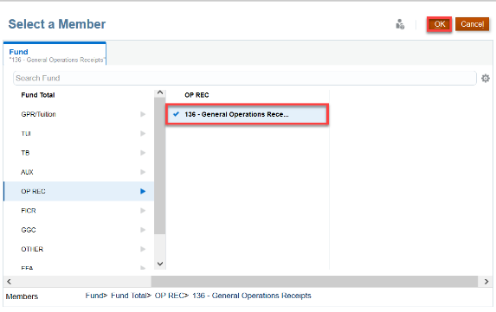


Revenue Input Process – Updating the Fund
Select the desired Fund, Fund Total, and specific Fund Total by selecting the icon. Continue to click OK. Ensure that the selected Fund is highlighted. Click on the Forward Arrow to execute the form.
Continue to complete this step again for the Program and Project option, if needed.
Remember! You can also change the POV by clicking on the pencil.

Slide 7
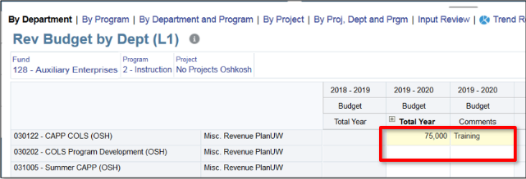
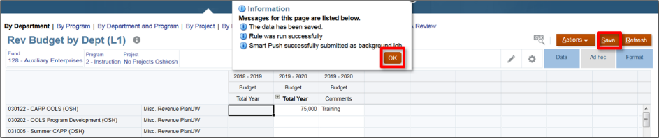
Revenue Input Process – By Department
Continue to enter data and comments. Click Save and OK when the pop-up appears.

Slide 8
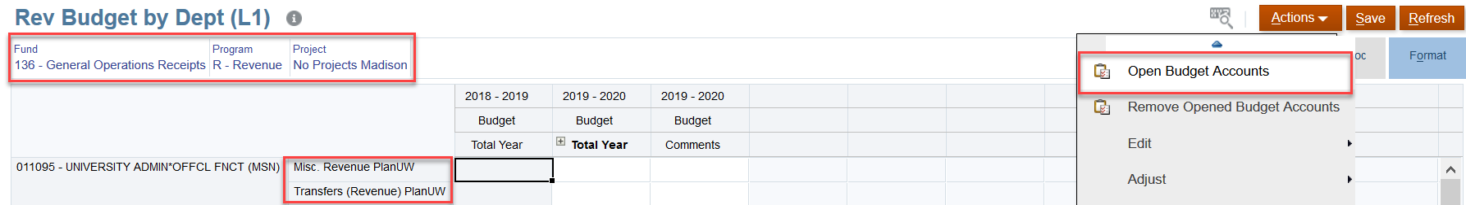
Revenue Input Process – Inserting a Wedge
To insert a wedge select a Fund, Program, and Project with no prior year data.
Click on the Actions drop down and select Open Budget Accounts.

Slide 9
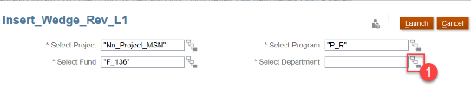
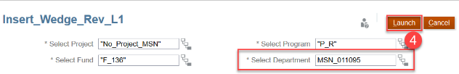
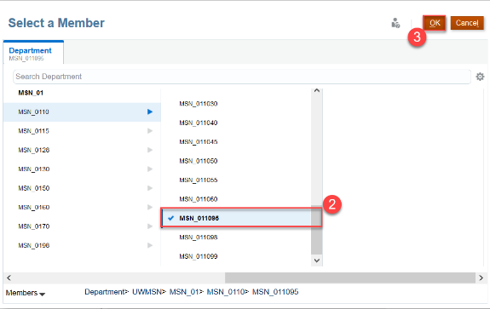
Revenue Input Process – Inserting a Wedge
Begin the process of finding the desired Department where the wedge will be inserted by:
Select the metadata drop down
Select the correct Department
Click OK
Confirm that the Department selected is displayed, Click on Launch

Slide 10
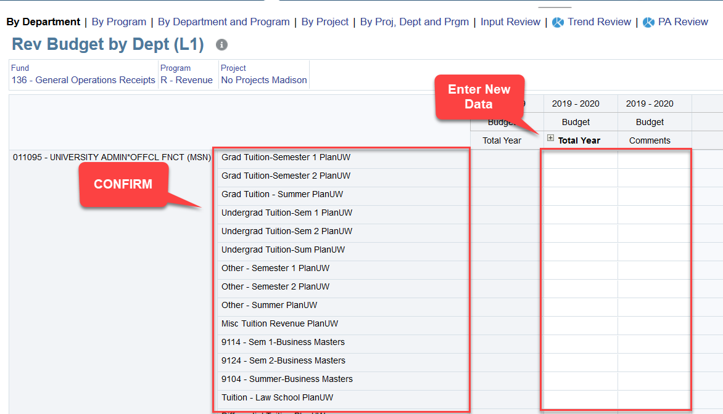

Revenue Input Process – Inserting a Wedge
Click OK on the pop-up confirmation and confirm that the information inserted is correct.
Continue to enter data in the available fields.

Slide 11

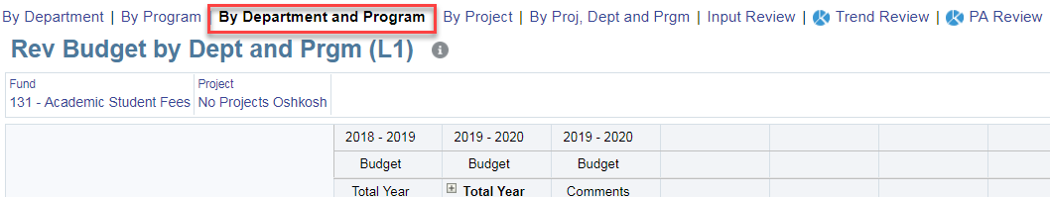
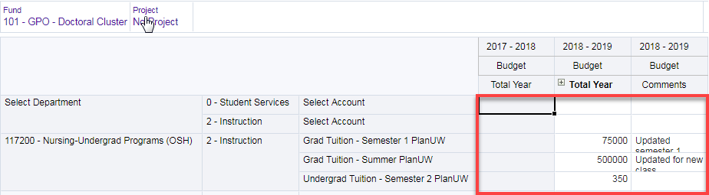
Revenue Input Process – By Program
Start by selecting the By Program tab and continue to follow the previous steps described.
Select By Department and Program from the top menu. Confirm data entered in Rev Budget By Dept (L1) and Rev Budget By Prgm (L1) forms appears in the Rev Budget By Dept and Prgm (L1) form as expected.

Slide 12
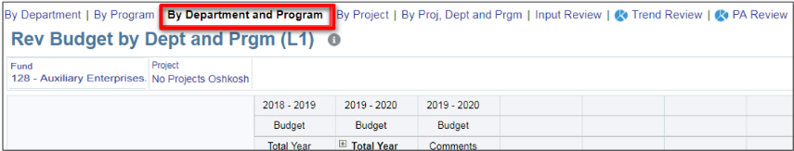
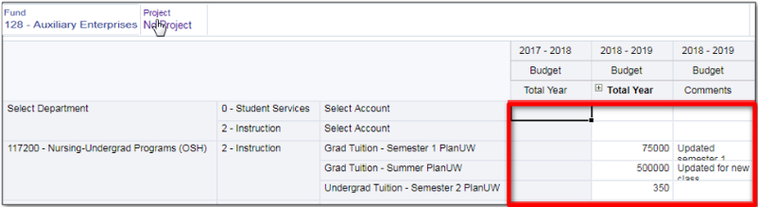
Revenue Input Process – By Department & Program
Select By Department and Program from the top menu. Confirm data entered in Rev Budget By Dept (L1) and Rev Budget By Prgm (L1) forms appears in the Rev Budget By Dept and Prgm (L1) form as expected.

Slide 13
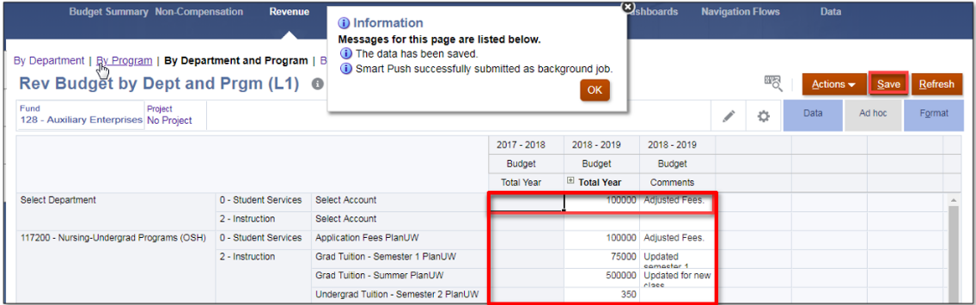
Revenue Input Process – By Department & Program
Enter and save data. Once the data is saved, review that the data is correct.

Slide 14

Reviewing Revenue Data

Slide 15
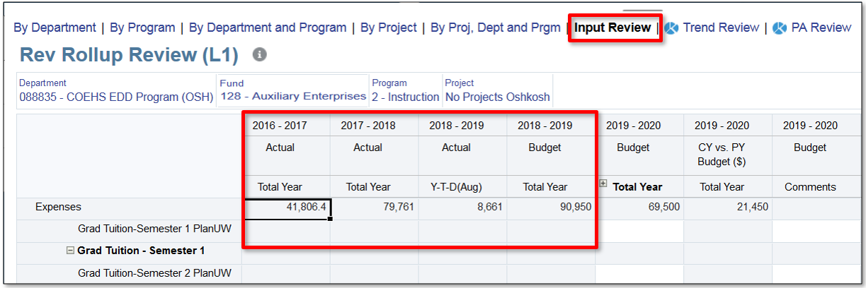
Reviewing Revenue Data – Input Review
Navigate to the Input Review form and confirm the actuals appear

Slide 16
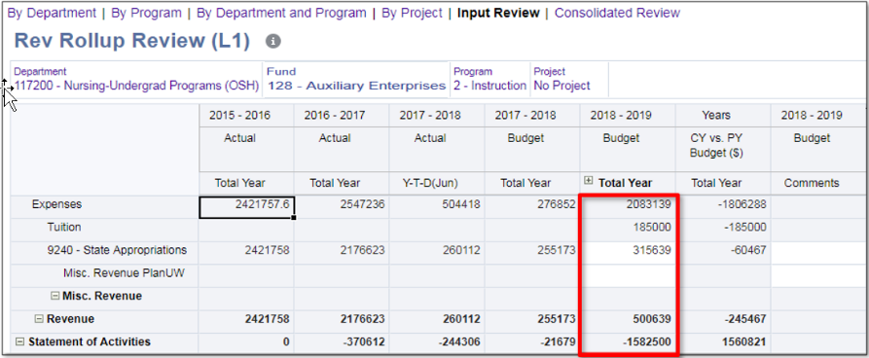
Reviewing Revenue Data – Input Review
'Validate the data you Input in the previous forms appears in the Input Review form as well.

Slide 17
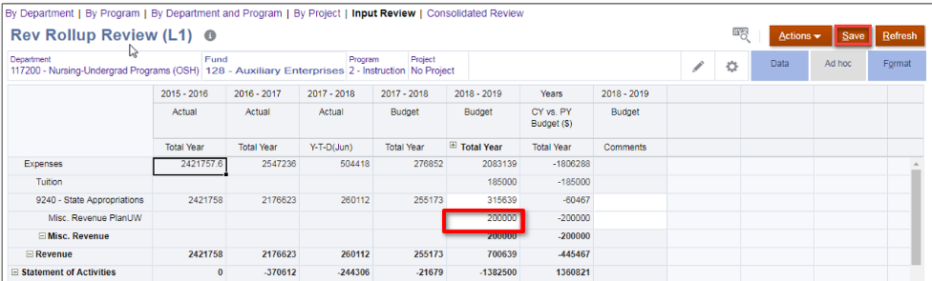
Reviewing Revenue Data – Input Review
If needed, adjust and save Budget data.

Slide 18
Knowledge Check – Revenue

Slide 19
Budget Review

Slide 20
Budget Review in Annual Budgeting Process

Slide 21
Budget Review – Before We Begin
The process of budget review section contains the instructions to conduct budget reviews for:
Trend Reviews
PA Reviews
Review by Fund
Fringe Level Checks
Fringe Budget by Departments
Non-Comp Level Check
Version Copy Review
How to Modify Data in Input Forms
How to View Variances
How to Copy a Fund Total
How to Clear Versions.

Slide 22
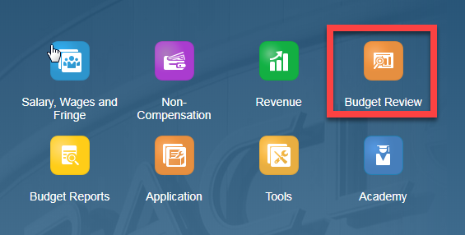
Budget Review
All budget review processes will begin at the Budget Review tile.

Slide 23
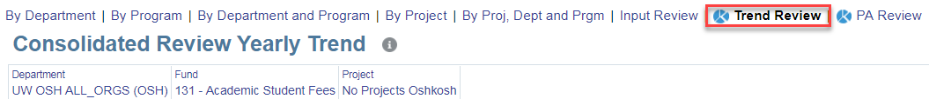
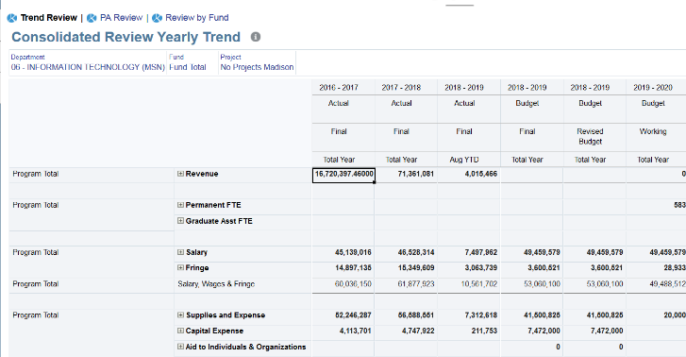
Budget Review– Trend Review
Select Trend Review from the top menu. Continue to update the Department following the steps already mentioned.
Any member with a symbol on it is "drillable" in any of the forms within PlanUW. Click on this symbol to expand the members that rollup to the parent member as applicable for your budget review.

Slide 24
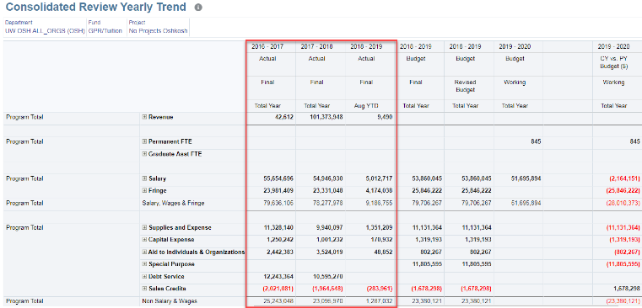
Budget Review– Trend Review
1
2
View the Actual data
View the current fiscal year's Redbook Budget
In the first year, the current fiscal year's Budget will only exist at the Major Class level due to the level of detail required in 3270. However, this budget will exist at whatever level was used to budget in the prior year in PlanUW

Slide 25
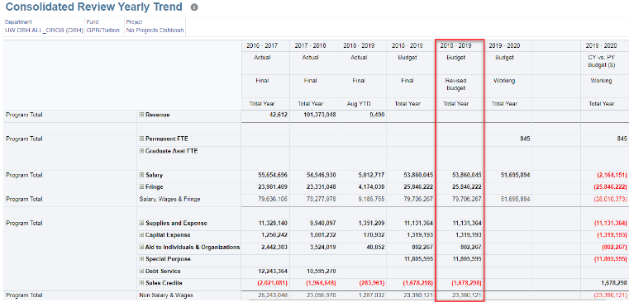
Budget Review– Trend Review
3
4
3. View the current fiscal year’s Revised Budget.
The Revised Budget will be the Redbook Budget (or budget developed in PlanUW going forward) + or - the Budget transfers loaded from SFS.
4. Validate the budget from previous inputs.

Slide 26
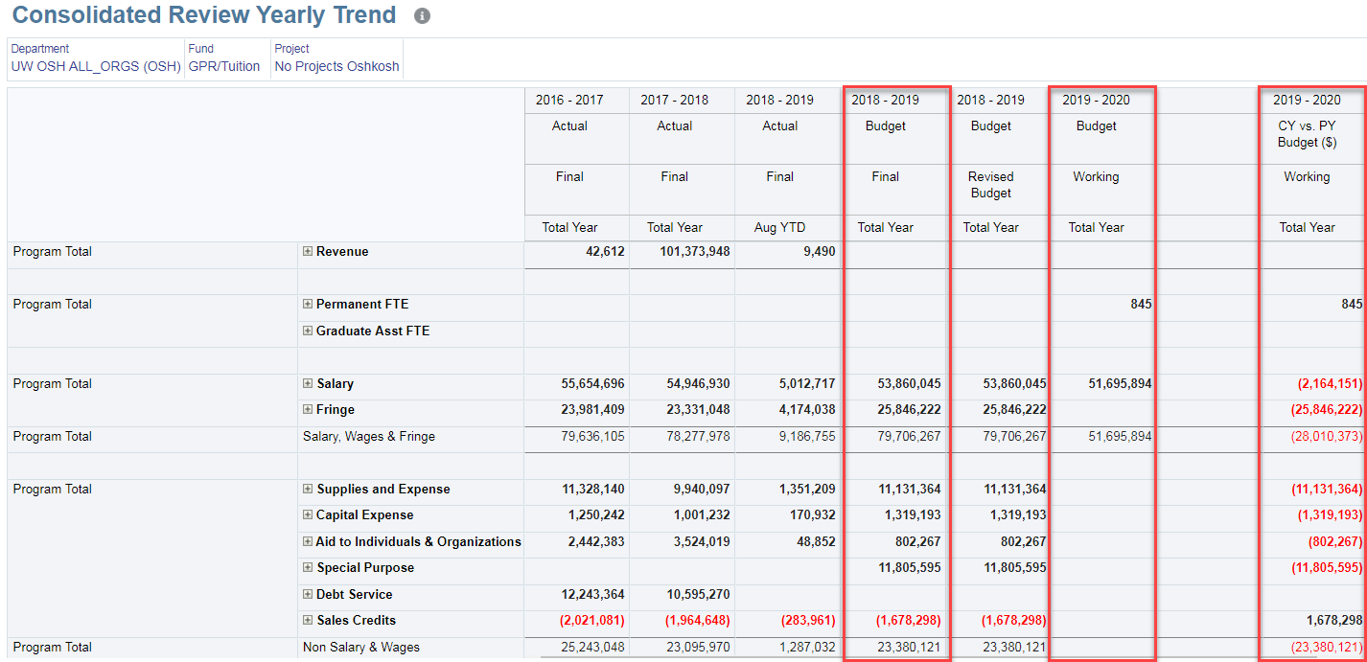
Budget Review– Trend Review
Review the Working vs. Redbook Budget Variance is calculated correctly

Slide 27
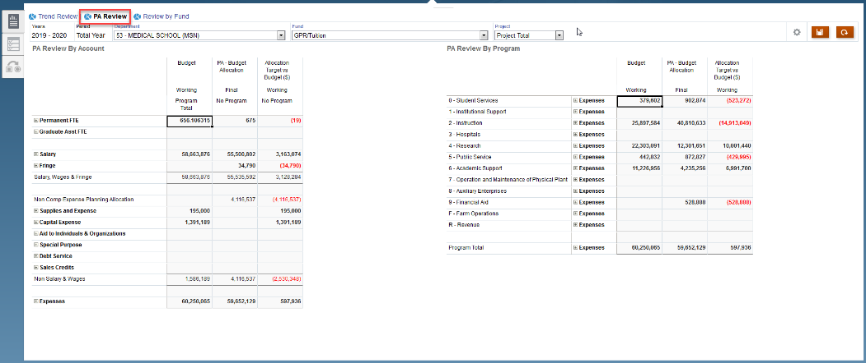
Budget Review – PA Review
To continue to conduct a Planning Allocation review, click on the PA Review tab on the top menu.

Slide 28
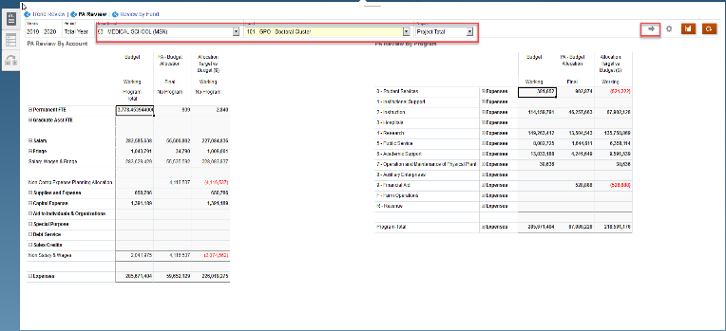
Budget Review – PA Review
Select the Department, Fund, and Project combination you wish to view on the PA Dashboard, and click the right arrow in the right hand corner to submit your selections
Only Madison and Milwaukee have planning allocation data at the Division/Department level.
All other Institutions will only be able to select their Total University from the page dropdown.

Slide 29
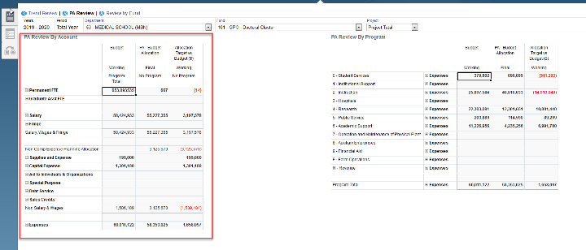
Budget Review – PA Review
Use the form on the left hand side of the dashboard to view the working Budget, data loaded from the Planning Allocation tool, and the variance by Salary, Fringe, and Non Compensation Expenditures.
For Institutions in the NE, South, and West Pods, this webform may not be applicable if you do not allocate Total Expenditures to the Salary, Fringe, and Non Compensation Expenditures
For Madison and Milwaukee - Major Class Non Compensation Expenditure Categories in this form are only applicable for the working budget, as data is loaded at the Total Non Compensation Expenditure level from the Planning Allocation Tool.

Slide 30
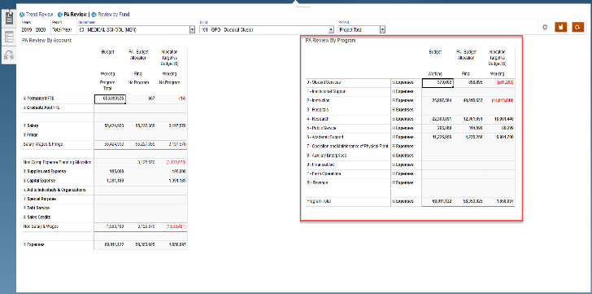
Budget Review – PA Review
Use the form on the right hand side of the dashboard to view the working Budget, data loaded from the Planning Allocation tool, and the variance for Total Expenditures by Program.
Institutions in the NE, South, and West Pods will be able to drill into Total Expenditures to view Salary Data by Position and NonComp data by Major Class.
Madison and Milwaukee will only have their data available at the Total Expenditure level. This is based on the data available from the Planning Allocation Tool.

Slide 31
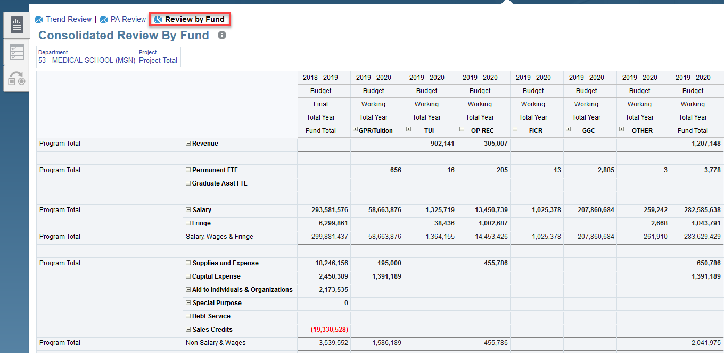
Budget Review – Review by Fund
Use the form on the right hand side of the dashboard to view the working Budget, data loaded from the Planning Allocation tool, and the variance for Total Expenditures by Program.

Slide 32
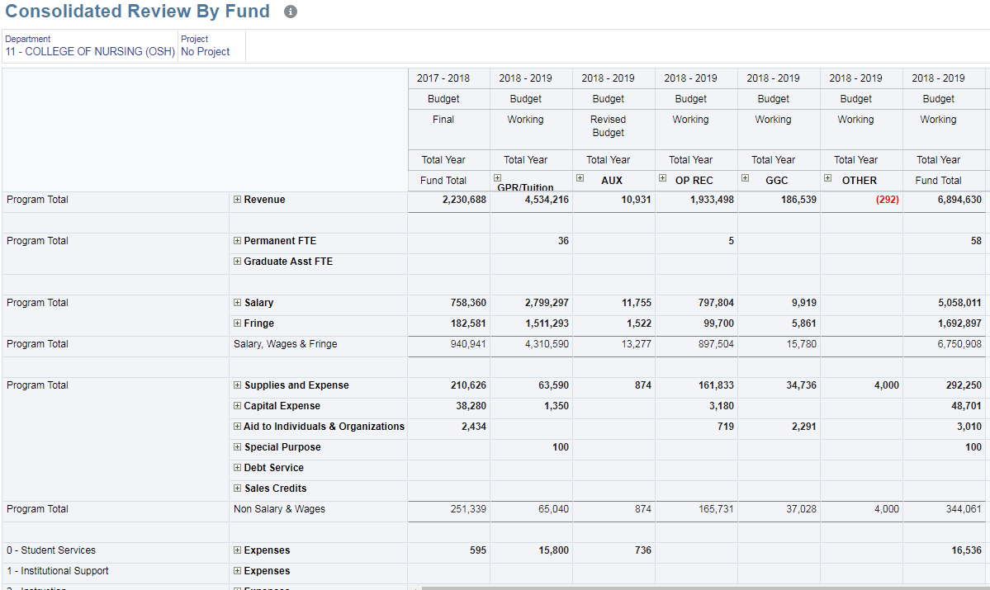
Budget Review – Review by Fund
Choose a parent level Department, and Project. View the current fiscal year (FY19) Redbook Budget.
All descendants of your User Institution, and All Projects are available in the page dropdown.
In the first year, the current fiscal year's Budget will only exist at the Major Class level due to the level of detail required in 3270. However, going forward this budget will exist at whatever level was used to budget in the prior year in PlanUW.

Slide 33
Budget Review – Review by Fund
  Validate the Budget you have entered from the input forms is correct and aggregated by Department, Program, Fund and Project.

Slide 34
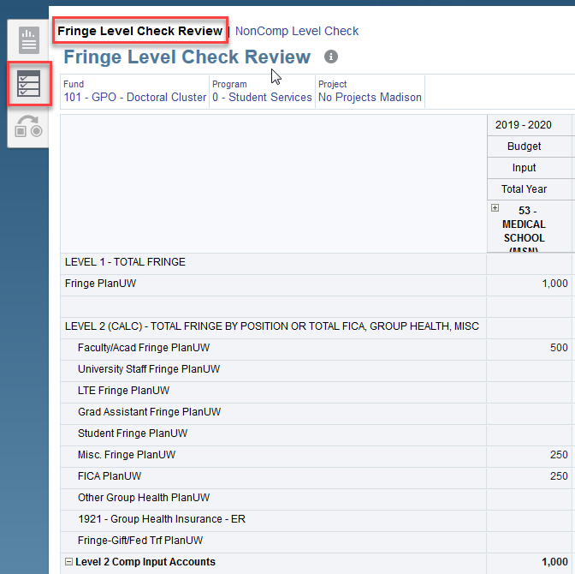
Budget Review – Fringe Level Check
Navigate to the “Level Check Form” page. The page will default to the Fringe Level Check Review form
Choose the Fund, Program and Project members from the page drop down
After your page selections, confirm the Fringe Level Check review form appears with your "User Institution" in the Column.
1
1
2
3

Slide 35
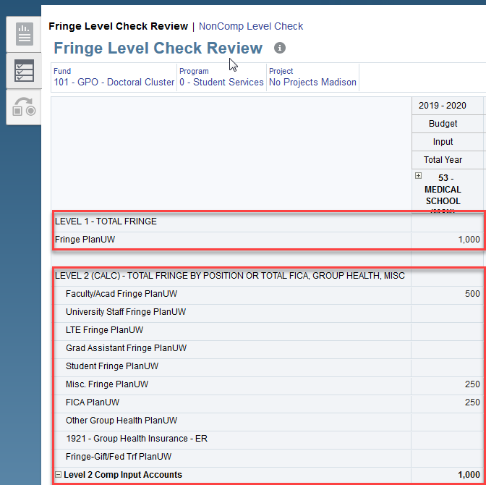
Budget Review – Fringe Level Check
View the fringe budget entries between the levels 1, 2, 3 and 4.
The following five accounts are in level 2 and 3, which will result in a account level overlap:
- Misc. Fringe
- FICA
- 1921 - Group Health Insurance – ER
- Other Group Health
- Fringe-Gift/Fed Trf
Account overlaps may or may not be an issue depending on your own unique institutional, and departmental processes and controls, and how you plan to utilize the new Budget CoA.

Slide 36
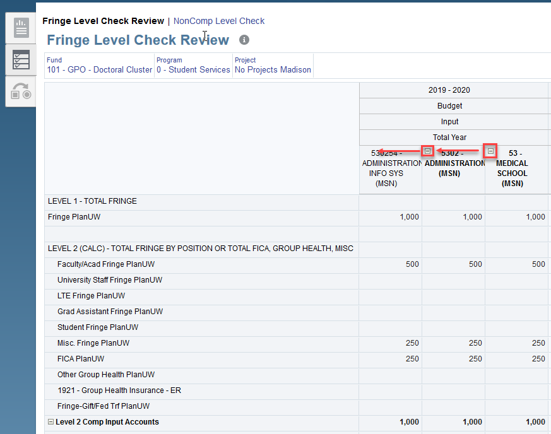
Budget Review – Fringe Level Check
Click the button on the department member in the column to expand the department dimension to identify which division(s), department(s), and sub-department(s) potential improper overlaps may be occurring in.
There is Column Suppression on the webform, meaning users will only see the division(s), department(s), and sub-department(s) that have data.

Slide 37
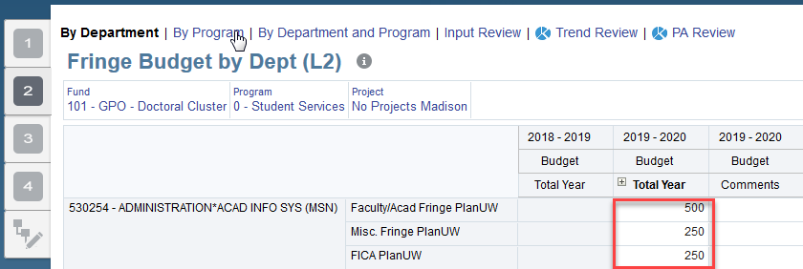
Budget Review – Fringe Budget by Department
The screen shot on this step shows the Fringe Budget by Dept (L1) webform, but you can choose any Fringe Input webform to make your fringe budget modifications.
If you find any improper fringe account overlaps, navigate back to a Fringe webform of your choice (direct input or by rate) to adjust the data as applicable to fix the overlaps, and repeat the previous steps in Fringe Level Check to ensure the adjustment has taken affect in the “Fringe Level Check” form.

Slide 38
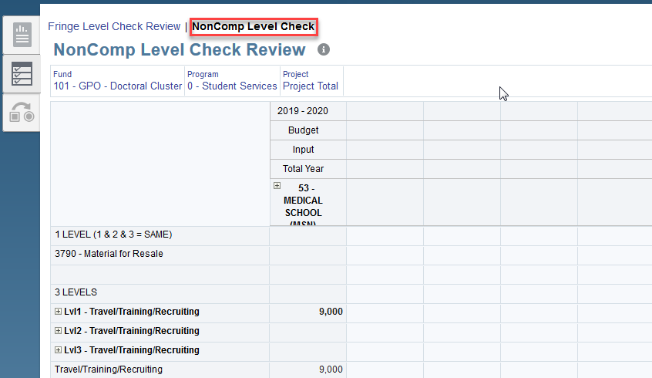
Budget Review – Non Comp Level Check
Click the “NonComp Level Check” Horizontal Tab. Confirm the “NonComp Level Check” form opens.
If the "There are no valid columns of data for this form." message appears, choose a Fund, Program, Project combination already budgeted for, or navigate back to the NonComp Input form, enter data, and confirm the data appears on this form for the same Fund, Program, Project combinations data was entered for or for the applicable parent members.

Slide 39
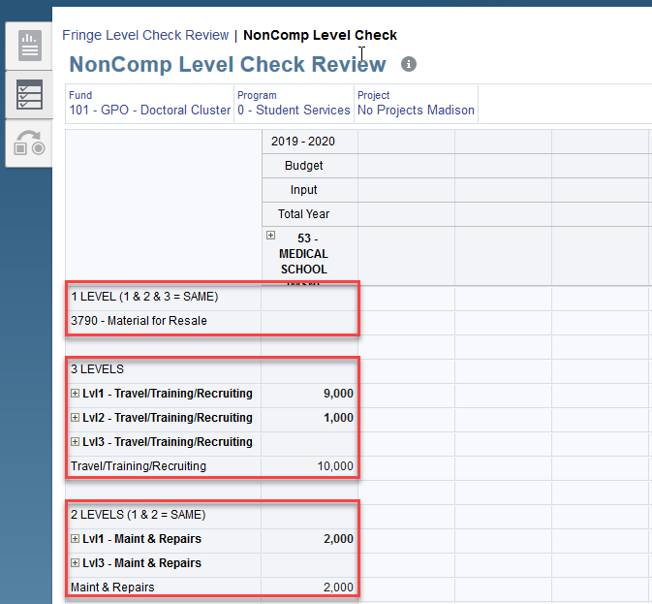
Budget Review – Non Comp Level Check
Choose the Fund, Program and Project members from the page drop down.
View the Non Comp Expenditure budget entries between the levels 1, 2, 3.
1
Account overlaps may or may not be an issue depending on your own unique institutional, and departmental processes and controls, and how you plan to utilize the new Budget CoA. This form is meant to highlight where potential improper overlaps may have occurred, but not control the data entry processes as the PlanUW application has been specifically designed to provide flexibility for data entry institution by institution, and user by user.
2

Slide 40
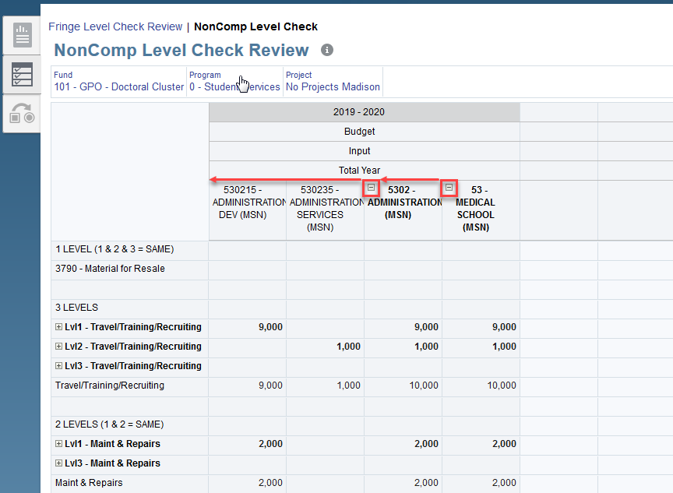
Budget Review – Non Comp Level Check
Click the button on the department member in the column to expand the department dimension to identify which division(s), department(s), and sub-department(s) potential improper overlaps may be occurring in.
There is Column Suppression on the webform, meaning users will only see the division(s), department(s), and sub department(s) that have data.

Slide 41
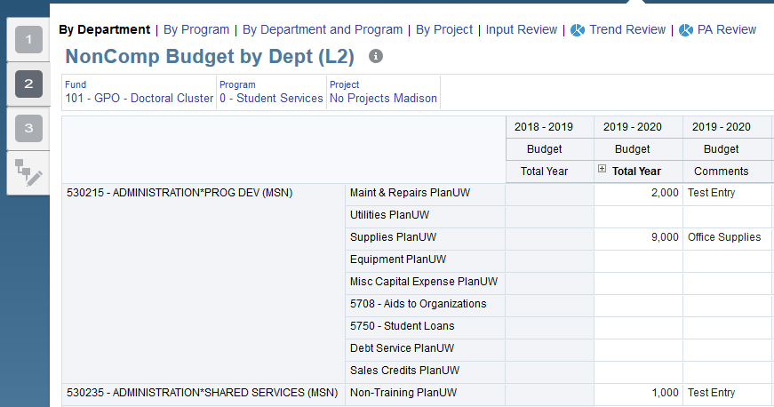
Budget Review – Non Comp Level Check
The screen shot on this step shows the NonComp Budget by Dept (L2) webform, but any NonComp Input webform can be chosen to make fringe budget modifications.
If you find any improper account overlaps, navigate back to a Non Comp webform of your choice to adjust the data as applicable to fix the overlaps, and repeat the previous steps in Non Comp Level Check to ensure the adjustment has taken affect in the “Non Comp Level Check” form.

Slide 42
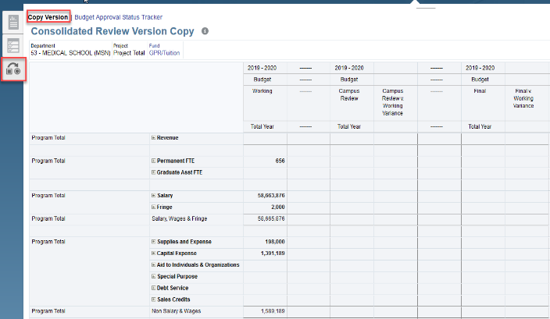
Budget Review – Version Copy Review
Navigate to the "Copy Version" Form.
Please ensure your User Institution variable is set to the Department you wish to view in this form. The department values are aggregated automatically when a user opens the "Copy Version" form. However, to maximize performance on the form load time, the aggregation is based on the user Institution you set in user variables for every pod but Madison (using PA Hierarchy).

Slide 43
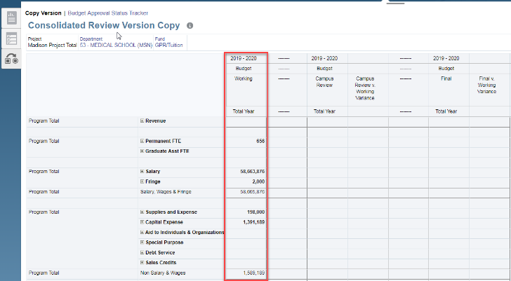
Budget Review – Version Copy Review
Choose a Department and Fund member from the page drop down.
Validate the working Budget is aggregated correctly based on your inputs from the input forms.
1
2
The Project dimension is fixed on the total project for the institution and cannot be changed. The Department dimension is fixed on the Divisional level, and the PA hierarchy level for your institution. The Fund dimension is fixed on the Fund groupings, so the 3-digit fund numbers are not selectable. The page selections are to correlate with the Budget Approval Status Tracker in subsequent steps.

Slide 44
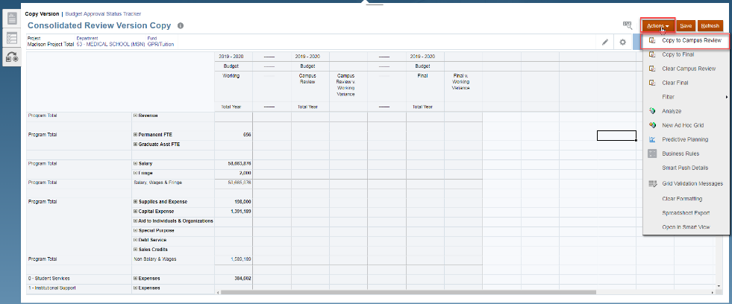
Budget Review – Version Copy Review
Right click anywhere on the form, or click the Actions button in the upper right hand corner to display the actions dropdown. Click the “Copy to Campus Review” menu to copy the working Budget to the Campus Review Version for the Department and Fund in the page.

Slide 45
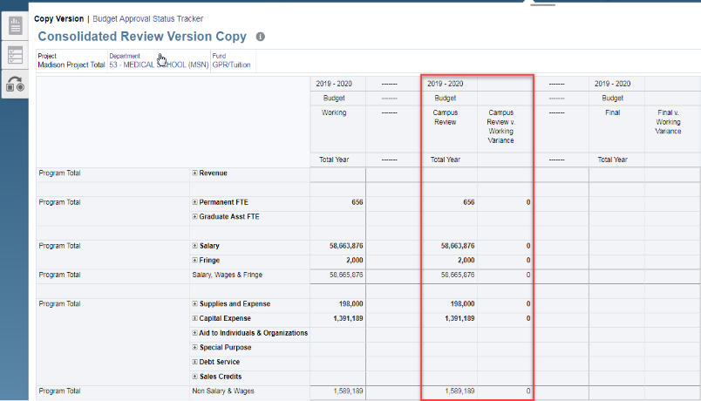
Budget Review – Version Copy Review
Confirm the Campus Review Version is populated and no variance exists between the Working version and Campus Review version.
The campus review version is "Read Only" for all users, so a variance will appear if/when data is continued to be modified in the working budget.

Slide 46
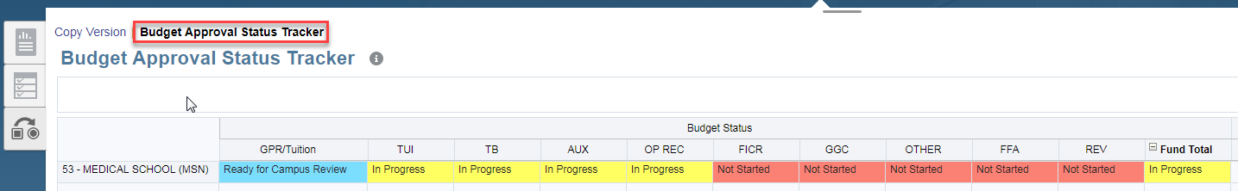
Status Approval Tracker – Ready for Campus Review
1
2
Navigate to the "Budget Approval Status Tracker" form
View the Budget Approval Status for your Division(s), or PA member(s) by Fund Grouping. Confirm the Division/Fund combination you copied from "Working" to the "Campus Review" version in the previous form is reflected with a status of "Ready for Campus Review" in this Webform.
A few things to consider:
The "Budget Approval Status Tracker" form is constructed to mirror the "Version Copy" form in terms of what you can select and view for the Department and Fund Dimensions.
The status should be "In Progress" for any Division/Fund combination you have input data into using the Input forms, and "Not Started" if you have not entered data yet.

Slide 47
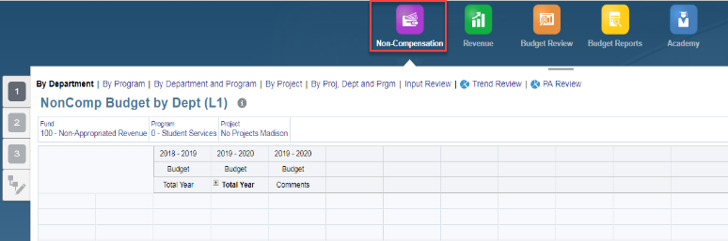
Budget Review – Modifying Data in Input Forms
To change a cell on the "Budget Approval Status Tracker" from "Not Started" to "In Progress", or back to "In Progress" from "Ready for Campus Review" navigate back to any input form.
Choose members from the page drop down.
1
The screen shot navigates back to the "NonComp Budget by Dept (L1)" form, but any input form (Fringe or Revenue) will have the ability to change the status as well.
2

Slide 48
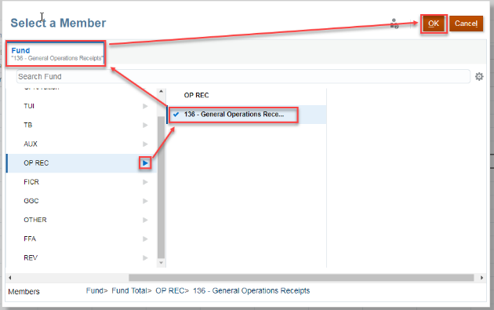
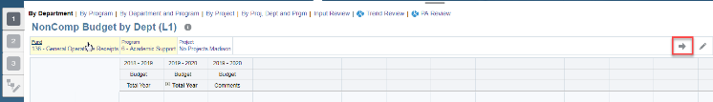
Budget Review – Modifying Data in Input Forms
Select a 3-digit fund underneath a Fund grouping that was previously "Not Started", and click "Ok
Click the right arrow on the right hand side to submit your selections.
1
The User Institution should be set to the Division or PA member that the change the Status is for in User Variables. Unlike Fund, for department, the Status tracker does not leverage the exact department used in the input form, but rather, uses the "User Institution" selected in User Variables
2
2

Slide 49
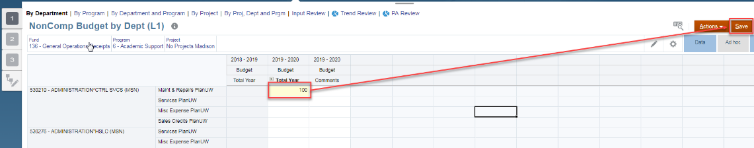
Budget Review – Modifying Data in Input Forms
To enter data in this form, simply enter data in an editable cell and click save.

Slide 50
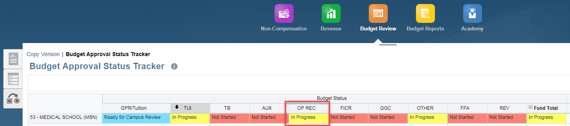
Status Approval Tracker – In Progress
1
2
Navigate back to the "Budget Approval Status Tracker" form.
Confirm the Division/Fund combination you modified data for is reflected with a status of "In Progress" in this Webform.

Slide 51
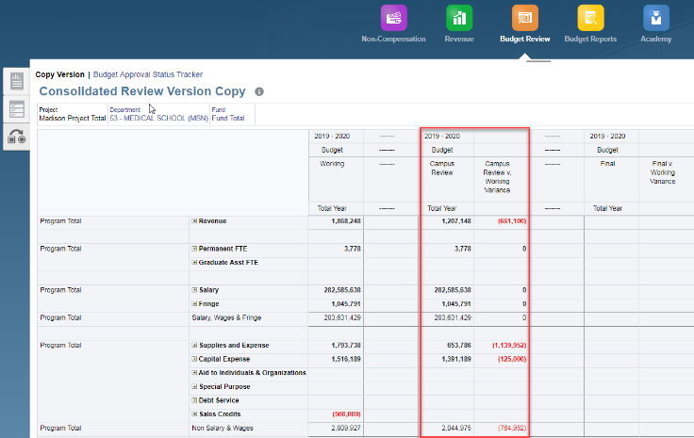
Budget Review – View Variances
Navigate back to the "Copy Version" form
View the variances between the working Budget and the Campus Review version, based on the additional data you input.
1
2

Slide 52

Budget Review – Copy Fund Total
1
2
Select "Fund Total" from the Page dropdown
Right click anywhere on the form, or click the Actions button in the upper right hand corner to display the actions dropdown. Click the “Copy to Campus Review” menu to copy your working Budget to the Campus Review Version for Fund Total

Slide 53

Budget Review – Copy Fund Total
Confirm the Campus Review Version is populated and no variance exists between the Working version and the Campus Review version.

Slide 54

Status Approval Tracker – Ready for Campus Review
(All Funds)
1
2
Navigate back to the "Budget Status Approval Tracker" form.
Confirm All Funds now have a status of "Ready for Campus Review" pushed to them via the version copy from "Working" to "Campus Review".
Similar to the Fund Dimension, if you are a Power User or an End User with access to all Institutions you will be able to view the status for all Divisions (or PA members for Madison) on this form, and be able to change your page selection for department on the "Version Copy" form to the total institution to push the status of "Ready for Campus Review" to every Division (or PA member for Madison) as well.

Slide 55

Budget Review Copy to “Final” – Power Users
1
Navigate back to the "Version Copy" form.
Select a specific Fund grouping, or "Fund Total" from the Page dropdown.
2

Slide 56

Budget Review Copy to “Final” – Power Users
Right click anywhere on the form, or click the Actions button in the upper right hand corner to display the actions dropdown.
Click the “Copy to Final” menu to copy your working Budget to the Final version.

Slide 57

Budget Review Copy to “Final” – Power Users
Confirm the Final Version is populated and no variance exists between the Working version and the Final version.

Slide 58

Status Approval Tracker - Complete
1
2
Navigate back to the "Budget Status Approval Tracker" form.
Confirm the Funds in which you copied now have a status of "Final" pushed to them via the version copy from "Working" to "Final".

Slide 59

Budget Review– Clear Versions
1
2
OR
Navigate back to the "Version Copy" form.
Right click anywhere on the form, or click the Actions button in the upper right hand corner to display the actions dropdown. Click the “Clear Campus Review” or "Clear Final" menu to clear old versions as applicable.
You do not need to clear old versions before re-copying data from working as the Copy menus completely overwrite the past values. However, this utility may be leveraged for Institutions/Users for any Institutional specific processes as applicable now or in the future

Slide 60

Status Approval Tracker – In Progress
1
2
Navigate back to the "Budget Approval Status Tracker" form.
Confirm the Funds in which you cleared now have a status of "In Progress" pushed to them via the version clear.
The clear menu will change the Budget Approval Status back to "In Progress" regardless of if you choose to clear the final version, or the campus review version. The working version cannot be cleared with the clear menu.

Slide 61
Knowledge Check – Budget Review

Slide 62

Budget Reports

Slide 63
Budget Reports in Annual Budgeting Process

Slide 64
Budget Reports
PlanUW offers seven reports to analyze budget data. All of the reports can be accessed through the Budget Reports tile and can be retrieved in HTML, PDF, and Excel formats.
There are 8 budget reports. This is the order in which they will be covered:
Budget Summary
Expense Budget Report
Budget Review
Salary Review
Summary by Program
Summary by Fund
Summary by Program and Fund
Budget vs Actual

Slide 65


Point of View Change – Before Continuing
As mentioned previously, the user can change the version to access information in the reports by clicking directly in the POV section.
If the POV will be changed, users should remember to always use the Working, Final, PlanV1, PlanV2, and PlanV3 versions.
Selecting the versions highlighted in red will only return partial or no information for the report.

Slide 66
Budget Summary in HTML Format
The Budget Reports page will open the Budget Summary tab automatically. The rest of the available reports are displayed on the following tabs.
Next, the Point of View should be updated to the data needed for the report.
From the File Format drop-down, select the format desired. For this section of the presentation, select HTML

Slide 67
Budget Summary in HTML Format
HTML Budget Summary reports are interactive: Columns expand or collapse and the user has access to expand data to more granular levels:
(The Year Column expands to monthly data by clicking on the drop down icon)
Year columns can be expanded to see monthly data
Rows Expand or Collapse

Slide 68
Budget Summary in HTML Format
HTML Reports can also be downloaded. To download the report, scroll down and click on the Export In Query-Ready Mode. The report will open in Excel. Follow the protocol of your browser to open the downloaded file (For Chrome, the file download bar shows on the bottom of the screen, etc. )

Slide 69


Budget Summary in PDF Format
To open a report in PDF format, follow the steps already outlined to access reports. Adjust the POC as necessary, then select the PDF option from the File Format drop down and the report will display.
Reports can be downloaded and/or printed!
Since PDF reports can be downloaded, we will demonstrate how downloading a PDF reports appears in Chrome, Firefox, and Internet Explorer.

Slide 70


Budget Summary PDF Format in Chrome
To download reports:
Click the download icon (the pop-up Save As will appear)
Name the report on the File Name field
Save the file.
* Remember where the file is saved!
1
2
3
Open the file once downloaded and it will display in PDF format.

Slide 71



Budget Summary PDF Format in Firefox
To download reports in Firefox:
Click the download icon (the pop-up Save As will appear)
Click on Save File.
The top right corner of the browser will display the download icon. Click on it and click on the file once the download completes.
1
2
3
Open the file once downloaded and it will display in PDF format.
3

Slide 72



Budget Summary PDF Format in Internet Explorer
1
3
To download reports:
Click the Open option (Save or Save as if desired)
Name the report on the File Name field
Click on Open
2

Slide 73

Budget Summary in Excel Format - Chrome
To open a report in Excel format, remember to follow the same steps to access reports. Once a Point of View for the data the report should contain, select the Excel option from the Version drop-down. This time, the report will download automatically. Since this is Chrome, the file will display at the bottom of the screen.

Slide 74

Budget Summary in Excel Format - Chrome
The Excel file is now downloaded and can be opened.
Remember - When the downloaded file is opened in Excel, the file loses its connection to the database. The file, however, can now be manipulated with Excel functions. Also remember that the file is not connected via Smart View.

Slide 75



Budget Summary in Excel Format – Firefox
To open a report in Excel format using Firefox, remember to follow the same steps to access reports. Once a Point of View for the data the report should contain, select the Excel option from the Version drop-down.
Unlike Chrome, when Excel is selected in the File Format option, the “Open with” pop up will display before downloading the report.
Select Excel on the File Format option.
Click OK to open the report or select Save File and then OK to save a version of the report.
If Excel does not open automatically with the report, click the download icon on the top right corner and click on the file to open the report.
1
3
3
2

Slide 76


Budget Summary in Excel Format – Internet Explorer
To open a report in Excel format using Firefox, remember to follow the same steps to access reports. Once a Point of View for the data the report should contain, select the Excel option from the Version drop-down.
In a similar fashion to Firefox, Internet Explorer will open a “What do you want to do” pop up.
Select Excel on the File Format option.
Click on Open and the Excel report should open automatically.
1
2

Slide 77


Expense Budget Report
To access the Expense Budget report, as mentioned, follow the previous steps described.
Once the form displays, select the Expense Budget Report tab and desired format, as described before.
You can adjust the Point of View depending on the data needed for the report. This report requires a Department/Version/Project combination.

Slide 78


Expense Budget Report
Once the report displays, depending on the format, you can now interact with it.

Slide 79

Budget Review Report
To access the Expense Budget report, as mentioned, follow the previous steps described.
Once the form displays, select the Expense Budget Report tab and desired report format, as described before.
You can adjust the Point of View depending on the data needed for the report. This report requires a Version/Department/Fund/Program/Project combination.

Slide 80


Budget Review Report
Once the report displays, depending on the format, you can now interact with it.

Slide 81

Salary Review Report
To access the Salary Review report, as mentioned, follow the previous steps described.
Once the form displays, select the Salary Review tab and desired file format, as described before.

Slide 82

Salary Review Report
In this example, the form is displayed under a PDF format. Remember that PDF file formats allow the use to print the form directly!

Slide 83

Summary by Program
Like all reports, the Summary by Program report is opened following the same steps.

Slide 84

Summary by Fund
Like all reports, the Summary by Fund report is opened following the same steps.

Slide 85

Summary by Program and Fund
Like all reports, the Summary by Program and Fund report is opened following the same steps.

Slide 86

Budget vs Actual
Like all reports, the Budget and Actual report is opened following the same steps.

Slide 87
Knowledge Check – Reports

Slide 88

Course Summary

Slide 89




Completed Course Objectives
In this course, you have been introduced to the UW Planning and Budgeting process and how to perform budgeting tasks within the PlanUW system.
You have learned about:
The UW Budget Process and Timeline
A review of the PlanUW System
How to complete budgeting tasks in PlanUW

Slide 90
Support and Resources
You can use the following resources for reference and support:
This course, located on the UW System Website/Plan UW: Planning & Budgeting Cloud Service
Project Website: https://www.wisconsin.edu/budget-planning/system-project/
Coworkers and Subject Matter Experts
Quick Reference Guide

