Slide 1

PlanUW Processes

Slide 2



Course Objectives
In this course, you will be introduced to the PlanUW process and how to perform budgeting tasks within the PlanUW system.
After completing this class, you will have learned:
The UW Budget Process and Timeline
How to set up your campus User Variable
How to complete budgeting tasks in PlanUW

Slide 3
Before We Begin
This presentation has been designed with the expectations that End Users follow each process on a step by step basis.
To provide support during and after the training, End Users will receive a Quick Reference Guide as an instructional for each process End Users can execute in PlanUW.

Slide 4

UW Budget Process and Timeline

Slide 5
Budgeting Process

Slide 6
Plan UW Integration
PlanUW is integrated with multiple UW source systems. The systems and the frequency data will be pulled is listed below.
Integration | Frequency
CAT to Plan UW | Nightly, 10am, 2pm
PA to Plan UW | Nightly
Plan UW to PA | Nightly
Combo Edit Checks | Nightly
Metadata refresh - Departments | Weekly (Saturday)
Metadata refresh - Accounts | Weekly (Saturday)
SFS Actuals to Plan UW | Monthly (10th day)
Plan UW Budget to SFS | Yearly
Projects | On Demand
Please Note: On Demand updates are available by contacting your System Administrators

Slide 7

Setting User Variables

Slide 8
Setting User Variables in Annual Budgeting Process

Slide 9






Accessing PlanUW
PlanUW is a cloud-based and can be accessed via any computer with internet access.
PlanUW is supported by any browser. Out of the browsers shown, we recommend Mozilla Firefox:
Microsoft Edge
v.12
Internet Explorer
v.11.x
Mozilla Firefox
v.38+
Google Chrome
v.42+
Apple Safari v.8.x and v.7.x
Firefox is the recommended browser

Slide 10
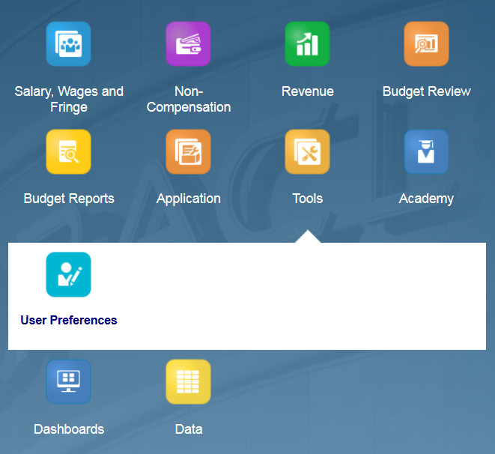



Setting User Variables
End Users and Power Users have to set User Variables according to their institutions. Setting User Variables is a key step in ensuring that the user filters access to campus exclusive data.
To access Preferences:
1. Click the Tools cluster
2. Select the User Preferences card
NOTE: User variables only need to be set once, but they can be changed at any time.

Slide 11
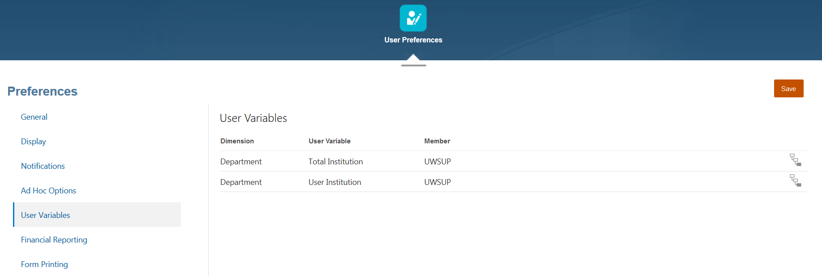

Setting User Variables – End Users
Member Selectors
Members can be selected for each dimension by clicking Member Selector
When setting User Variables, you only need to select a member for the Organization dimension. Do not edit any of the other dimensions.

Slide 12
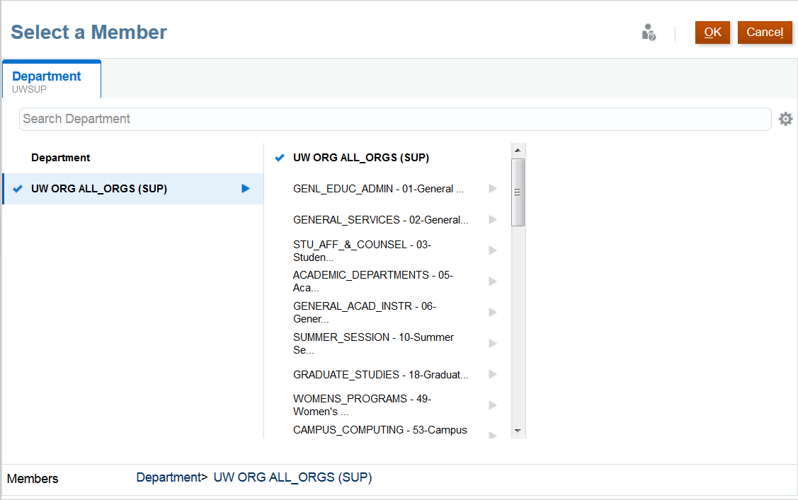
Selecting Members
Members can be selected in two ways from the Member Selection window:
Search Bar
Hierarchy
Search Bar
When selecting members through a Hierarchy, drill into a member by clicking
To select a member, click Add
Note that you are only able to select one member at a time
Select
Hierarchy
If the member selected does not appear on the User Variables selected, the next slide will explain the next steps.

Slide 13
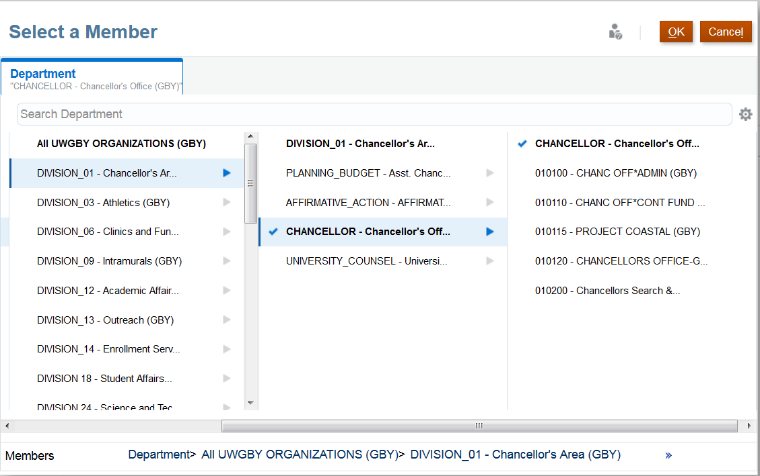
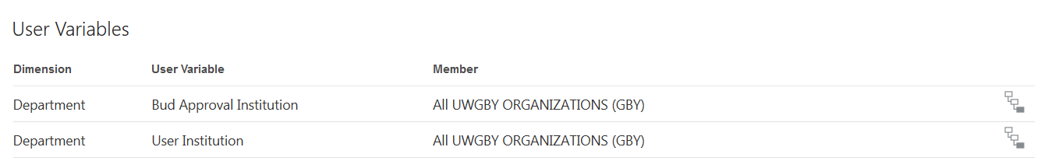
Selecting Members - Before Continuing
If you are not able to select a specific member, in this example “CHANCELOR – Chancellor’s Office”, PlanUW lets you click the member, the blue check box confirms the selection, and then they can click OK. However, the selection does not actually get set as the “User Institution”.
A work around for this is to type the member name directly into the box.
Did not update with new selection

Slide 14
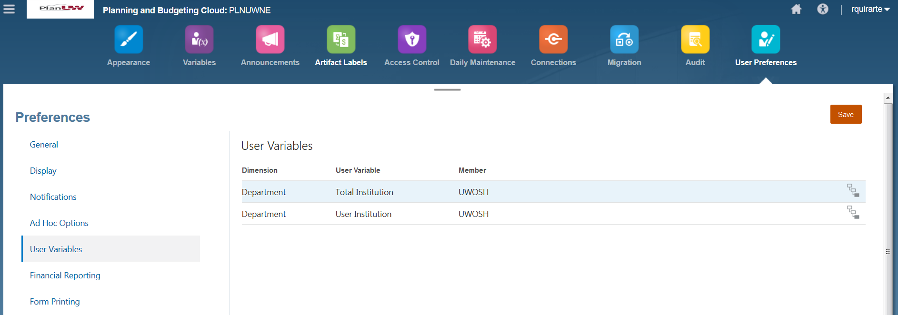

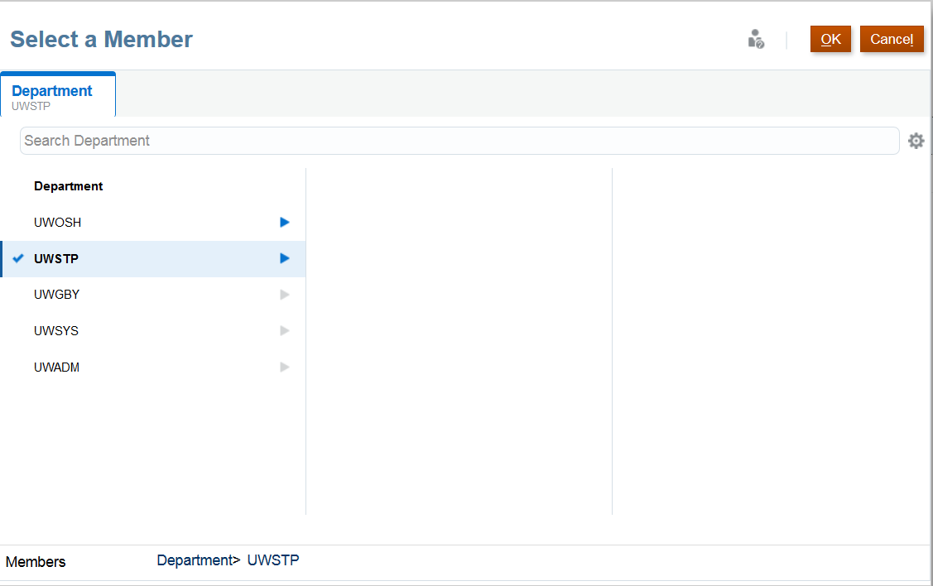
Setting User Variables – Power Users
Unlike End Users, Power Users will have access to set variables at the Total Institution variable level.
To set the Total Institution variable, follow the same steps described to End Users on how to set the User Institution variable (Previous slide).

Slide 15
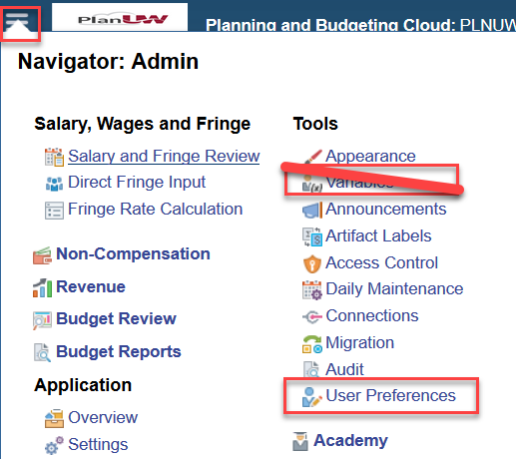
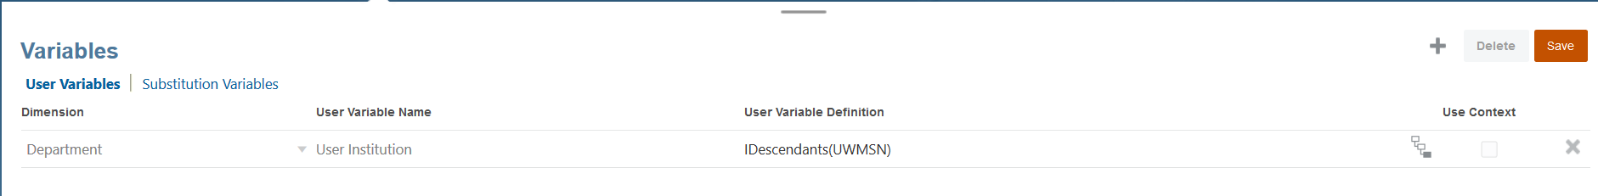
Setting User Variables – Power Users
Unlike End Users, Power Users will have access to an additional Navigation Menu item called Variables.
The variables menu item is where Power Users and Adminstrators can set the limits for End Users in User Preferences. The changes in the Variables menu are global and affect all users in that pod.
Below is the Variables screen. It should not be updated by Power Users. This screen should always show IDescendants of all the institutions in that pod.

Slide 16

Budget Tasks in PlanUW

Slide 17
PlanUW Tasks and Processes
Moving forward, this presentation will cover on a step-by-step basis, the “how” to complete normal tasks in the PlanUW system. Each process will be accompanied with the Quick Reference Guide book.
Click on the link to jump to the process:
Reviewing Salary Data
Input Fringe Rates
Calculating Fringe Using Rates Review
Input Fringe Data
Reviewing Fringe Data
Input Non Comp Data
Reviewing Non Comp Data
Reviewing Planning Allocation Data
Input Revenue Data
Reviewing Revenue Data
Budget Review

Slide 18
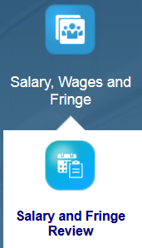
Salary & Wage Review

Slide 19
Reviewing Salary Data in Annual Budgeting Process

Slide 20
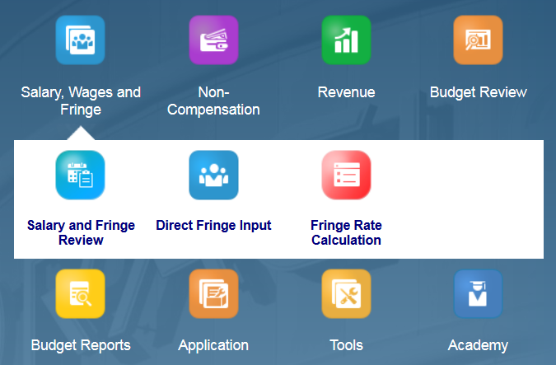

Review Salary Data
To begin the salary data review process:
Click the Salary, Wages and Fringe tile to open the cluster
Click on the Salary and Fringe Review to open the form.
This process will open the Review Salary Data form.
Before starting, remember that all salary data in PlanUW is for review only. If this information needs to be changed, it needs to take place directly in CAT.

Slide 21
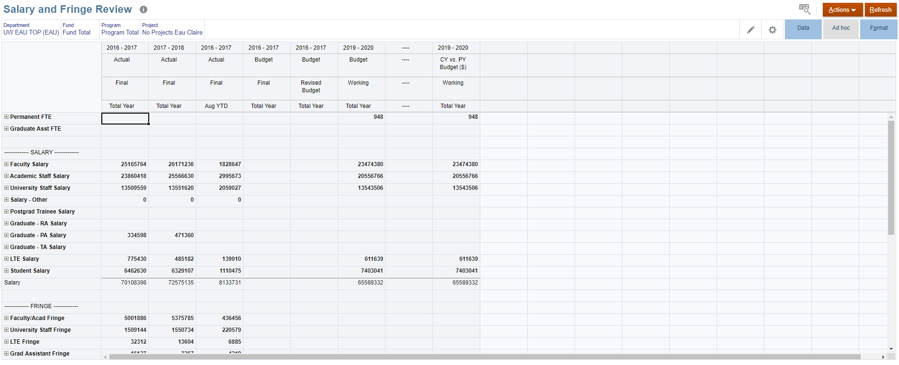
Review Salary Data
2
1
Since this is only a review form, the cells should be grey and you should not be able to input data.
When the form opens, this is a good opportunity to ensure that the columns contain the information needed.
The Point of View section can be changed to the Department Total, Fund Total, Program Total, and No Project member for your institution.
NOTE: The cells should be gray since no input should be available in a review form.

Slide 22
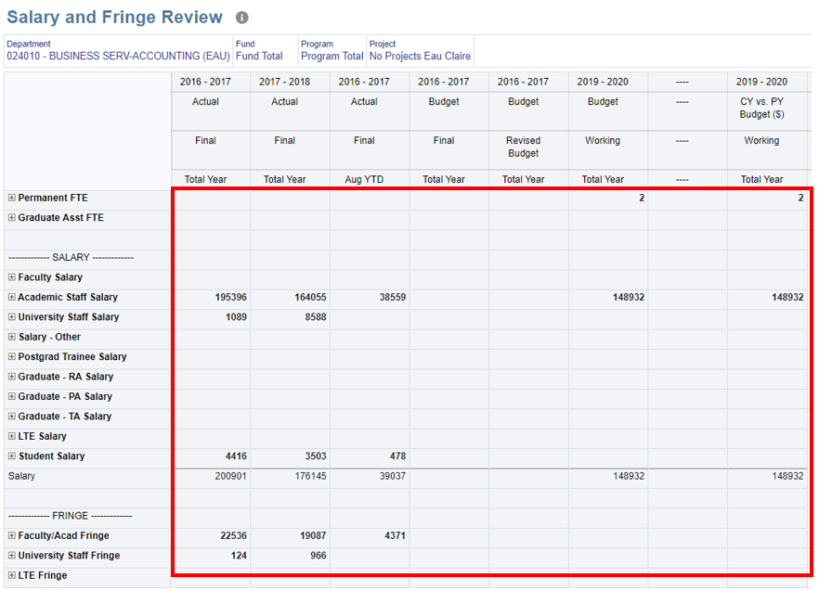
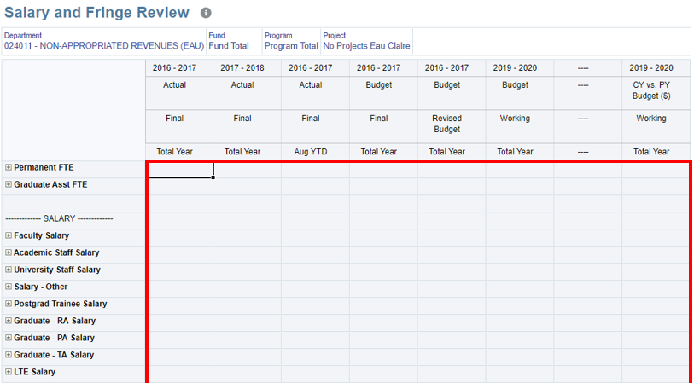
Review Salary Data
Start by selecting a department where data is available for review (Insert dept) to complete the steps described in the previous slide. Also, and for practices purpose, continue to select a department where data is not available (Insert dept). This will demonstrated how the form appears without data.
(Insert dept) – Contains Data
(Insert dept) – Does Not Contain Data

Slide 23
Knowledge Check – Salary Review

Slide 24

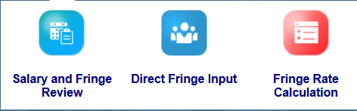
Input Fringe Rates

Slide 25
Input Fringe Rates in Annual Budgeting Process

Slide 26
Before We Start This Process
A few things to consider before beginning the process of Inputting Fringe Rates:
Campuses in the WEST, SO, and NE regions need to set user variables. This excludes the Madison and Milwaukee campuses.
Power and ADMIN Users need to set and push Global Fringe Rates before starting the input process.
  Once Global Fringe Rates have set, the user can continue to Calculate Fringe by Rate AND/OR continue to Input Fringe Directly.
The Calculating Fringe Using Rates process can be accomplished by following two options:
  By entering and reviewing data by Individual Staff Position Form
  By entering and reviewing data by All Staff Position Form
    Both options follow the same steps in the process.

Slide 27
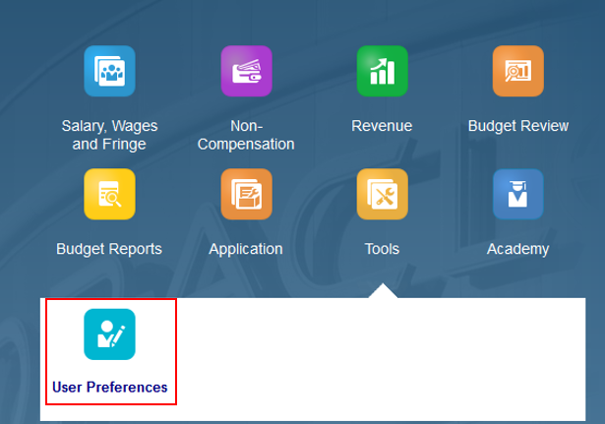
Setting User Variables for West, SO, NE
As explained in our introduction slide, before calculating fringe using rates, WEST, SO, and NE campuses need to set user variables.
Here is a reminder on how to set User Variables:
Click on the Tools cluster and click on User Preferences.

Slide 28
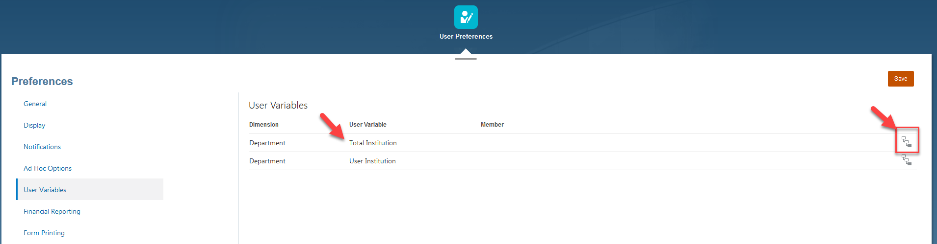
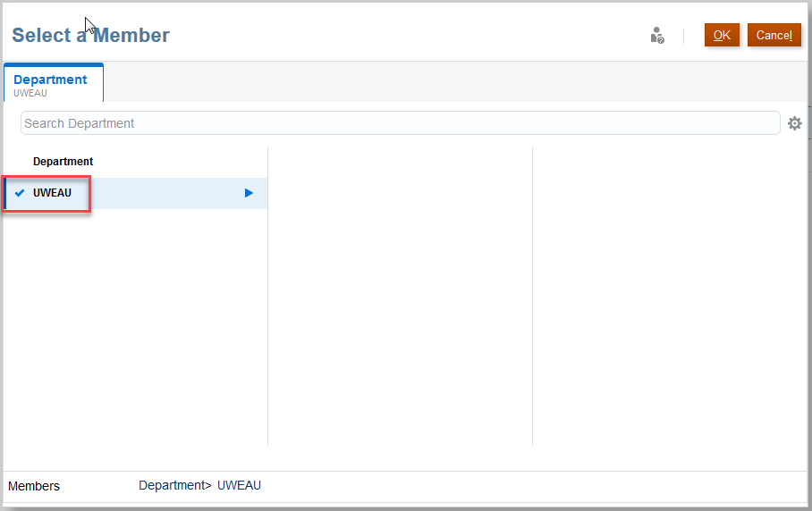
Setting User Variables for West, SO, NE
2
1
4
3
Click on User Variables
Open the member selector for Total Institution
Select your university by clicking on it.
Click OK
The Global Fringe Rates set in the form in the subsequent steps will get copied to all Sub Departments within the University selected in this step.

Slide 29
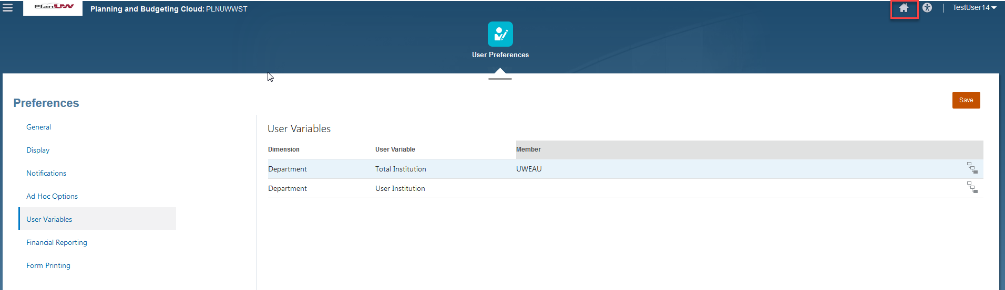
Setting User Variables for West, SO, NE
Click Save
Click the Home or Logo to get back to the PlanUW homepage.
2
1
Remember that this is a one time configuration setup and will not need to be changed again

Slide 30
Setting and Pushing Global Rates –
Power User/Administrator Steps

Slide 31
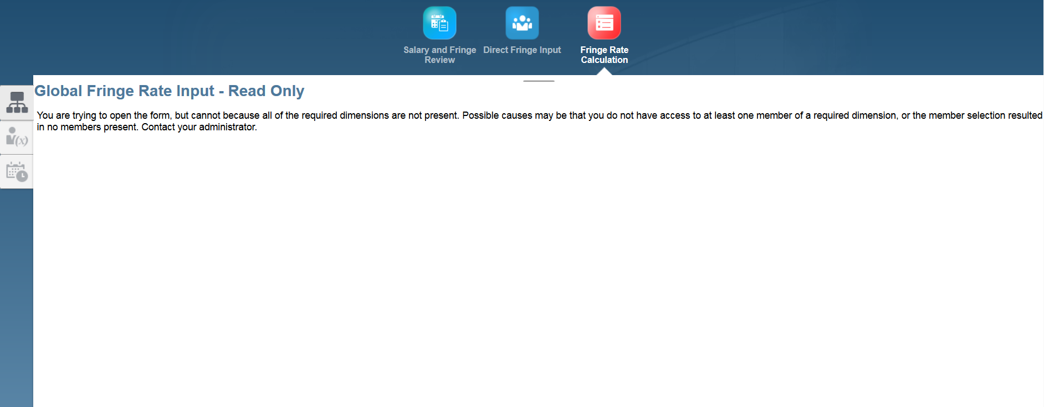
Setting and Pushing Global Rates – Power Users*
Before calculating fringe using rates, ADMIN/Power Users will need to set and push global rates. Here’s what End Users will see if this step has not been completed:

Slide 32
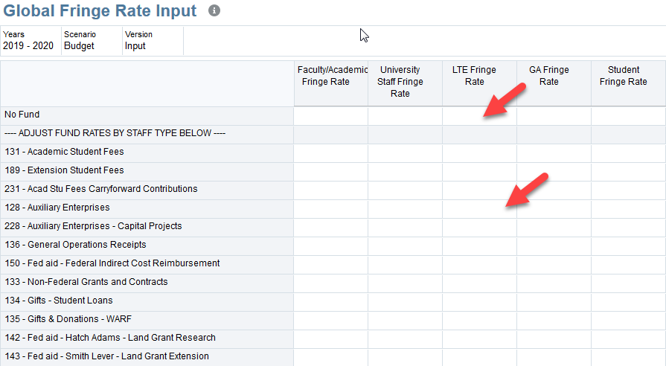
Setting and Pushing Global Rates – Power Users
When the form appears, Power Users/Administrator Users should notice that the input part of the form will be blank and ready for input.

Slide 33
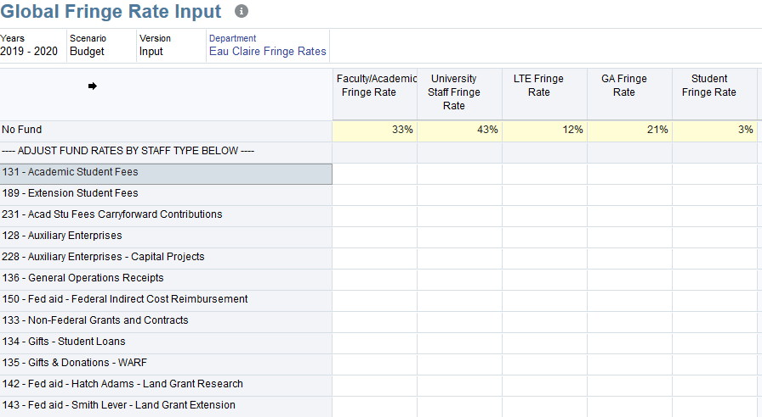
Setting and Pushing Global Rates – Power Users
To continue with the exercise, enter the following Fringe Rates by Staff Type:
Faculty/Academic Fringe Rate = .XX
University Staff = .XX
LTE = .XX
Graduate Assistant = .XX
Student = .XX

Slide 34
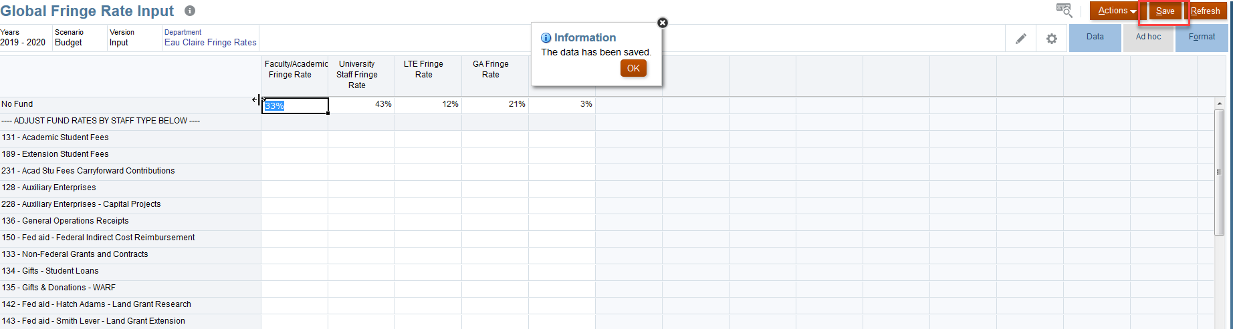
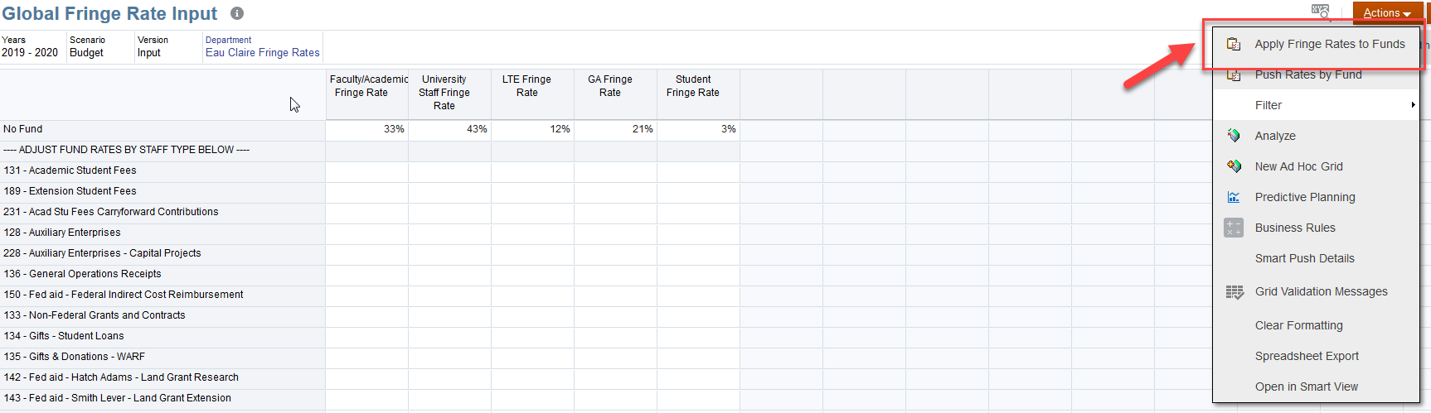
Setting and Pushing Global Rates – Power Users
1
Click Save and confirm cell color is white with data/rates inside the cells.
Click Actions and select 'Apply Fringe Rates to Funds' to copy rates into all Funds
2
Power users will only be able to apply rates by fund if the funds are blank. If the funds are already populated with rates, the rates will not be overwritten

Slide 35
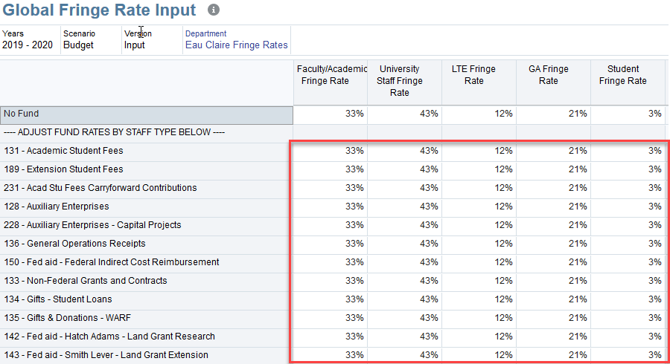
Setting and Pushing Global Rates – Power Users
After completing the previous steps, the Global Fringe Rate Input page should now display populated rates for all Funds and Staff Types.
NOTE: The next slides will explain how to change Fringe Rates that are displaying after this step after the completion of this step.

Slide 36
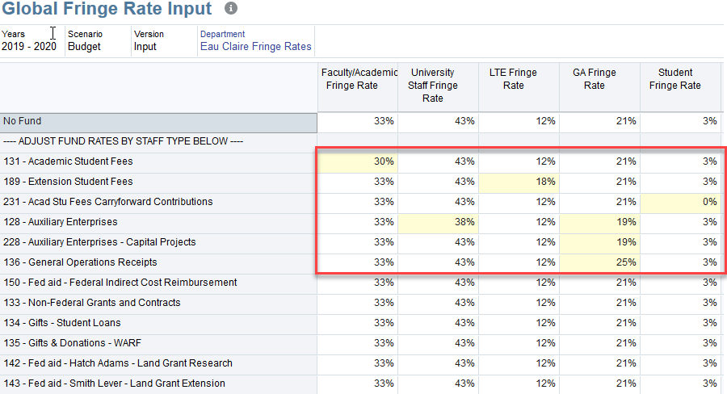
Setting and Pushing Global Rates – Power Users
As an exercise, change Fringe Rates by Fund:
Fund 131 = XXX
Fund 189 = XXX
Fund 231 = XXX

Slide 37
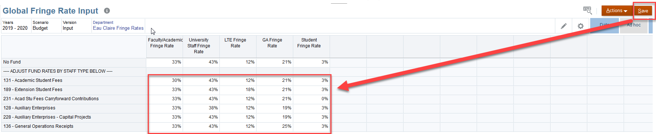
Setting and Pushing Global Rates – Power Users
When a user saves the data, cells should turn white.
Before (and also after) completing the process of pushing rates, users have the opportunity to clear specific account lines if Fringe Rates or Direct Fringe will be entered in the future.
Example: If the 128 – Auxiliary Enterprises account (shown above) will require direct Input Fringe in the future, the rates listed for this account can be deleted directly and the next step can continue.

Slide 38
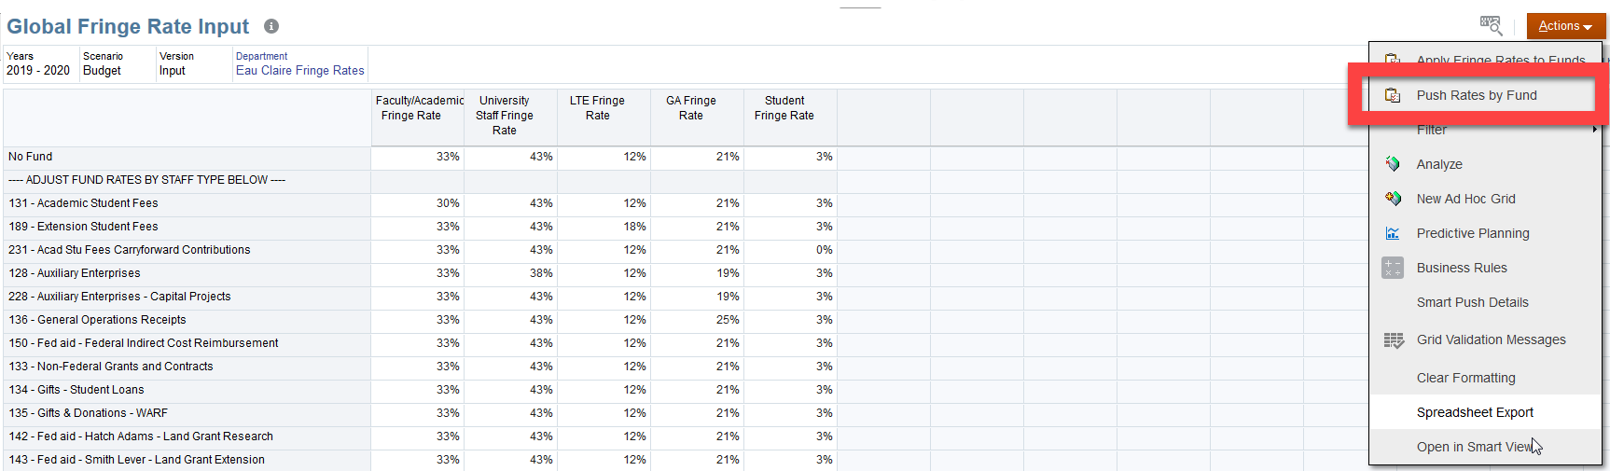
Setting and Pushing Global Rates – Power Users
To finalize the process, click Actions and select 'Push Rates to Fund' to copy rates by Fund into all Sub-Departments, Programs and Project Combinations.
As mentioned in the previous slide, users can still clear account lines after completing the process of Pushing Rates by Fund for future Rate or Data Fringe input. To do so, the user can clear the line by deleting the rates on the account line and executing another Push Rates by Fund process (calculation will only fill in blank cells (If there is data in the cells, the cells will not be overwritten.)

Slide 39
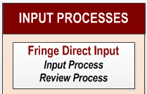
Fringe Input Rates Process

Slide 40
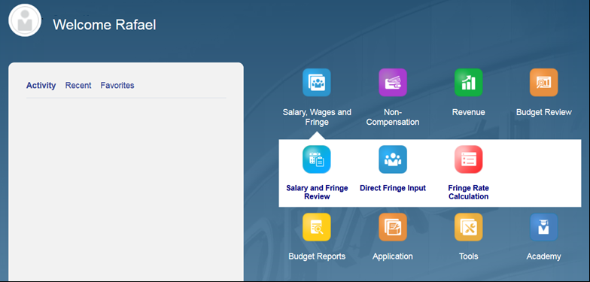
Input Fringe Rates
The Input Fringe rates process differs between two groups.
Due to campus size, the first group is comprised of the Madison and Milwaukee campuses
The second group contains the rest of the campuses. These campuses will have to set their User Variables before beginning.
To begin the process of fringe rates input:
Click the Salary, Wages and Fringe cluster to open the drop down,
Click on the Fringe Rate Calculation tile to open the page.

Slide 41
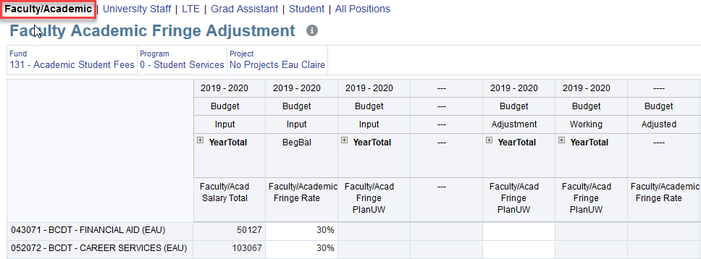
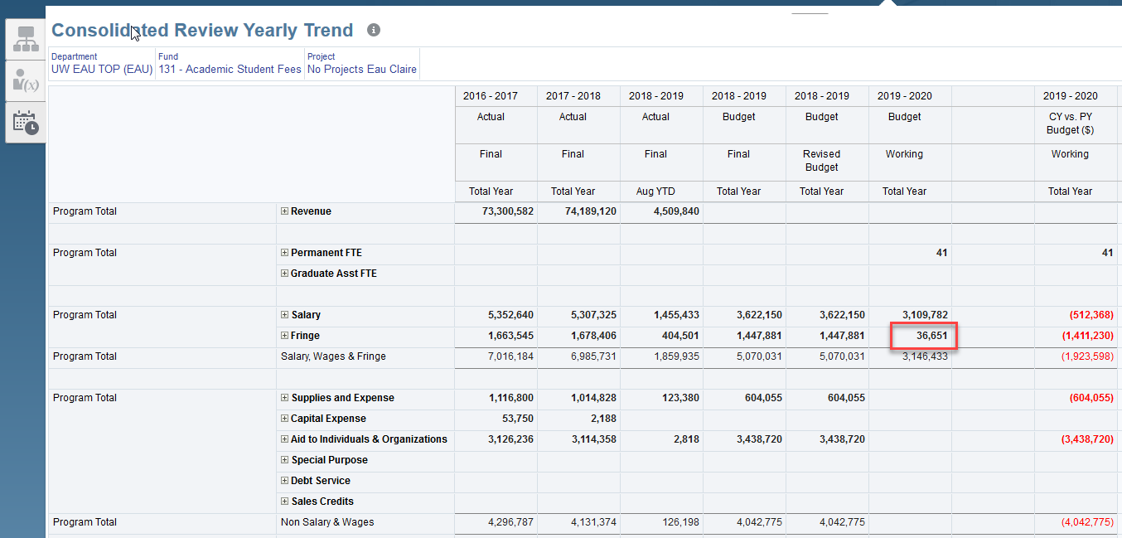
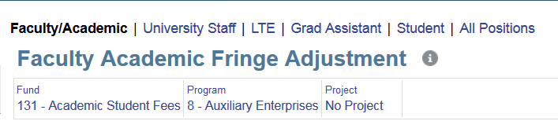
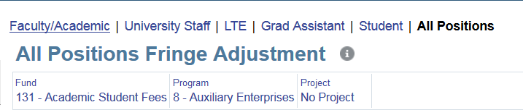
Calculate Fringe Using Rates
Navigate to the second vertical tab - "Fringe Rate Adj and Review“ and open the Faculty/Academic Fringe Adjustment Form.
To continue, you can input fringe rates using two options:
By entering and reviewing data by Individual Staff Position Form (We are using this option moving forward as an example)
By entering and reviewing data by All Staff Position Form.
1
2

Slide 42
Fringe Calculation Nightly Automated Process
The process of Fringe Calculation is an automated nightly process. It is very possible that users will not be able to see updated Fringe Rate data calculated until the automated process happens that night.

Slide 43
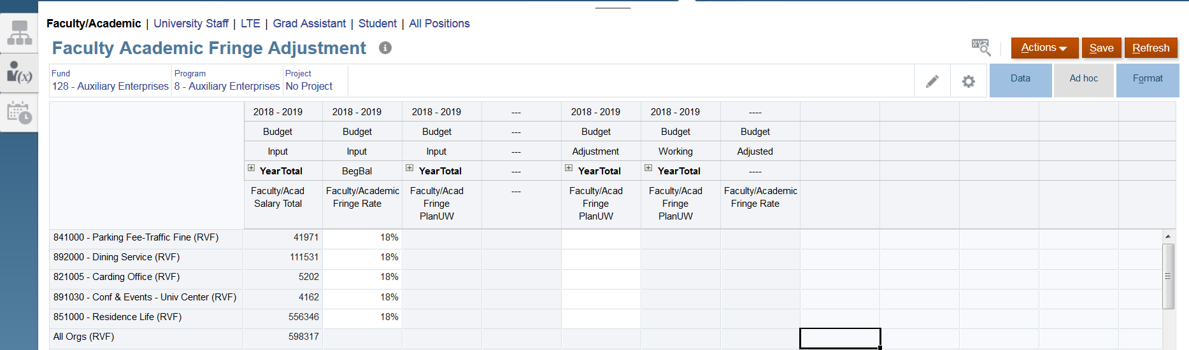
Calculate Fringe Using Rates
To validate rates:
Enter the desired Fund, Program, and Project
Once displayed, this is a good opportunity to ensure that the Point of View information is correct (the rates are correct at this fund, program, and project level.)
1
2

Slide 44
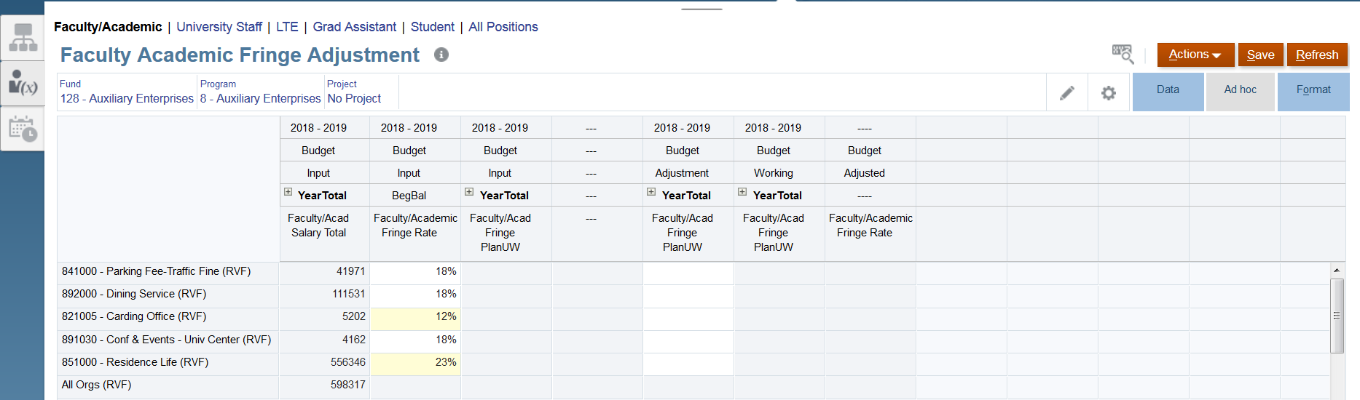
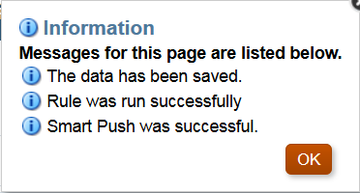
Calculate Fringe Using Rates
To adjust rates Fringe rates by Department:
Enter the rate in the appropriate department by using decimal points for percentage (Example: .18 = 18%)
Once all rates have been entered, click Save.
Click OK on the pop-up confirmation of the changes made.
2
1
3

Slide 45

Calculate Fringe Using Rates
Verify that the fringe rates saved in the previous step are correct.
If adjustments are needed, enter them in the Adjustment column.
Click Save
3
2
1

Slide 46
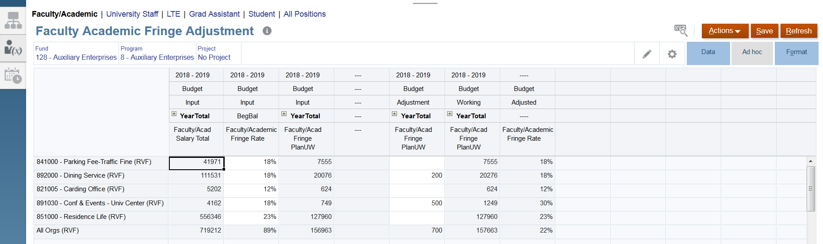
Calculate Fringe Using Rates
If whole number adjustment was required, confirm/validate the Position Fringe amounts, and Adjusted Fringe Rates are correct.

Slide 47

Calculate Fringe Using Rates Review

Slide 48
Calculate Fringe Using Rates - Review
To conduct a review of the calculation of fringe using rates:
Go to the third vertical tab "Consolidated Review".
Choose a Department, Fund, Project to review. This can be done at rollups such as a Division or all Aux funds, or more granularly at sub departments and the 3 digit fund codes.
Validate the aggregated Fringe amounts you calculated are correct, and other data as applicable.

Slide 49
Input Fringe Data

Slide 50
Fringe Data Input in Annual Budgeting Process

Slide 51
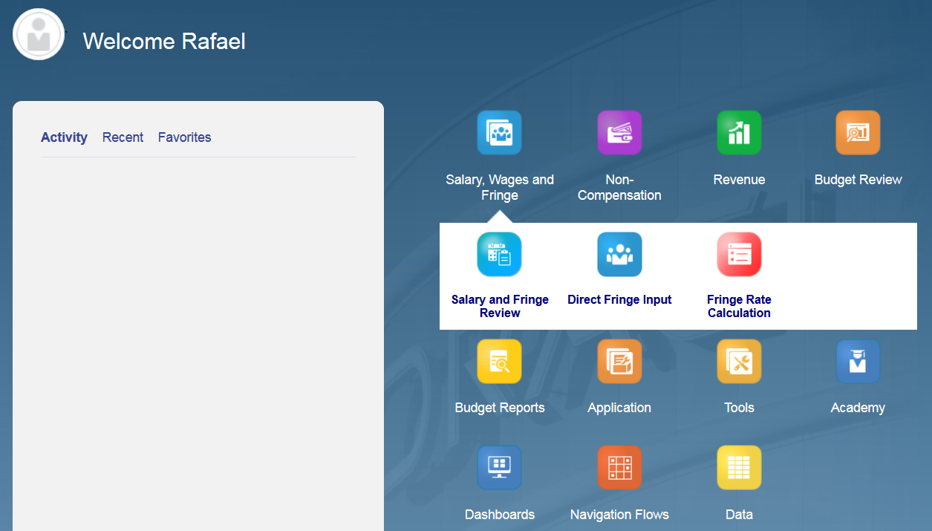
Input Fringe Data
To begin the process of fringe data input:
Click the Salary, Wages and Fringe tile to open the drop down,
Click on the Direct Fringe Input tile to open the page.
NOTE: For this example, we are entering data in Level 3.

Slide 52
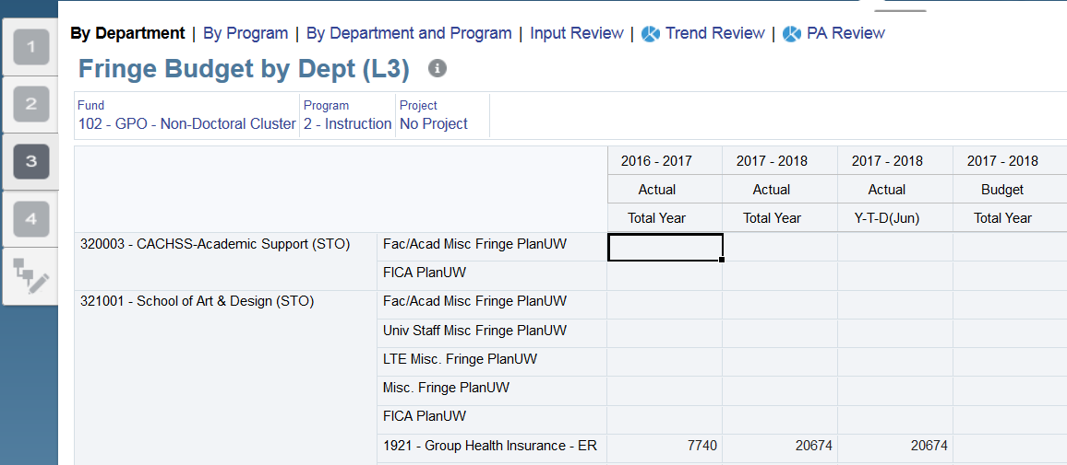
Input Fringe Data
1
Navigate to By Department
Click on Level 3.
Choose a Fund, Program, and Project that will be needed.
3
2

Slide 53
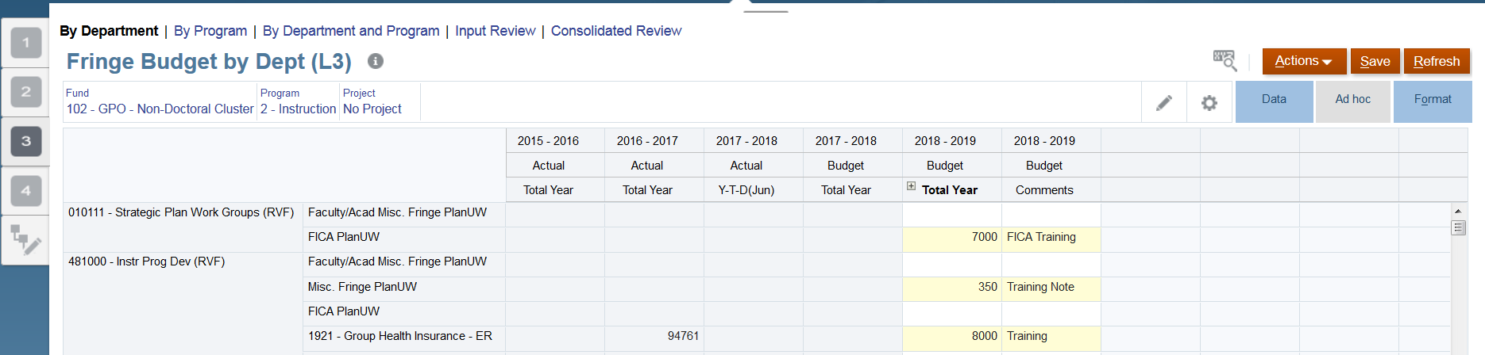
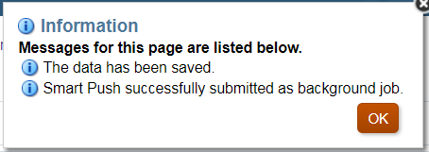
Input Fringe Data
3
1
2
Enter data in the Total Year column.
Enter comments in the Comment column, if needed.
Once done, click Save to save the sheet.
Click OK in pop up message.
4

Slide 54
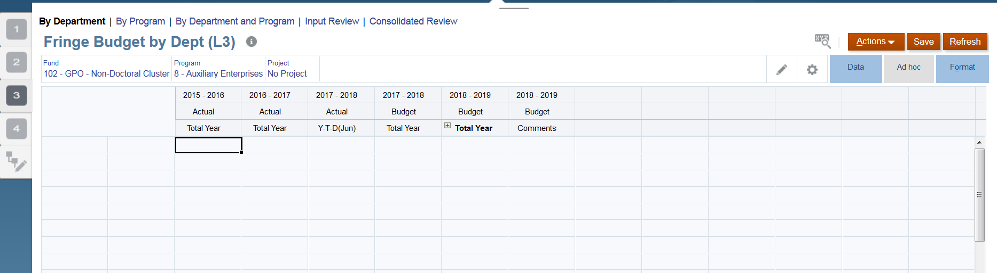
Before We Continue - What is a Wedge
Wedges (Open Budget Accounts Menu) are inserted when an account intersection does not have prior years of actuals. A wedge is inserted to allow users to budget for that intersection.
- An example of this is when a new department is created. Because new departments do not have any prior year actual data and will not show up on a form, a wedge is inserted with already existing department information.
- Inserting a wedge (or Opening Budget Accounts) opens accounts to be budgeted to.

Slide 55
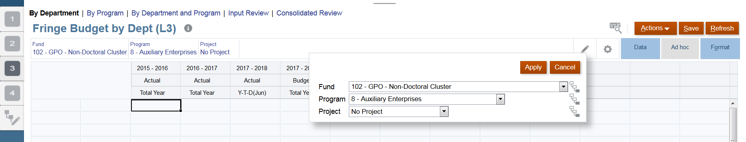
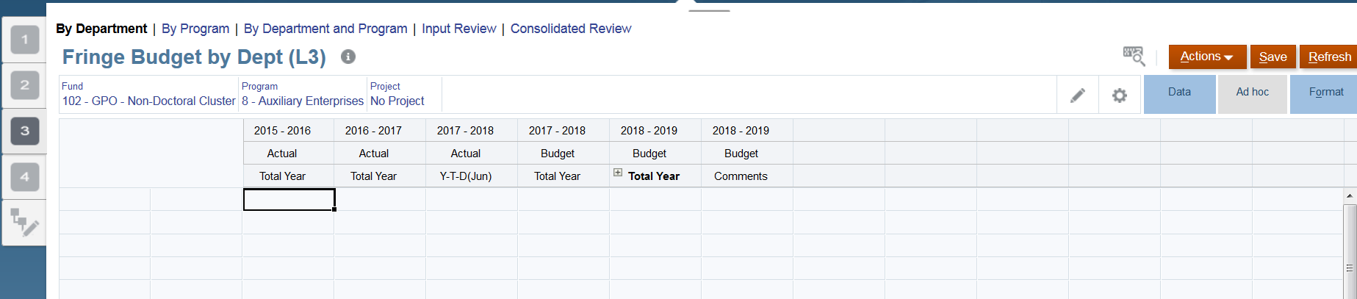
Input Fringe Data – Inserting Wedges
1
3
2
To begin the process of inserting a wedge:
Click on the Pencil icon (Edit)
Select a fund that had no prior year actuals data.
Click on Apply.
Remember that no prior year data exists. Because of this, no data will be displayed.
4
C
95
For an alternate option on how to insert a wedge, visit page 95 of the QRG

Slide 56
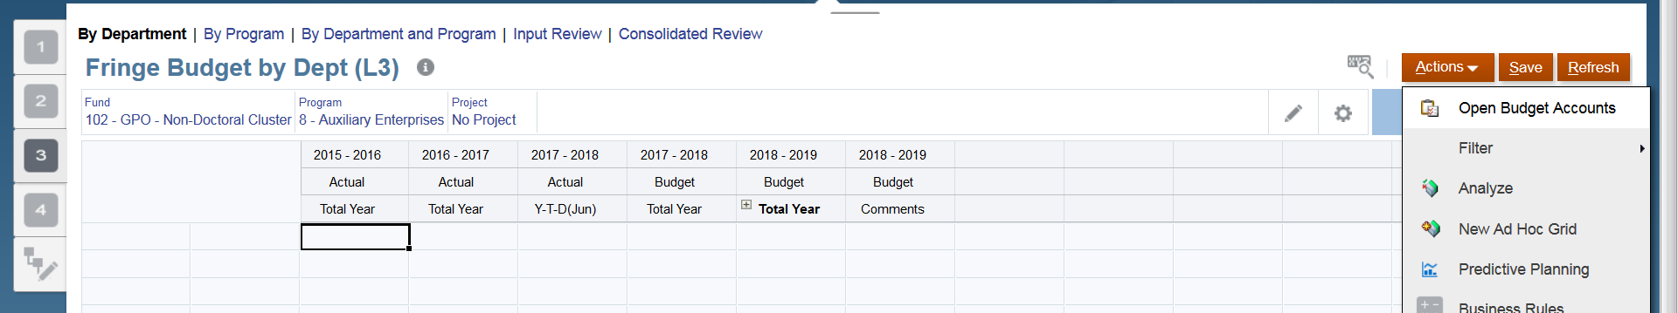
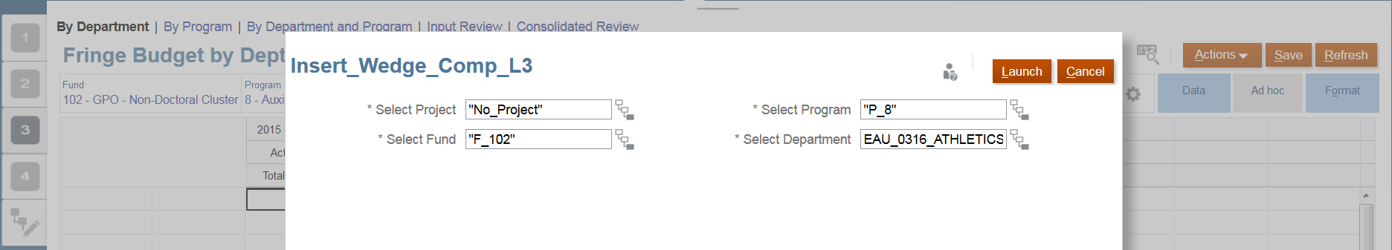
Input Fringe Data – Inserting Wedges
1
2
Under the Actions drop down, click on Open Budget Accounts.
Enter the Department to budget to using the metadata dropdown and click Launch .
In Step 2, there is an alternate way to insert department information. Please refer to the QRG on page

Slide 57
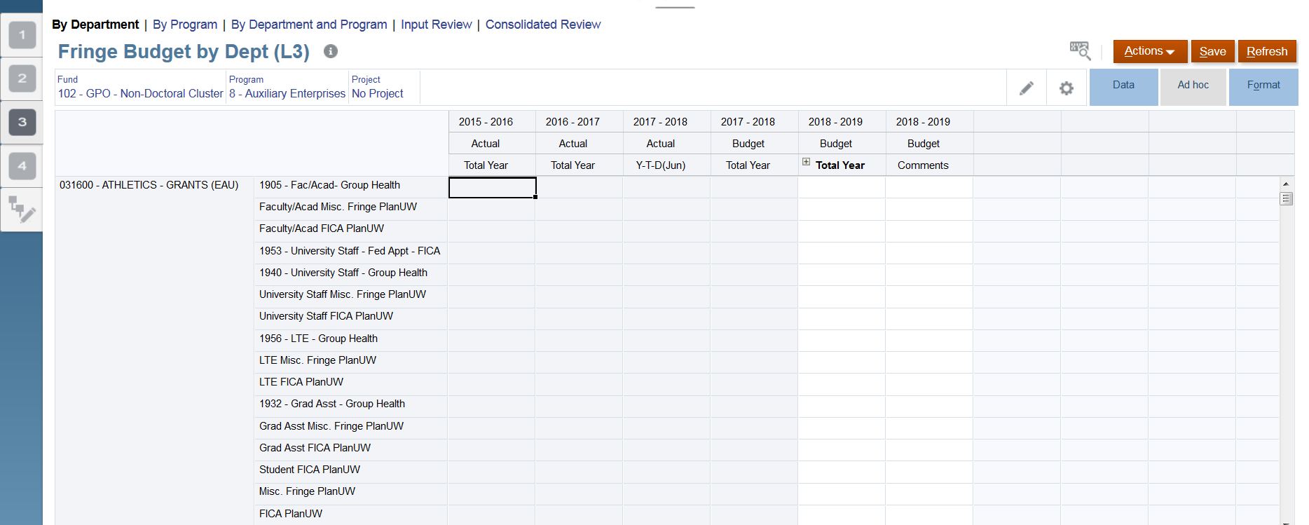
Input Fringe Data – Inserting Wedges
The Department selected on step 2 of the previous slide should now appear along with a column for all Level 3 Accounts.
The process of Fringe Calculation is an automated nightly process. It is very possible that users will not be able to see updated Fringe Rate data calculated until the automated process happens that night.

Slide 58
Input Fringe Data
Once the information from the wedge is populated, the user can now enter data in the editable cells and Save after finishing.

Slide 59
Review Fringe Data

Slide 60
Reviewing Fringe Data
To begin the salary data review process:
Click the Salary, Wages and Fringe tile
Click on the Salary and Fringe Review to open the form

Slide 61
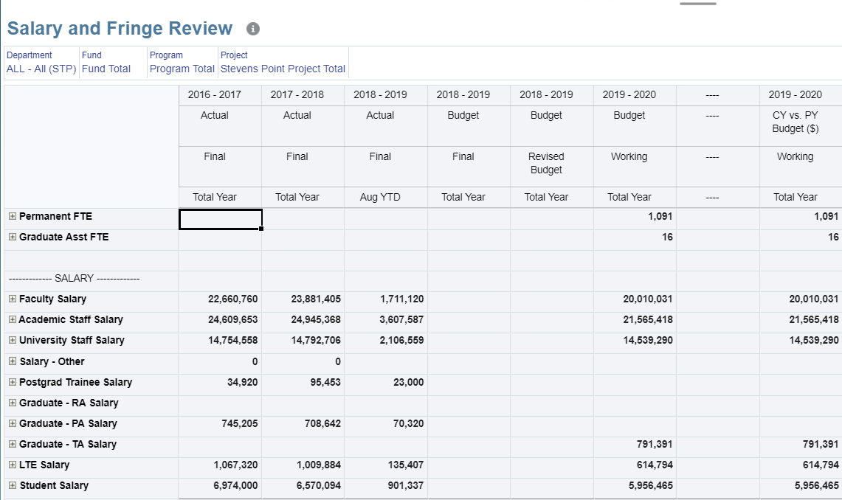
Reviewing Fringe Data
Navigate to the Salary and Fringe Review form:
Confirm that the Actual Data columns look correct
Review previously entered data in Fringe Input Data process.
Review rolled up data and validate it is correct.

Slide 62
Knowledge Check – Fringe

Slide 63
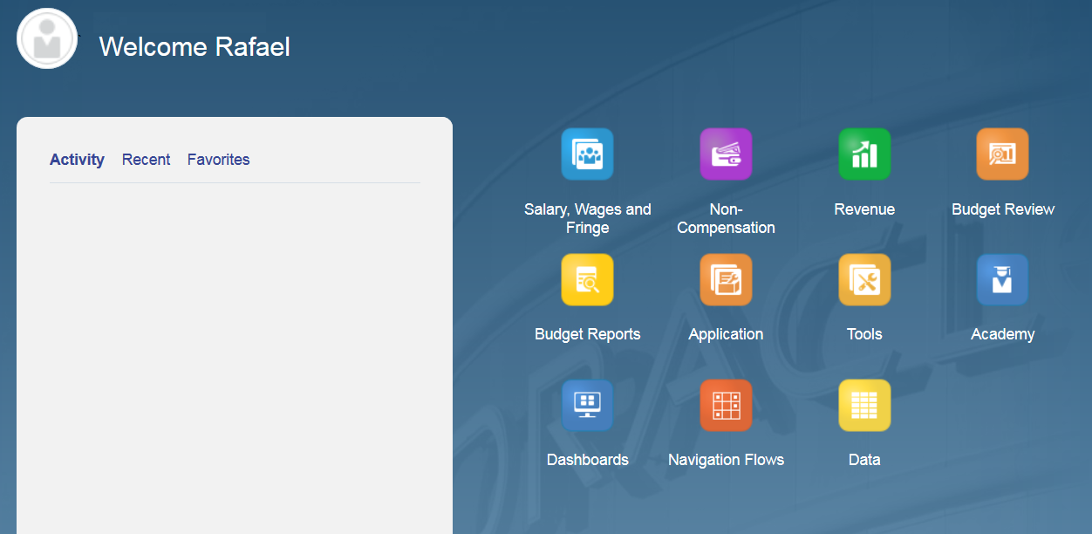
Input Non Compensation Data

Slide 64
Non Comp Input Process in Annual Budgeting Process

Slide 65
Non Compensation Input Process
A few things to consider before beginning the Non Compensation Input process:
This input process can take place at all three levels.
At all three levels, the input process can take place by:
  By Department
  By Program
  By Department & Program
This presentation will cover the Non Compensation Input process at Level 1 and it will cover it By Department, By Program, and By Department & Program. This will be followed by an Input Review section.

Slide 66
Non Comp Input Process – [L1] – By Department
To begin the input process for Non Comp:
Click the Non-Compensation tile to open the spreadsheet.
NOTE: For this example, we are entering data at LEVEL 1. To enter data at LEVEL 2 or LEVEL 3 follow the same instructions but selecting the correct level.

Slide 67


Non Comp Input Process – [L1] – By Department
4
2
1
3
By default, the form will open on Level 1 and By Department. To edit, click on the Edit – Pencil button:
Select the Fund
Program
Project with prior year data.
Click on Apply once done.

Slide 68

Non Comp Input Process – [L1] – By Department
4
1
2
3
Ensure that the correct budget accounts are displayed.
Confirm that the current year (2017-2018) is read-only (Grey)
The next fiscal year budget and comment columns should be available for input. Enter data and comments, and click Enter once done. This should turn the cells yellow.
Click Save once done.

Slide 69

Non Comp Input Process – [L1] - Inserting a Wedge
In the case that several departments do not have data, click on the Actions drop down and click on Open Budget Accounts.

Slide 70


Non Comp Input Process – [L1] - Inserting a Wedge
Select the Department desired to insert into the form. Click Launch.

Slide 71

Non Comp Input Process – [L1] - Inserting a Wedge
The Department selected in the previous step should now be inserted into the form.

Slide 72

Non Comp Input Process – [L1] - Inserting a Wedge
Following steps already described, enter the data in the available cells and click Save once done.

Slide 73

Non Comp Input Process – [L1] – Remove Open Budget Accounts
All Budget Accounts may not be used once they are opened. To improve visibility on a form the budget accounts that are not used can be removed. In the Actions drop down on the form select Remove Opened Budget Accounts.

Slide 74
Non Comp Input Process – [L1] – Remove Open Budget Accounts
Select the Department to Remove Opened Budget Accounts from. Click Launch.

Slide 75

Non Comp Input Process – [L1] – Remove Open Budget Accounts
Validate any accounts that were opened and not budgeted to were removed. Validate any accounts that had data in the prior year, or had budgeted data remained on the form.

Slide 76

Non Comp Input Process – [L1] – By Program
3
1
1
2
The process of budgeting By Program follows the same steps than the process of budgeting By Department:
Select your appropriate Fund and Project using the Point of View Member Selection OR using the pencil.
Input Data into several Programs
Save Data.
If needed, continue to insert a wedge by following the steps already mentioned.

Slide 77

Non Comp Input Process – [L1] – By Department & Program
For Non Comp Inputs By Department and Program, navigate to the By Department and Program Form

Slide 78

Non Comp Input Process – [L1] – By Department & Program
'Select your appropriate Fund and Project using the Point of View Member Selection OR using the pencil as demonstrated in previous steps.
'Enter data into several Programs or Accounts
Click Save.
3
1
1
2

Slide 79

Non Comp Input Process – [L1] – By Project
All pods also have a form with Projects in the rows. To adjust the POV in this form:
Select the Department to adjust the member via the Member Selector.
Select the Fund to adjust the member via the Member Selector.
Select the Program to adjust the member via the Member Selector.

Slide 80

Non Comp Input Process – [L1] – By Proj, Dept and Prgm
In the Madison pod there is an addition form By Proj, Dept and Prgm to facilitate data entry. To adjust the POV for this form.
Select the Fund to adjust the member via the Member Selector.

Slide 81
Reviewing Non Compensation Data

Slide 82

Reviewing Non Comp Data
The last three tabs offer the option to conduct reviews from different perspectives:
Input Review
Trend Review
PA Review level

Slide 83

Reviewing Non Comp Data – Input Review
Once in the Input Review tab, review the Actual Data columns, and review previously entered data in Fringe Input Data process.

Slide 84


Input Review – Before Continuing
Remember that input forms for each level will be unsuppressed for Input Review. This means that input review forms at Level 1 will just contain Level 1 accounts. Level 2, however, will have Level 1 and 2 accounts, and Input Review form at Level 3 will contain Level 1, 2 and 3 accounts.
HOWEVER, the input review forms in the last section will be suppressed to only show areas that have been budgeted in or had actuals in the past

Slide 85


Before Continuing – Cont..
Unlike the other general input forms, Users will not be able to use the “account drop downs” or “Open Budget Accounts” in any of these forms.
When using the Account dropdown it is important to note, you are not overwriting the account already on the form.
Click Save to see the new account, plus the accounts that were already on the form.

Slide 86


Reviewing Non Comp Data – Input Review
1
2
3
Confirm the Actual numbers are correct
Confirm Prior year budget amount by Major Class
Locate your Data entered within the input forms to see how the data rolls up to the Major Class

Slide 87

Reviewing Non Comp Data – Input Review
2
1
Make a change to any data within an editable cell
Save data.

Slide 88

Reviewing Non Comp Data – Trend Review
To conduct a Trend Review, once in the Consolidated Review tab, click on the Trend Review tab.

Slide 89

Reviewing Non Comp Data – Trend Review
To conduct a Trend Review, once in the Consolidated Review tab, click on the Trend Review tab.
For this example, select a Department, Fund and Project from the Point of View or Pencil edit section.

Slide 90

Reviewing Non Comp Data – Trend Review
Review the Actual data.
View the current fiscal year's Redbook Budget
View the current fiscal year's Revised Budget
Validate the Budget entered from the input forms
Validate the Working vs. Redbook Budget Variance
1
2
3
4
5

Slide 91
Knowledge Check – Non Compensation

