Slide 1
Planning Allocation Process
End User Training

Slide 2
Course Objectives
In this course you will learn how to perform Planning Allocation tasks within PlanUW
After completing this class, you will have learned:
UWSA Allocation Process and Concepts
How to Report on Allocations from UWSA
How to Create and Report on Campus Allocations

Slide 3
Agenda (aimee to edit)
Planning Allocation Overview
Process Overview
Dimensional Overview
Planning Allocation Functions
Setting User Variables
Reviewing UWSA Allocation (Budget Target) Reports – refreshed nightly
Campus Allocations
Target Allocations
Creating an Allocations
Creating Distributions
SmartView
Campus Allocation Reports
Budget vs. Budget Target Reports – refreshed every 15 minutes
Allocation (Budget Target) Reports – refreshed in real time
Non-Target Allocations
Allocation Upload Template
Finalize & Revise Allocations

Slide 4
UW Planning Allocation
Process Overview

Slide 5
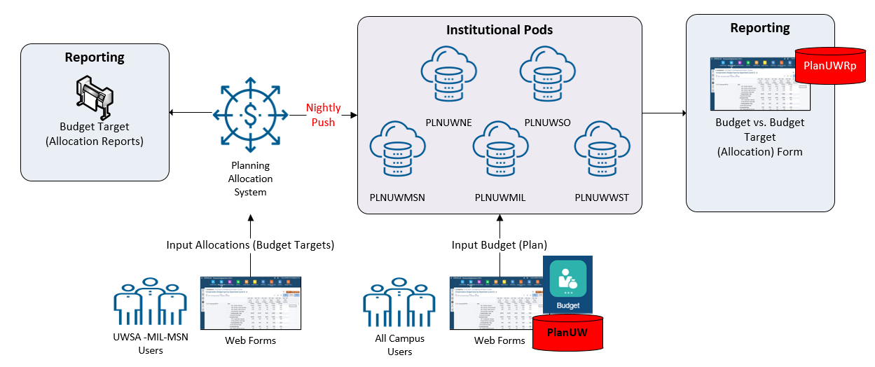
Current State
UWSA & Campus Allocations

Slide 6
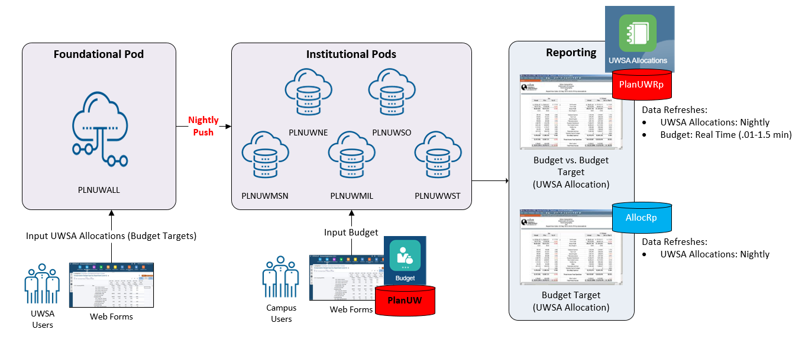
Future State
1. UWSA Allocations

Slide 7
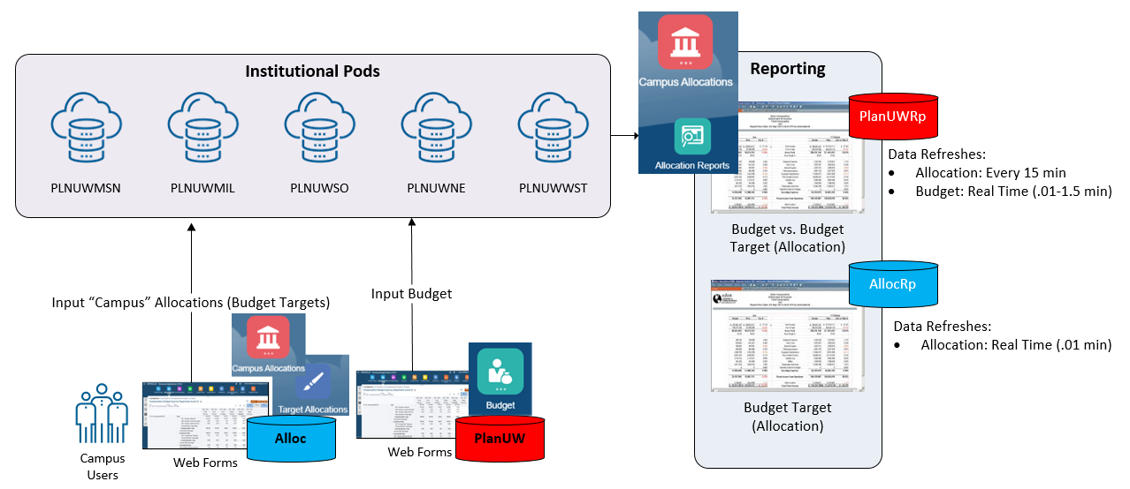
Future State
2. Campus Allocations
UWSA and Campus Allocations are distinct sets of data that do not overlap or interact

Slide 8
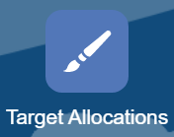
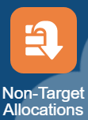
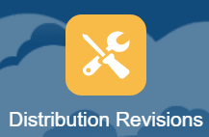
Future State
2. Campus Allocations cont.
Card | Content
10 | Provides the ability to create allocations within your campus to individual Divisions, Departments or Subdepartments for GPR and PR Funds during Budget Development.
 | Provides the ability to create allocations (or commitments) that shouldn’t added to the ‘Budget Target’ until ‘Approved’.
 | Provides the ability to revise, or create new allocations, within your campus after you have finalized the budget target for the next fiscal year. Conceptually like Budget Transfers, but for Budget Target, and not Redbook
Once ‘Approved’
After ‘Finalized’

Slide 9
UW Planning Allocation
Dimensional Overview

Slide 10
New Cubes and Dimensions
6 new dimensions have been created for Planning Allocation (Budget Target) input and reporting in PlanUW
# | Dimension | PlanUW | PlanUWRp | Alloc | AllocRp | Description
1 | Period | X | X | X | X
2 | Years | X | X | X | X
3 | Scenario | X | X | X | X | Updated for Planning Allocation (UWSA, Campus, Divisional)
4 | Version | X | X | X | X | Updated for Planning Allocation (Base, Non-Target, Final)
5 | Account | X | X | X | X
6 | Department | X | X | X | X
7 | Fund | X | X | smart list | X | Fund is a smart list, and not a dimension in Alloc.
8 | Program | X | X | smart list | X | Program is a smart list, and not a dimension in Alloc.
9 | Project | X | X | smart list | X | Project is a smart list, and not a dimension in Alloc.
10 | Allocation |  |  | X | X | New Ref # (UWSA_001, UWMSN_ 009.00). Differs by pod.
11 | Distribution |  |  | X | X | Used for unique allocation transactions. Same across pods.
12 | ALC_Type |  |  |  | X | Allocation Reporting Dim. 1-1 with Allocation #
13 | ALC_Duration |  |  |  | X | Allocation Reporting Dim. 1-1 with Allocation #
14 | ALC_Status |  |  |  | X | Allocation Reporting Dim. 1-1 with Allocation #
15 | ALC_To_From |  |  |  | X | Distribution Reporting Dim.
Total | Total | 9 | 9 | 8 | 15

Slide 11
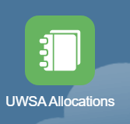
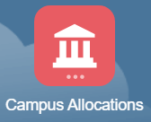
Allocation
Used to capture individual allocations, or as referred to in the PA system today, Reference Numbers.
UWSA and Campus Allocations are distinct sets of Allocation (Budget Target) data that do not overlap or interact
 |  | Each pod will contain: UWSA Allocations - The common list of created by UWSA, integrated from the Foundation pod nightly, and Campus Allocations - The distinct, separate, and unique list created within your institutional pod.
 |  | UWSA Allocation numbers: Created by UWSA in the Foundation pod Integrated to the institutional pods on a nightly basis Can be reported on via the UWSA Allocations card Read Access: Cannot be created, or changed by Institutions
 |  | Campus Allocation numbers: Created by Campuses within your own pod Not integrated across pods Write Access: Can be created, and reported on via the Campus Allocations card

Slide 12
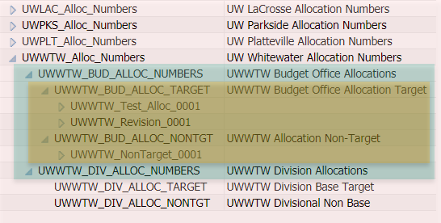
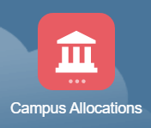
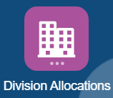
Allocation cont. – Campus Rollup Levels & Security
Even though the individual Campus Allocation or Reference #s will differ by institution,
The Campus Rollup for each pod will follow a common structure:
Level 1: Institutional Divide (Red)
Institutions cannot see other Institutions Reference #s or related target data
Not applicable for MSN and MIL
Level 2: Budget Office vs. Divisional Allocations (Green)
Separates the data sets between Budget Offices and Divisions
Divisions can see Budget Office Allocations, but not edit them, like the security between UWSA and Campus Allocations
Level 3: Target vs. Non-Target (Yellow)
Separates the data sets between Target vs. Non-Target
Non-Target Allocations are not added to the Budget Target unless approved
Budget Office and Divisional Allocations use separate Scenarios as well
Once ‘Approved’
Base and Non-Target use separate Versions as well

Slide 13
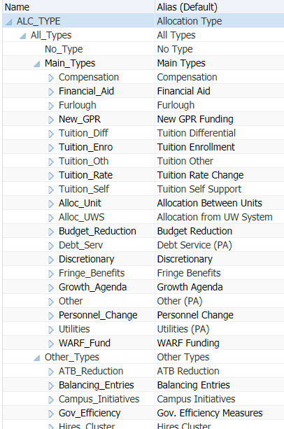
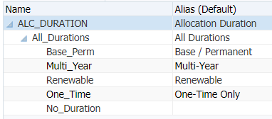
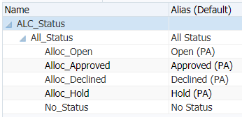
ALC_Type, ALC_Duration, and ALC_Status
Used for reporting on Allocation totals
An individual Allocation can only be tagged with one value from each of these 3 hierarchies
Target Campus Allocations will always have the Status = “Approved (PA)”
UWSA Allocations will always be:
Duration = “Base / Permanent”, and
Status = “Approved (PA)”
Campus Allocations with the “Base / Permanent” Duration will be copied to the next fiscal year when Campus Allocations (Budget Targets) are initialized
PlanUW Admins can add more Types as necessary

Slide 14
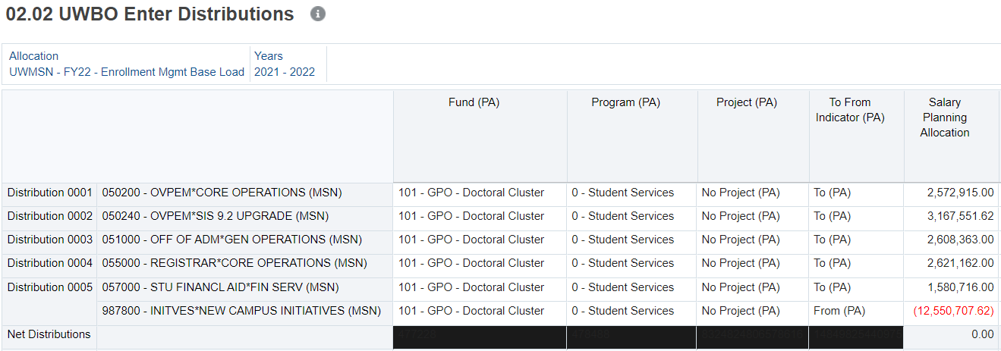
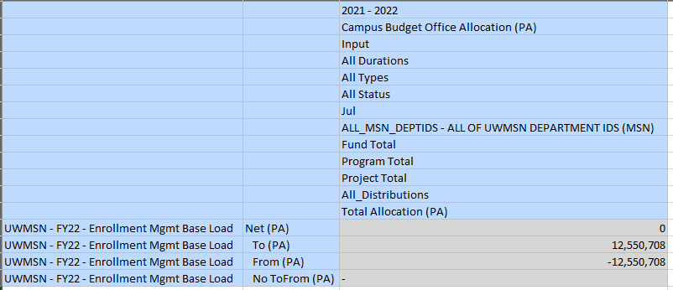
Distribution & ALC_To_From
Distribution
Used to enable unique transactions for Allocations
Unique distributions must be used to capture unique transactions or lines (when using the same Dept-Fund-Program-Project) combo
A single distribution member can be used when using different DeptIDs (as show on Distribution 5 below), but isn’t’ required
ALC_To_From
Distributions can be tagged as ‘To’ or ‘From’, or left as default (No To From)
If users choose to tag Distributions, ‘To’ should generally be used for Positive amounts and ‘From’ for Negative amounts

Slide 15
UW Planning Allocation
Setting User Variables

Slide 16
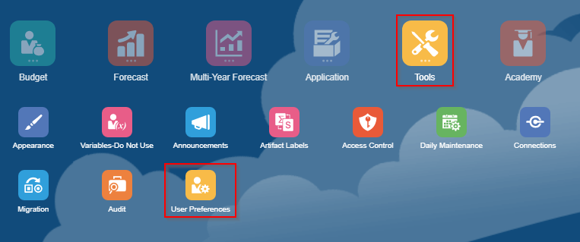
Setting User Variables
Users need to set User Variables according to their institutions. Setting User Variables ensures that the user filters input and review forms to campus exclusive data.
To access Preferences:
1. Click the Tools cluster
2. Select the User Preferences card
NOTE: It is important that users select the specific user variables in order to access certain forms and reports. Failure to set user variables may cause users to be unable to access these forms and reports. User variables only need to be set once, but they can be changed at any time.

Slide 17
Setting User Variables – End Users
Member Selectors
Members can be selected for each User Variable by clicking Member Selector

Slide 18
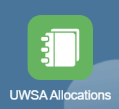
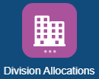
Setting User Variables
User Variable | Cluster | Object | Restriction | Description
Total Institution |  | UWSA Allocation vs Budget Report | Needs to be set to one of the "main" campus parents | Example UWMSN, UWMIL, UWRVF, etc. so the report will pull in all department IDs for both allocations and budget
User Division Alloc |  | Divisional Enter Distributions form | Currently only available to Madison | Needs to be set to a division in the PA_Dept_Members parent
User Institution Alloc |  | Allocation List report UWSA Alloc by Fund-Ref report UWSA Alloc by Ref-Fund report |  | Recommendation is to set to Tot_xxx_Input where xxx is the campus code (e.g., MSN, WTW, SUP, etc.)
User Institution UWSA Alloc |  | UWSA Enter Distributions form |  | Recommendation is to set to Tot_xxx_Input where xxx is the campus code (e.g., MSN, WTW, SUP, etc.)

Slide 19
Setting User Variables
If User Variables were not selected, you can expect to see the error warnings when opening specific forms and reports as seen on the right.

Slide 20
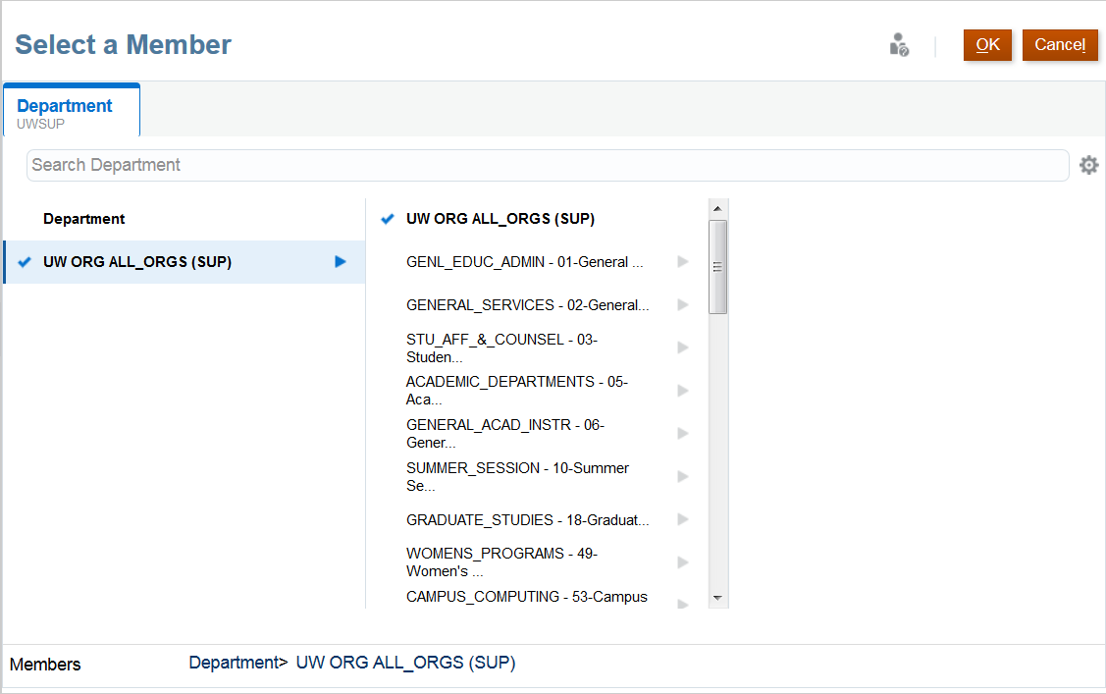
Selecting Members
Members can be selected in two ways from the Member Selection window:
Search Bar
Hierarchy
Search Bar
Select
When selecting members through a Hierarchy, drill into a member by clicking
To select a member, click on the member.
Note that you are only able to select one member at a time
Hierarchy
If the member selected does not appear on the User Variables selected, the next slide will explain the next steps.

Slide 21
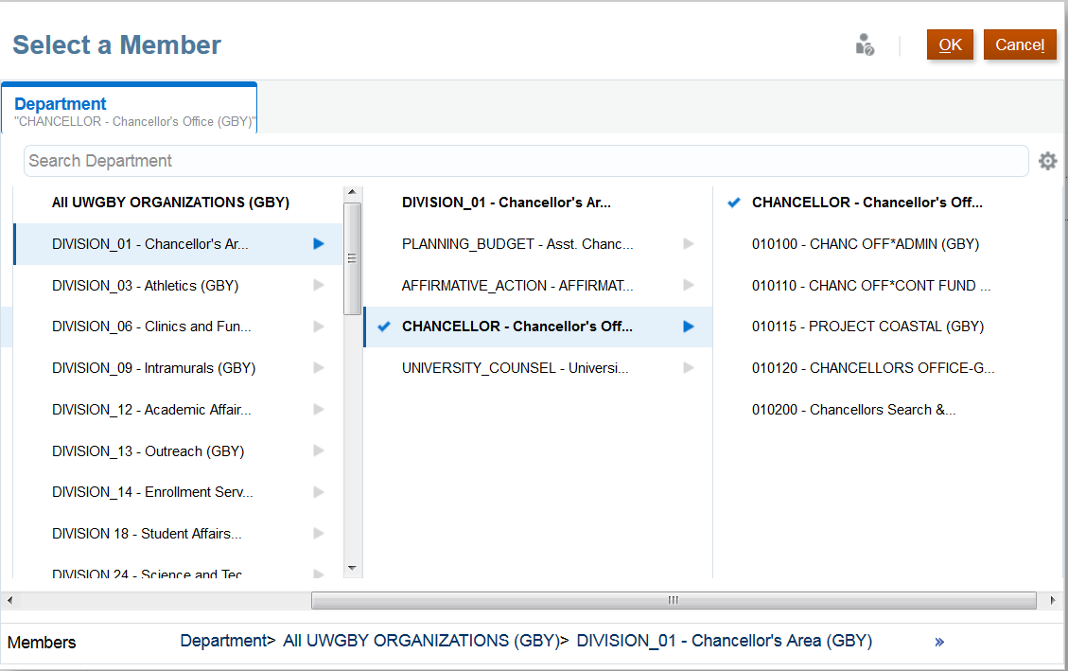
Selecting Members - Before Continuing
If you are not able to select a specific member, in this example “CHANCELLOR – Chancellor’s Office”, PlanUW lets you click the member, the blue check box confirms the selection, and then they can click OK. However, the selection does not actually get set as the “User Institution”.
A work around for this is to type the member name directly into the box.
Did not update with new selection

Slide 22
Saving User Variable Selections
Note: Please remember to save your user variable selection on the top right corner of the page to apply your selections. If user variables were not saved after clicking out, the selections will not be updated, and users will have to make the selection again.

Slide 23
User Variables – Special Notes
LIST OF USAGE OF USER VARIABLES IN REPORTS AND FORMS
Total Institution
UWSA Alloc vs Budget reports
User Institution Alloc
UWSA Ref/Fund and Fund/Ref reports
UWSA Allocation List report
User Institution UWSA Alloc
UWSA Enter Distribution form
User Division Alloc
Divisional enter distribution forms (target, non-target, revision)
No User Variable for Dept ID
Campus and Division Alloc vs Budget reports – selectable in POV
Campus and Division Allocation List – no Dept ID
Campus and Division Duration reports – in page
Campus and Division Ref/Fund and Fund/Ref - in row
Campus and Division POV reports- selectable in POV
Campus enter distribution forms (target, non-target, revision)
Allocation setup forms (all campus and divisional) – no Dept ID
Allocation list forms (all campus and divisional) – no Dept ID

Slide 24
UWSA Planning Allocation Reports
Notes:
Key items regarding reports:
POV selections
Version
Department
Fund
Status
Duration
Etc.
Report format
HTML
PDF
Excel

Slide 25
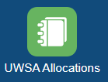
UWSA Allocation Reports
What you will learn: How to report on Budget Targets (or Allocations provided by UWSA) using the reports in the table below. Please note – These reports will be refreshed with Budget Target data from the UWSA Foundation pod on a nightly basis.
Report Name | Description
Budget vs. Budget Target (Allocation) | Variances by Program, FTE, Major Class (uses Total Institution variable)
Working | Working version – UWSA Allocation vs. Budget
Final | Final version – UWSA Allocation vs. Budget
Revised (Only Applicable to Revised Budget) | Revised version – UWSA Allocation vs. Budget
PDF – Any Version | User selectable versions
Budget Target (Allocation) | (uses User Institution Alloc variable)
Allocation List | List of UWSA allocations with key characteristics
Allocation by Fund / Ref | Allocations with Fund on the page and Allocation Ref on the row
Allocation by Ref / Fund | Allocations with Allocation Ref on the Page and Fund on the row
Allocation Report by Fund | Allocations with Account in Row and Program in Columns
Allocation Distribution Dashboard

Slide 26
UWSA Allocation Reports
To view the UWSA Allocations reports:
Go to Home screen
Click on the UWSA Allocations tile to open

Slide 27
UWSA Allocation Reports
The UWSA Allocation tile is a new edition to the homepage and provides a clear review of the Planning Allocations done in the UWSA pod. The UWSA Allocation Reports are available in 3 vertical tabs:
UWSA Budget vs Allocation
UWSA Allocation Reports
UWSA Allocation Reviews
The UWSA Budget vs Allocation tab presents several out of the box reports to view allocations that mirror the layout of the Budget reports for comparison.
The UWSA Allocation Reports tab provides users the ability to view a list of allocations and reports by different cuts of Allocation Reference, Fund and Department.
The UWSA Allocation Reviews tab provides users the ability to view detail distributions for each UWSA allocation.

Slide 28
Point of View Change – Before Continuing
The active POV for reports will typically be the last POV a user selected while working in the system. If a report opens with unexpected results, the first step is to check the POV to ensure it correctly reflects the members that are desired. The selected Version and Department often lead to blank or null reports.
If the POV can change for version, users should remember to always use one of the following 4 versions:
Working: This version contains the Target Allocations you created (or provided by UWSA)
Final: This version contains the Target Allocations you created after they have been copied to final
Revised: This version contains the Allocation Revisions made + Final
Requests: This version contains the Non-Target Allocations you created and have not approved

Slide 29
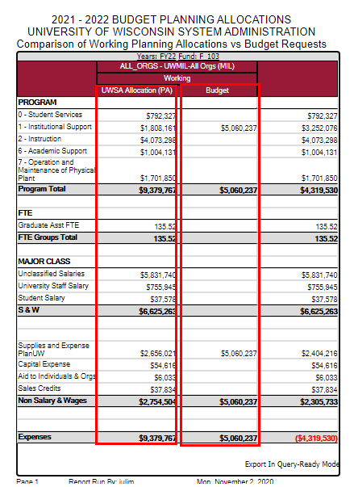
Working - UWSA Allocations vs Budget (HTML Format)
UWSA Allocations vs Budget report
1. Select File Format: PDF, HTML or Excel
2. Select Years and Fund

Slide 30
Final - UWSA - Allocation vs Budget in PDF Format
Final- UWSA - Allocation vs Budget
1. Select File Format: PDF, HTML or Excel
2. Select Years and Fund

Slide 31
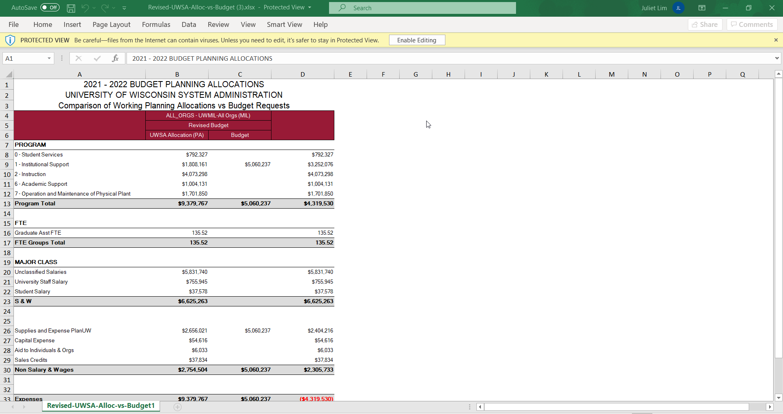
Revised - UWSA - Allocation vs Budget
Revised - UWSA - Allocation vs Budget
1. Select File Format: PDF, HTML or Excel
2. Select Years and Fund

Slide 32
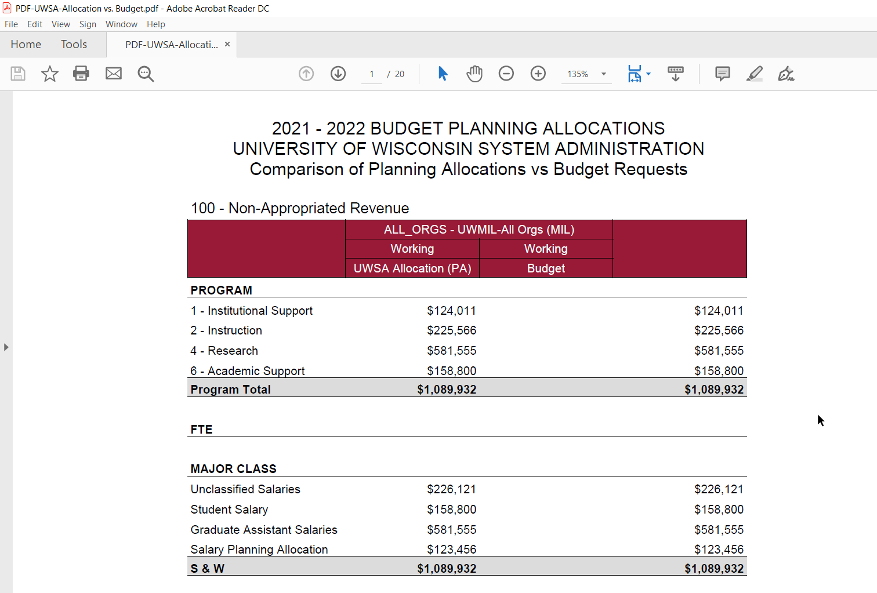
PDF - UWSA - Allocation vs Budget
Expense Planning Allocation Report
1. Select File Format: PDF, HTML or Excel
2. Select Department and Version

Slide 33
UWSA Allocation Reports
UWSA Allocation Reports
1. Select File Format: PDF, HTML or Excel
2. Select Department and Version

Slide 34
UWSA Allocation List
UWSA Allocation List
1. Select File Format: PDF, HTML or Excel
2. Select Years and Allocation Type

Slide 35
UWSA Allocation by Fund/Ref
UWSA Allocation by Fund/Ref
1. Select File Format: PDF, HTML or Excel
2. Select Years, Version and Allocation Type

Slide 36
UWSA Allocation by Ref/Fund
UWSA Allocation by Ref/Fund
1. Select File Format: PDF, HTML or Excel
2. Select Years, Version and Allocation Type

Slide 37
UWSA Allocation Report by Fund
UWSA Allocation Report by Fund
1. Select File Format: PDF, HTML or Excel
2. Select Years, Department and Fund

Slide 38
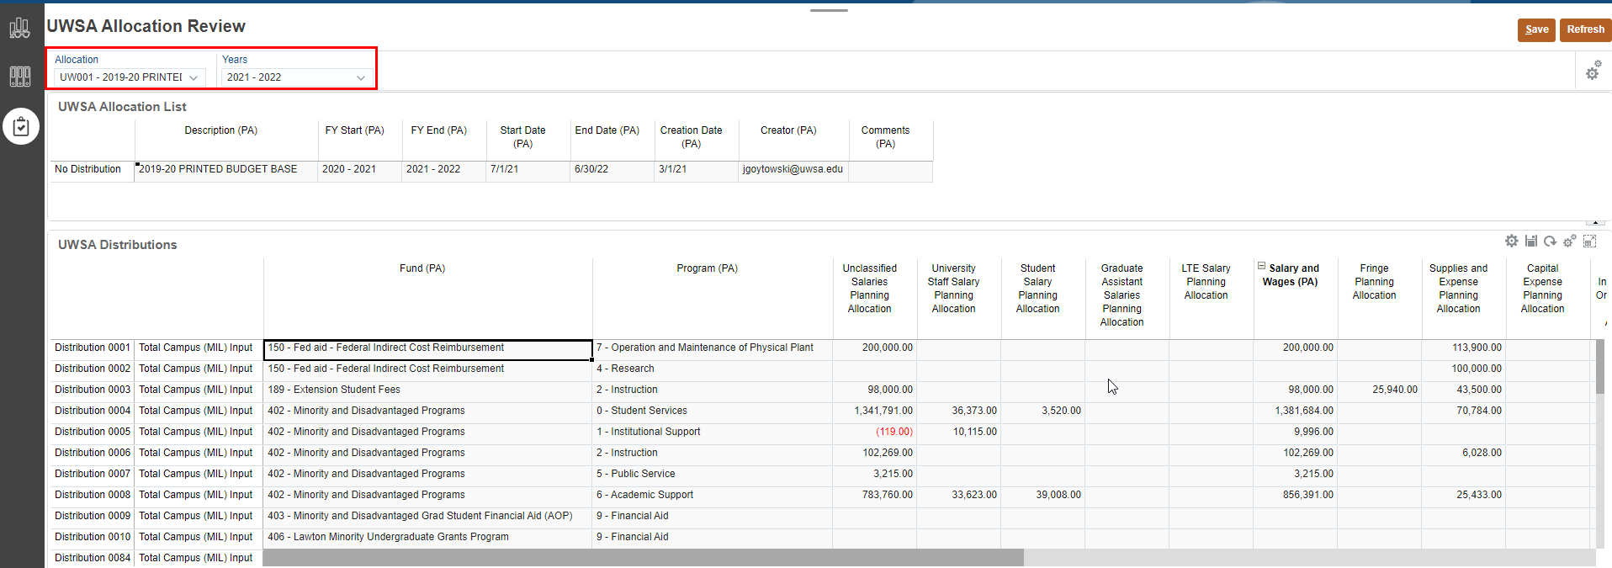
UWSA Allocation Review
1
2
Note: Cells should be read only on both forms
3
The third vertical icon shows the UWSA Allocation Review form:
Select Allocation and Years from drop down list for review
Review UWSA Allocation Information
Review Distribution data.

Slide 39
UW Campus Allocations
Target Allocation

Slide 40
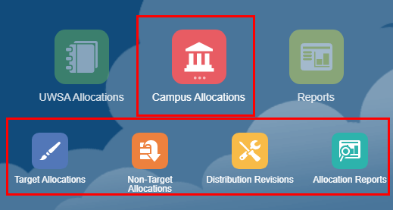
PlanUW Planning Allocation Tasks and Processes
The Campus Allocation tile is a new addition to the homepage that provides institutions the ability to allocate funding to divisions at the institution. The Campus Allocation process are divided into sections such as:
Target Allocations
Non-Target Allocations
Distribution Revisions
Allocation Reports
The Target Allocation tile provides users the ability to create and report on target allocations for each institutions.
The Non-Target Allocations tile provides users the ability to create and report on non-target allocations for each institution.
The Distribution Revisions tile provides users the ability to make revisions on allocations for each institutions when necessary.
The Allocation Reports tile presents several out of the box reports to view allocations that mirror the layout of the Budget reports for comparison

Slide 41
Future State
2. Campus Allocations cont.
Card | Content
10 | Provides the ability to create allocations within your campus to individual Divisions, Departments or Subdepartments for GPR and PR Funds during Budget Development.
 | Provides the ability to create allocations (or commitments) that shouldn’t added to the ‘Budget Target’ until ‘Approved’.
 | Provides the ability to revise, or create new allocations, within your campus after you have finalized the budget target for the next fiscal year. Conceptually like Budget Transfers, but for Budget Target, and not Redbook
Once ‘Approved’
After ‘Finalized’

Slide 42
PlanUW Campus Allocation Column Definitions
Each form in these tiles contains specific columns as part of its standard layout. Here is a brief explanation of these titles.
Members | Alias | Description
Alloc_Description | Description (PA) | Name of the Allocation
Alloc_Type | Type (PA) | Contains a list of Categories. Tuition Differential, Allocation Between Units, Campus Initiatives, other
Alloc_Duration | Duration (PA) | Base / Permanent, One-Time Only, Multi-Year, Renewable
Alloc_Status | Status (PA) | Requested, Approved, Declined, Commitment Approved
Alloc_To_From | To / From (PA) | In, Out, Balance
Alloc_Start_Date | Start Date (PA) | e.g. 7/1/21. Informational
Alloc_End_Date | End Date (PA) | e.g. 6/30/22
 |  | Informational
Alloc_Start_FY | Year Start (PA) | e.g. FY21. Drives start FY for Commitments

Slide 43
PlanUW Campus Allocation Column Definitions
Members | Alias | Description
Alloc_End_FY | End Year (PA) | e.g. FY21. Drives end FY for Commitments
Alloc_Creation_Date | Creation Date (PA) | e.g. 8/27/20
Alloc_Creator | Creator (PA) | mroarty (PBCS username)
Alloc_Fund | Fund (PA) | All level 0 Funds
Alloc_Program | Program (PA) | All level 0 Programs
Alloc_Project | Project (PA) | All level 0 Projects
Alloc_Comments | Comment (PA) | User comments
Alloc_Approval_Date | Approval Date (PA) | e.g., 7/1/21
Alloc_Approved_By | Approved By (PA) | zpalet (PBCS username)

Slide 44
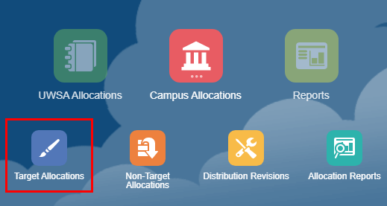
Target Allocations
In the Target Allocation process, users can:
Modify and create Allocation Reference numbers
Enter distributions by department, fund, program and accounts
Revise allocation distributions that have been finalized
View and report on different intersections of allocations and distributions
To begin the target allocations input and review process:
Click the Campus Allocations tile to open the cluster
Click on the Target Allocation tile to open the forms
The Budget Office Target Alloc Setup Dashboard will open.
1
2

Slide 45
PlanUW Planning Allocation Tasks and Processes
Input Forms
The UWBO Allocation Setup Target and UWBO Allocation List forms
The UWBO Enter Distributions form
Action Menus
Some forms will have additional action menu functions that you can use to perform:
New Target Allocation – creating a new target allocation
Display 10 Distribution Rows – displays blank rows for Distribution 0001 through Distribution 0010
Display 100 Distribution Rows -- displays blank rows for Distribution 0001 through Distribution 0100
Display x Distribution Rows – displays Distribution 0001 through Distribution #...
Note that user variables are not used in the Campus (UWBO) forms

Slide 46
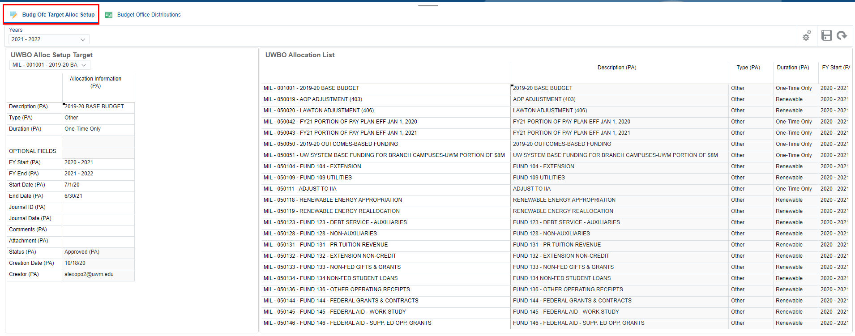
Target Allocation Setup Dashboard
1
2
3
This "form" is a dashboard type of form that contains 3 sections:
The upper section where the Years dimension drop-down box is displayed is the "Page" or "POV" section. It controls the year for the other two sections. If any selection is made in this section, you must hit the "Go" button on top right to update selection.
The left section is the "UWBO Allocation Setup Target" section where you can choose what allocation you want to work on. If any selection is made in this section, you must hit the "Go" button within section 2 to update selection.
The right section is the "UWBO Allocation List" section where Allocation reference numbers that have already been setup will appear.

Slide 47
Target Allocation Setup Dashboard
Section 1: Controls the year for the two forms on the dashboard. Hit "Go" whenever a change is made to the selection.
The other 3 icons can be ignored.
Section 2: Action icons within this section exclusively controls the "UWBO Allocation Setup Target" only. After you have selected which allocation to work on. Hit "Go" whenever a selection is made.
Other important icons to know:
Action Menu
Save
Refresh

Slide 48
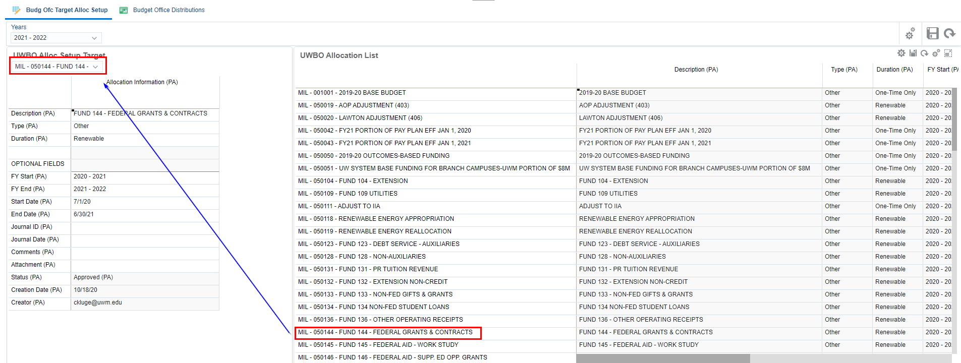
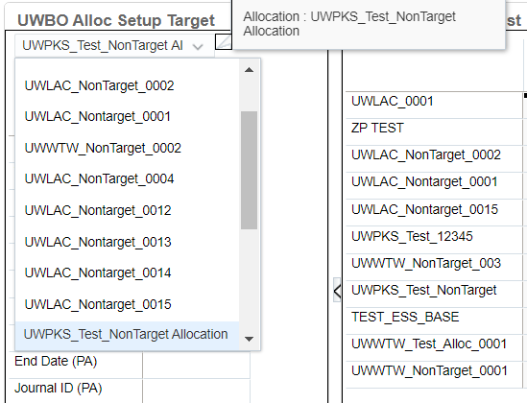
Target Allocation Setup Dashboard
Allocations are setup for each individual fiscal year, which allows you to change the characteristics of the allocation from year-to-year.
If the allocation appears in the UWBO Allocation List, then that allocation has already been setup for the selected fiscal year. If the allocation has already been setup you can check to see if distributions have been entered by checking it on the Budget Office Distributions form.
If the allocation does not appear in the UWBO Allocation List, that means it has not been setup for that year and should be available to use.
1
2

Slide 49
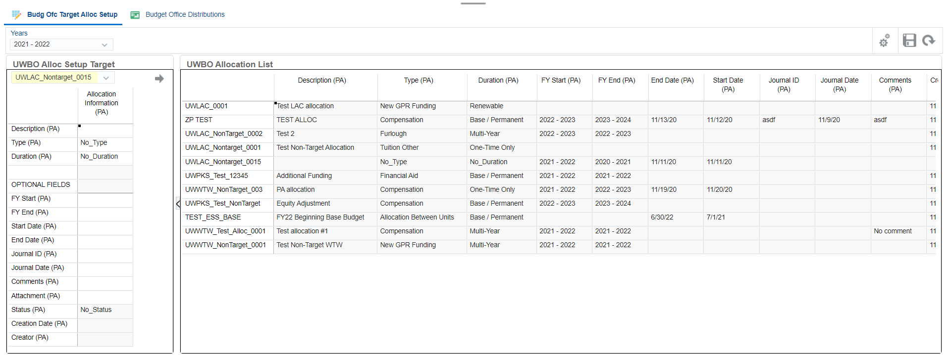
Working on Existing Allocations
2
1
3
4
5
To work on an existing allocation:
Choose a Year on the drop down to set up allocations.
If selection was made in the first section of the dashboard. You must click on the arrow for that section to confirm selection.
Select an Allocation from the drop down.
Click on the arrow to confirm selection.
Make adjustments to the UWBO Allocation Information.

Slide 50
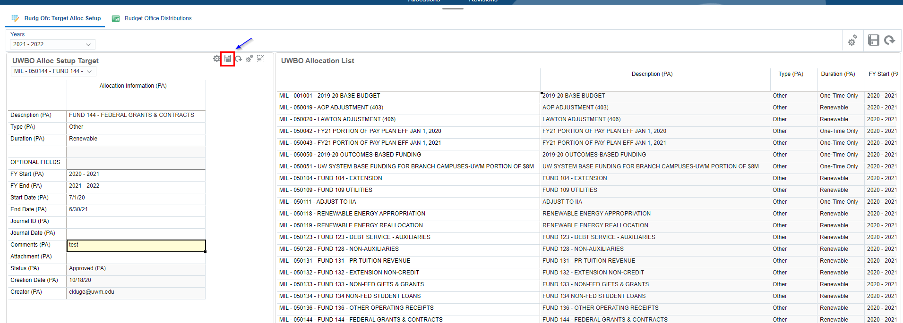
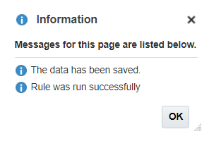
Cont. Working on Existing Allocations
1
2
3
Working on an existing allocation, after adjustments have been made to the UWBO Allocation Information :
Click Save on the UWBO Allocation Setup Target Form.
Click OK.
Review updated allocation setup information on the UWBO Allocation List.
Note: Do not hit the larger save button in the upper right corner of the dashboard (over the UWBO Allocation List form). That save button will not run the business rules nor push data into the reporting cubes.

Slide 51
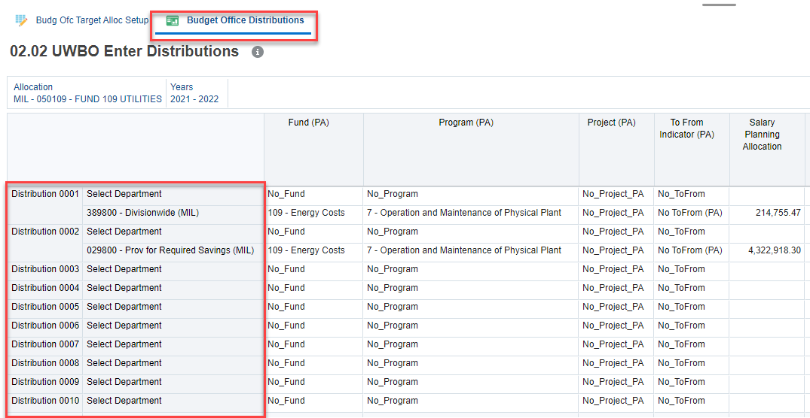
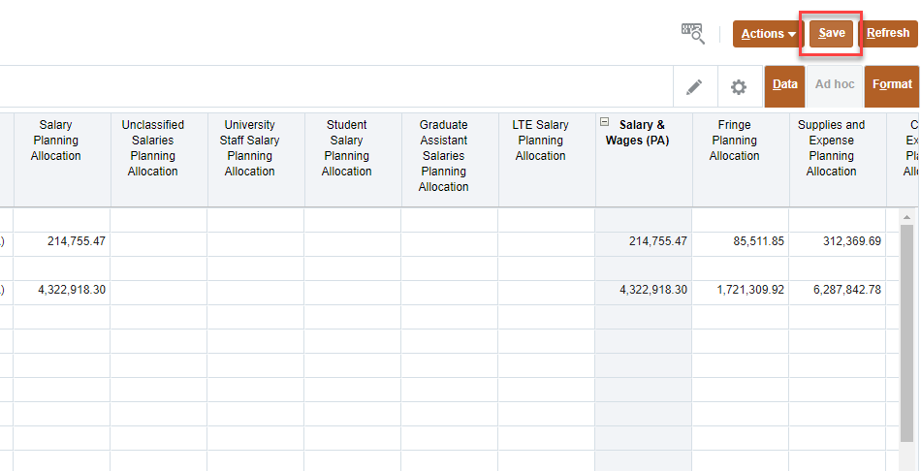
Cont. Working on Existing Allocations
1
2
3
3
Working on an existing allocation, after savings adjustments made to UWBO Allocation Setup Target form:
Navigate to the Budget Office Distributions tab.
Click Save in order to push the changes to the reporting cube.
Confirm the unused rows have been suppressed.
Note: If changes are made to the allocation information (per previous slide) after entering distributions, you must come back and save the distributions page again.

Slide 52
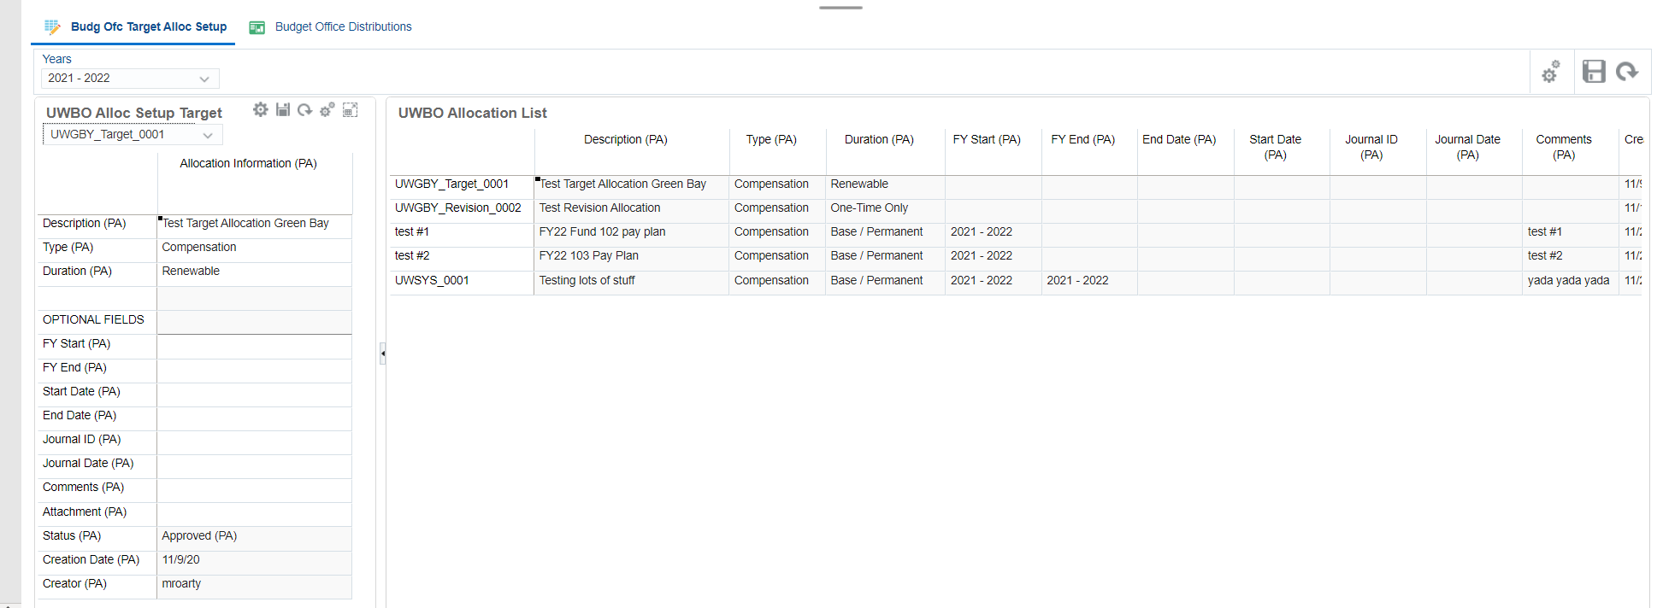
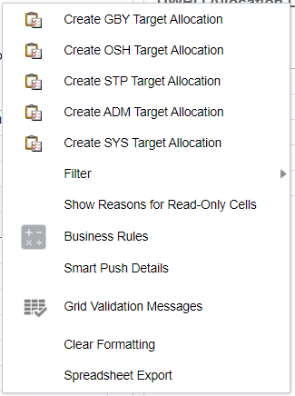
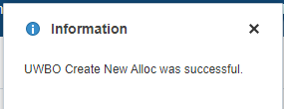
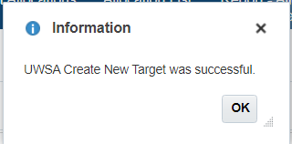
Creating New Allocation
Note: This Action button is located on the upper right side of the UWBO Alloc Setup form
1
2
4
3
5
The New Target Allocation box defaults to the last Allocation member created. When creating new allocation members:
The member name you input must not be the same as an existing member name. An error will be displayed if this occurs.
The member name can be any 80 characters; however, it is recommended that you limit your input to numbers, letters and the underscore character.
Note: there might be slight variations in the wording of this menu item, but it should contain 'Create', 'Allocation' and your campus code, e.g., 'Create MSN Target Allocation' or 'Create New Allocation UWMIL Target'.
To create a New Target Allocation:
Click on Actions.
Select 'Create New Allocation UWXXX Target’.
Enter New Target Allocation Name
Click Launch.
Click OK.

Slide 53
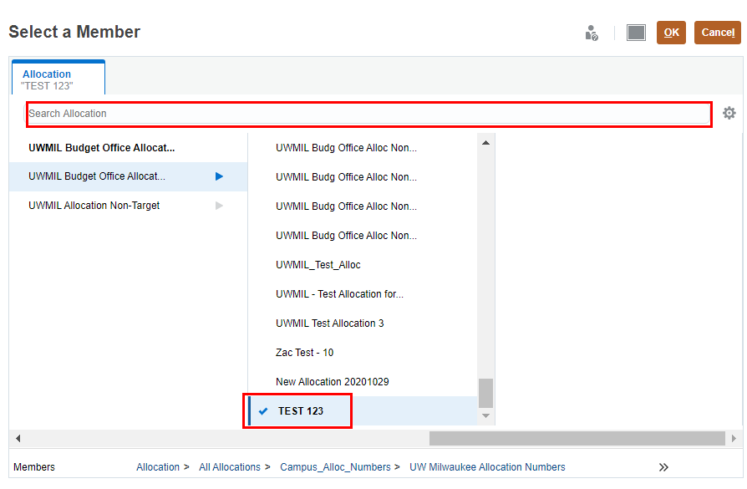
Cont. Creating New Allocation
3
Note: This Arrow button is located on the upper right side of the UWBO Alloc Setup form
1
2
4
To select newly created allocations from drop down list on the UWBO Allocation Setup Target form:
Scroll up and click Select.
Search for the new allocations created in search bar then select new allocation member from the hierarchy. (Verify blue tick appears next to selected member)
Click OK.
Click on the arrow to confirm selection.
Note: The 'Go' arrow for the UWBO Alloc Setup Target form should appear on the right side of the section.

Slide 54
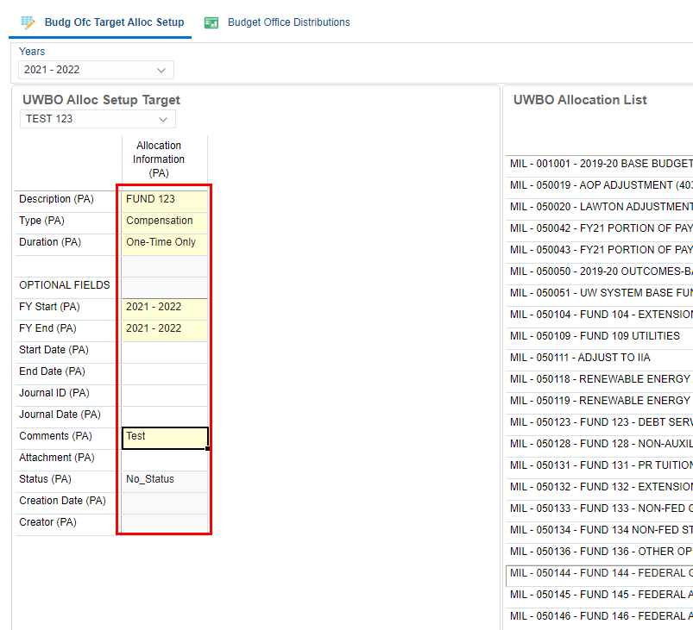
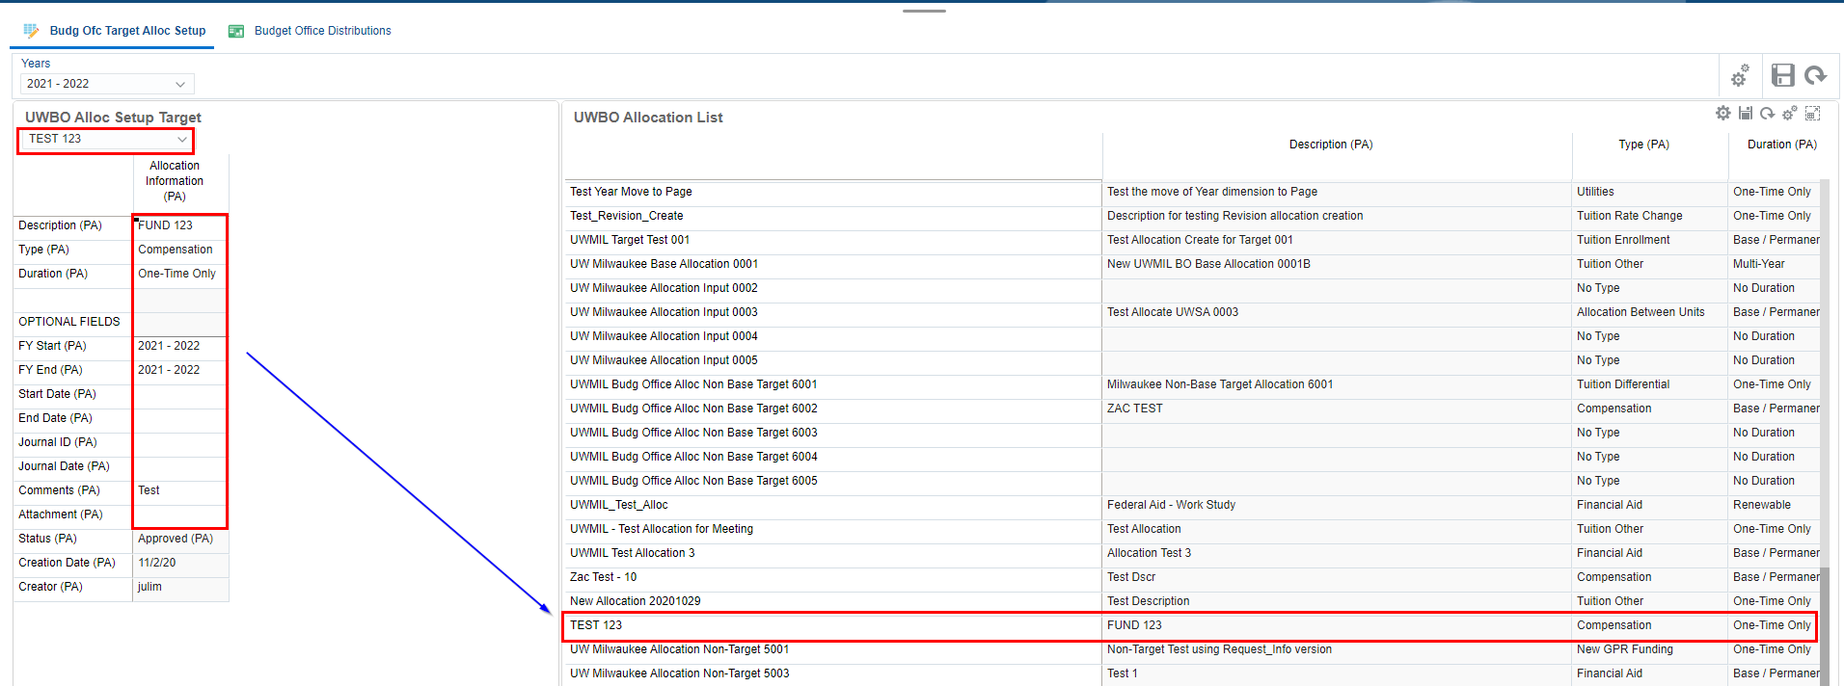
Cont. Creating New Allocation
Note: This Save button will appear when you hover over the upper right of the UWBO Alloc Setup Target form.
1
3
2
4
5
To select newly created allocations from drop down list on the UWBO Allocation Setup form:
Validate allocation is selected when cell is white
Enter or adjust the UWBO Allocation Information (PA). Once you hit enter, the cells will turn yellow until they are saved.
Click Save.
Click OK.
Confirm new allocation created is added to the UWBO Allocation List.

Slide 55
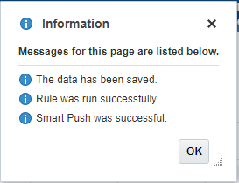
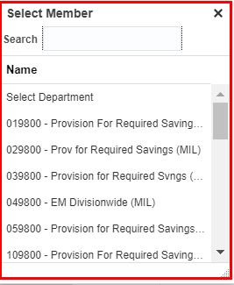
Budget Office Distribution Form
1
6
2
3
5
4
7
To adjust or create distributions:
Select second horizontal tab – ‘Budget Office Distributions’. The UWBO Enter Distributions form will open.
Choose Allocation and Years from POV.
If you make a change to the members of the POV selection, click the Go arrow to confirm your change.
Select Department from the drop down for the distribution you want to allocate on.
You must select a Fund and Program from the list and enter data for a distribution ONLY AFTER selecting a department.
When done, click Save.
Click OK.
Note: Create at least one distribution created before saving. Once you hit enter, the cells will turn yellow (until they are saved).

Slide 56
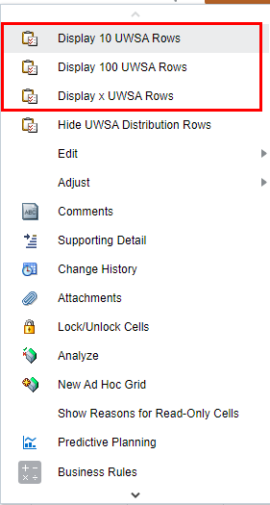
Create/Add New Distributions in the Budget Office Distribution Form
1
2
To create or add new distributions, go to Action Menu. Select:
- Display 10 UWBO Rows for 10 rows
- Display 100 UWBO Rows for 100 rows
- Display x USWA Rows for a specific number of rows
Note: these functions will display a blank row for the range of distribution members indicated. For example:
a. "Display 10" function displays blank rows for Distribution 0001 through Distribution 0010
b. "Display 100" will display blank rows for Distribution 0001 through Distribution 0100
c. "Display #" will allow you to input the number of rows to display and the function will display Distribution 0001 through Distribution #.

Slide 57
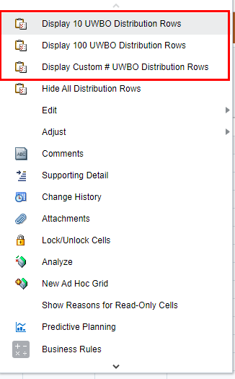
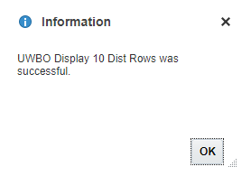
Create/Add New Distributions in the Budget Office Distribution Form
4
3
2
To create or add 10 new distributions:
Click on the Action menu
Select Display 10 UWBO Distribution Rows
Confirm Allocation and Year selected
Click Launch.
Confirm UWBO Display 10 Dist Rows was successful.
5

Slide 58
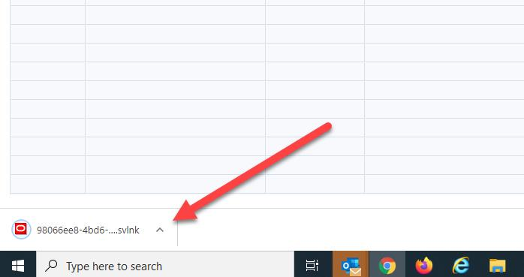
Entering Budget Office Distribution in Smart View
1
Note: Before opening in Smart View it is advised that you save any spreadsheets that you have open.
2
4
3
To adjust or create distributions in Smart View:
Go to Action Menu.
Select 'Open in Smart View’.
Open downloaded .svlnk file
After clicking on link, navigate to Excel on your desktop
You may get a pop up asking you to sign in. If you do, please select Company Sign In and Log on through Smart View.
5

Slide 59
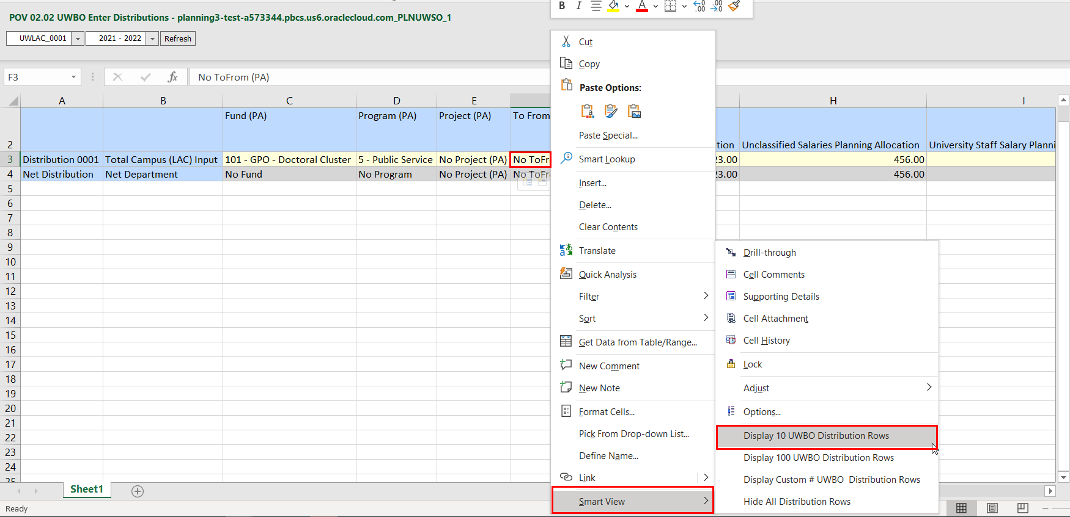
Entering Budget Office Distribution in Smart View
1
4
3
2
5
View the report in Smart View, and slice and dice as needed. To add or create distributions in Smart View:
Right click on any cell.
Scroll down and click 'Smart View’
Select “Display 10 UWBO Distribution Rows” for 10 rows .
A pop-up will prompt you to confirm allocation number and fiscal year. Click Display.
Confirm Business Rule was completed successfully, click ok.

Slide 60
Entering Budget Office Distribution in Smart View
3
1
2
4
After adding rows, to adjust or create distributions in Smart View:
Confirm that new rows are added to make up a total of 10/100/X # of rows as selected.
Enter Fund, Program, Project and To From Indicator using the drop down. Enter allocations on the allocations column.
Click on the 'Smart View' tab above, then click submit data to save.
Confirm that data is saved when all cells are light yellow and extra distribution rows without data are removed.

Slide 61
UW Campus Allocations
Allocation Reports

Slide 62
Campus Allocation vs Budget Reports
Once you have created your Allocations and associate distributions, navigate to the Campus Allocation vs Budget Reports on the vertical tab to ensure the data has been updated per the allocations and associated distributions you made.
Before reviewing reports, User Variables for the specific departments and institutions need to be set. Please refer to the section ‘Setting User Variables’ (slide 20) for more details.
Only the Working Allocation vs. Budget and PDF Allocation vs. Budget reports will contain your updates. The Final and Revised versions are only populated when Allocations are finalized.
Allocations from UWSA will not have a Revised version, so the Revised Allocation column always equal the Final column from the Final report, and the Revised Budget column will likely not align with the Revised Allocation column.

Slide 63
Campus Allocation Reports
In addition to the Campus Alloc vs. Budget Reports, please navigate to the Campus Allocation Reports tab to ensure the data has been updated per the allocations and associated distributions you made. Verify that the second vertical icon Campus Allocation Reports is selected,

Slide 64
Working Allocations vs Budget
1
2
Campus - Working Allocations vs Budget
1. Select File Format: PDF, HTML or Excel
2. Select Years, Department and Fund

Slide 65
Final Allocations vs Budget
1
2
Campus - Final Allocations vs Budget
1. Select File Format: PDF, HTML or Excel
2. Select Years, Department and Fund

Slide 66
Revised Allocations vs Budget
1
2
Campus - Revised Allocations vs Budget
1. Select File Format: PDF, HTML or Excel
2. Select Years, Department and Fund

Slide 67
PDF Allocations vs Budget
2
3
4
1
Campus – PDF Allocations vs Budget
Upon opening this report, a prompt will pop up to enter version for allocations and Plan. Select versions.
Select File Format: PDF, HTML or Excel
Select Select Years and Department
Once the report has rendered, you can review the data onscreen or download or print the file using the buttons on the screen

Slide 68
Campus Allocation List
2
1
3
Campus Allocation List:
Verify that the second vertical icon Campus Allocation Reports is selected
Select File Format: PDF, HTML or Excel
Select Years, Allocation Type, Allocation Duration and Allocation Status

Slide 69
Campus Allocation by Dept/Fund/Ref
1
2
Campus Allocation by Dept/Fund/Ref:
Select File Format: PDF, HTML or Excel
Select Version, Years, Allocation Type, Allocation Duration and Allocation Status

Slide 70
Campus Allocation by Fund/Ref/Dept
1
2
Campus Allocation by Fund/Ref/Dept:
Select File Format: PDF, HTML or Excel
Select Version, Years, Allocation Type, Allocation Duration and Allocation Status

Slide 71
Campus Allocation by Ref/Fund/Dept
1
2
Campus Allocation by Ref/Fund/Dept:
Select File Format: PDF, HTML or Excel
Select Version, Years, Allocation Duration and Allocation Status

Slide 72
PlanUW Planning Allocation Tasks and Processes
Input Forms
The UWBO Allocation Setup Non-Target and UWBO Allocation List Non-Target forms
The UWBO Enter Distribution Non-Target form
Approve Non-Target Allocation form
Action Menus
Some forms will have additional action menu functions that you can use to perform:
New Target Allocation – creating a new target allocation
Display 10 Non-Target Rows – displays blank rows for Distribution 0001 through Distribution 0010
Display 100 Non-Target Rows -- displays blank rows for Distribution 0001 through Distribution 0100
Display x Non-Target Rows – displays Distribution 0001 through Distribution #...
NOTE: the process to setup a non-target allocation and enter distributions is the same as that for target allocations and distributions. Please refer to the Target Allocations sections for the steps needed.

Slide 73
Approve Non-Target Allocations
Allocations are setup for each individual fiscal year, which allows you to change the characteristics of the allocation from year-to-year.
The Allocation setup and distribution entry for non-target allocations is the same as for target allocations. The main difference is that non-target allocations are entered in the Request (or non-target) scenario and are separate from target allocations.
1
2

Slide 74
Approve Non-Target Allocations
1
2
3
3
To work on an existing allocation:
Choose a Year on the drop down to set up allocations.
Select an Allocation from the drop down.
Click on the arrow to confirm selection.
Adjust the UWBO Allocation Information.

Slide 75
Approve Non-Target Allocations
1
2
3
4
5
Note: These two fields in red are required. Enter additional values in the remaining fields if necessary. They are optional.
To Approve allocation:
Click on Actions.
Select Approve Non-Target Allocation.
Enter and verify 'Year for Target Distributions' is correct. Do not change values already in 'Non-Target Year’
Click Launch.
'Confirm UWBO Non-Target Approval Diff Year was successful, click OK.

Slide 76
Approve Non-Target Allocations
1
2
5
3
4
To verify approved allocation:
Verify that 'Non-Target Distributions' are zero-ed out; approved allocations are moved to 'Target Distributions’.
Go back to the second horizontal tab-- Non-Target Distributions.
Confirm you are looking at the right Allocation and Years from POV
Confirm that the distribution lists are displayed and zero-ed out.
Click Save to recalculate New Distribution.
Note: Review that all distribution has zero-ed out and confirm that Net Distribution has been recalculated.

Slide 77
UW Campus Allocations
Campus Allocation Upload Templates

Slide 78
Mass Upload- Target Allocations
1
2
4
3
5
To do a mass upload of allocations:
Open excel file with Target and Non-Target Allocation Setup and Distribution templates.
Click on the 1.A-Target Allocation Setup tab.
Enter the list of Allocations to be created. The following naming convention is recommended: UWXXX - FYXX - DSCR.
Enter information for the allocations along the rows
Delete any unused lines

Slide 79
Mass Upload- Target Distributions
2
Note: This template is set up with 10 distributions per allocation, so you must copy and paste the name of each individual allocation multiple times for however many distributions you expect to need for each allocation as shown in the screen shot.
1
To do a mass upload of distributions:
On the excel file with Target and Non-Target Allocation Setup and Distribution templates, click on the 1.B-Target Distributions tab.
Copy and Paste the names of the Allocations created in the Target Allocation Setup Tab into the Target Distributions tab.

Slide 80
Mass Upload- Target Distributions
Note: If you use the same Distribution member (i.e. Distribution 0001) for a Department, Fund, Program and Project combination twice within the same Allocation, the second entry will overwrite the first. Each unique Department, Fund, Program and Project combination must have a unique Distribution (Distribution 0001 vs. Distribution 0002).
1
2
To do a mass upload of distributions:
Denote the Departments, Funds, Programs and Projects you would like to make Allocations too. What you enter must match what is in the application exactly.Copy and Paste the names of the Allocations created in the Target Allocation Setup Tab into the Target Distributions tab.
If more than 10 distributions are required for any given Allocation, add more rows to the spreadsheet by copying and pasting lines from above in numerical order as shown in the example screen shot.

Slide 81
Mass Upload- Target Distributions
2
1
Note: If you do not wish to mark if the distribution is 'to' or 'from', please select 'No ToFrom (PA)' in the dropdown
To do a mass upload of distributions:
Enter distributions for expense and FTE accounts as applicable, and mark if the distribution is 'to' or 'from' the subdepartment you selected.
Delete any unused lines as applicable.

Slide 82
Mass Upload- Target Distributions
1
2
3
After submitting distribution entries:
Check to ensure there is data in each cell within the lookup columns U-->AH. These columns should be populated from the entries made on the previous tab.
If no entry was made, they will be marked with 'BLANK' in yellow.
If cells are marked '#N/A' in red, it is likely because the name of the Allocation listed in this tab does not match the name denoted on the previous tab, and you must ensure the names match.
Note: If cells do have any values (either the lookup value, "BLANK", or "#N/A") it means the formula in the cell is missing. Please copy and paste the formula from the cell above or below to remediate this error.

Slide 83
Mass Upload- Non-Target Allocations
1
2
To mass do a mass upload of Non-Target Allocations:
Open excel file with Target and Non-Target Allocation Setup and Distribution templates.
Click on the 2.A-Non-Target Allocation Setup and Non-Target Distribution tab.
Repeat steps from slide 77 to 81.

Slide 84
Email Completed Template to the PlanUW
Once allocation and distribution templates are ready, email the template to the PlanUW@uwsa.edu inbox.
UWSA Admins will use the information to do the following:
- Create the Target and Non Target Allocations and Commitments under the applicable parent
- Upload the Allocation information and distribution data (removing 'BLANK' distribution lookups)
- Push the data to the PlanUWRp and AllocRp cubes to be used in the reports using the 2 applicable Data Maps
- Email you once the steps above are complete

Slide 85
Verifying Uploaded Allocations and Distributions
1
2
3
Once you receive the email from UWSA admins that the allocations have been uploaded you can check to see that the Allocations have been uploaded:
Navigate to Campus Allocations, and click on Target Allocations.
View the Allocation Information in the UWBO Allocation Setup and List Dashboard
View the Distributions in the 'Budget Office Distributions' form

Slide 86
Verifying Uploaded Non-Target Allocations and Distributions
2
1
3
Once you receive the email from UWSA admins that the allocations have been uploaded you can check to see that the Allocations have been uploaded:
Navigate to Campus Allocations, and click on Non-Target Allocations.
View the NonTarget Allocation Information in the UWBO Allocation Non Target Setup and List Dashboard
Navigate to Campus Allocations, and click on Allocation Reports to view the Allocation (Budget Target) vs. Budget reports, and Allocation reports

Slide 87
UW Campus Allocations
Finalizing Allocations

Slide 88
Email Completed Template to the PlanUW
After all allocations have been made to either target or non target allocations, send an email to planuw@uwsa.edu and detail which year or combination of years should be finalized by running the DATACOPY Alloc Base to Final Rule.

Slide 89
UW Campus Allocations
Distribution Revisions

Slide 90
PlanUW Planning Allocation Tasks and Processes
Input Forms
The UWBO Allocation Setup Revision and UWBO Allocation List Revision forms
The UWBO Revise Distribution form
Action Menus
Some forms will have additional action menu functions that you can use to perform:
New Target Allocation – creating a new target allocation
Display 10 Distribution Rows – displays blank rows for Distribution 0001 through Distribution 0010
Display 100 Distribution Rows -- displays blank rows for Distribution 0001 through Distribution 0100
Display Custom # Distribution Rows – displays Distribution 0001 through Distribution #...
NOTE: the process to setup a non-target allocation and enter distributions is the same as that for target allocations and distributions. Please refer to the Target Allocations sections for the steps needed.

Slide 91
Distribution Revisions
In the Distribution Revision process, users can:
Revise distributions on an existing allocation after it has been finalized.
Create a new allocation and enter distributions to change finalized distributions.
To begin the target allocations input and review process:
Click the Campus Allocations tile to open the cluster
Click on the Distribution Revisions Allocation tile to open the forms
The Alloc Setup Revisions Dashboard will open.
1
2

Slide 92
Making Revisions to Finalized Allocations
1
5
2
3
4
6
To work on an existing allocation, check horizontal tab to make sure the first tab is selected:
Choose a Year on the drop down to set up allocations.
Select an Allocation from the drop down.
Click on the arrow to confirm selection.
Make adjustments to the UWBO Alloc Setup Revision Allocation Information (PA)
Save data to the database by clicking the Save button on the UWBO Alloc Setup Revision form.
Click Ok.

Slide 93
Course Summary

Slide 94
Completed Course Objectives
In this course, you have been introduced to the UW Planning Allocation process and how to perform Planning Allocation tasks within the PlanUW system.
You have learned about:
The UW Planning Allocation Process and Timeline
A review of the PlanUW System
How to complete Planning Allocation tasks in PlanUW

Slide 95
Support and Resources
You can use the following resources for reference and support:
This course, located on the UW System Website/Plan UW: Planning & Budgeting Cloud Service
Project Website: https://www.wisconsin.edu/budget-planning/system-project/
Coworkers and Subject Matter Experts
Quick Reference Guide

