Slide 1
Multi-Year Forecasting Process
End User Training

Slide 2
Course Objectives
In this course, you will be introduced to how to perform multi-year forecasting tasks within the PlanUW system.
After completing this class, you will have learned:
The UW Multi-Year Forecast Process and Timeline
How to complete Multi-Year Forecast tasks in PlanUW
How to set up your User Variables

Slide 3
UW Multi-Year Forecast
Process Overview

Slide 4
Multi-Year Forecasting Process – UW System Requirements
Below are submission requirements from UW System with expectations that data will be provided/loaded from institutional pods to the foundational pod at the frequency and level of detail described below.
Category | System Requirement
Submission Frequency | Submission Due: January (October Actuals)
Fund Balance Reporting Frequency | One time a year after the books are closed
Level of Detail: Sub-Department | Division
Level of Detail: Fund | All Funds
Level of Detail: Program | Total Program (Roll up all Programs)
Level of Detail: Project | Total Project (Roll up all Projects)
Level of Detail: Account | See Forecast Account Rollup Excel Support File
Budget Transfer Spread | No System Preference

Slide 5
UW Multi-Year Forecast
Forecast Tasks

Slide 6
PlanUW Multi-Year Forecast Tasks and Processes
Moving forward, this document will cover on a step-by-step basis, the “how” to complete Multi-Year Forecast tasks in the PlanUW system. Each process will be accompanied with the Quick Reference Guide book.
The following Processes are detailed in the QRG
Model Tuition, Segregated Fees, Housing & Meal Plans
Apply Global % Changes to Multi-Year Forecast
Input and review for Salary, Wages and Fringe
Input and review for Non-Compensation
Input and review for Revenue
Input and review for Transfers
Reviewing Multi-Year Forecast
Reviewing Multi-Year Forecast Reports

Slide 7
PlanUW Multi-Year Forecast Tasks and Processes
The Multi-Year Forecast tile is a new edition to the homepage and extends the existing Current Year Forecast process by four years. The Multi Year Forecast process mimics the Forecast process with forms being divided into the similar sections such as:
Salary, Wages and Fringe
Non-Compensation
Revenue
Transfers
Reports
The two pieces of NEW Optional Functionality that come with the Multi-Year Forecast are:
The Driver-Based Models tile which gives users the optional ability to plan MYF Tuition, Segregated Fees, Housing, and Meal Plan Revenue using detailed Driver-Based Models
The Global % Change tile which gives users the optional ability to plan MYF using Global % Change inputs applied by Account to their existing Current Year Forecast

Slide 8
Multi-Year Forecast Input Versions
NEW Functionality
There are three tabs for input and review:
Campus-Level – Enter forecast amounts at ‘Campus-Level’ using Divisions, in By Account, By Division, By Account and Division Forms and use Campus-Level Review to see total results.
Division-Level – Enter forecast amounts at ‘Divisional-Level’ using Divisions, in By Account, By Division, By Account and Division Forms and use Divisional-Level Review to see total results.
Sub-Department-Level – Enter forecast amounts at ‘Sub-Department-Level’ using Sub-Departments, in By Account, By Sub-Department, By Account and Sub-Department Forms and use Sub-Department-Level Review to see total results.
Forecast Input Version Diagram
By Campus
By Division
By Sub-Department

Slide 9
PlanUW Multi-Year Forecast Tasks and Processes
Input Forms
The Salary, Wages, and Fringe, Non- Compensation, and Revenue cards all contain input forms at Campus, Division and Sub-Department levels. Each level provides differing variations of the input forms and 1 review form.
Action Menus
Some forms will have additional action menu functions that you can use to perform:
Open Forecast Accounts – adding an Account, Fund, Sub-Department or Division that did not have previous activity and may not be displayed on the form
Remove Forecast Accounts – removing an Account, Fund, Sub-Department or Division that did not have previous activity and is displayed on the form
Form Suppression
Some forms will not display members that have no previous activity in Actuals or Budget. Use the Action menu “Open Forecast Accounts” to add missing members.

Slide 10
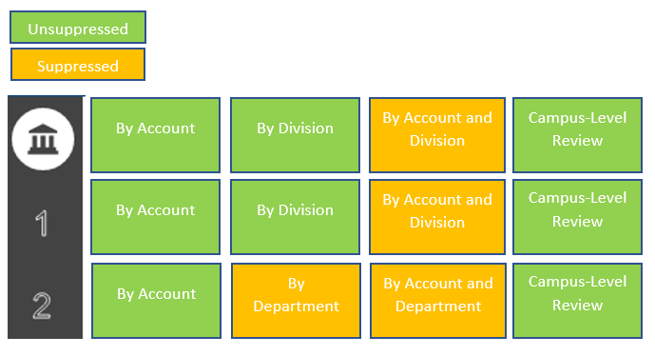
PlanUW Multi-Year Forecast Form Suppression
Suppression is used to reduce the number of lines on a form. When suppression is turned on a user must insert a “Wedge” to add new lines to the form.
Certain forms that do not get as large do not need suppression turned on and therefore do not require users to insert “Wedges”.

Slide 11
PlanUW Multi-Year Forecast Column Definitions
Each form in these tiles contains specific columns as part of its standard layout. Here is a brief explanation of these titles.
Column Title | Column Definitions for Input Tiles
YTD | Year to Date –Total Actuals from July to the month displayed in the YTD column.
CY YTD vs PY YTD | Multi-Year to Date versus Previous Year to Date variance column. This column compares CY YTD Actuals vs PY YTD Actuals in the input cards.
Forecast Input | This column is the baseline forecast where the system has taken the Multi-Year budget and spread it based on 2 prior years of actuals.
Forecast Transfers | This column displays the budget transfers that have been respread by users in the Forecast Transfers card.
Campus/Divisional/Sub-Departmental Forecast Adjustment | This column is open for input. This is where users can add adjustments to the forecast on top of Forecast Input and Forecast Transfers.
View | These columns display posted Actuals or Budget data throughout the year.

Slide 12
UW Multi-Year Forecast
Driver-Based Models

Slide 13
Driver-Based Models
NEW Optional Functionality
Use this card to enter drivers to Forecast for Tuition, Segregated Fees, Housing and Meal Plans for multiple years.
Enter drivers to manipulate the Total Tuition, Segregated Fees, Housing and Meal Plans for Multi-Year Forecast
To begin the driver data input and review process:
Click the Multi-Year Forecast tile to open the cluster
Click on the Driver-Based Models tile to open the forms
This process will open the Tuition, Segregated Fees, Housing and Meal Plans forecast input and review forms
1
2

Slide 14
Driver-Based Models
NEW Optional Functionality
There are four tabs for input and review:
Tuition Forecast – Model Tuition Revenue by Tuition Type via inputs including Headcount, Billing FTE, Retention %, New Enrollment %, Tuition Rate, Spring Factor, and Pool Reduction Factor to calculate Multi-Year Revenue using Tuition Rate % Change input for out-years.
Segregated Fees Forecast – Model Segregated Fee Revenue via inputs including Fall & Spring FTE/Headcount, Annual Seg Fee Rate and Seg Fee % Collectible for out-years.
Housing Fees Forecast – Model Housing Revenue by Room Type via inputs including Current Annual Housing Rate, Fall & Spring Occupancy, and Housing Fee % Collectible to calculate Multi-Year Revenue using Room Rate % Change input for out-years.
Meal Plan Forecast – Model Meal Plan Revenue by Meal Plan Type via inputs including Current Annual Meal Plan Rate, Fall & Spring Enrollment, and Meal Plan Fee % Collectible to calculate Multi-Year Revenue using Meal Plan Rate % Change input for out-years.
Tuition Forecast
Segregated Fees Forecast
Housing Forecast
Meal Plan Forecast

Slide 15
Tuition Forecast - Driver Based Models
NEW Optional Functionality - Tuition Modeling
Tuition Forecast
Tuition Forecast – Model Tuition Revenue by Tuition Type via inputs including Headcount, Billing FTE, Retention %, New Enrollment %, Tuition Rate, Spring Factor, and Pool Reduction Factor to calculate Multi-Year Revenue using Tuition Rate % Change input for out-years.

Slide 16
Setting User Variables
Prior to Tuition Modelling, your Tuition User Variable needs to be selected.
MYF Tuition Dept: Select specific Tuition Sub-Department member to work in the forms
User Variable member selection can be updated in two ways:
From User Preferences (see section Set User Variables)
Directly on the form from POV

Slide 17
Tuition Revenue Modeling Form - Driver-Based Models
1
2
Provides forecasting to a single Division/Sub-Department for multi-year forecast.
The Point of View shows your selected MYF Tuition Sub-Department user variable and Fund. Optionally, you can change your MYF Tuition Sub-Department directly on this form, by clicking MYF Tuition Dept and changing your selection.
Data can be input in columns with white cells for:
Fall Headcount
Fall Billing FTE Factor Retention %,
New Enrollment %,
Fall Tuition Rate
Spring Factor
Tuition Rate % Change
Pool Reduction Factor

Slide 18
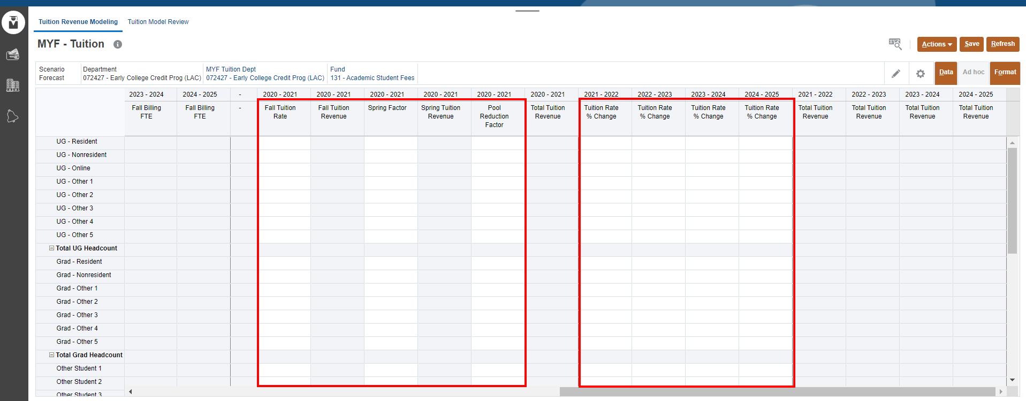
Tuition Revenue Modeling Form - Driver-Based Models
Scroll right to enter data in more columns valid for data entry.
NOTE: Grey columns are locked and cannot be edited. Only white cells allow entry. Data will be calculated after forms are saved.

Slide 19
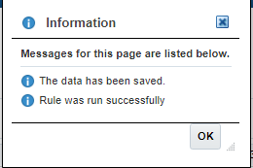
Tuition Revenue Modeling Form – Driver Based Models
3
1
2
Enter Tuition Type Name followed by data in the Fall Headcount and Fall Billing FTE Factor column for current year.
Enter data and % for future years on the form.
Once done, click Save to save the sheet.
Click OK in pop up message.
4

Slide 20
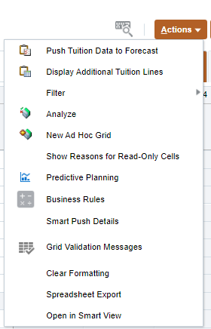
Additional Tuition Type Rows– Driver Based Models
NOTE: This is Optional
1
In order to expose additional Tuition Type row, go to the 'Actions Menu' and click 'Display Additional Tuition Lines'. The Display Additional Tuition Lines action will display the Extended form [MYF - Tuition - Extended] will show 20 "Other" Tuition types per category.
2
This form can be accessed via the Action Menu at any time. *This form is not suppressed.
To show additional Tuition Type rows:
Click on the Action menu
Select Display Additional Tuition Lines

Slide 21
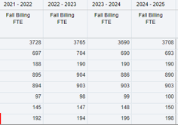
Push Tuition Data to Forecast – Driver Based Models
2
3
1
After saving tuition data:
Cells will appear white when data is saved. Review calculated data in the grey columns.
If data is ready to be pushed to Forecast, click on the Action menu
Select Push Tuition Data to Forecast
NOTE: This step can be completed from the Tuition Modeling Form or the Review Form via the Actions Menu and does not need to be completed twice.

Slide 22
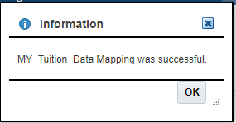
Cont. Push Tuition Data to Forecast – Driver Based Models
2
1
3
After selecting Push Tuition Data to Forecast from Action Menu:
Select Tuition Fund from the prompt by clicking on .
When done, click Launch.
Confirm that MY_Tuition_Data Mapping was successful. Click OK.
NOTE: This step can be completed from the Tuition Modeling Form or the Review Form via the Actions Menu and does not need to be completed twice.

Slide 23
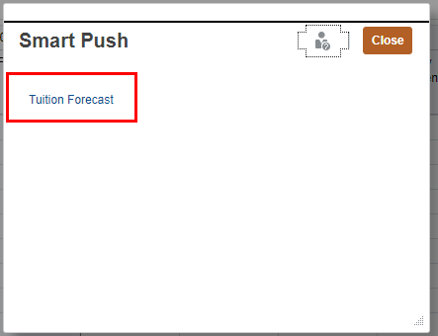
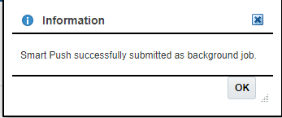
Push Tuition Data to Reports – Driver Based Models
1
3
3
To Push Tuition Data to Reports:
Click on the 'Actions' Menu
Select ‘Smart Push Details’
On Smart Push pop up, click on Tuition Forecast.
Confirm that Smart Push was successful. Click OK.
2
4
NOTE: This step can be completed from the Tuition Modeling Form or the Review Form via the Actions Menu and does not need to be completed twice.

Slide 24
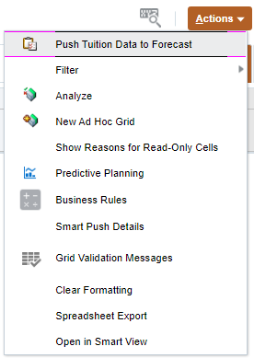
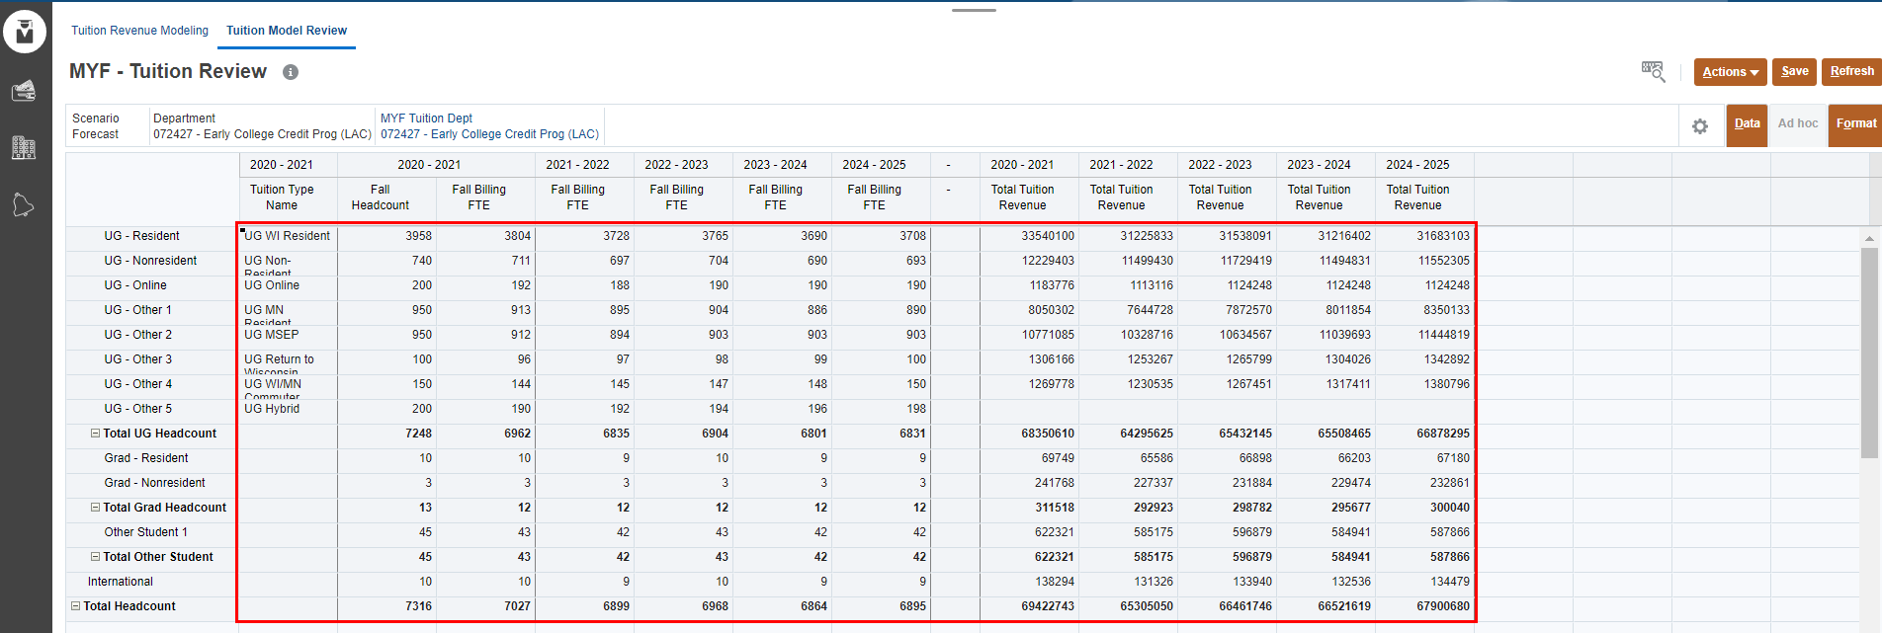
Tuition Model Review – Driver Based Models
All cells will be read-only
1
2
This form allows user to view all calculated data on one screen. If data is ready to be pushed to forecast:
Click on the Action menu
Select Push Tuition data to Forecast
NOTE: This step can be completed from the Tuition Modeling Form or the Review Form via the Actions Menu and does not need to be completed twice.

Slide 25
Cont. Push Tuition Data to Forecast – Driver Based Models
2
1
3
After selecting Push Tuition Data to Forecast from Action Menu:
Select Tuition Fund from the prompt by clicking on .
When done, click Launch.
Confirm that MY_Tuition_Data Mapping was successful. Click OK.
NOTE: This step can be completed from the Tuition Modeling Form or the Review Form via the Actions Menu and does not need to be completed twice.

Slide 26
Cont. Push Tuition Data to Forecast – Driver Based Models
Table below shows the data mapping of Tuition Data after being pushed into Forecast.
Dimension | Tuition Model | Multi-Year Forecast
Account | Total Tuition Revenue - UG Headcount | Undergrad Tuition Forecast
 | Total Tuition Revenue - Total Grad Headcount | Grad Tuition Forecast
 | Total Tuition Revenue - Total Other Students + International | Other Tuition Forecast
Department | MYF Tuition Department | MYF Tuition Department
Version | *Preselected and hidden on the form | Input
Fund | Selected Fund in POV *Fund 131 is default | Selected Fund in POV *Fund 131 is default
NOTE: Data gets pushed from sub-departmental level to Base of every Campus/Div/Dept Forecast version.

Slide 27
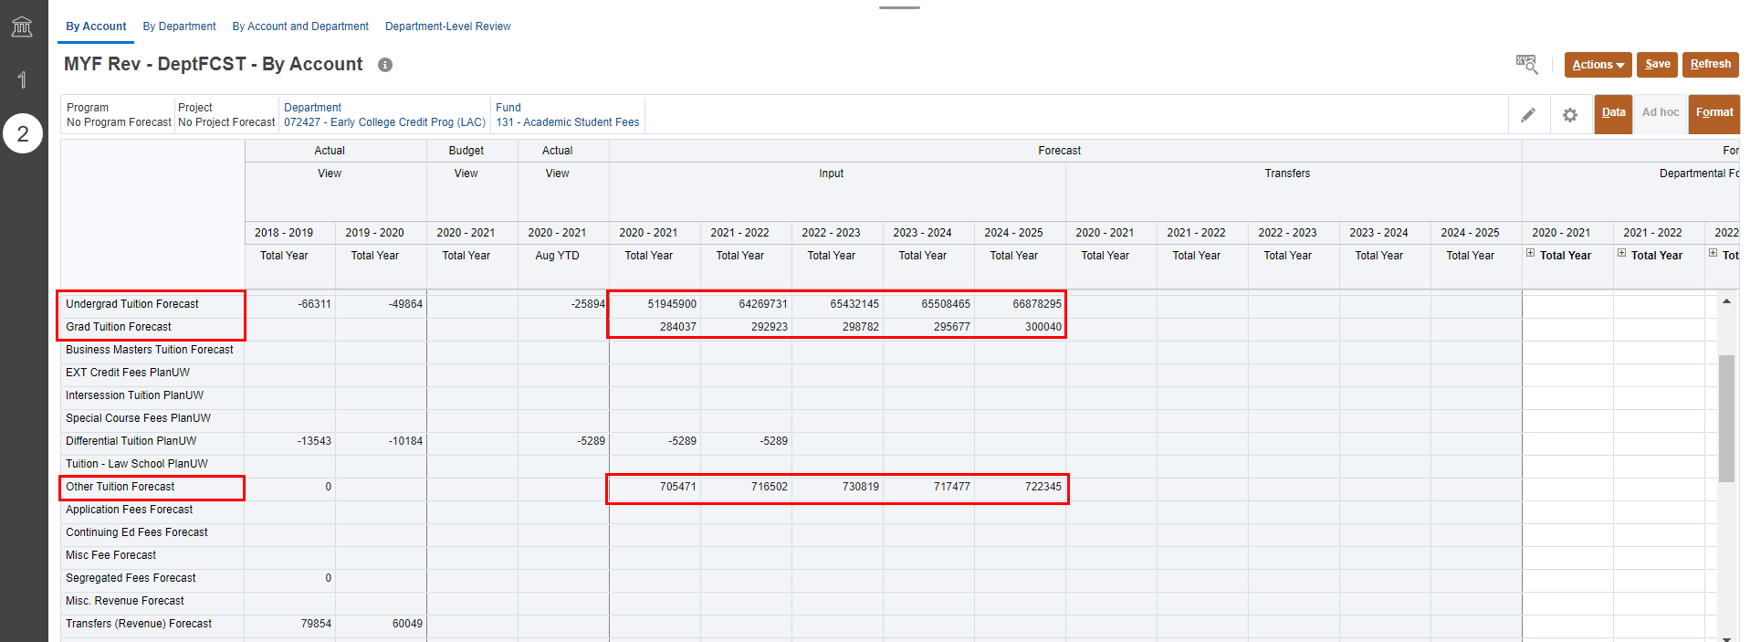
Review Tuition Data in Forecast – Driver Based Models
1
2
3
To Review Tuition Model Data that was pushed to Forecast, and manually Adjust:
Go to the ‘Revenue” card and navigate to the Tuition Department
Review Tuition Forecast data on the accounts: a. Undergrad Tuition Forecast b. Grad Tuition Forecast c. Other Tuition Forecast
Modeled data can be adjusted manually in the Forecast Adjustment input columns.

Slide 28
Segregated Fees Forecast - Driver Based Models
NEW Optional Functionality - Segregated Fees
Segregated Fees Forecast – Model Segregated Fee Revenue via inputs including Fall & Spring FTE/Headcount, Annual Seg Fee Rate and Seg Fee % Collectible for out-years.
Segregated Fees Forecast

Slide 29
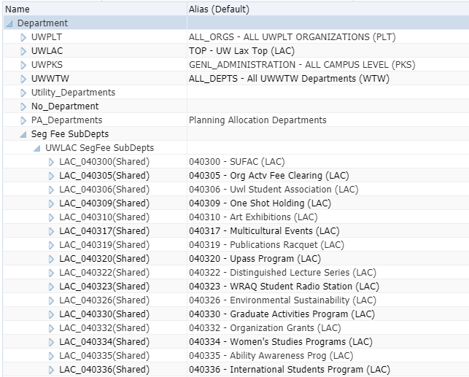
Seg Fee Modeling- Driver-Based Models
The Sub-Departments included in the Segregated Fee Modeling Form are part of an alternate Department hierarchy created for this model to only pull applicable sub-departments.
The list of sub-departments for each institution was created based on historical Segregated Fee Actuals.
If a sub-department should be added/removed, please contact the Admin team via email at planuw@uwsa.edu

Slide 30
Seg Fee Modeling Form - Driver-Based Models
1
2
Un-suppressed
Scenario is locked in the POV to Forecast. Segregated Fee Sub-Departments are displayed unsuppressed.
Data can be input in columns with white cells for:
Fall FTE/Headcount
Spring FTE/Headcount
Annual Seg Fee Rate
Seg Fee% Collectible

Slide 31
Seg Fee Modeling Form– Driver Based Models
2
1
Un-suppressed
Enter data points to calculate Total Seg Fee Revenue across the forecasting years.
Once done, click Save to save the sheet.
Click OK in pop up message.
3

Slide 32
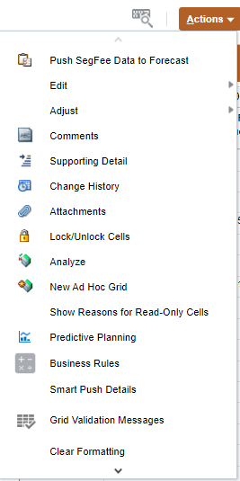
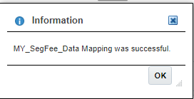
Push SegFee Data to Forecast – Driver Based Models
2
NOTE: This step can be completed from the Seg Fee Modeling Form or the Review Form via the Actions Menu and does not need to be completed twice.
3
After saving Seg Fee data:
Cells will appear white when data is saved. Review calculated data in the grey columns.
If data is ready to be pushed to Forecast, click on the Action menu
Select Push Seg Fee Data to Forecast
Confirm that MY_SegFee_Data Mapping was successful. Click OK.
4

Slide 33
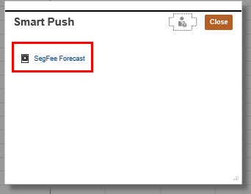
Push Seg Fee Data to Reports – Driver Based Models
1
3
To Push Seg Fee Data to Reports:
Click on the 'Actions' Menu
Select ‘Smart Push Details’
On Smart Push pop up, click on Seg Fee Forecast.
Confirm that Smart Push was successful. Click OK.
2
4
2
NOTE: This step can be completed from the Seg Fee Modeling Form or the Review Form via the Actions Menu and does not need to be completed twice.

Slide 34
Seg Fee Model Review – Driver Based Models
1
All cells will be read-only.
2
Suppressed
This form allows user to view all calculated data on one screen. If data is ready to be pushed to forecast:
Click on the Action menu
Select Push Seg Fee data to Forecast
Click OK.
3
NOTE: Push SegFee Data to Forecast can be completed from the Seg Fee Modeling Form or the Review Form via the Actions Menu and does not need to be completed twice.

Slide 35
Push Seg Fee Data to Reports – Driver Based Models
1
3
To Push Seg Fee Data to Reports:
Click on the 'Actions' Menu
Select ‘Smart Push Details’
On Smart Push pop up, click on Seg Fee Forecast.
Confirm that Smart Push was successful. Click OK.
2
4
2
NOTE: This step can be completed from the Seg Fee Modeling Form or the Review Form via the Actions Menu and does not need to be completed twice.

Slide 36
Cont. Push Seg Fee Data to Forecast – Driver Based Models
Table below shows the data mapping of Seg Fee Data after being pushed into Forecast.
Dimension | SegFee Model | Multi-Year Forecast
Account | Total Seg Fee Revenue | Segregated Fees Forecast
Department | SegFee Sub-Departments on Form | SegFee Sub-Departments
Version | *Preselected and hidden on the form | Input
Fund | *Preselected and hidden on the form | Fund 128
NOTE: Data gets pushed from sub-departmental level to Base of every Campus/Div/Dept Forecast version.

Slide 37
Housing Forecast - Driver Based Models
NEW Optional Functionality – Housing Modeling
Housing Fees Forecast – Model Housing Revenue by Room Type via inputs including Current Annual Housing Rate, Fall & Spring Occupancy, and Housing Fee % Collectible to calculate Multi-Year Revenue using Room Rate % Change input for out-years.
Housing Forecast

Slide 38
Setting User Variables
Prior to Housing Modelling, your Housing User Variable needs to be selected.
MYF Housing Dept: Select specific Housing Sub-Department member to work in the forms
User Variable member selection can be updated in two ways:
From User Preferences (see section Set User Variables)
Directly on the form from POV

Slide 39
Housing Revenue Modeling Form - Driver-Based Models
1
2
Un-suppressed
Provides forecasting to a single Division/Sub-Department for multi-year forecast.
The Point of View shows your selected MYF Housing Sub-Department user variable. Optionally, you can change your MYF Tuition Sub-Department directly on this form, by clicking MYF Housing Dept and changing your selection.
Data can be input in columns with white cells for:
Room Type Name
Annual Current Year Housing Rate
Room Rate % Change
Fall Housing Occupancy
Spring Housing Occupancy
Housing Fee % Collectible

Slide 40
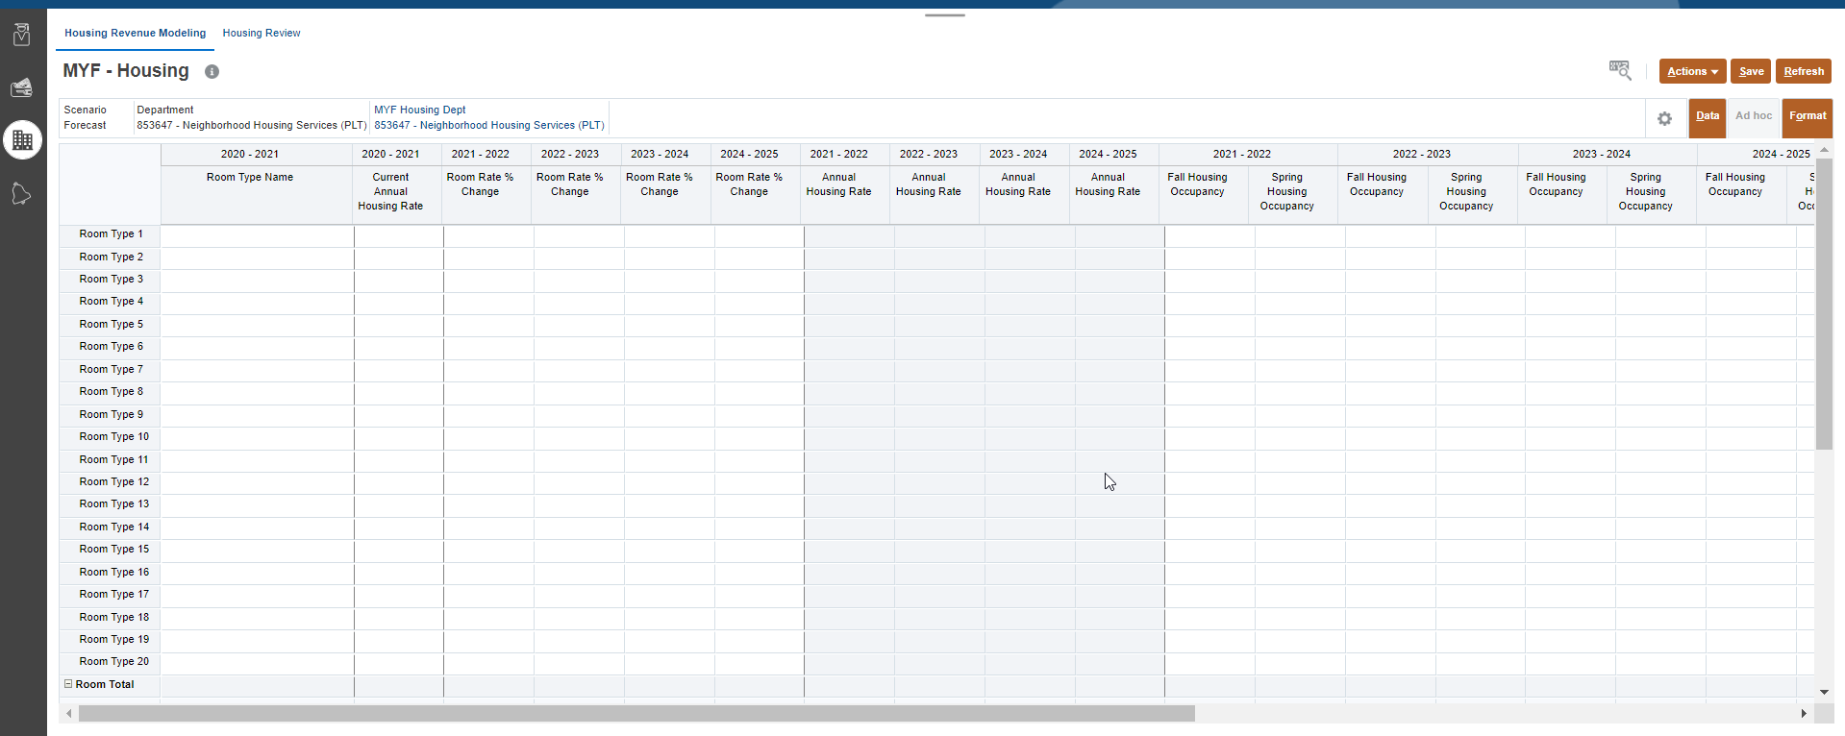
Housing Revenue Modeling Form - Driver-Based Models
Scroll right to enter data in more columns valid for data entry.
NOTE: Grey columns are locked and cannot be edited. Only white cells allow entry. Data will be calculated after forms are saved.

Slide 41
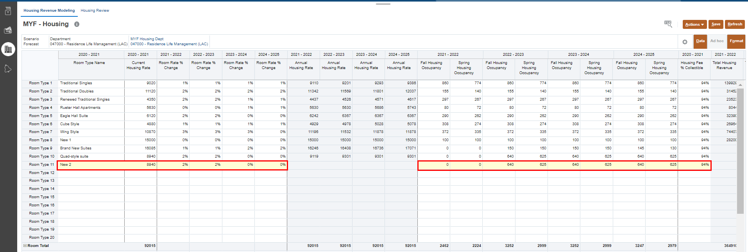
Housing Revenue Modeling Form – Driver Based Models
3
1
2
Un-suppressed
Enter Room Type Name followed by Current Housing Rate column for current year.
Enter data and % for future years on the form.
Once done, click Save to save the sheet.
Click OK in pop up message.
4

Slide 42
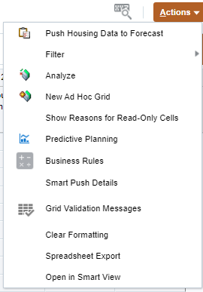
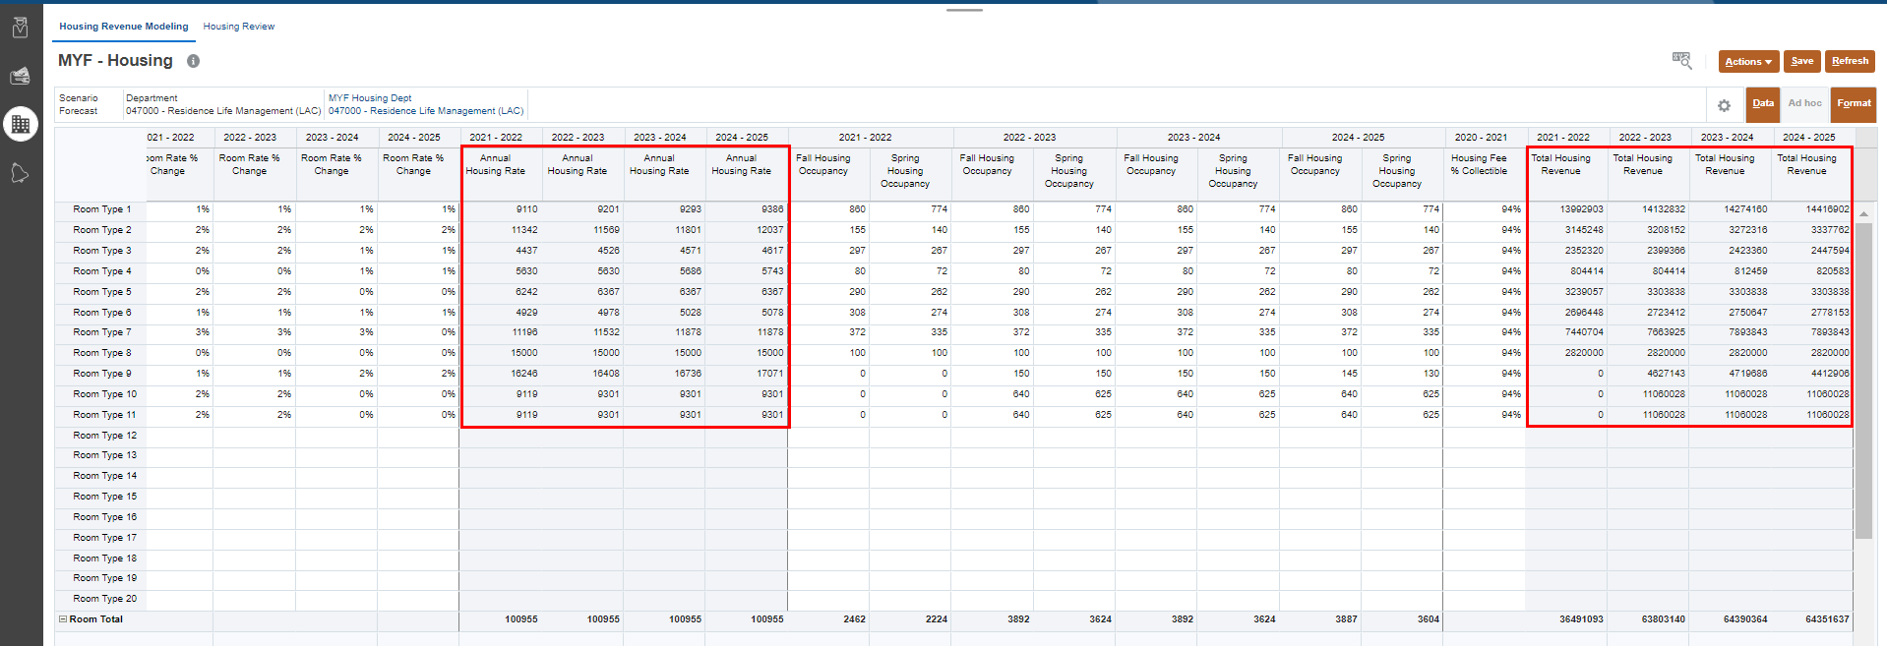
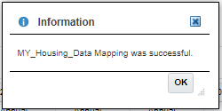
Push Housing Data to Forecast – Driver Based Models
2
NOTE: This step can be completed from the Housing Modeling Form or the Review Form via the Actions Menu and does not need to be completed twice.
3
1
After saving housing data:
Cells will appear white when data is saved. Review calculated data in the grey columns.
If data is ready to be pushed to Forecast, click on the Action menu
Select Push Housing Data to Forecast
Click OK.
4

Slide 43
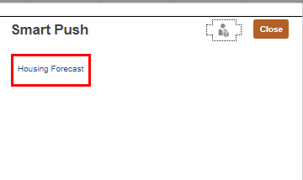
Push Forecast Data to Reports – Driver Based Models
1
3
To Push Housing Data to Reports:
Click on the 'Actions' Menu
Select ‘Smart Push Details’
On Smart Push pop up, click on Housing Forecast.
Confirm that Smart Push was successful. Click OK.
2
4
NOTE: This step can be completed from the Housing Modeling Form or the Review Form via the Actions Menu and does not need to be completed twice.

Slide 44
Housing Model Review – Driver Based Models
All cells will be read-only.
2
3
1
This form allows user to view all calculated data on one screen.
Review all calculated data in Total Housing Revenue.
Click on the Action menu
Select Push Housing Model data to Forecast
Click OK.
4
NOTE: Push Housing Model data to Forecast can be completed from the Housing Modeling Form or the Review Form via the Actions Menu and does not need to be completed twice.
4

Slide 45
Push Forecast Data to Reports – Driver Based Models
1
3
To Push Housing Data to Reports:
Click on the 'Actions' Menu
Select ‘Smart Push Details’
On Smart Push pop up, click on Housing Forecast.
Confirm that Smart Push was successful. Click OK.
2
4
NOTE: This step can be completed from the Housing Modeling Form or the Review Form via the Actions Menu and does not need to be completed twice.

Slide 46
Cont. Push Housing Data to Forecast – Driver Based Models
Table below shows the data mapping of Housing Data after being pushed into Forecast.
Dimension | Housing Model | Multi-Year Forecast
Account | Total Housing Revenue – Room Total | Housing Forecast
Department | MYF Housing Department | MYF Housing Department
Version | *Preselected and hidden on the form | Input
Fund | *Preselected and hidden on the form | Fund 128
NOTE: Data gets pushed from sub-departmental level to Base of every Campus/Div/Dept Forecast version.

Slide 47
Meal Plan Forecast - Driver Based Models
NEW Optional Functionality – Meal Plan Modeling
Meal Plan Forecast – Model Meal Plan Revenue by Meal Plan Type via inputs including Current Annual Meal Plan Rate, Fall & Spring Enrollment, and Meal Plan Fee % Collectible to calculate Multi-Year Revenue using Meal Plan Rate % Change input for out-years.
Meal Plan Forecast

Slide 48
Setting User Variables
Prior to Meal Plan Modeling, your Meal Plan User Variable needs to be selected.
MYF Meal Plan Dept: Select specific Meal Plan Sub-Department member to work in the forms
User Variable member selection can be updated in two ways:
From User Preferences (see section Set User Variables)
Directly on the form from POV

Slide 49
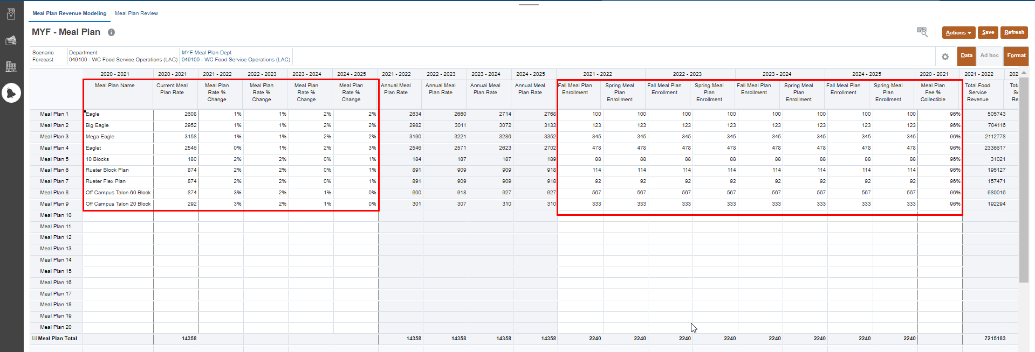
Meal Plan Revenue Modeling Form - Driver-Based Models
1
2
Un-suppressed
Provides forecasting to a single Division/Sub-Department for multi-year forecast.
The Point of View shows your selected MYF Meal Plan Sub-Department user variable. Optionally, you can change your MYF Meal Plan Sub-Department directly on this form, by clicking MYF Meal Plan Dept and changing your selection.
Data can be input in columns with white cells for:
Meal Plan Name
Current Annual Meal Plan Rate
Meal Plan Rate % Change
Fall Meal Plan Enrollment
Spring Meal Plan Enrollment
Meal Plan Fee % Collectible

Slide 50
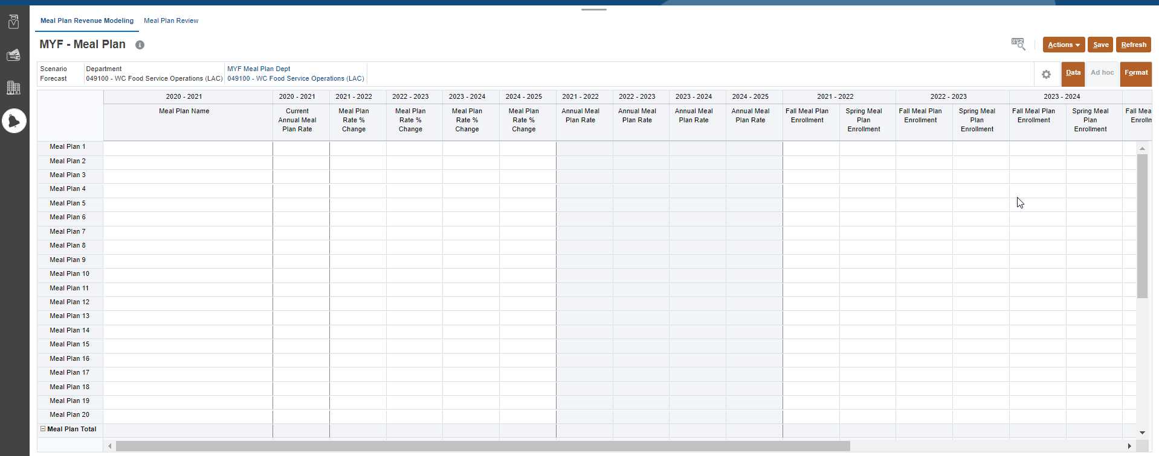
Meal Plan Revenue Modeling Form - Driver-Based Models
Scroll right to enter data in more columns valid for data entry.
NOTE: Grey columns are locked and cannot be edited. Only white cells allow entry. Data will be calculated after forms are saved.

Slide 51
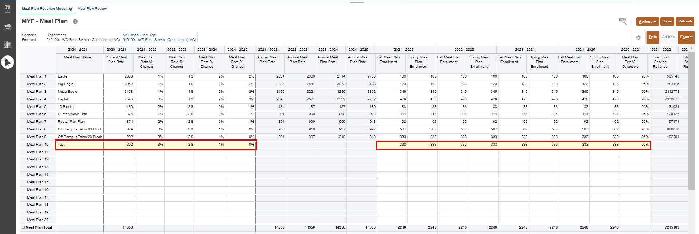
Meal Plan Revenue Modeling Form – Driver Based Models
3
1
2
Un-suppressed
Enter Meal Plan Name followed by Current Annual Meal Plan Rate column for current year.
Enter data and % for future years on the form.
Once done, click Save to save the sheet.
Click OK in pop up message.
4

Slide 52
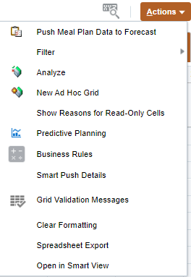
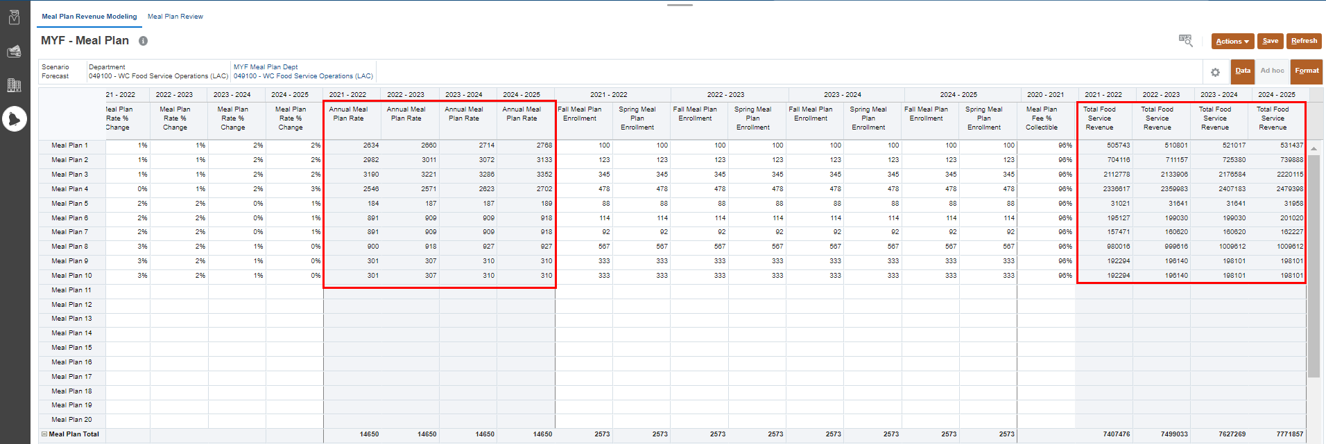
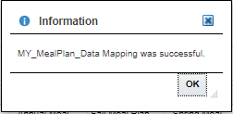
Push Meal Plan Data to Forecast – Driver Based Models
2
NOTE: This step can be completed from the Meal Plan Modeling Form or the Review Form via the Actions Menu and does not need to be completed twice.
3
1
After saving Meal Plan data:
Cells will appear white when data is saved. Review calculated data in the grey columns.
If data is ready to be pushed to Forecast, click on the Action menu
Select Push Meal Plan Data to Forecast
Click OK.
4

Slide 53
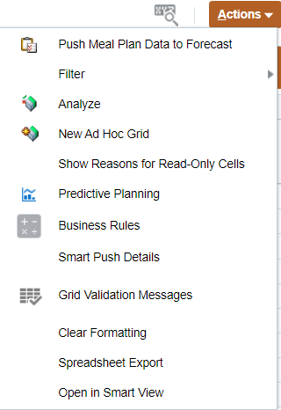
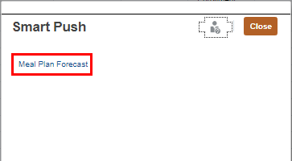
Push Forecast Data to Reports – Driver Based Models
1
3
To Push Meal Plan Data to Reports:
Click on the 'Actions' Menu
Select ‘Smart Push Details’
On Smart Push pop up, click on Meal Plan Forecast.
Confirm that Smart Push was successful. Click OK.
2
4
NOTE: This step can be completed from the Meal Plan Modeling Form or the Review Form via the Actions Menu and does not need to be completed twice.

Slide 54
Meal Plan Review – Driver Based Models
All all cells will be read-only.
2
3
1
This form allows user to view all calculated data on one screen. If data is ready to be pushed to forecast:
Review all calculated data in Total Food Service Revenue.
Click on the Action menu
Select Push Meal Plan data to Forecast
Click OK.
4
NOTE: Push Meal Plan data to Forecast can be completed from the Meal Plan Modeling Form or the Review Form via the Actions Menu and does not need to be completed twice.

Slide 55
Push Forecast Data to Reports – Driver Based Models
1
3
To Push Meal Plan Data to Reports:
Click on the 'Actions' Menu
Select ‘Smart Push Details’
On Smart Push pop up, click on Meal Plan Forecast.
Confirm that Smart Push was successful. Click OK.
2
4
NOTE: This step can be completed from the Meal Plan Modeling Form or the Review Form via the Actions Menu and does not need to be completed twice.

Slide 56
Cont. Push Meal Plan Data to Forecast – Driver Based Models
Table below shows the data mapping of Meal Plan Data after being pushed into Forecast.
Dimension | Meal Plan Model | Multi-Year Forecast
Account | Total Meal Plan Revenue - Meal Plan Total | Total Food Service Revenue
Department | MYF Meal Plan Department | MYF Meal Plan Department
Version | *Preselected and hidden on the form | Input
Fund | *Preselected and hidden on the form | Fund 128
NOTE: Data gets pushed from sub-departmental level to Base of every Campus/Div/Dept Forecast version.

Slide 57
UW Multi-Year Forecast
Global % Change

Slide 58
Global % Change
Use this card to input Global % Changes for future years based on current year Forecast version amounts by Campus, Division and Sub-Department levels.
View how Campus/Division/Sub-Department Forecast and Forecast Adjustments can be simulated to gain the full picture of your Forecast
Review historical data, total Forecast and key variances scenarios
To begin the Global % Change data input process:
Click the Multi-Year Forecast tile to open the cluster
Click on the Global % Change tile to open the forms
This process will open the Global % Change – CampusFCST input form.
1
2

Slide 59
Global % Change
NEW Optional Functionality – Global % Change
NOTE:
Only applicable if planning Current & Multi-Year Forecast at the same version level (Campus/Division/Sub-Dept)
MUST be completed prior to input in following cards (Salary, Wages & Fringe, Non-Compensation, and Revenue)
Do not use for GPR Tuition Funds
By Campus
By Division
The Global % Change forms allows input of % changes for future years based on current year forecast amounts by Campus, Division and Sub-Department levels. Enter or make adjustments to Global % Change data to manipulate the prepopulated base Forecast.
Campus-Level – Enter Global % Change amounts at ‘Campus-Level’ using Divisions.
Division-Level – Enter Global % Change amounts at ‘Divisional-Level’ using Divisions.
Sub-Department-Level – Enter Global % Change amounts at ‘Sub-Department-Level’ using Sub-Departments.
By Sub-Department

Slide 60
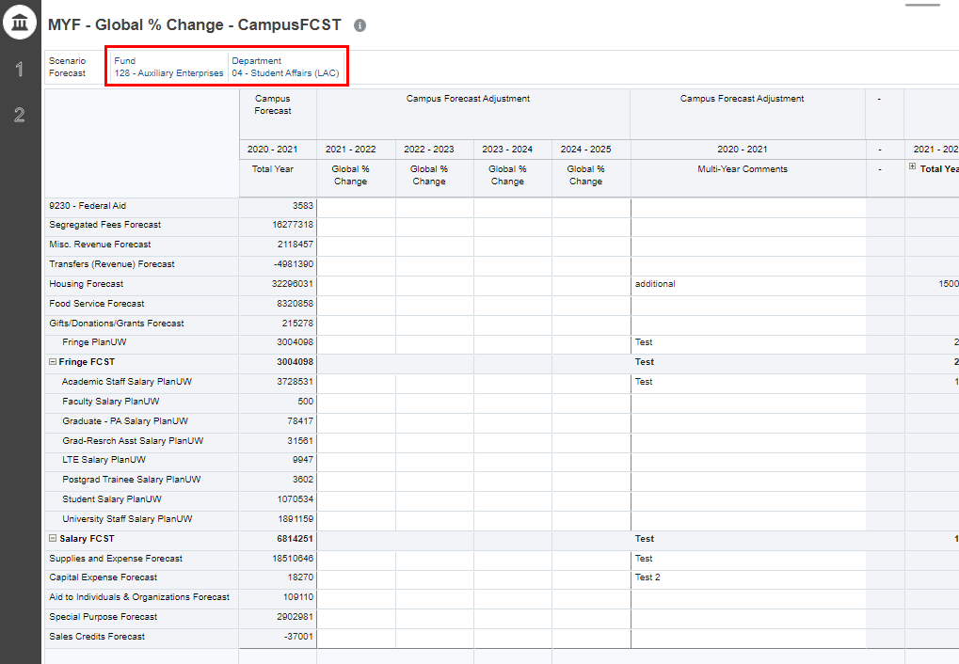
MYF CampusFCST – Global % Change
1
Provides Global % Change input to be applied to the prior year to calculate Multi-Year Forecast starting based on Current Year Forecast. If no data was entered the Forecast Adjustment will equal to the Current Year Campus Forecast.
The Point of View shows your selected Fund and Sub-Department. Optionally, you can change your Sub-Department and/or Fund directly on this form, by clicking the dimension and changing your selection.
Input data in Campus Forecast Adjustment Global % Change and Multi-Year Comments Columns. All other cells should be grey.
2
Suppressed

Slide 61
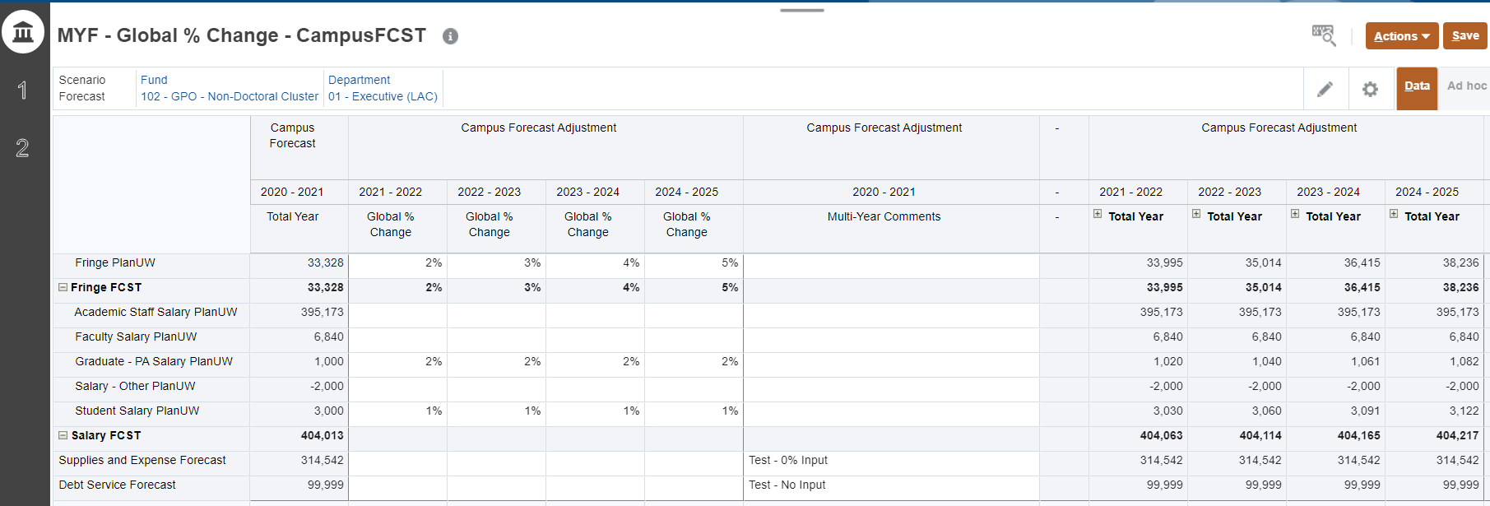
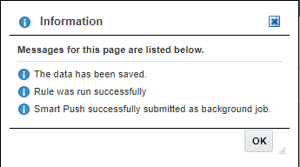
MYF CampusFCST – Global % Change
2
1
Enter Campus Forecast Adjustment Global % Change and Multi-Year Comments Columns.
Once done, click Save to save the sheet.
Click OK in pop up message.
3
Note: If data was entered to Global Change %, validate the data in Campus Forecast Adjustment has been calculated correctly based on the Current Year Campus Forecast and the Global % Change that was entered. If no data was entered in Global % Change, validate the data in Campus Forecast Adjustment is equal to the Current Year Campus Forecast.

Slide 62
Rinse and Repeat
By Campus
By Division
By Sub-Department
NOTE: This process for Global % Change form for the By Division and By Sub-Department levels are section are identical to the By Campus for except for being on the divisional or Sub-Departmental level. All processes are applicable in this section.

Slide 63
UW Multi-Year Forecast
Salary, Wages and Fringe

Slide 64
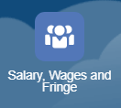
Rinse and Repeat
NOTE: This section will cover the Campus-Level input for Salary, Wages & Fringe. The same process is applicable for the Division-Level and Department-Level inputs in Salary, Wages & Fringe. It is an abridged version of what was covered in the CYF Training.

Slide 65
Salary, Wages and Fringe Data
Use this card to Forecast for Salary, Wages, and Fringe for Multi-Year Forecast.
Enter adjustments to manipulate the prepopulated base Forecast for
View how Forecast Base, Transfers, and Adjustments cumulate to gain the full picture of your Forecast
Review historical data, total Forecast and key variances scenarios
1
2
To begin the multi-year salary data input and review process:
Click the Multi-Year Forecast tile to open the cluster
Click on the Salary, Wages and Fringe tile to open the forms
This process will open the Salary, Wages and Fringe input and review forms
Note: The multi-year forms are very similar to current year forecast forms except for the additional columns for future year forecasts.

Slide 66
Campus-Level Salary, Wages and Fringe
By Campus
Campus-Level – Enter forecast amounts at ‘Campus-Level’ using Divisions, in By Account, By Division, By Account and Division Forms and use Campus-Level Review to see total results.

Slide 67
Campus-Level By Account Form – Salary, Wages and Fringe
1
2
Un-suppressed
Provides forecasting to a single Division by Fund.
The Point of View section can be changed to the Division/Sub-Department and Fund member for your institution limited to your security profile
Input data in Multi-Year Forecast Adjustment and Comments Columns. All other cells should be grey.
NOTE: This form is un-suppressed. The form displays all accounts although data might not exist.

Slide 68
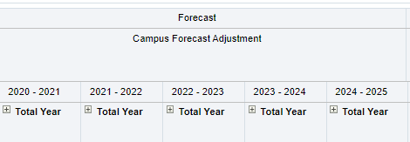
Campus-Level By Account Form– Salary, Wages and Fringe
Expand Year Total by clicking the plus sign to enter by Months. Functionality exists everywhere with a plus sign.
NOTE: Grey columns are locked and cannot be edited. Only white cells allow entry. Data will be spread evenly to the open periods based on a straight spread.

Slide 69
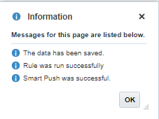
Campus-Level By Account Form– Salary, Wages and Fringe
3
1
2
4
Un-suppressed
Enter Forecast Adjustments in the Total Year column.
Enter comments in the Comment column, if needed.
Once done, click Save to save the sheet.
Click OK in pop up message.

Slide 70
Campus-Level By Division Form – Salary, Wages and Fringe
1
2
Un-suppressed
Provides forecasting to Multiple Divisions by Account and Fund.
The Point of View section can be changed to the Account and Fund member for your institution limited to your security profile
Input data in Forecast Adjustment Year Total and Comments Columns. All other cells should be grey
NOTE: The form is Un-suppressed and displays all Divisions although data might not exist.

Slide 71
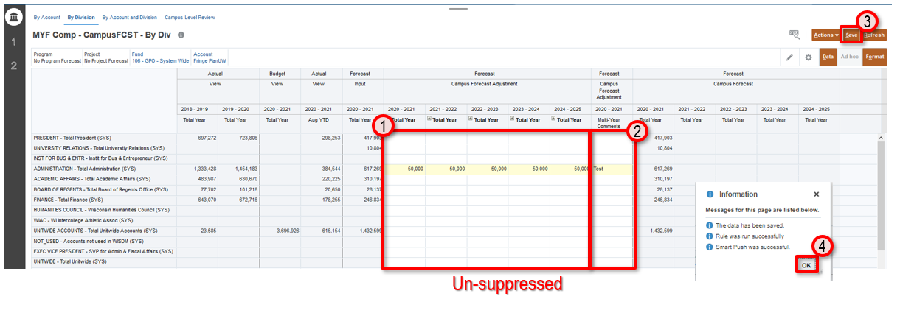
Campus-Level By Division Form – Salary, Wages and Fringe
Enter Forecast Adjustment data in the Total Year column (or expand to enter each open Month)
Enter comments in the Comment column, if needed
Once done, click Save to save the sheet
Click OK in pop up message

Slide 72
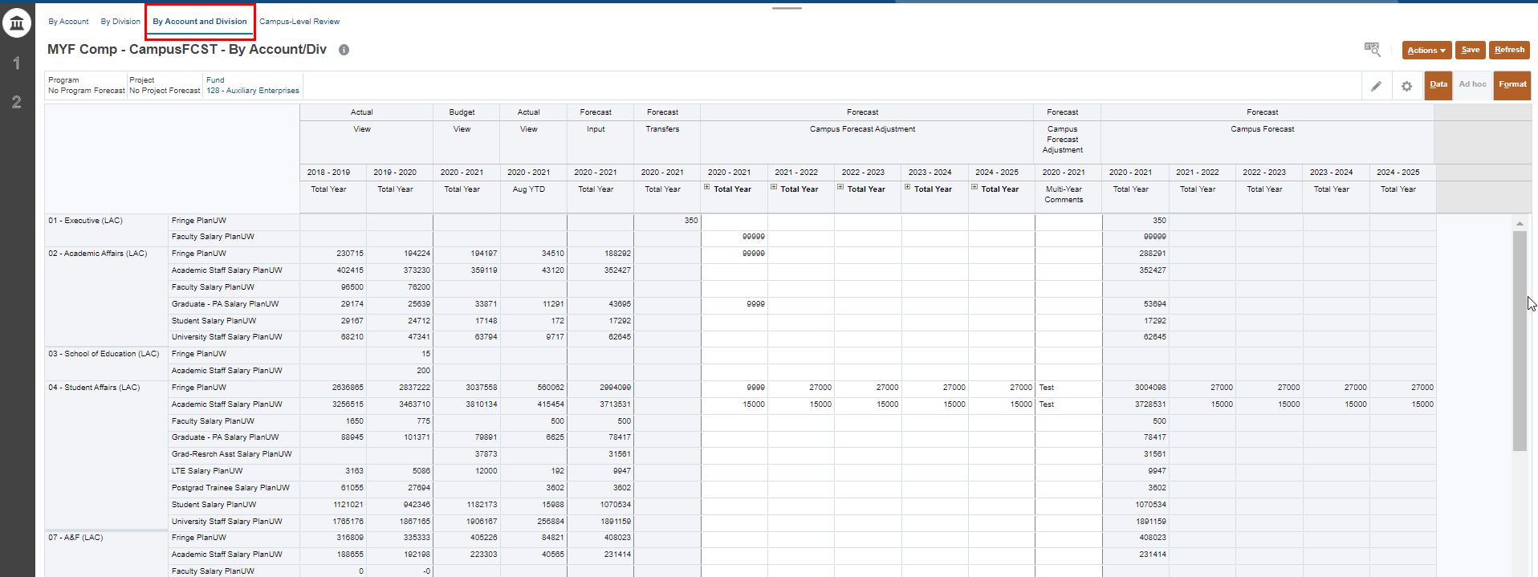
Campus-Level By Account & Division Form – Salary, Wages and Fringe
1
2
Suppressed
Provides forecasting to Multiple Divisions and Accounts by Fund.
The Point of View section can be changed to the Fund member for your institution limited to your security profile
Input data in Forecast Adjustment Year Total and Comments Columns. All other cells should be grey
NOTE: The form only displays Accounts or Divisions with activity. Use the Action menu Open Forecast Accounts if needed.

Slide 73
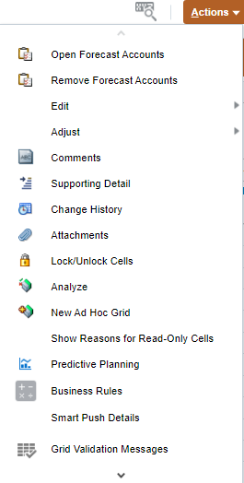
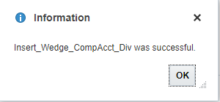
Open Forecast Accounts - Salary, Wages and Fringe
If there is no data Division or Account combination, the members will not display in the form.
The Open Forecast Accounts action will let you add a Division or Account to enter Forecast against
1
2
4
3
To insert a wedge:
Click on the Action menu
Select Open Forecast Accounts
Select Division and/or Account and/or Fund using the selector
Click Launch
Click OK in pop up message
5

Slide 74
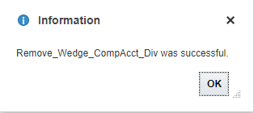
Remove Forecast Accounts - Salary, Wages and Fringe
If a member with no data for a Division or Account combination is unnecessary but is showing on the form
The Remove Forecast Accounts action will let you remove a Division or Account from being displayed on the form
1
2
4
3
To insert a wedge:
Click on the Action menu
Select Remove Forecast Accounts
Select Division and/or Fund using the selector
Click Launch
Click OK in pop up message
5

Slide 75
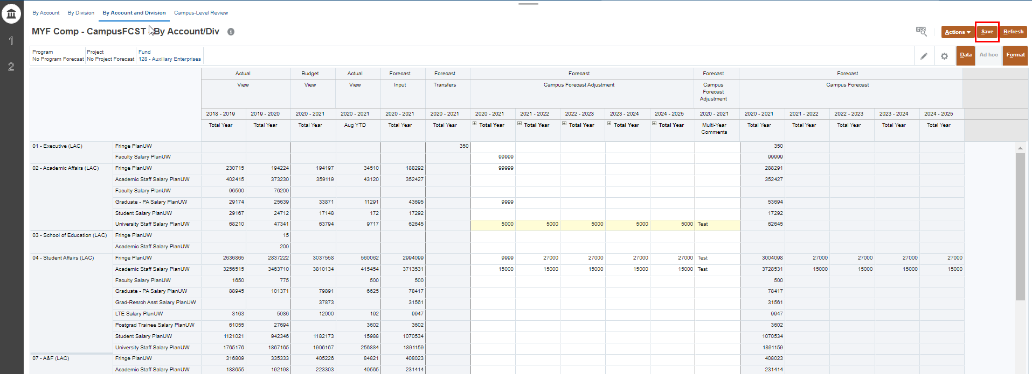
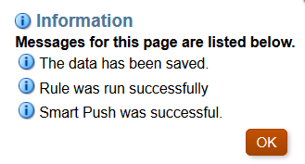
Campus-Level By Account & Division Form – Salary, Wages and Fringe
3
Suppressed
2
1
4
Enter data in the Total Year column (by Total Year or Month)
Enter comments in the Comment column, if needed
Once done, click Save to save the sheet
Click OK in pop up message
NOTE: The Open/Remove Forecast Accounts functionality is available on this form.

Slide 76
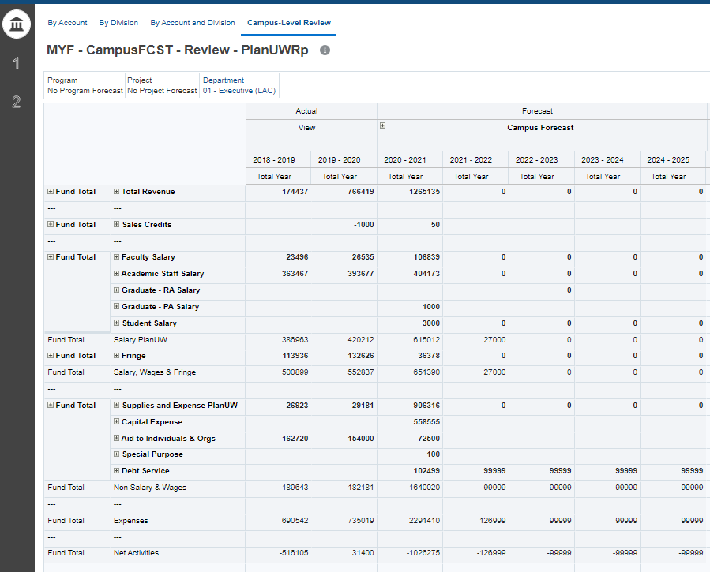
Campus-Level Review – Salary, Wages and Fringe
Provides a historical comparison of the summarized Forecast at the Program Total and Project Total level.
1
2
Provides historical Actual data, an overview of total forecast for multiple years.
The Point of View section can be changed to the Sub-Department member for your institution limited to your security profile.
Review data in Forecast Adjustment Year Total Columns and compare to Actuals and Budget Trends. All cells should be grey

Slide 77
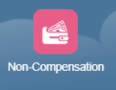
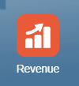
Rinse and Repeat
NOTE: The section above covered the Campus-Level input for Salary, Wages and Fringe, the same process is applicable for Campus-Level Input in the Non-Compensation and Revenue Cards.

Slide 78
UW Multi-Year Forecast
Non-Compensation

Slide 79
Rinse and Repeat
NOTE: This section will cover the Division-Level input for Non-Compensation. The same process is applicable for the Campus-Level and Department-Level inputs in Non-Compensation. It is an abridged version of what was covered in the CYF Training.

Slide 80
Non-Compensation
Use this card to Forecast for Non-Compensation.
Enter adjustments to manipulate the prepopulated base Forecast
View how Forecast Base, Transfers, and Adjustments cumulate to gain the full picture of your Forecast
Review historical data, total Forecast and key variances scenarios
To begin the Non-compensation data input and review process:
Click the Multi-Year Forecast tile to open the cluster
Click on the Non-Compensation tile to open the forms
This process will open the Non-compensation input and review forms
1
2

Slide 81
Division-Level Non-Compensation
Division-Level – Enter forecast amounts at ‘Divisional-Level’ using Divisions, in By Account, By Division, By Account and Division Forms and use Divisional-Level Review to see total results.
By Division

Slide 82
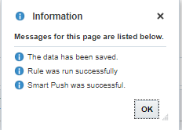
Division-Level By Account Form - Non-Compensation
3
4
1
2
Un-suppressed
Provides efficiency for forecasting to a single Division. The Point of View section can be changed to the Fund and Sub-Department member for your institution limited to your security profile.
Input data in Forecast Adjustment Year Total Columns and Comments if needed. All other cells should be grey
Enter data in the Total Year column (by Total Year, Total Quarter or Total Month)
Enter comments in the Comment column, if needed
Once done, click Save to save the sheet
Click OK in pop up message

Slide 83
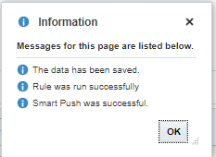
Division-Level By Division Form- Non-Compensation
3
1
2
4
Un-suppressed
Provides efficiency for users that are forecasting to multiple Divisions. The Point of View section can be changed to the Fund and Account member for your institution limited to your security profile.
Input data in Forecast Adjustment Year Total Columns and Comments if needed. All other cells should be grey
Enter data in the Total Year column (by Total Year or Month)
Enter comments in the Comment column, if needed
Once done, click Save to save the sheet
Click OK in pop up message
NOTE: The form only displays Sub-Departments with activity. Use the action menu Open Forecast Accounts if needed.

Slide 84
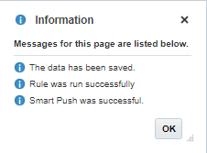
Division-Level By Account & Division Form- Non-Compensation
3
1
2
4
Suppressed
Provides forecasting to Multiple Divisions and Accounts by Fund. The Point of View section can be changed to the Fund member for your institution limited to your security profile.
Input data in Forecast Adjustment Year Total Columns and Comments if needed. All other cells should be grey
Enter data in the Total Year column (by Total Year or Month)
Enter comments in the Comment column, if needed
Once done, click Save to save the sheet
Click OK in pop up message
NOTE: The form only displays Account and Sub-Department combinations with activity. Use the action menu Open Forecast Accounts if needed.

Slide 85
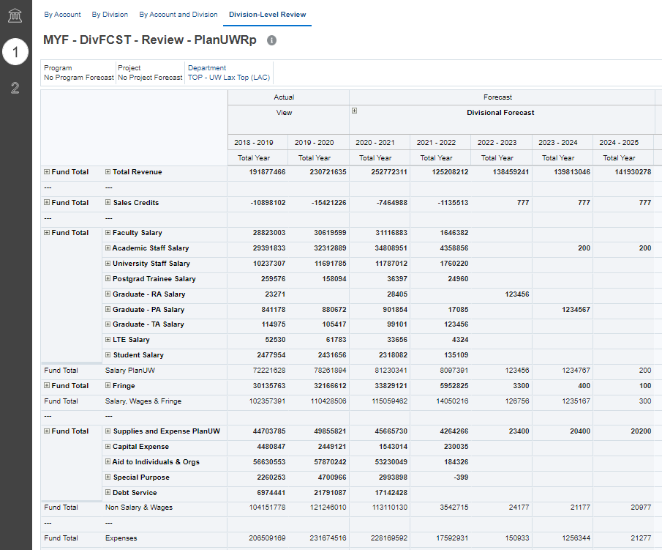
Division-Level Review – Non-Compensation
Provides a historical comparison of the summarized Forecast at the Program Total and Project Total level.
1
2
Provides historical Actual data, an overview of total forecast.
The Point of View section can be changed to the Sub-Department member for your institution limited to your security profile.
Review data in Forecast Adjustment Year Total Columns and compare to Actuals and Budget Trends. All cells should be grey

Slide 86
Rinse and Repeat
NOTE: The section above covered the Division-Level input for Non-Compensation, the same process is applicable for Division-Level Input in the Salary, Wages & Fringe and Revenue Cards.

Slide 87
UW Multi-Year Forecast
Revenue

Slide 88
Rinse and Repeat
In Smart View!
NOTE: This section will cover the Department-Level input for Revenue. The same process is applicable for the Campus-Level and Division-Level inputs in Revenue. It is an abridged version of what was covered in the CYF Training.

Slide 89
Revenue
Use this card to Forecast for Revenue.
Enter adjustments to manipulate the prepopulated base Forecast
View how Forecast Base, Transfers, and Adjustments cumulate to gain the full picture of your Forecast
Review historical data, total Forecast and key variances scenarios
To begin the Revenue data input and review process:
Click the Multi-Year Forecast tile to open the cluster
Click on the Revenue tile to open the forms
This process will open the Revenue input and review forms
1
2

Slide 90
Sub-Department-Level Revenue
Sub-Department-Level – Enter forecast amounts at ‘Sub-Department-Level’ using Sub-Departments, in By Account, By Sub-Department, By Account and Sub-Department Forms and use Sub-Department-Level Review to see total results.
By Sub-Department

Slide 91
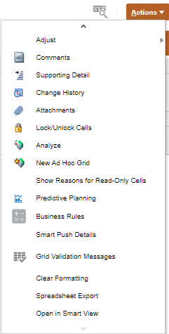
By Account - Revenue Data Smart View
1
Depending on the browser being used the pop up will look different please refer to the Smart View training guide for more information.
To open this form in Smart View:
Select the Actions menu
Select Open in Smart View (Use the scroll icon to scroll to the bottom of the list, if needed)
Navigate to open downloaded file Excel workbook, or open a blank workbook
2
3

Slide 92
Changing POV - Revenue Data Smart View
1
2
Smart View forms have all the same functionality as Web forms, the clicks are just different. To change the POV in Smart View forms:
Use the dropdowns to select the new member.
After all new members have been selected, users must click Refresh for those changes to apply.
If you know the name of the member you are looking for you can type it into the dropdown, and Smart View will filter the list.

Slide 93
Sub-Department-Level By Account Form - Revenue Data Smart View
3
Un-suppressed
1
2
Provides efficiency for forecasting to a single Division. The Point of View section can be changed to the Fund and Sub-Department member for your institution limited to your security profile.
Input data in Forecast Adjustment Year Total Columns and Comments, these columns will be light yellow. Once data is entered, they will change to a dark yellow. All other cells should be grey.
There is no pop up to confirm that data has saved.
Enter data in the Total Year column (by Total Year or Month)
Enter comments in the Comment column, if needed
Once done, click Submit Data to save the sheet

Slide 94
Navigating to New Forms in Smart View
Rather than going back to the web to open a new form in Smart View, users can navigate to the new form from the Smart View Panel.
To open a new form:
Select Smart View from the ribbon
In the Smart View ribbon select Panel, the panel will open at the far right side of the screen
Click the to expand the URL, PLNUW{INST}, Library, Multi-Year Forecast, Revenue
Select the form you would like to open, double click on the form to open
New form opens in worksheet.
3
2
4
1

Slide 95
Sub-Department-Level By Sub-Dept Form- Revenue Data
3
1
2
Suppressed
Provides efficiency for forecasting to a single Division (Units, Divisions, Sub-Departments). The Point of View section can be changed to the Fund and Sub-Department member for your institution limited to your security profile.
Input data in Forecast Adjustment Year Total Columns and Comments, these columns will be light yellow. Once data is entered, they will change to a dark yellow. All other cells should be grey.
Enter data in the Total Year column (by Total Year, Total Quarter or Total Month)
Enter comments in the Comment column, if needed
Once done, click Submit Data to save the sheet

Slide 96
Open Forecast Accounts– Revenue Smart View
NOTE: This is Optional
If there is no data for a Sub-Department or Account combination, the members will not display in the form.
The Open Forecast Accounts action will let you add a Division or Account to enter Forecast against
When entering data at Total Year, the amounts will be spread evenly across the remaining open months.
1
After entering data in the Total Year column:
Right click on the cell where data was entered
Select Smart View from the right click menu
Select Open Forecast Accounts
Select Sub-Department and/or Account and/or Fund using the selector
Click OK.
3
2
4
5

Slide 97
Remove Forecast Accounts– Revenue Smart View
NOTE: This is Optional
If a member with no Baseline Forecast for a Division or Account combination is unnecessary but is showing on the form
The Remove Forecast Accounts action will let you remove a Division or Account from being displayed on the form
1
After entering data in the Total Year column:
Right click on the cell where data was entered
Select Smart View from the right click menu
Select Remove Forecast Accounts
Select Sub-Department and/or Fund using the selector
Click OK.
3
2
4
5

Slide 98
Rinse and Repeat
NOTE: The section above covered the Department-Level input for Revenue, the same process is applicable for Department-Level Input in the Salary, Wages and Fringe and Non-Compensation Cards.

Slide 99
UW Multi-Year Forecast
Transfers

Slide 100
Transfers
To begin the Transfers process:
Click the Multi-Year Forecast tile to open the cluster
Click on the Transfers tile to open the forms
This process will open the Transfer Forms.
NOTE: All Transfers are inputted at the Sub-Department Level and are then included in the Campus-Level, Division-Level and Sub-Department-Level Forecasts
1
2

Slide 101
Transfers – Budget vs Forecast
During the Requirements phase, institutions communicated that Transfers were a large indicator of their potential spend for the year. So, they would need to be included as part of the Forecast.
Budget Transfers vs Forecast Transfers
Budget Transfers: Transfer data that has been entered in SFS that is loaded directly the PlanUW into the Budget scenario.
Forecast Transfers: Transfer data that has been copied from the Budget scenario in PlanUW to the Forecast scenario in PlanUW to facilitate Forecast creation.
How do I include Forecast Transfers in my Forecast?
Monitor Forecast Transfer forms monthly to ensure that transfers are not being missed from prior months.
If not monitoring monthly, open the Transfer Review form first. Use this form to identify transfers from prior months that need to be included in the current Forecast months.
To accommodate all uses of the Transfers in Forecasting, Transfers in the Forecast are being “dropped in” the month they were entered in SFS. This means that if not spread or adjusted, Forecast Transfer data could be lost in the next month process.

Slide 102
By Account - Transfers
3
4
1
2
Provides forecasting of Multi-Year Transfers by Account in current and future years. Select Fund and Sub-Department in point of view. Add and adjust Transfers to the years they are expected to occur.
Enter data in the Forecast years
Enter comments in the Comment column, if needed
Once done, click Save to save the sheet
Click OK in pop up message

Slide 103
By Sub-Department - Transfers
3
2
1
4
Provides forecasting of Multi-Year Transfers by Sub-Department in current and future years. Select Fund and Sub-Department in point of view. Add and adjust Transfers to the years they are expected to occur.
Enter data in the Forecast years
Enter comments in the Comment column, if needed
Once done, click Save to save the sheet
Click OK in pop up message

Slide 104
By Account and Sub-Department - Transfers
4
3
1
2
Provides forecasting of Multi-Year Transfers by Account & Sub-Department in current and future years. Select Fund and Sub-Department in point of view. Add and adjust Transfers to the years they are expected to occur.
Enter data in the Forecast years
Enter comments in the Comment column, if needed
Once done, click Save to save the sheet
Click OK in pop up message

Slide 105
UW Multi-Year Forecast
Reports

Slide 106
Multi-Year Forecast Reports
1
2
To view the Multi-Year Forecast reports:
Click the Multi-Year Forecast tile to open the cluster
Click on the MYF Reports tile to open

Slide 107
Multi-Year Forecast Review - Multi-Year Forecast Reports
2
3
1
Multi-Year Forecast Review Report
Select the Version member when prompted (Working, Campus, Divisional, Sub-Departmental)
Select a Department and Fund where you know there is data for your institution
Select File Format: PDF, HTML or Excel

Slide 108
Cont. Multi-Year Forecast Review - Multi-Year Forecast Reports

Slide 109
Budget Forecast Review - Multi-Year Forecast Reports
2
1
3
Budget Forecast Report
Select the Version member when prompted (Working, Campus, Divisional, Sub-Departmental)
Select a Department where you know there is data for your institution
Select File Format: PDF, HTML or Excel

Slide 110
Cont. Budget Forecast Review - Multi-Year Forecast Reports
2

Slide 111
4-Year Fund Balance Report - Multi-Year Forecast Reports
1
2
3
4-Year Fund Balance Report
Select the Version member when prompted (Working, Campus, Divisional, Sub-Departmental)
Select a Department where you know there is data for your institution
Select File Format: PDF, HTML or Excel

Slide 112
Cont. 4-Year Fund Balance Report - Multi-Year Forecast Reports
2

Slide 113
Course Summary

Slide 114
Support and Resources
You can use the following resources for reference and support:
This course, located on the UW System Website/Plan UW: Planning & Budgeting Cloud Service
Project Website: https://www.wisconsin.edu/budget-planning/system-project/
Coworkers and Subject Matter Experts
Quick Reference Guide

Slide 115
UW Multi-Year Forecast
Setting User Variables
C
QRG

Slide 116
Accessing PlanUW
PlanUW is a cloud-based and can be accessed via any computer with internet access.
PlanUW is supported by any browser. Out of the browsers shown, we recommend Mozilla Firefox:
Internet Explorer
v.11.x
Mozilla Firefox
v.38+
Google Chrome
v.42+
Apple Safari v.8.x and v.7.x
Firefox is the Huron recommended browser

Slide 117
Setting User Variables
End Users and Power Users need to set User Variables according to their institutions. Setting User Variables ensures that the user filters input and review forms to campus exclusive data.
To access Preferences:
1. Click the Tools cluster
2. Select the User Preferences card
NOTE: User variables only need to be set once, but they can be changed at any time.

Slide 118
Setting User Variables – End Users
Member Selectors
Members can be selected for each User Variable by clicking Member Selector

Slide 119
Setting User Variables – End Users
Use the Member Selector to select the Sub-Departments and Institutions you plan to use for Multi-Year Forecast. This selection can be changed in the future as needed via User Preferences.
MYF Housing Dept: Select specific Housing Sub-Department member to use the MYF Housing model.
MYF Meal Plan Dept: Select specific Meal Plan Sub-Department member to use the MYF Meal Plan model.
MYF Tuition Dept: Select specific Tuition Sub-Department member to use the MYF Tuition model.
Total Institution: Total Institution should be set to Top Level institution member (e.g. UWMIL, UWGBY, UWSTO, etc.).
User Institution: User Institution, could be a duplicate of Total Institution, but for now they should set it to the same as Total Institution.

Slide 120
Selecting Members
Members can be selected in two ways from the Member Selection window:
Search Bar
Hierarchy
Search Bar
Select
When selecting members through a Hierarchy, drill into a member by clicking
To select a member, click on the member.
Note that you are only able to select one member at a time
Hierarchy

