Slide 1

Navigating PlanUW

Slide 2





Course Objectives
This course displays the skills needed to navigate within PlanUW.
After completing this class, you will understand and learn how to:
Login and Access PlanUW
Understand the layout of the home page and forms
Set preferences and user variables
Interact with and enter data into forms
Understand advanced data entry features in forms
2

Slide 3
Accessing PlanUW

Slide 4






Accessing PlanUW
PlanUW is a cloud-based and can be accessed via any computer with internet access.
PlanUW is supported by any browser. Out of the browsers shown, we recommend Mozilla Firefox:
Microsoft Edge
Internet Explorer
11.x
Mozilla Firefox
38+
Google Chrome
42+
Apple Safari 8.x and 7.x
Firefox is the recommended browser

Slide 5

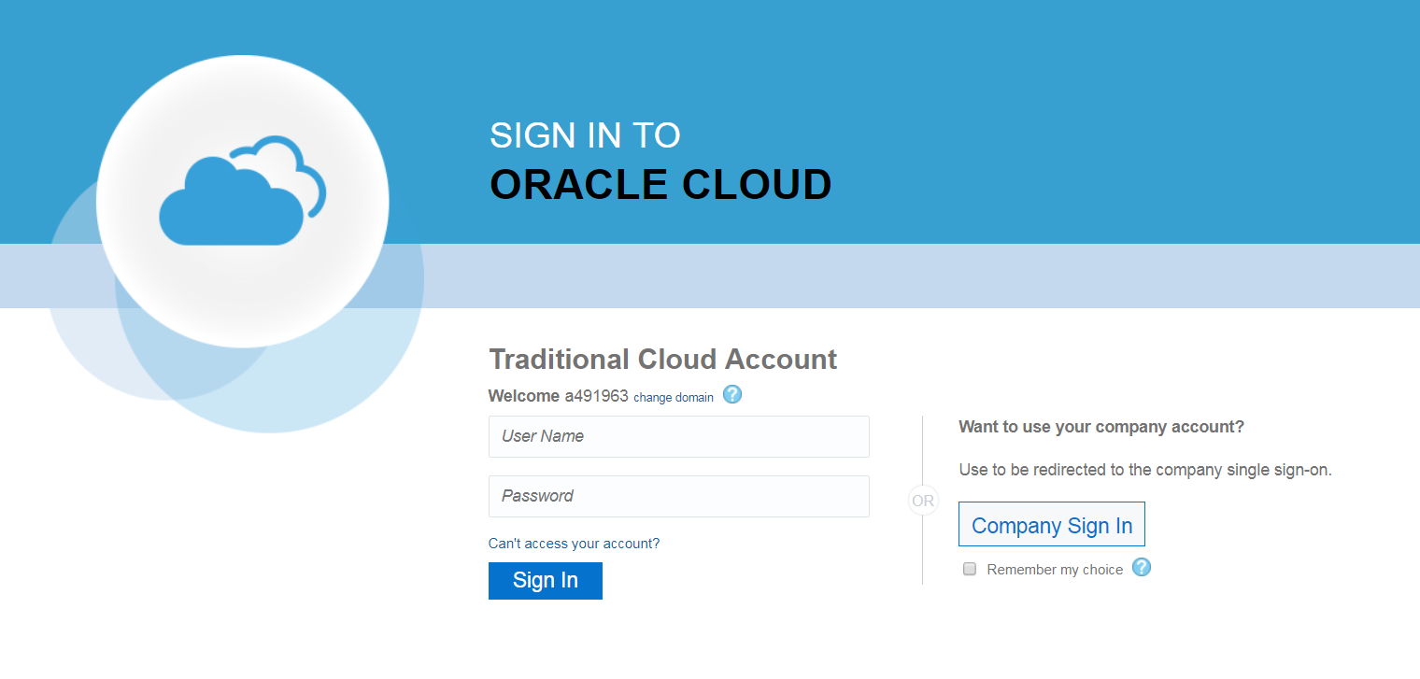
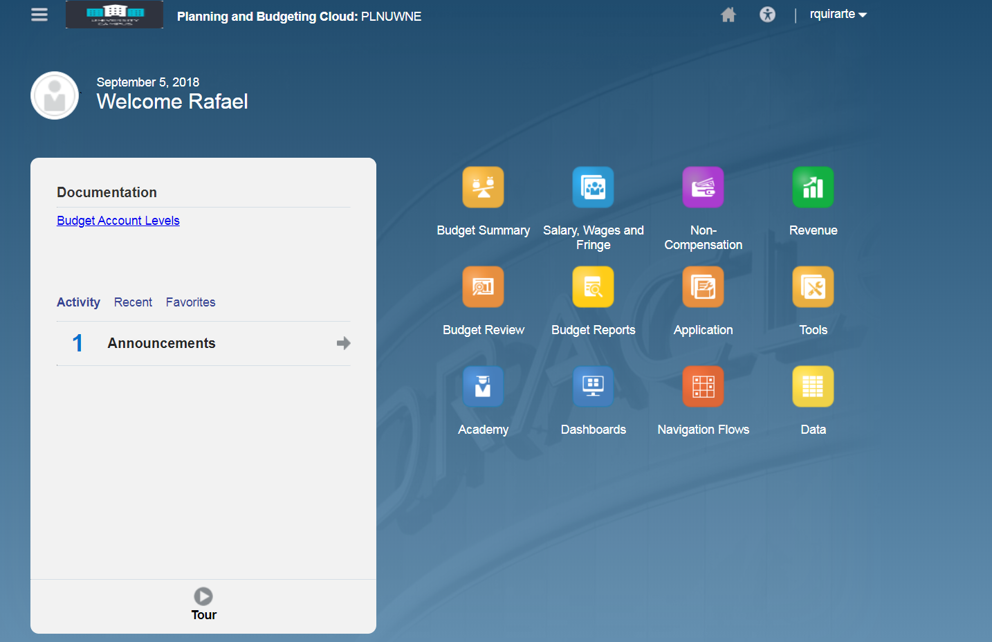
Logging Into PlanUW & The PlanUW Homepage
PlanUW is UW Single Sign On enabled. To log into PlanUW :
Click on Company Sign In. This will bring the UW Page
Enter your UW credentials and click Sign In
You will be logged on via Single Sign On
Once logged in, the PlanUW Home Page is displayed.
5

Slide 6
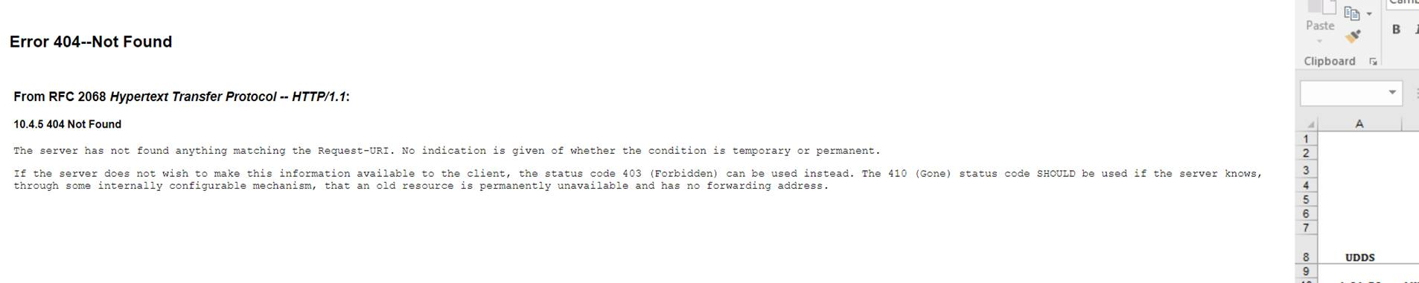
Logging Into PlanUW & The PlanUW Homepage
Some users may see the following screen after logging in. This does not mean that the user entered incorrect credentials. This is a known issue with PlanUW.
To by-pass this screen, simply refresh the page and the home page should display after the page reloads.

Slide 7
The PlanUW Homepage

Slide 8
The PlanUW Homepage
Navigator
Activity Pane
Navigation Flows
The PlanUW Home Page consists of three main regions:
Navigator
Activity Pane
Navigation Flows
8

Slide 9
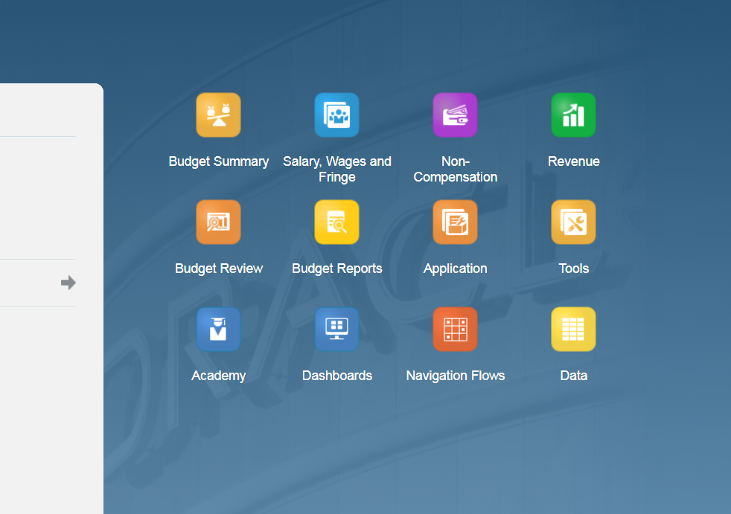
The PlanUW Homepage
Navigation Flows are a grouping of related content such as forms and reports which support the completion of a particular business process.
The navigation flows provide you with a very simple and streamlined outline and order to each step in the budgeting process.

Slide 10

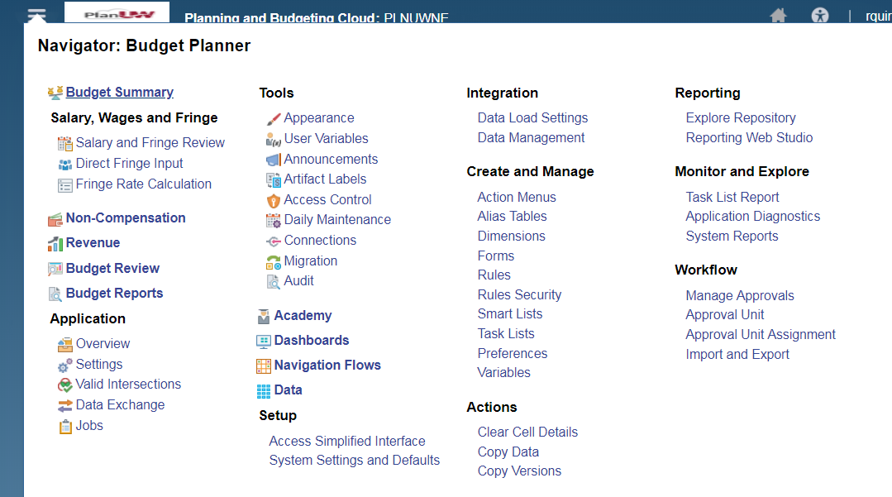
The PlanUW Homepage
The Navigator shows all forms, tools, and preferences available within PlanUW.
While you have access to Navigator, it is recommend you use the navigation flows to carry out all budgeting tasks.

Slide 11
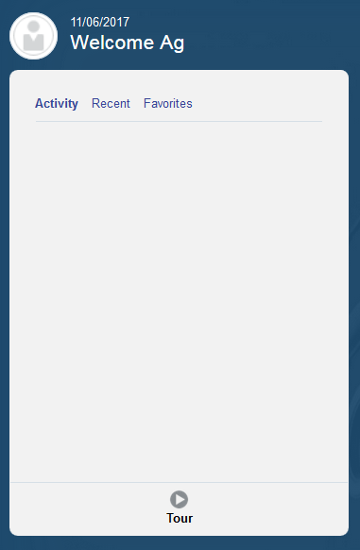
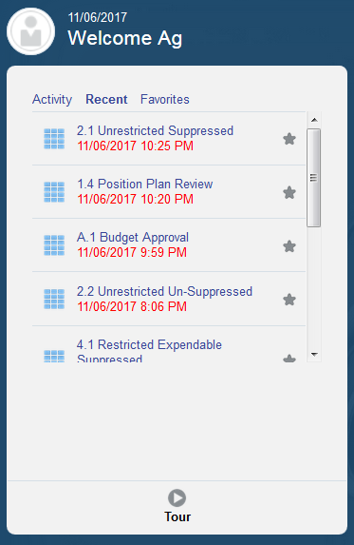
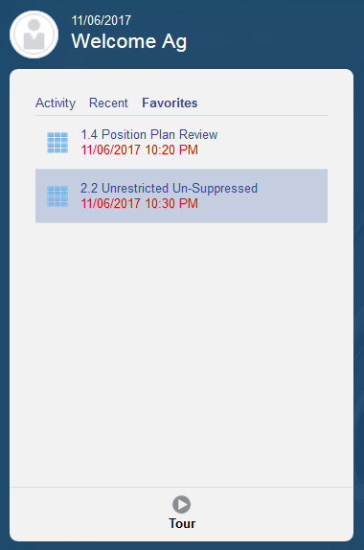

The PlanUW Homepage
The Activity Pane shows a list of recent activity and favorited objects.
Objects can be selected as favorites for easy access by clicking on the
11

Slide 12
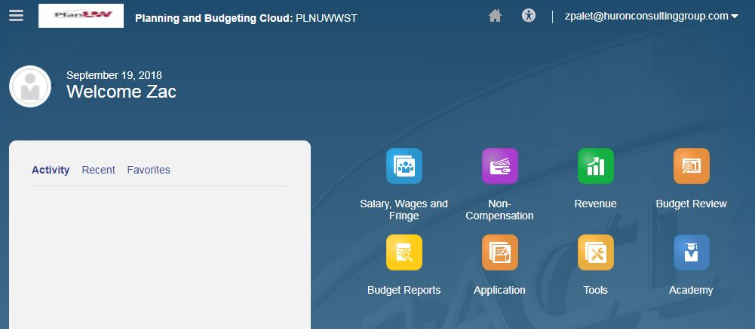


The PlanUW Homepage
Home
Home
You may return to the home page by:
Clicking the logo
Clicking Home
12

Slide 13
Setting User Variables

Slide 14
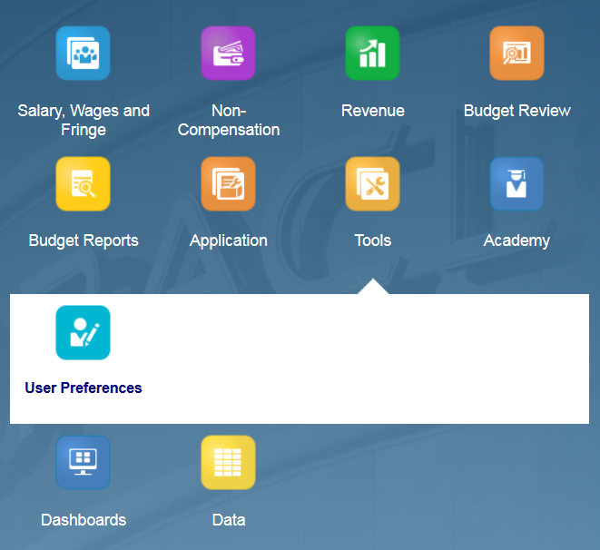



Setting User Variables
End Users and Power Users have to set User Variables according to their institutions. Setting User Variables is a key step in ensuring that the user filters access to campus exclusive data.
To access Preferences:
1. Click the Tools cluster
2. Select the User Preferences card
NOTE: User variables only need to be set once, but they can be changed at any time.
14

Slide 15
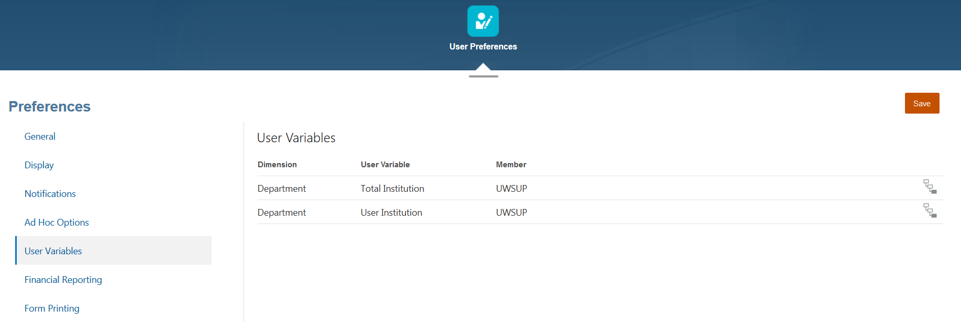

Setting User Variables – End Users
Member Selectors
Members can be selected for each dimension by clicking Member Selector
When setting User Variables, you only need to select a member for the Organization dimension. Do not edit any of the other dimensions.
15

Slide 16
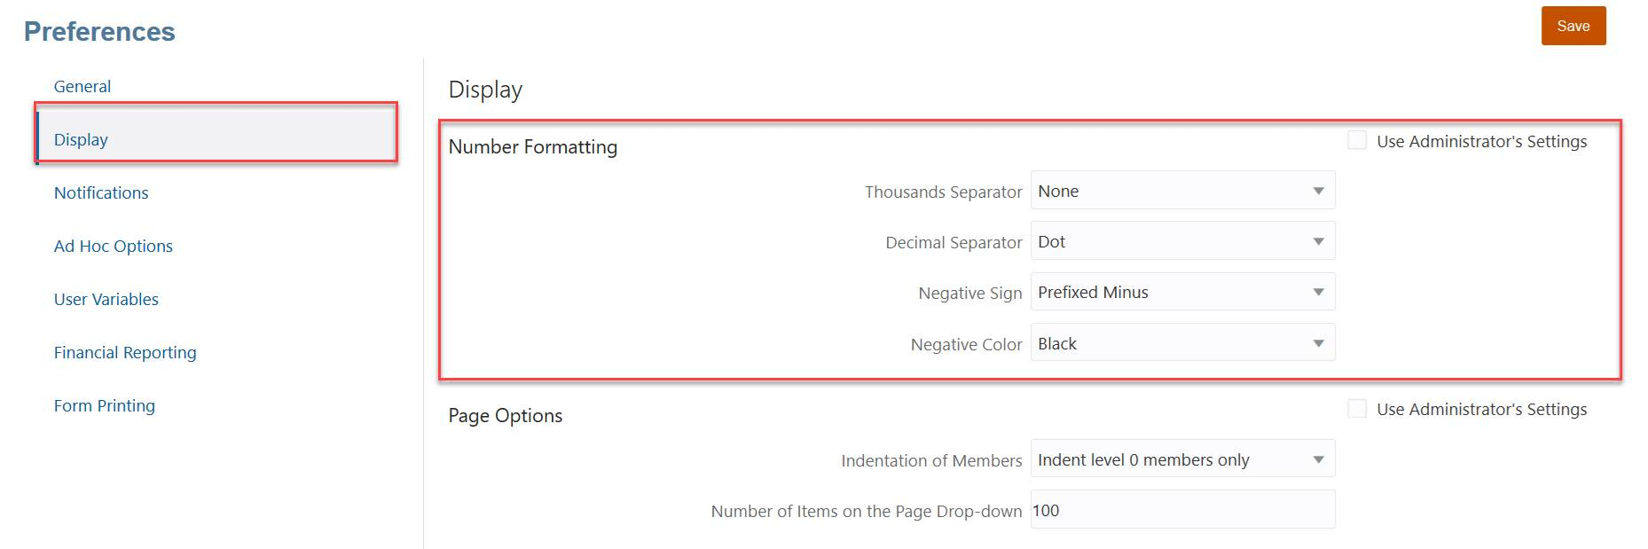
Setting User Variables – Display Setting
Under Display, End Users will be able to update their Number Formatting settings.
16

Slide 17
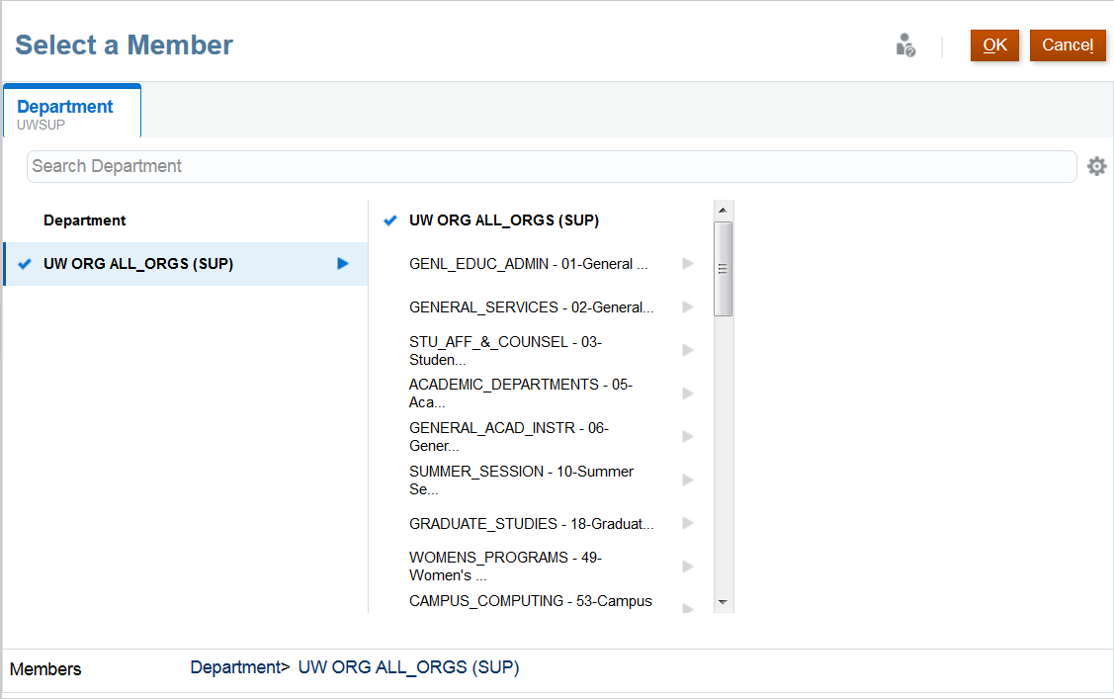
Selecting Members
Members can be selected in two ways from the Member Selection window:
Search Bar
Hierarchy
Search Bar
When selecting members through a Hierarchy, drill into a member by clicking
To select a member, click Add
Note that you are only able to select one member at a time
Select
Hierarchy
If the member selected does not appear on the User Variables selected, the next slide will explain the next steps.

Slide 18
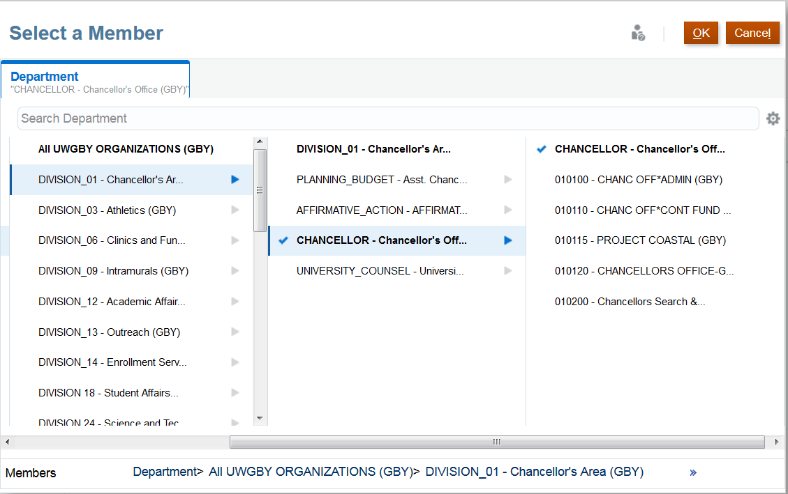
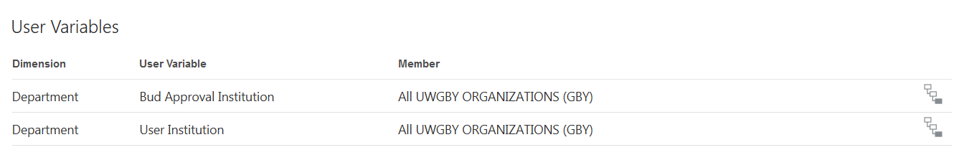
Selecting Members - Before Continuing
If you are not able to select a specific member, in this example “CHANCELOR – Chancellor’s Office”, PlanUW lets you click the member, the blue check box confirms the selection, and then they can click OK. However, the selection does not actually get set as the “User Institution”.
A work around for this is to type the member name directly into the box.
Did not update with new selection

Slide 19
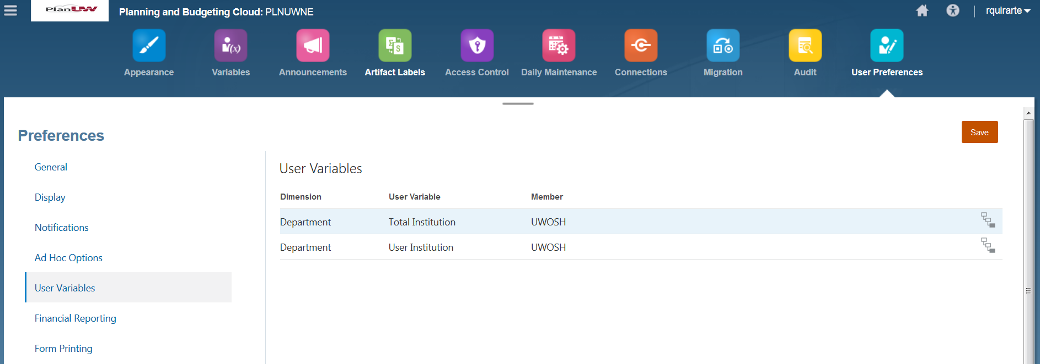

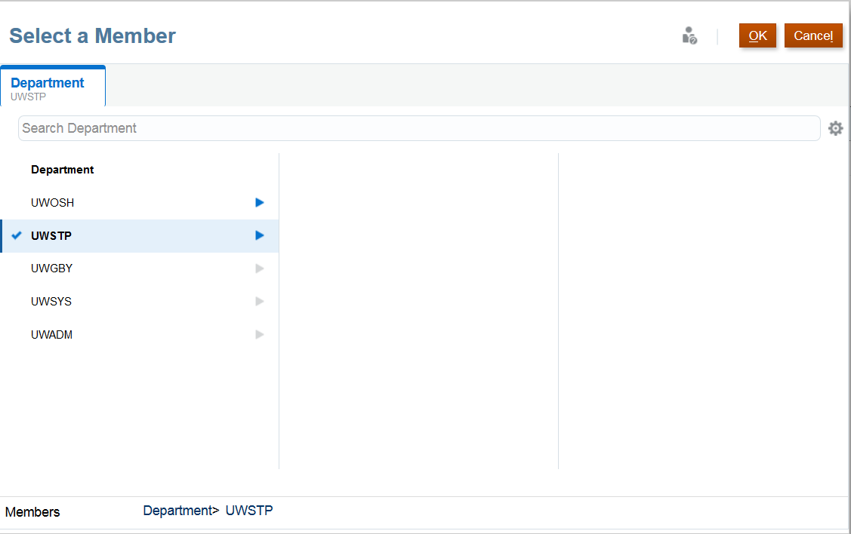
Setting User Variables – Power Users
Unlike End Users, Power Users will have access to set variables at the Total Institution variable level.
To set the Total Institution variable, follow the same steps described to End Users on how to set the User Institution variable (Previous slide).

Slide 20
Forms

Slide 21
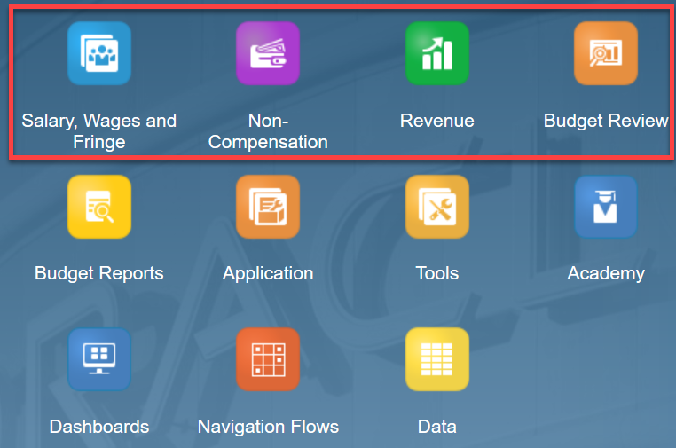
Accessing Forms
Users can access forms through the Salary, Wages and Fringe card, the Non-Compensation card, Revenue card and Budget Review card.
The process of setting user variables should be set before accessing Budget forms because variables allow users to see information narrowed to their own campus
21

Slide 22
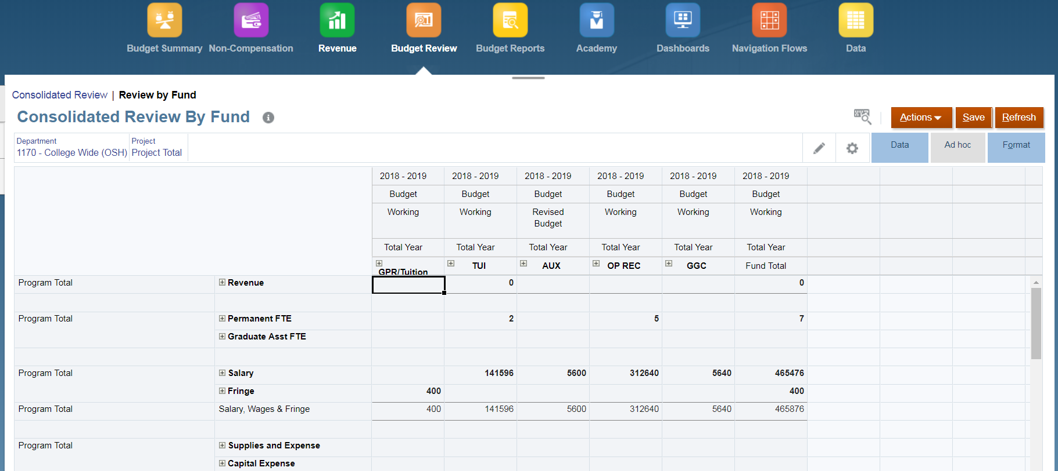
Form Layout
Forms in PlanUW have a similar structure:
Navigation Toolbar
Rows
Columns
Point of View (POV)
Data Entry Area
Navigation Toolbar
Columns
Point of View
Rows
Data
22

Slide 23
Navigation Toolbar
Navigation Toolbar
When a form is opened, the navigation toolbar is displayed above the form. The navigation toolbar allows you to navigate to the other cards in that cluster.
23

Slide 24
Instructions
Instructions
If the form has additional information, Click Instructions information and instructions on the form.
24

Slide 25
Point of View
Point of View
The Point of View (POV) defines the section of data in the PlanUW database you are viewing. You select the desired members for each dimension to determine the context for the pages, rows, and columns.
There are two ways of changing the POV: By clicking on the Pencil, or by clicking directly in the POV link.
The default Organization in the POV is defined by the user variables you set.

Slide 26
Editing the Point of View – Using the Pencil
Edit Members
One way to edit the POV, is by clicking on the click Pencil (Edit Members)
26

Slide 27
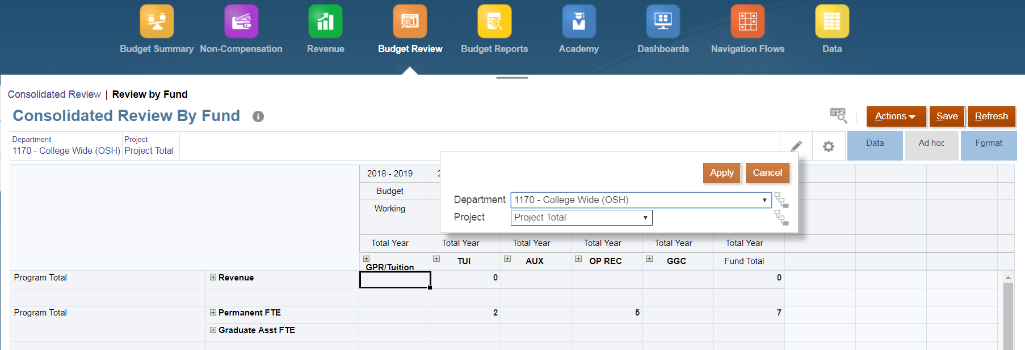
Editing the Point of View
Dropdown
The Edit Members window is displayed.
To select different members for the dimension, click the dropdown next to each dimension.

Slide 28
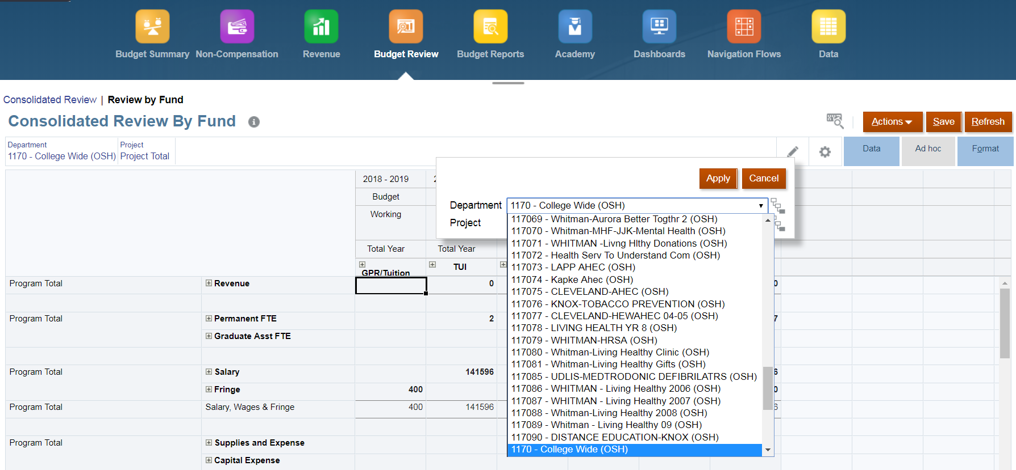
Editing the Point of View
Available Members
Select the desired member from the list of available members.
28

Slide 29
Editing the Point of View
Apply
Once the desired member is selected, click Apply.
29

Slide 30
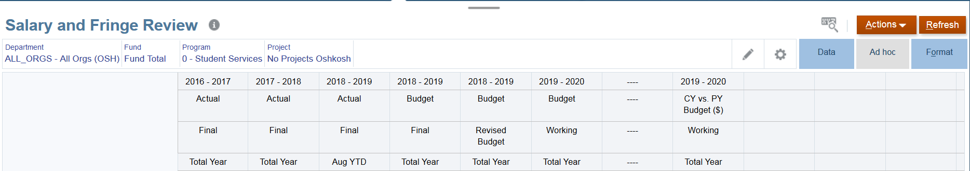
Editing the Point of View – Clicking the POV
Once the desired member is selected, click Apply.

Slide 31
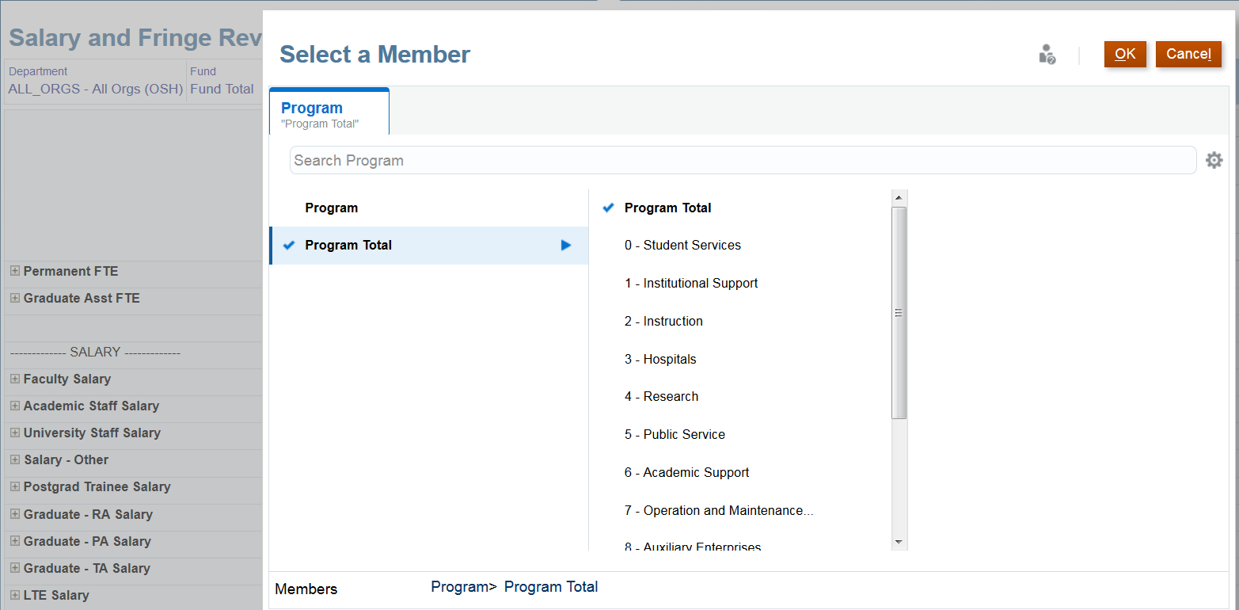
Editing the Point of View – Clicking the POV
Once the desired member is selected, click Apply.
31

Slide 32
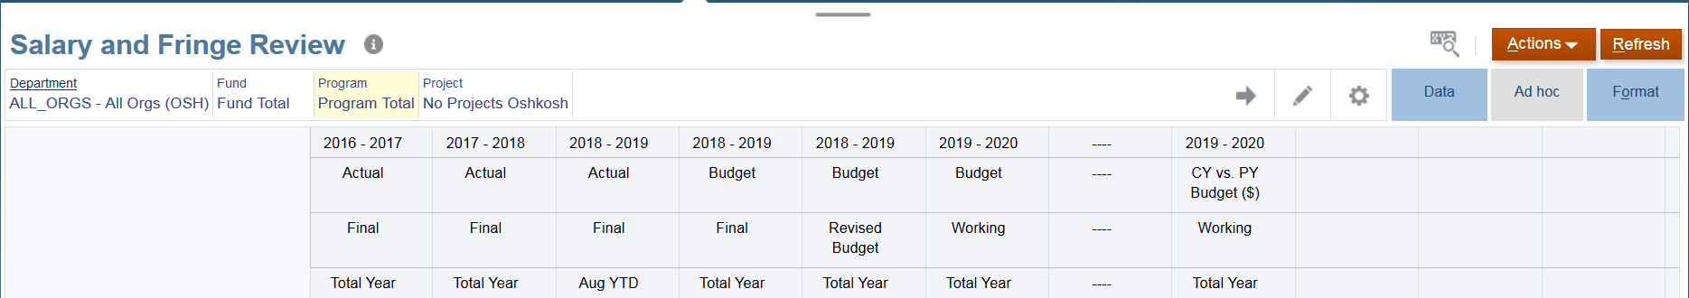
Editing the Point of View – Clicking the POV
The updated POV should reflect highlighted in yellow. If correct, click on the right arrow to execute the POV change.
32

Slide 33
Entering Data
Review Data Here
Data is entered in the grid area.
Remember, data can only be entered in level 0 cells.
33

Slide 34
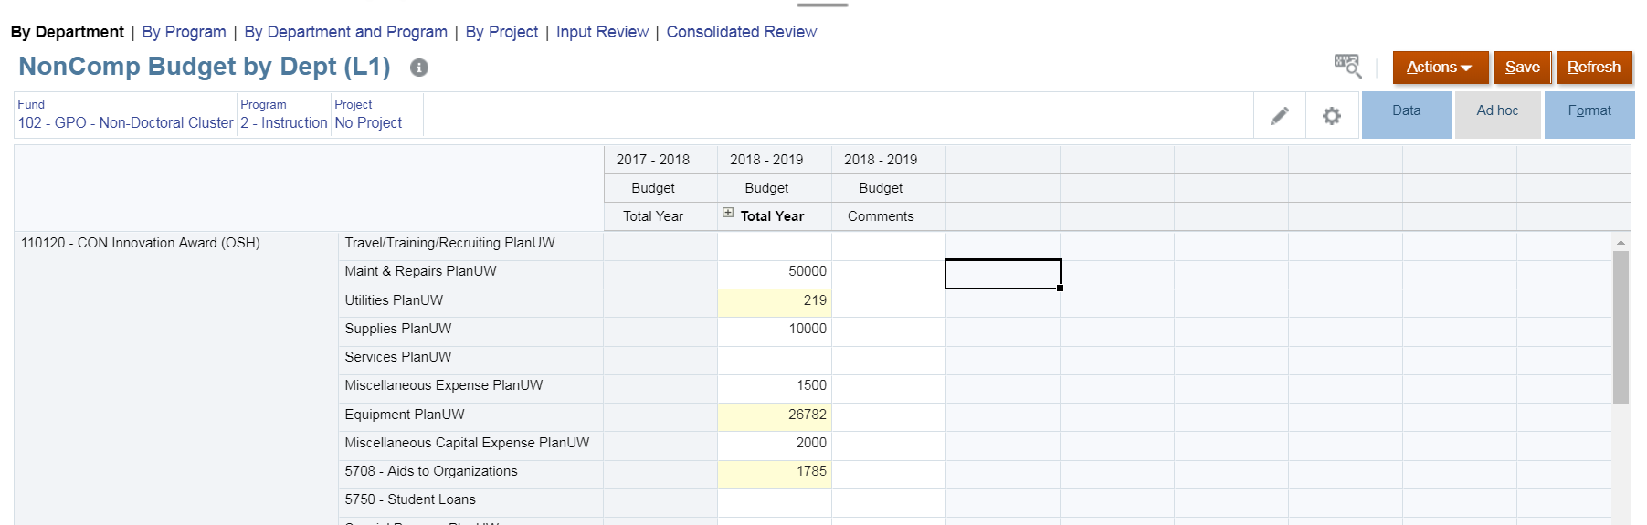
Entering Data
White
Grey
Yellow
Cell colors indicate the cell’s status:
White: default; data can be entered in these cells
Yellow: ”dirty” cells, whose values changed but are not yet saved
Grey: read-only cells
34

Slide 35
Saving Forms
Save
To save a form, click Save.
NOTE: You will not receive any error or message if you leave the form without saving your data. Any data entered without saving will be lost.
35

Slide 36
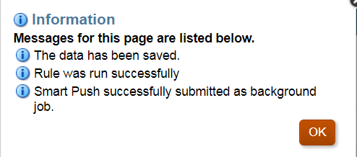
Saving Forms
An information box will display indicating that the data has been successfully saved and that the data has been “pushed” to the database.
If a business rule is ran, a notification will also be displayed in this information window.
36

Slide 37
Advanced Form Features

Slide 38
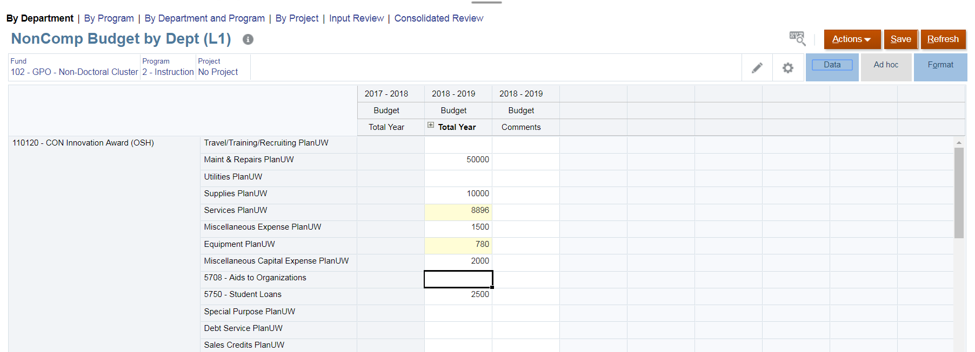

Data Entry Features
2
1
In addition to entering data, more data entry features are available.
To access these additional data entry features, click into any white, yellow, or teal cell.
Next, click
38

Slide 39
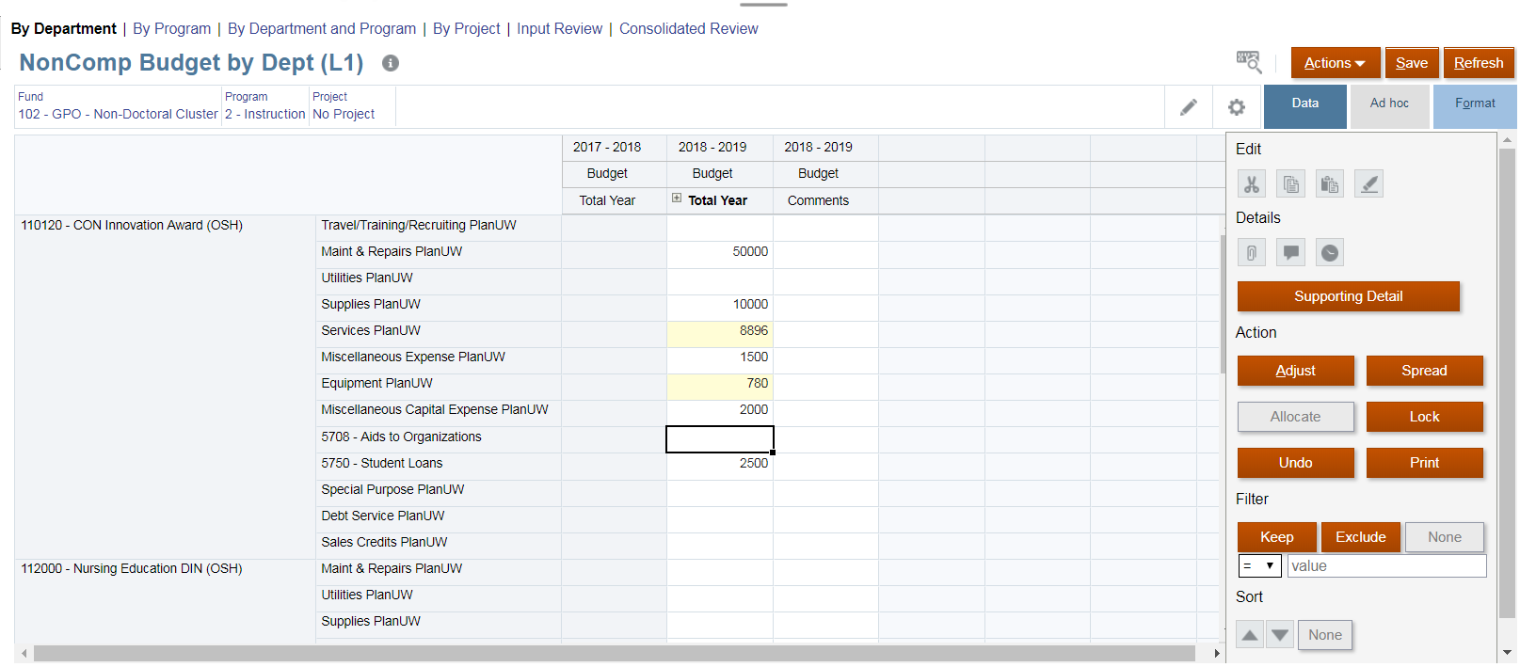
Data Entry Features
Data Entry Features Panel
The data entry features panel is displayed.
While there are several data entry features available to you, we will only demonstrate a few.
39

Slide 40
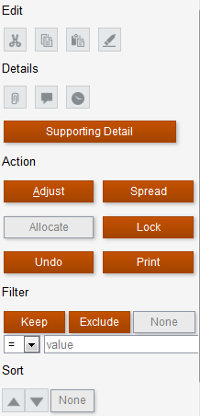

Data Entry Features
Copy
Paste
Cut
Clear
Attachments
Show Change History*
Add Comment
Data entry features include:
Adjust existing data via increase or decrease by a number or a percentage
Add supporting detail (e.g. breakdown of amounts summing to the overall data)
Lock to prevent changes (e.g. cannot initially input until someone else unlocks it)
Change History is not currently enabled.
40

Slide 41
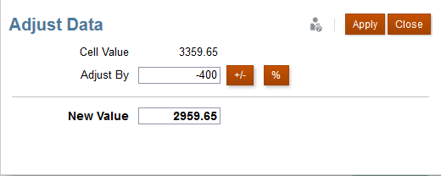
Data Entry Features
4
2
1
3
Adjust data allows you to increase or decrease a value by a number of a percentage.
To Adjust data:
Enter the desired value in the Adjust By field
Click Value or Percentage
The updated value will display in the New Value field
Click Apply to apply the adjustment.

Slide 42
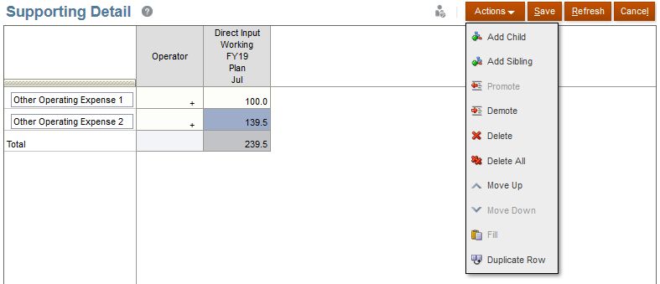
Data Entry Features
1
5
2
3
4
Add supporting detail allows you to break down the amounts summing to the overall data.
To add supporting detail:
Click Action and click Add Child and Add Sibling to define the supporting details.
Name the siblings and children.
Set the operator. Available operators include ~,+,-,*,/.
Set the value.
Click Save.
42

Slide 43
Types of Form

Slide 44
Data and Review Forms
Data Forms
Review Forms
There are two primary types of forms in PlanUW:
Data Forms: Forms where budget data will be entered in the 0 level members
Review Forms: Read-only summary of the Budget the user has generated to provide a real time look at the total budget by the selected organization.
44

Slide 45
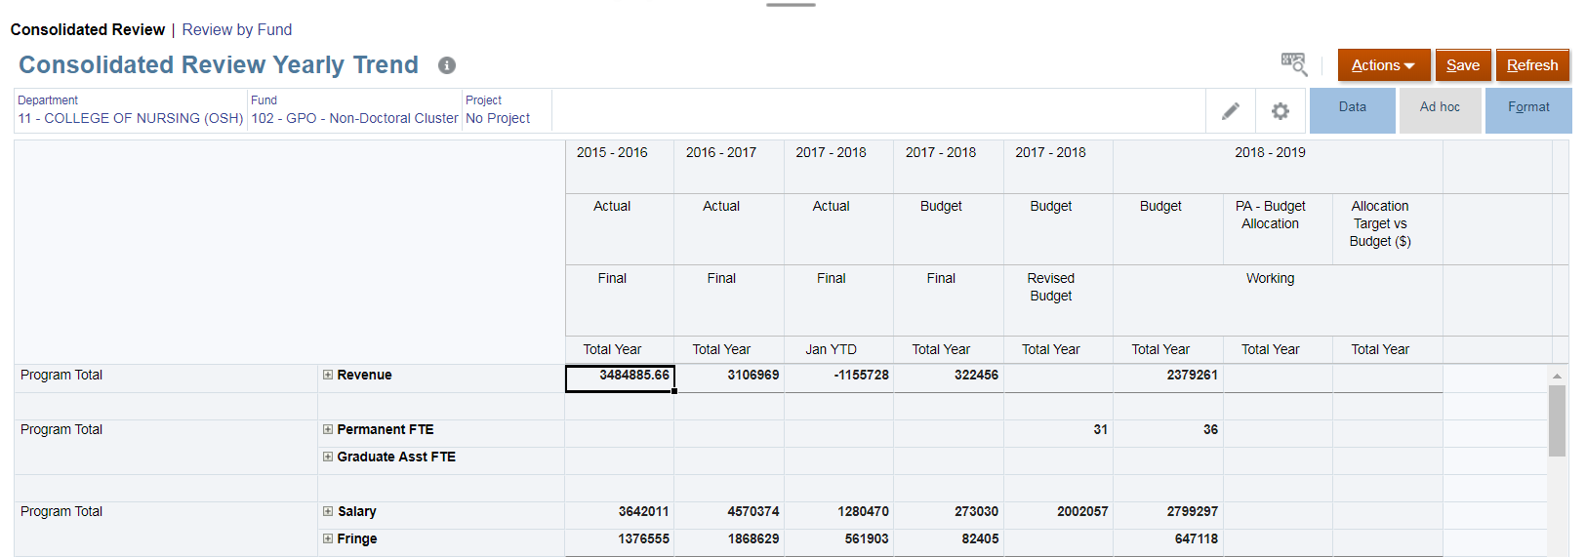
Review Forms
Review forms have been set to read-only (grey cells) and no data can be entered
45

Slide 46
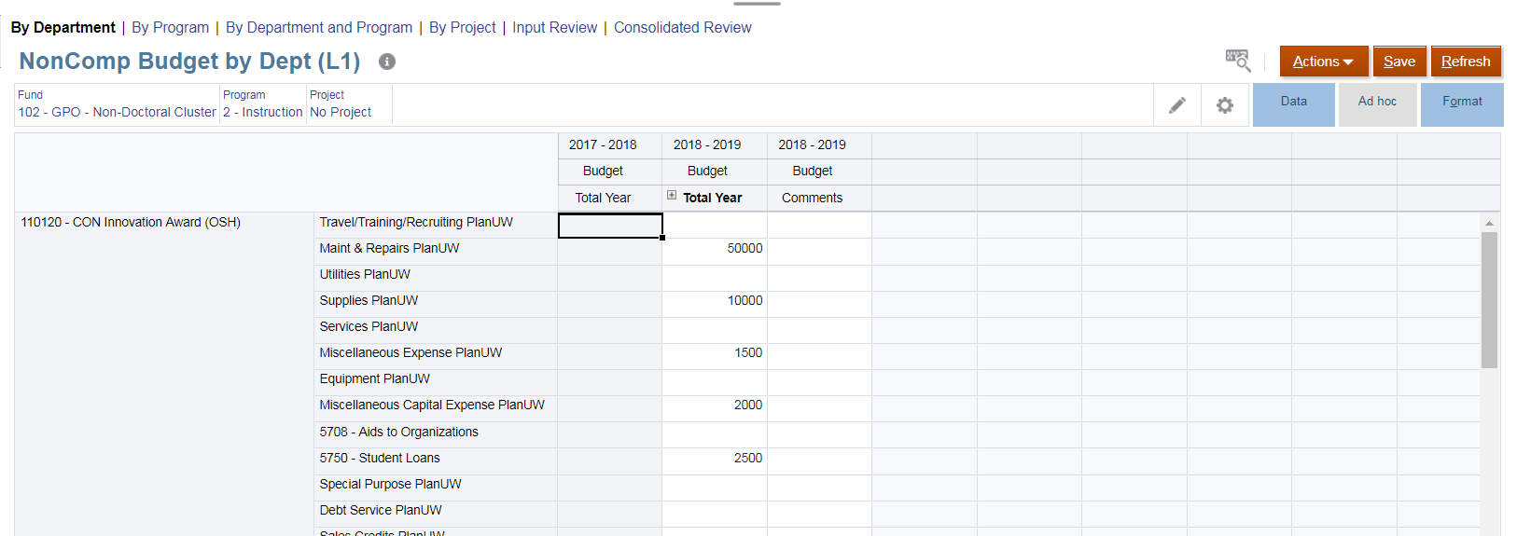
Data Forms
Data forms have cells where budget data can be entered (white cells)

Slide 47
Reports

Slide 48
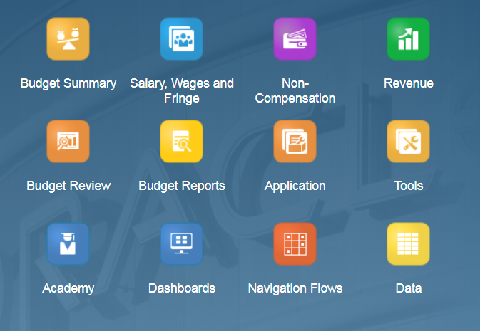
Accessing Reports
Budget Reports are available in the Budget Reports card.
It is important to note that actuals will be loaded monthly to support variance analysis. PlanUW does not support real-time actuals data reporting.
The two broad purposes of any report created in PlanUW are to:
Assist users in the system in building their budgets.
Help consumer users view budget development.
There are seven Budget Reports:
Budget Summary
Expense Budget Report
Budget Review
Salary Review
Summary by Program
Summary by Fund
Summary by Program and Fund
Budget vs Actual
48

Slide 49
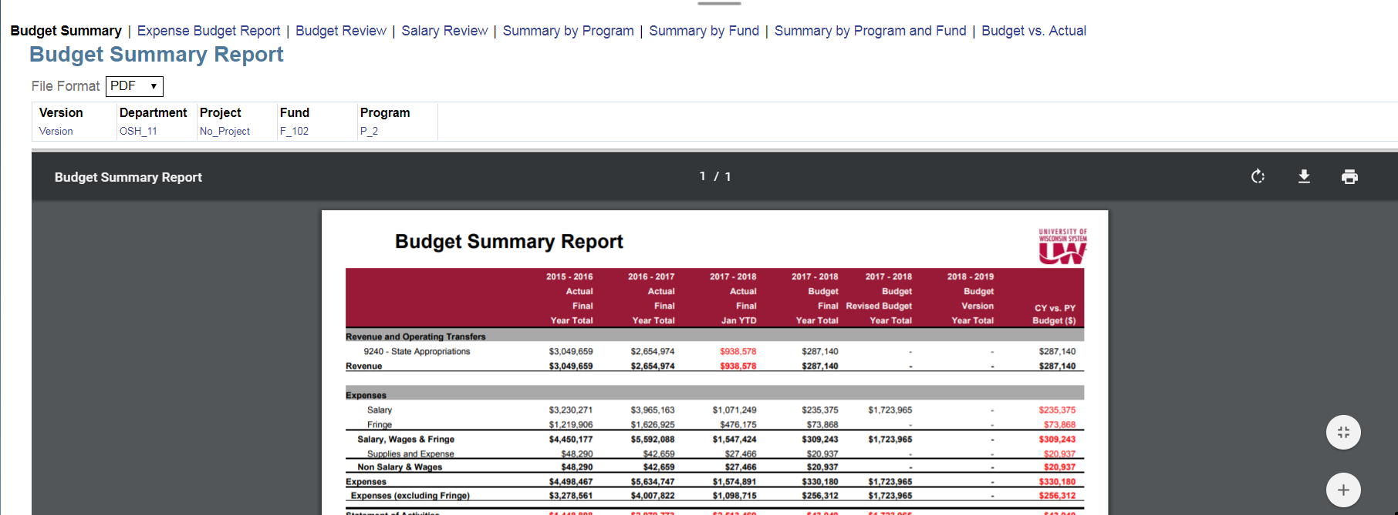
Accessing Reports
Report Tabs
Download
Change File Format
Change POV
Print
By default, reports open in PDF format. PDFs can be downloaded and printed.
The Version can by changed from the Point of View.
Reports can also be opened in HTML and Excel formats.
Additional reports can be accessed by clicking the report tabs.
49

Slide 50
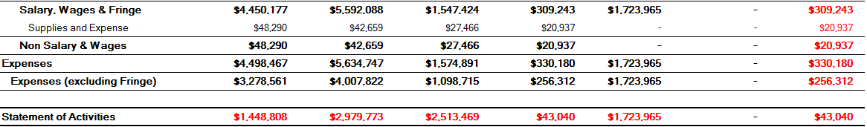
PDF Reports
Once the report is pulled, the bottom part will display the following information:
POV where the report information comes from
Report Name
Who ran the report
Date and Time when the report was pulled
50

Slide 51
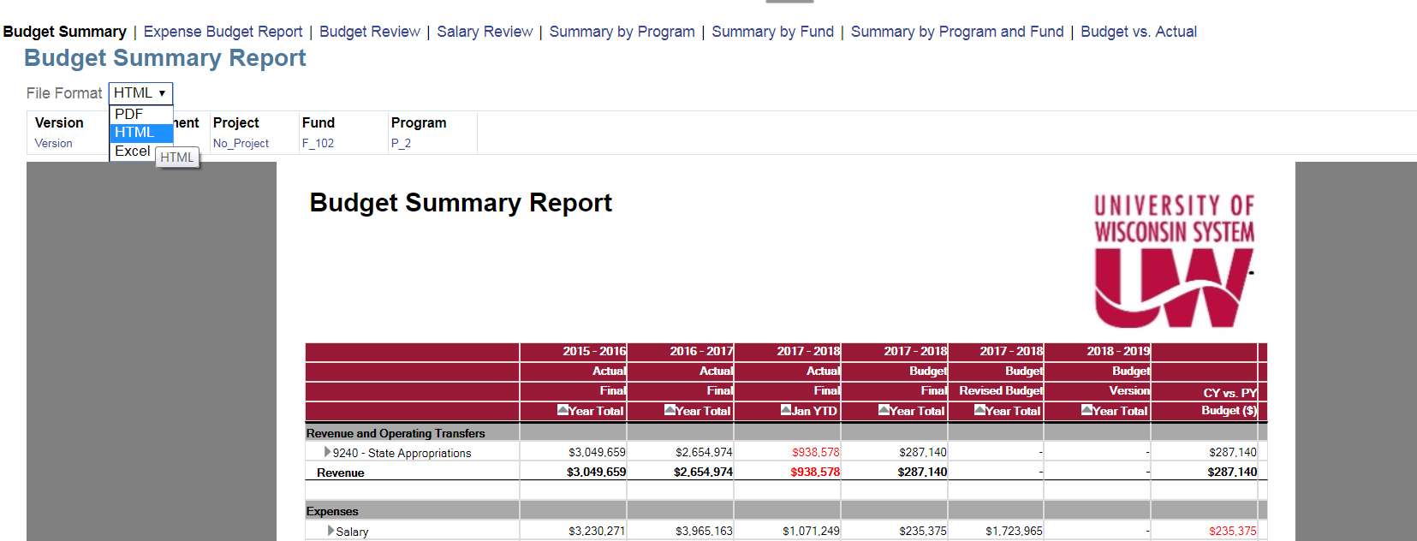
HTML Reports
HTML Format
HTML Reports can be interacted with by expanding the rows and/or columns:
Clicking on the icon provides detailed information on the column.
51

Slide 52
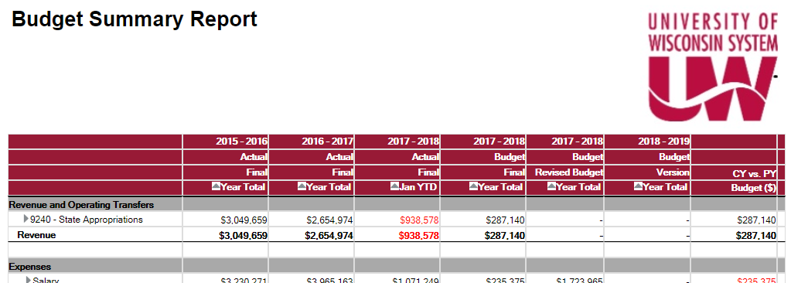

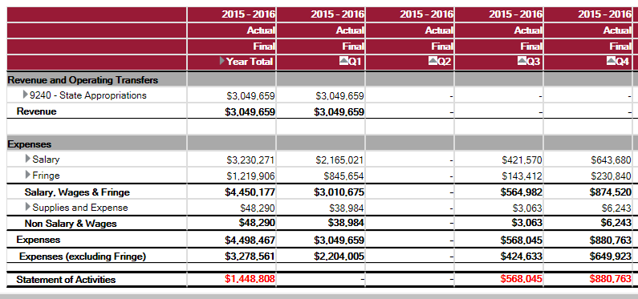
HTML Reports – Drop Down Option Example
2015-2016 Budget Drop-down
By clicking on the drop-down option in the 2015-2016 year, a detailed quarter by quarter report is displayed.
Quarter by quarter displayed

Slide 53
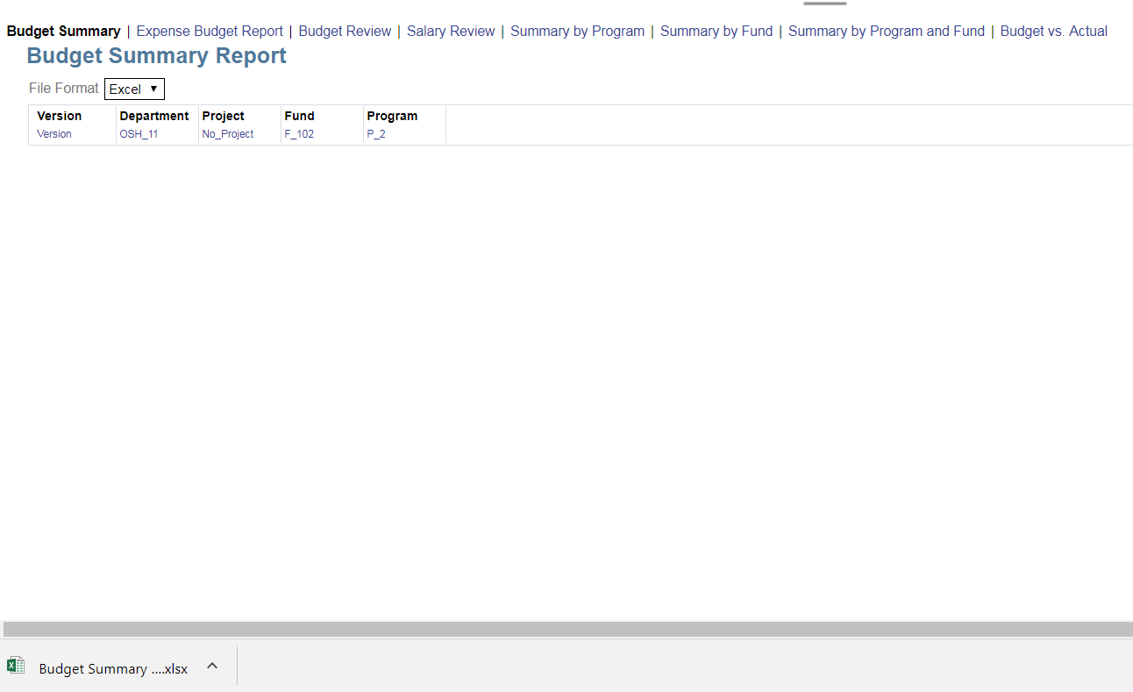
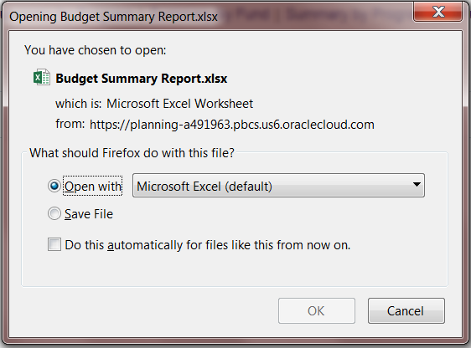
Excel Reports
Excel Reports automatically download.
Depending on the browser used, some users may be required to select the “Open with” option.
53

Slide 54
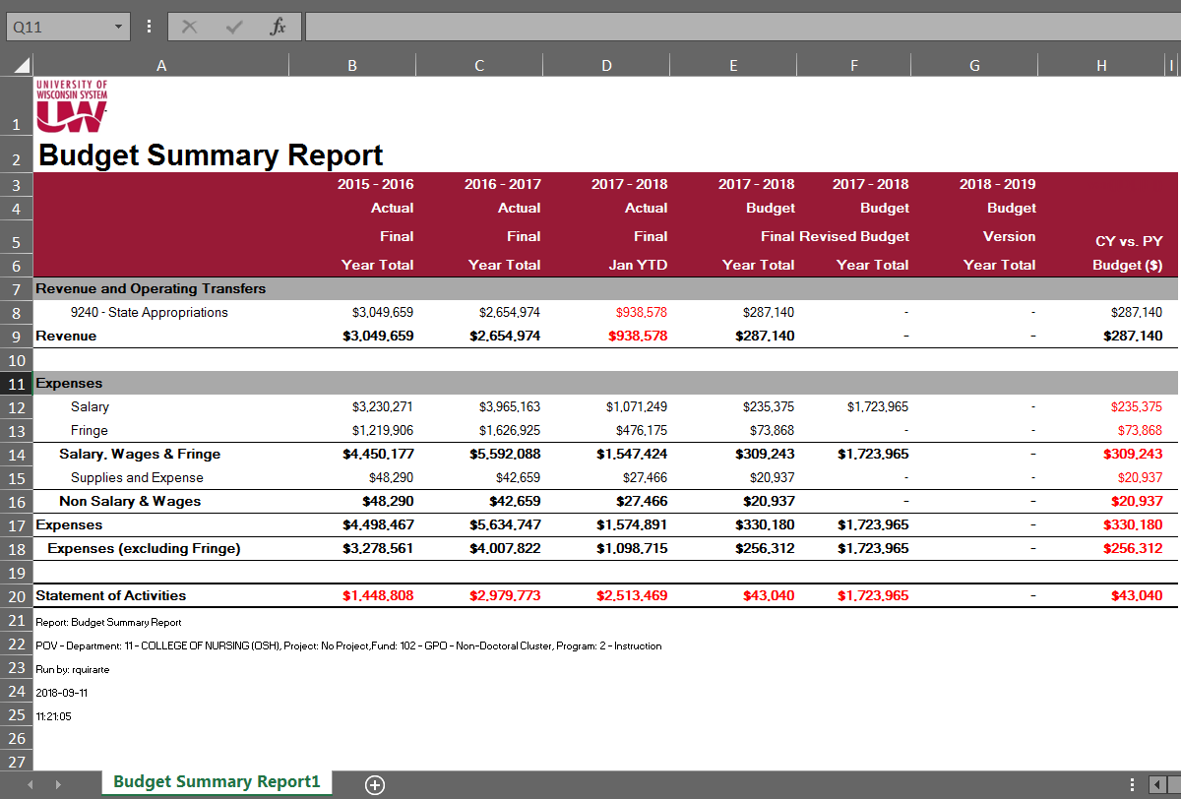
Excel Reports
Once the report is downloaded, the file can be opened to display the Excel report.

Slide 55

Course Summary

Slide 56

Completed Course Objectives
In this course, you learned the skills needed to navigate within the PlanUW system.
After completing this class, you now:
Know how to logging in and access PlanUW
Understand the layout of the home page and forms
Know how to set your system preferences and user variables
Know how to interact with and enter data into forms
Understand advanced data entry features in forms
Know how to access and interact with reports and dashboards
56

Slide 57
Support and Resources
You can use the following resources for reference and support:
This course, located on the UWisconsin System Website/Plan UW: Planning & Budgeting Cloud Service
Project Website: https://www.wisconsin.edu/budget-planning/system-project/
Coworkers and Subject Matter Experts
Available Quick Reference Guides:
  Process KBS
  Reporting KBS
  User Guides
57

