Slide 1

Introduction to PlanUW

Slide 2




Course Objectives
In this course, you will be introduced to the PlanUW system. After completing this course, you will have learned about:
An overview of the PlanUW system
An overview of the features in PlanUW
An overview of the levels and dimensions in PlanUW
Security and User Groups in PlanUW

Slide 3

PlanUW Overview

Slide 4
PlanUW
The University of Wisconsin is leading an effort to modernize its budgeting functions. As a part of the effort, UW has implemented a new system called PlanUW as the platform to support planning and budgeting activities.
PlanUW is a system that will support the business processes related to the University’s budget model and will aid in the creation of budgets. The benefits that PlanUW offers are:
  Reduced time in entering budgets
  Robust reporting, charting, and ad-hoc analysis
  Ease of access
  No downtime
  PlanUW is a cloud product (no maintenance or upgrades needed for patches)

Slide 5




PlanUW
PlanUW provides the institution with the ability to modernize, streamline, simplify, and enhance the University’s integrated budgeting, planning, and forecasting processes through data-driven decision making.
The primary objectives of the PlanUW system are to:
Providing end users a specific set of processes and procedures to perform their annual and multi-year budgeting plans, with the flexibility to grow with the University’s changing needs.
Integrate with existing data sources to provide users with consistent and timely data.
Supply aggregated reporting and analysis of the budget across the University.
Facilitate Budget vs Actual variance analysis and allow for more frequent forecasting updates based on the reallocation of University resources.

Slide 6
New Capabilities
Aggregating
Single source of all budget and planning data (revenue and expenses)
Roll up and drill down to different levels of information (College, Department, Fund, Account, etc.)
Streamlining
Spend more time on analysis than collection
Aggregate budget information quickly and easily
Create repeatable and maintainable import processes for source data used in the budget and planning process (Financials, Project, Foundation, HR)
Ensure data is complete and accurate by using standardized reporting and centralized data collection

Slide 7
Phased Approach
The overall budget redesign project will be completed in various phases.
Upon the completion of Phase I, PlanUW will be further refined and developed as needed to reflect any changes in the University's budgeting process approach, as well as introduce enhanced capabilities into the current model.
Phase 1
Phase 2
Phase 3
PBCS today

Slide 8
What is changing?
Budget Process – What is not changing?
Budget Process – What is changing?
Salary and Wages Budgets in CAT
Planning Allocation tool for Targets
Nightly Reports in InfoAccess
Final Budget Data Load into SFS
BDNS and BSUM will no longer be available in 3270
Budgets will developed utilizing rolled up detailed Account codes including budgeting for Expenditures and Revenue in the PlanUW tool
All SFS Departments ID’s are available for Budgets
New PBCS Reporting Tools (Smart View and Financial Reports)

Slide 9

Features Overview

Slide 10

Features Overview
Within PlanUW, there are a variety of features which have been configured to support the UW planning process. These features include:
Dimensions
Data Forms
Navigation Flows
Business Rules
Variables
Reports
Smart Lists
Note: This section is intended to introduce you to these features. More detailed descriptions and explanations of the features will be provided in later training.

Slide 11
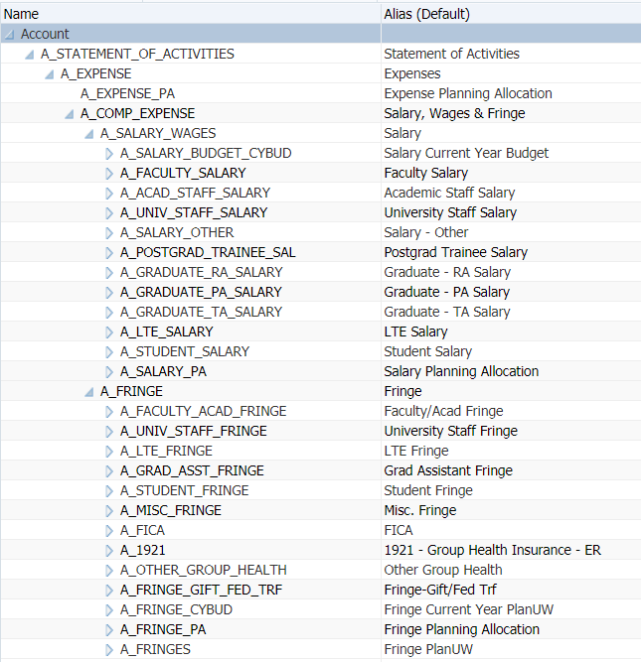

Dimensions
Dimensions are the defining descriptors of all data stored in the system’s database.
Used to categorize data elements required to meet business requirements.
Dimensions serve as the foundation for all other objects used within the application.
A dimension represents the highest consolidation level in PlanUW.
In the example to the right, Account is the dimension.
Note: A more detailed description of dimensions will be provided in the next section of this course.

Slide 12
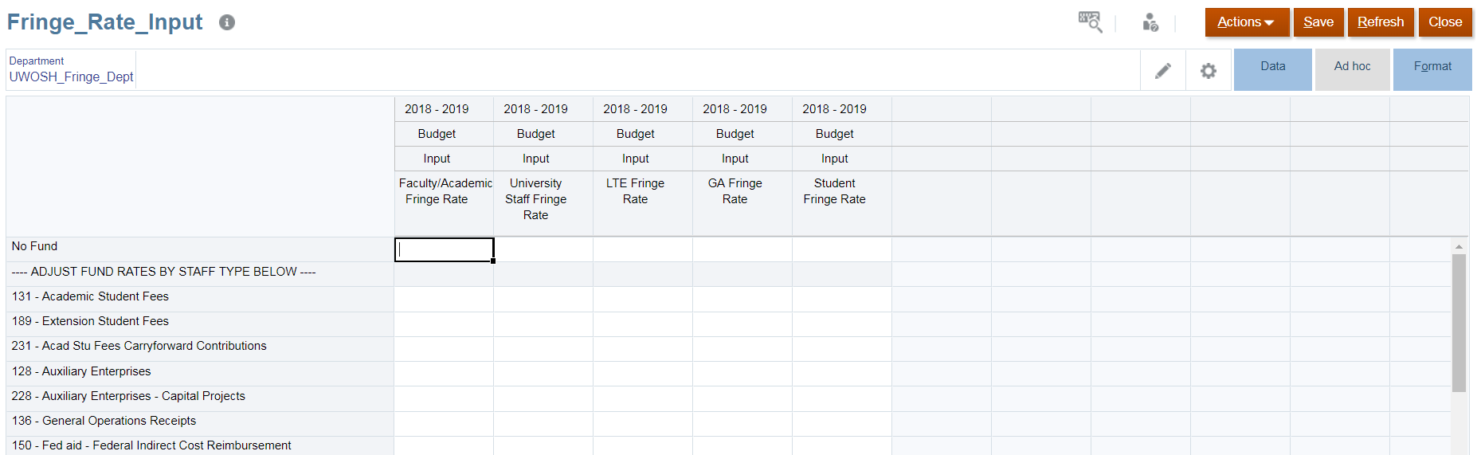
Data Forms
Data Forms are input/review ‘views’ of the PlanUW database.
Allow you to input data at the monthly, quarterly, and year total level, review data, and interactively select what portion of the data set they want to look at in the form (i.e. segments available in drop down menus).
Provide the ability to enter plan data, notes, and attach documents.
Data forms are one of the most essential parts of PlanUW

Slide 13
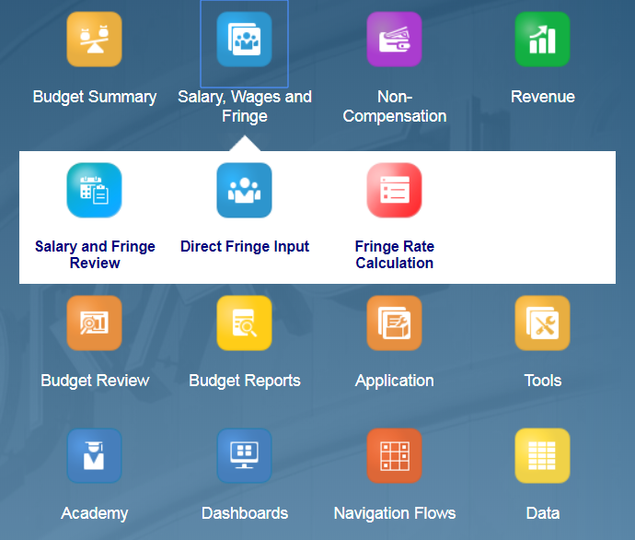
Navigation Flows
Navigation Flows are a grouping of related content such as data forms and dashboards which support the completion of a particular business process.
Example: Salary, Wages and Fringe
The navigation flows in PlanUW provide you with a very simple and streamlined outline and order to each step.

Slide 14
Business Rules
Example of a Business Rule
Salary x Fringe Rate
=
Fringe Amount
Business Rules are calculations which produce an output based upon a pre-determined formula.
These business rules are maintained by the system administrator.

Slide 15
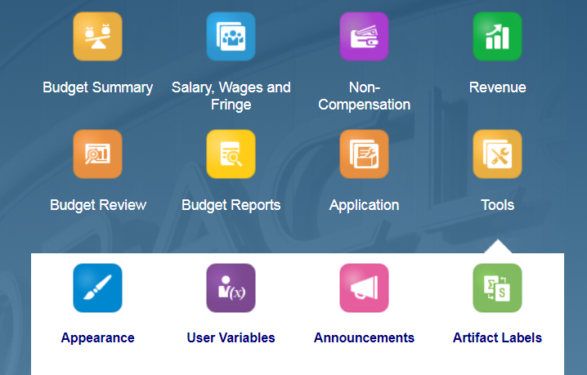
Variables
User Variables are embedded into the design of other objects (forms, business rules, reports, etc.) and are linked to an underlying member (i.e. Budget, Actuals, FY19, etc.).
The list of associated variable members is managed by the system administrator.
The administrator will update the variables within PlanUW on a regular basis.
Variables are essential for developing a renewable planning model with minimal recurring maintenance requirements.

Slide 16
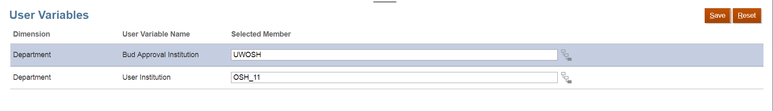
User Variables
User variables act as filters in forms, enabling users to only see data and information that are relevant to them.
Example: You may set your organization user variable to “O_C1200:College of Agriculture & Natural Resources Subdivision” so that you can just see the information related to the College of Agriculture & Natural Resources Subdivision.
User variables only need to be set once, but they can be changed at any time.

Slide 17
Substitution Variables
Example of a Substitution Variable
A substitution variable named CurMth is changed each month by the administrator to reflect the appropriate period. The appropriate field in the data form is updated.
Substitution Variables act as global placeholders for information that changes on a regular basis.
A substitution variable can have one value or a range of values (i.e. “Sep”:”Oct”).

Slide 18
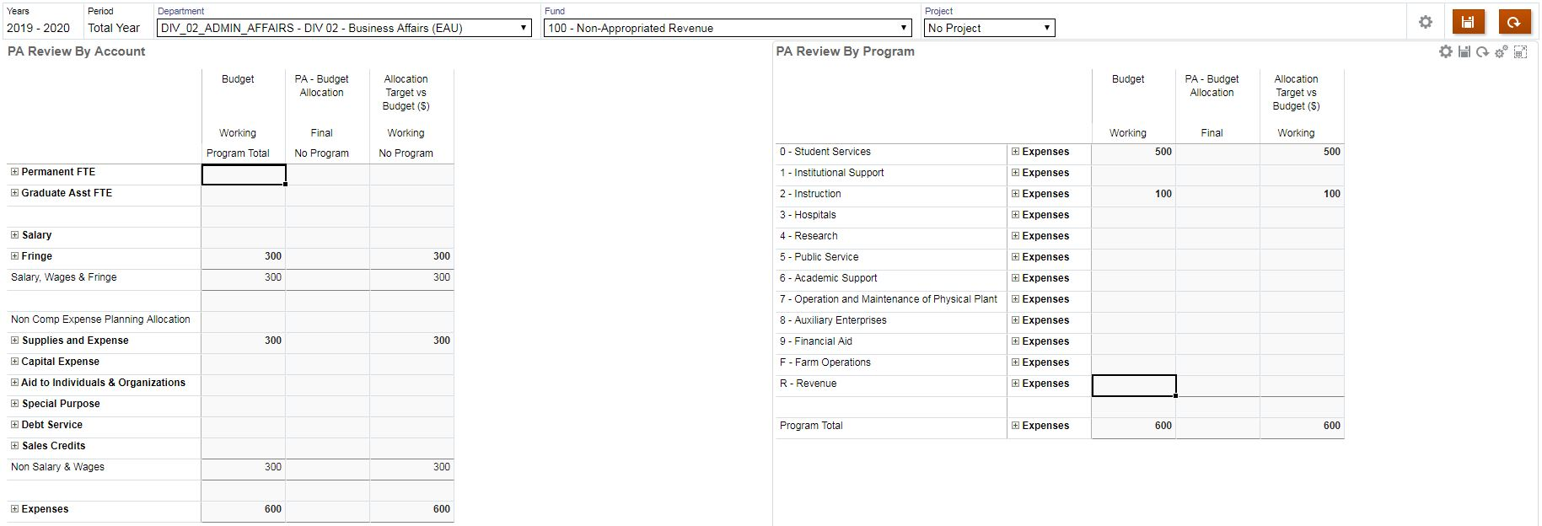

Dashboards
Dashboards provide users with visual representations of their budget/forecast data.
Dashboards available in PlanUW include a variety of chart/graph types, and can be created on any data saved within the application’s database.
Dashboard results will be updated with the latest data in the system as it is entered by users or loaded from other organizational source systems.
Dashboards can only be created by Administrator and Power Users.

Slide 19
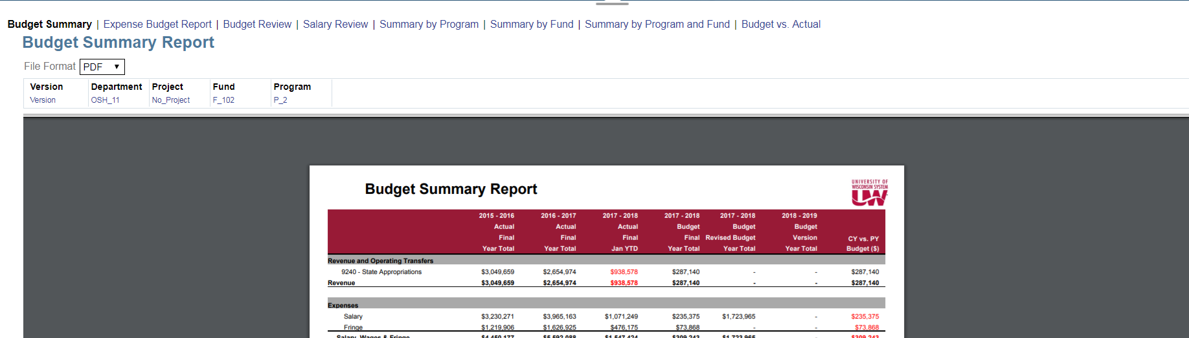
Reports
Reports in PlanUW connect directly to the database and can be downloaded in a variety of formats (Excel, PDF, HTML).
The two broad purposes of any report created in PlanUW are to:
Assist users in the system in building their budgets and forecasts
Help consumer users view budget and forecast development.

Slide 20

Dimensions Overview

Slide 21

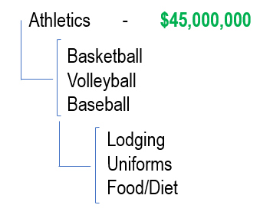
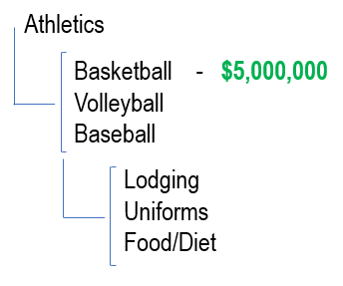
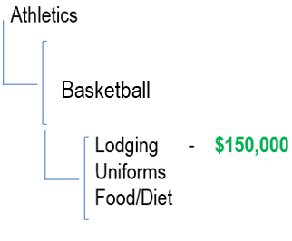
Budgeting Levels Example
With the implementation of PlanUW for the 2019-20 annual budget, institutional budgets will be much more granular. Institutions will have the option of three different levels of detail to which they can budget. For example:
EXAMPLE 1
EXAMPLE 2
EXAMPLE 3
Budgeting $45,000,000 for the entire Athletics department to fund all Basketball, Volleyball, and Baseball Lodging, Uniforms, and Food/Diet. Here’s the structure and string:
Budgeting $5,000,000 for the Basketball department for Lodging, Uniforms, and Food/Diet. This is what the levels would look like along with the budgeting string:
Budgeting $150,000 for Lodging for the Basketball team. This is what the levels would look like along with the budgeting string:

Slide 22
Budgeting CoA Background – Pre-Work
Before
Budgets were developed in 3270 only with Major Class accounts such as Total Fringe, Total S&E, etc.
There was no Revenue Budgeting
Issue
3270 accounts – Too High Level – Lead to a lack of meaningful budget analysis
SFS GL accounts – Too Detailed for Most Institutions – Using these accounts for planning and budgeting would be time consuming and cumbersome
Lack of consensus on how much detail, is the right amount of detail between institutions
Solution
A new Budget CoA was finalized in 2017 during the BPFS Planning / Pre-work phase. This tree:
  Is consistent across every Institution in the UW System
  Was developed in SFS to source into the PlanUW application. It is called PLANUW_BUDGET_ACCT
  Contains accounts for Revenue
  Has Account code rollups between the Major Classes and GL account levels
  Was specifically designed to allow inputs at different account levels along the hierarchy to provide institutions the flexibility and choice to budget at a detailed or higher levels

Slide 23
Budget CoA Background - Levels
Level 1
Highest Level of Budget Input
“Required” Level
Level 2
An intermediate level in between the GL accounts and level 1
Level 3
The lowest (or most granular) level available for Non Comp and Revenue budgeting, and will contain exclusively GL accounts from SFS
Level 4
The lowest (or most granular) level available for Fringe budgeting, and will contain exclusively GL accounts from SFS
There are Four specific account levels in Plan UW

Slide 24
Budget CoA Background – Account Categories
 | Salary | Fringe | Non-Comp | Revenue
Level 1 | #N/A Budgeted in CAT | 1 | 16 | 51
Level 2 |  | 10 | 41 | 60
Level 3 |  | 19 | 241 | 273
Level 4 |  | 62

Slide 25
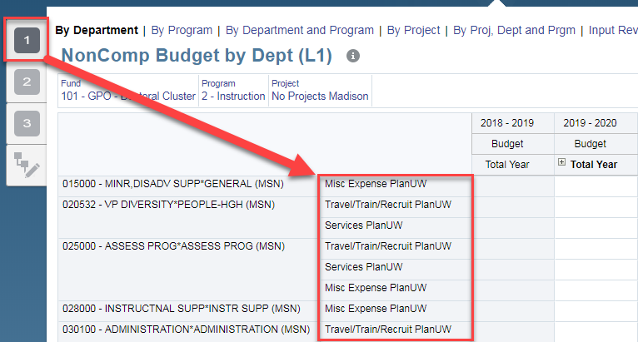
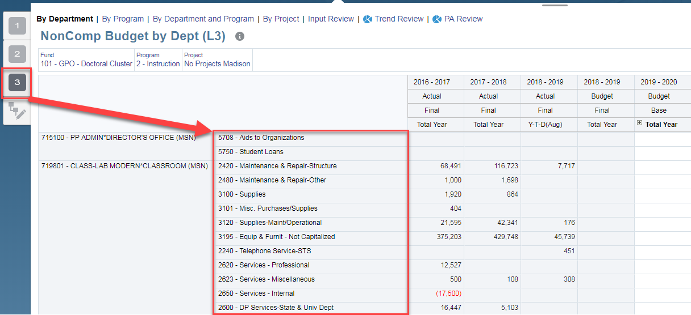
Webforms – Nav Flows
The webforms in PlanUW are organized by the level of accounts they contain
Level 1
Level 3

Slide 26
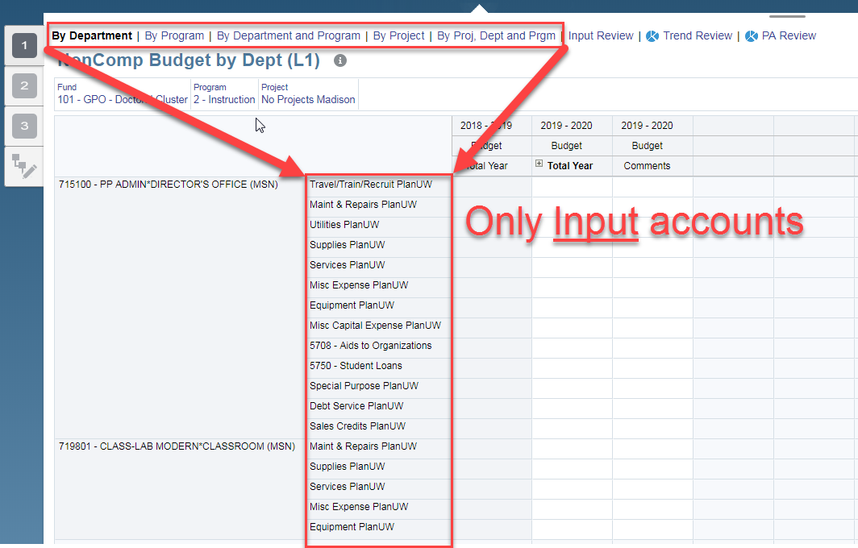
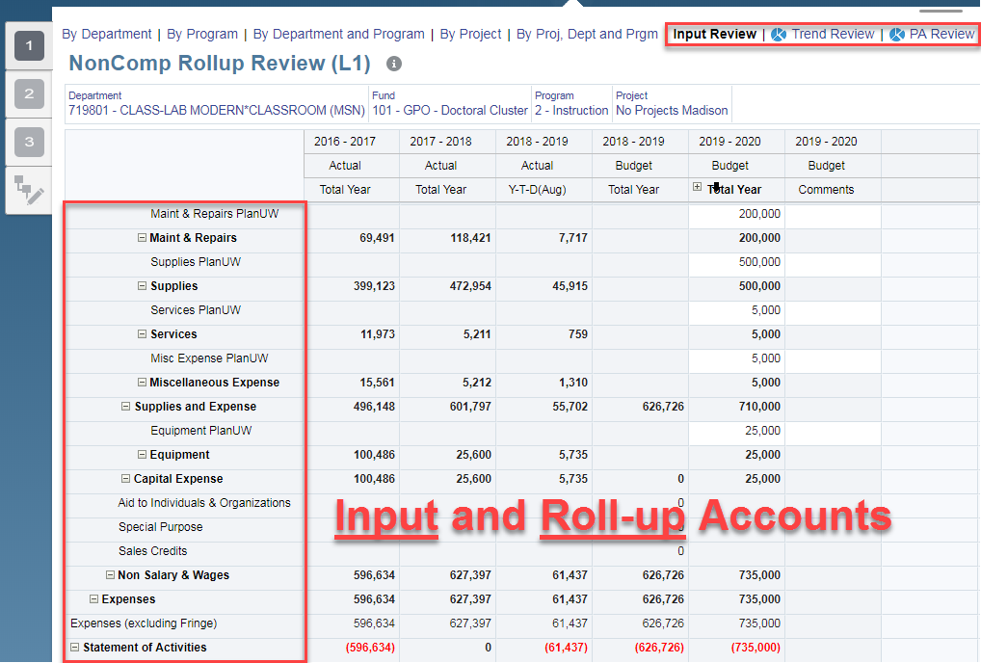
Webforms - Rollup accounts vs. Input accounts
Plan UW and GL accounts are Input accounts. Rollup accounts aggregate the Plan UW and GL accounts underneath them.

Slide 27
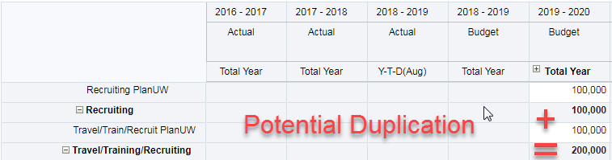
Budget CoA Levels – FAQ
Can I use multiple levels to build my budget?
Yes – you can use different levels to build your budget, but it is important to understand why and where you are using different levels.
Anything to watch out for when using multiple levels?
Be careful to not unintentionally enter the same budget data using different levels
Example – Do not budget $100k for “Travel/Train/Recruit Plan UW” AND “Recruiting Plan UW” if it truly represents the same Budget

Slide 28
Budget CoA Levels – FAQ cont
Do inputs at different levels overwrite each other?
No – An input into the “Travel/Train/Recruit Plan UW” Level 1 account will not overwrite an entry in the “Recruiting Plan UW” Level 2 account
Can I use multiple levels and utilize the higher Levels as “other” accounts?
Yes - But again, it is important to understand and coordinate where you are doing this
Are certain accounts being used in multiple levels?
Yes - To ensure that users can build a comprehensive budget without having to cross levels, higher level accounts (levels 1 and 2) are used in lowers levels when they don’t have the same level of detail as other account rollups.
  For example, Maint & Repairs PlanUW is included in level 1 and 2
Also, GL accounts can exist at higher levels (such as 1 or 2) when they are the highest required level one needs to budget at. No Plan UW accounts were created in these cases.
  For example, 3790 - Material for Resale is included in level 1, 2 and 3

Slide 29
Budget CoA Levels – FAQ cont
What levels are actuals from SFS getting loaded to:
Actual data is getting loaded to the GL level (level 3 for NonComp and Revenue, and level 4 for Fringe)
Can Actual data be mapped to the higher levels allowing me to see Actual data in the Input forms I use?
To keep a standard design among institutions, this was not included in the Phase 1 requirements or design. Please coordinate with system if this is an enhancement you may wish to pursue in the future.
I know I will not use certain levels for certain accounts. Can we apply security to prevent user input?
Please coordinate with system on potential security changes. Applying security to the account dimension may be complex. However, applying security to prevent users from seeing forms is much simpler and easier to maintain.
How will the new Budget vs. Actuals Reporting from WISDM?
The new Budget account tree will be added to WISDM to ensure proper Budget reporting capabilities

Slide 30

Salary and FTE Accounts

Slide 31
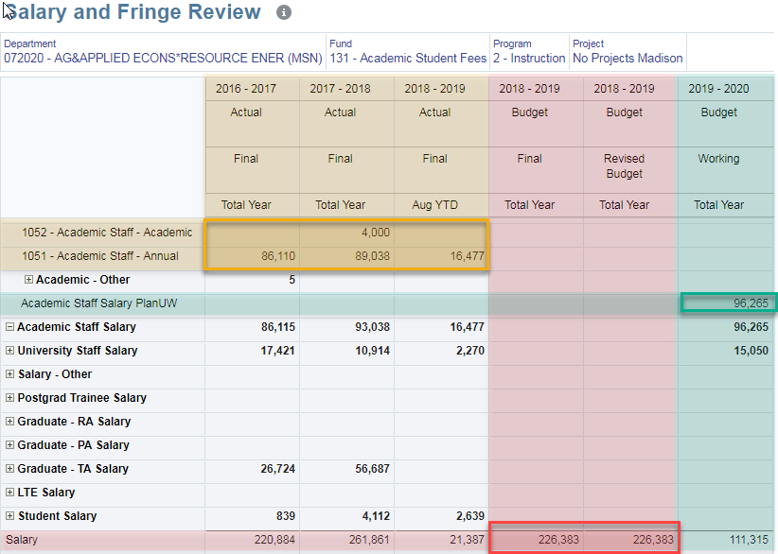
Salary
Since Salary data will be input from CAT, the accounts will not be input into. Thus no input level distinction is necessary
Actual data is loaded to the GL accounts from SFS
The Redbook budget will be loaded to a Total Salary account
Working Budget data is loaded to the PlanUW accounts from CAT

Slide 32
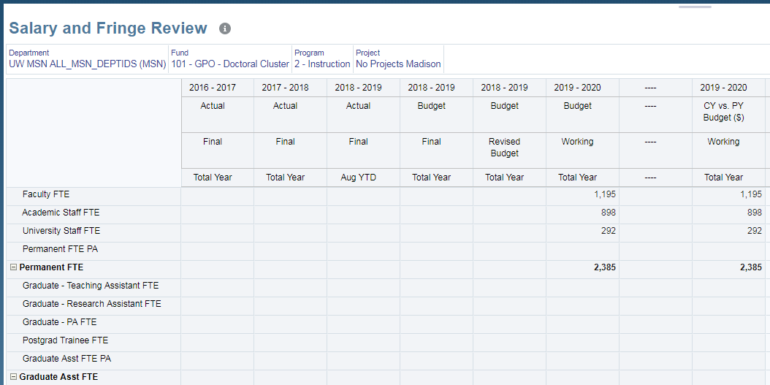
FTE
FTE data will be input from CAT as well

Slide 33

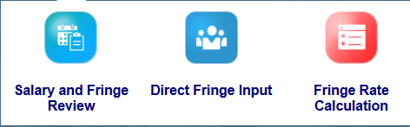
Fringe Accounts

Slide 34
Fringe Levels
Level 1
1 Account
FRINGE PLANUW
Level 2
10 Accounts
Rate Driven Option by 5 Position accounts OR Input
Level 3
19 Accounts
FICA, Group Health and Misc. Fringe by Position
Level 4
62 accounts
All G/L Accounts

Slide 35
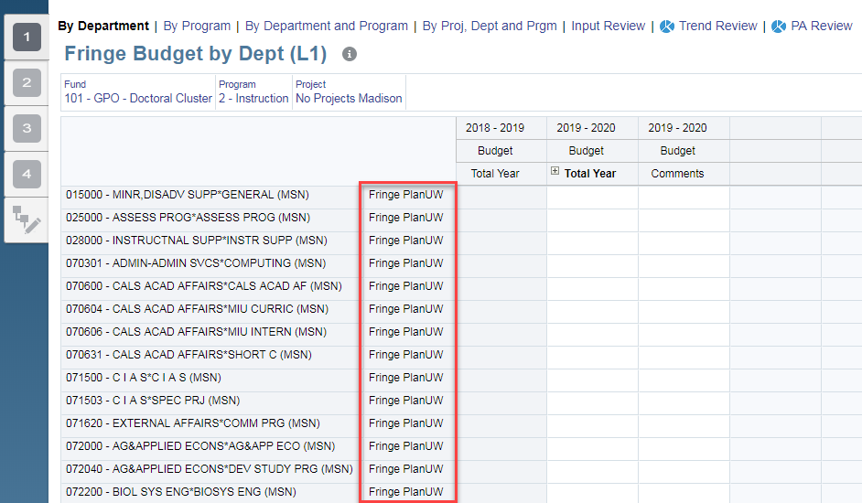
Fringe – Level 1
INPUT ONLY
Four levels exist in Fringe because, unlike the Non-Compensation and Revenue Categories, there is one total Fringe input account.
Level 1 only has one account:
Fringe Input Plan UW

Slide 36
Fringe – Level 2
RATE DRIVEN OR OUTPUT
The driver-based calculation by fringe rate can be used at level 2 to calculate Fringe amounts by Position.
5 out of the 10 Level 2 Fringe accounts are included in the fringe calculation:
  Faculty/Acad Fringe Input
  University Staff Misc. Fringe Input
  LTE Fringe Input
  Grad Assistant Fringe Input
  Student Fringe Input
The other 5 Level 2 Fringe accounts are not driven by the calculation because they are not grouped by position:
  Misc. Fringe Input
  FICA Input
  1921 - Group Health Insurance - ER
  Other Group Health Input
  Fringe-Gift/Fed Trf Input
 | Included in Rate Driven method?
Faculty/Acad Fringe | Yes
University Staff Misc. Fringe | Yes
LTE Fringe | Yes
Grad Assistant Fringe | Yes
Student Fringe | Yes
Misc. Fringe | No
FICA | No
1921 - Group Health Insurance - ER | No
Other Group Health | No
Fringe-Gift/Fed Trf | No

Slide 37
Fringe – Level 3
INPUT ONLY
Level 3 Fringe provides the ability to Input by Positions 1-5 above by:
  Group Health
  FICA
  Misc
Note: Student Fringe only has FICA
The 5 input accounts from level 2 that are not broken down by position exist at level 3 as well:
  Misc. Fringe Input
  FICA Input
  1921 - Group Health Insurance - ER
  Other Group Health Input
  Fringe-Gift/Fed Trf Input
 | Group Health | FICA | Misc.
Faculty/Acad Fringe | X | X | X
University Staff Misc. Fringe | X | X | X
LTE Fringe | X | X | X
Grad Assistant Fringe | X | X | X
Student Fringe |  | X

Slide 38
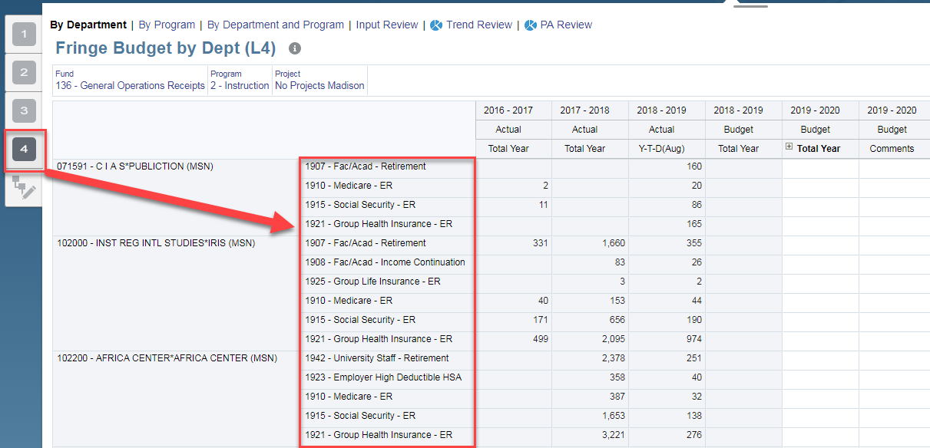
Fringe – Level 4
INPUT ONLY
Level 4 is the lowest (or most granular) level available for Fringe budgeting, and will contain exclusively GL accounts from SFS.

Slide 39
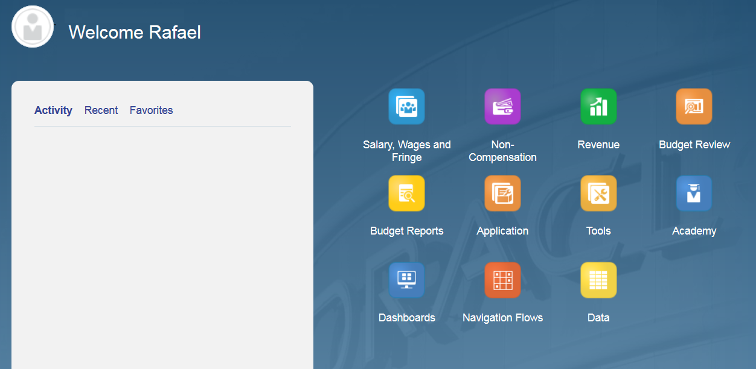
Non Comp Accounts

Slide 40
Non Compensation Levels
Level 1
16 Accounts
Level 2
42 Accounts
Level 3
241 Accounts
All GL Accounts

Slide 41
Non Compensation Expenditures
There are 16 required Level 1 accounts for Non Comp Expenditures
 |  |  |  | # of Accounts at each Level
# | Account | Major Class | Unique Levels | 1 | 2 | 3 | Account overlap?
1 | 3790 - Material for Resale | Supplies and Expense | 1 | 1 | 1 | 1 | Full Overlap at levels 1, 2 & 3
2 | Travel/Train/Recruit PlanUW | Supplies and Expense | 3 | 1 | 3 | 64 | No Overlap
3 | Maint & Repairs PlanUW | Supplies and Expense | 2 | 1 | 1 | 6 | Full Overlap at levels 1 & 2
4 | Utilities PlanUW | Supplies and Expense | 3 | 1 | 3 | 9 | Partial Overlap at levels 1 & 2
5 | Supplies PlanUW | Supplies and Expense | 2 | 1 | 1 | 13 | Full Overlap at levels 1 & 2
6 | Services PlanUW | Supplies and Expense | 3 | 1 | 7 | 31 | Partial Overlap at levels 2 & 3
7 | Misc Expense PlanUW | Supplies and Expense | 3 | 1 | 12 | 53 | No Overlap
8 | Equipment PlanUW | Capital Expense | 2 | 1 | 1 | 11 | Full Overlap at levels 1 & 2
9 | Misc Capital Expense PlanUW | Capital Expense | 3 | 1 | 4 | 23 | Partial Overlap at levels 1 & 2
10 | 5708 - Aids to Organizations | Aid to Individuals & Organizations | 2 | 4 | 4 | 21 | Full Overlap at levels 1 & 2 Partial Overlap at levels & 3
11 | 5750 - Student Loans
12 | Other Aids PlanUW
13 | Fellows & Scholars PlanUW
14 | Special Purpose PlanUW | Special Purpose | 3 | 1 | 2 | 3 | Partial Overlap at levels 2 & 3
15 | Debt Service PlanUW | Debt Service | 2 | 1 | 1 | 2 | Full Overlap at levels 1 & 2
16 | Sales Credits PlanUW | Sales Credits | 2 | 1 | 1 | 2 | Full Overlap at levels 1 & 2

Slide 42
Non Compensation Expenditures - Material for Resale
Major Class: Supplies and Expense
Unique Levels | 1
Level 1 accounts | 1
Level 2 accounts | 1
Level 3 accounts | 1
Account Overlap | Yes
Full or Partial Overlap? | Full
Levels with Overlap? | 1, 2 & 3
Full Overlap at levels 1, 2 & 3
Implication: It doesn’t matter what level you use. Budgeting for this required account will be the same.

Slide 43
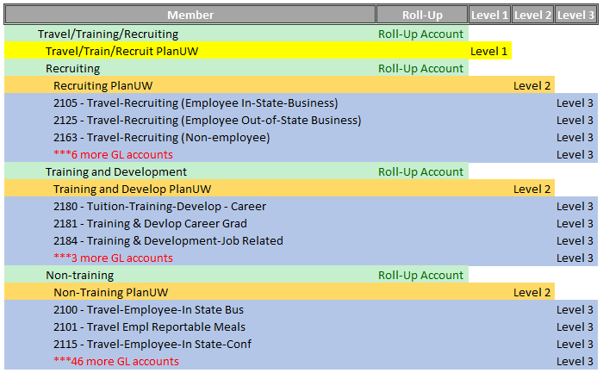
Non Compensation Expenditures – Travel/Training/Recruiting
Supplies and Expense
Unique Levels | 3
Level 1 accounts | 1
Level 2 accounts | 3
Level 3 accounts | 64
Account Overlap | No
Full or Partial Overlap? | #N/A
Levels with Overlap? | #N/A
No Overlap
Implication: This is the most straight forward case. Each has a completely unique set of accounts.

Slide 44
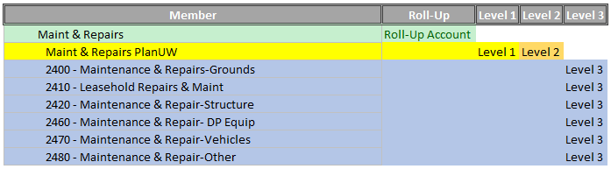
Non Compensation Expenditures - Maintenance & Repairs
Supplies and Expense
Unique Levels | 2
Level 1 accounts | 1
Level 2 accounts | 1
Level 3 accounts | 6
Account Overlap | Yes
Full or Partial Overlap? | Full
Levels with Overlap? | 1 & 2
Full Overlap at levels 1 & 2
Implication: It doesn’t matter if you use level 1 or 2. Budgeting for this rollup will be the same.

Slide 45
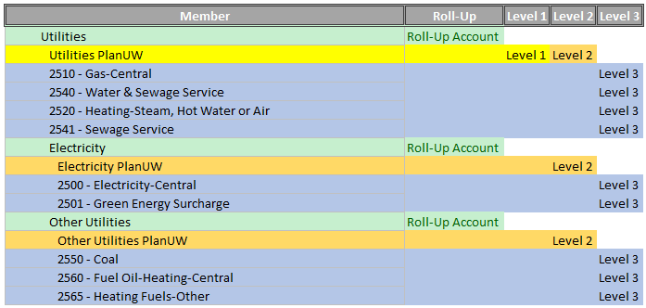
Non Compensation Expenditures - Utilities
Supplies and Expense
Unique Levels | 3
Level 1 accounts | 1
Level 2 accounts | 3
Level 3 accounts | 9
Account Overlap | Yes
Full or Partial Overlap? | Partial
Levels with Overlap? | 1 & 2
Partial Overlap at levels 1 & 2
Implication: Using Level 1 vs. 2 may change the meaning of the budgeted amount in the Utilities PlanUW account depending on your processes. At Level 1, the budgeted amount accounts for the full Utilities budget. However, if you use the same account at Level 2, you are implying budgeted amount only accounts for the 4 GL accounts: 2510, 2540, 2520, and 2541.

Slide 46
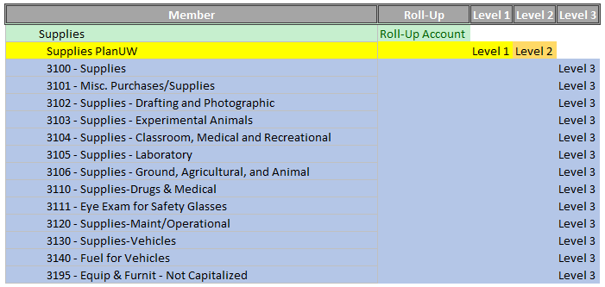
Non Compensation Expenditures - Supplies
Supplies and Expense
Unique Levels | 2
Level 1 accounts | 1
Level 2 accounts | 1
Level 3 accounts | 13
Account Overlap | Yes
Full or Partial Overlap? | Full
Levels with Overlap? | 1 & 2

Slide 47
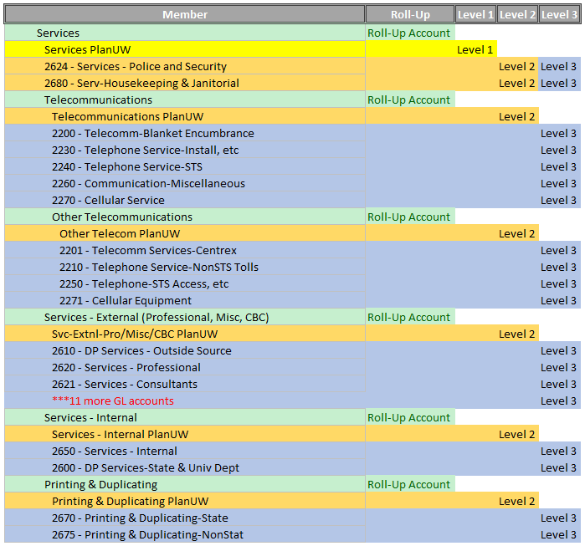
Non Compensation Expenditures - Services
Unique Levels | 3
Level 1 accounts | 1
Level 2 accounts | 7
Level 3 accounts | 31
Account Overlap | Yes
Full or Partial Overlap? | Partial
Levels with Overlap? | 2 & 3
Partial Overlap at levels 2 & 3
Implication: Unlike the partial overlap between Level 1 and 2, using Level 2 vs. 3 does not change the meaning of the budgeted amount in accounts 2624 or 2680 as they are both distinct GL accounts. The choice between budgeting at levels 2 and 3 simply implies what level of granularity you wish to use for the other services rollups.

Slide 48
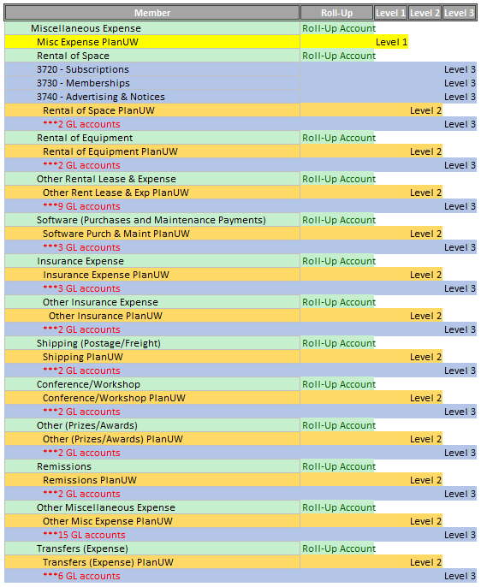
Non Compensation Expenditures – Misc. Expense
Supplies and Expense
Unique Levels | 3
Level 1 accounts | 1
Level 2 accounts | 12
Level 3 accounts | 53
Account Overlap | No
Full or Partial Overlap? | #N/A
Levels with Overlap? | None

Slide 49
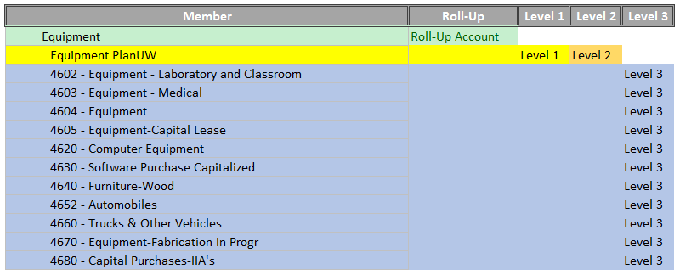
Non Compensation Expenditures – Equipment
Capital Expense
Unique Levels | 2
Level 1 accounts | 1
Level 2 accounts | 1
Level 3 accounts | 11
Account Overlap | Yes
Full or Partial Overlap? | Full
Levels with Overlap? | 1 & 2

Slide 50
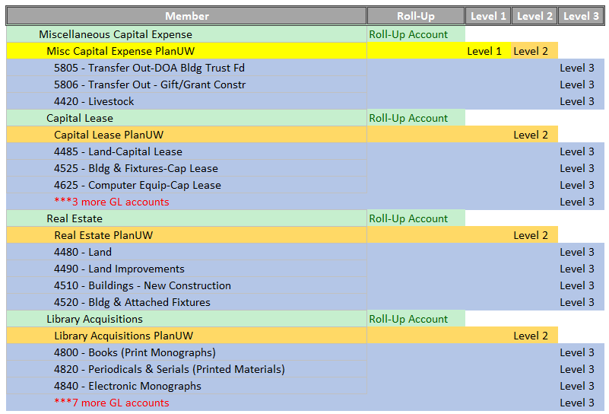
Non Compensation Expenditures – Misc. Capital Expense
Capital Expense
Unique Levels | 3
Level 1 accounts | 1
Level 2 accounts | 4
Level 3 accounts | 23
Account Overlap | Yes
Full or Partial Overlap? | Partial
Levels with Overlap? | 1 & 2

Slide 51
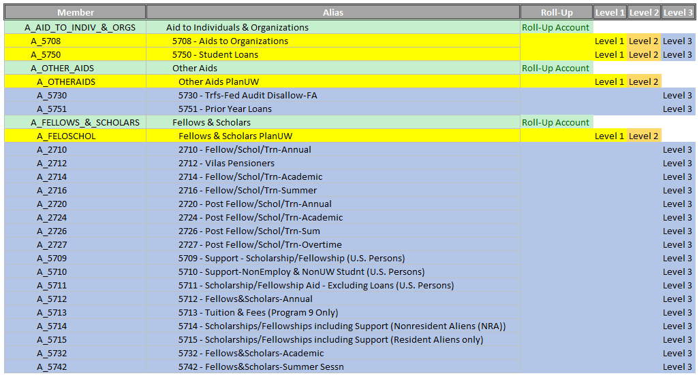
Non Compensation Expenditures – Aid to Indv. & Orgs
Aid to Individuals & Organizations
Unique Levels | 2
Level 1 accounts | 4
Level 2 accounts | 4
Level 3 accounts | 21
Account Overlap | Yes
Full or Partial Overlap? | Both
Levels with Overlap? | 1, 2 & 3
Full Overlap at levels 1 & 2
Partial Overlap at levels 2 & 3
Implication: Just like the partial overlap between Levels 2 and 3, using Level 1 vs. 2 vs. 3 does not change the meaning of the budgeted amount in accounts 5708 or 5750 as they are both distinct GL accounts. The choice between budgeting at levels 1, 2 and 3 simply implies what level of granularity you wish to use for the other aids rollups, and if you have amounts for those rollups.

Slide 52
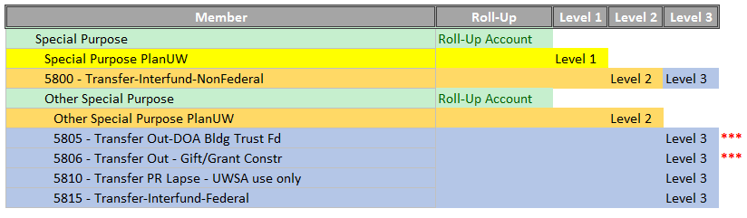
Non Compensation Expenditures – Special Purpose
Special Purpose
Unique Levels | 3
Level 1 accounts | 1
Level 2 accounts | 2
Level 3 accounts | 3
Account Overlap | Yes
Full or Partial Overlap? | Partial
Levels with Overlap? | 2 & 3

Slide 53
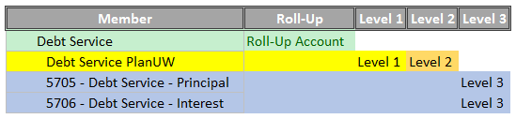
Non Compensation Expenditures – Debt Service
Debt Service
Unique Levels | 2
Level 1 accounts | 1
Level 2 accounts | 1
Level 3 accounts | 2
Account Overlap | Yes
Full or Partial Overlap? | Full
Levels with Overlap? | 1 & 2

Slide 54
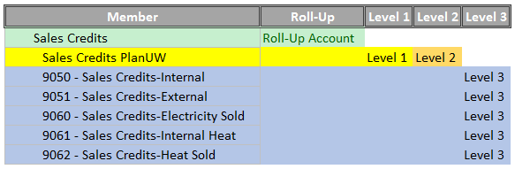
Non Compensation Expenditures – Sales Credits
Sales Credits
Unique Levels | 2
Level 1 accounts | 1
Level 2 accounts | 1
Level 3 accounts | 2
Account Overlap | Yes
Full or Partial Overlap? | Full
Levels with Overlap? | 1 & 2

Slide 55
Revenue Accounts

Slide 56
Revenue Levels
Level 1
51 Accounts
Level 2
60 Accounts
Level 3
273 Accounts
All GL Accounts

Slide 57
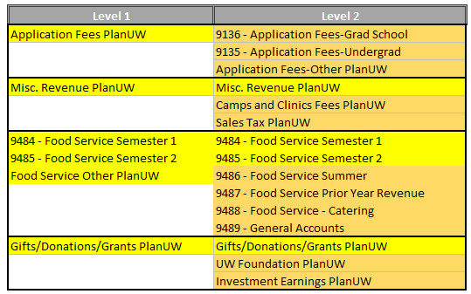
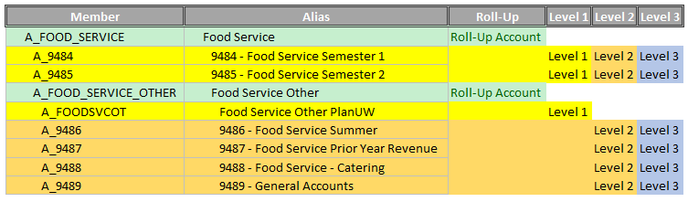
Revenue
There are only 11 Revenue accounts that exist at Level 2, but not at Level 1 (highlighted in Orange in the table below). These level 2 accounts provide more detail for:
  Application Fees
  Misc. Revenue
  Food Service, and
  Gifts/Donations/Grants
Example:

Slide 58
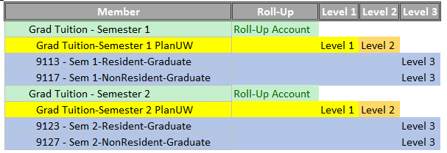
Revenue – Cont.
This means that there is no difference between budgeting at Level 1 or at Level 2 for:
  Tuition
  Misc. Fees
  Segregated Fees
  Continuing Ed Fees
  Housing Revenue
  Parking Revenue, and
  Textbook Sales & Rental

Slide 59
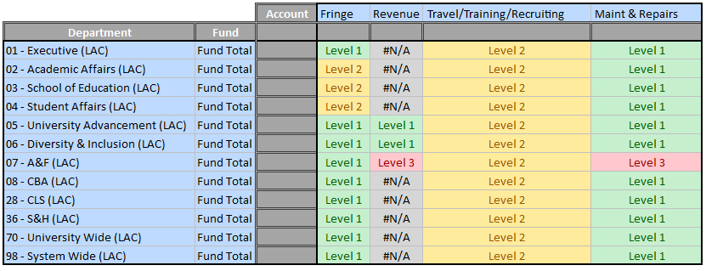
What Levels Should I Use?
There are no requirements from system, so the decision falls to the Institutions - But how do I go about deciding?
Recommendation – Use the Budget Account Level Documentation to develop a matrix about what levels you plan to use by the account categories, divisions, funds, etc. – Go as granular or High level as you would like or need!
An example may look like the following:
This is not required, and there is no set format to use, but this exercise may help Institutions in deciding what levels to use for what.

Slide 60
Dimensions

Slide 61
Dimension Design – All Dimensions
Dimension Name | Naming Convention Examples | Brief Description
Period | Name: Jul, Q1, YearTotal Alias: July, Qtr1, TotalYear | Months, Quarters, YearTotal, YTD, QTD
Account | Name: A_1002 Alias: 1002 – Faculty - Academic | The account dimension represents categorization of revenue, expenditures, and statistical accounts
Years | Name: FY18 Alias: 2017 - 2018 | Fiscal Year
Version | Name: Working Alias: Working | Works in conjunction with the Scenario dimension to provide the ultimate flexibility
Scenario | Name: Budget Alias: Budget | The scenario dimension is used to capture categories of data, for example budget load or budget transfers. It is possible to support multiple segmentations of budget prior to submission as part of the foundational design
Department | Name: WTW_101000 Alias: 101000 - Chancellor’s Office (UWWTW) | Departments represent unique academic or operational units. The current department naming convention is referred to as the UDDS which stands for Unit, Division, Department, Sub-Department
Fund | Name: F_101 Alias: 101 - GPO – Doctoral Cluster | Funds segregate financial information for the purpose of carrying on specific activities and categorizes the characteristics and limitations placed on resources recorded in the accounts
Program | Name: P_0 Alias: 0 - Student Services | Programs identify specific institutional or departmentally designated initiatives that are tracked at a level of detail not supported via departments, accounts, or funds
Project | Name: AAA8325 Alias: AAA8325 - Campus Strategic Planning | The project dimension is assigned by the grants model or project lite. While not all institutions are budgeting to this segment, it is recommended that the new budget system include the project segment as it exists in SFS with no added summarization

Slide 62
Dimension Design – Period
Dimension Name | Naming Convention Examples | Brief Description | Number of Members
Period | Name: Jul, Q1, YearTotal Alias: July, Qtr1, TotalYear | Months, Quarters, YearTotal, YTD, QTD | ~35
”TotalYear” rollup provides a dynamic way to include all months excluding quarter end rollups.

Slide 63
Dimension Design - Account
Dimension Name | Naming Convention Examples | Brief Description | Number of Members
Account | Name: A_1002 Alias: 1002 – Faculty - Academic | The account dimension represents categorization of revenue, expenditures, and statistical accounts. | ~1200
The account dimension is used to represent line items for Revenue, Expenses and statistical line items (i.e. drivers used to build up detail that feeds GL amounts).
Prefix for Account will be set as “A”

Slide 64
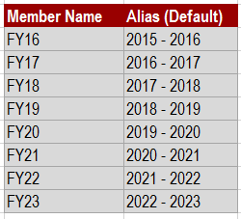
Dimension Design - Years
Dimension Name | Naming Convention Examples | Brief Description | Number of Members
Years | Name: FY18 Alias: 2017 - 2018 | Fiscal Year | 10
The Years Dimension is used to establish the application’s range of Years.
Starting range of years is estabilished as: 2016 – 2025
Years member describes the FY starting in July 1st and ends in June 30th of the following year
Additional years are easily added as an Admin function

Slide 65
Dimension Design – Version
Dimension Name | Naming Convention Examples | Brief Description | Number of Members
Version | Name: Working Alias: Working | Works in conjunction with the Scenario dimension to provide the ultimate flexibility | ~15
Versions allow multiple iterations of a budget (e.g., Budget Version_1), model possible assumptions based on different assumptions (e.g., Sandbox1, What-if)
A “Working” version will be used to collect and update data for the budget and forecast. Copies of this version by scenario will be created as needed based on the frequency of review with management during the Plan and other processes to allow for comparative reporting. Input and Adjustment
A “Final” version will be used to collect actuals and approved budget and forecast versions.

Slide 66
Dimension Design - Scenario
Dimension Name | Naming Convention Examples | Brief Description | Number of Members
Scenario | Name: Budget Alias: Budget | The scenario dimension is used to capture categories of data, for example budget load or budget transfers. It is possible to support multiple segmentations of budget prior to submission as part of the foundational design | ~12
The Scenario dimension is used to capture categories of data such as budget, forecast, and actual. Scenarios have the added functionality of defining a planning period range, which controls the months and years open for data entry for any given Scenario.

Slide 67
Dimension Design - Department
Dimension Name | Naming Convention Examples | Brief Description | Number of Members
Department | Name: WTW_101000 Alias: Chancellor’s Office (WTW – 101000) | Departments represent unique academic or operational units. The current department naming convention is referred to as the UDDS which stands for Unit, Division, Department, Sub-Department. | Will vary by institution
The organizational department structure will be stored in the ”Department” dimension.
Department structure will be specific to each institution.
Alternate views can be created in the hierarchy to represent different views of the “Department” dimension.
Department Prefix will utilize the naming convention from SFS (i.e. MSN, WTW)

Slide 68
Dimension Design – Department Cont.

Slide 69
Dimension Design - Fund
Dimension Name | Naming Convention Examples | Brief Description | Number of Members
Fund | Name: F_101 Alias: GPO – Doctoral Cluster (101) | Funds segregate financial information for the purpose of carrying on specific activities and categorizes the characteristics and limitations placed on resources recorded in the accounts. | ~100
The Fund financial information structure will be stored in the ”Fund” dimension.
Prefix for Fund will be set as “F”

Slide 70
Dimension Design - Program
Dimension Name | Naming Convention Examples | Brief Description | Number of Members
Program | Name: P_0 Alias: Student Services (0) | Programs identify specific institutional or departmentally designated initiatives that are tracked at a level of detail not supported via departments, accounts, or funds. | 12
The Program-initiative structure will be stored in the ”Program” dimension.
Prefix for Fund will be set as “P”

Slide 71
Dimension Design - Project
Dimension Name | Naming Convention Examples | Brief Description | Number of Members
Project | Name: AAA8325 Alias: Campus Strategic Planning (AAA8325) | The project dimension is assigned by the grants model or project lite. While not all institutions are budgeting to this segment, it is recommended that the new budget system include the project segment as it exists in SFS with no added summarization. | Will vary by institution
The budget Project structure will be stored in the ”Project” dimension.
To do - project codes within the project structure to be grouped. (AAA group, PRJ group, etc…)

Slide 72

Security and User Groups

Slide 73
Security Model
PlanUW has a security model to organize and track the users who can input data for various organizations.
Users are placed in various Hierarchy groups from in order to obtain access to the system and their data entry needs.
Hierarchy Groups
  Determines which Department ID’s a user will have the ability to input data into.
  Example: College of Nursing

Slide 74

Hierarchy Groups
The primary purpose of hierarchy based security groups is to assign user access to the various areas of the University’s organizational hierarchy for data entry and reporting.
Hierarchy groups are typically created at a parent level College or Department and assigned users will be given access to this parent level and all of the departments below it.
Users can be added, removed and moved between these groups to expand or limit their data entry access.
Users can exist within more than one of these groups. If a user is placed into more than one group, they will have access to each of those Organizational hierarchies.

Slide 75
Security Model
From a Security Perspective, it will be important to note that:
  We have security on:
    Department – Only budget for your sub departments
    Project – If you are in a multi-tenant Pod (NE, West and South) you will not be able to see the other institutions projects
    Scenario – Can input into budget, but not actuals
    Version – Can input into Base (and Adj for Fringe Rate), but not Final
  We don’t have security on:
    Program
    Fund – Regardless of what Departments you have access to. You can enter into any projects
    ***Project – Regardless of what Departments you have access to. You can enter into any projects

Slide 76

Course Summary

Slide 77

Completed Course Summary
In this course, you have been introduced to the PlanUW system.
You have learned about:
An overview of the PlanUW system
An overview of the features in PlanUW
An overview of the dimensions in PlanUW
Security and the user groups in PlanUW

Slide 78
Support and Resources
You can use the following resources for reference and support:
This course, located on the UW System Website/Plan UW: Planning & Budgeting Cloud Service
Project Website: https://www.wisconsin.edu/budget-planning/system-project/
Coworkers and Subject Matter Experts
Quick Reference Guide

