Slide 1

Current Year Forecasting Process
End User Training

Slide 2



Course Objectives
In this course, you will be introduced to how to perform forecasting tasks within the PlanUW system.
After completing this class, you will have learned:
The UW Current Year Forecast Process and Timeline
How to set up your campus User Variable
How to complete Current Year Forecast tasks in PlanUW

Slide 3
UW Current Year Forecast
Process Overview

Slide 4
Forecasting Process
Future State
  Historical data for Actual, Budget, and soon to be Forecast will be housed in PlanUW. It will be populated via automated Data Loads of different frequencies.
  Forecast Base will be prepopulated via a rule that respreads budget based on the average of 2 prior years of Actuals.
  Users will use input forms to enter adjustments for the forward-looking months. Versions of the Forecast will be saved on a monthly basis.
  Users will be able to use Smart View and out of the box reports and forms to report and review their Forecast.
  Campuses will report Forecast to UW System two times a year.

Slide 5
Forecasting Process – UW System Requirements
Below are submission requirements from UW System with expectations that data will be provided/loaded from institutional pods to the foundational pod at the frequency and level of detail described below.
Category | System Requirement
Forecast Submission Frequency | 1st Submission Due: December (October Actuals) 2nd Submission Due: April (February Actuals)
Fund Balance Reporting Frequency | One time a year after the books are closed
Level of Detail: Department | Division
Level of Detail: Fund | All Funds
Level of Detail: Program | Total Program (Roll up all Programs)
Level of Detail: Project | Total Project (Roll up all Projects)
Level of Detail: Account | See Forecast Account Rollup Excel Support File
Budget Transfer Spread | No System Preference

Slide 6
Forecasting Process – Frequency
Forecast Cycle | Actual data | Forecast Base data (Budget re-spread based on last 2 yrs avg of Actuals)
July Forecast | July | August – June
August Forecast | July – Aug | September – June
September Forecast | July - September | October - June
October Forecast (Submission 1) | July - October | November - June
November Forecast | July - November | December - June
December Forecast | July - December | January - June
January Forecast | July - January | February - June
February Forecast (Submission 2) | July - February | March - June
March Forecast | July - March | April - June
April Forecast | July - April | May - June
May Forecast | July - May | June - June
Based on a monthly forecast approach the following table represents the combination of Actual and Forecast data that will reside in months throughout the year:
The forecast scenario will be updated monthly. Actuals replace forecast base data following each month’s close. This will give users the ability to forecast at the UW System defined forecast dates or create any off-cycle forecasts needed at the institution level.

Slide 7
UW Current Year Forecast
Forecast Tasks

Slide 8
PlanUW Forecast Tasks and Processes
Moving forward, this document will cover on a step-by-step basis, the “how” to complete Forecast tasks in the PlanUW system. Each process will be accompanied with the Quick Reference Guide book.
The following Processes are detailed in the QRG
Input and review for Transfers
Input and review for Salary, Wages and Fringe
Input and review for Non-Compensation
Input and review for Revenue
Reviewing Forecast
Reviewing Forecast Reports

Slide 9
PlanUW Forecast Tasks and Processes
Forecast data is made up of Actuals and Budget
Actuals are updated on a monthly basis and will overwrite the budget amount previously existing
 |  | Jul | Aug | Sep | Oct | Nov | Dec | Jan | Feb | Mar | Apr | May | Jun
1st Submission – Due December |  | A | A | A | A | B | B | B | B | B | B | B | B
2nd Submission – Due April |  | A | A | A | A | A | A | A | A | B | B | B | B
Actuals | A
Budget | B

Slide 10
PlanUW Forecast Tasks and Processes
Budget data will spread into the Forecast based off of a seasonal average of 2 years of Prior Year Actuals. This approach will reflect an accurate monthly view of revenues and expenses and smooth out any 1 year anomalies.
NOTE: If your institution prefers to clear the prepopulated Current Year Forecast Input/Base, contact planuw@uwsa.com via email

Slide 11
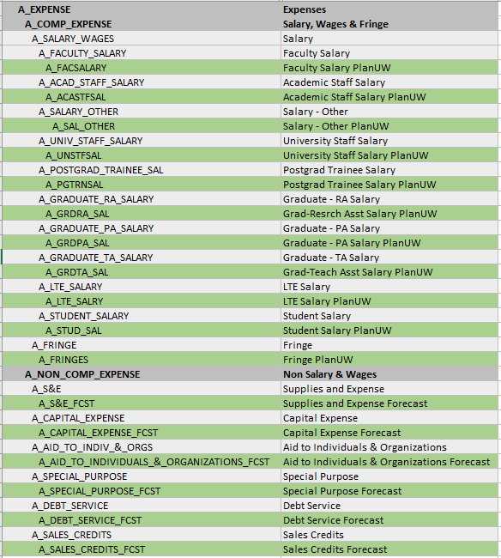
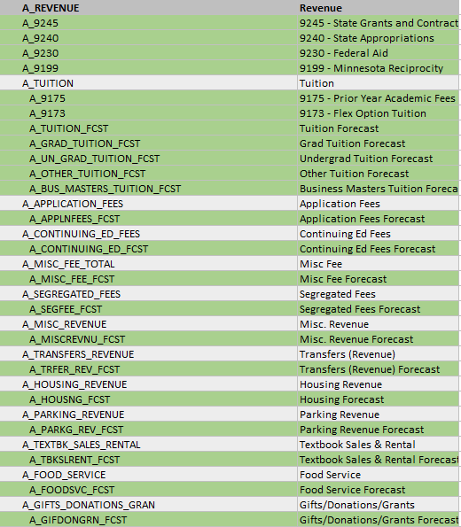
PlanUW Forecast Tasks and Processes
Roll Up Account
Forecast Account
Tuition & Salary contain an extra layer of detail, remaining Forecast accounts exist just below the top-level Accounts of Comp, Non Comp, and Revenue

Slide 12
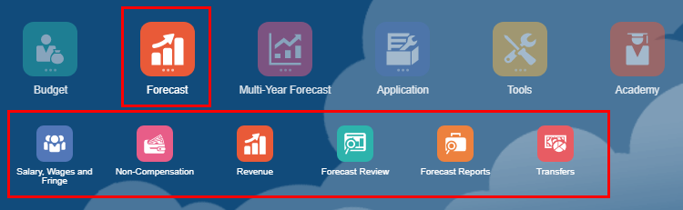
PlanUW Forecast Tasks and Processes
The Forecast tile is a new edition to the homepage and provides clear separation of Budget and Forecast processes in PlanUW. The Forecast process mimics the budget process with forms being divided into the similar input sections such as:
  Salary, Wages and Fringe
  Non-Compensation
  Revenue
The Forecast Review tile provides similar review options found in the Budget Review.
The Forecast Reports tile presents a number of out of the box reports that mirror the layout of the Budget reports.
The new Transfers card only exists under Forecast and allows for adjustment of Forecasted transfers as actuals become posted each month.

Slide 13
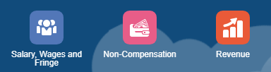

Forecast Input Versions
NEW Functionality
There are three tabs for input and review:
Campus-Level – Enter forecast amounts at ‘Campus-Level’ using Divisions, in By Account, By Division, By Account and Division Forms and use Campus-Level Review to see total results.
Division-Level – Enter forecast amounts at ‘Divisional-Level’ using Divisions, in By Account, By Division, By Account and Division Forms and use Divisional-Level Review to see total results.
Department-Level – Enter forecast amounts at ‘Department-Level’ using Sub-Departments, in By Account, By Department, By Account and Department Forms and use Department-Level Review to see total results.
Forecast Input Version Diagram
By Campus
By Division
By Department

Slide 14
PlanUW Forecast Tasks and Processes
Input Forms
The Salary, Wages, and Fringe, Non- Compensation, and Revenue cards all contain input forms at Campus, Division and Department levels. Each level provides differing variations of the input forms and 1 review form.
Action Menus
Some forms will have additional action menu functions that you can use to perform:
  Respread Forecast Adjustments – spreading based on Account 2 yr average historical trend.
  Open Forecast Accounts – adding an Account, Fund, Department or Division that did not have previous activity and may not be displayed on the form
  Remove Forecast Accounts – removing an Account, Fund, Department or Division that did not have previous activity and is displayed on the form
Form Suppression
Some forms will not display members that have no previous activity in Actuals or Budget. Use the Action menu “Open Forecast Accounts” to add missing members.

Slide 15
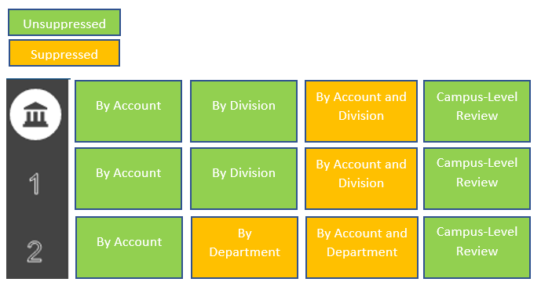
PlanUW Forecast Form Suppression
Suppression is used to reduce the number of lines on a form. When suppression is turned on a user must insert a “Wedge” to add new lines to the form.
Certain forms that do not get as large do not need suppression turned on and therefore do not require users to insert “Wedges”.

Slide 16
PlanUW Forecast Column Definitions
Each form in these tiles contains specific columns as part of its standard layout. Here is a brief explanation of these titles.
Column Title | Column Definitions for Input Tiles
YTD | Year to Date –Total Actuals from July to the month displayed in the YTD column.
CY YTD vs PY YTD | Current Year to Date versus Previous Year to Date variance column. This column compares CY YTD Actuals vs PY YTD Actuals in the input cards.
Forecast Input | This column is the baseline forecast where the system has taken the current year budget and spread it based on 2 prior years of actuals.
Forecast Transfers | This column displays the budget transfers that have been respread by users in the Forecast Transfers card.
Campus/Divisional/Departmental Forecast Adjustment | This column is open for input. This is where users can add adjustments to the forecast on top of Forecast Input and Forecast Transfers.
View | These columns display posted Actuals or Budget data throughout the year.

Slide 17

UW Current Year Forecast
Setting User Variables
C
QRG

Slide 18





Accessing PlanUW
PlanUW is a cloud-based and can be accessed via any computer with internet access.
PlanUW is supported by any browser. Out of the browsers shown, we recommend Mozilla Firefox:
Internet Explorer
v.11.x
Mozilla Firefox
v.38+
Google Chrome
v.42+
Apple Safari v.8.x and v.7.x
Firefox is the Huron recommended browser

Slide 19
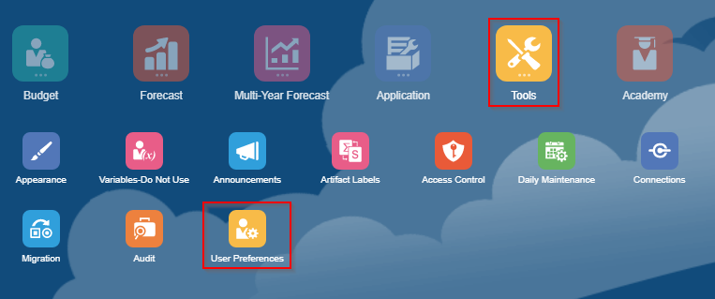



Setting User Variables
End Users and Power Users need to set User Variables according to their institutions. Setting User Variables ensures that the user filters input and review forms to campus exclusive data.
To access Preferences:
1. Click the Tools cluster
2. Select the User Preferences card
NOTE: User variables only need to be set once, but they can be changed at any time.

Slide 20
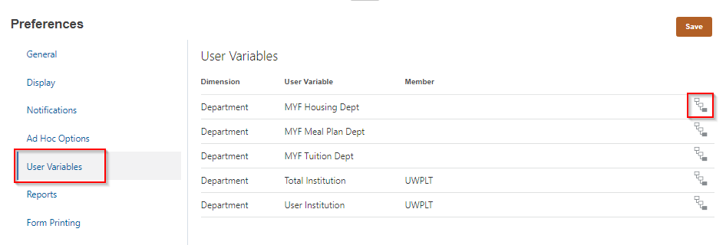

Setting User Variables – End Users
Member Selectors
Members can be selected for each User Variable by clicking Member Selector

Slide 21
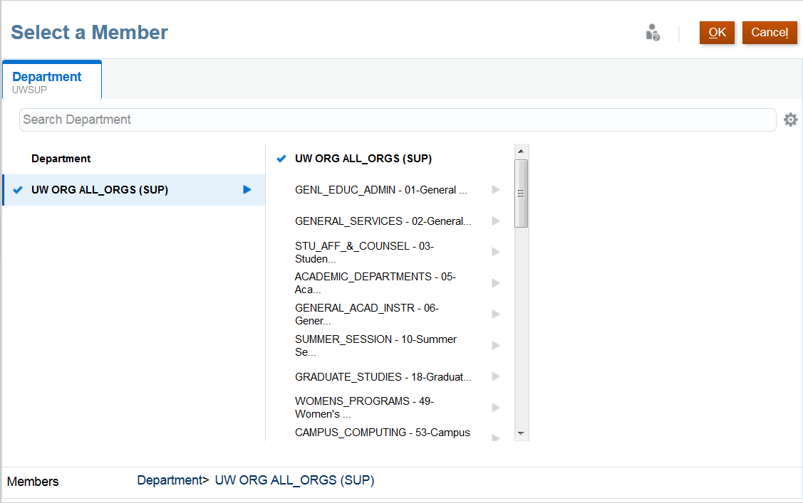
Selecting Members
Members can be selected in two ways from the Member Selection window:
Search Bar
Hierarchy
Search Bar
Select
When selecting members through a Hierarchy, drill into a member by clicking
To select a member, click on the member.
Note that you are only able to select one member at a time
Hierarchy
If the member selected does not appear on the User Variables selected, the next slide will explain the next steps.

Slide 22
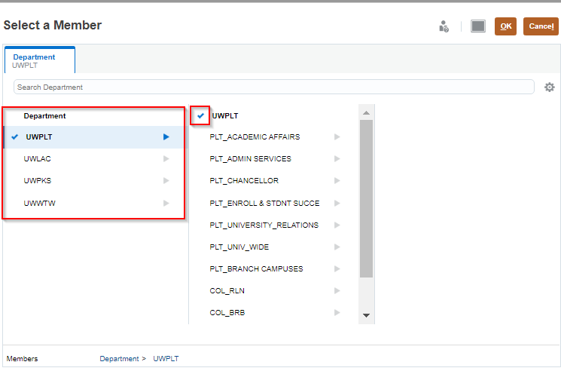
Setting User Variables – Total Institution
Users will have access to set variables at the Total Institution variable level.
To set the Total Institution variable, follow the same steps described to End Users on how to set the User Institution variable (Previous slide).
  NOTE: The Total Institution variable level will not be available to select in MSN or MIL PlanUW applications.

Slide 23
UW Current Year Forecast
Salary, Wages and Fringe

Slide 24
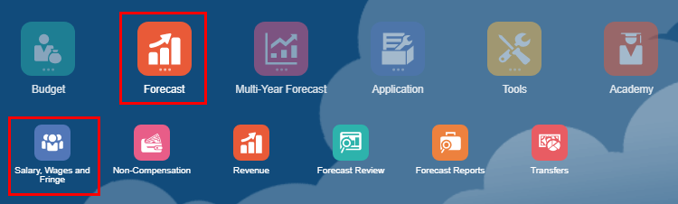

Salary, Wages and Fringe Data
Use this card to Forecast for Salary, Wages, and Fringe.
Enter adjustments to manipulate the prepopulated base Forecast
View how Forecast Base, Transfers, and Adjustments cumulate to gain the full picture of your Forecast
Review historical data, total Forecast and key variances scenarios
To begin the salary data input and review process:
Click the Forecast tile to open the cluster
Click on the Salary, Wages and Fringe tile to open the forms
This process will open the Salary, Wages and Fringe input and review forms
1
2

Slide 25
Campus-Level Salary, Wages and Fringe
By Campus
Campus-Level – Enter forecast amounts at ‘Campus-Level’ using Divisions, in By Account, By Division, By Account and Division Forms and use Campus-Level Review to see total results.

Slide 26
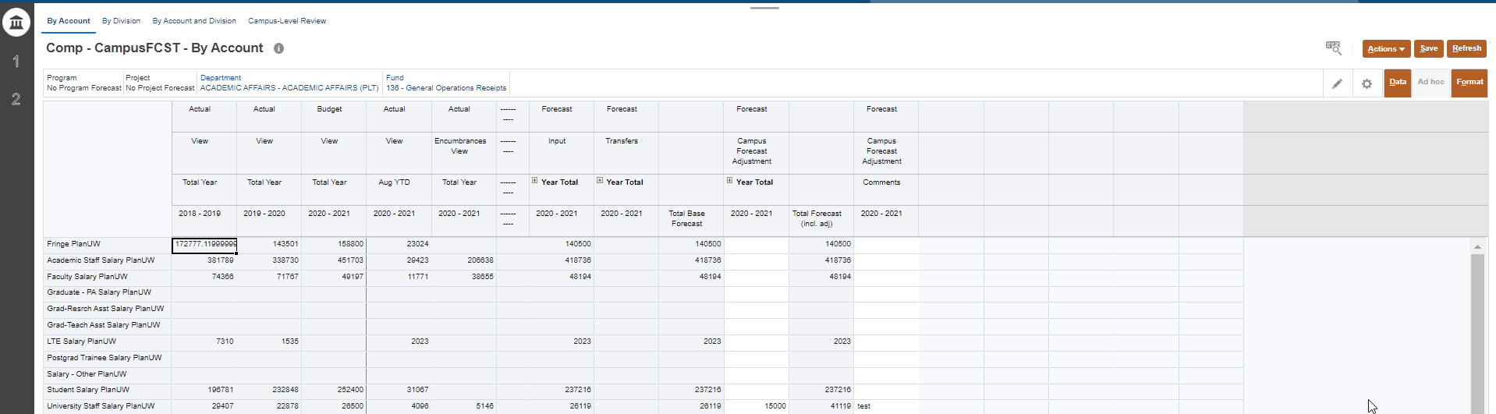
Campus-Level By Account Form – Salary, Wages and Fringe
1
2
Un-suppressed
Provides forecasting to a single Division by Fund.
The Point of View section can be changed to the Division/Department and Fund member for your institution limited to your security profile
Input data in Forecast Adjustment and Comments Columns. All other cells should be grey
NOTE: This form is un-suppressed. The form displays all accounts although data might not exist.

Slide 27
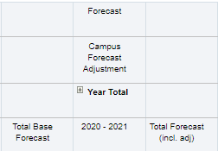

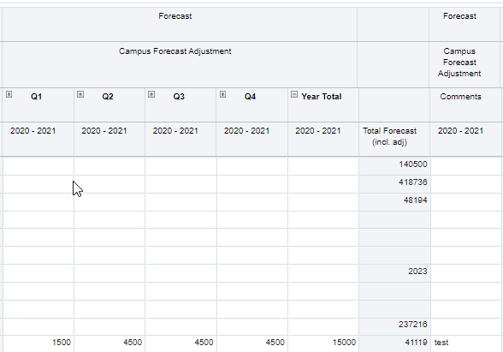
Campus-Level By Account Form– Salary, Wages and Fringe
Expand Year Total by clicking the plus sign to enter by Total Quarter.
NOTE: Grey columns are locked and cannot be edited. Only white cells allow entry. Data will be spread evenly to the open periods based on a straight spread.

Slide 28
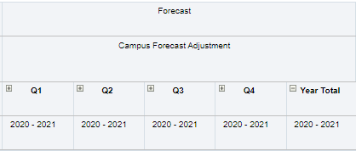
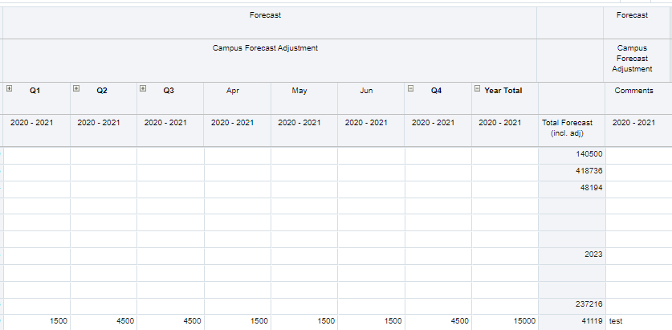
Campus-Level By Account Form– Salary, Wages and Fringe
Expand any Quarter Total by clicking the plus sign to enter by Total Month. Functionality exists everywhere with a plus sign.
NOTE: Grey columns are locked and cannot be edited. Only white cells allow entry. Data will be spread evenly to the open periods based on a straight spread.

Slide 29
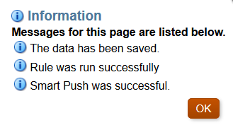
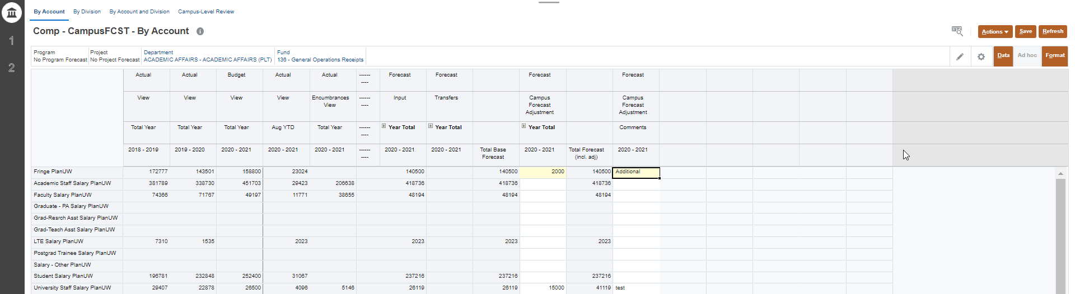
Campus-Level By Account Form– Salary, Wages and Fringe
3
4
1
2
Un-suppressed
Enter data in the Total Year column (by Total Year, Total Quarter or Total Month).
Enter comments in the Comment column, if needed.
Once done, click Save to save the sheet.
Click OK in pop up message.

Slide 30
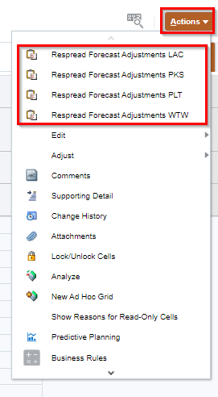
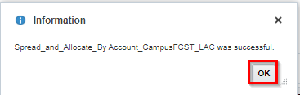
Respread Forecast Adjustments– Salary, Wages and Fringe
1
NOTE: This is Optional
2
When entering a Forecast Adjustment at the total year, it will spread to open months using a straight spread by default.
If you want to apply a seasonal spread the following will occur:
The Respread Forecast Adjustments action will distribute amounts entered in Year Total column to the individual months following the Forecast Base trend average of 2 prior years of Actuals.
If there was no Baseline Forecast, the amounts will be spread evenly across the remaining open months.
After entering data in the Total Year column:
Click on the Action menu
Select Respread Forecast Adjustments
Click OK in pop up message
3

Slide 31
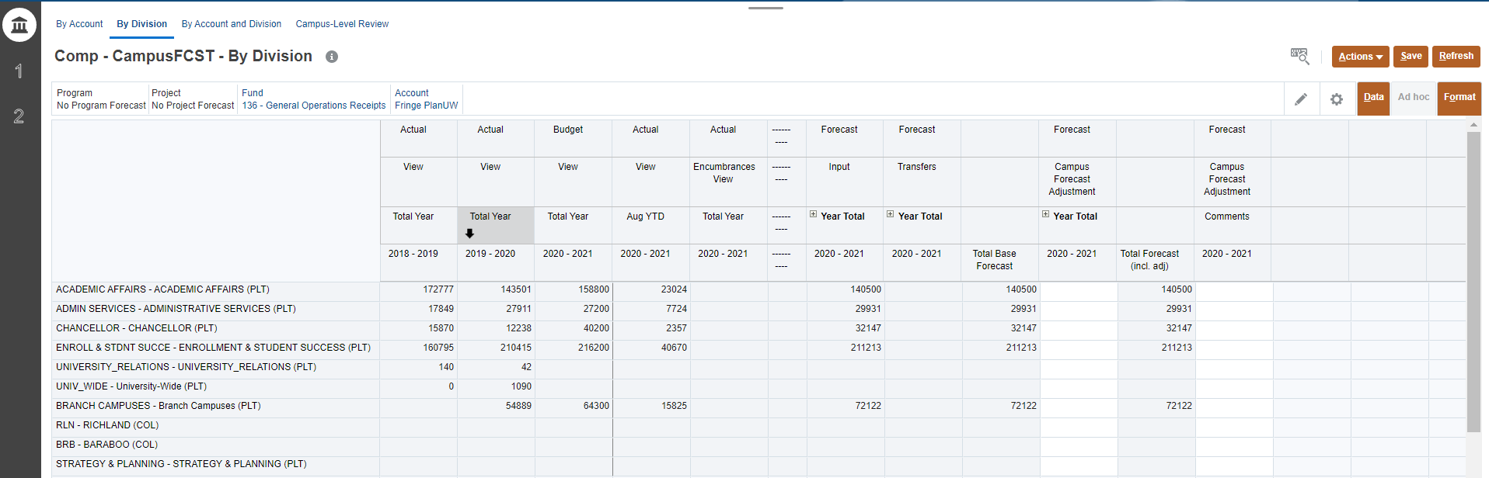
Campus-Level By Division Form – Salary, Wages and Fringe
1
2
Un-suppressed
Provides forecasting to Multiple Divisions by Account and Fund.
The Point of View section can be changed to the Account and Fund member for your institution limited to your security profile
Input data in Forecast Adjustment Year Total and Comments Columns. All other cells should be grey
NOTE: The form is Un-suppressed and displays all Divisions although data might not exist.

Slide 32
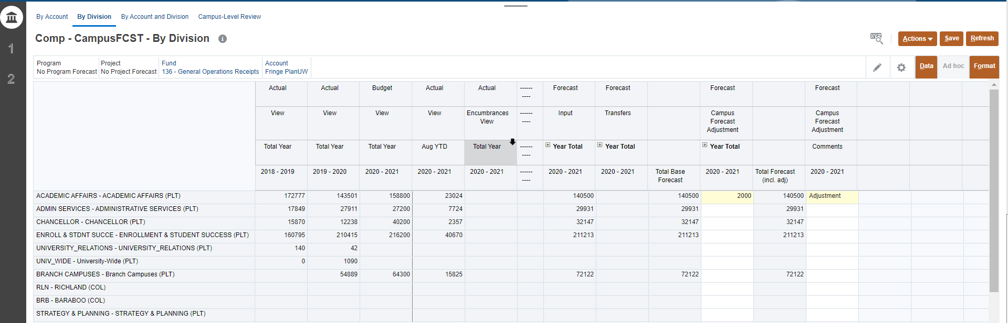
Campus-Level By Division Form – Salary, Wages and Fringe
3
4
4
1
2
Un-suppressed
Enter data in the Total Year column (or expand to enter Total Quarter or Total Month)
Enter comments in the Comment column, if needed
Once done, click Save to save the sheet
Click OK in pop up message

Slide 33
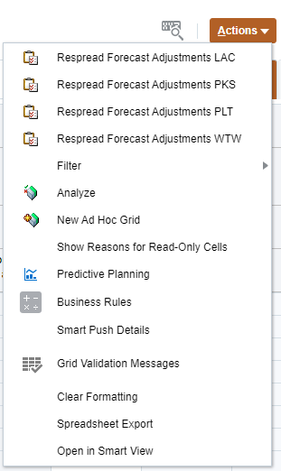
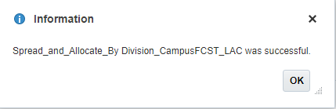
Respread Forecast Adjustments– Salary, Wages and Fringe
NOTE: This is Optional
1
When entering a Forecast Adjustment at the total year, it will spread to open months using a straight spread by default.
If you want to apply a seasonal spread the following will occur:
The Respread Forecast Adjustments action will distribute amounts entered in Year Total column to the individual months following the Forecast Base trend average of 2 prior years of Actuals.
If there was no Baseline Forecast, the amounts will be spread evenly across the remaining open months.
You will only see the Respread Forecast Adjustments function applicable to your Divisional setting based on your security profile.
2
After entering data in the Total Year column:
Click on the Action menu
Select Respread Forecast Adjustments
Click OK in pop up message
3

Slide 34
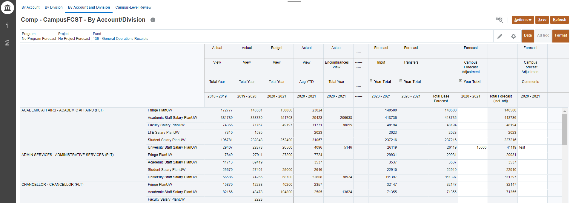
Campus-Level By Account & Division Form – Salary, Wages and Fringe
1
Suppressed
2
Provides forecasting to Multiple Divisions and Accounts by Fund.
The Point of View section can be changed to the Fund member for your institution limited to your security profile
Input data in Forecast Adjustment Year Total and Comments Columns. All other cells should be grey
NOTE: The form only displays Accounts or Divisions with activity. Use the Action menu Open Forecast Accounts if needed.

Slide 35
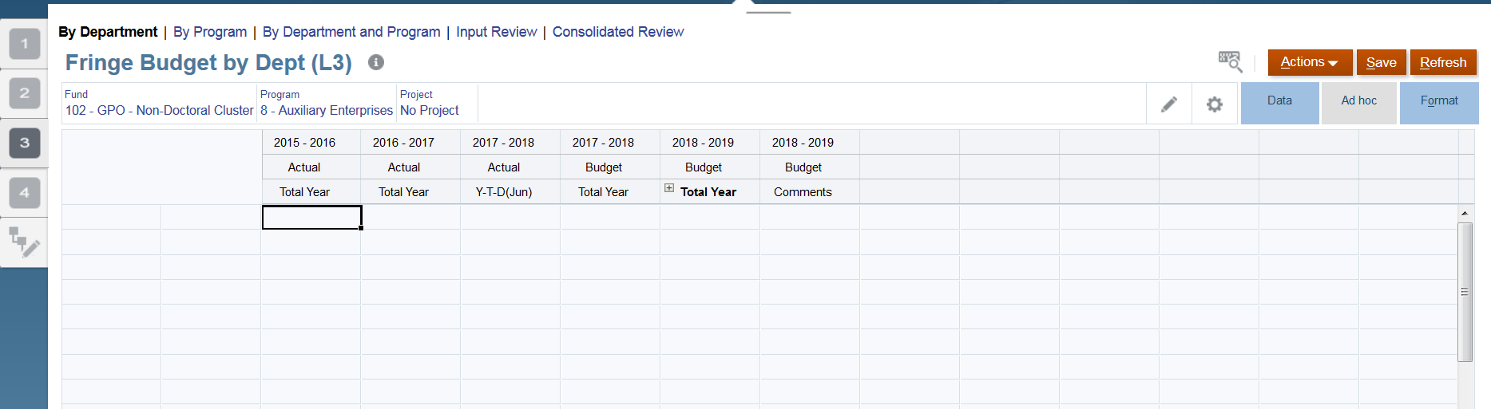
Before We Continue - What is a Wedge
Wedges (Open Forecast Accounts) are inserted when an account intersection does not have prior years of actuals or budget data. A wedge is inserted to allow users to forecast for that intersection.
- An example of this is when a new department is created. Because new departments do not have any prior year actual data and will not show up on a form, a wedge is inserted with already existing department information.
- Inserting a wedge (or Opening Forecast Accounts) opens accounts to be forecasted to.

Slide 36
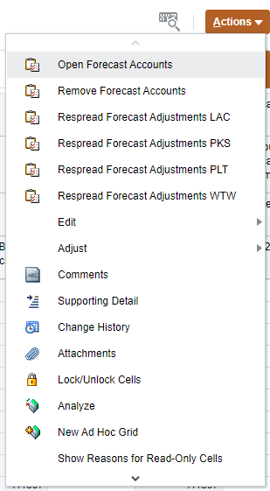
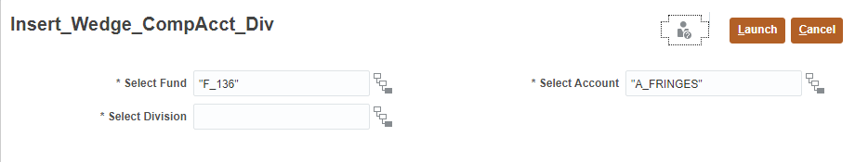
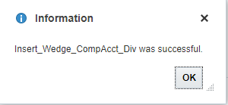
Open Forecast Accounts - Salary, Wages and Fringe
If there was no Baseline Forecast for a Division or Account combination, the members will not display in the form.
The Open Forecast Accounts action will let you add a Division or Account to enter Forecast against
1
2
4
3
To insert a wedge:
Click on the Action menu
Select Open Forecast Accounts
Select Division and/or Account and/or Fund using the selector
Click Launch
Click OK in pop up message
5

Slide 37
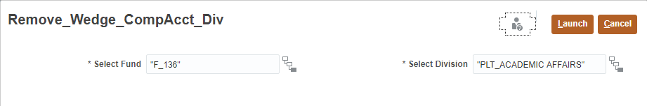
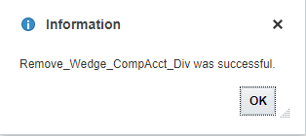
Remove Forecast Accounts - Salary, Wages and Fringe
If a member with no Baseline Forecast for a Division or Account combination is unnecessary but is showing on the form
The Remove Forecast Accounts action will let you remove a Division or Account from being displayed on the form
1
2
4
3
To insert a wedge:
Click on the Action menu
Select Remove Forecast Accounts
Select Division and/or Fund using the selector
Click Launch
Click OK in pop up message
5

Slide 38
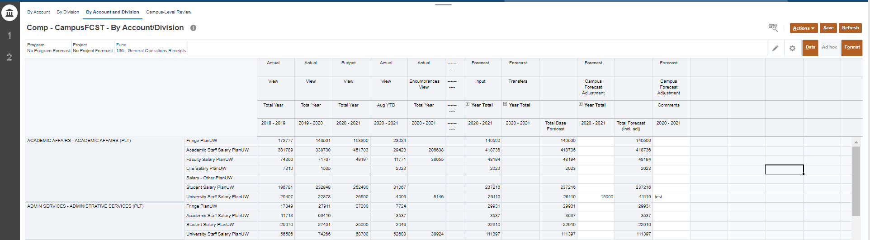
Campus-Level By Account & Division Form – Salary, Wages and Fringe
4
4
3
1
2
Suppressed
Enter data in the Total Year column (by Total Year, Total Quarter or Total Month)
Enter comments in the Comment column, if needed
Once done, click Save to save the sheet
Click OK in pop up message
NOTE: The Open/Remove Forecast Accounts functionality is available on this form.

Slide 39
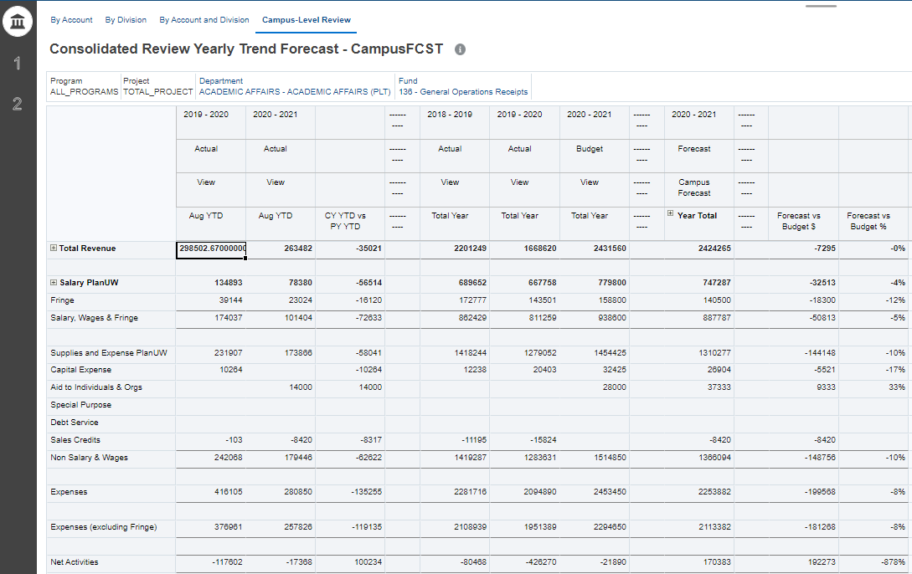
Campus-Level Review – Salary, Wages and Fringe
Provides a historical comparison of the summarized Forecast at the Program Total and Project Total level.
1
2
3
Provides historical Budget and Actual data, an overview of total forecast, as well as the variance of Forecast vs Budget and CY vs PY Actuals Year to Date.
The Point of View section can be changed to the Fund and Department member for your institution limited to your security profile.
Review data in Forecast Adjustment Year Total Columns and compare to Actuals and Budget Trends. All cells should be grey

Slide 40

Division-Level Salary, Wages and Fringe
Division-Level – Enter forecast amounts at ‘Divisional-Level’ using Divisions, in By Account, By Division, By Account and Division Forms and use Divisional-Level Review to see total results.
By Division

Slide 41
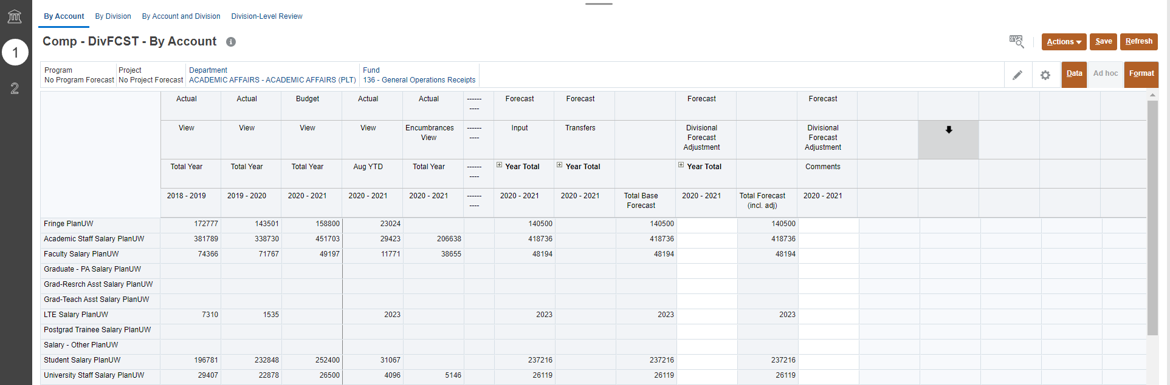
Division-Level By Account Form – Salary, Wages and Fringe
1
2
Un-suppressed
Provides forecasting to a single Division by Fund.
The Point of View section can be changed to the Division/Department and Fund member for your institution limited to your security profile
Input data in Forecast Adjustment and Comments Columns. All other cells should be grey
NOTE: This form is un-suppressed. The form displays all accounts although data might not exist.

Slide 42
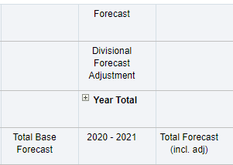
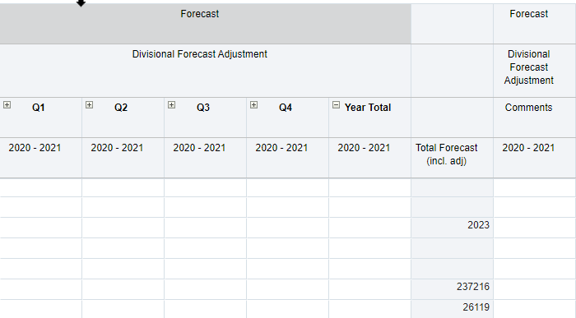
Division-Level By Account Form – Salary, Wages and Fringe
Expand Year Total by clicking the plus sign to enter by Total Quarter.
NOTE: Grey columns are locked and cannot be edited. Only white cells allow entry. Data will be spread evenly to the open periods based on a straight spread.

Slide 43
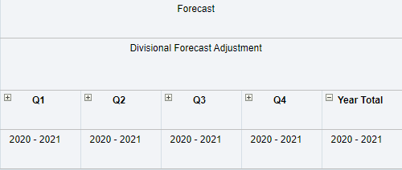
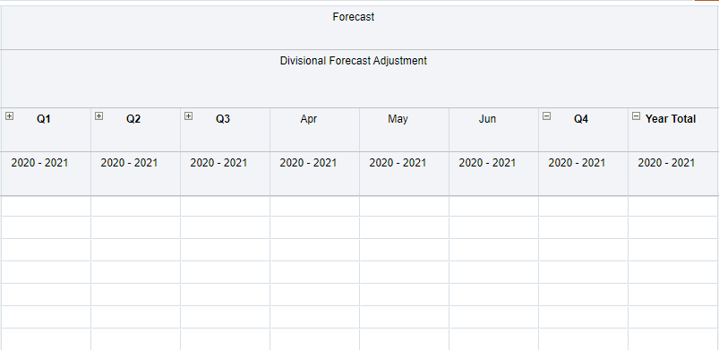
Division-Level By Account Form – Salary, Wages and Fringe
Expand any Quarter Total by clicking the plus sign to enter by Total Month. Functionality exists everywhere with a plus sign.
NOTE: Grey columns are locked and cannot be edited. Only white cells allow entry. Data will be spread evenly to the open periods based on a straight spread.

Slide 44
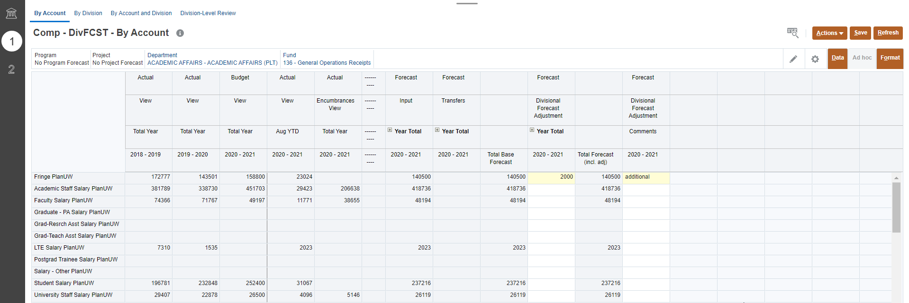
Division-Level By Account Form – Salary, Wages and Fringe
3
4
4
1
2
Un-suppressed
Enter data in the Total Year column (by Total Year, Total Quarter or Total Month).
Enter comments in the Comment column, if needed.
Once done, click Save to save the sheet.
Click OK in pop up message.

Slide 45
Respread Forecast Adjustments– Salary, Wages and Fringe
1
NOTE: This is Optional
2
When entering a Forecast Adjustment at the total year, it will spread to open months using a straight spread by default.
If you want to apply a seasonal spread the following will occur:
The Respread Forecast Adjustments action will distribute amounts entered in Year Total column to the individual months following the Forecast Base trend average of 2 prior years of Actuals.
If there was no Baseline Forecast, the amounts will be spread evenly across the remaining open months.
After entering data in the Total Year column:
Click on the Action menu
Select Respread Forecast Adjustments
Click OK in pop up message
3

Slide 46
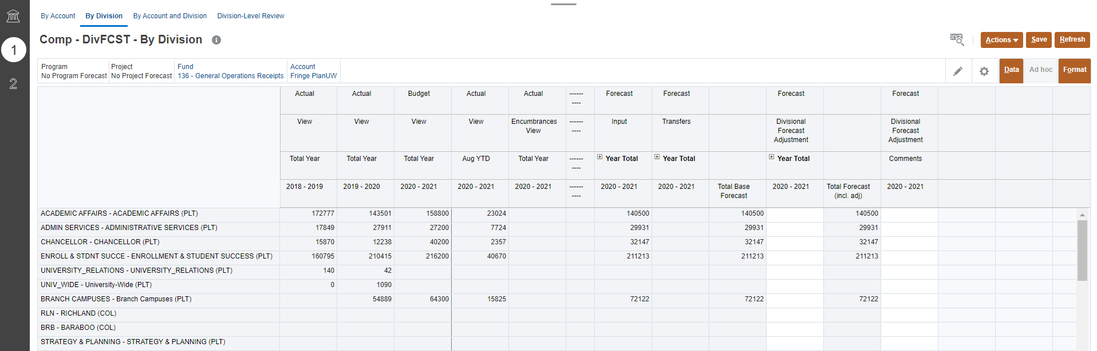
Division-Level By Division Form – Salary, Wages and Fringe
1
2
Un-suppressed
Provides forecasting to Multiple Divisions by Account and Fund.
The Point of View section can be changed to the Account and Fund member for your institution limited to your security profile
Input data in Forecast Adjustment Year Total and Comments Columns. All other cells should be grey
NOTE: The form is Un-suppressed and displays all Divisions although data might not exist.

Slide 47
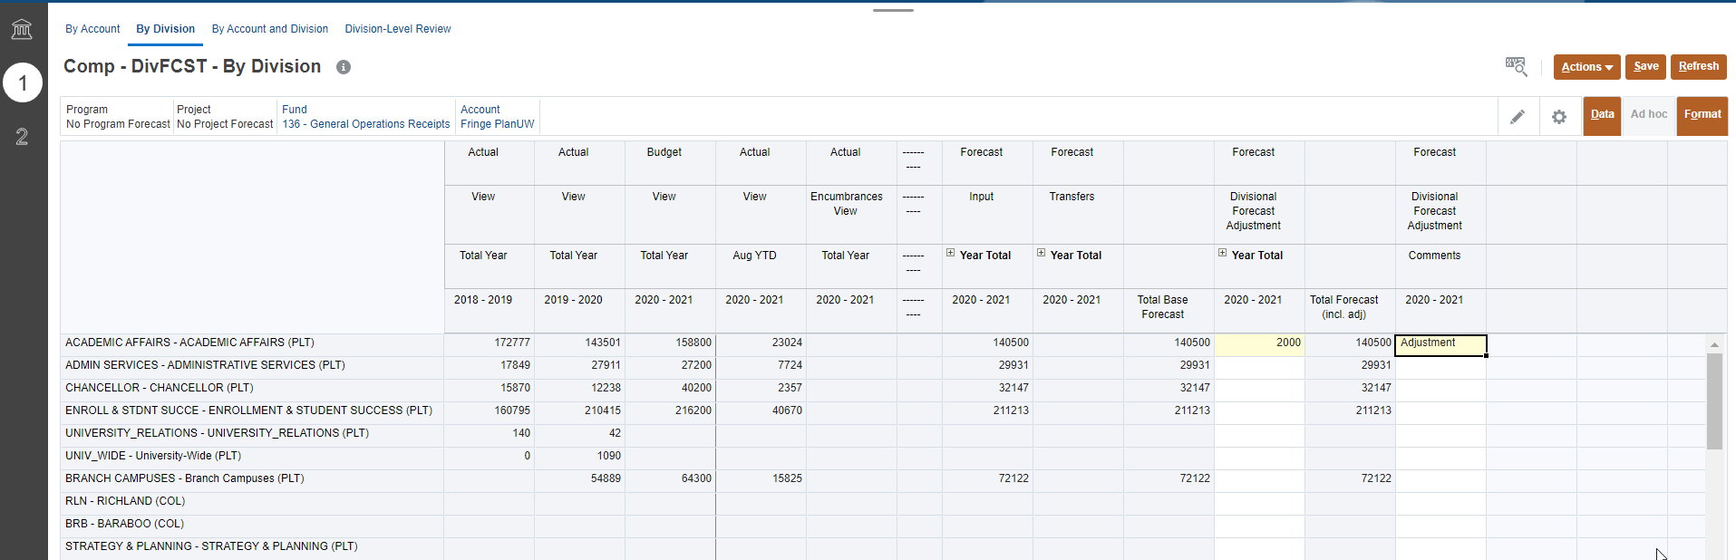
Division-Level By Division Form – Salary, Wages and Fringe
3
4
4
1
2
Un-suppressed
Enter data in the Total Year column (or expand to enter Total Quarter or Total Month)
Enter comments in the Comment column, if needed
Once done, click Save to save the sheet
Click OK in pop up message

Slide 48
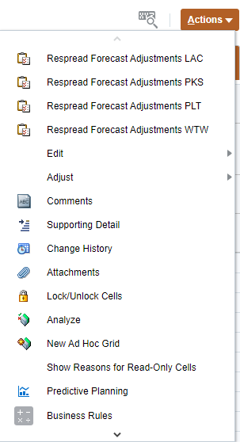
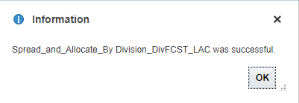
Respread Forecast Adjustments– Salary, Wages and Fringe
1
When entering a Forecast Adjustment at the total year, it will spread to open months using a straight spread by default.
If you want to apply a seasonal spread the following will occur:
The Respread Forecast Adjustments action will distribute amounts entered in Year Total column to the individual months following the Forecast Base trend average of 2 prior years of Actuals.
If there was no Baseline Forecast, the amounts will be spread evenly across the remaining open months.
You will only see the Respread Forecast Adjustments function applicable to your Divisional setting based on your security profile.
2
After entering data in the Total Year column:
Click on the Action menu
Select Respread Forecast Adjustments
Click OK in pop up message
3

Slide 49
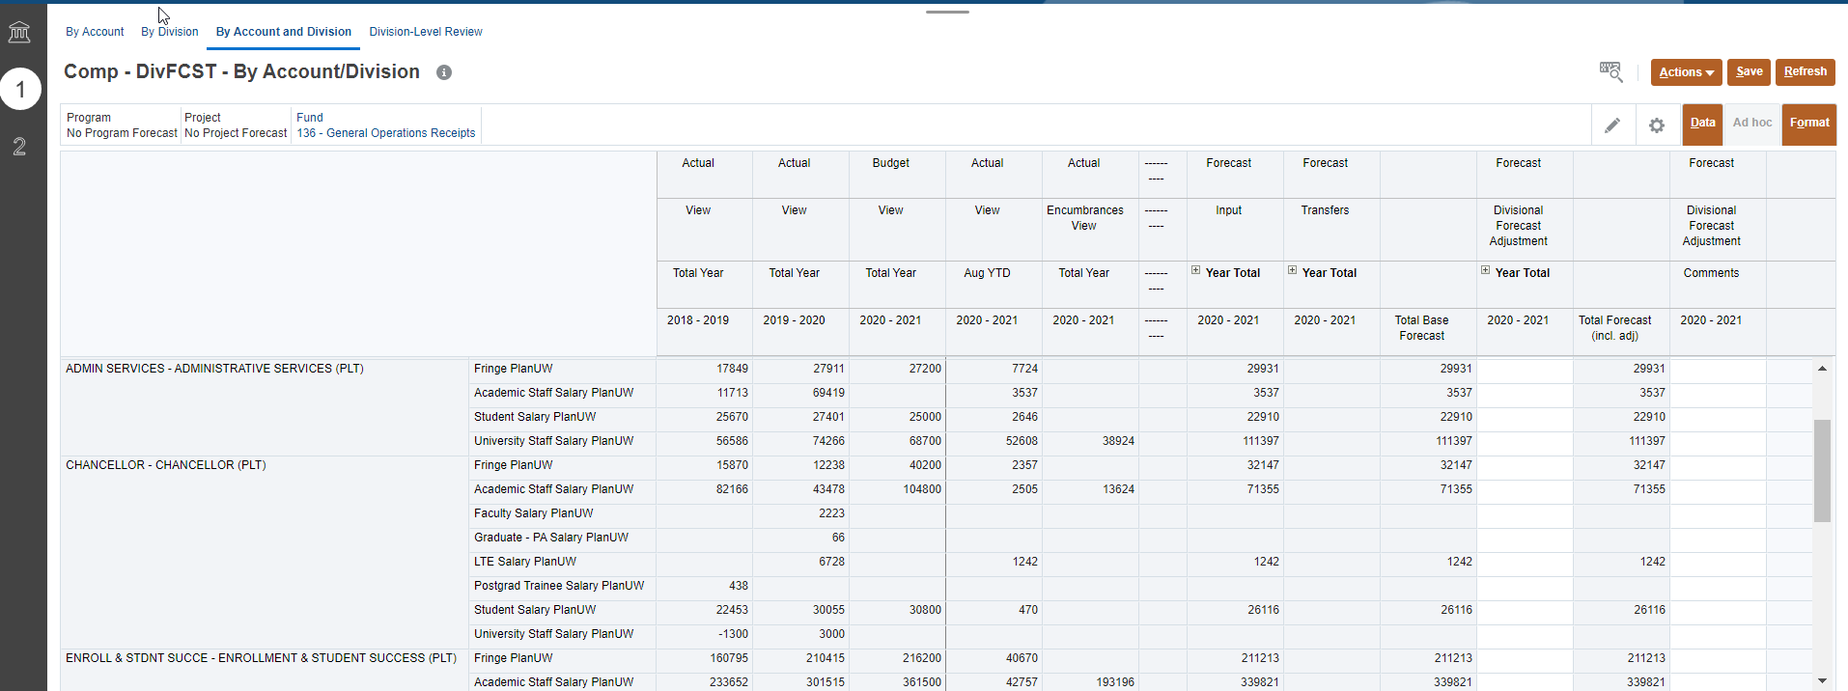
Division-Level By Account and Division – Salary, Wages and Fringe
1
2
Suppressed
Provides forecasting to Multiple Divisions and Accounts by Fund.
The Point of View section can be changed to the Fund member for your institution limited to your security profile
Input data in Forecast Adjustment Year Total and Comments Columns. All other cells should be grey
NOTE: The form only displays Accounts or Divisions with activity. Use the Action menu Open Forecast Accounts if needed.

Slide 50
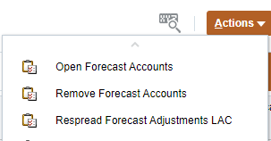
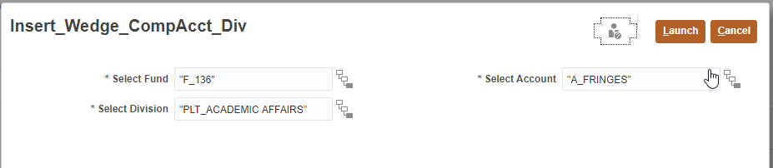
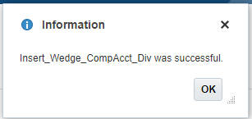
Open Forecast Accounts - Salary, Wages and Fringe
If there was no Baseline Forecast for a Division or Account combination, the members will not display in the form.
The Open Forecast Accounts action will let you add a Division or Account to enter Forecast against
1
2
4
3
To insert a wedge:
Click on the Action menu
Select Open Forecast Accounts
Select Division and/or Account and/or Fund using the selector
Click Launch
Click OK in pop up message
5

Slide 51
Remove Forecast Accounts - Salary, Wages and Fringe
If a member with no Baseline Forecast for a Division or Account combination is unnecessary but is showing on the form.
The Remove Forecast Accounts action will let you remove a Division or Account from being displayed on the form
1
2
4
3
To insert a wedge:
Click on the Action menu
Select Remove Forecast Accounts
Select Division and/or Fund using the selector
Click Launch
Click OK in pop up message
5

Slide 52
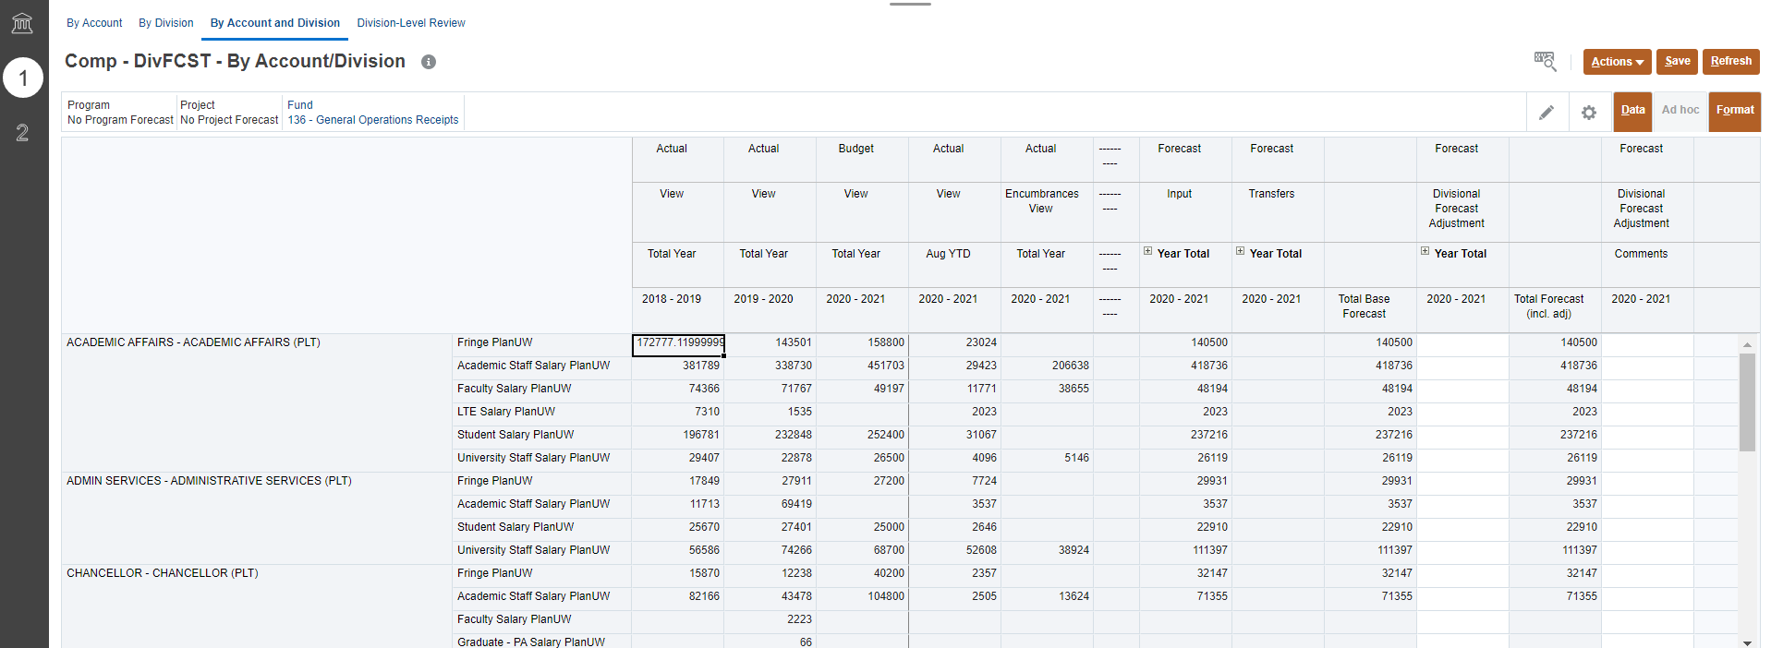
Division-Level By Account and Division – Salary, Wages and Fringe
3
4
4
1
2
Suppressed
Enter data in the Total Year column (by Total Year, Total Quarter or Total Month)
Enter comments in the Comment column, if needed
Once done, click Save to save the sheet
Click OK in pop up message
NOTE: The Open/Remove Forecast Accounts functionality is available on this form.

Slide 53
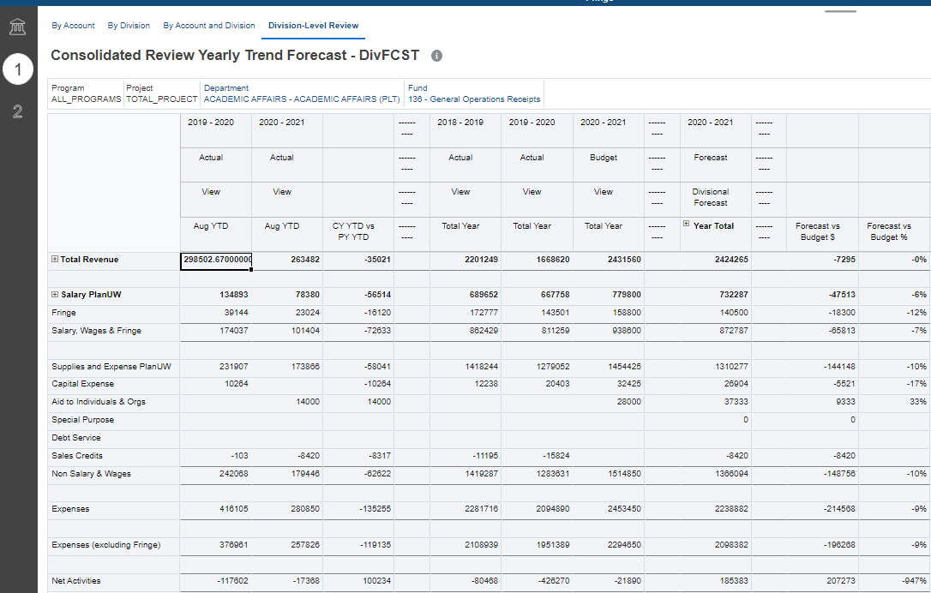
Division-Level Review – Salary, Wages and Fringe
Provides a historical comparison of the summarized Forecast at the Program Total and Project Total level.
1
2
Provides historical Budget and Actual data, an overview of total forecast, as well as the variance of Forecast vs Budget and CY vs PY Actuals Year to Date.
The Point of View section can be changed to the Fund and Department member for your institution limited to your security profile.
Review data in Forecast Adjustment Year Total Columns and compare to Actuals and Budget Trends. All cells should be grey

Slide 54

Department-Level Salary, Wages and Fringe
Department-Level – Enter forecast amounts at ‘Department-Level’ using Sub-Departments, in By Account, By Department, By Account and Department Forms and use Department-Level Review to see total results.
By Department

Slide 55
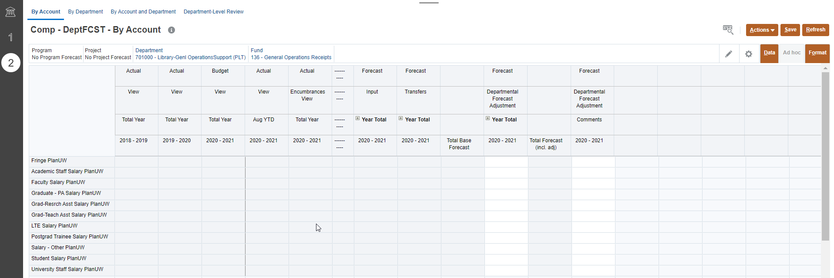
Department-Level By Account Form – Salary, Wages and Fringe
1
2
Un-suppressed
Provides forecasting to a single Department by Fund
The Point of View section can be changed to the Division/Department and Fund member for your institution limited to your security profile.
Input data in Forecast Adjustment and Comments Columns. All other cells should be grey.
NOTE: This form is un-suppressed. The form displays all accounts although data might not exist.

Slide 56
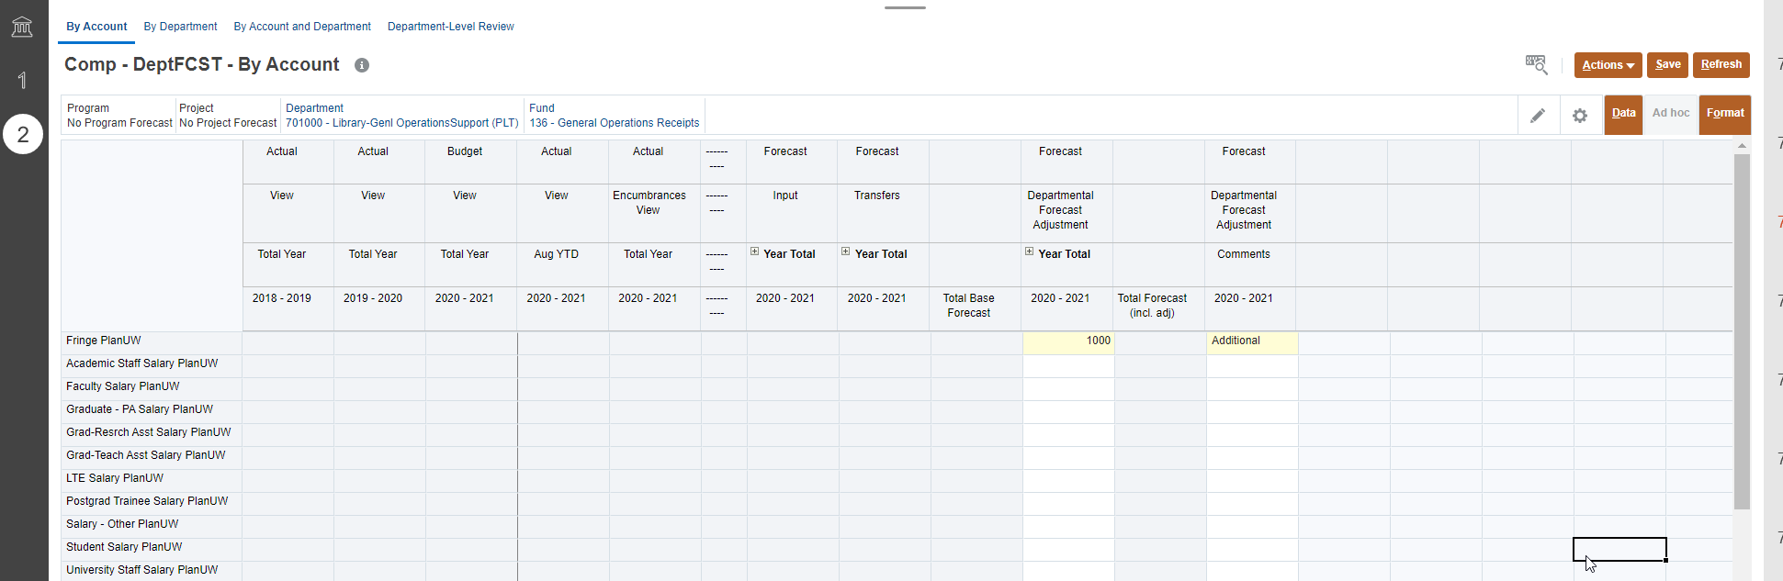
Department-Level By Account Form – Salary, Wages and Fringe
3
4
4
1
2
Un-suppressed
Enter data in the Total Year column (by Total Year, Total Quarter or Total Month)
Enter comments in the Comment column, if needed
Once done, click Save to save the sheet
Click OK in pop up message

Slide 57



Respread Forecast Adjustments– Salary, Wages and Fringe
NOTE: This is Optional
1
The Respread Forecast Adjustments action will distribute amounts entered in Year Total column to the individual months following the Forecast Base trend average of 2 prior years of Actuals.
If there was no monthly trend or budget amounts in the Baseline Budget, the amounts will be spread evenly across the remaining open months..
2
4
3
After entering data in the Total Year column:
Click on the Action menu
Select Respread Forecast Adjustments
Select Fund and/or Account and/or Department using the selector
Click Launch
Click OK in pop up message
5

Slide 58

Department-Level By Department Form – Salary, Wages and Fringe
1
2
Suppressed
Provides forecasting to Multiple Departments by Account and Fund
The Point of View section can be changed to the Account and Fund member for your institution limited to your security profile
Input data in Forecast Adjustment Year Total and Comments Columns. All other cells should be grey
NOTE: The form will not display Departments without activity. Use the Action menu Open Forecast Accounts if needed.

Slide 59



Open Forecast Accounts - Salary, Wages and Fringe
If there was no Baseline Forecast for a Department or Account, the members will not display in the form.
The Open Forecast Accounts action will let you add a Department or Account to enter Forecast against.
1
2
3
4
To insert a wedge:
Click on the Action menu
Select Open Forecast Accounts
Select Department and/or Account using the selector
Click Launch
Click OK in pop up message
5

Slide 60



Remove Forecast Accounts - Salary, Wages and Fringe
If a member with no Baseline Forecast for a Division or Account combination is unnecessary but is showing on the form
The Remove Forecast Accounts action will let you remove a Division or Account from being displayed on the form
1
2
4
3
To insert a wedge:
Click on the Action menu
Select Remove Forecast Accounts
Select Division and/or Fund using the selector
Click Launch
Click OK in pop up message
5

Slide 61

Department-Level By Department Form – Salary, Wages and Fringe
3
4
4
1
2
Suppressed
Enter data in the Total Year column (by Total Year, Total Quarter or Total Month)
Enter comments in the Comment column, if needed
Once done, click Save to save the sheet
Click OK in pop up message
NOTE: The form only displays Departments with activity. Use the Action menu Open Forecast Accounts if needed.

Slide 62



Respread Forecast Adjustments– Salary, Wages and Fringe
NOTE: This is Optional
1
The Respread Forecast Adjustments action will distribute amounts entered in Year Total column to the individual months following the Forecast Base trend average of 2 prior years of Actuals.
If there was no monthly trend or budget amounts in the Baseline Budget, the amounts will be spread evenly across the remaining open months..
2
4
3
After entering data in the Total Year column:
Click on the Action menu
Select Respread Forecast Adjustments
Select Fund and/or Account and/or Department using the selector
Click Launch
Click OK in pop up message
5

Slide 63

Department-Level By Account & Department Form – Salary, Wages and Fringe
1
2
Suppressed
Provides forecasting to Multiple Departments and Accounts by Fund.
The Point of View section can be changed to the Fund member for your institution limited to your security profile.
Input data in Forecast Adjustment Year Total and Comments Columns. All other cells should be grey.
NOTE: The form only displays Accounts and Departments combinations with activity. Use the action menu Open Forecast Accounts if needed.

Slide 64


Open Forecast Accounts - Salary, Wages and Fringe
If there was no Baseline Forecast for a Department or Account, the members will not display in the form.
The Open Forecast Accounts action will let you add a Department or Account to enter Forecast against.
1
2
3
4
To insert a wedge:
Click on the Action menu
Select Open Forecast Accounts
Select Department and/or Account using the selector
Click Launch
Click OK in pop up message
5

Slide 65
Remove Forecast Accounts - Salary, Wages and Fringe
If a member with no Baseline Forecast for a Division or Account combination is unnecessary but is showing on the form
The Remove Forecast Accounts action will let you remove a Division or Account from being displayed on the form
1
2
4
3
To insert a wedge:
Click on the Action menu
Select Remove Forecast Accounts
Select Division and/or Fund using the selector
Click Launch
Click OK in pop up message
5

Slide 66

Department-Level By Account & Department Form – Salary, Wages and Fringe
4
3
4
1
2
Suppressed
Enter data in the Total Year column (by Total Year, Total Quarter or Total Month)
Enter comments in the Comment column, if needed
Once done, click Save to save the sheet
Click OK in pop up message

Slide 67

Department-Level Review – Salary, Wages and Fringe Data
1
Provides a historical comparison of the summarized Forecast at the Program Total and Project Total level.
2
Provides historical Budget and Actual data, an overview of total forecast, as well as the variance of Forecast vs Budget and CY vs PY Actuals Year to Date.
The Point of View section can be changed to the Fund and Department member for your institution limited to your security profile.
Review data in Forecast Adjustment Year Total Columns and compare to Actuals and Budget Trends. All cells should be grey

Slide 68
UW Current Year Forecast
Non-Compensation

Slide 69

Rinse and Repeat
NOTE: This section is an abridged version of what is covered in the Salary, Wages and Fringe Input section. All processes are applicable in this section; however, you will need to refer to the Salary, Wages and Fringe Input section for additional details.

Slide 70

Non-Compensation
Use this card to Forecast for Non-Compensation.
Enter adjustments to manipulate the prepopulated base Forecast
View how Forecast Base, Transfers, and Adjustments cumulate to gain the full picture of your Forecast
Review historical data, total Forecast and key variances scenarios
To begin the Non-compensation data input and review process:
Click the Forecast tile to open the cluster
Click on the Non-Compensation tile to open the forms
This process will open the Non-compensation input and review forms
1
2

Slide 71
Campus-Level Non-Compensation
By Campus
Campus-Level – Enter forecast amounts at ‘Campus-Level’ using Divisions, in By Account, By Division, By Account and Division Forms and use Campus-Level Review to see total results.

Slide 72

Campus-Level By Account Form - Non-Compensation
3
4
4
1
2
Un-suppressed
Provides efficiency for forecasting to a single Division. The Point of View section can be changed to the Fund and Division/Department for your institution limited to your security profile.
Input data in Forecast Adjustment Year Total Columns and Comments if needed. All other cells should be grey
Enter data in the Total Year column (by Total Year, Total Quarter or Total Month)
Enter comments in the Comment column, if needed
Once done, click Save to save the sheet
Click OK in pop up message

Slide 73

Campus-Level By Division Form - Non-Compensation
3
4
1
2
Un-suppressed
Provides efficiency for users that are forecasting to multiple Divisions. The Point of View section can be changed to the Fund and Account member for your institution limited to your security profile.
Input data in Forecast Adjustment Year Total Columns and Comments if needed. All other cells should be grey
Enter data in the Total Year column (by Total Year, Total Quarter or Total Month)
Enter comments in the Comment column, if needed
Once done, click Save to save the sheet
Click OK in pop up message

Slide 74

Campus-Level By Account and Division Form- Non-Compensation
3
4
1
2
Suppressed
Provides forecasting to Multiple Divisions and Accounts by Fund. The Point of View section can be changed to the Fund member for your institution limited to your security profile. Add an account by using Action menu Open Forecast Account if needed.
Input data in Forecast Adjustment Year Total Columns and Comments if needed. All other cells should be grey
Enter data in the Total Year column (by Total Year, Total Quarter or Total Month)
Enter comments in the Comment column, if needed
Once done, click Save to save the sheet
Click OK in pop up message
NOTE: The form only displays Account and Division combinations with activity. Use the action menu Open Forecast Accounts if needed.

Slide 75

Campus-Level Review – Non-Compensation
Provides a historical comparison of the summarized Forecast at the Program Total and Project Total level.
1
2
Provides historical Budget and Actual data, an overview of total forecast, as well as the variance of Forecast vs Budget and CY vs PY Actuals Year to Date.
The Point of View section can be changed to the Fund and Department member for your institution limited to your security profile.
Review data in Forecast Adjustment Year Total Columns and compare to Actuals and Budget Trends. All cells should be grey

Slide 76
Division-Level Non-Compensation
Division-Level – Enter forecast amounts at ‘Divisional-Level’ using Divisions, in By Account, By Division, By Account and Division Forms and use Divisional-Level Review to see total results.
By Division

Slide 77

Division-Level By Account Form - Non-Compensation
3
4
4
1
2
Un-suppressed
Provides efficiency for forecasting to a single Division. The Point of View section can be changed to the Fund and Department member for your institution limited to your security profile.
Input data in Forecast Adjustment Year Total Columns and Comments if needed. All other cells should be grey
Enter data in the Total Year column (by Total Year, Total Quarter or Total Month)
Enter comments in the Comment column, if needed
Once done, click Save to save the sheet
Click OK in pop up message

Slide 78

Division-Level By Division Form- Non-Compensation
3
4
1
2
Suppressed
Provides efficiency for users that are forecasting to multiple Divisions. The Point of View section can be changed to the Fund and Account member for your institution limited to your security profile.
Input data in Forecast Adjustment Year Total Columns and Comments if needed. All other cells should be grey
Enter data in the Total Year column (by Total Year, Total Quarter or Total Month)
Enter comments in the Comment column, if needed
Once done, click Save to save the sheet
Click OK in pop up message
NOTE: The form only displays departments with activity. Use the action menu Open Forecast Accounts if needed.

Slide 79

Division-Level By Account & Division Form- Non-Compensation
3
4
1
2
Suppressed
Provides forecasting to Multiple Divisions and Accounts by Fund. The Point of View section can be changed to the Fund member for your institution limited to your security profile.
Input data in Forecast Adjustment Year Total Columns and Comments if needed. All other cells should be grey
Enter data in the Total Year column (by Total Year, Total Quarter or Total Month)
Enter comments in the Comment column, if needed
Once done, click Save to save the sheet
Click OK in pop up message
NOTE: The form only displays Account and Department combinations with activity. Use the action menu Open Forecast Accounts if needed.

Slide 80

Division-Level Review – Non-Compensation
Provides a historical comparison of the summarized Forecast at the Program Total and Project Total level.
1
2
Provides historical Budget and Actual data, an overview of total forecast, as well as the variance of Forecast vs Budget and CY vs PY Actuals Year to Date.
The Point of View section can be changed to the Fund and Department member for your institution limited to your security profile.
Review data in Forecast Adjustment Year Total Columns and compare to Actuals and Budget Trends. All cells should be grey

Slide 81
Department-Level Non-Compensation
Department-Level – Enter forecast amounts at ‘Department-Level’ using Sub-Departments, in By Account, By Department, By Account and Department Forms and use Department-Level Review to see total results.
By Department

Slide 82

Department-Level By Account Form – Non-Compensation
1
2
Un-suppressed
Provides forecasting to a single Division by Fund (similar to the By Division form)
The Point of View section can be changed to the Division/Department and Fund member for your institution limited to your security profile.
Input data in Forecast Adjustment and Comments Columns. All other cells should be grey.
NOTE: This form is un-suppressed. The form displays all accounts although data might not exist.

Slide 83

Department-Level By Department Form – Non-Compensation
1
2
Suppressed
Provides forecasting to Multiple Departments by Account and Fund
The Point of View section can be changed to the Account and Fund member for your institution limited to your security profile
Input data in Forecast Adjustment Year Total and Comments Columns. All other cells should be grey
NOTE: The form will not display Departments without activity. Use the Action menu Open Forecast Accounts if needed.

Slide 84

Department-Level By Account & Department Form – Non-Compensation
1
2
Suppressed
Provides forecasting to Multiple Departments and Accounts by Fund.
The Point of View section can be changed to the Fund member for your institution limited to your security profile.
Input data in Forecast Adjustment Year Total and Comments Columns. All other cells should be grey.
NOTE: The form only displays Accounts and Departments combinations with activity. Use the action menu Open Forecast Accounts if needed.

Slide 85

Department-Level Review – Non-Compensation
Provides a historical comparison of the summarized Forecast at the Program Total and Project Total level.
1
2
Provides historical Budget and Actual data, an overview of total forecast, as well as the variance of Forecast vs Budget and CY vs PY Actuals Year to Date.
The Point of View section can be changed to the Fund and Department member for your institution limited to your security profile.
Review data in Forecast Adjustment Year Total Columns and compare to Actuals and Budget Trends. All cells should be grey

Slide 86
UW Current Year Forecast
Revenue

Slide 87

Rinse and Repeat
In Smart View!
NOTE: This section is an abridged version of what is covered in the Salary, Wages and Fringe Input section. All processes are applicable in this section, but this section will demonstrate the clicks as the forms would be used in Smart View.

Slide 88

Revenue
Use this card to Forecast for Revenue.
Enter adjustments to manipulate the prepopulated base Forecast
View how Forecast Base, Transfers, and Adjustments cumulate to gain the full picture of your Forecast
Review historical data, total Forecast and key variances scenarios
To begin the Revenue data input and review process:
Click the Forecast tile to open the cluster
Click on the Revenue tile to open the forms
This process will open the Revenue input and review forms
1
2

Slide 89
Campus-Level Revenue
By Campus
Campus-Level – Enter forecast amounts at ‘Campus-Level’ using Divisions, in By Account, By Division, By Account and Division Forms and use Campus-Level Review to see total results.

Slide 90


By Account - Revenue Data Smart View
1
To open this form in Smart View:
Depending on the browser being used the pop up will look different please refer to the Smart View training guide for more information.
Select the Actions menu
Select Open in Smart View (Use the scroll icon to scroll to the bottom of the list, if needed)
Navigate to open downloaded file Excel workbook, or open a blank workbook
2
3

Slide 91

Changing POV - Revenue Data Smart View
1
2
Smart View forms have all the same functionality as Web forms, the clicks are just different. To change the POV in Smart View forms:
Use the dropdowns to select the new member.
After all new members have been selected, users must click Refresh for those changes to apply.
If you know the name of the member you are looking for you can type it into the dropdown, and Smart View will filter the list.

Slide 92


Campus-Level By Account Form - Revenue Data Smart View
3
Un-suppressed
1
2
Provides efficiency for forecasting to a single Division. The Point of View section can be changed to the Fund and Department member for your institution limited to your security profile.
Input data in Forecast Adjustment Year Total Columns and Comments, these columns will be light yellow. Once data is entered, they will change to a dark yellow. All other cells should be grey.
Enter data in the Total Year column (by Total Year, Total Quarter or Total Month)
Enter comments in the Comment column, if needed
Once done, click Submit Data to save the sheet
There is no pop up to confirm that data has saved, if this is a step that frustrates you in the web. Smart View is a great option!

Slide 93




Respread Forecast Adjustments– Revenue Smart View
NOTE: This is Optional
When entering a Forecast Adjustment at the total year, it will spread to open months using a straight spread by default.
If you want to apply a seasonal spread the following will occur:
The Respread Forecast Adjustments action will distribute amounts entered in Year Total column to the individual months following the Forecast Base trend average of 2 prior years of Actuals.
If there was no Baseline Forecast, the amounts will be spread evenly across the remaining open months.
1
After entering data in the Total Year column:
Right click on the cell where data was entered
Select Smart View from the right click menu
Select Respread Forecast Adjustments in the subsequent menu
Click OK on the pop up confirmation.
2
3
4

Slide 94


Navigating to New Forms in Smart View
Rather than going back to the web to open a new form in Smart View, users can navigate to the new form from the Smart View Panel.
To open a new form:
Select Smart View from the ribbon
In the Smart View ribbon select Panel, the panel will open at the far right side of the screen
Click the to expand the URL, PLNUW{INST}, Library, Forecast, Revenue
Select the form you would like to open, double click on the form to open
New form opens in worksheet.
3
2
1
4

Slide 95


Campus-Level By Division Form- Revenue Data
3
1
2
Un-suppressed
Provides efficiency for forecasting to a single Division (Units, Divisions, Departments). The Point of View section can be changed to the Fund and Department member for your institution limited to your security profile.
Input data in Forecast Adjustment Year Total Columns and Comments, these columns will be light yellow. Once data is entered, they will change to a dark yellow. All other cells should be grey.
Enter data in the Total Year column (by Total Year, Total Quarter or Total Month)
Enter comments in the Comment column, if needed
Once done, click Submit Data to save the sheet

Slide 96
UW Current Year Forecast
Forecast Review

Slide 97

Forecast Review
1
Forecast Review provides a set of forms that are used to analyze data and facilitate more accurate monthly Forecast.
Here you will be able to :
View historical Budget and Actual data and how it compares to Forecast.
Evaluate variances between Budget and Forecast as well as view Forecast in its totality to aid in any further adjustments needed.
Additionally users can review Forecast adjustments entered in the input forms to confirm accurate entry and track the progress being made as you go through your Forecast cycle.
2
To navigate to Forecast Review:
Click the Forecast tile to open the cluster
Click on the Forecast Review tile to open the forms.

Slide 98

Review Forms - Forecast Review
Click on the 1st tab at the top left of the form to see the Reviews Forms
Campus-Level Review, Dimension-Level Review and Department-Level Review forms are tools used to review total Forecast data. These Forms can be used to compare Forecast against previous years budget and actuals before copying to different Versions.
NOTE: The User Variable must be set at the Division (or parent) for the level you are trying to check.

Slide 99

Campus-Level Review - Forecast Review
Provides a historical comparison of the summarized Forecast at the Program Total and Project Total level.
1
2
3
Provides historical Budget and Actual data, an overview of total forecast, as well as the variance of Forecast vs Budget and CY vs PY Actuals Year to Date.
The Point of View section can be changed to the Department and Fund member for your institution limited to your security profile
All Accounts are listed in the rows although data might not exist
Review Forecast Year Total

Slide 100

Division-Level Review - Forecast Review
Provides a historical comparison of the summarized Forecast at the Program Total and Project Total level.
1
2
3
Provides historical Budget and Actual data, an overview of total forecast, as well as the variance of Forecast vs Budget and CY vs PY Actuals Year to Date.
The Point of View section can be changed to the Department and Fund member for your institution limited to your security profile
All Accounts are listed in the rows although data might not exist
Review Forecast Year Total

Slide 101

Department-Level Review - Forecast Review
Provides a historical comparison of the summarized Forecast at the Program Total and Project Total level.
1
2
3
Provides historical Budget and Actual data, an overview of total forecast, as well as the variance of Forecast vs Budget and CY vs PY Actuals Year to Date.
The Point of View section can be changed to the Department and Fund member for your institution limited to your security profile
All Accounts are listed in the rows although data might not exist
Review Forecast Year Total

Slide 102
Push Forecast to Working to Final
Upon completion of Forecast at the Campus, Division, or Department-Level, Institutions will need to notify UWSA PlanUW Admin’s of which Version(s) they want pushed to their Working Forecast for Review and then Final Forecast.
This step can be done via email to planuw@uwsa.edu detailing the Version(s) that should be copied.
Options to copy to Working:
- Campus Level only
- Division Level only
- Department Level only
- Campus Level for Fund 1xx - 1xx and Division Level for Fund 2xx - 3xx
- Division Level for Department 1xxxxx - 3xxxxx, Department Level for Department 4xxxxx - 7xxxxx

Slide 103

Working Review - Forecast Review
Upon completion of the Push to Working by UWSA, the Working Review form can be leveraged by the Institutions to confirm accurate data copy from their input Version(s).
1
2
3
Provides a historical comparison of the summarized Forecast at the Program Total and Project Total level.
Provides historical Budget and Actual data, an overview of total forecast, as well as the variance of Forecast vs Budget and CY vs PY Actuals Year to Date.
The Point of View section can be changed to the Department and Fund member for your institution limited to your security profile
All Accounts are listed in the rows although data might not exist
Review Forecast Year Total

Slide 104


Working Review By Fund - Forecast Review
4
1
2
3
Provides a different view of Forecast data by high level accounts Fund groupings.
The Point of View section can be changed to the Department Total for your institution limited to your security profile
All Accounts are listed in the rows although data might not exist
Review Forecast Year Total before final submission
Expand Fund for more detail

Slide 105

Forecast Trackers - Forecast Review
Click on the 2nd tab at the top left of the form to see the Consolidated Version to Working Copy Review, Consolidated Copy Review

Slide 106

Consolidated Version to Working Copy Review
Upon completion of the Push to Working by UWSA, this is another form that can be leveraged by the Institutions to confirm accurate data copy from their input Version(s), especially if copying from multiple Versions (Campus/Division/Department).
1
2

Slide 107

Consolidated Copy Review
UWSA will then Push Working → Final which can be reviewed by Institutions on this form.
No action is needed by the Institutions for this step.
1
2

Slide 108
UW Current Year Forecast
Transfers

Slide 109
Transfers Processes Overview
* Forecast Transfers will be cleared out from the prior month as Actuals are loaded in. If a user has not spread a transfer amount across the open months the amount will be cleared when Actuals are loaded.
* If a user has spread a transfer over the remaining months and an additional transfer comes in on that line, the new transfer will overwrite the spread that was previously updated by the user.
Please utilize the Forecast vs Budget Transfers Review form to identify issues described above

Slide 110

Transfers
Monthly Budget Transfers are copied to the Forecast Transfers Scenario.
The Transfers tile allows users to adjust or re-spread monthly transfer
Transfers will be cleared monthly, as Actuals are populated into the Forecast
Adjust the Forecast transfers to the months they are expected to occur in
The Review forms will display variances between Budget transfers and Forecast transfers to assist in re-adjustments
To begin the Transfers process:
Click the Forecast tile to open the cluster
Click on the Transfers tile to open the forms
This process will open the Transfer Forms
1
2
NOTE: All Transfers are inputted at the Sub-Department Level and are then included in the Campus-Level, Division-Level and Department-Level Forecasts

Slide 111
Transfers – Budget vs Forecast
During the Requirements phase, institutions communicated that Transfers were a large indicator of their potential spend for the year. So, they would need to be included as part of the Forecast.
Budget Transfers vs Forecast Transfers
Budget Transfers: Transfer data that has been entered in SFS that is loaded directly the PlanUW into the Budget scenario.
Forecast Transfers: Transfer data that has been copied from the Budget scenario in PlanUW to the Forecast scenario in PlanUW to facilitate Forecast creation.
How do I include Forecast Transfers in my Forecast?
Monitor Forecast Transfer forms monthly to ensure that transfers are not being missed from prior months.
If not monitoring monthly, open the Transfer Review form first. Use this form to identify transfers from prior months that need to be included in the current Forecast months.
To accommodate all uses of the Transfers in Forecasting, Transfers in the Forecast are being “dropped in” the month they were entered in SFS. This means that if not spread or adjusted, Forecast Transfer data could be lost in the next month process.

Slide 112

By Account - Transfers
1
4
3
1
2
Provides forecasting of Transfers by Account in the remaining open months of the budget year. All other cells should be grey. Prior months will be cleared and closed for entry. Select Fund and Department in point of view. Add and adjust Transfers to the months they are expected to occur. Make adjustments and spread transfers across the open months as needed.
Enter data in the open months of the budget year
Enter comments in the Comment column, if needed
Once done, click Save to save the sheet
Click OK in pop up message

Slide 113


By Department - Transfers
3
1
2
4
Provides forecasting of Transfers by Department in the remaining open months of the budget year. All other cells should be grey. Prior months will be cleared and closed for entry. Make adjustments and spread transfers across the open months as needed.
Enter data in the open months of the budget year
Enter comments in the Comment column, if needed
Once done, click Save to save the sheet
Click OK in pop up message

Slide 114

By Account and Department - Transfers
3
1
4
1
2
Provides forecasting of Transfers by Department and Account in the remaining open months of the budget year. All other cells should be grey. Select Fund in point of view. Add and adjust Transfers to the months they are expected to occur. Make adjustments and spread transfers across the open months as needed.
Enter data in the open months of the budget year
Enter comments in the Comment column, if needed
Once done, click Save to save the sheet
Click OK in pop up message

Slide 115

Transfers Review - Transfers
Provides a review of respreads/adjustments done to budget transfers to ensure that they are reflected in the appropriate month they will be hitting to provide an up to date and accurate forecast.
As Forecast Transfers are cleared out monthly, users can compare them to actuals in each month and:
  Identify where Budget overwrites Transfers.
  Make additions and adjustments to Transfers in any of the 3 input forms and spread to the months they are expected to occur in.
  Select Fund and Department in point of view. Every column represents a high-level account.

Slide 116
UW Current Year Forecast
Reports

Slide 117

Current Year Forecast Reports
To view the Current Year Forecast reports:
Click the Forecast tile to open the cluster
Click on the Forecast Reports tile to open

Slide 118

Forecast Review - Current Year Forecast Reports
Forecast Review Report
1. Select File Format: PDF, HTML or Excel
2. Select Version, Department and Fund

Slide 119

Forecast Review Detail - Current Year Forecast Reports
Forecast Review Detail Report
1. Select File Format: PDF, HTML or Excel
2. Select Department and Fund

Slide 120


Forecast Variance Report - Current Year Forecast Reports
Forecast Variance Report
1. Select File Format: PDF, HTML or Excel
2. Prompt for Scenario
3. Select Department and Fund

Slide 121


Expense Forecast Report - Current Year Forecast Reports
Expense Forecast Report
1. Select File Format: PDF, HTML or Excel
2. Select Department and Version

Slide 122


Revenue Forecast Report - Current Year Forecast Reports
Revenue Forecast Report
1. Select File Format: PDF, HTML or Excel
2. Select Department and Version

Slide 123


Revenue & Expense - Current Year Forecast Reports
Forecast Review Report
1. Select File Format: PDF, HTML or Excel
2. Select Department and Version

Slide 124


Summary by Fund - Current Year Forecast Reports
Summary by Fund Report
1. Select File Format: PDF, HTML or Excel
2. Select Department and Version

Slide 125

Course Summary

Slide 126

Forecasting Process
A Forecast is an estimate or projection of a future financial outcome. A forecast is built based on historical financial information, YTD Actuals results and forward-looking indicators.
The purpose of a forecast is to evaluate current and future financial conditions that may impact in-year and future decision making.
Forecasting helps to identify unexpected issues or new information so that decisions for corrective action can be quickly made.
Forecasting also helps to identify potential opportunities and risks.
NOTE: It is critical to maintain a long-term view in these situations so that short term tactics do not overpower long term goals.
126

Slide 127


Completed Course Objectives
In this course, you have been introduced to the UW Forecasting process and how to perform Forecasting tasks within the PlanUW system.
You have learned about:
The UW Forecast Process and Timeline
A review of the PlanUW System
How to complete Forecasting tasks in PlanUW

Slide 128
Support and Resources
You can use the following resources for reference and support:
This course, located on the UW System Website/Plan UW: Planning & Budgeting Cloud Service
Project Website: https://www.wisconsin.edu/budget-planning/system-project/
Coworkers and Subject Matter Experts
Quick Reference Guide

